Slide 1

ECEY4008
Presentations

Slide 2
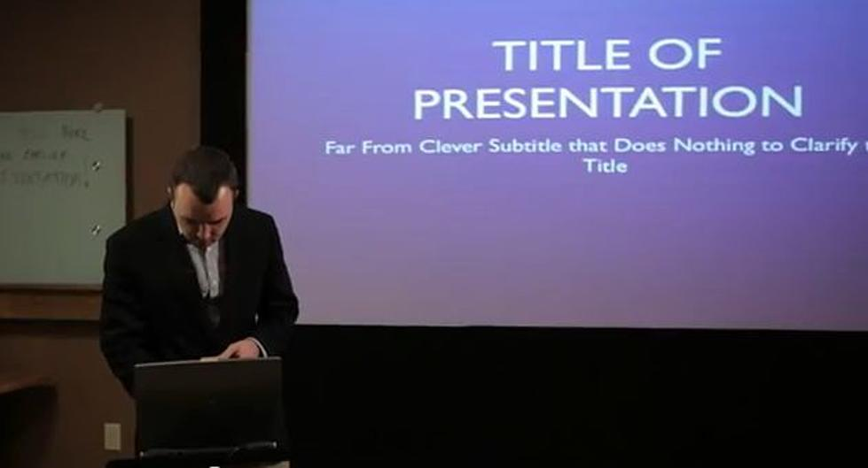
Contents
Aims and objectives
Examples
Structure
Presentation image
Referencing
Presentation skills
Body language
Resources
PP Presentation
Examples of slides
Images
References
Strategies for presenting

Slide 3
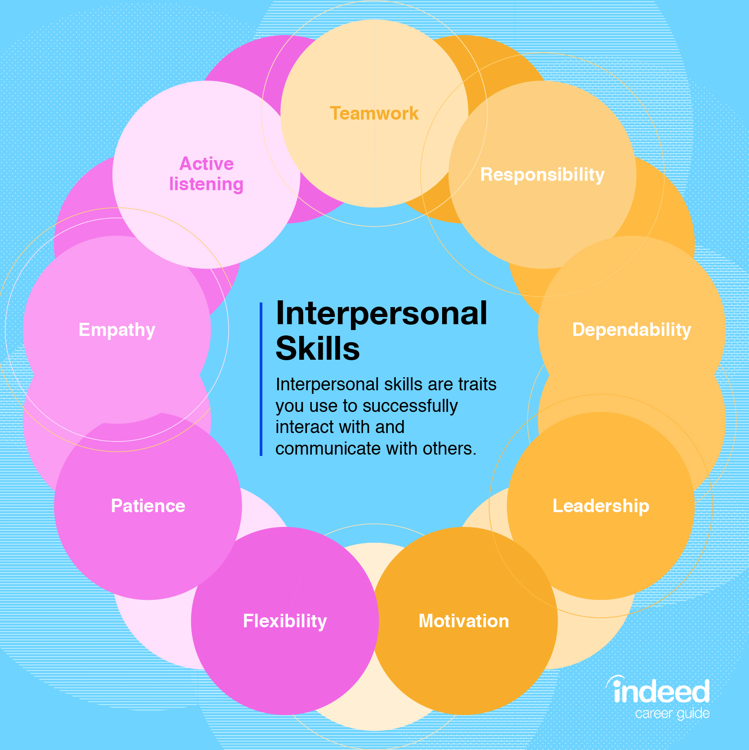
Presentation Skills
Employability/Transferable Skills/Presentational skills
Interpersonal skills; behaviours used to interact with others – audience/other professionals in a group presentation.
Organisation
Planning
ICT

Slide 4
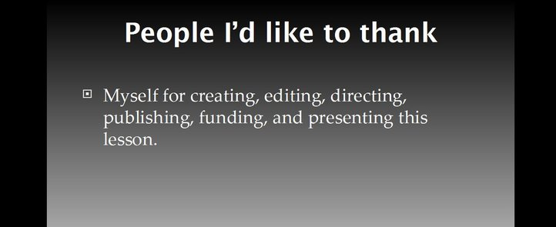
Planning
When writing an oral presentation/seminar you will always need to consider the following before you start:
  Subject
  Length of time
  Audience
  Mode of delivery

Slide 5
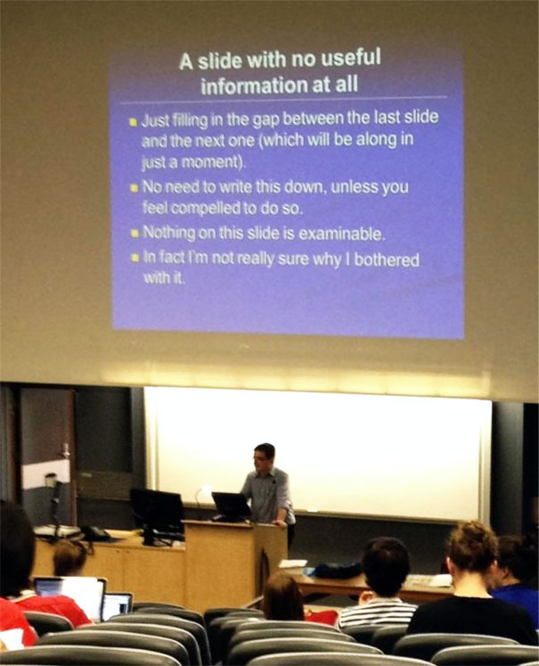
Subject
Read the title carefully
Research your topic by reading books, journals and appropriate articles on the internet
Reference the source of your information following guidelines in the Reference Guidance Handbook/cite them right

Slide 6
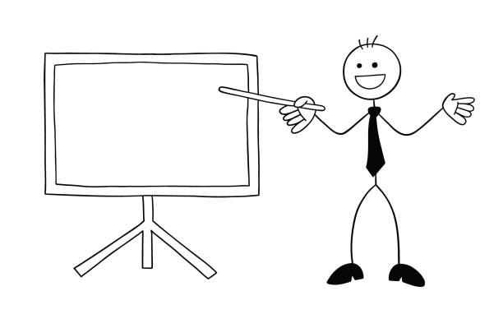
Length
Length of time is an important consideration
Too short - superficial coverage
Too long – rambling
Level 4- shorter
Levels 5 and 6 – slightly longer
Under the time limit lose marks
Over and you will be asked to conclude

Slide 7
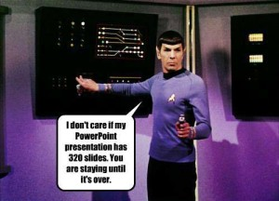
Order
You will need:
An introduction
A discussion of the main points
A conclusion

Slide 8
Design; keep it simple
Clear
Do not put too many words on the slide/poster
Use visuals
Use headings
Make it look as attractive as you can
References are needed on the poster/slideshow
Notes:
gwneud iddo edrych mor ddeniadol ag y gallwch

Slide 9
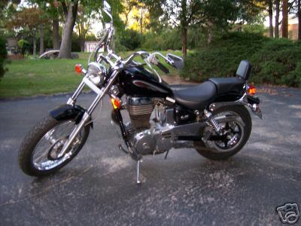
Motorbikes
My favourite bike: Suzuki Savage
Light (-380 pounds)
Plenty of power (650cc engine)
Low seat which suits most riders
Notes:
This can be critiqued in terms of contract, size of fônt etc.

Slide 10





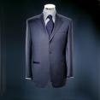

Prynu Siwt Newydd
buying a new suit

Slide 11


Motorbikes
My favourite bike: Suzuki Savage
Light (-380 pounds)
Plenty of power (650cc engine)
Low seat which suits most riders
.

Slide 12
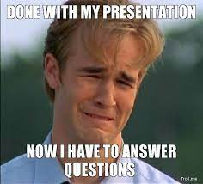
Tips
Impossible to remember everything
Use brief notes / cue cards but not too excessively
Attach the cards by their corner with a piece of string
Don’t read word for word – speak from the heart
Be enthusiastic
They are not tests – they should be a prompt for you to expand upon

Slide 13
The Introduction
Introduce yourself and your topic
Get the audience’s attention and interest
When using quotations, reference the author and read it word for word

Slide 14
Main Points
Only use 3 to 5 main points
Logical progression
Dates - link key dates together
Chronological framework
Each point has its own cue card?

Slide 15
Conclusion
Key to your seminar
Draw together the main points
Do not introduce any new information
Suggest a way forward
In some instances a sentence that motivates your audience is suitable

Slide 16
Structure
Introduce yourself
Order of presentation
Introduction
Main body
Conclusion
Referencing
Questions (if relevant)

Slide 17

Presentation Image
Font
Number of words
6x6 rule*
Visual aids
Consistency of style
*no more than six words per line and no more than six bullet points per slide

Slide 18
Referencing on slides
All images must be referenced
All information on slides need referencing
Verbal referencing – naming sources/authors/
theorists

Slide 19
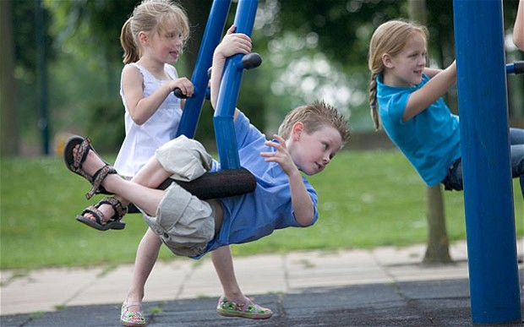
Referencing an image/picture
(Source: Telegraph, 2012)

Slide 20
Reference list
The Telegraph (2012) ‘Quarter of children play outdoors every day’, http://www.telegraph.co.uk/women/mother-tongue/9134900/Quarter-of-children-play-outdoors-every-day.html (Accessed: October 17 2013).

Slide 21

Referencing information on slides
Example:
Heredity
- eye/hair/skin colour
Phenotype (physical and inherited)
- level of intelligence
- ability to learn
- personality (Source: Telegraph, 2012)
- behaviour
(Beckley, 2012; Doherty a/and Hughes, 2009)
Notes:
Example of a slide referencing

Slide 22
Reference list
Beckley, P. (ed.) (2012) Learning in early childhood. London:
Sage Publications Limited.
Doherty, J. and Hughes, M. (2009) Child development:
theory and practice 0-11. Essex: Pearson Education Limited.
The Telegraph (2012) ‘Quarter of children play outdoors every day’, http://www.telegraph.co.uk/women/mother-tongue/9134900/Quarter-of-children-play-outdoors-every-day.html (Accessed: October 17 2013).

Slide 23
Referencing information
Example:
Responses of participants
(Ross, 2010).
Enthusiasm
(Mitchell a Hobson, 2011; Ross, 2010).
Bias
(Cohen et al., 2005; Daly a Lumley, 2002).

Slide 24

Presentation skills
The voice
Vary the voice
Pitch
Intonation
Tone
Tempo
Strength

Slide 25
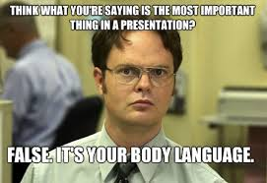
Body language
Eye contact
Nerves
Positioning
Pleasant
Include everyone
Professional

Slide 26
Presentation Protocol
Timetable
Submission date is final
Not turning up = 0%
Within week = capped at 40%
With approved extension = can be marked out of 100%
Extenuating Circumstances
Do not sign timetable on behalf of friends/peers

Slide 27
Reference list
Beckley, P. (ed.) (2012) Learning in early childhood. London: Sage Publications Limited.
Cohen, L., Manion, L. and Morrison, K. (2005) Research methods in education. 5th edn. London: Routledge & Falmer.

Slide 28
Reference list
Daly, J. and Lumley, J. (2002) ‘Bias is qualitative research designs’, Australian and New Zealand Journal of Public Health, 26, 4, pp. 299-300.
Doherty, J. and Hughes, M. (2009) Child development: theory and practice 0-11. Essex: Pearson Education Limited.
Notes:
Mitchell, N. and Hobson, A. J. (2011) ‘The influence of prior experience on research participants perspectives,’ Journal of Empirical Research on Human Research Ethics: An International Journal, 6,1 pp. 83-84.
Ross, J. (2010) ‘Recruiting Better Research Participants.’ http://www.uxmatters.com/mt/archives/2010/07/recruiting-better-research-participants.php [Accessed: 10th December 2011].
The Telegraph (2012) ‘Quarter of children play outdoors every day,’ http://www.telegraph.co.uk/women/mother-tongue/9134900/Quarter-of-children-play-outdoors-every-day.html [Accessed: 17th October 2013].

Slide 29
Reference list
Mitchell, N. and Hobson, A. J. (2011) ‘The influence of prior experience on research participants perspectives,’ Journal of Empirical Research on Human Research Ethics: An International Journal, 6,1 pp. 83-84.
Ross, J. (2010) ‘Recruiting better research participants.’ http://www.uxmatters.com/mt/archives/2010/07/recruiting-better-research-participants.php (Accessed: 10th December 2011).
Notes:
The Telegraph (2012) ‘Quarter of children play outdoors every day,’ http://www.telegraph.co.uk/women/mother-tongue/9134900/Quarter-of-children-play-outdoors-every-day.html [Accessed: 17th October 2013].

Slide 30
Reference list
The Telegraph (2012) ‘Quarter of children play outdoors every day’, http://www.telegraph.co.uk/women/mother-tongue/9134900/Quarter-of-children-play-outdoors-every-day.html (Accessed: 17th October 2013).

