Slide 1
Transaction Management II
Lecture 12b: Database Management Systems (DBMS)
Dr Kemi Ademoye

Slide 2
Today’s Lecture
Concurrency Control
  Serialisability
  Locking & Timestamping
Database Recovery

Slide 3
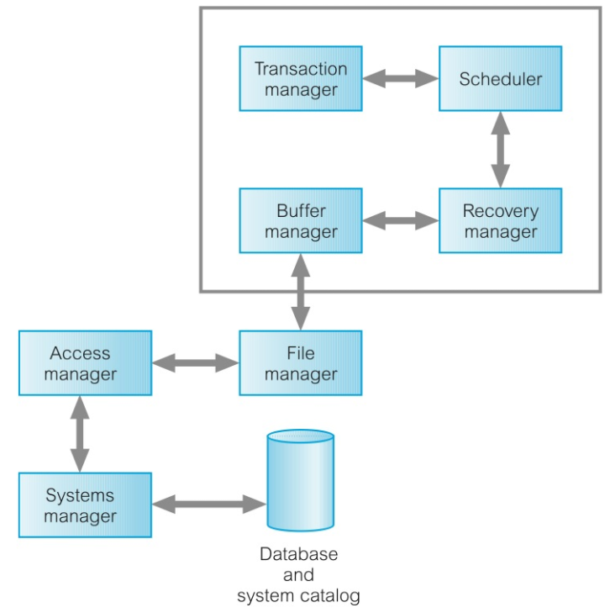
Database Architecture Support for Transactions
Notes:
Image Source: Source: [© Pearson - Database Systems: A Practical Approach to Design, Implementation, and Management - http://app.kortext.com/read/80118/?page=672]

Slide 4
Database Architecture Support for Transactions
Transaction Manager coordinates transactions and it communicates with the Scheduler.
Scheduler (aka Lock Manager) responsible for implementing concurrency control strategy.
  The objective of the scheduler is to maximise concurrency.
Recovery Manager responsible for ensuring that database is restored to a consistent state in the event of a failure.
Buffer Manager responsible for efficient transfer of data between disk storage and main memory.

Slide 5
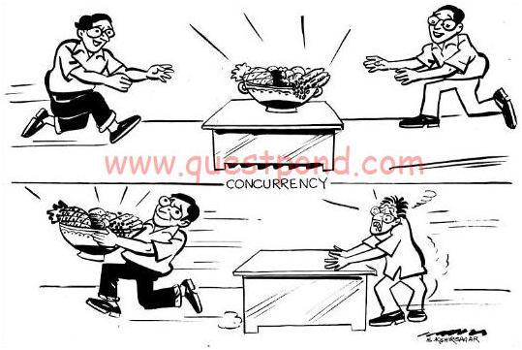
Concurrency Control
We both want the same item, who wins?
Notes:
Images from:
http://www.codeproject.com/Articles/114262/ways-of-doing-locking-in-NET-Pessimistic-and-opt [accessed: 16-Feb-2018]

Slide 6
Concurrency Control
A major objective of a database is to enable users to access shared data concurrently (at the same time).
This is relatively easy as long as users are only reading data.
If, however, two or more users are accessing the same data simultaneously, and at least one of them is updating data, there may be interference that can result in inconsistencies.

Slide 7
Concurrency Control
Concurrency Control is the process of managing simultaneous operations on the database without having them interfere with one another.
In order for the DBMS to provide concurrent access, user transactions are interleaved.
  Instead of the system being idle, it switches between the operations of the transactions of the users in an alternating fashion.

Slide 8
Interleaving
Transaction T₁
  Starts
  Executes commands…
  I/O Operation
  Resume commands
  …
  End
Transaction T₂
  Starts
  Executes commands…
  I/O Operation
  …
  End
Switch to T₂
Switch back to T₁

Slide 9
Interleaving
The system starts executing first transaction (T₁) till it reaches an I/O operation.
While I/O is being performed on T₁, it switches to next transaction (T₂) and executes commands from that transaction till I/O is reached and then switches back to T₁ to resume where it suspended.
Although the two transactions may be perfectly correct by themselves, the interleaving of operations may produce an incorrect result and compromise the integrity and consistency of the database.

Slide 10
Exercise
Transactions T₁ and T₂ are operating on two account balances:
  bal_{X}: initial value £20
Assume the following transactions are to be performed:
  Transaction T₁ is depositing £10 into bal_{X} and increasing bal_{Y} by £200.
  Transaction T₂ is doubling the current value of bal_{X}
If the two transactions are performed serially (one after the other)
  What are the final balances of the two accounts?
  bal_{Y}: initial value £50

Slide 11
Exercise
Transactions T₁ and T₂ are operating on two account balances:
  bal_{X}: initial value £20
Assume the following transactions are to be performed:
  Transaction T₁ is depositing £10 into bal_{X} and increasing bal_{Y} by £200.
  Transaction T₂ is doubling the current value of bal_{X}
Using the same initial values, performing the same transactions still serially
  What are the final balances of the two accounts if the order of the transaction is changed to T₂ first, then T₁?
  bal_{Y}: initial value £50

Slide 12
Question
Changing the order has produced different results.
Does this mean that the two transactions have interfered with each other, resulting in the database being in an inconsistent state?

Slide 13
Problems of Concurrency
Examples of three potential problems that may be caused by concurrency when interleaving is in use:
  The Lost Update Problem
  The Uncommitted Dependency Problem
  The Inconsistent Analysis Problem

Slide 14
Problems of Concurrency
Recall that a transaction is a sequence of operations consisting of:
  Read/write actions on the database,
  Non-database operations,
  Followed by a commit or abort action.
Let’s have a look at how these problems occur when we have concurrent transactions running and interleaving of operations is in use.
  The examples use pseudocode to illustrate the operations involved in the transactions.

Slide 15
The Lost Update Problem
Occurs when a successfully completed update is overridden by another user.
Example
  Jack and Jill have a joint savings account with a balance (bal_{x}) of £100.
  Jack (T₁) is withdrawing £10 from the account.
  Jill (T₂) is depositing £100 into the same account.
  If these transactions are performed serially (no interleaving), the balance will be £190.
    Hopefully, you all agree ☺.

Slide 16



The Lost Update Problem
Jack (T₁) overwrites Jill’s (T₂) previous update, and thereby “losing” the previously added £100 deposit.
Loss of Jill’s (T₂) update is avoided by preventing Jack (T₁) from reading the balance until after Jill’s update (T₂) is complete.
Time | T₁ (Jack) | T₂ (Jill) | Balance (bal_{x})
t1 |  | BEGIN TRANSACTION | 100
t2 | BEGIN TRANSACTION | read (bal_{x}) | 100
t3 | read (bal_{x}) | bal_{x} = bal_{x} + 100 (200) | 100
t4 | bal_{x} = bal_{x} - 10 (90) | write (bal_{x}) | 200
t5 | … | COMMIT | 200
t6 | write (bal_{x}) |  | 90
t7 | COMMIT |  | 90

Slide 17
Exercise
The Uncommitted Dependency Problem
The Inconsistent Analysis Problem
Go to OneNote

Slide 18
The Uncommitted Dependency (or Dirty Read) Problem
Occurs when one transaction can see the intermediate results of another transaction before it has committed.
A bank account has a balance (bal_{x}) of £100.
A transaction (T₁) is started and credits the account with £100, making balance now £200, but:
  The transaction is aborted for some reason, and
  The balance is set back to the original £100.
Meanwhile, another transaction (T₂) has already read the intermediate £200 balance and used as a basis for withdrawing £10.

Slide 19
The Uncommitted Dependency (or Dirty Read) Problem
Time | T₁ (Deposit) | T₂ (Withdrawal) | Balance (bal_{x})
t1 | BEGIN TRANSACTION |  | 100
t2 | read (bal_{x}) |  | 100
t3 | bal_{x} = bal_{x} + 100 (200) |  | 100
t4 | write (bal_{x}) | BEGIN TRANSACTION | 200
t5 | … | read (bal_{x}) | 200
t6 | ROLLBACK | bal_{x} = bal_{x} - 10 (190) | 100
t7 |  | write (bal_{x}) | 190
t8 |  | COMMIT | 190
T₂ has read dirty data, T₁’s intermediate modified data before it has been committed.
Problem is avoided by preventing T₂ from reading the balance (bal_{x}) until after T₁ commits or aborts.

Slide 20
Inconsistent Analysis Problem
Occurs when a transaction reads several values but a second transaction updates some of the read values during the execution of the first transaction.
Also referred to as dirty read, or unrepeatable read.
A transaction (T₁) is started to find the total sum of the balance of three savings accounts:
  bal_{x} (£100) bal_{y} (£50) bal_{z}(£25)
At the same time, another transaction, Jack (T_{2,}) transfers £10 from bal_{x} to the balance, bal_{z}.
Therefore, T₁ ends up with the wrong total balance.

Slide 21
Inconsistent Analysis Problem
Time | T₁ (Sum Balance) | T₂ (Transfer) | bal_{x} | bal_{y} | bal_{z} | sum
t1 | BEGIN TRANSACTION |  | 100 | 50 | 25
t2 | sum = 0 | BEGIN TRANSACTION | 100 | 50 | 25 | 0
t3 | read (bal_{x}) | read (bal_{x}) | 100 | 50 | 25 | 0
t4 | sum = sum + bal_{x} (100) | bal_{x} = bal_{x} - 10 (90) | 100 | 50 | 25 | 100
t5 | read (bal_{y}) | write (bal_{x}) | 90 | 50 | 25 | 100
t6 | sum = sum + bal_{y} (150) | read (bal_{z}) | 90 | 50 | 25 | 150
t7 |  | bal_{z} = bal_{z} + 10 (35) | 90 | 50 | 25 | 150
t8 |  | write (bal_{z}) | 90 | 50 | 35 | 150
t9 | read (bal_{z}) | COMMIT | 90 | 50 | 35 | 150
t10 | sum = sum + bal_{z} (185) |  | 90 | 50 | 35 | 185
t11 | COMMIT |  | 90 | 50 | 35 | 185
Problem is avoided by preventing T₁ from reading the balance (bal_{x}) until after T₂ completes the updates.

Slide 22
Question
What other real life scenario(s) apart from bank accounts transfers and withdrawals can you also associate the potential problems of concurrency and interleaving of operations with?

Slide 23
More Concurrency Problems
Some other concurrency problems include:
  Nonrepeatable (or Fuzzy) read
  Phantom read
The interested reader is referred to the course text.

Slide 24
Scheduling

Slide 25
Concurrency Control Scheduling
To solve these problems, a concurrency control protocol is needed to schedule transactions in a way to avoid any interference between them.
Transactions could be run serially, but this limits the degree of concurrency or parallelism in the system, which a multi-user DBMS aims to maximise.
The DBMS uses something called Serializability to help identify those executions of transactions guaranteed to ensure consistency.

Slide 26
Serializability
Serializability is used by the DBMS to schedule the ordering of the operations of a transaction.
A Schedule is a sequence of read/write actions by a set of concurrent transactions that preserves the order of the operations in each of the transactions.
Two types:
  In a Serial schedule, the operations of each transaction are executed consecutively without any interleaved operations from other transactions.
  In a Nonserial schedule, the operations from the concurrent transactions are interleaved.

Slide 27
Serializability
The objective of serializability is to find nonserial (interleaving) schedules that allow transactions to execute concurrently without interfering with one another.
In other words, find a nonserial schedule that will produce the same results as if it were a serial execution.
  Such a schedule is called serializable.

Slide 28
Serializability
In serializability, the ordering of read/writes is important:
If two transactions only read a data item, they do not conflict and order is not important.
If two transactions either read or write separate data items, they do not conflict and order is not important.
If one transaction writes a data item and another reads or writes same data item, order of execution is important.

Slide 29
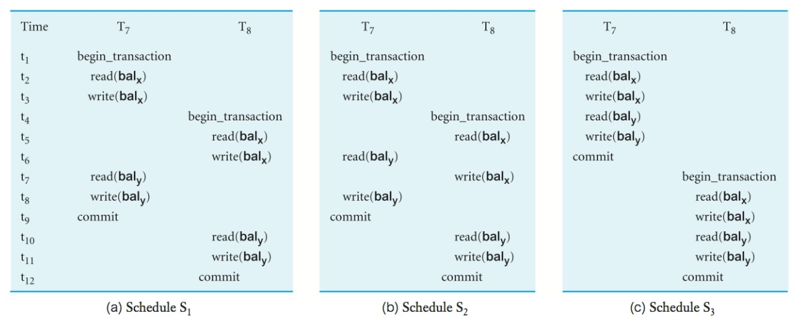
Nonserial vs. Serial Schedule Example
Which is/are serial and which is nonserial?
Are they equivalent? Are the nonserial schedules serializable or will the output be different?
Notes:
Image Source: Source: [© Pearson - Database Systems: A Practical Approach to Design, Implementation, and Management - http://app.kortext.com/read/80118/?page=677]

Slide 30
Conflict Serializability
The previous schedules are examples of Conflict Serializability.
A Conflict serializable schedule orders any conflicting operations in the same way as some serial execution.
In other words, the operations of the transactions are ordered and executed in a way that they do not conflict (interfere) with each other.

Slide 31
Guaranteeing Serializability
Two main concurrency control methods used by the DBMS to guarantee serializability:
  Locking
  Timestamping
They are both conservative (or pessimistic) approaches.
  They cause transactions to be delayed in case they conflict with other transactions at some point.
Optimistic approaches assume conflict is rare and only check for conflicts at commit.

Slide 32
Locking
A transaction accessing the database can ask DBMS to place locks on data items to deny access to other transactions while executing and so prevent incorrect results
Most widely used approach to ensure serialisability.
To use locking, a transaction must claim a:
  Shared Lock: can read item but not update it. Other transactions can read item too.
  Exclusive Lock: can both read and update item. Other transactions will not be able to read or update item.
    Only one transaction can hold an exclusive lock at a time.

Slide 33
Transaction Locking Requests
Transaction 1 Current Locks | Transaction 2 Requests Shared Lock | Transaction 2 Requests Exclusive Lock
Holds No Lock | YES Shared Lock granted to Transaction 2 | YES Exclusive lock granted to Transaction 2
Holds Shared Lock | YES Shared Lock granted to Transaction 2 | NO Exclusive lock not granted to Transaction 2
Holds Exclusive Lock | NO Shared lock not granted to Transaction 2 | NO Exclusive lock not granted to Transaction 2

Slide 34
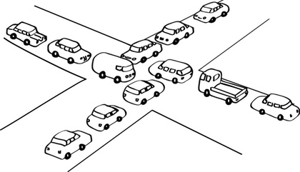
Locking Problems
Deadlocks: may occur when two or more transactions are waiting to access data the other transaction has locked.
Unfortunately, there is only one way to break deadlock: abort one or more of the transactions.
  In some cases, the choice of which to abort may not be obvious.
Notes:
Image source: http://udayarumilli.com/mssql-concurrency-control-locking-mssql-interview-questions-answers/ [accessed: 16-Feb-2018]

Slide 35
Locking Problems
Another problem is that transactions release locks too soon, resulting in loss of total isolation and atomicity.
To guarantee serializability, need an additional protocol concerning the positioning of lock and unlock operations in every transaction.
  The Two-phase Locking (2PL) Protocol is used.

Slide 36
Two-Phase Locking (2PL) Protocol
In two-phase locking (2PL), a transaction acquires all its locks before releasing any, but not necessarily all at once.
It has two phases:
  Growing phase: transaction obtains locks but cannot release any locks.
  Shrinking phase: transaction releases locks but cannot acquire any new locks.

Slide 37
2PL Rules
Transaction must acquire a lock on an item before operating on the item.
For read only access, a shared lock is sufficient. For write access, an exclusive lock is required.
Once the transaction enters its shrinking phase (releases a lock), it cannot acquire any new locks.
Note that deadlocks may still occur with this method.

Slide 38
Preventing the Lost Update Problem with 2PL
Time | T₁ (Jack) | T₂ (Jill) | Balance (bal_{x})
t1 |  | BEGIN TRANSACTION | 100
t2 | BEGIN TRANSACTION | write_lock (bal_{x}) | 100
t3 | write_lock (bal_{x}) | read (bal_{x}) | 100
t4 | WAIT | bal_{x} = bal_{x} + 100 (200) | 100
t5 | WAIT | write (bal_{x}) | 200
t6 | WAIT | COMMIT/unlock (bal_{x}) | 200
t7 | read (bal_{x}) |  | 200
t8 | bal_{x} = bal_{x} - 10 (190) |  | 190
t9 | write (bal_{x}) |  | 190
t10 | COMMIT/unlock (bal_{x}) |  | 190
Notes:
You can provide similar solutions for the Uncommitted Dependency and Inconsistence Analysis problems.
See course text, page 686

Slide 39
Timestamping
An alternative concurrency control method for guaranteeing serialisability of schedules.
Each transaction has a timestamp, which gives the global order execution of the transaction.
There are no locks involved, so no deadlocks!
Transactions involved in a conflict are simply rolled back and restarted.
In the Timestamping concurrency protocol, transactions are ordered in such a way that older transactions (have smaller timestamps), get priority in the event of a conflict.

Slide 40
Timestamps
Timestamps are a unique identifier created by the DBMS that indicates the relative starting time of a transaction.
Can be generated by:
  Using the system clock, or by
  Incrementing a logical counter every time a new transaction starts.
Timestamping in MS SQL Server is implemented via the rowversion data type.
You add a column with this data type to the table(s).
  It is simply a logical counter – an incrementing number.
Notes:
http://stackoverflow.com/questions/17768608/what-is-the-practical-use-of-timestamp-column-in-sql-server-with-example

Slide 41
Database Recovery

Slide 42
Database Recovery
Process of restoring database to a correct state in the event of a failure.
Writing to the database is not a single-step action
  Thus committed transactions may not have been permanently recorded in the physical database.
Two types of storage: volatile (main memory) and non-volatile.
  Volatile storage does not survive system crashes.
  Stable storage represents information that has been replicated in several non-volatile storage media with independent failure modes.

Slide 43
Example
t1
t2
t3
t4
t5
t6
t₀ t_{c} t_{f}
DBMS starts at time t₀, but fails at time t_{f}
T₁ and T₆ have to be undone, as they did not commit.
In the absence of any other information, recovery manager has to redo T₂, T₃, T₄, and T₅.

Slide 44
Checkpointing
Checkpoint contains identifiers of all transactions active at time of checkpoint.
Redo all transactions not committed at checkpoint and undo all transactions active at time of crash.
In previous example, t_{c} is a checkpoint, so only need to redo T₄ and T₅ and undo T₁ and T₆.
  We would now know that T₂ and T₃ have been written to secondary storage at time t_{c}.
T1
T2
T3
T4
T5
T6
t₀ t_{c} t_{f}

Slide 45
Recovery Techniques
If database has been damaged, restore last backup of database and reapply updates of committed transactions using log file.
Three recovery techniques
  Immediate Update: updates are applied to the database as they occur.
  Deferred Update: updates not written to database till it reaches its commit point.
  Shadow Paging: maintains two page tables during the life of a transaction: current and shadow.

Slide 46
Immediate Update
T1
T2
T3
T4
T5
T6
t₀ t_{c} t_{f}
Redo updates of committed transactions following a failure.
May need to undo transactions not committed at failure time as their changes may still be in volatile storage.
What transactions need to be undone, redone?

Slide 47
Deferred Update
T1
T2
T3
T4
T5
T6
t₀ t_{c} t_{f}
At failure time, updates not written to database, so no need to undo changes.
May need to redo committed transactions as their changes may still be in volatile storage.
What transactions need to be undone, redone?

Slide 48
Revision Questions
Given the following schema:
    Ticket (TicketID, Name, Quantity, QuantitySold)
    TicketOrder (PurchaseNo, PurchaseDateTime, PurchasedBy)
    TicketPurchase (PurchaseNo, TicketID, Quantity)
  Write an SQL transaction to execute ALL statements required to order tickets?
Use the schema definition and pseudocode to demonstrate how the following concurrency problems that may occur:
  The Lost Update Problem
  The Uncommitted Dependency Problem

Slide 49
Revision Questions: Immediate Update
T1
T2
T3
T4
T5
T6
t₀ t_{c} t_{f}
Redo updates of committed transactions following a failure.
May need to undo transactions not committed at failure time as their changes may still be in volatile storage.
What transactions need to be undone, redone?
Notes:
Using an Immediate Recovery Technique
Undo T1 and T6
Redo T4 and T5
T2 and T3 are not affected, already committed

Slide 50
Revision Questions: Deferred Update
T1
T2
T3
T4
T5
T6
t₀ t_{c} t_{f}
At failure time, updates not written to database, so no need to undo changes.
May need to redo committed transactions as their changes may still be in volatile storage.
What transactions need to be undone, redone?
Notes:
Using a Deferred Recovery Technique
No need to undo T1 and T6, as not yet written to database
Redo T4 and T5
T2 and T3 are not affected, already committed

Slide 51
More Information
For the interested student, more information on how to implement locking and handle deadlocks in MS SQL Server is provided on following slides

Slide 52
Implementing Locking in MS SQL
In MS SQL Server, to request a lock, you set a Transaction Isolation Level before starting the transaction.
There are five isolation levels and you specify the one to use for the transaction.
The syntax is:
    SET TRANSACTION ISOLATION LEVEL
    { READ UNCOMMITTED | READ COMMITTED
    | REPEATABLE READ | SNAPSHOT
    | SERIALIZABLE }
Notes:
https://msdn.microsoft.com/en-us/library/ms173763.aspx

Slide 53
MS SQL Server Locking Options
Isolation Level | Description
READ UNCOMMITED | Can read rows that have been modified by other transactions but not yet committed (NO LOCK).
READ COMMITTED | Cannot read data that has been modified but not yet committed by other transactions. Depends on another setting: READ_COMMITTED_SNAPSHOT
REPEATABLE READ | READ COMMITTED + and that no other transactions can modify data that has been read by the current transaction until the current transaction completes.
SNAPSHOT | Data modifications made by other transactions after the start of the current transaction are not visible to statements executing in the current transaction.
SERIALIZABLE | REPEATABLE READ + Other transactions cannot insert new rows with key values that would fall in the range of keys read by any statements in the current transaction until the current transaction completes.

Slide 54
SET Isolation Level Example
An Example of a transaction requesting shared locks.
    SET TRANSACTION ISOLATION LEVEL REPEATABLE READ;
    GO
    BEGIN TRANSACTION;
    GO
    SELECT * FROM HumanResources.EmployeePayHistory;
    GO
    SELECT * FROM HumanResources.Department;
    GO
    COMMIT TRANSACTION;
    GO
Notes:
Source: https://msdn.microsoft.com/en-us/library/ms173763.aspx

Slide 55
Locking Problems: Deadlocks
Three solutions for deadlocks:
Timeouts: indicates how long a transaction will wait for a lock. In MS SQL Server use:
    SET LOCK_TIMEOUT timeout_period
Deadlock prevention:
  DBMS uses timestamps (next slide) to order transactions and look ahead and check if transaction will cause deadlock and never allows deadlock to occur.
Deadlock detection and recovery:
  DBMS allows deadlock to occur but recognizes it and breaks one or more transactions.
  There are several things to be considered by DBMS to determine which transaction(s) to break.
  In MS SQL Server, you can help the DBMS with this decision by setting the DEADLOCK priority of the transaction.
    SET DEADLOCK_PRIORITY { LOW | NORMAL | HIGH | <numeric-priority> }
Notes:
https://msdn.microsoft.com/en-us/library/ms189470.aspx
https://msdn.microsoft.com/en-us/library/ms186736.aspx

