Slide 1



Dr Hart’s
disappearance

Slide 2


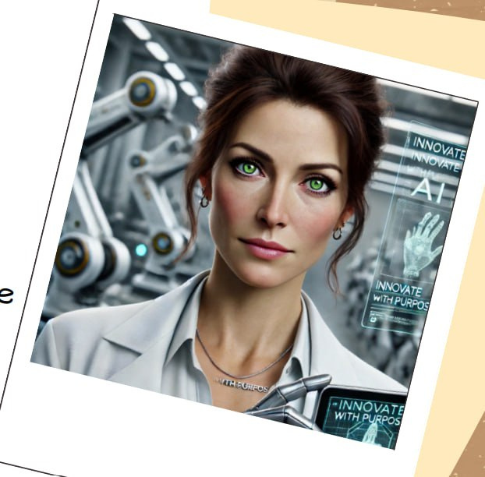
INTRODUCTION
  Dr Dana Hart, 42 years old
  Senior AI and Robotics Engineer at NovaTech Industries
  Disappeared after leaving her workplace between January 5th and January 6th

Slide 3

KEY EVIDENCE AND ANALYSIS
  Dr Hart was stressed about meeing with company executives - a lot of pressure.
  Her lab was trashed, but the equipment was untouched - did they know what to look for?
  She had disagreements with other researches - There are often conflicts between researchers in this field because no one can say for sure where the use of AI will lead us (Gonsalves, 2023).

Slide 4

THEORIES AND CONCLUSIONS
Running
Kidnapping
She ran away on her own
She was kidnapped by someone
Her company?
Competitor?
Or someone helped her?

Slide 5
Thank you for your attention!

Slide 6
References
  Gonsalves, F. (2023) AI - The good, the bad, and the Scary, Virginia Tech Engineer. Available at: https://eng.vt.edu/magazine/stories/fall-2023/ai.html (Accessed: 25.02.2025)
  Masterson, V. and Shine, I. (2023) 9 ways robots are helping humans: Robodogs to magnetic slime, World Economic Forum. Available at: https://www.weforum.org/stories/2023/07/robots-ai-help-humans-at-work/ (Accessed: 27.02.2025).
  Muzaffar, M. (2023) Tesla engineer attacked by robot at company’s Giga Texas factory. Available at: https://www.independent.co.uk/news/world/americas/tesla-robot-attacks-engineer-texas-b2470252.html (Accessed: 26.02.2025)
  Ness, S.R., Shepherd, N. and Teo Rong Xuan (2023) 'Synergy Between AI and Robotics: A Comprehensive Integration', Asian Journal of Research in Computer Science, 16(4), pp. 80–94. Available at: https://doi.org/10.9734/ajrcos/2023/v16i4372
  Yuan, W. (2024) 'Revolutionizing Surgery: The Impact of Machine Learning and Artificial Intelligence on Surgical Robotics', Transactions on Computer Science and Intelligent Systems Research, 5, 1009–1014. Available at: https://doi.org/10.62051/akga3421

