Slide 1



Digital Skills and Research Methods (BMSW4003_BIRM)
Abdi Rahman
How do we use technology to collaborate at UWTSD
1
(2119559) Marian Postolache
(2123633) Madalina Zaharia
(2123635) Robert Bogdan

Slide 2




2
Office 365
UWTSD is a reputable and high-quality university, being up to date with current technology. Within this institution, several main methods of communication are considered, which will be presented in the following slides. These methods serve an essential role in communicating, delivering information, and providing students with the support they need:
Customized faculty email via the Outlook platform
Office 365, free access provided within the university
UWTSD hub, the university application that contains all the courses and all the information a student needs
Microsoft teams, an essential app in communication between tutors and students, offers numerous facilities on both sides.

Slide 3
3
According to(Schinkten Oliver 2022), Microsoft Teams for education is a robust platform for communicating, collaborating, and more with students and teachers.
From one platform, you can create collaborative classes, join professional learning groups, network with colleagues as well as:
Meetings: Teachers can create video meetings or schedule them in advance on a channel's calendar.
Chat: Text formatting and priority highlighting are just two of the current messaging capabilities available in Teams Chat. During chat sessions, users can also share files directly.
Channels: Standard channels are open to anyone who wishes to join, while private channels focus on specific themes or activities. Users must be granted permission to enter the channel by the channel administrator.
Microsoft Teams is a cloud-based digital hub that delivers channels, conversations, meetings, files, and apps in Microsoft Office 365.
Communicating effectively
Organizing teams
Creating conversations
Scheduling and starting video meetings
Sharing files
Apps and optional features
Settings and customization
Working with the mobile app
(Nick Brazzi 2021)

Slide 4
UWTSD Hub
4
According to (UWTSD Hub) the Hwb is the one-stop shop for all the information and assistance needed to make the most of the time at UWTSD.
The Student Hub has been designed to provide detailed information on all student-related matters. It can refer users for specialist support such as academic support, financial inquiries, campus life, health and wellness, and much more will be included in the app. All the questions will be answered in one place.
The UWTSD Hwb app can be used every hour of every day across different nations and devices with one of the best Education category applications.
  Featuring:
  -Moodle
  - Quick access to timetables and Email
  - Navigate the online library and book study rooms
  - Report issues with IT or accommodation
  - Office365
  - FAQ's and access to dedicated Student Hwb team
  - View student details, and amend student record

Slide 5
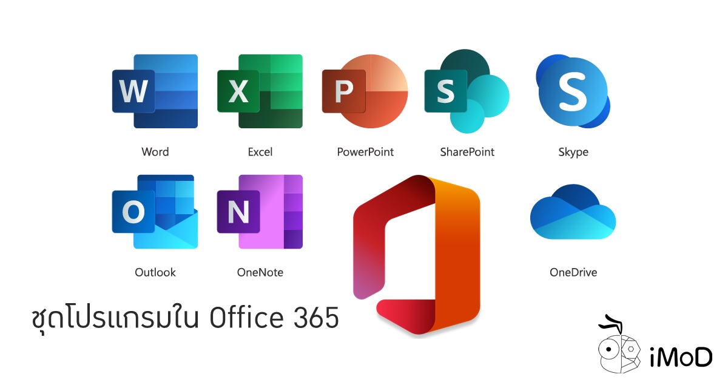


Office 365
5
  Microsoft's Office 365 cloud platform for education provides a broad platform of tools for communication, collaborating, processing, and sharing electronic documents and user workspaces.
  The key benefit of Office 365 is that users may log in from anywhere and at any time.
  From the perspective of the educational process, the advantages are much more evident. The extensive functionality of the services accessible, together with teachers' and students' unified access, creates a single environment for learning and cooperation. (Trieda A. Hlinku, 2018)
  Students learned about the functionality of several applications/services that we delivered over the semester:
  Office and Work Organization Applications
  Applications for online communication
  Collaboration applications
  Applications for personal development and education

Slide 6
One of the leading collaboration and communication tools in research and teaching is the email used in the Outlook platform(Xi and Wang, 2010).
6
Features of emails:
Automatic reply to messages
Auto-forward and redirection of messages
Facility to send messages to many people
Announcement when an email cannot be sent
Emails are date and time imprinted automatically
All kinds of documents can be forwarded as attachments
When PCs cannot be accessed, webmail and mobile mail can be used to send and receive messages
Signatures can be added
Address book can be used to store email addresses directly
Recovery and filing of messages automatically

Slide 7



Ethical considarations:
Using an online communication solution like Microsoft Teams, Microsoft Hub and Microsoft Email is some of the most effective ways to boost team cooperation at any University and especially at UWSTD. Multiple users can stay connected and collaborate on projects using this tools from almost any place and on practically any connected device.
Questionnaires will be used on students in order to rank the most commonly used digital tool at UWSTD.
According to Kara (2018), when collecting data from people, some ethics which will lead any kind of research must be considered. These ethics include: anonymity, consent, confidentiality and potential for harm.
Do you have any questions
This Photo by Unknown Author is licensed under CC BY-NC
This Photo by Unknown Author is licensed under CC BY-NC

Slide 8
References
8
(Schinkten,Oliver 2020) Learning Microsoft Teams for Education. Accessible here: linkedin.com (Accessed on 23/02/2022). | (UWTSD Hub) Accessible here: https://www.uwtsd.ac.uk/hwb/ (Accessed on 15/02/2022).
(Online Teaching & Learning | UWTSD) Accessible here: https://www.uwtsd.ac.uk/onlinelearning/ (Accessed on 22/02/2022). | Kara, H. (2018) Research Ethics In The Real World. 1st Ed. Policy Press. https://books.google.co.uk/books (Accessed on 23/02/2022).
(Melissa Hubbard, Matthew J. Bailey, D'arce Hess, Mårten Hellebro 2021) Book Accessible here: https://link.springer.com/book/10.1007/978-1-4842-6898-8?noAccess=true (Accessed on 20/02/2022). | El-Sabban, F., (2009) Advantages of utilizing e-mail for communicating with students at institutions of higher learning. In Proceedings of the First Kuwait Conference on e-Services and e-Systems (pp. 1- Accessible here: https://dl.acm.org/doi/abs/10.1145/1836029.1836045 (Accessed on 02/02/2022).
Xie, M. and Wang, H.,(2010). A collaboration-based autonomous reputation system for email services. In 2010 Proceedings IEEE INFOCOM (pp. 1-9). IEEE. Accessible here: https://www.sciencedirect.com/science/article/abs/pii/S036013151830246X (Accessed on 26/02/2022). | Trieda A. Hlinku 2018; USING THE OFFICE 365 CLOUD SOLUTION IN THE EDUCATION PROCESS, Accessible here: http://www.slpk.sk/eldo/2018/dl/9788075981806/files/10/s10p09.pdf (Accessed on 22/02/2022).
(Eva Oláhová 2018)Journal Article, USING THE OFFICE 365 CLOUD SOLUTION IN THE EDUCATION PROCESS Accessible here: http://www.slpk.sk/eldo/2018/dl/9788075981806/files/10/s10p09.pdf (Accessed on 23/02/2022).

