Slide 1
Political Bodies: Surveillance, Risk and Regulation

Slide 2
How, in everyday life, are your bodies regulated and surveyed?
And how performs the regulation?

Slide 3
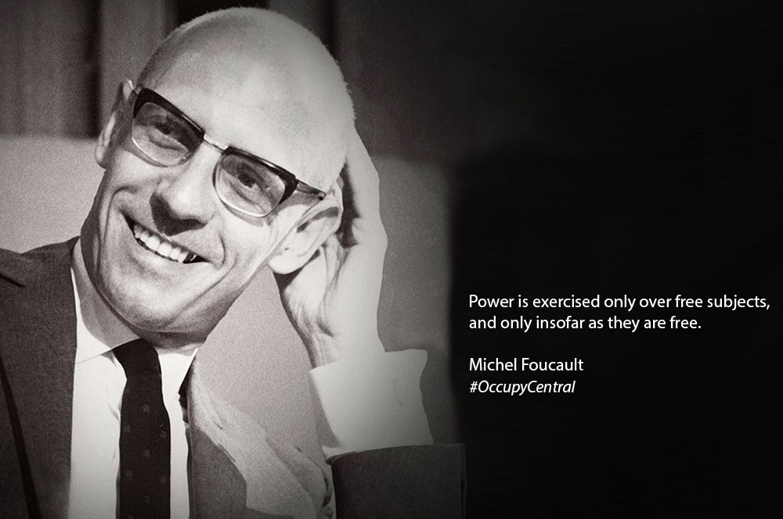
What do we know about Foucault? And what does he have to do with bodies?

Slide 4
Foucault & Regulatory Power
Micro-operations and technologies of power
As a critique of Marx and the dominance of economic power
Not held by agencies
  Power is exercised not possessed
Incorporated into numerous practices
Capillary network

Slide 5
The ‘How’ of Power
We are all regulated
How power operates
  Strategies, networks and mechanisms
How major shifts in exercising power had occurred
It is only by asking the ‘how’ of power, that we can get to the ‘who’
Bureaucracy, categorisation, discourse

Slide 6
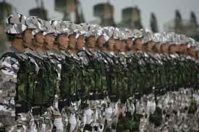

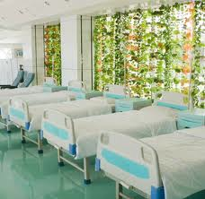
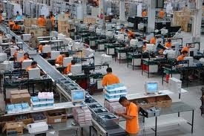

Slide 7
Techniques of the Body
Not unique to capitalism
  But gained prominence in 17th & 18th centuries
Not a mastery of your own body
  Like monks
Nor an express appropriation
  Slavery
But an everyday manipulation

Slide 8
“A modest suspicious power”
Bodies just don’t do as they are told
  Less about output
They behave as they are disciplined
Subjected bodies
To be a ‘productive’ body, it first has to be a ‘subjected’ body.
‘A political technology of the body’

Slide 9
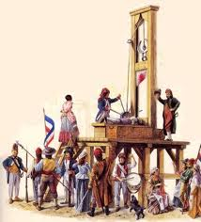
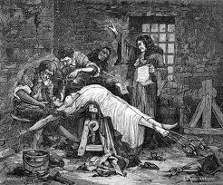
Discipline and Punish
Western Europe, 18th century
Shift from exemplary torture as punishment
  Inefficient and costly
To surveillance as punishment

Slide 10
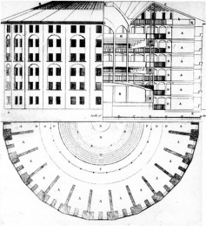
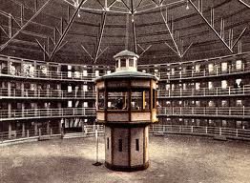
Bentham’s Panopticon (1785)
Metaphor for power relations
All-seeing gaze
  Marked yet masked
Prisoners assume that they are being watched
Begin to self-discipline
Internalization
“Docile Bodies’

Slide 11
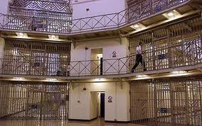
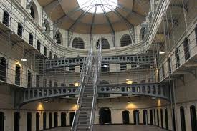
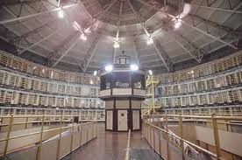

Slide 12
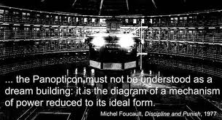

Slide 13
Ong (1988)
Production lines in Malaysia
Japanese owned
Rural girls working in the city
Males supervisors
Women become possessed by spirits
  That reside (primarily) in toilets and ‘unclean’ places

Slide 14
How could you go about interpreting this possession?
Biomedically?
  Physiological and pyschological explanation
As negotiating a new social world?
As a conscious disruption to production?
  As resistance?
As violations to existing moral codes?
  Especially concerning gender roles and notions of purity

Slide 15
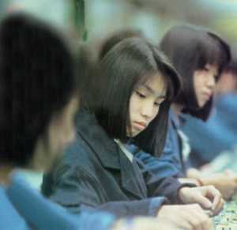
The naturalisation of women’s work- bodies
Discourse of ‘nimble fingers’
“the oriental girl… qualified by nature and inheritance to contribute to the efficiency of a bench assembly production line” (1988: 35)
Maintains women in a subordinate position

Slide 16
Employers
‘we had our counter-measure. I think this is a method of how you give initial education to the workers, how you take care of the medical welfare of the workers. The worker who is weak, comes in without breakfast, lacking sleep, then she will see ghosts!’ (1988: 36)

Slide 17
Spirit possession repackaged as ‘sickness’
Biomedical explanations and solutions
Became a technique of manipulation
Pushed responsibility onto the individual – to get well – rather than the social conditions of the workplace
‘In corporate discourse, both the biomedical and psychological interpretations of spirit possession defined the affliction as an attribute of individuals rather than stemming from the general social condition’ (ibid: 37)

Slide 18
Ong’s interpretation
Women entering ‘unclean’ realms where spirits lurk
  While also having a moral responsibility to remain ‘pure’
Subjected to constant male surveillance
  Bodily functions
Disrupts production but is not limited to this
An expression of a violation of moral codes in a culturally recognised idiom
‘Takes as expressions of fear and resistance against the multiple violations of moral boundaries in the modern factory’ (ibid: 38)

Slide 19

What does this have to do with Foucault?

Slide 20
What does this have to do with Foucault?
The visibility of ‘deviant’ and ‘normal’ women
Possessed workers make themselves vulnerable to biomedical intervention
  Instead of the social support that was sought
Other workers keep a vigilant watch
Induces self-regulation
  Reinforced by the scientific gaze

