Slide 1

Policing
Week 2

Slide 2
What Is Policing?
“It is important to distinguish between the ideas of the ‘police’ and ‘policing’.
(Reiner, 2000:1)

Slide 3
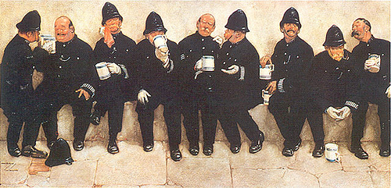
Policing by consent?
‘Peelian principles’…
Task:
Do these principles have contemporary relevance
in todays society?
Does the principle have contemporary relevance today?
Does it fit with the values and customs of our times?
Does it make sense today?
Should it be updated? Or discussed?
Is it achievable?
Notes:
Task here: 9 grps – point each – consider and critique – does this principle have contemporary relevance? 5WH
Relevance (5WH) - does it fit with the values and customs of our times - does it even make sense today - should it be updated - reconceptualised - is it really achievable?

Slide 4
The basic mission for which the police exist is to prevent crime and disorder
The ability of the police to perform their duties is dependent upon public approval of police actions.
Police must secure the willing co-operation of the public in voluntary observance of the law to be able to secure and maintain the respect of the public.
The degree of co-operation of the public that can be secured diminishes proportionately to the necessity of the use of physical force.
Police seek and preserve public favour not by catering to public opinion but by constantly demonstrating absolute impartial service to the law.
Police use physical force to the extent necessary to secure observance of the law or to restore order only when the exercise of persuasion, advice and warning is found to be insufficient.
Police, at all times, should maintain a relationship with the public that gives reality to the historic tradition that the police are the public and the public are the police;
Police should always direct their action strictly towards their functions and never appear to usurp the powers of the judiciary.
The test of police efficiency is the absence of crime and disorder, not the visible evidence of police action in dealing with it.

Slide 5
Who Are The Police?
Prior to 19th century no formal police, there are two accounts of how policing developed into the ‘new police’ of the 19th century,
These were the
Orthodox account – introduction of police was a rational response to crime and criminality to the benefit of society, and the
Revisionist account - argued by some to be an extension of state control over the dangerous, oppressed and poor working classes.
Notes:
Night Watchmen, Gamekeepers etc. Orthodox = Primary Objects tackle crime, drunkeness, public order etc.
.

Slide 6
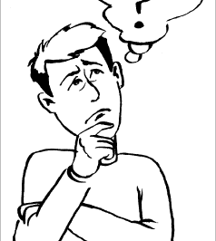
What does police and policing mean to you?

Slide 7
Who are the Police & What is Policing?
‘Police’ refers to a particular kind of social institution, while
‘Policing’ implies a set of process with specific social functions”.
Notes:
Police - perform functions by the institution of the police service and the broader processes of social regulation and reproduction that govern everyday lives.
The word ‘policing’ is linked to ‘politics’, the government
‘Policing’ did not come to be associated with the particular activities of a specific institution (the police) until relatively recently in many societies
It is important to define what is meant by ‘policing’ as it is a term that is often misunderstood. Policing is often seen as little more than what the police do. Indeed it is common to find many books and articles on policing dedicated solely to the public police. It is, however, only relatively recently that the association of the word police with policing began to be used. Before the mid-eighteenth century, policing encompassed a much broader concept of the regulation of government and the morals or economy of society (Johnston, 1992). It was only after the mid-eighteenth century that the word ‘police’ begin to be associated with the maintenance of order and crime prevention. It was only natural then to define the ‘police’ as the body of men and women which had recently formed to undertake these functions (Johnston, 1992). A problem that has emerged as a consequence is the assumption that solely ‘the police’ undertake policing. It is important that these terms are differentiated because there are many other organisations engaged in this process. ‘The police’ refers to a particular organisation while ‘policing’ refers to a social process of which the former and other phenomena are a part (Reiner, 1994). It has indeed been argued that the vast bulk of policing is carried out by people and organisations other than the police (Rawlings, 1995).

Slide 8
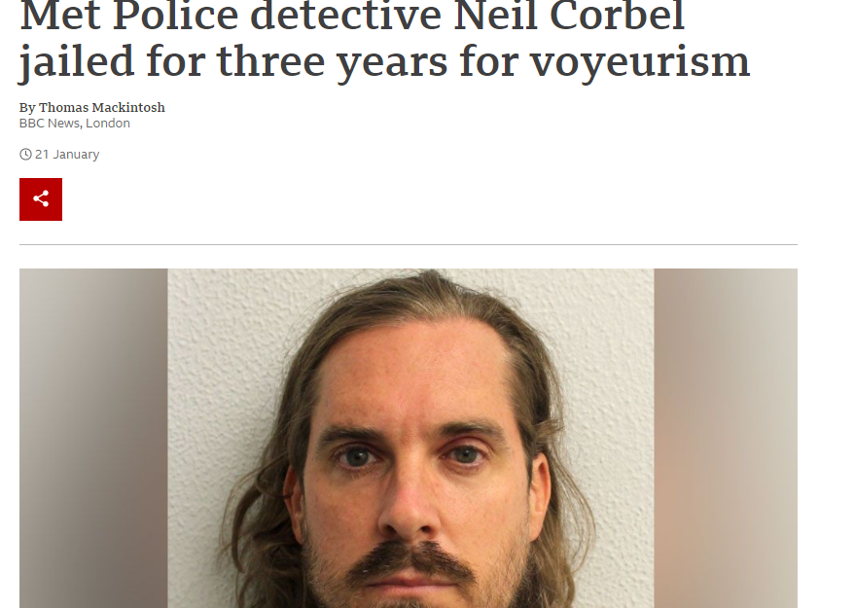
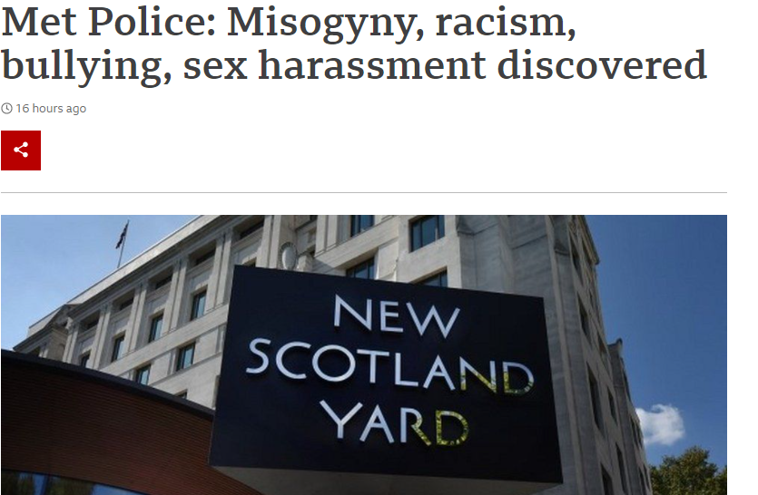
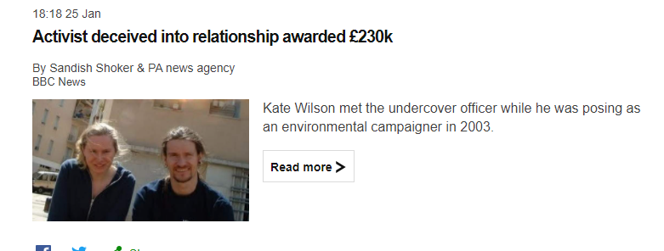
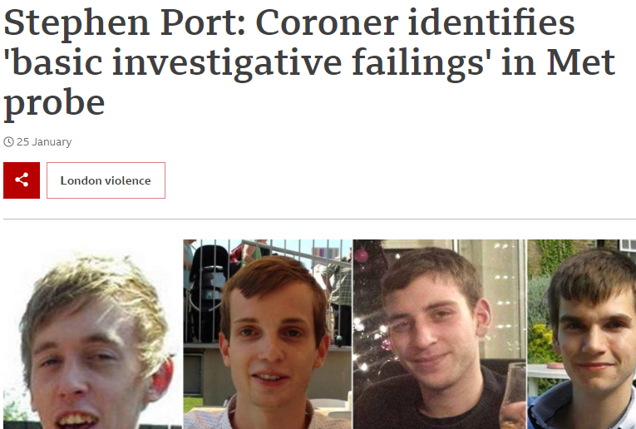
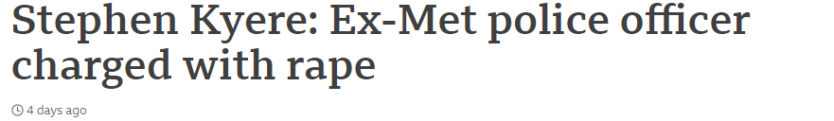
Police Today?

Slide 9
Key Terms In Policing
Police and policing: the distinction between police and policing differentiates between the relatively narrow range of activities conducted by the police service and broader processes of social regulation performed more widely by a diverse range of agencies and actors.
As an increasing range of public, private and civil sector organisations become involved in law enforcement, crime prevention, and community safety, policing in these broader terms has become more salient.
Rowe (2019)

Slide 10
What is policing 1
A narrow, law-enforcement approach
The crime-fighting mandate of police has been self-evident in public discussion of policing for sometime.
2010: Policing in the 21st Century: Reconnecting Police and the People: ‘the key priority for police is to cut crime’
Problems are:
Enforcing the law is not simple
Law is under-enforced
Law changes
Only a small proportion of police time is spent on law-enforcement
Notes:
https://assets.publishing.service.gov.uk/government/uploads/system/uploads/attachment_data/file/118241/policing-21st-full-pdf.pdf

Slide 11
law-enforcement approach
https://www.southwalescommissioner.org.uk/media/1923/crp002-crime-plan-2020-eng-p5.pdf

Slide 12
What is policing 2
The significance of ‘force’ to policing
The authority to use legitimate force over a given territory
So the right to use legitimate force against fellow citizens is a defining characteristic? The emphasis on police use of force reveals important properties of police work. Problems are:
police officers tend to under utilise their capacity to use force to resolve conflict: most encounters do not use force
Increasingly other agencies are afforded option to the use of force

Slide 13
Use of Force
Police officers are allowed to use a reasonable degree of force
‘minimal use of force’ has been central securing the legitimacy of the British police.
Increase of ‘less-than-lethal’ weapons available
CS-spray and ‘tasers’ use have been deployed and use of increasing.

Slide 14
Use of Force
https://www.youtube.com/watch?v=yYifef0mhtI
police race relations advisor is tasered by an officer -
Claire Boddie Tasered Judah Adunbi while on patrol in Bristol after she mistook the race relations adviser for a wanted suspect and he refused to identify himself. Today she was cleared of all misconduct charges after discharging the Taser as close range. One of the barbs struck the community elder in the face and yesterday the officer's hearing was told Pc Boddie had used 'unnecessary, unreasonable or disproportionate force'.
https://www.youtube.com/watch?v=neVa7PappvI

Slide 15
What is policing 3
Service-oriented work being the concept of crime-control is a much more vague concept
Bittner, 1974:
“when one looks at what policemen actually do, one finds that criminal law enforcement is something that most of them do with the frequency located somewhere between virtually never and very rarely”
Bayley (1994) seven to ten per cent of calls relate to crime
Breen (2020) USA Police 95.6% of calls to police don’t involve crime.
College of Policing (2019) 83% non-crime related calls to police.
Notes:
https://www.police-foundation.org.uk/2017/wp-content/uploads/2017/06/roles_and_resp.pdf
https://www.app.college.police.uk/app-content/major-investigation-and-public-protection/hate-crime/responding-to-non-crime-hate-incidents/

Slide 16
Service-oriented work continued…..
Attempts to distinguish between
  ‘frontline’,
  ‘mid-office’
  ‘back-office’
  police functions and reviews of police pay and conditions have led to a refocus on the proper balance between various roles that offices perform (HMIC, 2011a and b; Winsor, 2011)
Conceptualising police work
Narrow conceptualising – carry out social regulation
Wider conceptualising – wider activities that the police carryout

Slide 17
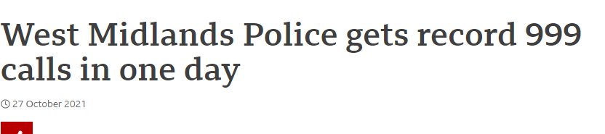
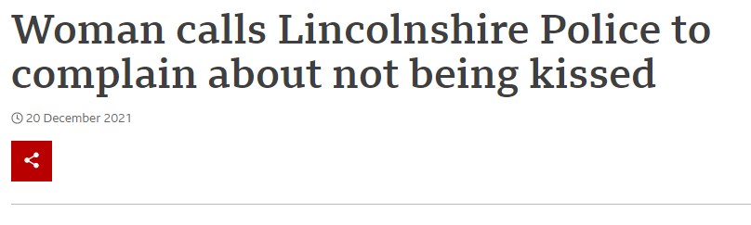
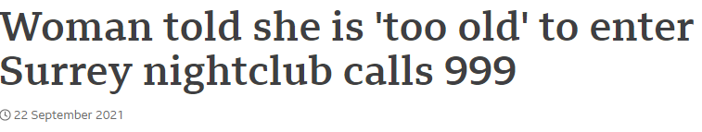
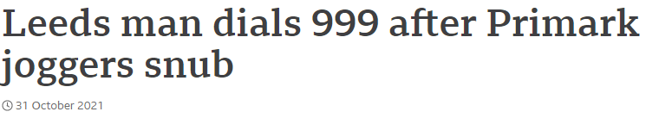
Notes:
https://www.bbc.co.uk/news/uk-england-leeds-59109881

Slide 18
What is policing 4
Police as Bureaucrats
The routines of police work are occupied by administrative and procedural work which might not be understood as ‘real’ policing.
High percentage of police time spent inside police stations, high levels spent to the custody process and completing paperwork
With financial austerity more pressure on police officers to protect frontline policing.
micro-manage officer behaviour and hold managers to account, to ensure powers are discharged fairly - organisational justice
Notes:
https://whatworks.college.police.uk/Research/Documents/150317_Fair_cop%202_FINAL_REPORT.pdf

Slide 19
What is policing 5
An institutional perspective
The police service is a key agency in the criminal justice system.
Might be the ‘state in uniform’, a visible body that enforces the rule of law but it is not the only agency influencing and regulating social conflict and cohesion
Courts / Youth Offending Teams / CPS / Prisons / Probation Service

Slide 20
https://www.researchgate.net/publication/272772630_The_case_for_a_narrower_focus_to_policing
https://www.police-foundation.org.uk/project/understanding-the-publics-priorities-for-policing/
https://www.police-foundation.org.uk/2017/wp-content/uploads/2010/10/understanding_public_priorities_appendices_final.pdf
https://shura.shu.ac.uk/23814/10/Williams_future_for_policing%28VoR%29.pdf
https://assets.publishing.service.gov.uk/government/uploads/system/uploads/attachment_data/file/118241/policing-21st-full-pdf.pdf

Slide 21
https://www.polfed.org/leics/news/2018/hard-hitting-reality-of-policing-video-a-huge-success/

Slide 22
To watch – Questions in class
https://www.youtube.com/watch?v=mI4qPlYaf9k - Russell Howard / PC Wayne Marques
https://www.youtube.com/watch?v=fQQMta-obf4# - Policing by consent.

