Slide 1
Health and Social Care
Module: Digital Skills and Research Methods LCH4007/ Aliyuda Ali
Group Members: Anyzabel Das Neves – 2542803, Karla Esmeralda Rodriguez de Romero – 2435930, Juliet Harrison – 2541296, Klaudie Balazova – 2542629, HalleBerry Owiredua Boadi - 2539714

Slide 2
Staff Communication
Staff communication means sharing important information with colleagues, so everyone knows what is happening. This can include handovers, updates, meetings, and quick messages between staff members. (Indeed UK, n.d.)

Slide 3
Microsoft Teams
Is a virtual hub for chat, calls, and shared files, and support staff working on site remotely in one place (NHS England, n.d.). Is the best tool for staff communication because it allows people to chat, have meetings, make calls, and share files in one place. It helps staff send messages quickly instead of waiting for email replies, which makes communication faster and easier.[syscom.2018]

Slide 4
Advantages
Disadvantages
Staff need training to use it properly ​
Too many messages can become confusing ​
It depends on people checking it regularly
Fast communication ​
Easy group chats and meetings ​
File sharing in one place ​
Works on phones, tablets and laptops

Slide 5
Staff Training
Staff training in a nursing home is when the carers, nurses and administrative personnel are being trained with the information and abilities required to deliver safe efficient care.
Training could consist of;
Procedures for administering medications
Training on health and safety prevention
Management of infection

Slide 6
Microsoft Teams
Microsoft team is a digital app made by Microsoft to promote communication and teamwork. It supports online meeting and schedule and sharing of files.

Slide 7
Why Microsoft teams is suitable for staff training
Microsoft teams is the best for staff training because it supports videos and audio calls and with this Riverdale. It can easily train staff using live meetings because it can be recorded for the staff that were not able to joint the meeting, so they can later watch the meeting.
Staff can easily get de access to policies and messages because teams can store these policies and be viewed when ever.

Slide 8
Efficiency and communication
Teams improves efficiency by making comminution faster and more organised.
During a staff training at Riverdale nursing staff can ask question during the session.
Staff can massage the trainer afterwards and receive files without looking through mails. It reduce the need for repeated face to face meetings since meetings can be recorded and shared.

Slide 9
Advantages and Limitations
Advantages
Limitations
"I chose staff training as my workplace task and Microsoft Teams as the best tool because it will allow Riverdale staff to;
Join live training and meetings
Share documents
Questions can be asked during staff training to reduce misinformation.
Requires a stable internet connection
Some employees might not feel comfortable using digital technology
Notifications alerts during sessions can be distracting

Slide 10
Introduction
Riverdale Nursing Home
Older adults supported daily.
Riverdale Nursing Home provides care and support for older adults who require daily personal care, medication assistance and health monitoring.
Staff work across two buildings
Communication issues identified.
Efficient digital working required.

Slide 11
Secure File Storage and Sharing
OneDrive is Microsoft's cloud-based storage platform that allows users to securely store, access and share files from any authorised device (Microsoft, 2025).
Care records stored securely
Information shared safely
Access limited to authorised staff
Accurate records maintained

Slide 12
Microsoft 365 Tool Selected
OneDrive
Using OneDrive improves efficiency because all staff can access up-to-date information in a secure environment.
Cloud-based storage
Secure file sharing
Access from different locations
Current document versions available
(Microsoft, 2025)

Slide 13
Why OneDrive is Suitable
OneDrive supports secure collaboration and document management through:
Automatic file backup
Access permissions available
Real-time document updates
Version history maintained
Supports secure working
(NCSC, 2025; The Access Group, 2024)

Slide 14
Improving Efficiency and Communication
The most suitable Microsoft 365 tool for secure file storage and sharing at Riverdale Nursing Home is OneDrive.
OneDrive enables staff across both buildings to securely store, access and share important documents while maintaining confidentiality and data security. By adopting OneDrive consistently, Riverdale Nursing Home can improve communication, reduce duplication of work and increase overall efficiency
Documents accessed by different teams
Duplicate work reduced
Information shared more quickly
Communication between buildings improved
(Nimble, 2024)

Slide 15
Advantages and Limitations
Advantages
Limitations
Secure storage
Easy collaboration
Supports confidentiality
Limitations
Staff training required
Internet connection needed
Access settings must be managed
Staff training required
Internet connection needed
Access settings must be managed

Slide 16

Care Documentation in healthcare
Different types of care documentation:
Progress/Daily notes
Care Plans
Admission and discharge Summaries
What are they used for?
Recording health progress
Treatments
Assessments
Responses to care
(Birdie, 2026)

Slide 17
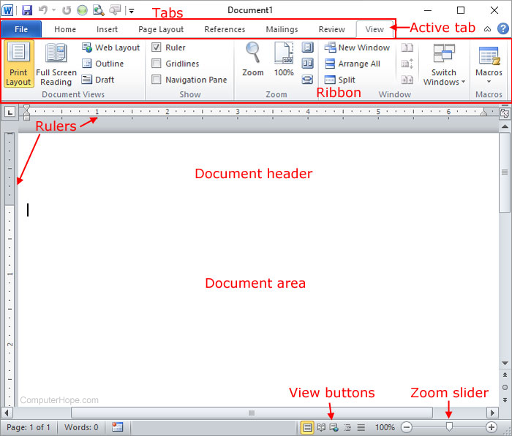
Word Document For Care Plans
Key features
Text Formatting
Templates
Media Integration
Reviewing Tools
Editing and sharing text-based documents.
Watch this video https://www.youtube.com/watch?v=j-ZAVHk5SaU
Figure 2. Microsoft Word, (Computer Hope, 2026).
(Knowledge Academy, 2026).

Slide 18
Benefits of Microsoft Word for Care Plans
Secure Offline Access
Flexible and easy to customise layouts
Time-saving Templates
Add organisation Branding
Collaboration and review.

Slide 19
About Riverdale:
Riverdale Nursing Home provides full care and support for elderly residents
It operates across two different buildings, located close to each other
The nursing home employs a large team of care assistants, nurses and cleaners
The staffs work at different times; early mornings, afternoons, nights, public holidays and weekends.
(good planning is very important to make sure residents always get the right care and support)

Slide 20
Microsoft Excel
Microsoft Excel is a spreadsheet tool utilised for analysis of data, the organization and calculation. Explanation for Excel's Relevance in Staff Scheduling and why its ideal for rota management are as follows;
Develop weekly and monthly staffing schedules. Document employee names, positions, and shift schedules.
Supervise yearly leave and absences. Estimate working hours and helping to utilise procedures at the workplace.
In application for Riverdale Nursing Home
At Riverdale Nursing Home, Excel enable managers to maintain sufficient staffing levels and minimise uncertainty around shift managements. According to Microsoft (2024), Excel supports efficient organisation and analysis of workforce information.

Slide 21

How Microsoft Excel Improves Efficiency and Communication
Improving Efficiency
Microsoft Excel may enhance Riverdale Nursing Home productivity by:
Minimising errors made during scheduling.
Saving time over paper rotas.
Helping workforce management and planning.
Improving Communication
Excel shares personnel schedules via Microsoft 365, making sure employees have the latest rota, this aims to reduce:
Unread messages.
Miscommunication among two or more facilities.
Duplicate work scheduling.
Effective workforce planning contributes to improved service delivery and continuity of care (NHS England, 2023).

Slide 22
Advantages and Limitations of Microsoft Excel
Right now staffs are planning their shifts using paper sheets or old computer files that are not updated properly.
01
It is very difficult to make changes quickly when someone calls in sick or even goes on a holiday.
02
Staffs often see old incorrect versions of the rota which can lead to staffs forgetting when they are working.
03
It takes managers a long time to write out or edit the schedule everyweek
04

Slide 23
References
Birdie (2026) Daily care notes examples. Available at: https://www.birdie.care/blog/daily-care-notes-examples (Accessed: 31 May 2026).
Care Quality Commission (2024) Guidance for providers on staffing and quality of care. Available at: https://www.cqc.org.uk (Accessed: 7 June 2026). Note: Full content of this page could not be accessed.
Computer Hope (2026) Microsoft Word. Available at: https://www.computerhope.com/jargon/m/microsoft-word.htm (Accessed: 31 May 2026).
Indeed UK (n.d.) Staff communications. Available at: https://uk.indeed.com/career-advice/career-development/staff-communications (Accessed: 4 June 2026). Note: Full content of this page could not be accessed.
Knowledge Academy (2026) What is Microsoft Word?. Available at: https://www.theknowledgeacademy.com/blog/what-is-microsoft-word/ (Accessed: 31 May 2026). Note: Full content of this page could not be accessed.
Microsoft (n.d.) Collaboration: achieve more together. Available at: https://www.microsoft.com/en-gb/microsoft-teams/collaboration?msockid=0d0a194bf6e265b908160e2ef7de64f5 (Accessed: 4 June 2026).
Microsoft (n.d.) Screen Sharing in Microsoft Teams. Available at: https://www.microsoft.com/en-gb/microsoft-teams/screen-sharing (Accessed: 6 June 2026).
Microsoft (2025) OneDrive cloud storage. Available at: https://www.microsoft.com/en-gb/microsoft-365/onedrive/online-cloud-storage (Accessed: 7 June 2026).
Microsoft (2024) Microsoft Excel help and learning. Available at: https://support.microsoft.com/excel (Accessed: 7 June 2026). Note: Full content of this page could not be accessed.
Microsoft Support (n.d.) Introducing Microsoft Teams. Available at: https://support.microsoft.com/en-gb/office/introducing-microsoft-teams-59b4cf2f-84ef-4a41-860a-37d3b9af09d3 (Accessed: 12 June 2026).
Microsoft Support (n.d.) Share files in Microsoft Teams. Available at: https://support.microsoft.com/en-US/teams/files/share-files-in-microsoft-teams (Accessed: 4 June 2026).

Slide 24
Microsoft Support (n.d.) Show your screen during a meeting. Available at: https://support.microsoft.com/en-us/office/show-your-screen-during-a-meeting-90c84e5a-b6fe-4ed4-9687-5923d230d3a7 (Accessed: 12 June 2026).
National Cyber Security Centre (2025) National Cyber Security Centre. Available at: https://www.ncsc.gov.uk/ (Accessed: 7 June 2026). Note: Full content of this page could not be accessed.
NHS England (n.d.) Microsoft Teams and remote working. Available at: https://www.england.nhs.uk/long-read/microsoft-teams-and-remote-working/ (Accessed: 4 June 2026). Note: Full content of this page could not be accessed.
NHS England (2023) Workforce planning guidance. Available at: https://www.england.nhs.uk (Accessed: 7 June 2026). Note: Full content of this page could not be accessed.
Nimble (2024) Email security awareness: 10 tips to keep your inbox safe. Available at: https://www.nimble.com/blog/email-security-awareness-10-tips-to-keep-your-inbox-safe/ (Accessed: 7 June 2026). Note: Full content of this page could not be accessed.
Nursing and Midwifery Council (2018) The Code: Professional standards of practice and behaviour for nurses, midwives and nursing associates. London: NMC.
Syscom (2018) Exploring the benefits of Microsoft Teams for business. Available at: https://www.syscom.co.uk/news/exploring-the-benefits-of-microsoft-teams-for-business (Accessed: 4 June 2026).
The Access Group (2024) Confidentiality in health and social care. Available at: https://www.theaccessgroup.com/en-gb/blog/hsc-confidentiality-in-health-and-social-care/ (Accessed: 7 June 2026). Note: Full content of this page could not be accessed.

