Slide 1
Electrical Engineering
(ACDA5001)
Lecture - 3

Slide 2
Content
Ohm’s Law
Exercises

Slide 3
Learning Outcome
The student upon completion of the lecture will be able to:
Define Ohm’s law.
List the advantages of Ohm’s law

Slide 4
Ohm’s law
Ohm’s law was stated by George Simon Ohm.
Ohm’s Law Provides the relation between Voltage, Current and Resistance
Lecture 3 / Electrical Engineering

Slide 5
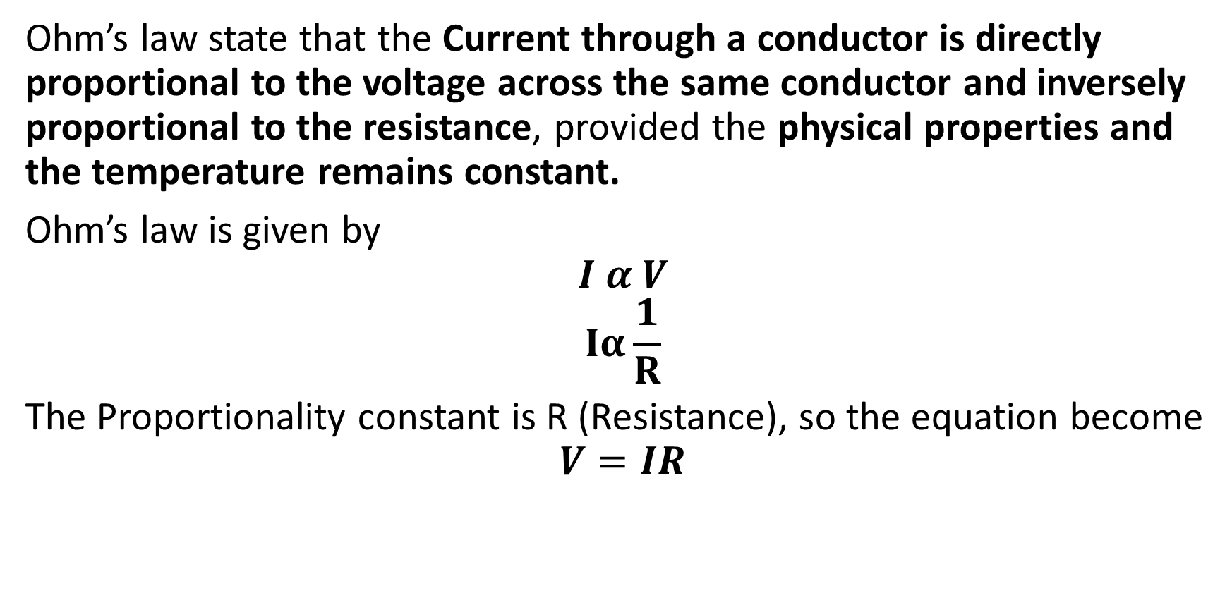
What is Ohm’s Law?
Ohm’s law state that the Current through a conductor is directly proportional to the voltage across the same conductor and inversely proportional to the resistance, provided the physical properties and the temperature remains constant.
Ohm’s law is given by
$$I α V$$
$$Iα\frac{1}{R}$$
The Proportionality constant is R (Resistance), so the equation become
$$V=IR$$

Slide 6
What is Ohm’s Law?
Where,
V – Voltage across the conductor
I – Current across the conductor
R – Resistance across the conductor

Slide 7
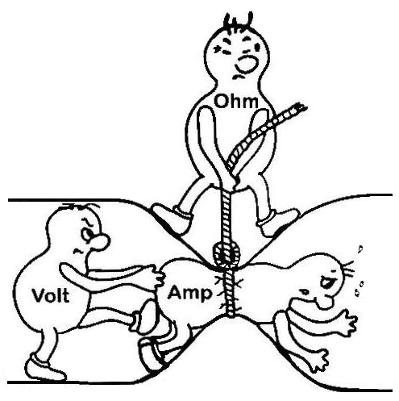
Ohm’s law

Slide 8
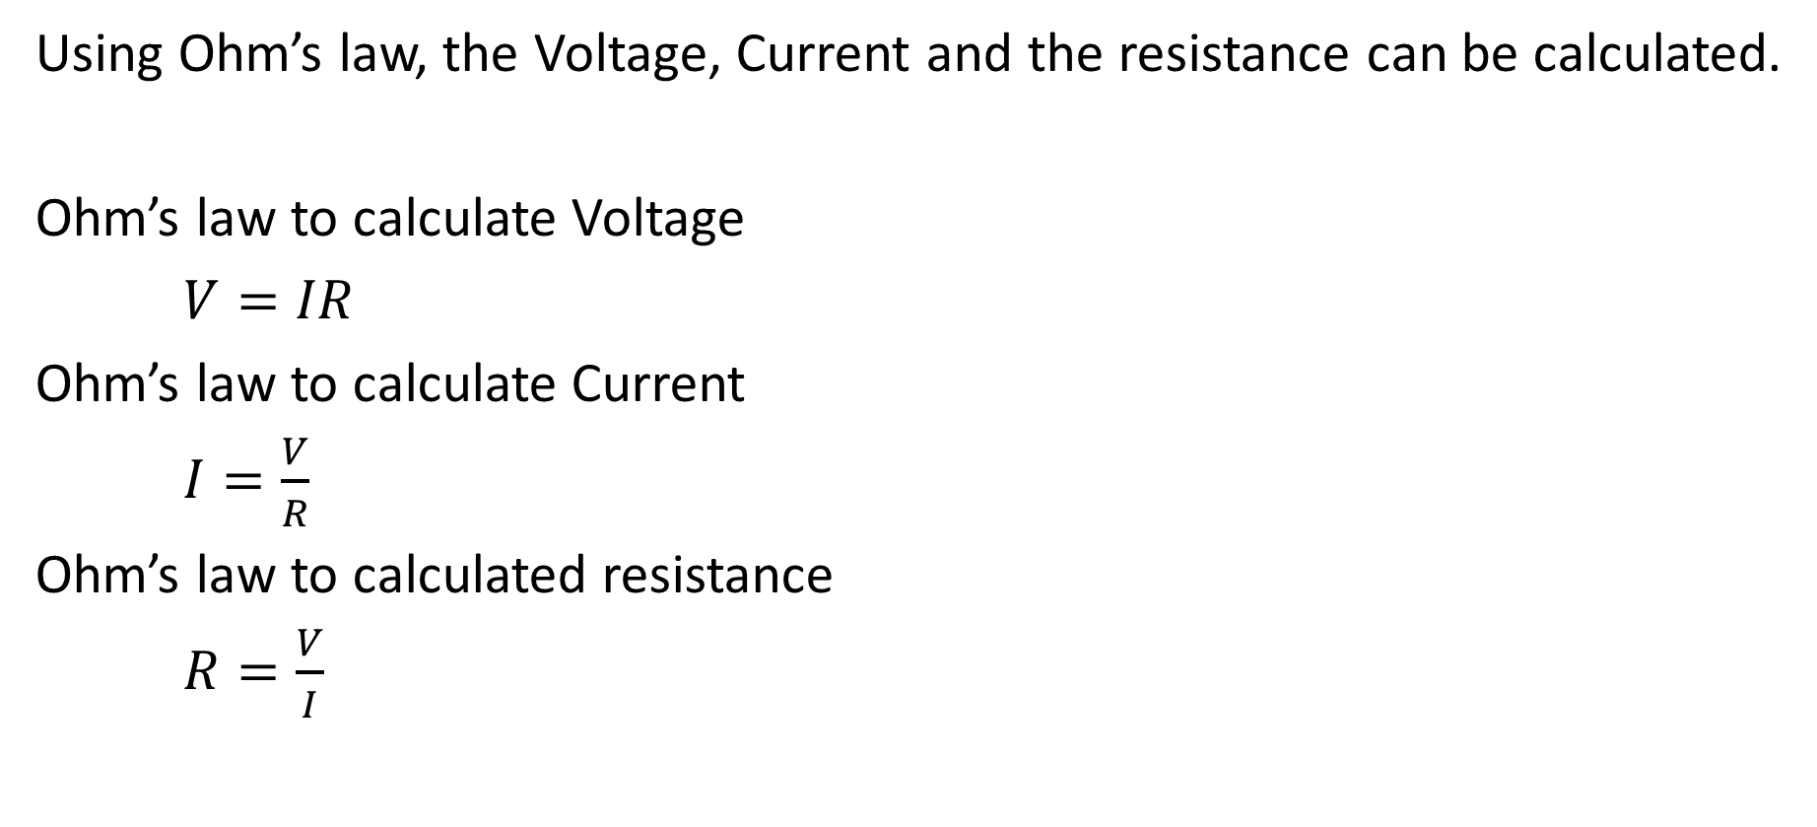
Ohm’s Law
Using Ohm’s law, the Voltage, Current and the resistance can be calculated.
Ohm’s law to calculate Voltage
$V=IR$
Ohm’s law to calculate Current
$I=\frac{V}{R}$
Ohm’s law to calculated resistance
$R=\frac{V}{I}$

Slide 9
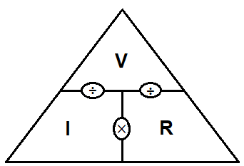
Ohm’s Law Triangle
WSJ Lectures

Slide 10
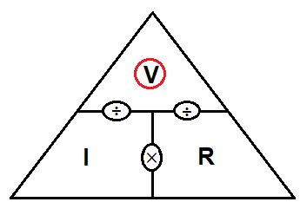
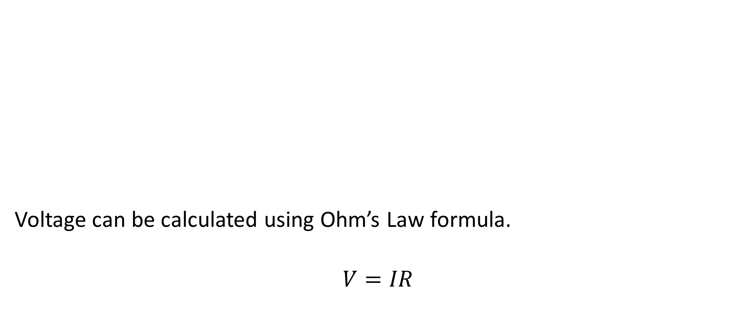
Ohm’s Law Triangle
Voltage can be calculated using Ohm’s Law formula.
$$V=IR$$

Slide 11
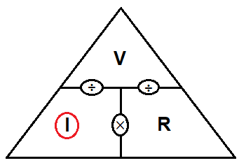
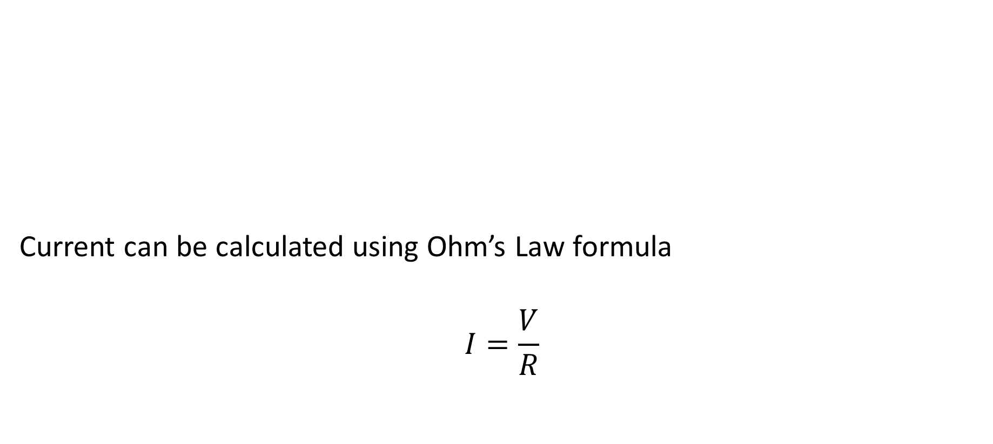
Ohm’s Law Triangle
Current can be calculated using Ohm’s Law formula
$$I=\frac{V}{R}$$

Slide 12
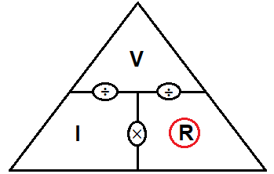
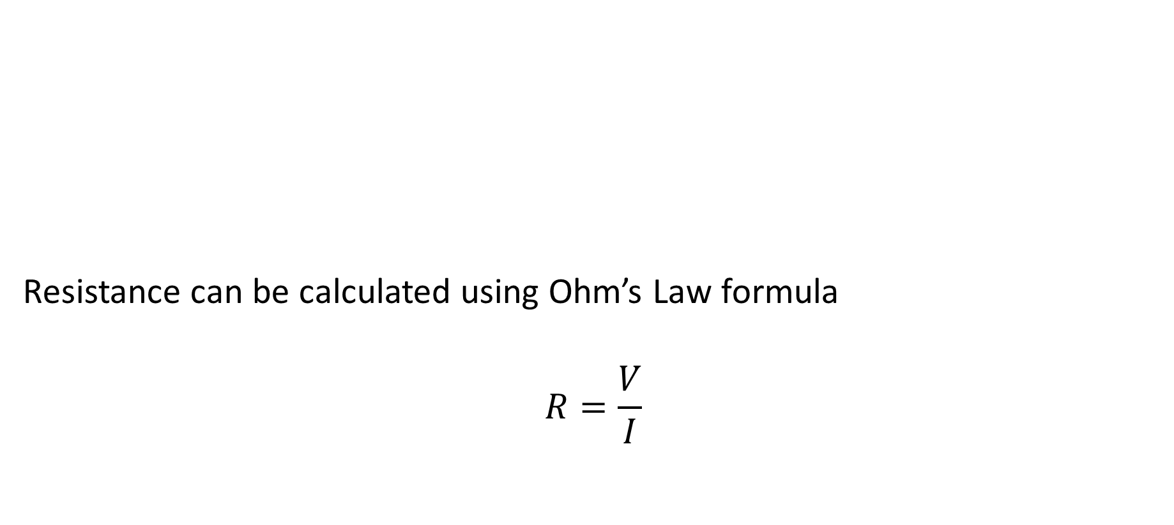
Ohm’s Law Triangle
Resistance can be calculated using Ohm’s Law formula
$$R=\frac{V}{I}$$

Slide 13
Advantages of Ohm’s law
Ohm’s law can be used to calculate Voltage, current and Resistance in a circuit.

Slide 14
Limitations of Ohm’s law
It cannot be applied in a circuit, in which the temperature keeps changing.
This law cannot be applied to unilateral networks.
(Circuit having elements like diode, transistors, etc.)
It is also not applicable in non – linear elements.
(Non-linear elements are those which do not have current exactly proportional to the applied voltage)

Slide 15
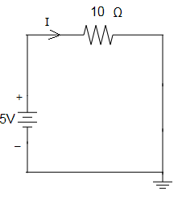
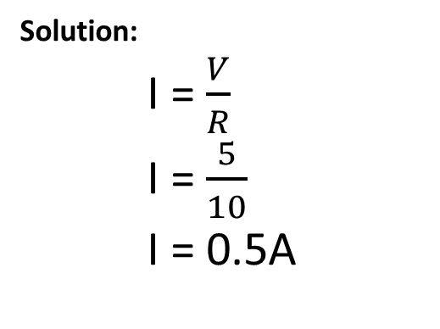
Exercise 1
Calculate the current flowing through the resistor in the following circuit diagram
Solution:
I = $\frac{V}{R}$
I = $\frac{5}{10}$
I = 0.5A

Slide 16
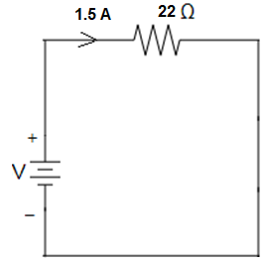
Exercise 2
Calculate the Voltage across the resistor
Solution:
V = IR
V = 1.5 × 22
V = 33 A

Slide 17
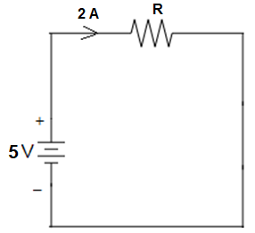
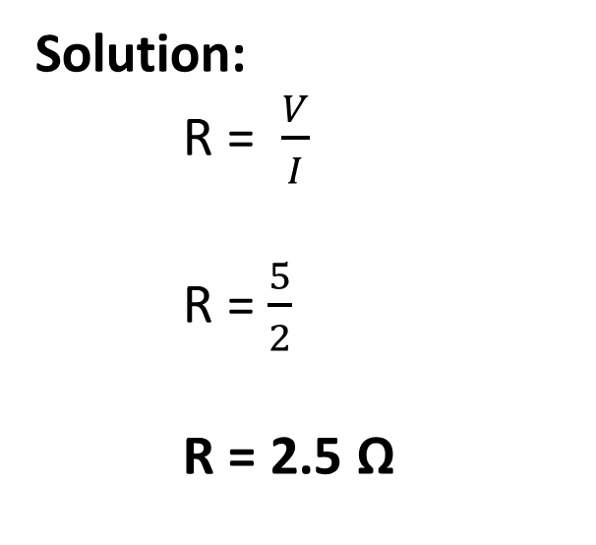
Exercise 3
Calculate the resistance across the resistor
Solution:
R = $\frac{V}{I}$
R = $\frac{5}{2}$
R = 2.5 Ω

Slide 18
Thank You
Notes:
Health and Safety module – coming soon on Moodle

