Slide 1


Component 2 Individual Presentation
Name: Zakiyabanu Zakirhusen Malek
Student ID:2531983
Lecturer Name: Muhammed Khan
Module Code: LCHS7003
Module Title: Community Care and Management of Longer-term Conditions
Topic: long term condition- Dementia
Target: Care home workers as social group

Slide 2


Overview of the long-term condition-Dementia
Definition
Dementia, as a long-term condition, refers to the loss of memory and other thinking abilities of individuals (Huizenga et al., 2023).
FOCUSING ON THE CARE HOME WORKERS AS SOCIAL GROUP
Symptoms
Symbolising by increasing loss of memory, thinking abilities, functional and behavioural activities (Sharifi et al., 2024; Schwertner et al., 2022).
Causes
Dementia, as a neurodegenerative disease, causes damage to nerve cells (Moroz et al., 2024).
Notes:
Long-term conditions indicate the need for ongoing medical support and daily action for maintaining effective care practices. Thus, Dementia is one of the long term conditioned diseases that causes progressive declining of memory , thinking abilities, and functional loss as well. Further, developing the existing practices for enhancing the quality of life for care home workers by availing safety measures, cognitive support, assisting with daily work, and acquiring highly skilled professionals.

Slide 3

Global and UK-based practice of Dementia
  The Government of the United Kingdom shares the records of 483000 cases in England related to Dementia (Gov.UK, 2025).
  The statistical record of UK shares the prevalence rate was 4.2 percent in 2024 against Dementia (Gov.UK, 2025)
  Global records share that 57 million people had dementia as per the 2021 records (WHO, 2025).
Notes:
World health organisations have been encouraged to implement integrated care management practices through identifying modifiable risk and early interventions to serve fast facilities for dementia patients. Furthermore, encouraging different practices such as personalised care system facilities, community-based care practices, and early diagnostics through biomarkers is supported by countries like Australia, New Zealand, the United Kingdom, America, and many more.

Slide 4


Economic and Social Burden of Dementia
Economic Burden
Global Expenses against Dementia was recorded at 1313.4 billion US dollars by 2019 (NCBI, 2023).
Social Burden
Global societal cost projected to be 1.3 trillion US dollars by 2019 (NCBI, 2024).
Socio-Economic View
Requiring a consistent flow of capital investment and cooperation of family and friends is considered an informal burden against Dementia.
Notes:
Statistical insights indicated that dementia was emphasizing the patients with the low to moderate income range. Thus, the requirements of high-cost investment and consistent care support create a burden for the patient's families. Along with this, it negatively impacts both the caregivers and patients by reducing their cognitive health in a substantial manner.

Slide 5

Diagnosis and Initial Analysis of Dementia
Diagnosis
Diagnoses include combining physical, cognitive, and functional tests, including patient medical histories (Kusoro et al., 2025).
Global Facts
Global Statistical reports share only 15 percent of individuals diagnosed under memory clinics for Dementia (Hsu et al., 2025).
Initial Assessment
Care home staff should notify clinicians of any early indicators, such as behavioral changes and memory loss.
Notes:
Diagnosis and initial assessment against Dementia includes extensive analysis of earlier medical history records and other test results of the patient. Although different neurological tests and vascular testing are required to determine the dementia within the patient. Although currently in the UK, gathering the reports of primary care and diagnostic reports to understand dementia.

Slide 6


Analysis of Management Practices of Dementia
  NICE Guidelines (NG97): Evidence-based guidance for dementia diagnosis, treatment, and ongoing management (OECD.ORG, 2026).
  NHS Long Term Plan (2019): promotes personalised, integrated, and community-based dementia care (Dementia UK. Org, 2026)
  Integrating artificial intelligence through CST assistance for serving first-line treatment with accurate determination (Care England, 2025).
Notes:
Currently, emphasising non-pharmaceutical treatments by using cognitive simulation therapy, which improved the cognitions action, behavioural development, enhance communication. Thus, it was recognised by both WHO and NICE to conduct effective management actions towards the recovery of Dementia within the patient.

Slide 7
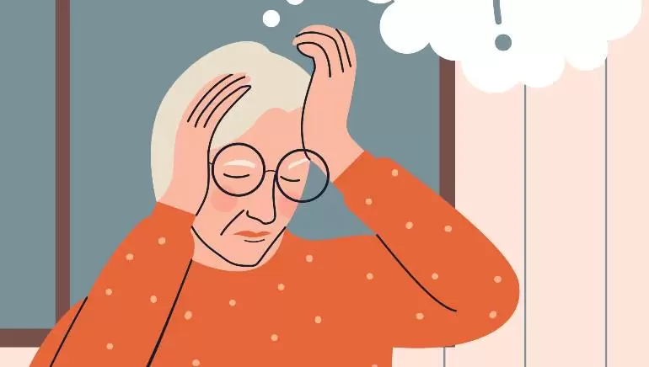
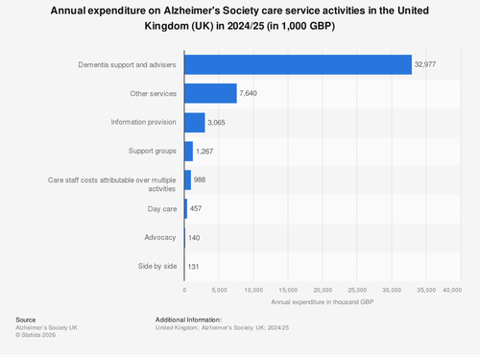
Available treatment strategies of the United Kingdom
Pharmacological approach
Cholinesterase inhibitors and improvement in the cognitive symptoms (Chib et al., 2025).
Non-Pharmacological approach
Cognitive stimulations, reminiscence and person-centred care (Fisher et al., 2025).
The Alzheimer's Society in the UK spent around 33 million British pounds on dementia counselors and support in 2024-2025 (Statista, 2026).
Source: (Statista, 2026)
Notes:
The treatment for dementia follows the NICE guidelines, which include a combination of medication as well as psychological interventions. Drugs including cholinesterase inhibitors, can be considerable for providing the symptomatic relief where therapies such as cognitive stimulation enhance quality of life.

Slide 8

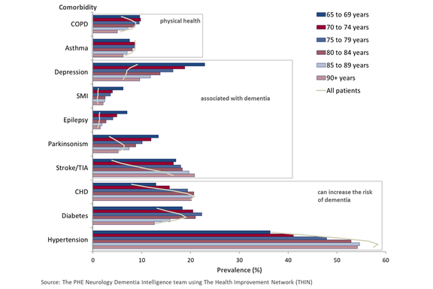
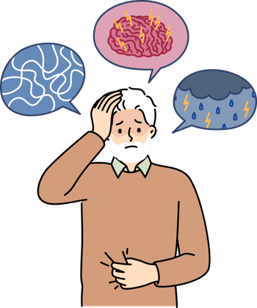
Concurrent symptoms of Dementia
The cognitive symptoms of dementia are loss of memory, confusion and impaired judgement (Blaszczyk, 2022).
The behaviour change includes aggression, anxiety and social withdrawal (Ismail, 2022).
At least one of the comorbidities is diagnosed in 77% of dementia patients (UK GOV, 2019).
Source: (UK GOV, 2019).
Notes:
Dementia includes the cognitive, behaviour and physical symptoms which can be the reason for the worsening situation over the time. Loss of the memory and reducing thinking ability are the primary symptoms of dementia along with the emotion and behavioural disturbances. Several patients have multiple comorbidities which further increases the care complexity in care home settings.

Slide 9


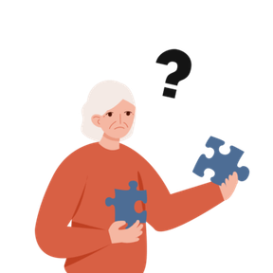
Preventive Measures of Dementia
It is suggested to focus on a healthy lifestyle with balancing the diet, regular exercise and avoiding smoking (Dhana et al., 2024).
Cognitive stimulations through education, social engagement and mental activity can also be the preventive measures for dementia (Telenius et al., 2022).
Modifiable risk factors account for 40% of dementia cases (Dukelow et al., 2023).
Notes:
Dementia prevention is primarily targeted at alterable risk factors. Treatment of diseases like hypertension and diabetes can help to reduce considerably risk and the disease progression. Socializing and combining the mind is also helpful in maintaining mental status. Caregivers should be involved in promoting regular exercises and a healthy and balanced diet. Such lifestyle interventions can help maintain the overall brain health and reduce the chances of dementia or slow its onset in those at risk

Slide 10

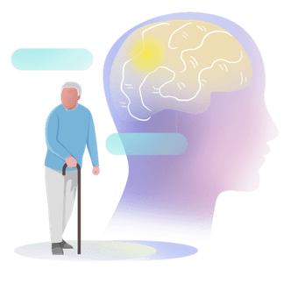

Analysis of co-productive care practices against Dementia
  Encouraging the decision-making between the patients, family and care staff could be the primary co-productive care practice in dementia (Lewis et al., 2025).
  Improving the person-centred care facilities for improving the dignity, autonomy and quality of life (Boumans et al., 2022).
  There is conflict between providing person-centered care (autonomy, dignity) and real-world limitations including cognitive decline, safety hazards, and scarce resources for care homes.
Notes:
Co-productive care in dementia involves collaboration between patients, healthcare professionals, and family members to deliver personalised and respectful care. Expanding on the dignity, autonomy, and quality of life. The role of care home workers cannot be undermined in ensuring smooth communication and interaction among all parties. They guarantee that the process of making care decisions is both inclusive and consonant to the preferences of the patient in addition to taking into account ethical obligations particularly where the pertinence of decisions on care and participation is influenced by cognitive impairment

Slide 11


Application of the Comprehensive Model of Personal Care
The Six Components of the Comprehensive Model of Personalised Care
Shared decision-making: Involving patients, relatives, and carers in decisions about their care is known as shared decision-making (NHS England, n.d).
Personalised care and support planning: Encouraging the routine base activities for maintaining the independence and cognitive functions (Harwood et al., 2023).
Enabling choice: Encouraging choice is offering choices for daily activities, treatments, and care routines in order to preserve autonomy (Johnson et al., 2023)
Notes:
The use of structured care plans, including shared decision-making between patients, families, and professionals, should be incorporated into the personalised planning of care in dementia. Care home workers have a crucial role in modifying care based on personal preferences, values and needs, which are important to enhance dignity and improve outcomes. They promote person-centred practices through which care is dignified and purposeful. By fostering personalised care as a part of the UK healthcare system, dementia care can be enhanced on three levels by offering independence, improved quality of life, and facilitating the provision of coherent, holistic care to the individuals with dementia

Slide 12
Application of the Comprehensive Model of Personal Care
Social prescribing: Implementations of personalised care planning can allow for the needs and preferences of individuals (Heaven et al., 2025).
Supported self-management: Encouraging independence through routines, assistive technology, and caregiver support is known as supported self-management (Essam, 2019).
Personal health budgets: Personal health budgets give people and families authority over the utilization of medical resources (Entwistle et al., 2022).
Notes:
The self management in dementia mainly focuses on Independence for as long as possible. The care home workers can support the structure routines, simple choice of the patient and daily engagement. Educating the family can improve the continuity in the care where the assistive technology including reminder can improve the safety.

Slide 13
References
Błaszczyk, J.W., (2022). Pathogenesis of dementia. International Journal of Molecular Sciences, 24(1), p.543. Available at: https://www.mdpi.com/1422-0067/24/1/543 [Accessed on 10 April 2026]
Boumans, J., Van Boekel, L.C., Verbiest, M.E., Baan, C.A. and Luijkx, K.G., (2022). Exploring how residential care facilities can enhance the autonomy of people with dementia and improve informal care. Dementia, 21(1), pp.136-152. Available at: https://journals.sagepub.com/doi/pdf/10.1177/14713012211030501 [Accessed on 10 April 2026]
Care England, (2025).Dementia Care in 2026: Why the Sector Must Shift From Reactive to Outcome-DrivenSupport.Available at:https://www.careengland.org.uk/dementia-care-shift-from-reactive-to-outcome-driven-support/ [Accessed on 10 April 2026]
Chib, S., Sharma, K. and Singh, R., (2025). Interventions of cognitive impairment in older adults: A comprehensive review. Aging and Health Research, 5(1), p.100223. Available at: https://www.sciencedirect.com/science/article/pii/S2667032125000046 [Accessed on 10 April 2026]
Dhana, K., Agarwal, P., James, B.D., Leurgans, S.E., Rajan, K.B., Aggarwal, N.T., Barnes, L.L., Bennett, D.A. and Schneider, J.A., (2024). Healthy lifestyle and cognition in older adults with common neuropathologies of dementia. JAMA neurology, 81(3), pp.233-239. Available at: https://pmc.ncbi.nlm.nih.gov/articles/PMC9136504/ [Accessed on 10 April 2026]
DimentiaUK.Org. Progress for dementia care in the NHS 10-year Health Plan.Available at:https://www.dementiauk.org/news/progress-for-dementia-care-in-the-nhs-10-year-health-plan-for-england/
Dukelow, T., Lawrence, E.G., Jacobson, L., Vassilev, P., Koychev, I., Muhammed, K. and Kennelly, S.P., (2023). Modifiable risk factors for dementia, and awareness of brain health behaviors: Results from the Five Lives Brain Health Ireland Survey (FLBHIS). Frontiers in Psychology, 13, p.1070259. Available at: https://pmc.ncbi.nlm.nih.gov/articles/PMC9879702/ [Accessed on 10 April 2026]
Entwistle, V.A., Cribb, A., Mitchell, P. and Walter, S., (2022). Unifying and universalizing personalised care? An analysis of a national curriculum with implications for policy and education relating to person-centred care. Patient Education and Counseling, 105(12), pp.3422-3428. Available at: https://www.sciencedirect.com/science/article/pii/S0738399122003019 [Accessed on 10 April 2026]
Essam, M.A. et al. (2019) Implementing the comprehensive model of personalised care. Available at: https://napc.co.uk/wp-content/uploads/2019/10/NAPC19-Implementing-the-comprehensive-model-of-personalised-care.pdf.[Accessed on 10 April 2026]
Fisher, E., Chick, I., Fossey, J. and Spector, A., (2025). Barriers and facilitators to implementing cognitive stimulation and reminiscence therapy for dementia in care homes: systematic review. International Journal of Geriatric Psychiatry, 40(7), p.e70124. Available at: https://onlinelibrary.wiley.com/doi/pdfdirect/10.1002/gps.70124 [Accessed on 10 April 2026]
Gov.uk, (2025).Dementia profile: prevalence and supporting well topics statistical commentary, March 2025.Available at:https://www.gov.uk/government/statistics/dementia-profile-march-2025-update/dementia-profile-prevalence-and-supporting-well-topics-statistical-commentary-march-2025 [Accessed on 10 April 2026]
Harwood, R.H., Goldberg, S.E., Brand, A., van Der Wardt, V., Booth, V., Di Lorito, C., Hoare, Z., Hancox, J., Bajwa, R., Burgon, C. and Howe, L., (2023). Promoting Activity, Independence, and Stability in Early Dementia and mild cognitive impairment (PrAISED): randomised controlled trial. bmj, 382. Available at: https://www.bmj.com/content/382/bmj-2023-074787.short [Accessed on 10 April 2026]
Heaven, A., Foster, M., Foy, R., Hawkins, R., Hulme, C., Humphrey, S., Smith, J. and Clegg, A.P., (2025). Personalised care planning for older people with frailty: a review of factors influencing implementation. BJGP open, 9(1). Available at: https://bjgpopen.org/content/9/1/BJGPO.2024.0163.abstract [Accessed on 10 April 2026]
Hsu, J.L., Park, K.H., Panegyres, P.K., Huang, Y.H., Eom, Y.I., Prusty, V., Tan, L.S. and Shea, Y.F., 2025. Early Alzheimer’s disease (mild cognitive impairment or mild dementia): Prevalence, diagnostics, treatment options, and guidelines in Asia, Australasia, and Pacific nations countries. The journal of prevention of Alzheimer's disease, p.100362.Available at:https://www.sciencedirect.com/science/article/pii/S2274580725003048 [Accessed on 10 April 2026]
Huizenga, J., Scheffelaar, A., Bleijenberg, N., Wilken, J.P., Keady, J. and Van Regenmortel, T., 2023. What matters most: Exploring the everyday lives of people with dementia. International journal of geriatric psychiatry, 38(8), p.e5983.Available at:https://onlinelibrary.wiley.com/doi/pdfdirect/10.1002/gps.5983 [Accessed on 10 April 2026]
Ismail, Z., (2022). Understanding behavioural changes in moderate stage dementia. World Alzheimer report, pp.168-169. Available at: https://www.researchgate.net/profile/Laura-Lebec/publication/387218693_The_impact_of_cognitive_impairment_on_employability/links/676432e68cfcdf077fe57641/The-impact-of-cognitive-impairment-on-employability.pdf#page=168 [Accessed on 10 April 2026]
Johnson, L., Kirk, H., Clark, B., Heath, S., Royse, C., Adams, C. and Portillo, M.C., (2023). Improving personalised care, through the development of a service evaluation tool to assess, understand and monitor delivery. BMJ Open Quality, 12(3). Available at: https://bmjopenquality.bmj.com/content/bmjqir/12/3/e002324.full.pdf [Accessed on 10 April 2026]
Kusoro, O., Roche, M., Del‐Pino‐Casado, R., Leung, P. and Orgeta, V., (2025). Time to diagnosis in dementia: a systematic review with meta‐analysis. International Journal of Geriatric Psychiatry, 40(7), p.e70129. Available at: https://onlinelibrary.wiley.com/doi/pdf/10.1002/gps.70129?domain=p2p_domain&fbclid=IwZXh0bgNhZW0CMTAAYnJpZBEwbWM1bGVMV2V4OGI2MXZ2OQEej5keGjrWrqQC2eWvvlsHXhuZAFkZAV0huUj18j1pj0YHddBWVZ5KbsaJzb4_aem_vojILxwAwKQyJ2UfZ_D5EQ&token=5WMXGVD5GSUAWMJFYPAI [Accessed on 10 April 2026]
Lewis, L., Farrington, N., Patel, H.P., Wagland, R. and Hunt, K., (2025). Experience of decision-making for older adults, their significant others, and health care professionals after a diagnosis of cancer: A systematic review. Journal of Geriatric Oncology, 16(8), p.102716. Available at: https://www.sciencedirect.com/science/article/pii/S1879406825005326 [Accessed on 10 April 2026]
Moroz, O.F., Kravchenko, V.I., Kushch, B.O. and Zholos, A.V., (2024). Dementia and neurodegenerative diseases: What is known and what is promising at the cellular and molecular level. Basic & Clinical Pharmacology & Toxicology, 135(5), pp.550-560. Available at: https://onlinelibrary.wiley.com/doi/pdf/10.1111/bcpt.14087 [Accessed on 10 April 2026]
NCBI, (2023).The worldwide costs of dementia in 2019.https://pubmed.ncbi.nlm.nih.gov/36617519/#:~:text=Results:%20In%202019%2C%20the%20annual,global%20cost%20comparisons%20are%20needed [Accessed on 10 April 2026]
NCBI, (2024).Societal Costs of Dementia: 204 Countries, 2000–2019.Available at:https://pmc.ncbi.nlm.nih.gov/articles/PMC11380273/#:~:text=Understanding%20the%20full%20societal%20costs,to%20$2.5%20trillion%20by%202030 [Accessed on 10 April 2026]
NHS England, (n.d) NHS England » Comprehensive model of personalised care. Available at: https://www.england.nhs.uk/personalisedcare/comprehensive-model-of-personalised-care/#:~:text=This%20comprehensive%20model%20of%20personalised,choices%20when%20their%20health%20changes [Accessed on 10 April 2026]
OCED.ORG, (2026).Policies for people with dementia across OECD countries.Available at:https://www.oecd.org/content/dam/oecd/en/publications/reports/2026/01/policies-for-people-with-dementia-across-oecd-countries_5d13347a/e41e6eaa-en.pdf [Accessed on 10 April 2026]
Schwertner, E., Pereira, J.B., Xu, H., Secnik, J., Winblad, B., Eriksdotter, M., Nägga, K. and Religa, D., (2022). Behavioral and psychological symptoms of dementia in different dementia disorders: a large-scale study of 10,000 individuals. Journal of Alzheimer’s Disease, 87(3), pp.1307-1318. Available at: https://journals.sagepub.com/doi/pdf/10.3233/JAD-215198 [Accessed on 10 April 2026]
Sharifi, F., Ghandali, R., Alimohammadi, M. and Ahmadipour, P., (2024). Symptoms and diagnosis of dementia. In Nutrition in Brain Aging and Dementia (pp. 59-91). Singapore: Springer Nature Singapore. Available at: https://www.researchgate.net/profile/Dr-Saeid-Abbasi-Maleki/publication/383474532_Probiotic_Agents_for_Alzheimer_and_Dementia/links/68258c02be1b507dce8b5912/Probiotic-Agents-for-Alzheimer-and-Dementia.pdf#page=74 [Accessed on 10 April 2026]
Statista, (2026). Annual expenditure on Alzheimer's Society care service activities in the United Kingdom (UK) in 2024/25. Available at: https://www.statista.com/statistics/506615/alzheimers-society-annual-expenditure-care-service-activities-united-kingdom-uk/?srsltid=AfmBOooLw0JQvUSCCLNofo9MFp1FFv31VgEqAWIvW9ojm7RWbEN4_0v1 [Accessed on 10 April 2026]
Telenius, E.W., Tangen, G.G., Eriksen, S. and Rokstad, A.M.M., (2022). Fun and a meaningful routine: The experience of physical activity in people with dementia. BMC geriatrics, 22(1), p.500. Available at: Available at: https://link.springer.com/content/pdf/10.1186/s12877-022-03149-6.pdf [Accessed on 10 April 2026]
UK GOV, (2019). Dementia: comorbidities in patients - data briefing. Available at: https://www.gov.uk/government/publications/dementia-comorbidities-in-patients/dementia-comorbidities-in-patients-data-briefing [Accessed on 10 April 2026]
WHO, (2025).Dementia.Available at:https://www.who.int/news-room/fact-sheets/detail/dementia [Accessed on 10 April 2026]
Notes:
Heaven, A., Foster, M., Foy, R., Hawkins, R., Hulme, C., Humphrey, S., Smith, J. and Clegg, A.P., (2025). Personalised care planning for older people with frailty: a review of factors influencing implementation. BJGP open, 9(1). Available at: https://bjgpopen.org/content/9/1/BJGPO.2024.0163.abstract [Accessed on 10 April 2026]
UK GOV, (2019). Dementia: comorbidities in patients - data briefing. Available at: https://www.gov.uk/government/publications/dementia-comorbidities-in-patients/dementia-comorbidities-in-patients-data-briefing [Accessed on 10 April 2026]
Dukelow, T., Lawrence, E.G., Jacobson, L., Vassilev, P., Koychev, I., Muhammed, K. and Kennelly, S.P., (2023). Modifiable risk factors for dementia, and awareness of brain health behaviors: Results from the Five Lives Brain Health Ireland Survey (FLBHIS). Frontiers in Psychology, 13, p.1070259. Available at: https://pmc.ncbi.nlm.nih.gov/articles/PMC9879702/ [Accessed on 10 April 2026]
Harwood, R.H., Goldberg, S.E., Brand, A., van Der Wardt, V., Booth, V., Di Lorito, C., Hoare, Z., Hancox, J., Bajwa, R., Burgon, C. and Howe, L., (2023). Promoting Activity, Independence, and Stability in Early Dementia and mild cognitive impairment (PrAISED): randomised controlled trial. bmj, 382. Available at: https://www.bmj.com/content/382/bmj-2023-074787.short [Accessed on 10 April 2026]
Statista, (2026). Annual expenditure on Alzheimer's Society care service activities in the United Kingdom (UK) in 2024/25. Available at: https://www.statista.com/statistics/506615/alzheimers-society-annual-expenditure-care-service-activities-united-kingdom-uk/?srsltid=AfmBOooLw0JQvUSCCLNofo9MFp1FFv31VgEqAWIvW9ojm7RWbEN4_0v1 [Accessed on 10 April 2026]

Slide 14

Thank You

