Slide 1
University of Wales Trinity
Saint David
Benefits of Effective Communication at the Workplace
◤
Presentation Prepared by: Beatris Gelkova

Slide 2
Introduction
In this group project, we will aim to discuss several sorts of constraints that can hinder successful communication.
This will also cover the following:
Positive work experiences
Benefits of effective communication
Channels that can be used to improve communication
The type of barriers for effective communication
Effective communication
Conclusion
Reference

Slide 3
Positive work experiences for your team can be greatly influenced by effective communication abilities. Good communication entails learning how to handle conflict, build better connections, and trust your team. Three main channels of communication can be distinguished: written, nonverbal, and verbal. Language, cultural, and organizational barriers are typical obstacles to effective communication.

Slide 4


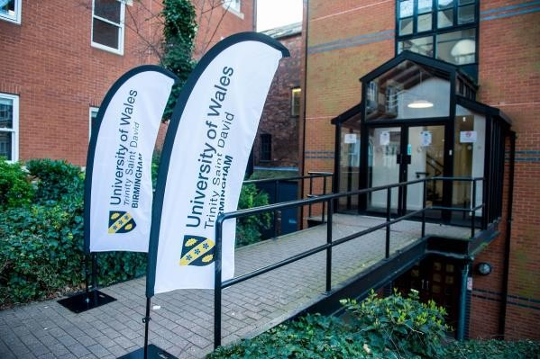
UWTSD Highlights

Slide 5
Benefits of effective communication
Increased access to job opportunity
Preparations for a specialized career
Trust
Increased marketability
Team building
Better relationship
Personal growth and improved self-esteem
Problem solving
Networking opportunities

Slide 6
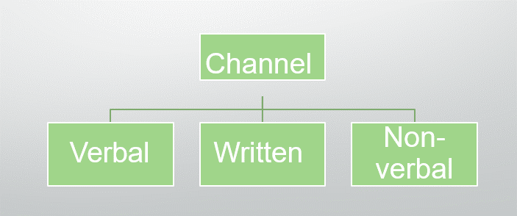
Channels that can be used to improve
communications
Communication channels can be categorized into three principal channels each of these channels have different strengths and weaknesses, they can be found on the diagram below:
,

Slide 7
The types of barriers for effective communications
Efficient communication is frequently hampered by verbal, nonverbal, written, listening, and visual barriers.
Ineffective communication puts both ourselves and others in danger.
On the diagram below we can see the foundation of communication barriers that we can meet in any organization or team
Language Barriers
Cultural Barriers
Physical Barriers
Psychological Barriers
Technological Barriers
Organizational Barriers

Slide 8

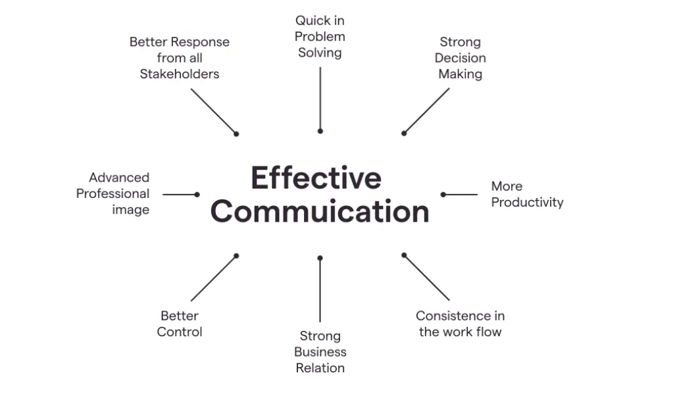
Examples of good communication culture in the workplace

Slide 9
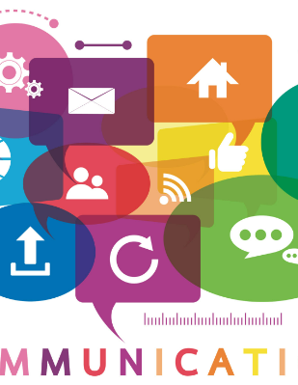
Conclusion
Positive work experiences for your team can be greatly influenced by effective communication abilities.
Good communication entails learning how to handle conflict, build better connections, and trust your team.
Three main channels of communication can be distinguished: written, nonverbal, and verbal.
Language, cultural, and organizational barriers are typical obstacles to effective communication.

Slide 10
Reference
◤
Dingwall,J.R. labrie, C. ,McLennon,T. , Underwood,L. (2022) "Communication Channel" Available
at: https://ecampusontario.pressbooks.pub/profcommsontario/chapter/communic ation-channel/
IHASCO(2022) "What are the benefits of effective communication
skills?" Available at: https://www.ihasco.co.uk/blog/entry/3234/what-are-the- benefits-of-effective-communication-skills
Toppr(2022) "Barriers in Communication" Available
at: https://www.toppr.com/guides/business-correspondence-and-
reporting/communication/barriers-in-communication/
AMOS(2022) "Shannon and Weaver Model of Communication" Available at: https://www.communicationtheory.org/shannon-and-weaver-model-of- communication/

Slide 11



