Slide 1
Stakeholders
LCBB4007
Week 5 – Session 2

Slide 2
Objectives of the session
    Defining stakeholders
    Stakeholder management
    Importance of stakeholder management
    Categorizing stakeholder
      Internal stakeholders
      External stakeholders
    Examples of stakeholder
    Stakeholder management process and communication plan

Slide 3

Defining stakeholder
Stakeholders are individuals, or groups, or entities that have an interest or "stake" in a particular organization, project, programme, or portfolio.
Stakeholders can significantly impact or be impacted by an organisation’s decisions, actions, and outcomes.

Slide 4
Stakeholder management (1 of 2)
Stakeholder management implies that organizations should manage the stakeholder behaviors and actions.

Slide 5
Stakeholder management (2 of 2)
Stakeholder management relies on the effective exchange of information and the integration of feedback in order to:
  Cultivate and maintain positive relationships with stakeholders, while also working towards the organization's goals.
  Recognize and proactively addressing potential risks and resistance.

Slide 6

Importance of stakeholder management (1 of 2)
Stakeholders are fundamental for project management, decision-making, and the goals of the organization. This is because stakeholders shape the reputation and brand image of the company in the market.

Slide 7
Importance of stakeholder management (2 of 2)
Is it fundamental for organizations to assess the following questions in relation to its projects:
  Who are the interested individuals and parties?
  What is their reactions to the project?
  What is their role or potential influence within the community?
  What are their current and future level of commitment?
  What risks and opportunities do they present?
  What level of power do these individuals have?

Slide 8
Categorizing stakeholders (1 of 2)
Primary stakeholders
Secondary stakeholders
Primary stakeholders are those individuals who are part of the core group.
These are the people who are essential for the success of a project or mission.
The organization needs to prioritize spending time engaging and working with individuals in this group.
Secondary stakeholders are affected by the work and project.
They are not as influential.
The organization should consult with them but they won’t carry as much weight as the primary group.

Slide 9
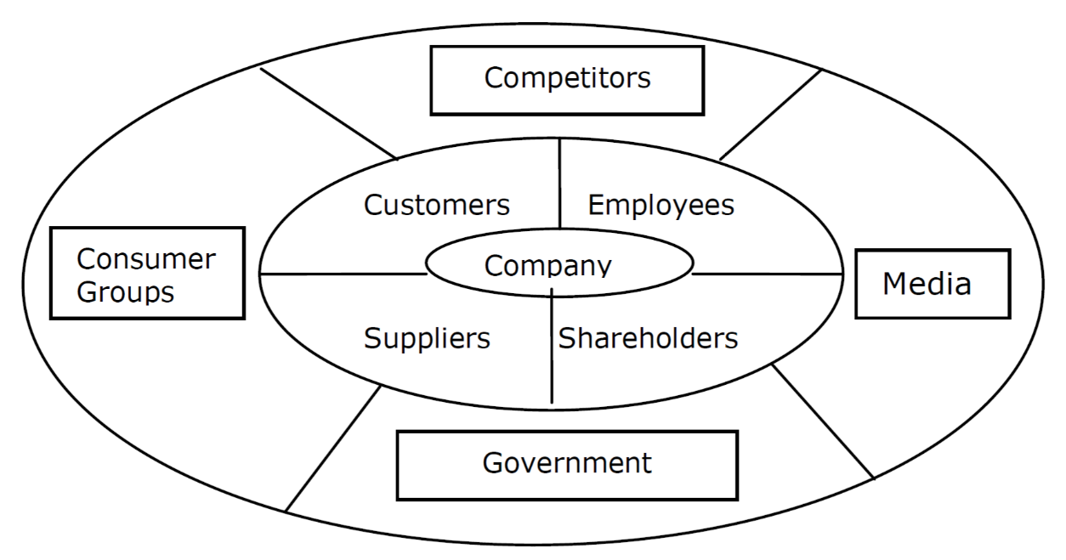
Categorizing stakeholders (2 of 2)

Slide 10
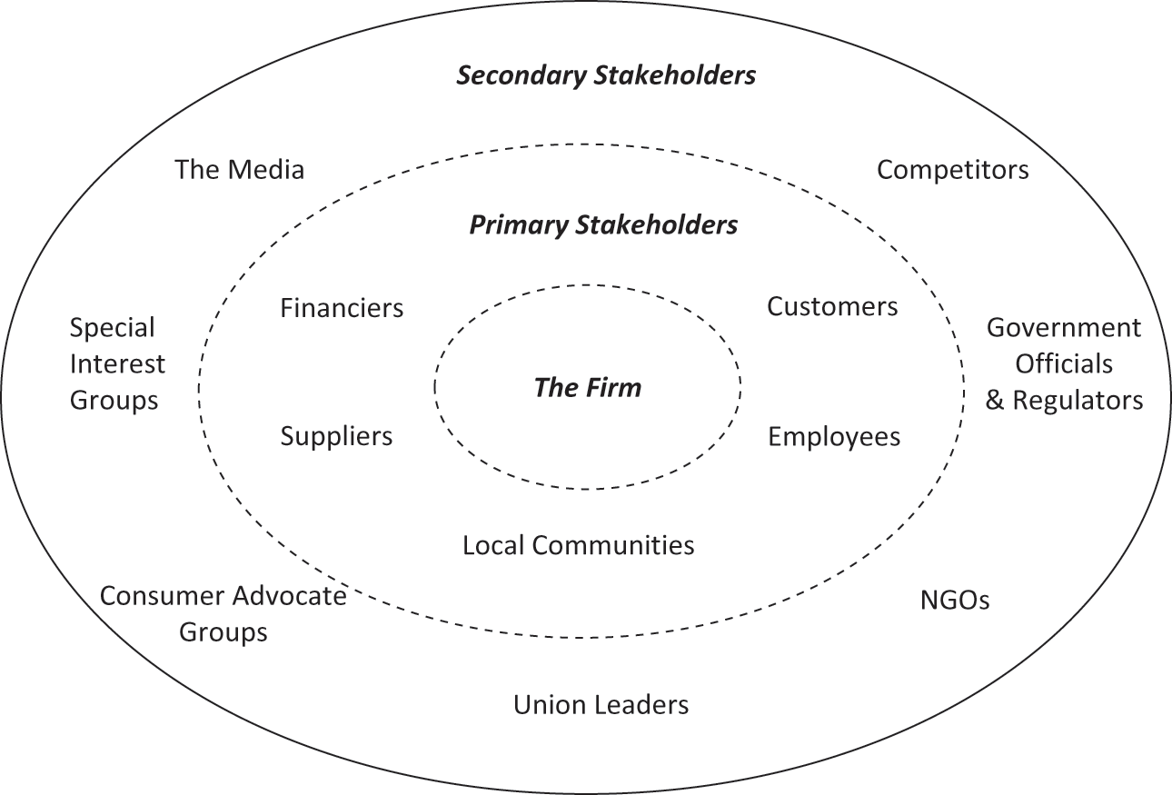
Examples of Stakeholders

Slide 11

Stakeholder management process
The stakeholder management analysis process can be completed through the following steps:
  Identify possible stakeholders
  Assess and analyse the stakeholders
  Plan a management and communication strategy
  Act by applying the action plan and monitoring the results

Slide 12
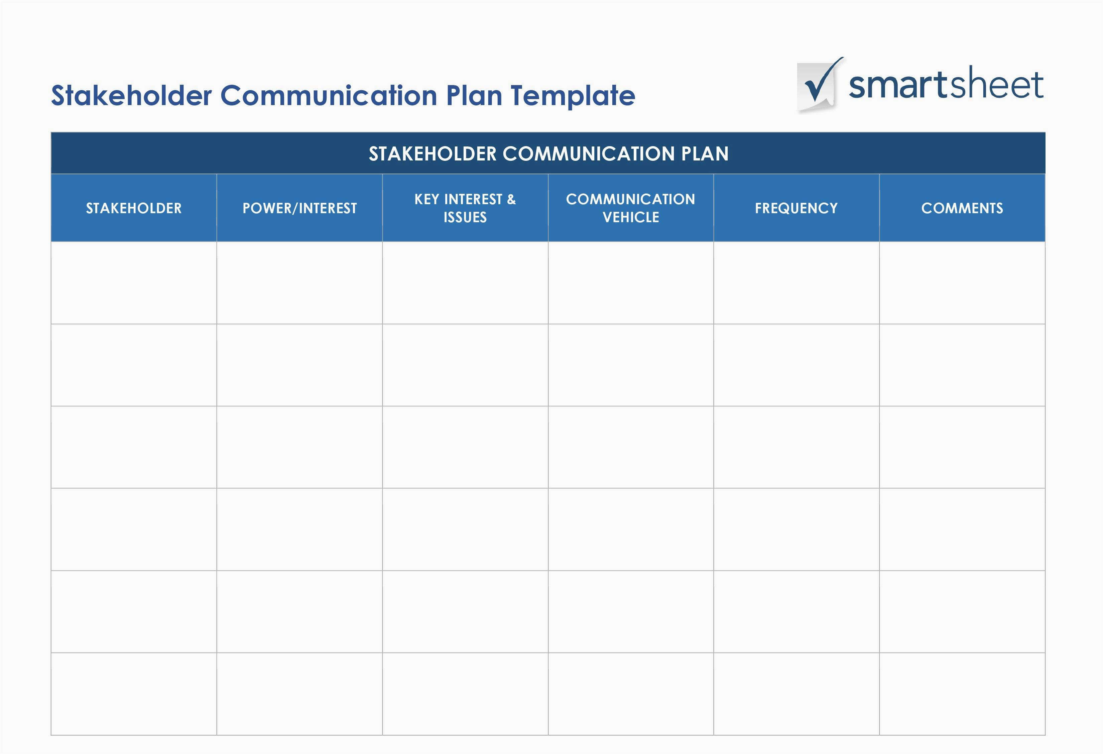
Stakeholder management process and communication plan

Slide 13
Activity 1
In groups, choose an organization of your choice and identify the primary and secondary stakeholders of the organization.
Attempt to create a communication plan for 2 of the primary and secondary stakeholders.
Specify why these stakeholders are important to consider for the organization.

Slide 14
References
Freeman, R.E., Harrison, J.S. and Zyglidopoulos, S. (2018) Stakeholder theory: Concepts and Strategies. Cambrisge University Press. doi:10.1017/9781108539500.
Harrin, E. (2020) Engaging stakeholders on projects : how to harness people power. Princes Risborough, Buckinghamshire: Association for Project Management.

