Slide 1

Module Title – Professional Development within Health and Social care
Module Code – LCHS 4009
Assignment Title – Self- Awareness Presentation
Student Name – Romeenah Akhtar
Student Number- 2433755
Lecturer’s Name – Anika Tahsin Ahmed
Date 17th July 2025

Slide 2
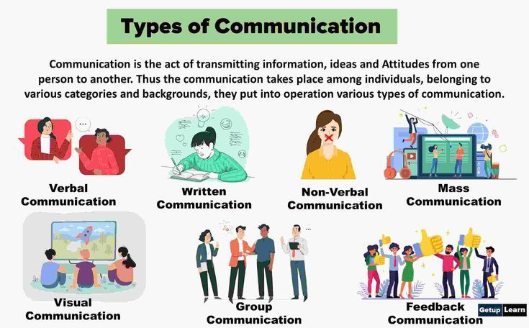
What is communication?
Process of sharing and interpreting information
Enables understanding of patient needs
Builds trust and therapeutic relationships
Includes verbal and non-verbal communication
Active listening strengthens understanding (Arnold and Boggs, 2020)
Communication failures are a major cause of patient complaints (Reader et al., 2014)
(Bing,N.D.)

Slide 3
Communication Skills & Why They Are Needed ?
Active listening improves understanding (Bramhall, 2021)
Clear and simple language reduces misunderstanding
Empathy supports person-centred care
Professional body language reinforces trust
Accurate documentation ensures safe care (O’Hagan et al., 2014)
Personal accountability for record keeping (Royal College of Nursing, 2019)
Improves patient safety
Builds trust and confidence
Supports person-centred care
Reduces errors
Arnold & Boggs, 2020)
Importance of communication in health and social care

Slide 4
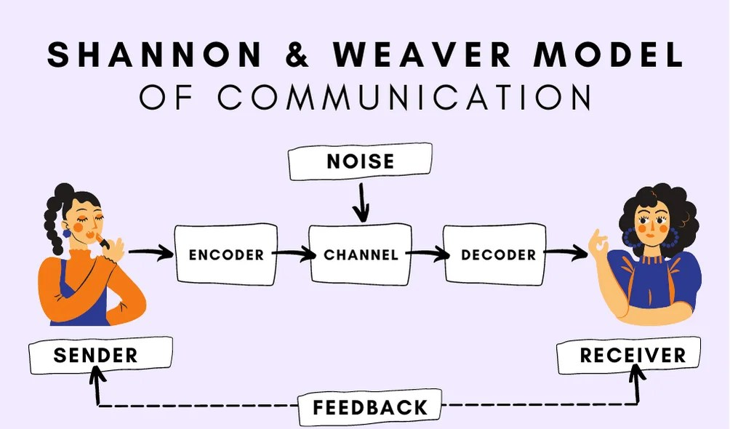
Shannon & Weaver (1949) Communication Model
Sender – Person delivering the message
Message – Information being communicated to the patient
Channel – Method (spoken, written, electronic)
Receiver – Person receiving the message, (patient or colleague)
Feedback – Confirms and shows understanding
Noise – Barriers interfering with communication e.g., stress, language, environment
(Bing, N.D.)

Slide 5

Example of Communication in Nursing Practice
Professional introduction and explanation of role (Silverman, Kurtz and Draper, 2016)
Open-ended questioning to gather information
Clear explanation of procedures
Accurate documentation for continuity
Documentation must be specific, factual and measurable (Gault, 2017)

Slide 6
How Effective Is Communication?
Effectiveness:
Improves safety and reduces errors
Strengthens patient-centred outcomes (Sharkiya, 2023)
Enhances trust and satisfaction
Supports teamwork and collaboration
Electronic prescribing reduces errors (Qureshi et al., 2015)
Barriers:
Language and cultural differences
Emotional distress or anxiety
Environmental distractions
Time pressures
Burnout affecting empathy (Zhang et al., 2014)

Slide 7
Conclusion
Communication underpins safe practice
Essential for person-centered care
Influences patient outcomes and safety
Requires empathy and accountability
Key skill for professional development

Slide 8
References
Arnold, E.C. and Boggs, K.U. (2020) Interpersonal relationships: Professional communication skills for nurses. 8th edn. St. Louis: Elsevier.
Bramhall, E. (2021) ‘Effective communication skills in nursing practice’, Nursing Standard, 36(3), pp. 45–50.
Gault, I. (2017) Communication in nursing and healthcare: A guide for compassionate practice. London: SAGE.
O’Hagan, S., Manias, E., Elder, C., Pill, J., Woodward-Kron, R., McNamara, T. and McColl, G. (2014) ‘What counts as effective communication in nursing?’, Journal of Clinical Nursing, 23(15–16), pp. 2325–2338.
Qureshi, H., Smith, J., Patel, R., Khan, A. and Lee, S. (2015) ‘Impact of electronic prescribing on medication errors’, Journal of Evaluation in Clinical Practice, 21(5), pp. 1–7.
Reader, T.W., Gillespie, A. and Roberts, J. (2014) ‘Patient complaints in healthcare systems’, BMJ Quality & Safety, 23(8), pp. 678–689.
Royal College of Nursing (2019) Record keeping guidance for nurses and midwives. London: RCN.
Shannon, C.E. and Weaver, W. (1949) The mathematical theory of communication. Urbana, IL: University of Illinois Press.
Sharkiya, S.H. (2023) ‘Quality communication and patient-centred outcomes’, BMC Health Services Research, 23, p. 886.
Silverman, J., Kurtz, S. and Draper, J. (2016) Skills for communicating with patients. 3rd edn. Boca Raton: CRC Press.
Zhang, Y.Y., Wang, H., Wang, L. and Li, X. (2014) ‘Burnout and professional values among nurses’, Nursing Ethics, 21(7), pp. 747–760.

