Slide 1
Flowcharts and Control Structures
Lecture 4: Analysing and solving problems

Slide 2
Today’s Lecture
Flowcharts
  visual diagrams that help us represent the logical steps in a problem solution.
  Flowcharts are handy for planning out a program before writing any code, as they show the flow of actions and decisions clearly.
Control Structures
  building blocks that determine the order in which instructions are executed in a program.
  three main types: sequence, selection, and repetition (they allow to make decisions and repeat actions within the algorithms)

Slide 3
Combining Strings in Pseudocode
Here is the pseudocode to the Bank Deposit problem:
Display “What is your account number?”
Input accountNumber
Set customerBalance = 50.00
Display “Your current balance is:”
Display customerBalance
Display “How much would you like to deposit?”
Input depositAmount
Set newBalance = customerBalance + depositAmount
Display “You paid in:”
Display depositAmount
Display “Your new balance is:”
Display newBalance
What is your account number?
123456 [Enter]
Your current balance is:
50.00
How much would you like to deposit?
20.00 [Enter]
You paid in:
20.00
Your new balance is:
70.00

Slide 4
Combining Strings in Pseudocode
You can combine a message string and a variable value on one line in pseudocode.
  As long as both lines are for output i.e. Display …
For example, for the following pseudocode:
    Display “How much would you like to deposit?”
    Input depositAmount
    Display “You paid in: ”
    Display depositAmount
Lines 3 and 4 can be combined by separating the strings with a comma as follows:
    Display “You paid in: ”, depositAmount

Slide 5
Combining Strings in Pseudocode
Shorter example, combining strings:
    Display “What is your account number?”
    Input accountNumber
    Set customerBalance = 50.00
    Display “Your current balance is: ”, customerBalance
    Display “How much would you like to deposit?”
    Input depositAmount
    Set newBalance = customerBalance + depositAmount
    Display “You paid in: ”, depositAmount
    Display “Your new balance is: ”, newBalance

Slide 6
Combining Strings in Pseudocode
Shorter example, combining strings:
    …
    Display “Your current balance is: ”, customerBalance
    Display “How much would you like to deposit?”
    Input depositAmount
    Set newBalance = customerBalance + depositAmount
    Display “You paid in: ”, depositAmount
    Display “Your new balance is: ”, newBalance
What is your account number?
123456 [Enter]
Your current balance is: 50.00
How much would you like to deposit?
20.00 [Enter]
You paid in: 20.00
Your new balance is: 70.00

Slide 7
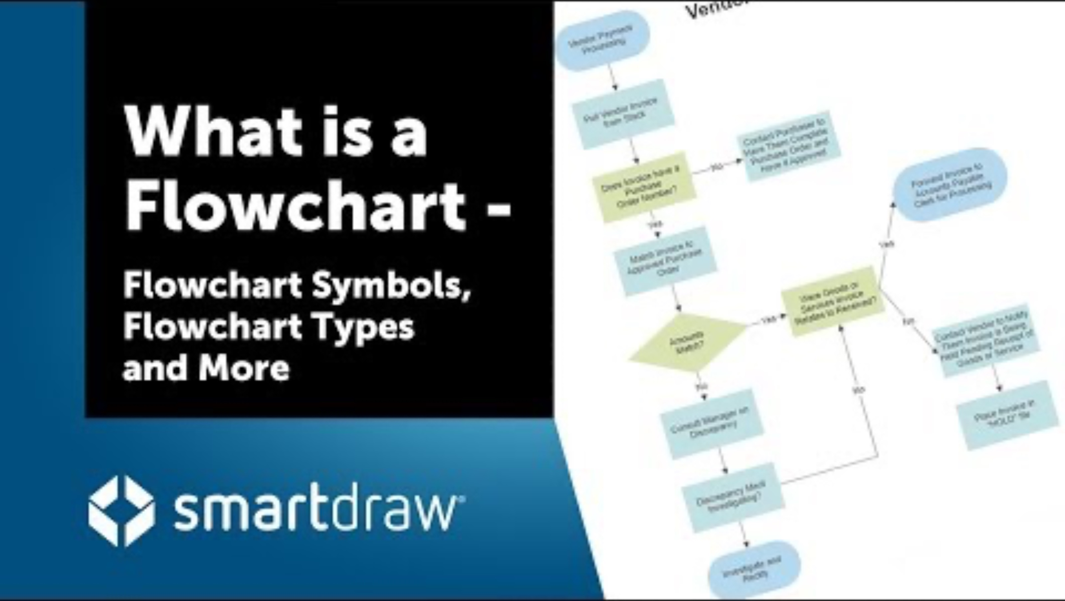
What is Flowcharts?

Slide 8
https://www.youtube.com/watch?v=nlotZCvL9RU&t=30s

Slide 9
Flowcharts
A diagram that visually shows the steps to take in a computer problem solution.
It is an alternative method of showing the logical flow of steps for a solution.
It uses connected symbols to show the sequence of steps, any repetition and alternative steps.
Some people find flowcharts easier than writing pseudocode for algorithms.
And many use a combination of both.

Slide 10
Basic Flowchart Symbols
Symbol | Name | Description
 | Terminator | Used to indicate the start or end
 | Input/output | Represents an input or output operation
 | Process | Represents processes e.g. a calculation, initialising (setting) variables
 | Decision | Represents a branch point i.e. different alternatives
 | Connector | An entry to, or from a particular step. Commonly used if the flowchart cannot fit on one page.

Slide 11
Flowchart Examples
We will look at creating flowcharts for the pseudocode examples and exercises from last week.

Slide 12
Pseudocode: Tip Calculator Problem
Pseudocode
Possible output (input shown in bold)
Display “What is the Bill Amount?”
Input billAmount
Display “What tip amount would you like to give?”
Input tipAmount
Set totalBillAmount = billAmount + tipAmount
Display “You chose to pay the following tip:”
Display tipAmount
Display “Your final, total bill amount to pay is:”
Display totalBillAmount
What is the Bill Amount?
500 [Enter]
What tip amount would you like to give?
10 [Enter]
You chose to pay the following tip:
10
Your final, total bill amount to pay is:
510

Slide 13
Exercises
Walkthrough Demonstration

Slide 14
Control Structures

Slide 15
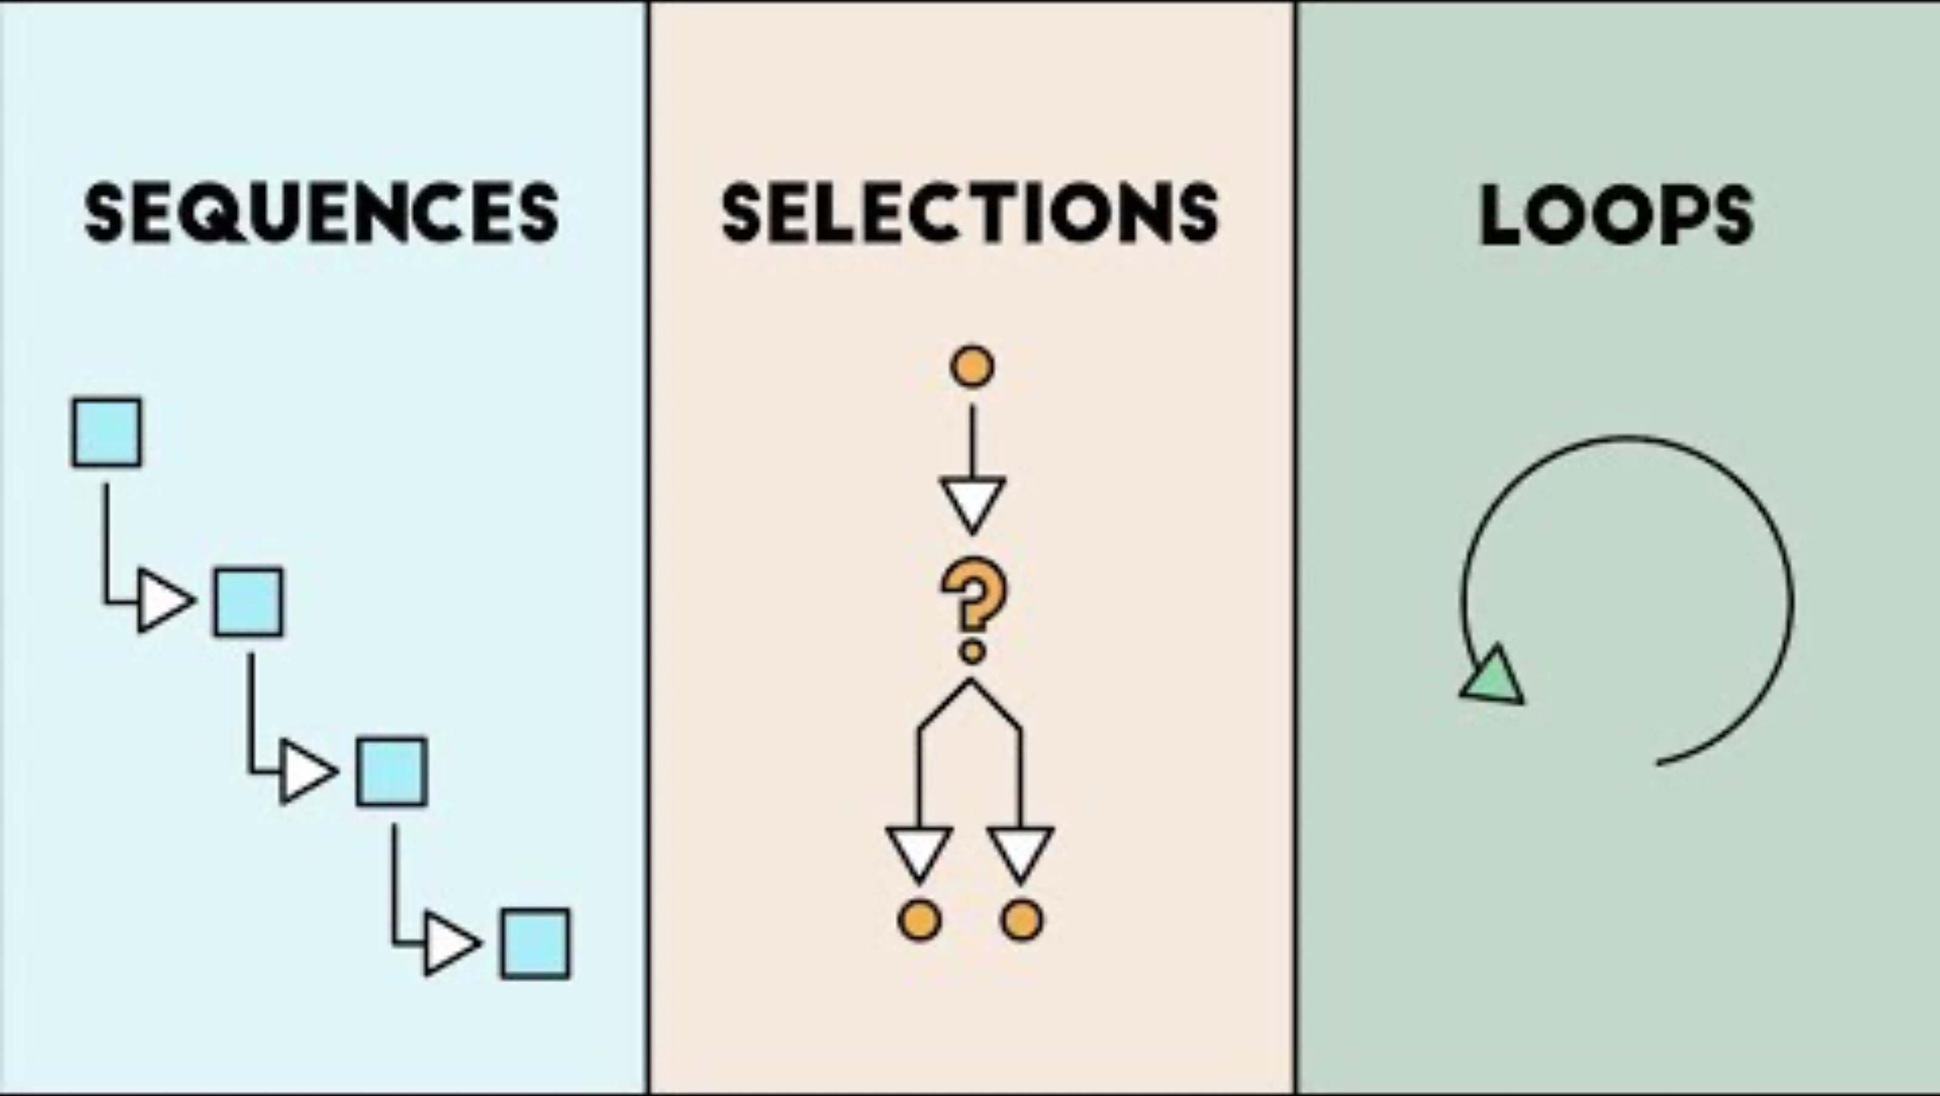
What is Control Structures?

Slide 16
Comparison Operators
It is common practice to compare things in computing.
Comparison operators enable us to do that, they return a True or False value.

Slide 17
Comparison Operators
Operator | Name
= | Equals | True if two values are the same 5 = 5 is True, 4 = 5 is False
> | Greater than | True if value on left is greater than value on the right. 5 > 4 = True, 4 > 5 is False
< | Less than | True if value on left is smaller than value on the right. 4 < 5 = True, 5 < 4 is False
>= | Greater than or equal to | True if value on left is greater than or equal to value on the right.
<= | Less than or equal to | True if value on left is smaller than or the same as the value on the right.
<> | Not equal to | True if the two values are not the same. 5 <> 4 is True, 5 <> 5 is False

Slide 18
Control Structures
What if we wanted to make the following changes to the simple algorithms we have been writing:
  In the Student Credits problem, if student has a enough credits display a congratulations message, otherwise display credits left
  The Shopping Basket Calculator: allow the user to enter any number of Item prices they want.
We need control structures!

Slide 19
Control Structures
So far we have looked at simple solutions to problems.
They start at a beginning and continue in a sequential order (one-step after the other).
In computing, this is usually not enough to describe the steps of a solution.
There are three main types of control when defining the order of steps in a computer solution:
  Sequence
  Selection
  Repetition

Slide 20
Sequence
This is what we have been doing so far.
Start at a beginning and execute steps one after the other in sequence (serial) order.
Statement 1
Statement 2
Statement 3

Slide 21
Selection (Decision)
Choose the statement (branch) to executive is selected based on a condition.
The Selection statement is also called a Branch or Decision
Condition = True?
No
Yes
Statement 1
Statement 2

Slide 22
Selection (Decision) A Simple Example
Start
Is it Raining?
No
Yes
Go to the Cinema
Go to the Beach
Finish

Slide 23
Selection
You can have multiple branches in a Selection control statement.
For example
Option = A, B or C?
A
C
B
Statement 1
Statement 2
Statement 3

Slide 24
Repetition
Repeat statements one or more times
Also called a Loop
Needs a stop condition i.e. when to stop repeating the loop
Two types:
Condition = True?
Yes
Statement 1
Statement 1
No
Condition = True?
Yes
No

Slide 25
Repetition A Simple Example
Start
Pick Film to Watch
Is Film Rating > 4*?
Yes
No
Pay to watch film
Pick Another Film to Watch
Stop
Notes:
“

Slide 26
Pseudocode and Control Structures
We know how to write pseudocode for Sequence statements.
What about for Selection and Repetition?

Slide 27
Lab Exercise
Download instructions from Moodle

