Slide 1

Contemporary Approaches to Management
Contemporary Management Approaches
Shannon Jones
1803188

Slide 2

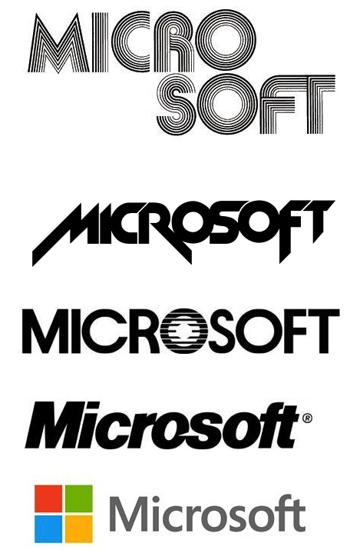
Introduction
Microsoft was created in 1975 by Bill Gates and Paul G. Allen
The first Disk Operating System (DOS) was released in 1981
In 1993 Microsoft released improved security networks
In 2001 Microsoft released the Xbox
Notes:
In 1975 Bill Gates and Paul Allen, two friends converted a popular mainframe for use on a computer. Shortly after Gates and Allen founded Microsoft. The name came from the words Microcomputer and software. In 1980 International Business Machines Corporation (IBM) asked Microsoft to produce software or operating system for its first computer. Since then Microsoft have expanded in to new markets by creating different software's and devices for example in 1993 Microsoft released an improved security network and in 2001 produced the gamin device Xbox.

Slide 3
Mission statement
"The Microsoft mission regarding global diversity and inclusion is to create an environment that helps Microsoft capitalize on the diversity of its people and the inclusion of ideas and solutions to meet the needs of its increasingly global and diverse customer base.“(Microsoft, n.d.).

Slide 4
Vision
Global diversity and inclusion is an integral and inherent part of our culture, fuelling our business growth while allowing us to attract, develop, and retain this best talent, to be more innovative in the products and services we develop, in the way we solve problems, and in the way we serve the needs of an increasingly global and diverse customer and partner base.“(Microsoft, n.d.)

Slide 5


Goals & objectives
Appropriately distribute rights and responsibilities amount board member, managers and share holders
Provide structure through which management and the board set objectives and monitor performance
Strengthen and safeguard our culture of business integrity and responsible business practices
Encourage the efficient use of resources, and require accountability for stewardship of those resources
Create more personal Computing
Notes:
Microsoft’s goals and objectives is to provide structure within their management and board to set objectives and monitor performance by doing this it will make the business more efficient . Another goal is to be as sustainable as possible Microsoft has managed to achieve 100% carbon neutrality every year since 2012 and reduce product packaging weight by 20%. Microsoft also aims to make sure Developing economies gets the chance to use technology. (Microsoft, n.d.)

Slide 6
Pestle
Political
Political stability in majority of markets
Increasing international trade agreement
Economical
Technological
Social
Rapid adoption of mobile technology
High growth in developing countries
Stable attitudes about leisure
Legal
Increasing preference for green products
Stable demand for high quality customer service
Growing middle class disposable income
Increasing volume of online transactions
Energy consumption regulations
Increasing electronic waste disposal regulations
Increasing availability of recyclable materials
Environmental
Notes:
Political stability of markets world wide creates opportunities for Microsoft to increase investments and performance. Microsoft can improve sales and marketing investments in Europe to increase revenues.
Microsoft Benefits from economic stability of developed countries. Microsoft also have the opportunity to boost in sales revenues in high developing countries. This translates a steady progress in global sales. Microsoft can adapt to customers needs for example the company can increase its investment in computer gaming products. Microsoft can improve on performance through innovation of mobile devices. This could also be a threat as it creates competition against other brands. Microsoft has an increasing amount of green products. The company can develop more environmentally friendly products and increase the use of green energy in its business. More regulations creates an opportunity for Microsoft to implement more effective recycling and disposable programs that improve their reputation. New regulations could cause a threat of additional challenges in addressing environmental impact of it’s business. (Ferguson,2017)

Slide 7
Swot
Strength
Brand reputation
Financial Performance
Weakness
Security Flaws
Poor investment
Opportunity
Mobile advertising
Cloud based service
Threat
Large competition
Change in consumer needs and habits
Notes:
Microsoft has many strengths for example Microsoft is one of the worlds largest companies According to Interbrand Microsoft brand is the 5th most valuable brand in the world, valued at $57.8 billion. Brand reputation leads to higher sales and grater market share. Microsoft increased its revenues by 20% from 2008 to 2012 and has $63 billion retained that cab be used for acquisition and investments. Its weaknesses include criticism over security flaws. The software Windows had been criticised for being weak against viruses compared to other Software windows is the least protected against attacks. Microsoft has made some successful investments which have increased revenue but are soon shut down or divested. Opportunities for Microsoft include mobile advertising, mobile advertising is expected to increase by double over the next few years. Microsoft could also invest and expand into could services and software as demand increases. companies such as Google and Apple create new products meaning there is competition for Microsoft to maintain their reputation. As customers needs and wants change Microsoft market needs to keep current as it may never establish itself (Jurevicius, 2013)

Slide 8
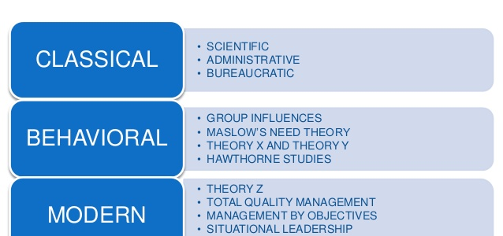
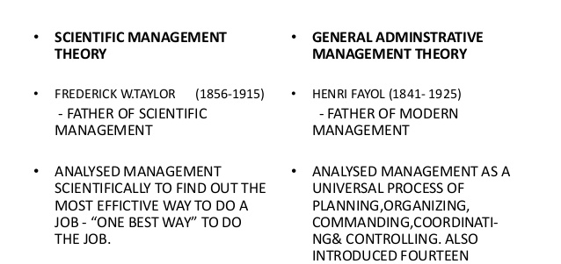
Management Approach
Made work as comfortable, inspiring and fun as possible for workers to spend more time there
Making sure the company is innovative
Encourages creativity and innovation
Notes:
Bill Gates was focused on what he wanted right from the start and that was to make sure that there was a computer on every desk and in every home. Bill Gates would make the work environment as comfortable and inspiring and fun as possible for the workers to spend more time there to get work done. He would also interrupt his employees in meeting to make sure they were focused and knew what they were doing within the project he also believed that it was important to have input from employees. This is similar to the behavioural approach as it concentrates on human behaviour at work such as motivation, conflict, expectations and improved productivity. (Behavioural Managment Theory, n.d.)

Slide 9
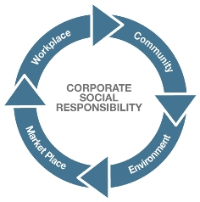
Corporate Social Responsibility
$1.4 Billion donated around the world
75% reduction in carbon emissions
12 million young people were provided with computer learning experiences
Notes:
Microsoft has a focus on empowering people to achieve more for example 12 million young people were provided with computer science learning experiences through non-profit organizations in 54 countries. The company also have strong values when it comes to strengthening communities for example $1.4 billion worth of software and services was donated to non profit organizations around the world while $158 million was donated to local communities by employees. Microsoft also focus on safeguarding the planet. They have managed to do this by cutting down on carbon emissions by 75% and 100% carbon neutral operations were attained. (Microsoft, 2018)

Slide 10
References in notes
Notes:
References
Behavioural Management Theory. (n.d.). Retrieved from CliffsNotes: https://www.cliffsnotes.com/study-guides/principles-of-management/the-evolution-of-management-thought/behavioral-management-theory
Bill Gates Chairman Microsoft management style and CIOs. (2010, August 23). Retrieved from WordPress: https://mubbisherahmed.wordpress.com/2010/08/23/bill-gates-chairman-microsoft-management-style-and-cios/
Ferguson, E. (2017, February 21). Microsoft Corporation’s PESTEL/PESTLE Analysis & Recommendations. Retrieved from Panmore Institute: http://panmore.com/microsoft-corporation-pestel-pestle-analysis-recommendations
Grimsley, S. (n.d.). What Is Administrative Management Theory? - Definition & Functions. Retrieved from Study: https://study.com/academy/lesson/what-is-administrative-management-theory-definition-functions-quiz.html
Hall, M., & Zachary, G. P. (n.d.). Microsoft Corporation . Retrieved from Britannica: https://www.britannica.com/topic/Microsoft-Corporation
Interbrand. (2013). Best global brands . Retrieved from Interbrand: http://www.interbrand.com/en/best-global-brands/2012/Best-Global-Brands-2012.aspx
Jurevicius, O. (2013, February 16). SWOT Analysis of Microsoft. Retrieved from Strategic Management insight : https://www.strategicmanagementinsight.com/swot-analyses/microsoft-swot-analysis.html
Microsoft. (2018). 2018 Microsoft Corporate. Retrieved from file:///C:/Users/user1/Downloads/2018-Microsoft-CSR-Report-Highlights.pdf
Microsoft. (n.d.). Goals . Retrieved from Weebly : https://billgates-waldhauer.weebly.com/goals-and-objectives.html
Svetlik, J. (2018, May 30). From DOS to Windows: How Microsoft became one of the most valuable companies on earth. Retrieved from BT: http://home.bt.com/tech-gadgets/computing/history-of-microsoft-how-it-became-valuable-and-successful-11364045249599

