Slide 1
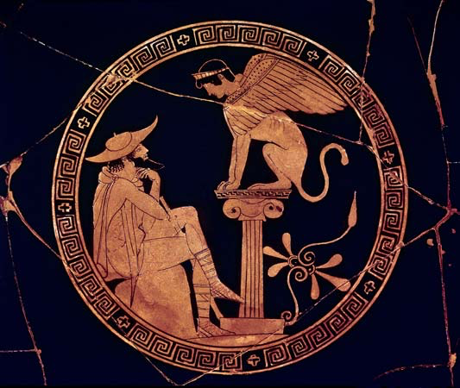
Levi-Strauss & Structuralism

Slide 2
Criticisms of Other Theories
Psychoanalysis & other social approaches: makes data fit the conclusion you want?
‘If a given mythology confers prominence on a certain figure, let us say an evil grandmother, it will be claimed that in such a society grandmothers are actually evil and that mythology reflects the social structure and social relations; [Sociological approach] but should the actual data be conflicting, it would be as readily claimed that the purpose of mythology is to provide an outlet for repressed feelings. Whatever the situation, a clever dialectic will always find a way to pretend that meaning has been found.’ (psychoanalytic approach)

Slide 3
Criticisms II
Are these fair criticisms?
He seems to be conflating the sociological and psychoanalytic approaches to make them seems less plausible – sociologists don’t generally jump to a psychoanalytic explanation just because the sociological one they had doesn’t fit – they’ll come up with a different sociological theory.
He’s offering two different scenarios and only one approach to each scenario.
Seems therefore committed to the idea that myth can only have one function?

Slide 4
The problems of Mythology
‘Mythology [the study of myth] confronts the student with a situation which at first sight appears contradictory. On the one hand it would seem that in the course of a myth anything is likely to happen. There is no logic, no continuity. Any characteristic can be attributed to any subject; every conceivable relation can be found. With myth, everything becomes possible. But on the other hand, this apparent arbitrariness is belied by the astounding similarity between myths collected in widely different regions. Therefore the problem: If the content of a myth is contingent, how are we going to explain the fact that myths around the world are so similar?’

Slide 5
Similar Myths
Flood narratives – Greek, Hebrew, Mesopotamian, Hindu
https://en.wikipedia.org/wiki/List_of_flood_myths
At first this list looks impressive…
But: China. China’s flood myth does not involve only 2-8 people surviving.
It’s purpose is not to wipe out the population so things can start again.
More likely that the prevalence of the flood myth is then due to cultural exchange? (Why would this myth spread further than other myths?)
How to tell whether a flood myth is ‘native’ or not? (should this matter in the way Strauss thinks it does?)

Slide 6
Levi-Strauss’s Approach
Initial claims:
‘If there is a meaning to be found in mythology, it cannot reside in the isolated elements which enter into the composition of a myth, but only in the way those elements are combined.’
Language in myth exhibits specific properties – it has complex properties beyond those of ‘any other kind’ of linguistic expression.
Myths are made up of ‘gross constituent units’ (mythemes) – that belong to a ‘higher, more complex order’ of language. They’re at the sentence level.

Slide 7
Levi-Strauss’s Approach II
Mythemes are sentences.
Each sentence reveals a ‘relation’ between a certain function and a given subject.
But this isn’t complicated enough!
Lingustic units at all levels are made up of relations, and myth has to be distinguishable from other language, so…

Slide 8
Levi-Strauss’s Approach III
‘The true constituent units of a myth are not the isolated relations but bundles of such relations, and it is only as bundles that these relations can be put to use and combined so as to produce meaning.’
Relations between bundles don’t have to be chronological – there are relationships beyond ‘this happened at the same time as/before/after x’

Slide 9
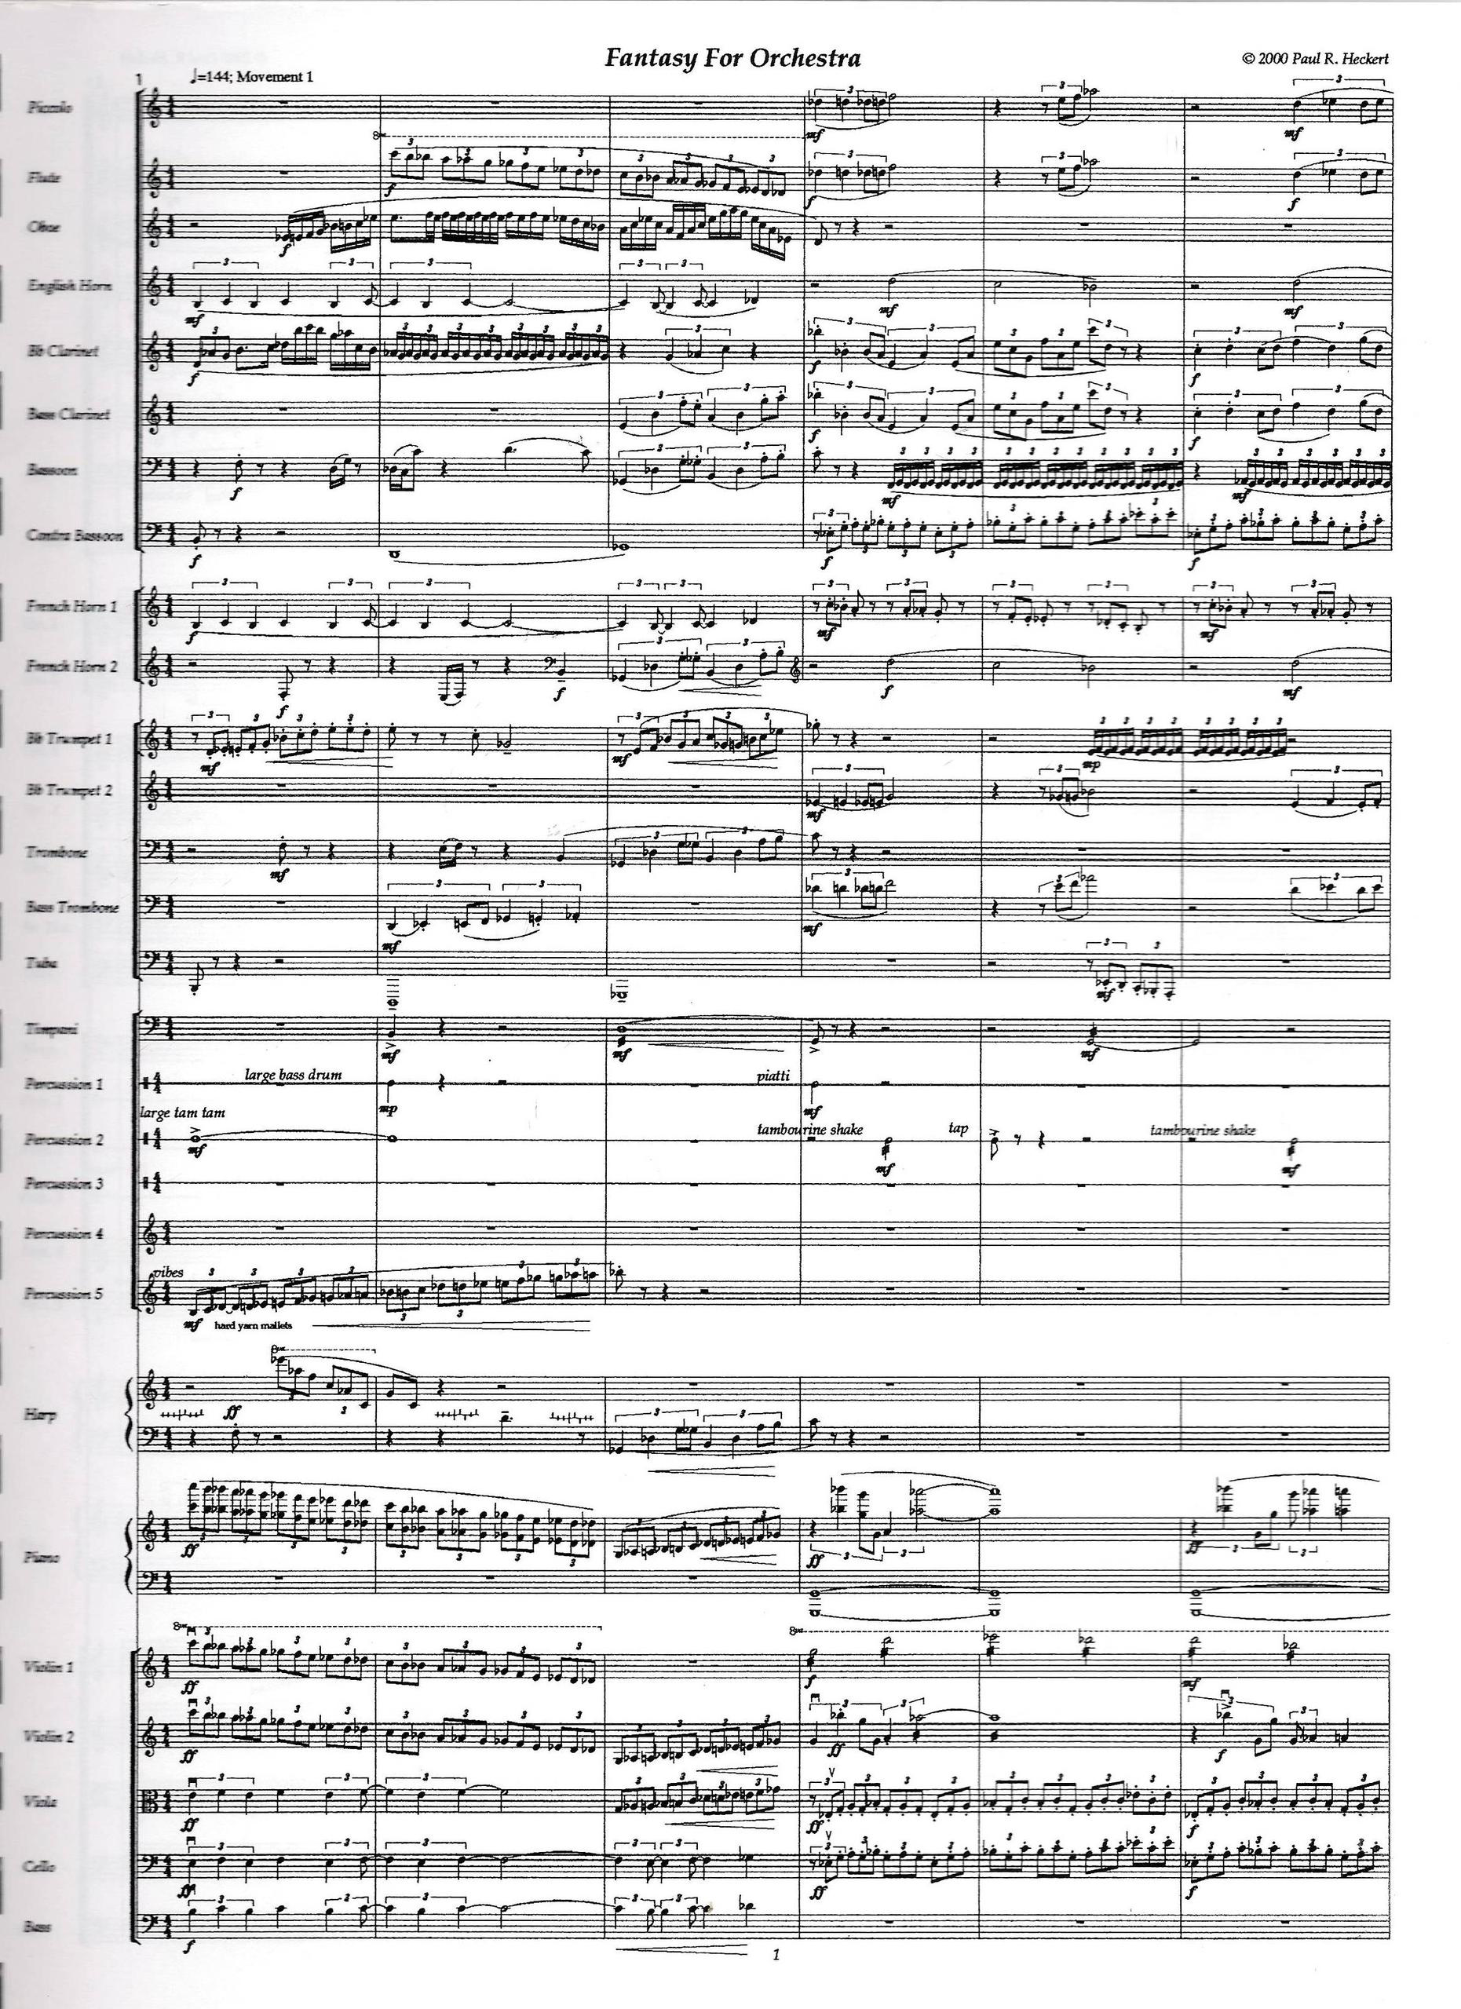

Slide 10
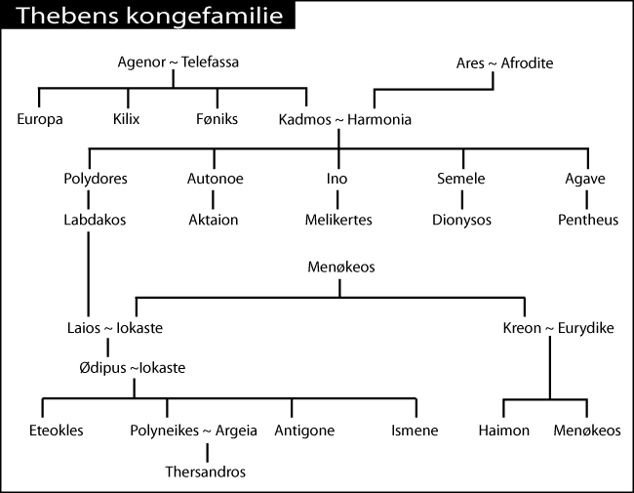
Contextualising Oedipus: The Labdacids

Slide 11
Variants:
Labdakos: not mentioned before Sophocles’ Antigone.
Laios & Chrysippus: Laios abducts Chrysippos, first mention of this is Euripides.
Later variant: the Sphinx is a punishment on the city for failing to punish Laios for the abduction.
Another variant: transgression by Laios – goes to the Oracle at Delphi. The Oracle tells him not to have kids in order to save the city. He doesn’t like that answer; asks again. And again. Not a wise idea. (Aeschylus)
Or… he goes to Delphi for unspecified reasons, and is told not to have kids, otherwise his son will grow to be his murderer (and marry his mother)
Euripides: Laios goes to consult Delphic oracle precisely because of his childlessness, and is told to leave it that way or: parricide and incest.
tl;dr: he fails at not having kids. Pierces child through the ankles and asks a herdsman to expose it; someone else find him, raises him.

Slide 12
Context II
Where does the Sphinx come from?
Children: Eteocles, Polyneices, Antigone, Ismene
Sometimes Laios and Oedipus have two wives (so Oedipus only sleeps with his step-mother).
For a full list of all the variants, See Gantz.

Slide 13
Levi-Strauss’ analysis
Brace yourselves: there’s a table.

Slide 14
Cadmos seeks his sister Europa, ravished by Zeus.
 |  | Cadmos kills the dragon
 | The Spartoi kill one another
 |  |  | Labdacos (Laios’ father) = lame (?)
 | Oedipus kills his father, Laios |  | Laios (Oedipus’ father) = left-sided (?)
 |  | Oedipus kills the Sphinx
 |  |  | Oedipus = swollen-foot (?)
Oedipus marries his mother, Jocasta
 | Eteocles kills his brother, Polynices
Antigone buries her brother, Polynices, despite prohibition

Slide 15
First & Second Column
Column 1: overrating of blood relations
This seems straight-forward, though the wording is perhaps clumsy – it’s being too close to blood relations in ways which are not socially acceptable.
Column 2: underrating of blood relations
This seems even more straightforward: familial bonds should prevent killing.

Slide 16
The third column
‘Column three refers to monsters. The dragon is a chthonian being which has to be killed in order that mankind be born from the Earth; the Sphinx is a monster unwilling to permit men to live. The last unit reproduces the first one, which has to do with the autochthonous origin of mankind. Since the monsters are overcome by men, we may thus say that the common feature of the third column is denial of the autochthonous origin of man.’
i.e. the monsters are the things that are autochthonous, and men are killing them, thus denying their own autochthony.

Slide 17
The Fourth Column
Column 4: persistence of the autochthonous origin of man.
All the names refer to some difficulty walking/standing up straight.
‘In mythology it is a universal characteristic of men born from the Earth that at the moment they emerge from the depth they either cannot walk or the walk clumsily.’
If this were true, this column would perhaps be intuitive.

Slide 18
The Final Interpretation
Whole myth: ‘has to do with the inability, for a culture which holds the belief that mankind is autochthonous, to find a satisfactory transition between this theory and the knowledge that human beings are actually born from the union of man and woman. Although the problem obviously cannot be solved, the Oedipus myth provides a kind of logical tool which relates the original problem – born from one or born from two? – to the derivative problem: born from different or born from same? By a correlation of this type, the overrating of blood relations is to the underrating of blood relations as the attempt to escape autochthony is to the impossibility to succeed in it. Although experience contradicts theory, a social life validates cosmology by its similarity of structure. Hence, cosmology is true.’

Slide 19
Interpreting that:
The oppositional between belief in autochthony and the presented reality of sexual reproduction is a conflict that needs resolving somehow
The Oedipus myth provides a ‘tool’: it replaces the initial unresolvable opposition with an analogous one: the over/underrating of blood relations.
This analogous opposition is somehow already ‘accepted’

Slide 20
Pros:
Myths do have structures
Those structures do frequently repeat (the hero being cast out/exposed/sent on quest from which he is not expected to return and then returning.)
Structuralism seems to fit well with the idea of myths have some aetiological function.
Allows us to analyse a myth in a new light, and critically think about how the components of that myth fit together.
Has as explanation as to why we find the same myths recurring frequently in different cultures.

Slide 21
Criticisms I
‘I am well aware that the Oedipus myth has only reached us under late forms and through literary transmutations concerned more with esthetic and moral preoccupations than with religious or ritual ones, whatever these may have been. But we shall not interpret the Oedipus myth in literal terms, much less offer an explanation acceptable to the specialist. We simply wish to illustrate – and without reaching any conclusions with respect to it – a certain technique, whose use is probably not legitimate in this particular instance, owing to the problematic elements indicated above.’

Slide 22
Criticisms II
How to decide which elements belong in which column?
Burying Polynices – is the prohibition against his burial not an example for column 2?
Bogus etymology
Is Strauss not also cherry-picking bits of the myth? What about the death of Antigone, or the survival of Ismene? He argues Jocasta’s suicide and Oedipus’ blinding can be integrated into columns 3 and 4 respectively. This is not convincing. Is he now not also adapting myth to fit his desired interpretation?
Binaries. So many binaries.
The fact that Oedipus was actually actively trying to avoid sleeping with his mom and killing his dad?
The role of the gods is totally absent.
How do you decide which themes are essential to a myth and which are ‘aesthetic’ – do we have to rule out all drama? Pandora in Hesiod’s Works and Days vs. Theogony.
How to decide which mythemes belong in which column?

Slide 23
Criticisms III
‘At the same time there is something significant in these additions, since the shift from foot to head is to be correlated with the shift from autochthonous origin to self-destruction’
So why not just have a column for self-destruction?
(Laios, Oedipus, Jocasta, Eteocles and Polynices… even Antigone?)
Because that wouldn’t be a binary!

Slide 24
Plot twist!
Suddenly he wants to define myth as ‘consisting of all its versions; or to put it otherwise, a myth remains the same as long as it is felt as such.’
Now he thinks we should take all variants into account. From these we can organise ‘permutation groups’
The first sensible thing he’s said.
The second sensible thing:
Such an analysis should be expanded to include all interrelated myths.
Practically, that’s a problem: there are a lot of myths.

Slide 25
The 3D Model

Slide 26
The Genetic Formula of Myth
He comes up with a ‘genetic law of myth’ – a formula:
fx_{(a)} : fy_{(b)} : : fx_{(b)} : f(a-1)_{(y)}
|________|
binary opposition
fx_{(a)} is the inverse of f(a-1)_{(y)}

Slide 27
Conclusions:
As with psychoanalysis and other theories of myth, there seem to be some elements of structuralist interpretation that are intuitive and useful.
The strength of a structuralist reading is dependent on the ability of the structuralist.
A true structuralist demonstration of the 3D model would be fascinating, but is it even possible? Myths bleed together.
You can use structuralist ideas and perspectives without buying into structuralism wholesale.

