Slide 1
Operations Management
BMTP5019

Slide 2
Operational Planning
Operational plans are detailed, practical plans that outline specific actions and activities an organisation or business will undertake to achieve its strategic objectives.
These plans are focused on the day-to-day implementation of the overall strategic plan and are designed to guide the organisation in carrying out its daily tasks and responsibilities.
Operational plans typically cover a shorter time frame, often one year or less, and provide specific details on how the organization will allocate resources, manage processes, and achieve its goals.

Slide 3
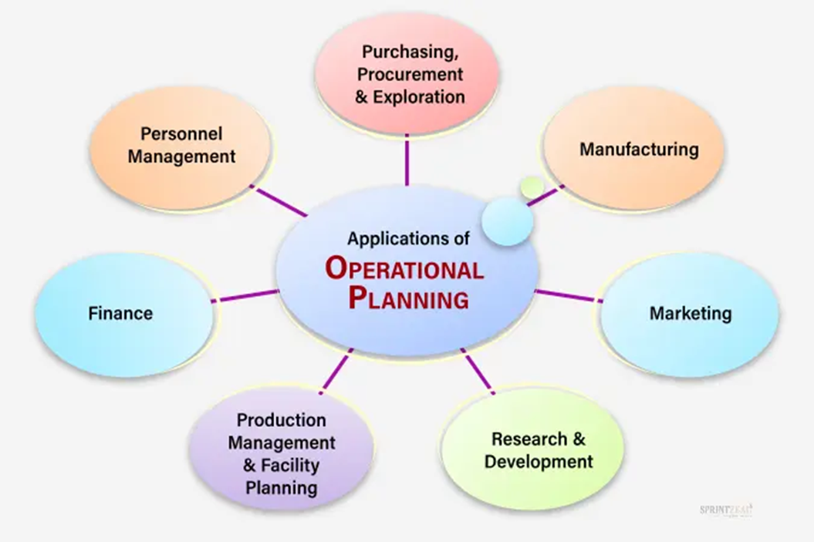

Slide 4
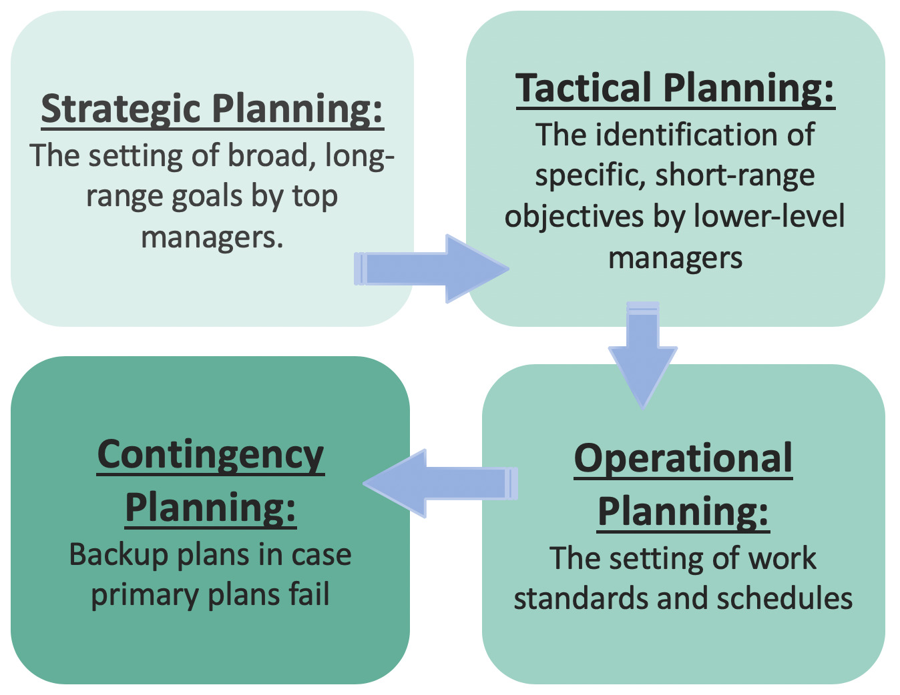
A strategic plan is the company’s big picture. It defines the company’s goals of time, whether that’s one year or ten, and ensures that those goals align with the company’s mission, vision, and values.
Four types of organisational planning
The tactical strategy describes how a company will implement its strategic plan. A tactical plan is composed of several short-term goals, typically carried out within one year, that support the strategic plan.
Contingency plans in case of a crisis or unforeseen event. Contingency plans cover a range of possible scenarios and appropriate responses for issues varying from personnel planning to advanced preparation for outside occurrences that could negatively impact the business. Companies may have contingency plans for things like how to respond to a natural disaster, malfunctioning software, or the sudden departure of a C-level executive
Operational plans encompass what needs to happen continually, on a day-to-day basis to execute tactical plans. Operational plans could include work schedules, specific task assignments that relate to goals within the tactical strategy, such as a protocol for documenting and addressing work absences.

Slide 5
An operational plan
Should also focus on implementation. What daily and weekly actions does your team need to take to accomplish your longer-term strategic plan? What specific Key Performance Indicators (KPIs) do you need to track on a regular basis is progressing towards objectives?
There are three levels to who should create an operational plan:
Scope: Your operational plan will capture the who, what, and when of each activity. It should be laser-focused on a team or initiative.
Timeline: Depending on how fast your organization moves, your operational plan should span a quarter, six months, or a fiscal year.
Stakeholders: Make sure the people involved in operational planning are close to the work, so they can accurately project and predict what work should be included in the plan.

Slide 6
The Benefits of operational planning
An operational plan helps you hit your strategic goals. According to our research, only 26% of knowledge workers have a very clear understanding of how their individual work relates to company goals. Research shows that when teams have clarity on how they contribute to company objectives, their engagement at work doubles.
By creating a detail-oriented operational plan, can define exactly what short-term goals need to achieve to be on track towards long-term objectives. It can help think through the actions taking or need to take to execute goals.
an operational plan:
Clarifies exactly what the team will be doing on a weekly and daily basis.
Provides a comprehensive guide of the day-to-day operations members need to take to accomplish goals. (SMART framework )
Sets a benchmark for daily expectations to avoid getting off track.

Slide 7
Key components and characteristics of operational plans
Specific Goals and Objectives: Clearly defined and measurable goals and objectives are essential in operational plans. These goals should align with the broader strategic objectives of the organization.
Detailed Action Steps: break down the high-level objectives into specific, actionable steps. They provide a roadmap for how each task will be accomplished, including timelines, responsibilities, and resources required.
Resource Allocation: specify how resources such as personnel, finances, and materials will be allocated to support the outlined activities. This includes budgeting, staffing plans, and other resource management strategies.
Timeline and Schedules: A clear timeline is crucial in operational plans. This includes deadlines for specific tasks and milestones to ensure that the organization stays on track and meets its objectives within the designated time frame.
Responsibility Assignment: identify who is responsible for each task or activity. Clearly defined roles and responsibilities help ensure accountability and facilitate effective coordination among team members.

Slide 8
Key components and characteristics of operational plans
Monitoring and Evaluation: Metrics and key performance indicators (KPIs) are often included in operational plans to monitor progress and evaluate the success of implemented strategies. Regular reviews and assessments help organizations make necessary adjustments to stay on course.
Contingency Plans: include contingency measures for potential challenges or unforeseen circumstances. This ensures that the organization is prepared to adapt to changes and uncertainties.
Communication and Coordination: Effective communication channels and coordination mechanisms are specified in operational plans to ensure that information flows smoothly within the organization. This includes regular meetings, reporting structures, and collaboration strategies.
Flexibility and Adaptability: should be flexible enough to accommodate changes in the business environment. This adaptability is crucial for responding to unexpected challenges or taking advantage of new opportunities.
Integration with Strategic Plans: should align closely with the overarching strategic goals of the organization. They serve as the bridge between high-level strategy and day-to-day operations.

Slide 9

Examples of operational plans
Include marketing plans, production plans, financial plans, and human resource plans.
Each of these plans addresses specific aspects of the organization's operations and contributes to the overall achievement of its strategic objectives.

Slide 10
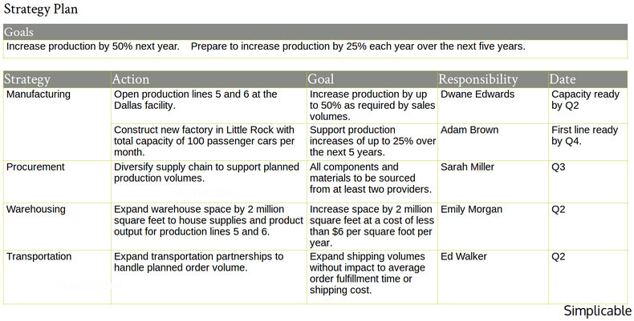
Strategy plan

Slide 11
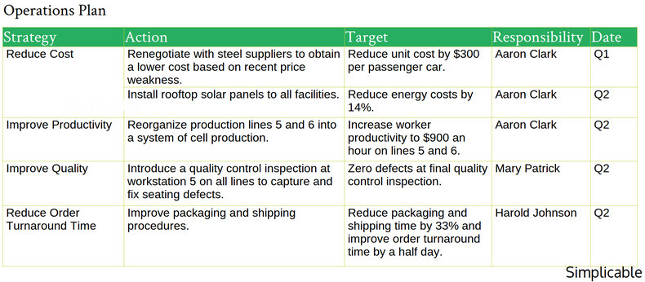
Operations plan

Slide 12
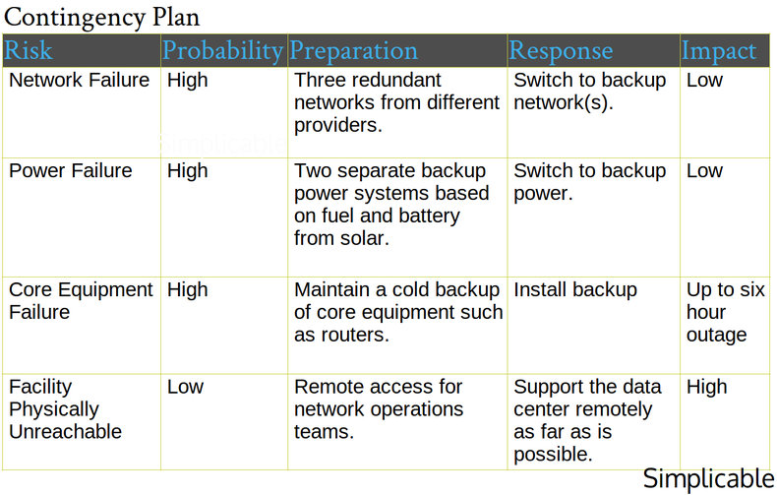
Contingency plan

Slide 13
What Is a Financial Operating Plan (FOP)?
Outlining the revenues and expenses over time. Uses past performances, incomes, and expenses to forecast what to expect in the following years. It then incorporates past and recent trends into the planning to accurately forecast what is to come. It will define goals for areas such as budgeting, sales, and payroll as well as create a cash flow projection.
Helps managers and key investors understand how the company will operate and grow in the future. It helps keep the company on track and identify areas that need attention.
For example, a retailer might use such a plan not only to increase revenue and profits, but to allow for expansion of the operation. The company can assess its potential liquidity and capital that would be available to support the development of additional locations, the hiring of more staff, other services needed to support the expansion. The plan would also account for maintaining the ongoing business while accommodating for expansion. Planned changes in the business, such as the projected costs of research and development of new products, may also be accounted for in the plan.
https://www.investopedia.com/terms/f/fop.asp

Slide 14
To write an operational plan
Identify important goals, milestones, or objectives
Determine key initiatives to help achieve those goals
Define key assumptions you’re making about challenges
Decide how to measure success (KPI’s)
Clearly outline responsibilities and tasks
Assign responsibilities and tasks to team members
Create reasonable deadlines
Define necessary resources to accomplish tasks
Provide training as necessary

