Slide 1
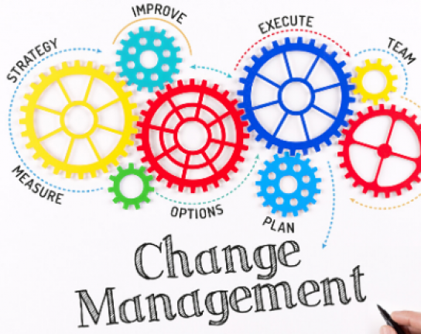
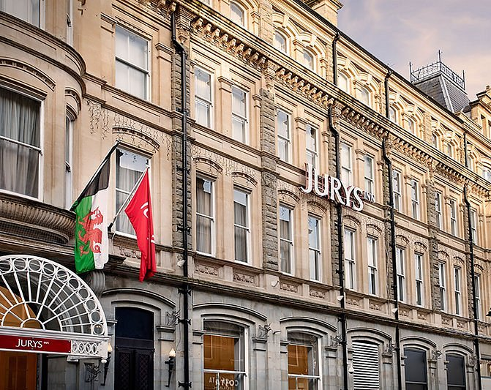
Jaliya De Silva - 1803778
19 May 2021
University of Wales Trinity Saint David

Slide 2

Case Study -
Headquarter in Dublin Ireland
36 hotels across UK and Ireland
approximately 7,500 rooms between them, served by 4,000 employees
Jurys Inn is itself a member of the Leonardo Hotels Group
Founded in 1881

Slide 3


Change –
Many People adopt well to change but most often experience significant problems during change. Andersen, M.K. (2011).
Changed Experienced – Outsourced Housekeeping Department in 2018- present
Reason – Sustain cost effective housekeeping operations, improve quality, efficiency, and performance of the department by downsizing

Slide 4
Service Outsourcing Associated With Many Changes
Change in employer
Change in working condition
Change quality and rhythm
R.T. (2005),

Slide 5
Transition Change management process
Employees go through four stages of Transition which are
Shock and disbelief
Resistance and frustration
Transformation phrase
Embrace
T.G. and Worley, C.G. (2005)
Changes behaviour
Make changes in work habits
Roles and routines
T.F.E., & Robaina P.V. (2005)

Slide 6
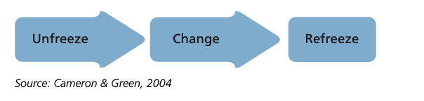
Lewins Model
Unfreeze - To be able to alter current behaviors or mental processes (ideas, perceptions, and beliefs).
Change the habit. . The individual must try out the new behavior, assess what works and what doesn’t,
and change their behavior accordingly.
Refreeze the new habit. The new behavior must become ingrained in the mind.
Dibella, A. (2007)

Slide 7
Sources of resistance to change Kotter And Schlesinger (1979)
Potential Individuals Who May Resist Change With Different Reasons.
Firstly, The fear that new circumstances will damage employees' self-interest is one of the most apparent reasons for people to oppose change initiatives.
Secondly, The goal of reform initiatives has been to establish a new working style that workers are supposed to follow..
Third, Almost every recommendation for an effective change implementation emphasizes the importance of educating people about the nature of change.
Fourth, Change plans are designed to shift an entity from its current state to its ideal state, and as Stapley (1996) points out, this transformation period is like a journey filled with unknowns.

Slide 8
References
R.T. (2005), “Organisational change management”, Journal of Change Management, Vol. 5 No. 4, pp. 369-80.
Cummings, T.G. and Worley, C.G. (2005), Organization Development and Change, Thomson, Mason, OH.
Rodriguez T.F.E., & Robaina P.V. (2005). A resource-based view of outsourcing and its implications for organizational performance in the hotel sector, Tourism Management, 26 (5), 701-721.
Dibella, A. (2007), “Critical perceptions of organisational change”, Journal of Change Management, Vol. 7 No. 3, pp. 231-42.
Paraskevas, A., (2001). Exploring hotel internal service chains a theoretical approach. International Journal of contemporary hospitality management, 13(5), 251-258.
"Amaris Hospitality to complete £100m investment programme with Brighton's Waterfront Hotel re-brand". Big Hospitality. Retrieved 17 May 2021.

Slide 9
THANK YOU

