Slide 1
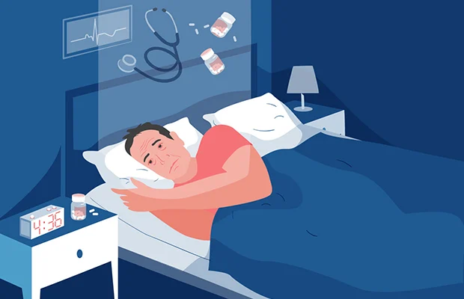
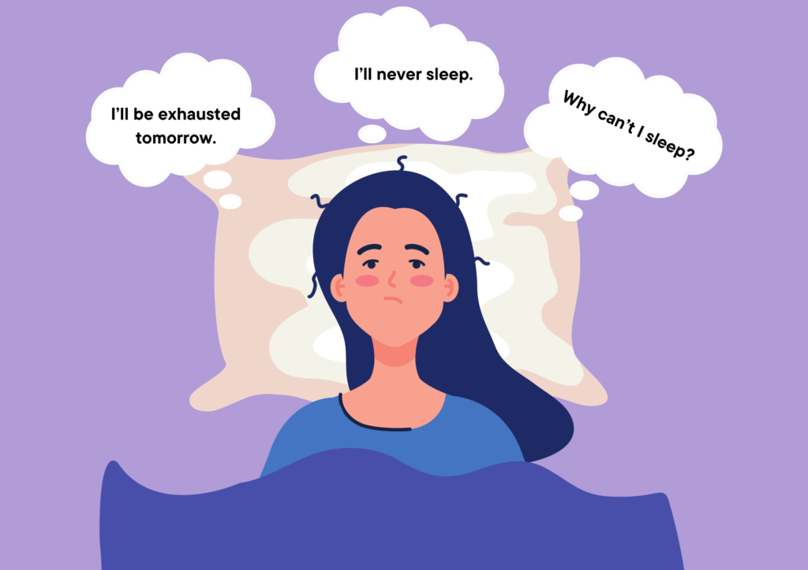
Topic: social media intervention for insomnia among individuals from 18 to 70 year old in united kingdom

Slide 2
Social media intervention for insomnia among individuals from 18 to 70 year old in united kingdom
Group member name | Student id | task
Gaurav janakbhai patel | 2318687 | 3 slides of introduction
 |  | Justification
 |  | Application
Mileen bhagwan patil | 2321878 | Barriers
Hellyben dharmendrakumar patel | 2318627 | benefits

Slide 3

Aim
Our aim is to create user-friendly sleep app that provides support and guidance to individuals from 18 to 70 year old in uk with insomnia. Through social media platform is to reduce the prevalence and severity of insomnia. the intervention seeks to rise awareness of healthy sleep practices , give practical tools and techniques to improve sleep.

Slide 4
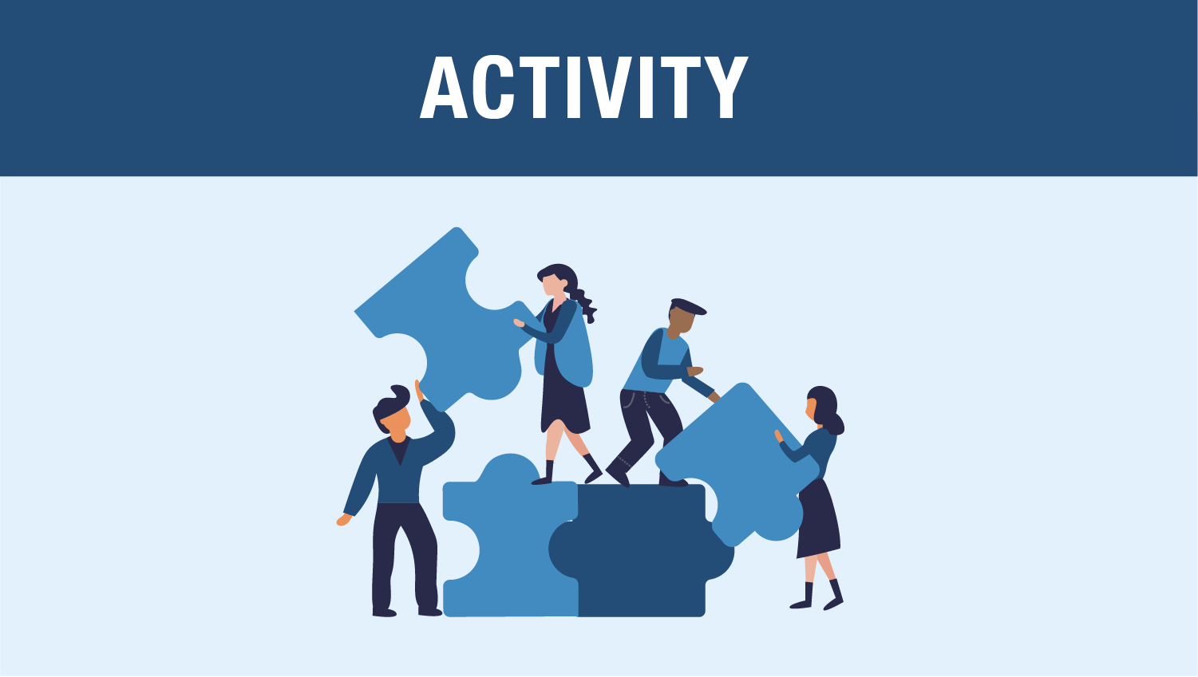
Activity
Awareness Campaigns: we are planning to lunch online social media campaigns that can help rise awareness about our app and insomnia resources, a desire to promote and it’s objectives and the value of society with the chance to reach people seeking aid at the right time( Saha et al,2019).
We are planning rise awareness of cuddle therapy and Transcendental Meditation (TM) for better and fast relief from insomnia.
Arrange educational or motivational seminar which more focus on open eye and guide towards healthy sleep.

Slide 5

Digital health technology intervention
“sleep-well” application designed to provide information healthy sleeping and importance sleep hygiene.
The Sleep Well app is compatible with most iOS and Android devices, including smartphones, tablets, desktop and laptop computers.
huge collection with adult novels and relaxing sleep music
sleep coach and instructional videos to help you
Comprehensive sleep assessment
qualified sleep physicians are going to educate you on sleep knowledge, your physical and mental wellness, and sleep hygiene.
Reminders and notifications sleeping score and sleep hours
User privacy and security
Cognitive behavioral treatment (CBT) sessions
built-in sleep tracking function
psychological education, stimulus management, nap-focused therapy, and limiting sleep.
suggest time to bed following sleep guidelines
Additionally we introduce new features cuddle therapy and 气功 (Qigong): it is meditation to cultivate and balance the body’s energy.
(Werner et al,2019).

Slide 6


Professional cuddle therapist
气功 (Qigong)

Slide 7

Social media intervention for insomnia among individuals from 18 to 70 year old in united kingdom

Slide 8
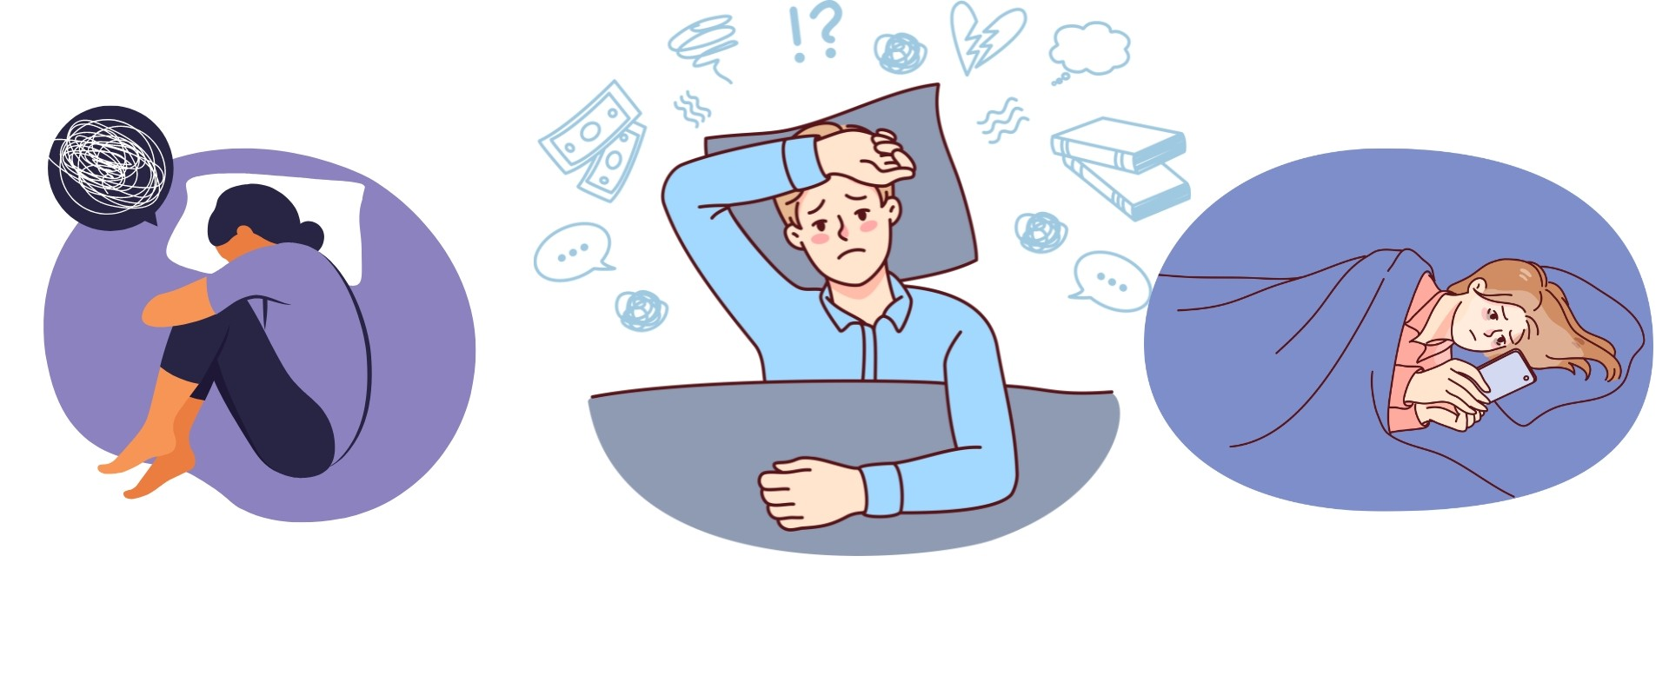
Introduction of insomnia
Insomnia is defined as having trouble sleeping on a regular basis. It normally improves after adjusting your sleeping patterns (NHS,2024).
lack of sleep is prevalent, ranging 19% to 50% of adults experiencing symptoms of sleeplessness in some published surveys (Krystal, Ashbrook and Prather,2021).
Insomniacs evaluated a worse standard of life ( roth,2007).

Slide 9
JUSTIFICATION- Why insomnia
The costs both directly and indirectly of insomnia surpass 100 billion dollars each year. Direct costs include doctor's visits, medicines, and procedures.
Insomnia patients are 2.5 times more likely than non-insomniacs to report car accidents due to sleepiness (Matteson et al,2010).
Disrupted sleep is linked to stress, psychological strain, and distress, as well as damage in social, professional, and other critical areas of functioning (Fietze et al,2021).

Slide 10
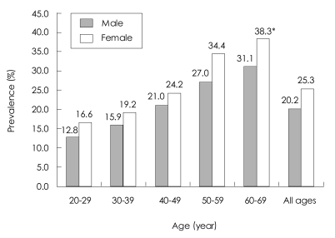
Justification why 18 to 70 year old ?
In 2020, 17.8% of adults experienced difficulty sleeping on the majority or every day in the thirty days prior to the survey. Children and adolescents were less inclined to have issues sleeping (13.8% among people aged 18-44) then adults aged 45-64 (21.8%) or 65 and older (20.3%) (Amanda, Adjaye and Black, 2022).
It's a common disease that affects roughly one out of every three persons in the UK. It is particularly common among the elderly (NHS,2024).
Insomnia is 1.5-2 times very common in female than in male, while greater than 25% of women have it during pre-menopause (NICE,2024).
Globally, insomnia affects 10%-30% of the population, with some cases reaching 50%-60%. It is widespread in adults, older persons, those suffering from medical or psychological conditions (Bhaskar, Hemavathy and Prasad,2016).

Slide 11
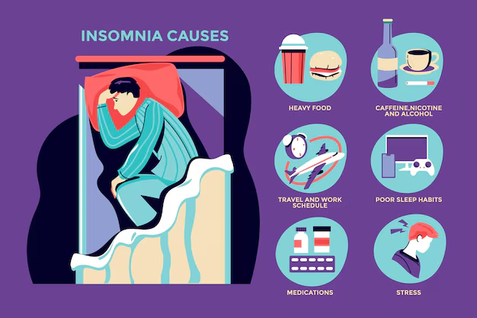
Justification effects of insomnia
It is Causing clinically considerable anxiety or decline in social, business, or other key aspects of functioning.
The Light exposure and irregular sleep cycles are variables that contribute to their persistence.
People with depression-related sleeplessness show abnormal activity in neocortical areas that regulate cognition and emotion (Colten and Altevogt,2006).
Insomnia is tied to lower quality of life, affecting mental health, energy, and overall well-being, even with other health issues considered (Katz and McHorney,2002).

Slide 12

JUSTIFICATION- Why social media?
Social medial sites or network is one of the major reason which lead to insomnia because majority of people spend their average 2 hours on social media site before sleeping in their daily life which disturb their sleep cycle and they get used to this patten which lead sleeping disorders.
Excessive usage of social networks (SM) including Instagram, TikTok, Facebook, and Twitter is a popular strategy in the twenty-first century to avoid undesirable symptoms in regular life.
Obsessive social media use is strongly linked to higher symptoms of depression, anxiety, stress, negative thoughts, and suicidal thoughts, as well as poor sleep quality and insomnia.(Brailovskaia et al,2023).
"Future efforts will increasingly focus on enhancing sleep health, targeting improved sleep duration and quality through better habits and greater awareness among healthcare professionals, policymakers, and the public (Albakri, Drotos and Meertens, 2021).

Slide 13
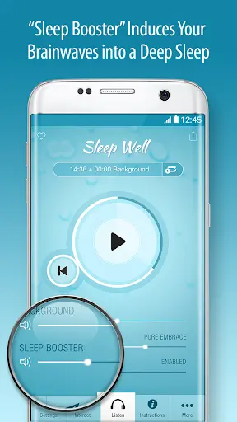
Nature of proposed health promotion
We will introduce application called “ sleep-well” that adults can download ,which provide them accurate information about healthy sleeping, sleep hygiene, CBT , peer support, mindfulness and relaxation techniques ,treatment and counselling for those who need it in insomnia.
There will be paid advertisement on various social media networks like (Instagram, Tiktok, facebook etc.) which is more use it before going to sleep which lead to insomnia.
There will be allocate features for regular feedback and adjustments through tracking and monitoring their sleep patten/cycle.
Education and 24/7 support regading your queries and hesitation regading insomnia.

Slide 14
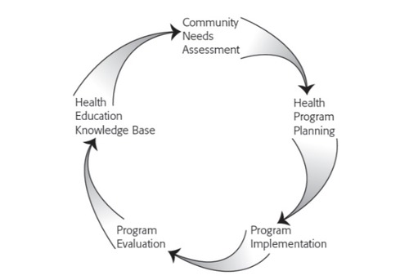
Chosen planning model is
Multilevel Approach to Community Health (MATCH)
The model's primary focus is on evaluating and assessing insomnia in population health, as well as engaging with communities to identify opportunities for improving community health.
The methodology also facilitates the implementation of evidence-based initiatives , policies application for digital promotions . This paradigm aids in the resolution of recognized health challenges through appropriate strategies and policies (pondicherry-university,2022).

Slide 15
Phase: 1 Goals selection.
Insomnia is linked to daytime fatigue, increased healthcare use, medication misuse, impaired function, memory issues, and a higher risk of illness and accidents.
In the U.S., 33% of people experience drowsiness, with 9% reporting it happens nightly and 24% experiencing it occasionally, often during stressful times (Harvey,2002).
Insomnia can treat with regular medication, cognitive behavioral therapy (CBT), sleep limit therapy (SRT),sleep hygiene education and mindfulness-based stress reduction (MBSR) and our application called SLEEP-WELL will focus on this areas to improve individual health.

Slide 16

Phase:2 intervention planning
We are planning to lunch app through social media intervention, which guide people in lot of aspect of their sleeping problems. we will introduce social media campaign to promote our app and our goal is to reach out as many people as possible to improve their health in general.
A large number of people with sleeplessness go untreated. 2/3 of insomnia patients claim a lack of understanding of treatment choices, with many resorting to alcohol (28%), or untested over-the-counter medications (23%).
Insomnia is influenced by psychological, behavioral, and biological factors, with significant evidence supporting the effectiveness of both hypnotic medications and cognitive behavioral therapy as treatments (Sharma and Andrade, 2012).

Slide 17
Phase: 3 program development.
One of the most effective therapies for insomnia is cognitive behavioral therapy (CBT), a psychological treatment that focuses on the maladaptive habits and dysfunctional ideas that contribute to sleep issues.
The National Institutes of Health's State-of-the-Science conference on insomnia reported that CBT is "as effective as prescription medications for temporary treatment of chronic insomnia.“
CBT is often difficult to access due to a lack of trained clinicians, uneven regional availability, high costs, and limited access to therapy and clinics.
One way to overcome these challenges is by offering treatment online, making this effective intervention more accessible to underprivileged patients. The internet already plays a crucial role in providing healthcare and medical information ( Ritterband et al,2009).
Therefore our app provide digital solution and promotion of insomnia with healthy mind and sleep.

Slide 18
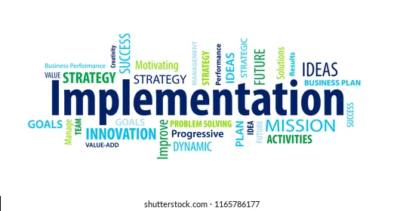
Phase: 4 implementation preparation
Create written teaching materials for a large population with sleep issues.
Promote alternatives to drugs treatment of insomnia by grounding the content of the course in the concepts of cognitive behavioral therapies for insomnia (CBTi), as advised by scientific literature.
Follow best practices by incorporating patients and healthcare experts from multiple fields in the development process (coteur et al,2022).

Slide 19

Phase: 5 evalution
Participants used the Internet Intervention Utility Questionnaire (IIUQ) to evaluate their experience with Sleep-Well app, covering both general online measures and specific aspects of the intervention.
The IIUQ also includes two open-ended questions about the program's most and least beneficial components, helping to inform future adjustments.
The 16-item test uses a 5-point Likert scale (0-4, with 4 being the most positive response) to assess the accessibility, popularity, effectiveness, clarity, and convenience of the internet intervention (Ritterband et al,2012).

Slide 20
Group member: 2
Barriers, Stakeholders, and Legal & Ethical Considerations

Slide 21
Introduction
Definition of Insomnia: Insomnia is a sleep disorder characterized by difficulty falling asleep, staying asleep, or getting quality sleep (Devi et al., 2018).
Prevalence in the UK: Approximately 1 in 3 people in the UK suffer from insomnia (Morphy et al., 2007).
Importance of Addressing Insomnia: Insomnia can lead to various health issues, including chronic fatigue, depression, and decreased productivity (Wade, 2010).

Slide 22
Overview of the Intervention
Description of Social Media Intervention: Utilizing social media platforms to deliver cognitive-behavioral therapy for insomnia (CBT-I), sleep hygiene tips, and peer support (Koffel et al., 2020).
Goals and Objectives:
Improve sleep quality and duration.
Increase accessibility to insomnia treatment.
Reduce stigma around seeking help for sleep disorders (Cheung et al., 2014).
Target Audience: Individuals aged 18-65 in the UK experiencing insomnia (Kocevska et al., 2021).

Slide 23
Stakeholders: The 4 Ps
01
02
Patients
Role: Primary beneficiaries of the intervention.
Involvement: Engage with the content, participate in CBT-I sessions, provide feedback on the intervention's effectiveness.
Policy makers
Role: Ensure the intervention aligns with public health policies and regulations.
Involvement: Advocate for digital health initiatives, create supportive policies for mental health interventions, ensure compliance with GDPR and other legal frameworks.

Slide 24
Stakeholders: The 4 Ps
03
04
Providers
Role: Deliver the intervention through social media platforms.
Involvement: Develop and share accurate content, offer professional guidance, monitor patient progress, and adapt interventions based on feedback.
Payors
  Role: Fund and support the financial sustainability of the intervention.
  Involvement: Insurance companies, government programs, and other funding bodies invest in the development and maintenance of the social media intervention, potentially covering costs for patients.

Slide 25
Barriers to Implementation
Access to Technology: Not all individuals have access to the necessary devices or internet (Chadwick et al., 2013).
Digital Literacy: Varying levels of comfort and ability to use digital tools.
Stigma Around Mental Health: Fear of judgment or ridicule may prevent individuals from participating.
Resistance to Digital Interventions: Preference for face-to-face interactions.
Funding: Securing financial resources for development and maintenance.
Cost of Technology: High costs may limit participation (Viborg Andersen et al., 2007).
Social Barriers
Economic Barriers
Technical Barriers

Slide 26
Legal and Ethical Issues
Data Privacy and Security
GDPR Compliance: Ensuring all data handling meets GDPR standards.
Data Breaches: Risk of personal information being exposed.
Informed Consent
Understanding the Intervention: Ensuring users are fully informed about the intervention's purpose and use of their data (Yardley et al., 2015).
Ethical Use of Social Media
Avoiding Misinformation: Ensuring the accuracy of shared information.
Promoting Accurate Content: Collaborating with credible sources and fact-checking.

Slide 27

Literature Review - Technical Barriers
Current Research Findings
Studies indicate a significant portion of the population lacks access to reliable internet and digital devices.
Digital literacy varies widely, impacting the effectiveness of digital health interventions.
Perspectives
Optimistic: Increasing digital access through government initiatives and educational programs.
Pessimistic: Persistent digital divide due to socioeconomic factors (Facer and Selwyn, 2021).

Slide 28
Literature Review - Social Barriers
Current Research Findings
Mental health stigma remains a barrier to seeking help, even in online environments.
Social media can both reduce and exacerbate stigma, depending on the platform and community.
Perspectives
Optimistic: Growing acceptance and discussion of mental health issues on social media.
Pessimistic: Ongoing stigma and misinformation may hinder participation and effectiveness (Banerjee and Meena, 2021).

Slide 29
Literature Review - Economic Barriers
Current Research Findings
Funding for digital health interventions is often limited and competitive.
High costs of technology can limit access, particularly for lower-income individuals (Campbell et al., 2019).
Perspectives
Optimistic: Increasing investment in digital health from public and private sectors.
Pessimistic: Limited resources and high costs continue to be significant barriers.

Slide 30
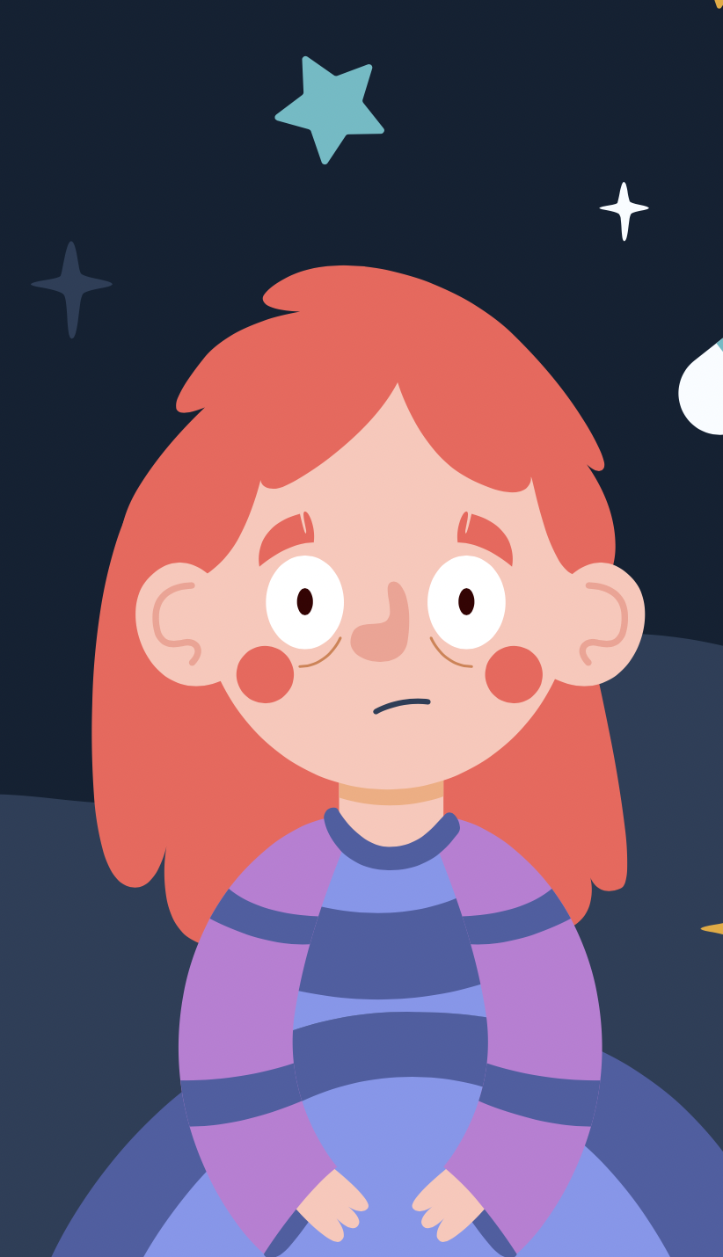
Addressing Legal and Ethical Issues
Strategies for Ensuring Data Privacy
Encryption: Using strong encryption methods to protect user data.
Secure Data Storage: Storing data in secure, compliant servers (Kaaniche and Laurent, 2017).
Promoting Ethical Use
Fact-Checking: Implementing rigorous fact-checking processes.
Collaborating with Credible Sources: Partnering with reputable health organizations and experts.

Slide 31
Conclusion
Summary of Barriers and Solutions
Technical, social, and economic barriers need to be addressed through targeted strategies.
Effective Strategies for Implementation
Increasing digital literacy, reducing stigma, and securing funding.
Future Research Directions
Further studies on long-term effectiveness and ways to overcome identified barriers.

Slide 32
Group member: 3

Slide 33
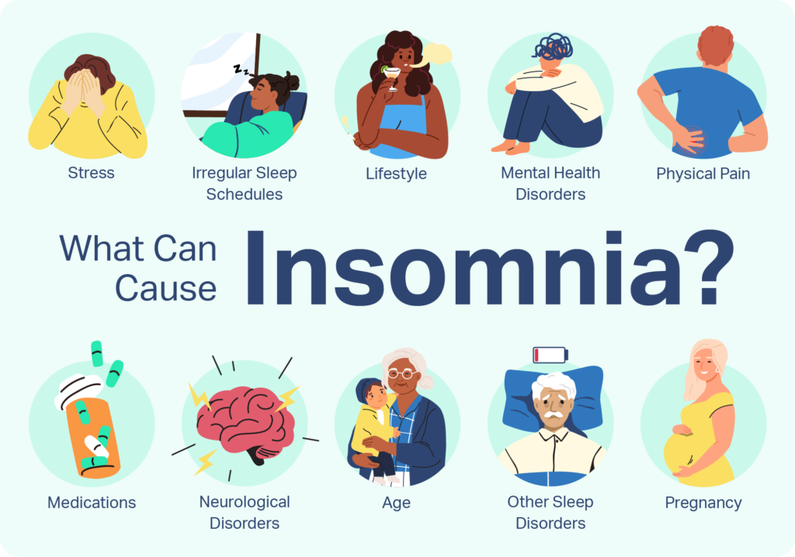
Insomnia and Social Media Intervention for Insomnia
Insomnia is a common disease in the United Kingdom, which affects a sizeable share of the population.
According to the estimates, just over a third of adults in the UK may suffer from insomnia at some point in their lives (Aviva, 2017).
This condition refers to the inability to fall asleep st, ay asleep, or get a restful night's sleep.
Notes:
Its consequences are numerous health hazards, such as a decrease in cognitive performance, physical health, and general life satisfaction. Based on the literature, social media interventions appear to be a feasible solution to the treatment of insomnia in people ages 18 through 65. Due to the popularity of the main social media platforms, these interventions can offer easily accessible, inexpensive, and populace solutions for targeting people with sleep disturbances.

Slide 34
Benefits-Accessibility and Reach
Accessibility and reach are some of the greatest advantages of social media-based interventions, especially in the case of insomnia (Graham et al., 2021).
Social media networks by now have become essential hinges of daily life for millions of people residing in Great Britain.
It includes such services as Facebook, Instagram, YouTube, and Twitter.
Notes:
The wide use of apps makes it possible to reach out to as many people as possible and engage them without having to meet them physically for a checkup or getting treated in fear that their condition is particular and contagious. Hence, it is posited that social media interventions can reach a large and heterogeneous population and provide sleep materials to users on their devices.

Slide 35
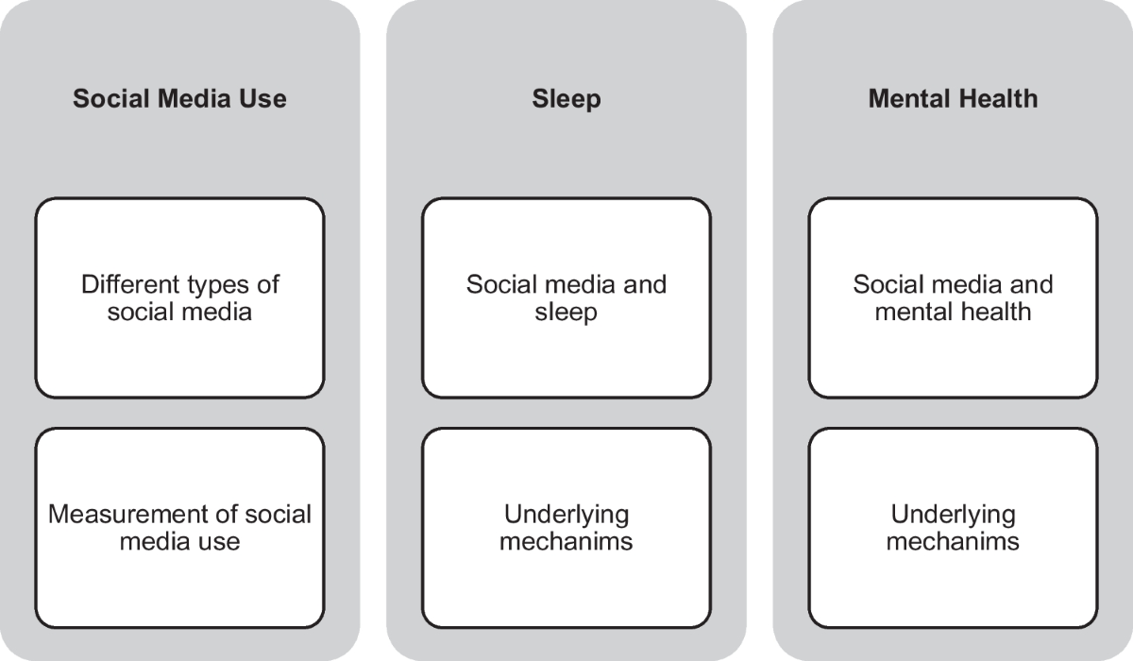
Benefits-Cost-Effectiveness
Social media interventions are way more economical than other conventional techniques of healthcare (Serenko, Turel and Bohonis, 2021).
Digital content, including video lessons, infographic pictures and various types of posts, requires fewer costs as compared to in-person consultation, the development of informative printed materials, and the creation of cures for patients.
Notes:
Also, social media are also highly scalable, and it is possible to disseminate a single post widely with further expenses. This cost-efficient characteristic is quite essential, especially in the health context, as the availability of resources remains a concern while the target population to be reached due to the available funding is enormous.

Slide 36
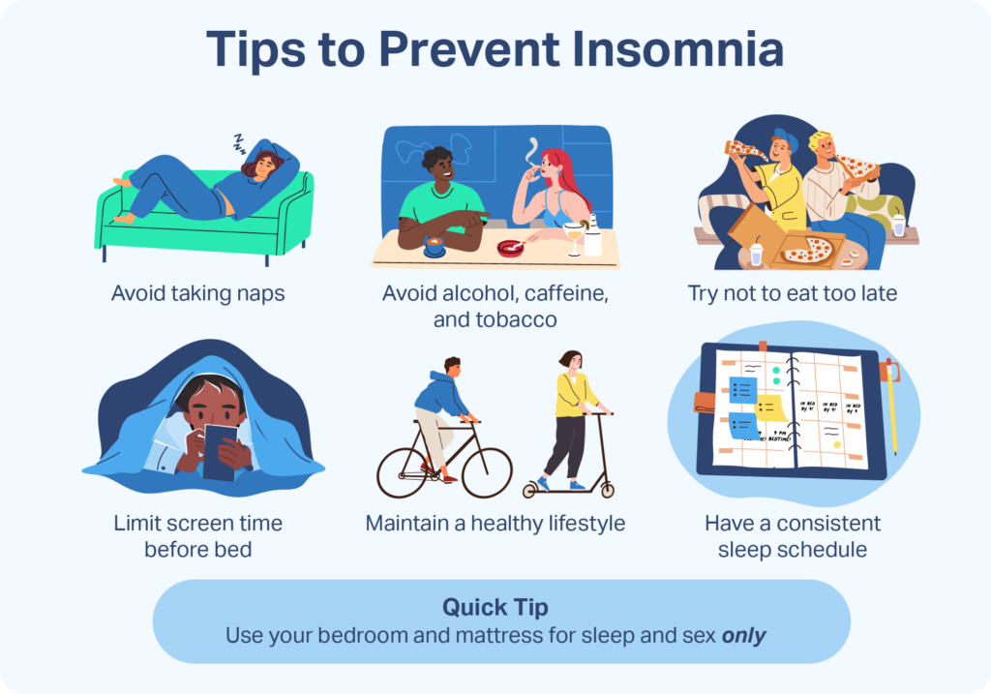
Benefits-Personalisation and Engagement
Social media possess strong shaping and interaction features that can supplement insomnia treatments.
These aspects imply that algorithms can deliver the most relevant and attractive content to the specific user depending on his or her reviews and other actions.
For example, users who have interacted with articles on good sleeping habits or methods of stress relief would be recommended more content in such categories, which would enhance the chances of behaviour modification (Baglioni et al., 2020).
Notes:
Technological qualities include comments, where a user can post a question or personal experience or get a response from someone; likes, where a user can endorse a particular post, share or pass on to other users; and direct messages, where users can have a one-on-one conversation. Such an interaction level can create a perception of togetherness and mutual support, which is vital for patients with insomnia.

Slide 37
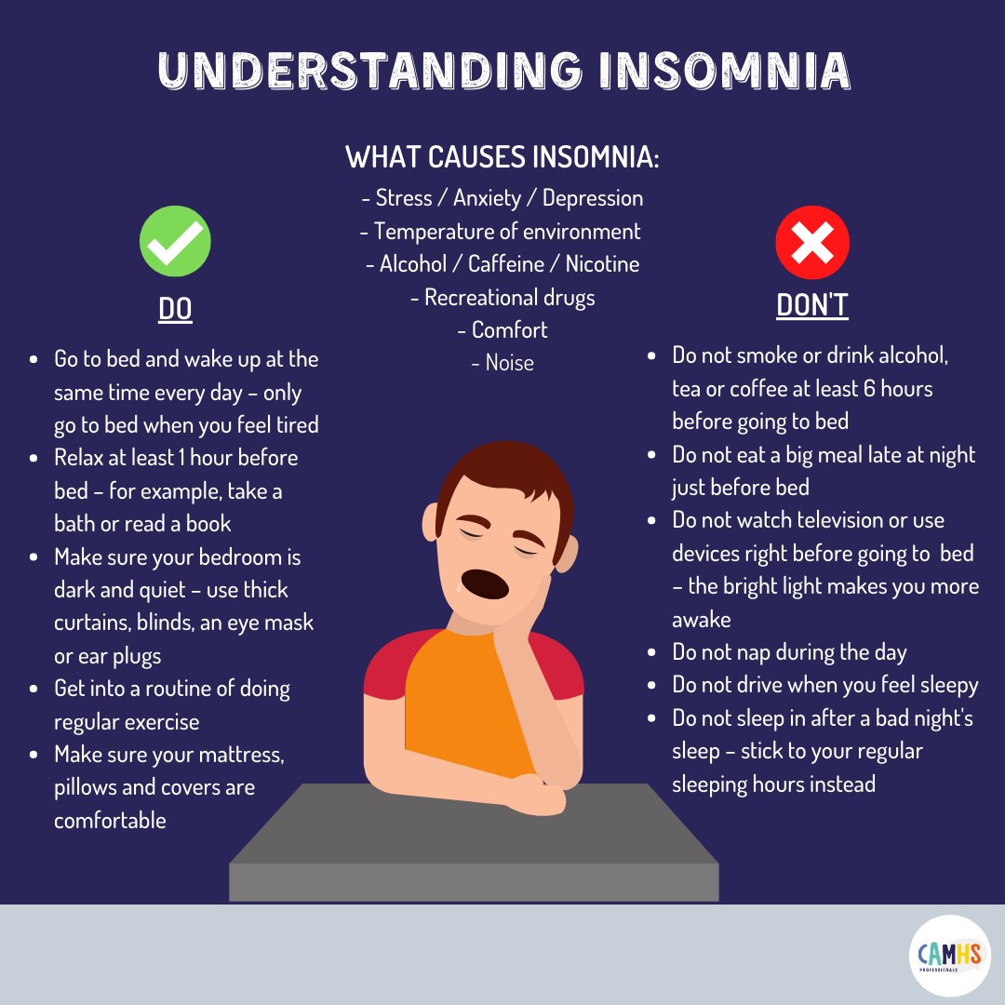
Flexibility and Convenience
Due to the nature of social media interventions, namely flexibility and convenience, it is suitable for insomnia.
Information disseminated through social media can be accessed at any time throughout a day, month or year, which would only be convenient for the user (Henry et al., 2021).
This constant accessibility is especially useful for those people with shifting sleeping schedules or any other busy schedule.
Notes:
They do not have to worry about getting help at an inconvenient time or having to rearrange their schedule to accommodate the help. In addition, the existence of short posts too long articles and videos addresses the need to meet clients' needs.

Slide 38
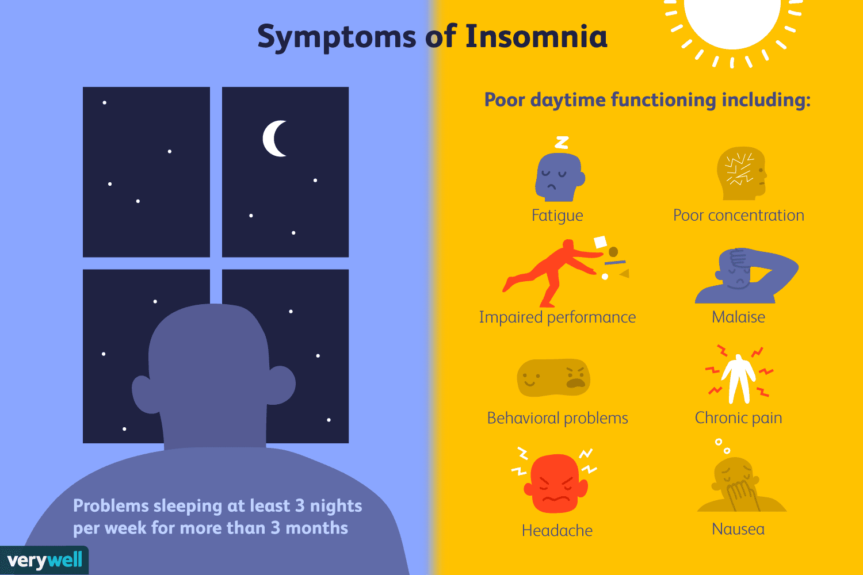
Benefits-Data-Driven Insights
Information acquired from social media fellowships is actualised and has special implications on the behaviour, preference, and success of interventional measures (Alonzo et al., 2021).
The factors involved are:
  Level of engagement
  the number of content shares and feedback received.
Notes:
The service providers and researchers involved in this line can fine-tune and adjust their programs to address the target population's needs more adequately. Its effectiveness lies in the fact that the decisions made in its framework are based on the data, which means that the solutions proposed should remain timely, appropriate, and sensitive to trends and issues in managing insomnia.

Slide 39
Benefits-Encouragement of healthy sleep patterns
Using social media interventions, awareness of healthy sleep behaviour and the significance of sleep can be created (Alonzo et al., 2021).
These interventions may, therefore, assist in ensuring that evidence-based information, tips and success stories are frequently shared.
It eradicates the stigma that comes with seeking help for sleep problems.
Notes:
Through health promotion initiatives in the social media context, the resultant influence can be utilised to promote healthy lifestyles, including diet, exercise and screen time that interferes with sleep quality. Also, it is effective to present the patients who successfully treat insomnia as such success stories can encourage others to work on improving their situation.

Slide 40
Support for Self-Management
Education and encouragement of persons to become more proactive in managing their sleep health is another major advantage of social media interventions.
These interventions allow the users to manage information
Resources that are provided to them and with the help of the strategies provided, they can decide on the best sleep hygiene to adopt in their lifestyles (Ferini‐Strambi et al., 2021).
Notes:
For instance, instructional deep breathing, mindfulness, and CBT interventions can be provided through social media where the users can easily employ them using the instructions provided wherever they are. As a result of this self-management approach, patients are relieved from the pressure put on the healthcare systems; at the same time, the person suffering from insomnia will have the ability to control his or her condition.

Slide 41
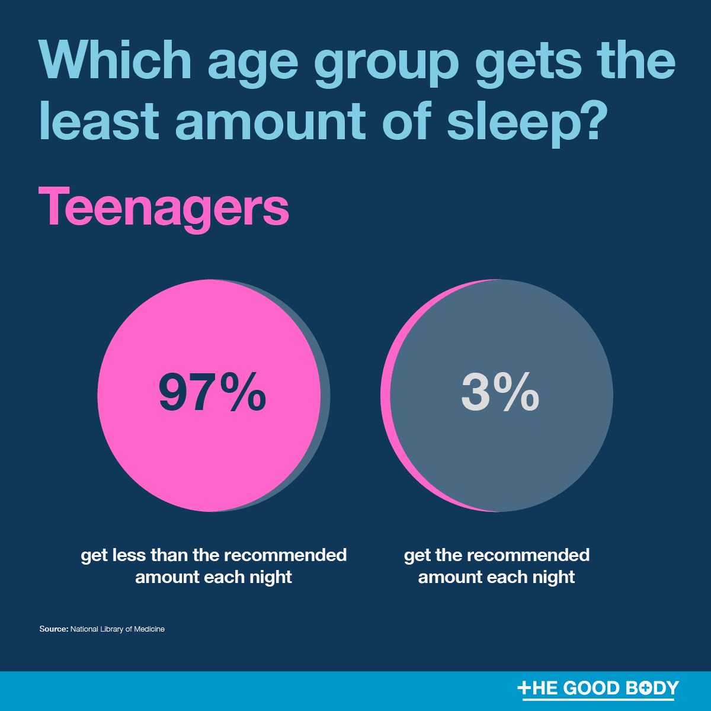
Implication of the Social media intervention on policies, research and education
The integration of social media interventions to fight insomnia in people of 18 to 70 years in the UK has several impacts on the policy, future research, and teaching and learning domains.
This new concept works with the possibilities of presentations in social networks.
It expands the opportunities for developing and improving health promotion programs, strengthening the base for propping policies, advancing scientific discoveries, and developing education (Braghieri, Levy and Makarin, 2022).
Notes:
The use of social media interventions in public health requires the reconsideration of the existing health promotion models from the policy perspective. Decision-makers need to factor in the communication modalities where digital health interventions are hinged to be effective in communicating sound and safe information adoption. This might call for coming up with new policies and norms of health communication embracing the use of new media and particularly techniques to ascertain the authenticity of information disseminated in cyberspace, such as in Twitter.

Slide 42
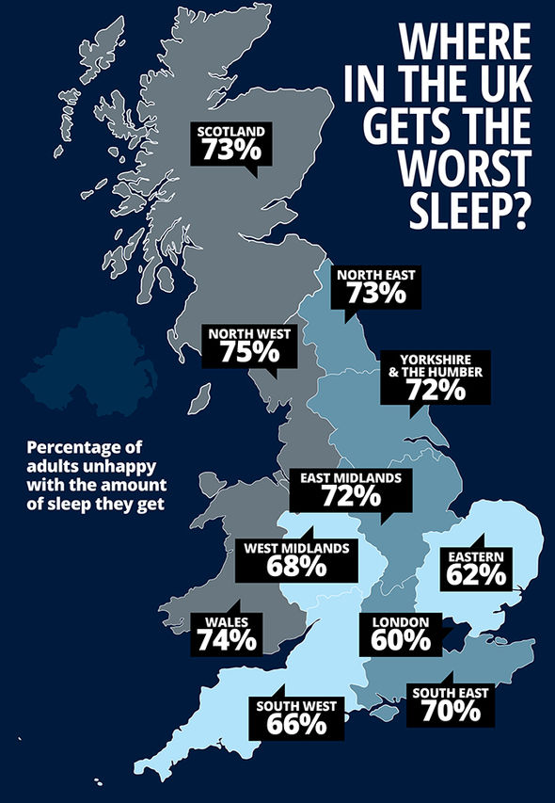
Policy Implications
Policies should consider privacy and data security issues since the accumulating and analysing of user data are crucial to these interventions.
The broad utilisation of social media interventions can direct healthcare financing and resource distribution (Edinger et al., 2021).
Showcasing the cost efficiency and the possibility of increasing the scale of the digital approaches urged the policymakers to invest more resources into the development and application of similar solutions to other health problems.
Notes:
Achieving the delicate balance between safeguarding the users' data while at the same time facilitating the creation of a responsive public health data system is the paramount goal that policymakers strive to accomplish. Such change might result in better utilisation of the weakened public health potentials and needs and improved utilisation of scarce financial resources, which may have a positive effect on the alleviation of the pressure on conventional health care services.

Slide 43
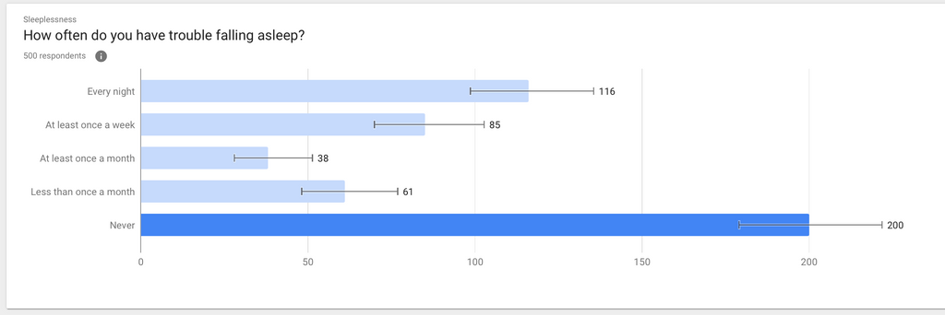
Research Implications
Social media application for insomnia intervention is research directions that are yet to be explored.
The collection of data is important for the further advancement of knowledge about sleep disorders and ways of coping with them (Malaeb et al., 2021).
Social networks make it possible to use big data obtained from social media to study trends, patterns, and relationships associated with insomnia.
Notes:
The picture painted above can be useful for interventionists who design interventions based on the demographics of the affected population within the age bracket of 18 to 65 years. Further, interventions delivered through social media platforms present a research possibility of making real-time assessments of large groups and heterogenic populations.

Slide 44
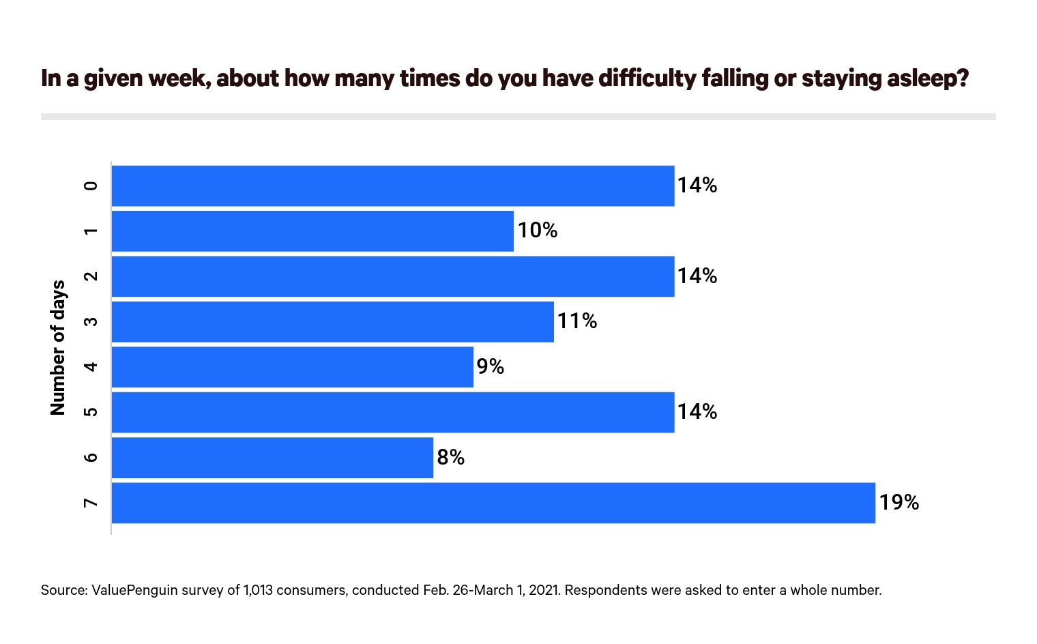
Research Implications (cont.)
Investigators can develop and execute RCTs and observatory studies in which social media forms the medium of intervention and data capturing.
This also expands the possibilities of large-scale research and improves the external validity of conclusions, as the interventions are administered in a natural environment.
Multidisciplinary cooperation, as well as cooperation with both healthcare facilities and technical organisations, is crucial for the development of the field of digital health interventions (Naslund et al., 2020).
Notes:
Such partnerships may create the basis for the advancement of new and complex algorithms and machine learning models to use big data from such platforms to assess a specific person's potential risk of developing insomnia, and assess the effectiveness of the given approach. Such innovations can result in better ways to treat and manage insomnia and consequently enhance sleep health.

Slide 45
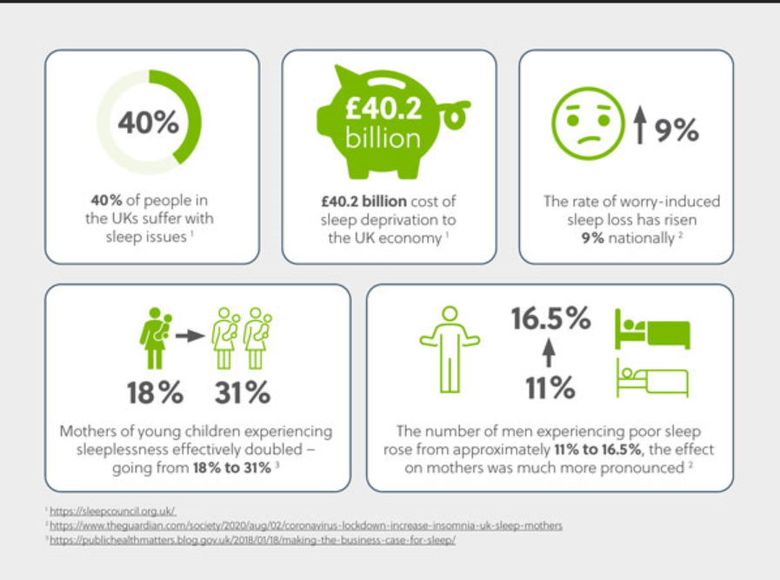
Educational Implications
Ensure that digital health tools are incorporated into their curricula.
Ensure that professionals of the company are trained in social media analytics.
Raise awareness about appropriate conduct in digital health (Kolhar, Kazi and Alameen, 2021).
Notes:
As part of the education for medical and public health specialists, incorporating digital health as an educational component can help the upcoming practitioners to be acquainted with social media and other related technologies in their practice. This training can improve communication with the patients and the general public, to spread knowledge on health improvement and alteration of certain behaviors.

Slide 46
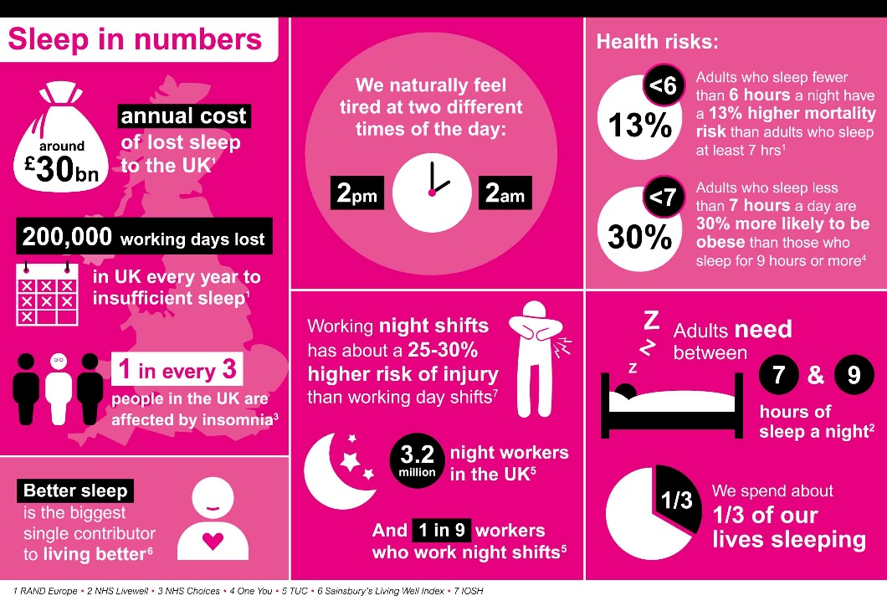
Educational Implications (cont.)
It is vital to outline the existing confidentiality and data protection laws within the context of digital health interventions (Lin et al., 2021).
This will help the future profession to avoid pitfalls in the development of this novel domain.
In general, the results of social media interventions for insomnia can be helpful in designing public health and educational programs.
Notes:
Thus, using the guidelines of appropriate digital communication and audience engagement, educators can create more meaningful health promotion interventions. This can increase population knowledge of various illnesses, alter people's behaviour and ultimately have a direct positive impact on population health.

Slide 47
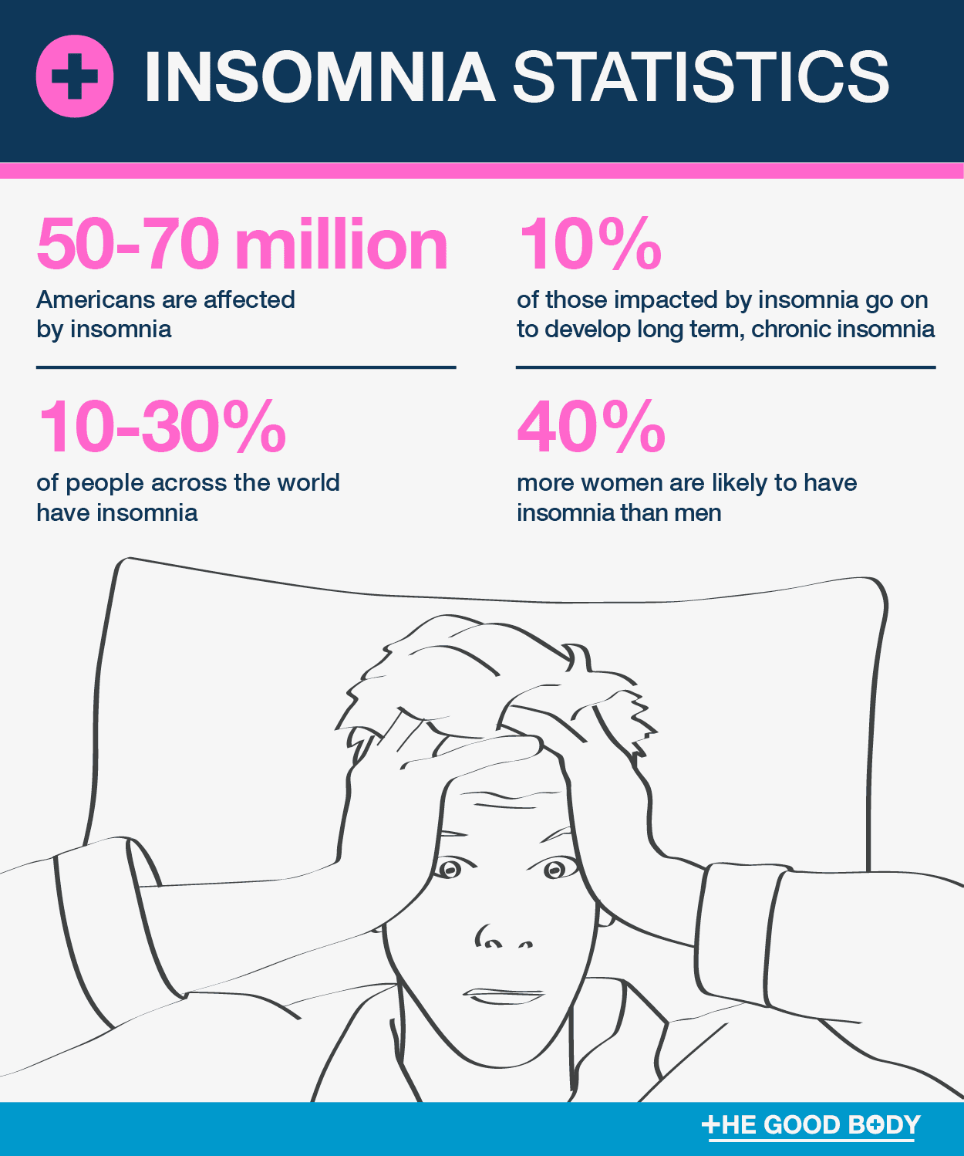
Educational Implications (cont.)
The use of social media interventions for insomnia in people between 18 and 65 years who are living in the UK is significant for future policies, investigations, as well as training advancements.
Politics have to develop rules that will protect populations from receiving unsafe and ineffective digital health communication while addressing the question of privacy (Zhou et al., 2022).
Studying social media can help researchers obtain a better understanding of the phenomenon under consideration, namely insomnia, and improve the methods of intervention (Dhir et al., 2021).
Notes:
Educational programs must adapt continuously in order to bring up people who will be ready to fulfil the human capital needed for the purposeful use of digital health tools. By adopting these implications, the system of healthcare will remain relevant and ready to address insomnia together with other health issues in the era of the digital revolution, as well as promote the overall quality and longevity of people's lives.

Slide 48


Slide 49
References
Albakri, U., Drotos, E. and Meertens, R., 2021. Sleep health promotion interventions and their effectiveness: an umbrella review. International journal of environmental research and public health, 18(11), p.5533.
Alonzo, R., Hussain, J., Stranges, S. and Anderson, K.K., 2021. The interplay between social media use, sleep quality, and mental health in youth: A systematic review. Sleep medicine reviews, 56, p.101414.
Aviva, 2017. Sleepless cities revealed as one in three adults suffer from insomnia. [online] Aviva Plc. Available at: <https://www.aviva.com/newsroom/news-releases/2017/10/Sleepless-cities-revealed-as-one-in-three-adults-suffer-from-insomnia/> [Accessed 7 August 2024].
Bhaskar, S., Hemavathy, D. and Prasad, S., 2016. Prevalence of chronic insomnia in adult patients and its correlation with medical comorbidities. Journal of family medicine and primary care, 5(4), pp.780-784.
Brailovskaia, J., Balcerowska, J.M., Precht, L.M. and Margraf, J., 2023. Positive mental health mediates the association between insomnia symptoms and addictive social media use in Germany and Poland. Computers in Human Behavior, 143, p.107676.
Banerjee, D. and Meena, K.S., 2021. RETRACTED: COVID-19 as an “Infodemic” in Public Health: Critical Role of the Social Media. Frontiers in Public Health, 9, p.610623. Available at https://www.frontiersin.org/articles/10.3389/fpubh.2021.610623/pdf
Baglioni, C., Altena, E., Bjorvatn, B., Blom, K., Bothelius, K., Devoto, A., Espie, C.A., Frase, L., Gavriloff, D., Tuuliki, H. and Hoflehner, A., 2020. The European Academy for Cognitive Behavioural Therapy for Insomnia: An initiative of the European Insomnia Network to promote implementation and dissemination of treatment. Journal of sleep research, 29(2), p.e12967.
Braghieri, L., Levy, R.E. and Makarin, A., 2022. Social media and mental health. American Economic Review, 112(11), pp.3660-3693.
Colten, H.R. and Altevogt, B.M., 2006. Committee on sleep medicine and research. Sleep disorders and sleep deprivation: an unmet public health problem.
Coteur, K., Matheï, C., Schoenmakers, B. and Van Nuland, M., 2022. Co-design to increase implementation of insomnia guidelines in primary care. Patient Education and Counseling, 105(12), pp.3558-3565
Cheung, J.M., Bartlett, D.J., Armour, C.L., Glozier, N. and Saini, B., 2014. Insomnia patients' help-seeking experiences. Behavioral Sleep Medicine, 12(2), pp.106-122. Available at https://www.tandfonline.com/doi/abs/10.1080/15402002.2013.764529

Slide 50
Chadwick, D., Wesson, C. and Fullwood, C., 2013. Internet access by people with intellectual disabilities: Inequalities and opportunities. Future internet, 5(3), pp.376-397. Available at https://www.mdpi.com/1999-5903/5/3/376
Campbell, B.R., Ingersoll, K.S., Flickinger, T.E. and Dillingham, R., 2019. Bridging the digital health divide: toward equitable global access to mobile health interventions for people living with HIV. Expert review of anti-infective therapy, 17(3), pp.141-144. Available at https://www.tandfonline.com/doi/abs/10.1080/14787210.2019.1578649
Devi, C.B.P., Samreen, S., Kumari, N.K. and Sharma, J., 2018. A review on insomnia: The sleep disorder. Pharma Innov. J, 7, pp.227-230. Available at https://www.academia.edu/download/83577115/7-11-125-807.pdf
Dhir, A., Talwar, S., Kaur, P., Budhiraja, S. and Islam, N., 2021. The dark side of social media: Stalking, online self‐disclosure and problematic sleep. International Journal of Consumer Studies, 45(6), pp.1373-1391.
Edinger, J.D., Arnedt, J.T., Bertisch, S.M., Carney, C.E., Harrington, J.J., Lichstein, K.L., Sateia, M.J., Troxel, W.M., Zhou, E.S., Kazmi, U. and Heald, J.L., 2021. Behavioral and psychological treatments for chronic insomnia disorder in adults: an American Academy of Sleep Medicine clinical practice guideline. Journal of Clinical Sleep Medicine, 17(2), pp.255-262
Ferini‐Strambi, L., Auer, R., Bjorvatn, B., Castronovo, V., Franco, O., Gabutti, L., Galbiati, A., Hajak, G., Khatami, R., Kitajima, T. and McEvoy, D., 2021. Insomnia disorder: clinical and research challenges for the 21st century. European journal of neurology, 28(7), pp.2156-2167.
Facer, K. and Selwyn, N., 2021. Digital technology and the futures of education: Towards ‘Non-Stupid’optimism. Futures of Education initiative, UNESCO. Available at https://www.academia.edu/download/98619725/Unesco_Background_Ed_Tech.pdf
Fietze, I., Laharnar, N., Koellner, V. and Penzel, T., 2021. The different faces of insomnia. Frontiers in Psychiatry, 12, p.683943
Graham, S., Mason, A., Riordan, B., Winter, T. and Scarf, D., 2021. Taking a break from social media improves wellbeing through sleep quality. Cyberpsychology, Behavior, and Social Networking, 24(6), pp.421-425.

Slide 51
Harvey, A.G., 2002. A cognitive model of insomnia. Behaviour research and therapy, 40(8), pp.869-893
Henry, A.L., Miller, C.B., Emsley, R., Sheaves, B., Freeman, D., Luik, A.I., Littlewood, D.L., Saunders, K.E., Kanady, J.C., Carl, J.R. and Davis, M.L., 2021. Insomnia as a mediating therapeutic target for depressive symptoms: a sub‐analysis of participant data from two large randomised controlled trials of a digital sleep intervention. Journal of sleep research, 30(1), p.e13140.
Krystal, A.D., Ashbrook, L.H. and Prather, A.A., 2021. What is insomnia?. Jama, 326(23), pp.2444-2444.
Kolhar, M., Kazi, R.N.A. and Alameen, A., 2021. Effect of social media use on learning, social interactions, and sleep duration among university students. Saudi journal of biological sciences, 28(4), pp.2216-2222.
Katz, D.A. and McHorney, C.A., 2002. The relationship between insomnia and health-related quality of life in patients with chronic illness. Journal of Family Practice, 51(3).
Koffel, E., Amundson, E., Polusny, G. and Wisdom, J.P., 2020. “You’re missing out on something great”: patient and provider perspectives on increasing the use of cognitive behavioural therapy for insomnia. Behavioural sleep medicine. Available at https://www.tandfonline.com/doi/shareview/10.1080/15402002.2019.1591958
Kocevska, D., Lysen, T.S., Dotinga, A., Koopman-Verhoeff, M.E., Luijk, M.P., Antypa, N., Biermasz, N.R., Blokstra, A., Brug, J., Burk, W.J. and Comijs, H.C., 2021. Sleep characteristics across the lifespan in 1.1 million people from the Netherlands, United Kingdom and United States: a systematic review and meta-analysis. Nature human behaviour, 5(1), pp.113-122. Available at https://www.nature.com/articles/s41562-020-00965-x
Kaaniche, N. and Laurent, M., 2017. Data security and privacy preservation in cloud storage environments based on cryptographic mechanisms. Computer Communications, 111, pp.120-141. Available at https://www.sciencedirect.com/science/article/pii/S014036641730796X
Lin, C.Y., Potenza, M.N., Ulander, M., Broström, A., Ohayon, M.M., Chattu, V.K. and Pakpour, A.H., 2021, September. Longitudinal relationships between nomophobia, addictive use of social media, and insomnia in adolescents. In Healthcare (Vol. 9, No. 9, p. 1201). MDPI.

Slide 52
Malaeb, D., Salameh, P., Barbar, S., Awad, E., Haddad, C., Hallit, R., Sacre, H., Akel, M., Obeid, S. and Hallit, S., 2021. Problematic social media use and mental health (depression, anxiety, and insomnia) among Lebanese adults: Any mediating effect of stress?. Perspectives in psychiatric care, 57(2), pp.539-549.
Matteson-Rusby, S.E., Pigeon, W.R., Gehrman, P. and Perlis, M.L., 2010. Why treat insomnia?. The Primary Care Companion for CNS Disorders, 12(1), p.27019.
Morphy, H., Dunn, K.M., Lewis, M., Boardman, H.F. and Croft, P.R., 2007. Epidemiology of insomnia: a longitudinal study in a UK population. Sleep, 30(3), pp.274-280. Available at https://academic.oup.com/sleep/article-abstract/30/3/274/2708160
Naslund, J.A., Bondre, A., Torous, J. and Aschbrenner, K.A., 2020. Social media and mental health: benefits, risks, and opportunities for research and practice. Journal of technology in behavioral science, 5, pp.245-257.
Ng, A.E., Adjaye-Gbewonyo, D. and Black, L.I., 2022. Regular bedtimes among children aged 5–17 years: United States, 2020.
NHS,2024 https://www.nhs.uk/conditions/insomnia
NHS,2024 https://www.nhsinform.scot/illnesses-and-conditions/mental-health/insomnia/
NICE,2024 https://cks.nice.org.uk/topics/insomnia/background-information/prevalence
Roth, T., 2007. Insomnia: definition, prevalence, etiology, and consequences. Journal of clinical sleep medicine, 3(5 suppl), pp.S7-S10.
Ritterband, L.M., Thorndike, F.P., Gonder-Frederick, L.A., Magee, J.C., Bailey, E.T., Saylor, D.K. and Morin, C.M., 2009. Efficacy of an Internet-based behavioral intervention for adults with insomnia. Archives of general psychiatry, 66(7), pp.692-698.
Ritterband, L.M., Bailey, E.T., Thorndike, F.P., Lord, H.R., Farrell‐Carnahan, L. and Baum, L.D., 2012. Initial evaluation of an Internet intervention to improve the sleep of cancer survivors with insomnia. Psycho‐Oncology, 21(7), pp.695-705.
Serenko, A., Turel, O. and Bohonis, H., 2021. The impact of social networking sites use on health-related outcomes among UK adolescents. Computers in Human Behavior Reports, 3, p.100058

Slide 53
Saha, K., Torous, J., Ernala, S.K., Rizuto, C., Stafford, A. and De Choudhury, M., 2019. A computational study of mental health awareness campaigns on social media. Translational behavioral medicine, 9(6), pp.1197-1207.
Sharma, M.P. and Andrade, C., 2012. Behavioral interventions for insomnia: Theory and practice. Indian journal of psychiatry, 54(4), pp.359-366.
Viborg Andersen, K., Zinner Henriksen, H., Secher, C. and Medaglia, R., 2007. Costs of e‐participation: the management challenges. Transforming Government: People, Process and Policy, 1(1), pp.29-43. Available at https://www.emerald.com/insight/content/doi/10.1108/17506160710733689/full/html
Werner-Seidler, A., Wong, Q., Johnston, L., O’Dea, B., Torok, M. and Christensen, H., 2019. Pilot evaluation of the Sleep Ninja: a smartphone application for adolescent insomnia symptoms. BMJ open, 9(5), p.e026502.
https://www.studocu.com/in/document/pondicherry-university/applied-psychology/match-model/37956122
Wade, A.G., 2010. The societal costs of insomnia. Neuropsychiatric disease and treatment, pp.1-18. Available at https://www.tandfonline.com/doi/abs/10.2147/NDT.S15123
Yardley, L., Morrison, L., Bradbury, K. and Muller, I., 2015. The person-based approach to intervention development: application to digital health-related behavior change interventions. Journal of medical Internet research, 17(1), p.e4055. Available at https://www.jmir.org/2015/1/e30/'%20+%20match%20+%20'
Zhou, Y., Draghici, A., Abbas, J., Mubeen, R., Boatca, M.E. and Salam, M.A., 2022. Social media efficacy in crisis management: effectiveness of non-pharmaceutical interventions to manage COVID-19 challenges. Frontiers in psychiatry, 12, p.626134.

