Slide 1
Name: Salsabin Akthar
ID: 2029236
Module: Introduction to Research
Module Code: BMHP5005
Lecturer Name: Dr. Fahad Khan
Title: Online Examination

Slide 2
Introduction:
Autism is a type of disability that can range in severity from mild to severe. People with autism typically need lifetime assistance in different ways to lead normal lives.
This review attempts to concentrate on the common obstacle for a person with autism, such as the ignorance of autism before the identification of their ASD symptoms.
This paper will be helpful in identifying the causes of the lack of understanding, which can then be used to address social and health access issues for people with ASD from the time of diagnosis through their lifetime of care.

Slide 3
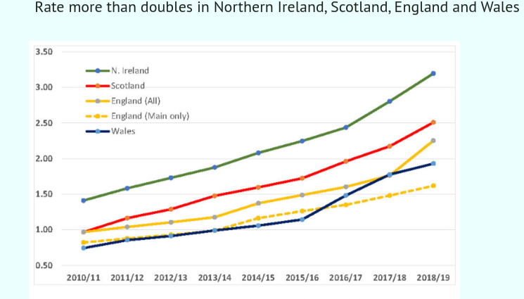
Background:
ASD was estimated to affect 1 in 44 children between 2009 and 2017, and 17% of children aged 3 to 17 in the UK were given the diagnosis of autism developmental impairment.
The National Council on Severe Autism (NCSA) report from 2010 to 2019 reveals that the rates of autism are rapidly increasing in England, Wales, Scotland, and Northern Ireland. By 2018/2019, Wales had the lowest rate (1.92%), England had the highest prevalence (3.20% of all students), Scotland had the highest rate (2.51%), and Northern Ireland had the lowest prevalence (3.20% of all students).

Slide 4
Methodology:
In this review, the qualitative research method was crucial in learning about people's experiences, journals, or articles on autism to understand and gather knowledge and information about the concept of "why lack of awareness causes more difficulties for autistic people living in the UK?" The systematic literature review was developed by following the PRISMA flow chart.
Key Concept relating to the Inclusion Criteria | Search terms Used as like: | Exclusion Criteria
Lack of Awareness | Why does lack of awareness cause autism in Uk? Or people misconception about ASD | Adult with ASD employment
Parents or family members concerns | Autistic people Experience or legislations or signs & symptoms | Autistic people benefit.
Autism related experience | Uk parents experience of their children receiving diagnosis | Outside UK parents experiences about diagnosis.
Methodology | Qualitative or Mixed Methods | Quantitively methods

Slide 5
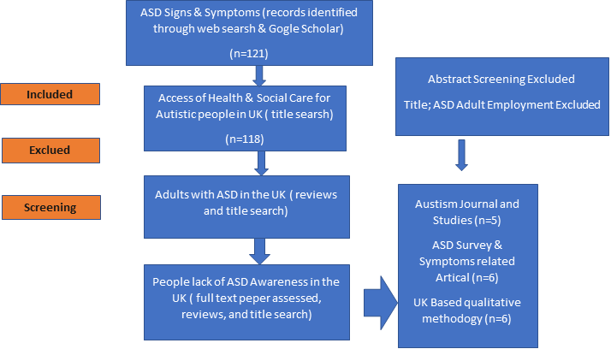

Slide 6
Result and Themes:
In the PRISM flow diagram, a total of 17 studies were included to review the research topic of the lack of awareness of ASD in the UK.
The studies were qualitative, with only two studies being quantitative (USA and Australia).
The major themes such as the ASD survey, misconceptions about ASD, theories about ASD, formal diagnosis from childhood to adulthood, parents' or family members' concerns, and their duties towards the person with autism, related articles or studies involved to provide a systematic literature review and a synthesis result of key findings across the research sources organised according to the research questions.

Slide 7
Concussion:
Does ignorance contribute to the issues faced by autistic persons in the UK? In order to, determine the cause of this lack of understanding and raise awareness among UK residents, this research offered a methodical literature review. A child with ASD presents special challenges for parents. Recognizing and acknowledging ASD might help the family cope with the situation because parents may feel overwhelmed by it.

Slide 8
References:
Available at: https://www.nhs.uk/conditions/autism/what-is-autism/
Available at: https://www.cdc.gov/ncbddd/autism/signs.html
Available at: https://www.ncsautism.org/blog//prevalence-of-autism-spikes-in-uk-schools
Available at: https://www.nimh.nih.gov/health/statistics/autism-spectrum-disorder-asd
Karaminis, T., Gabrielatos, C., Maden-Weinberger, U. and Beattie, G. (2022), ‘Portrayals of autism in the British press: A corpus-based study’, Autism, p.13623613221131752.
Legg, H. and Tickle, A. (2019) ‘UK parents’ experiences of their child receiving a diagnosis of autism spectrum disorder: A systematic review of the qualitative evidence’, Autism., 23(8), pp. 1897–1910. Available at: https://doi.org/10.1177/1362361319841488.
Lang, R., Machalicek, W., Rispoli, M. and Regester, A. (2009), ‘Training parents to implement communication interventions for children with autism spectrum disorders (ASD): A systematic review’, Evidence-Based Communication Assessment and Intervention, 3(3), pp.174-190.
Lord, C., Elsabbagh, M., Baird, G. and Veenstra-Vanderweele, J, (2018), ’Autism spectrum disorder’, The lancet, 392(10146), pp.508-520.
Lord, C., Brugha, T.S., Charman, T., Cusack, J., Dumas, G., Frazier, T., Jones, E.J., Jones, R.M., Pickles, A., State, M.W. and Taylor, J.L. (2020), ‘autism spectrum disorder’, Nature reviews Disease primers, 6(1), pp.1-23.
Malik-Soni, N., Shaker, A., Luck, H., Mullin, A.E., Wiley, R.E., Lewis, M.S., Fuentes, J. and Frazier, T.W. (2022), ‘Tackling healthcare access barriers for individuals with autism from diagnosis to adulthood’, Pediatric Research, 91(5), pp.1028-1035.
McLeod, S. (2020), ‘Lev Vygotsky's sociocultural theory’.
Mitchell, G.E. and Locke, K.D. (2015) ‘Lay beliefs about autism spectrum disorder among the general public and childcare providers’, Autism., 19(5), pp. 553–561. Available at: https://doi.org/10.1177/1362361314533839.
Reichow, B., Barton, E.E., Boyd, B.A. and Hume, K. (2014), ‘Early intensive behavioral intervention (EIBI) for young children with autism spectrum disorders (ASD): A systematic review’, Campbell Systematic Reviews, 10(1), pp.1-116.
Schünemann, H.J. and Moja, L. (2015), ‘Reviews: rapid! rapid! rapid!… and systematic’, Systematic Reviews, 4(1), pp.1-3.

