Slide 1

e-Business
Week 8
Supply Chain Management
“the premier application of e-business”

Slide 2
Outline
Key Underlying Business Principles of Supply Chain Management
Supply Chain Management in e-Business
Bullwhip Effect and Collaborative Commerce
Notes:
This class is a summary for SCM, with focus on E-SCM and concept of collaborative commerce
Bullwhip effect refers to oscillating demand amplification upstream the supply chain.

Slide 3
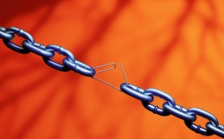
Defining Supply Chain
Supply chain: The flow of materials, information, money, and services from raw material suppliers through factories and warehouses to the end customers
A supply chain is the network of activities that deliver a product/service to the customer
  Sourcing of: raw materials, assembly, warehousing, order entry, distribution, delivery
Notes:
Chaffey 2007: 267 maintains that SCM involves the coordination of all supply activities of an organisation from its suppliers and delivery of products to its customers. Thus, one can distinguish between upstream supply chain (i.e. transactions between an organisation and its suppliers and intermediaries which are equivalent to the buy-side e-commerce) and downstream supply chain (i.e. transactions between an organisation and its customers and intermediaries which are equivalent to the sell-side e-commerce).
The value chain concept is closely related to SCM. It considers how value can be added both between and within elements of the supply chain and at the interface between them. In particular, procurement and inbound logistics fall within the upstream SC whilst sales, outbound logistics and fulfilment fall within the downstream SC.

Slide 4
Supply Chains & SCM
Supply Chain Management (SCM) is the business function that coordinates all of the network links
Coordinates movement of goods through supply chain from suppliers to manufacturers to distributors to final customers
Notes:
Chaffey 2007: 267 maintains that SCM is the coordination of all supply activities of an organisation from its suppliers/partners to its customers and that supply chain is concerned with material and information flows. One can distinguish between upstream (i.e. transactions between an organisation and its suppliers and intermediaries equivalent to buy-side e-commerce) and downstream supply chain activities (transactions between and organisation and its customers and intermediaries equivalent to sell-side e-commerce).
The links between an organisation and all partners involved in multiple supply chains are referred to as supply chain networks.
The key issues identified as areas to be concerned about –
Profitability, cost management, customer satisfaction, and a shift in global supply chain realities about flexibility

Slide 5
Goal of SC and SCM
Goal: match demand with supply
Maximize value & lower waste
Reducing operational costs, transferring the saved cost to add value to customers, increasing profitability.
Value proposition
Notes:
The key thrust of SCM is to provide a superior value proposition to the customer of which efficient consumer response (ECR) is one method. Some of the key objectives of ECR include: a) timely, accurate, paperless information flows; b) smooth continual product flow matched to variations in consumption levels; c) optimise inventories; d) optimise for time and cost in the ordering process; e) maximise effectiveness of new product development. Overall SCM provides great opportunities to improve product performance and deliver superior value to customers. As a result, SCM can dramatically have an impact on profitability by reducing operating costs and increasing customer satisfaction and, therefore, company revenues.

Slide 6
Key Activities for each component of SCM
Upstream Supply Chain
Transactions between an organisation and its suppliers and intermediaries; logistics
activities of a manufacturing company with its suppliers
Internal Supply Chain
Internal collaboration for processing, purchasing, planning, quality assuring, shipping.
in-house processes for transforming the inputs from the suppliers into the outputs
Downstream Supply Chain
Transactions between an organisation and its customers and intermediaries
activities involved in delivering the products to the final customers
Notes:
As well as upstream and downstream supply chain, there is also an internal supply chain which essentially refers to internal processes for transforming inputs into outputs. Nowadays, many SCM activities are being outsourced and organisations tend to carve out specific core competencies within their SC. Indeed, according to Van de Ven (2005) competition has shifted from between individual firms to between networks of firms.
Because of the shift to network of firms sometimes called the networked organisation this is where the value network as come from, again the shift from value chain to value network or value web.

Slide 7
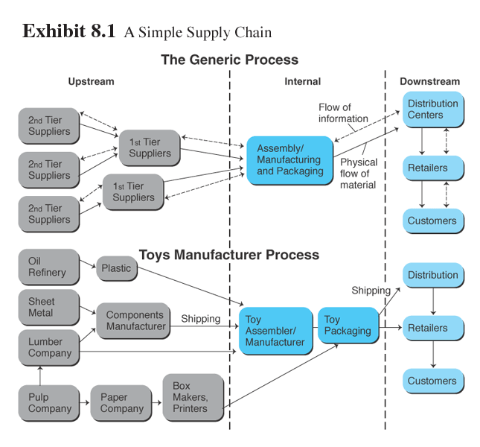
Supply Chain
Turban (2004), Prentice Hall
Notes:
The above is a snapshot of a toys manufacturer which has first and second tier suppliers and possibly first and second tiers customers. In these cases it is better to speak of supply chain networks (i.e. links between an organisation and all partners involved in multiple supply chains).

Slide 8
Push or Pull?
Push is more Supply-driven
  Push model enables mass production to every potential customers.
Pull is more Demand-driven
  Pull model enables customization right to each individual customer
Notes:
Push model: a supply chain that emphasises distribution of a product to passive customers. This approach strives for mass production (and therefore economies of scale).
Pull model: customers are actively involved in product and service specification. This approach strives for mass customisation.

Slide 9
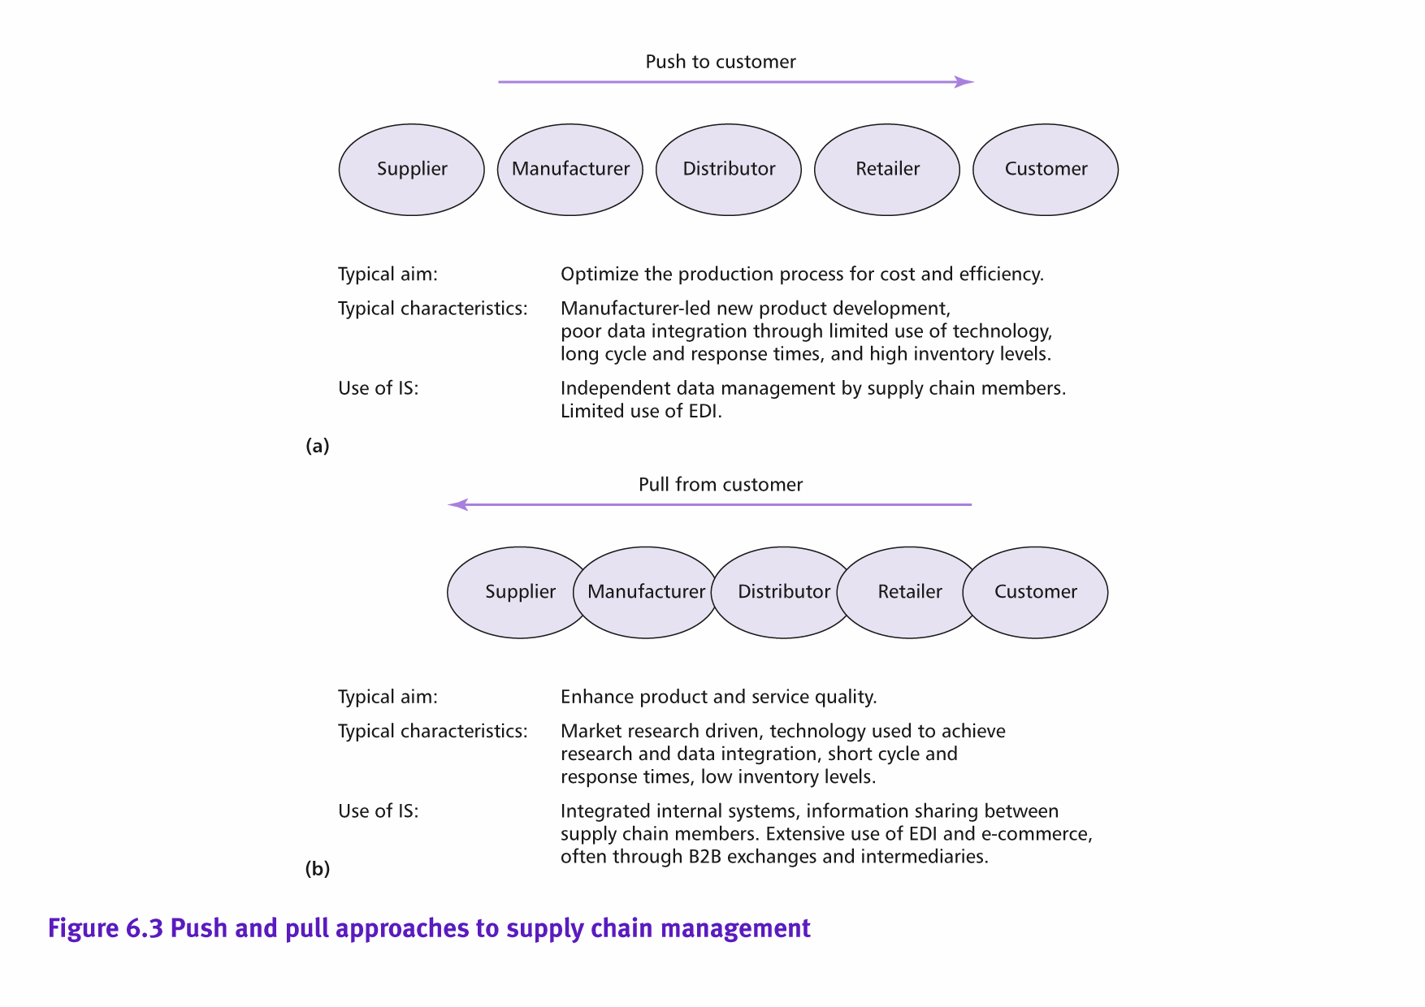
PUSH AND PULL SCM MODELS
Chaffey 2015
Notes:
There has been a move from push models of selling to pull models or combined push-pull approaches.
The push model is illustrated by a manufacturer who develops an innovative product and then identifies a suitable target market. A distribution channel is then created to push the product to the market. The aim of a push approach is to optimise the production process for cost and efficiency.
The alternative approach is focused on the customer's needs and it starts with analysis of their requirements through market research and close cooperation with customers and suppliers in new product development Here the supply chain is constructed to deliver value to the customer by reducing costs and increasing service quality.
The aim of a pull approach is to optimise the production process for customer response, cost and efficiency

Slide 10
Push vs Pull
In summary –
The supply chain is becoming part of the organisation marketing capability.
Its not just the value proposition but the supply chain that allows that to happen.
Notes:
Global Supply Chain Challenges
As companies look to amplify growth and expand quickly into promising new markets, they will have to take a hard look at what their current supply chains are capable of, and whether those capabilities are enough to support global competition

Slide 11
Evolution of SCM
Untill 1970s, logistics mainly focused on movement of finished goods
  Stock control, warehousing, distribution treated as separate activities
1970s on: introduction of JIT and MRP
  MRP integrates the various operational IS to maintain optimum level of all resources (inventory management was key)
Notes:
MRP: Manufacturing Resource Planning (effective planning of all resources where financial resources are in $/£ or Euros and operational planning in units)

Slide 12
Evolution of SCM
JIT (Just In Time) manufacturing aims as far as possible to eliminate inventory
MRP systems facilitate this by integrating the information systems that handle:
  Customer orders
  Production scheduling
  Supplier orders
  Transportation
  Storage
Notes:
Why do you not want inventory sitting around?
It costs to have inventory, holding costs, admin costs, warehouse costs, lack of demand may have unwanted good in storage.

Slide 13
Evolution of SCM
From 1990s on, ERP software (eg SAP) enabled overall SCM
These systems integrate the business and also interface with suppliers’ systems
They also changed the Supply chain emphasis:
  From manufacturer-led ‘push’
  to customer-led ‘pull’.
Notes:
According to Ko et al. (2006) ERP aims to improve internal efficiency by integrating different parts in the organisation while SCM focuses on external relationships with trading partners in the supply chain (SC). Technologically, ERP is said to be the backbone of SCM. As they rely on a very similar framework such as intranet, extranet and EDI, it is possible and feasible to integrate them.
In the 21st century, single companies no longer compete with each other but different SCs compete against each other. Thus, companies must position themselves into a competitive SC. See Van de Ven’s (2005) article.

Slide 14
E-supply chain:
SC in e-Business
E-supply chain: A supply chain that is managed electronically, usually with Web technologies
It includes e-commerce, e-procurement, e-manufacturing, e-collaboration and e-operations
Notes:
Based on the process supported by Internet tools, it is possible to distinguish between e-commerce (i.e. support to sales, distribution and customer service), e-procurement (i.e. support to sourcing, procurement, tendering and order fulfilment processes) and e-manufacturing (i.e. supporting demand and capacity planning, forecasting and internal supply chain integration) and e-collaboration (i.e. the use of the Internet to strengthen the relationships along the supply chain). Cagliano et al. (2005) have identified e-commerce (sales and customer service and support), e-procurement (procurement of strategic and standard parts through the Internet) and e-operations (i.e. the operational activities across the value chain including order processing and tracking, production planning and scheduling, inventory management and transportation planning). However, they note that the adoption of the Internet is higher in downstream and upstream processes while is lower within the company (e-operations).
Cgaliano et al. (2005) have also identified 4 main e-business strategies along the supply chain: a) traditionals; b) e-sellers (downstream integration); c) e-purchasers (e-procurement systems adopted upstream); d) e-integrators: companies that integrate both internal and external operations along the value chain. According to them, Internet adoption generally follows incremental strategies that go from a limited to a wider use of e-business tools along the supply chain, starting from external processes and subsequently integrating internal ones. In addition, e-integrators seem to be characterised by extensive information sharing and system coupling both upstream and downstream the value chain.

Slide 15
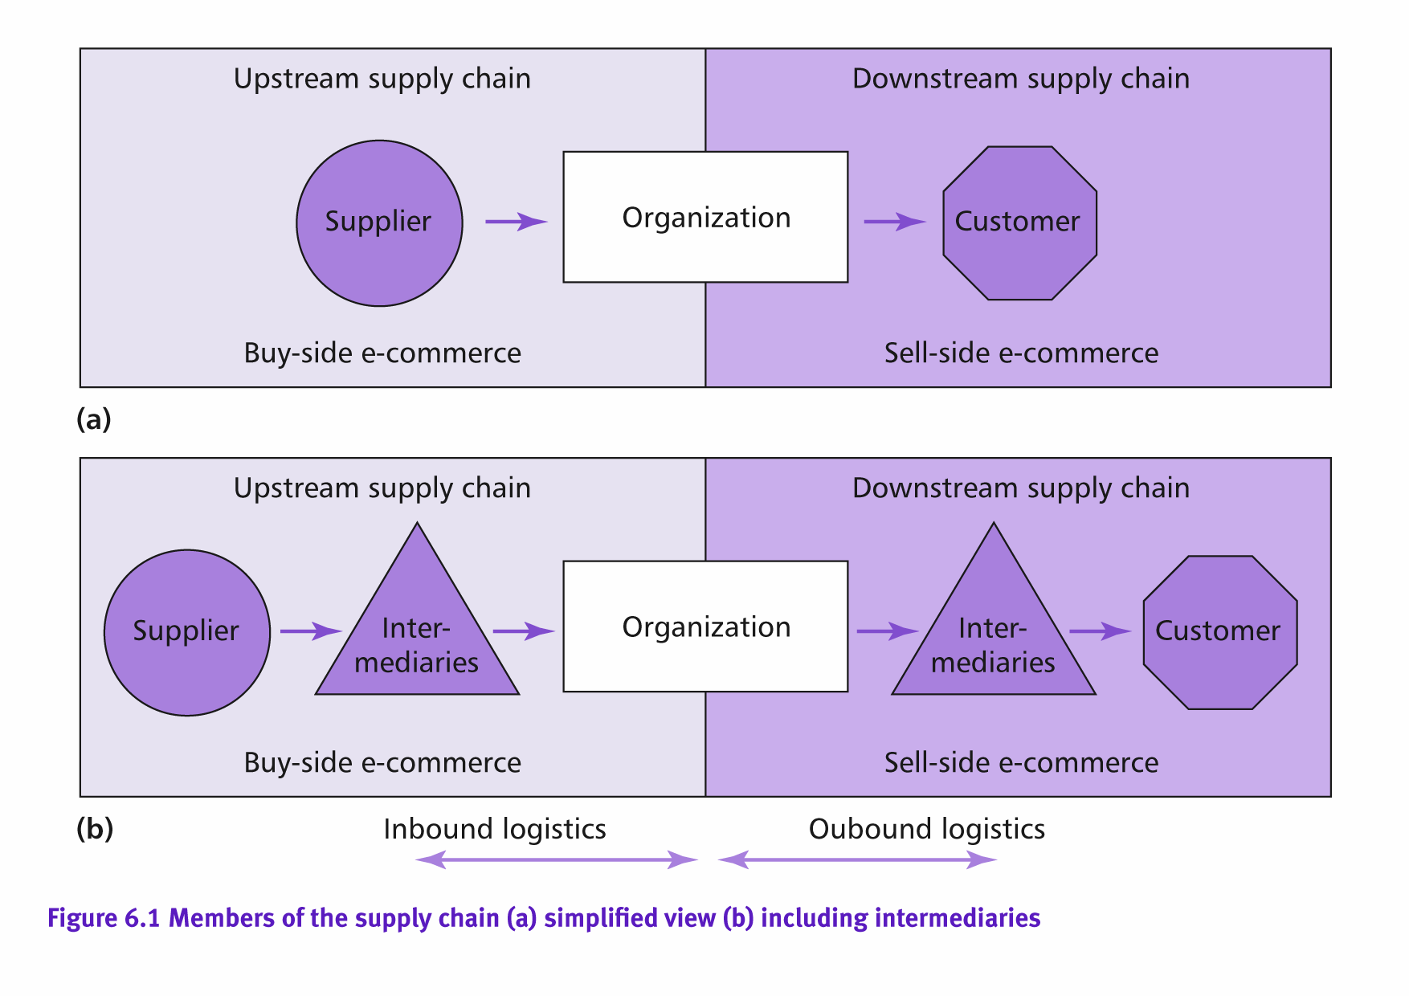
Notes:
See Chaffey 2007: 68.

Slide 16
Upstream supply chain:
Disintermediation offers the opportunity to buy direct from the supplier with reduced costs and shorter cycle times.
Reintermediation offers the chance to use business-to-business exchanges to source products at lower costs.
Downstream supply chain:
Disintermediation offers the opportunity to sell direct to the customer with lower cost of sales and improved lead time for customers.
Reintermediation offers the opportunity to compete in new marketplaces through B2B exchange

Slide 17
Key Activities of SCM in e-Business
Upstream Supply Chain
buy-side e-commerce (B2B with E-procurement)
Collaboration with Suppliers
Managing relationship with suppliers (SRM)
Internal Supply Chain
Internally – B2E and ERP
Processing, purchasing, planning, quality, shipping…..
Downstream Supply Chain
Sell-side e-commerce (B2C/B2B)
Collaboration with Distributors and/or retailer by SCM
Further extended to manage customers relationship with (CRM)
Notes:
SRM= Supplier Relationship Mgmt
B2E= Business to employee

Slide 18
Main goals of SCM in e-Business
Business: Achieve the Goal of Business:
  Reducing operational costs
  Add value to customers
Technology: System Integration of Buy-side E-commerce and Sell-side E-commerce from upstream to downstream.
Notes:
An example of reduced operational costs is to resort to outsourcing (a company can outsource or use virtual integration to transfer assets and costs such as inventory holding costs to third parties). Technology is also an enabler in forming value networks, thus making it faster to change suppliers on the basis of cost and quality.
Technology: improved data integration between elements of the SC (e.g. reduced costs of paper processing), increased efficiency of individual processes, etc.

Slide 19
The Enabling Technologies in Supply Chain
    The need for IT systems to communicate within an organization led to the evolution of enterprise application integration (EAI).
    EAI is the process of creating an integrated infrastructure for linking disparate systems, applications, and data sources across the corporate enterprise.
    EAI enables to share seamlessly and exchange data between ERP, CRM, SCM, databases, data warehouses, and other important internal systems within the company
    Portal Integration (PI, the Corporate Portal)

Slide 20
Cross Docking
In 1979
  Kmart had 1891 stores and average revenues per store of $7.25 million
  Wal-Mart was a small niche retailer in South USA with only 229 stores and average revenues under $3.5 million
10 Years later
  Wal-Mart had
    highest sales per square foot of any discount retailer
    highest inventory turnover of any discount retailer
    Highest operating profit of any discount retailer.
    Today Wal-Mart is the largest and highest profit retailer in the world
  Kmart ????

Slide 21
What accounts for Wal-Mart’s remarkable success
A focus on satisfying customer needs
  providing customers access to goods when and where they want them
  cost structures that enable competitive pricing
This was achieved by way the company replenished inventory the centerpiece of its strategy.
Wal-Mart employed a logistics technique known as cross-docking
  goods are continuously delivered to warehouses where they are dispatched to stores without ever sitting in inventory.
This strategy reduced Wal-Mart’s cost of sales significantly and made it possible to offer everyday low prices to their customers.

Slide 22
Characteristics of Cross-Docking:
Goods spend at most 48 hours in the warehouse
Cross Docking avoids inventory and handling costs,
Wal-Mart delivers about 85% of its goods through its warehouse system, compared to about 50% for Kmart
Stores trigger orders for products.

Slide 23
The Enabling Technologies in Supply Chain
B2B Exchange Standard:
  Electronic Data interchange –EDI
    Enables the computer-to-computer exchange between two organizations of standard transactions.
  XML-based B2B exchange (XML-based Web Services Infrastructure)
    the latest technology that enables EAI and PI
    Improve EDI
Notes:
PI= Portal integration.
Recall that XML (eXtensible Markup Language) is a standard for transferring structured data. It can therefore enable the electronic exchange of structured data between the computer systems of separate organisations. Electronic communications enable value networks to be created that enable the external value chain to be dynamically updated in response to marketplace variables.
Electronic communications have facilitated new models of SCM (for example, EDI and Web-based tracking/ordering). In particular the deployment of EDI & web-based applications enables:
More efficient, lower-cost execution of processes;
Disintermediation;
Improved data integration;
Dynamic outsourcing of non-core activities.

Slide 24
E-PROCUREMENT
E-PROCUREMENT
The electronic integration and management of all procurement activities including purchasing request, authorisation, ordering, delivery and payment between a purchaser and a supplier
Chaffey, 2007:309
Notes:
1. E-procurement does help drive down costs, trigger process improvements and enable
restructuring of supply chains. Every aspect of transactional purchasing, can be carried out
electronically.
2. There are also indirect benefits from e-procurement as it should reduce the cycle time between order and use of supplies. In addition, e-procurement may enable greater flexibility in ordering goods from different suppliers according to best value.
3. However, there is also a much more strategic perspective associated with information
transparency, supplier connectivity and the creation of trading alliances for competitive
advantage.

Slide 25
E-PROCUREMENT
Considered as :
  a structural enabler for re-engineering the traditional procurement process
  the means for conducting business electronically across the upstream supply chain between buyers and suppliers
Five Rights of Purchasing:
  Right price
  Delivered at the right time
  Right quality
  Right Quantity
  From the Right source
Notes:
EPS (e-procurement systems): electronic systems used to automate all or part of the procurement function by enabling the scanning, storage and retrieval of invoices and other documents; management of approvals, routeing of authorization requests, interfaces to other finance systems, and matching of documents to validate transactions.
Options for introducing e-procurement include:
sell-side e-procurement: whenever buyers purchase directly from the seller’s website without the need for integration between procurement systems;
buy-side e-procurement: integration of sellers’ catalogues with buyers’ procurement systems;
marketplace procurement: trading through an intermediary with many suppliers whose systems may or may not be integrated with buyers’ procurement systems. Covisint, for example, has evolved from a marketplace portal to a hosted e-procurement service (see Chaffey 2007: 326-328).

Slide 26
How important is procurement?
‘We estimate that for every dollar a company earns in revenue, 50 cents to 55 cents is spent on indirect goods and services – things like office supplies and computer equipment.
That half dollar represents an opportunity: By driving costs out of the purchasing process, companies can increase profits without having to sell more goods.’ Hildebrand (2002)

Slide 27
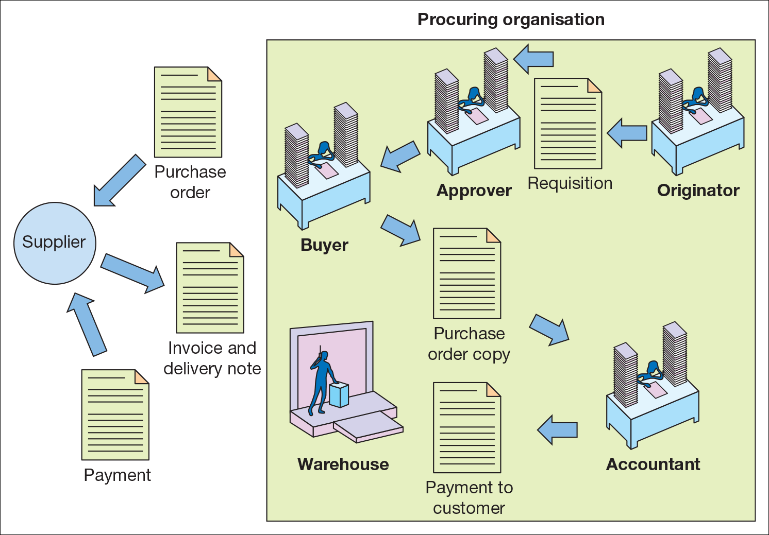
Figure 7.1 Key procurement activities within an organisation

Slide 28
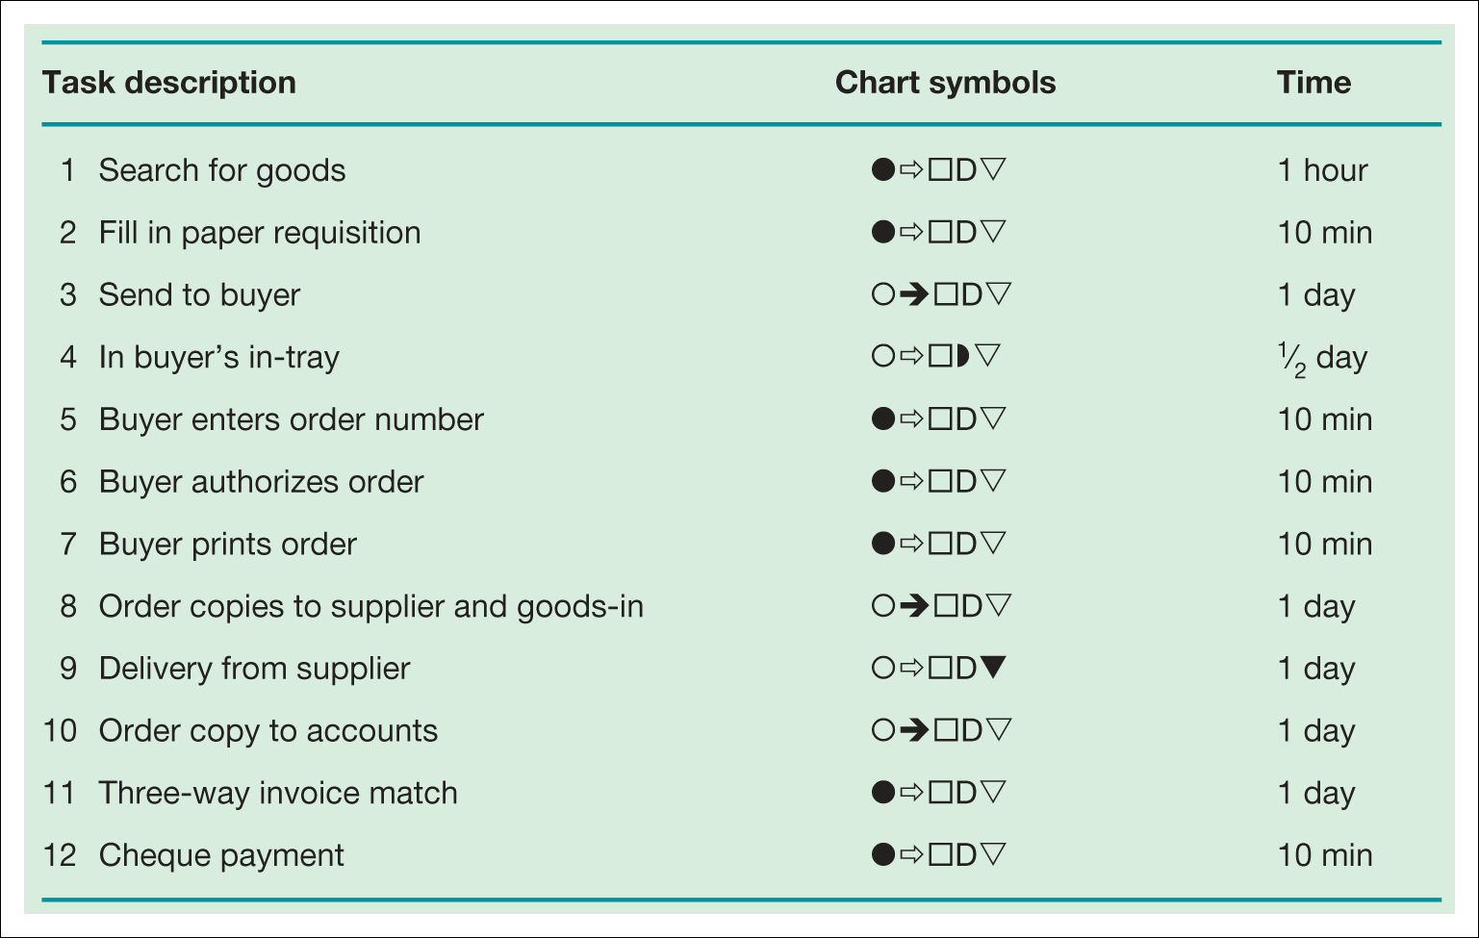
Table 7.1 Process flow analysis for traditional procurement (typical cycle time,
5¹⁄₂ days)
Note: see Table 7.2 on p.302 for key to symbols.
Notes:
Insert Table 7.1

Slide 29
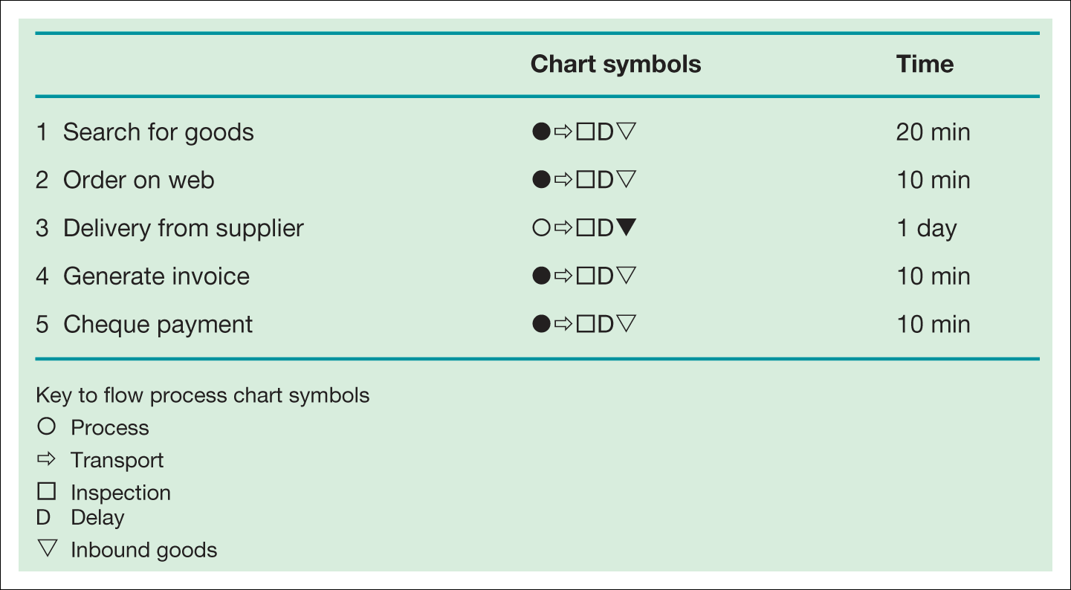
Table 7.2 Process flow analysis for new procurement (typical cycle time, 1¹⁄₂ days)
Notes:
Insert Table 7.2

Slide 30
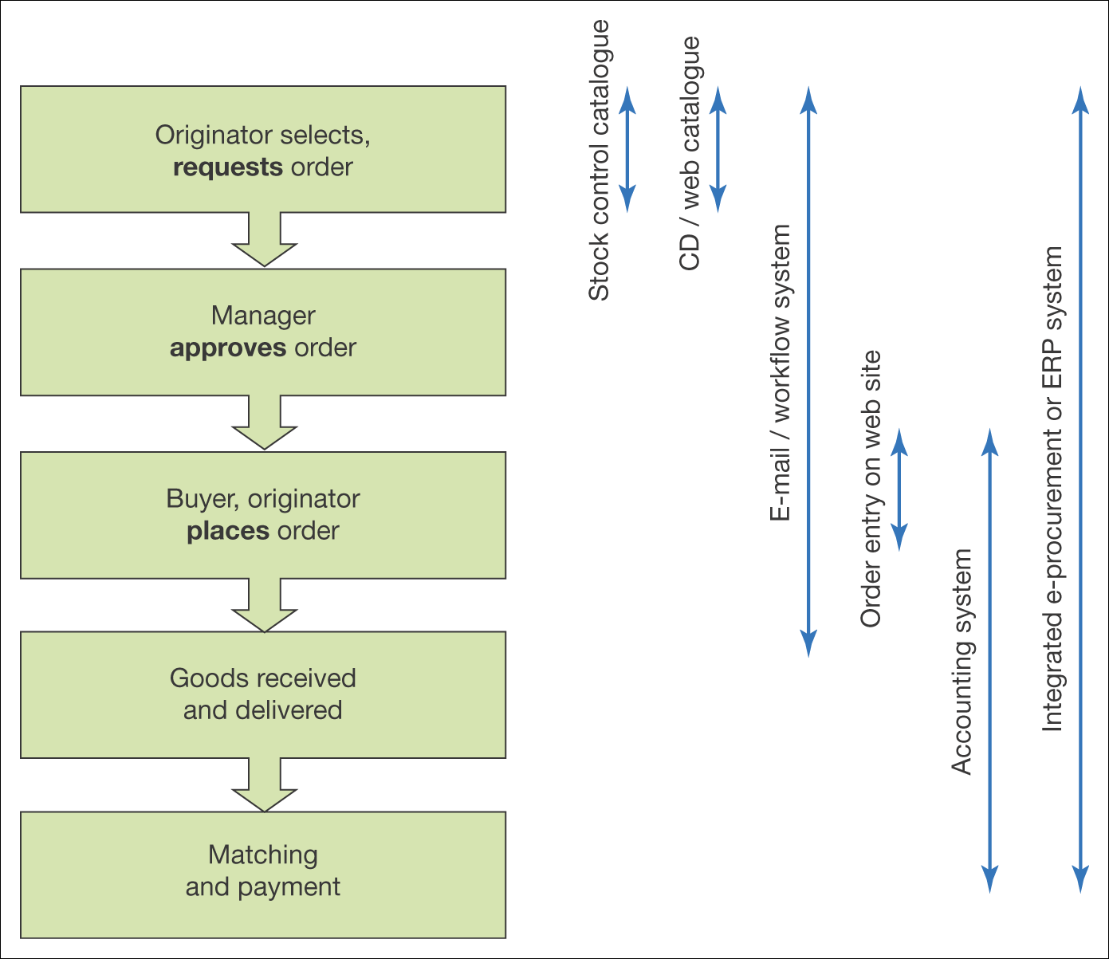
Figure 7.3 Use of different information systems for different aspects of the
fulfilment cycle

Slide 31
Collaborative Commerce
Collaborative commerce
(c-commerce): The use of digital technologies that enable companies to collaboratively plan, design, develop, manage, and research products, services, and innovative EC applications
Notes:
This can be linked with collaboration platforms

Slide 32
Collaborative Commerce (cont.)
Collaboration can be done both between and within organizations.
Collaborative platform can help in communication and collaboration between
  headquarters and subsidiaries
  franchisers and franchisees
The platform provides around the globe
  e-mail
  message boards and chat rooms
  online corporate data access
Notes:
An example tool I ProjectPlace

Slide 33
Collaborative Commerce (cont.)
Major benefits are: cost reduction, increased revenue, better customer retention
As a result of:
  fewer stock outs
  less exception processing
  reduced inventory throughout the supply chain
  lower materials costs
  increased sales volume
  increased competitive advantage
Notes:
Generally the rules allow for the majority of the events to be automated

Slide 34
Collaborative Commerce (cont.)
Information sharing between retailers and suppliers: P&G and Wal-Mart
  Wal-Mart provides P&G access to sales information on every item P&G makes for Wal-Mart
  Accomplished electronically
    P&G has accurate demand information
    Wal-Mart has adequate inventory
Notes:
Usually RFID (Radio frequency identification) technologies are being used to provide access to sales information along the supply chain. RFID are microchip-based electronic tags used for monitoring anything they are attached to (either products or even people).

Slide 35
Corporate (Enterprise) Portals
Corporate (enterprise) portal: A gateway for entering a corporate Web site, enabling communication, collaboration, and access to company information
Corporate portals offer employees, business partners, and customers an organized focal point for their interactions with the firm
Notes:
Portal (see Chaffey 2007: 41): an intermediary site focused on providing a gateway to other information on other sites but also often providing its own content and services (e.g. search engines, ISPs, online newspapers and magazines).

Slide 36
Corporate (Enterprise) Portals (cont.)
Corporate portal applications
  knowledge bases and learning tools
  business process support
  customer-facing (front-line) sales, marketing, and services
  collaboration and project support
  access to data from disparate corporate systems
Personalized pages for various users
effective search and indexing tools
security applications
best practices and lessons learned
directories and bulletin boards
identification of experts
news
Internet access
Notes:
e.g. TallyFox portal

Slide 37
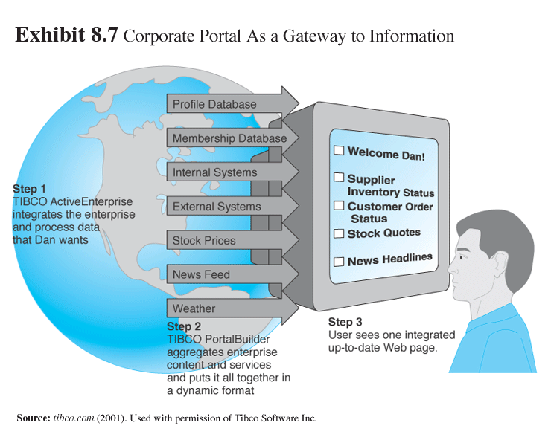
Collaborative Planning and Fulfillment

Slide 38
The BullWhip Effect
Bullwhip effect refers to oscillating demand amplification upstream in the supply chain.
  Reduction in the Bullwhip Effect
    Reduction in Inventory
    Improved service level
    Better utilization of Resources

Slide 39
Hewlett-Packard Co. and Dell Inc. saw February sales plunge by 10% -15%. Analysts add that PC makers incorrectly assumed that laptops were so hot that they were immune from the post-Christmas sales slump that has traditionally afflicted desktops.”
In the example if PC makers are able to pass timely and accurate information to their parts suppliers, perhaps the sudden swing in supplying computer parts could be avoided.
Many companies don’t want to give up too much of their information because they fear that outsiders will compromise the information. Unfortunately, this way of old-style thinking costs too much money in terms of lost opportunities, overstocked and underused parts, and overpriced products.
(BusinessWeek, March 15, 2004)
Laudon and Laudon 2014

Slide 40
Business Value of SCM Systems
The benefits of implementing an integrated, supply chain management system include:
Match supply to demand - this has the Ability to increase processes in pull phase
Reduce inventory levels
Improve delivery service
Speed product time to market
Use assets more effectively
In turn, a company can:
Improve customer service and responsiveness
Reduce costs
Increase sales
Utilise cash better
Laudon and Laudon 2014

Slide 41
Supply Chain Management
Technologies
SAP
Oracle
Microsoft Business Solutions Navision

Slide 42
Retailers Upstream Supply Chain
Tesco’s Upstream Supply Chain – Tesco Information Exchange (TIE)
Sainsbury – Sainsbury Information Direct
Safeway – Safeway Supplier Information Service
Notes:
How can information systems support the supply chain?
Information systems are used to increase the efficiency of information flow by:
• Delivering more information (e.g. sales data in Tesco TIE system).
• Analysing information (e.g. alerting a large order).
• Delivering it more rapidly (e.g. reduced lead times in e-procurement).

Slide 43
Seminar
RFID technology in the supply chain
The BullWhip Effect
Tesco Supply Chain Case Study

