Slide 1
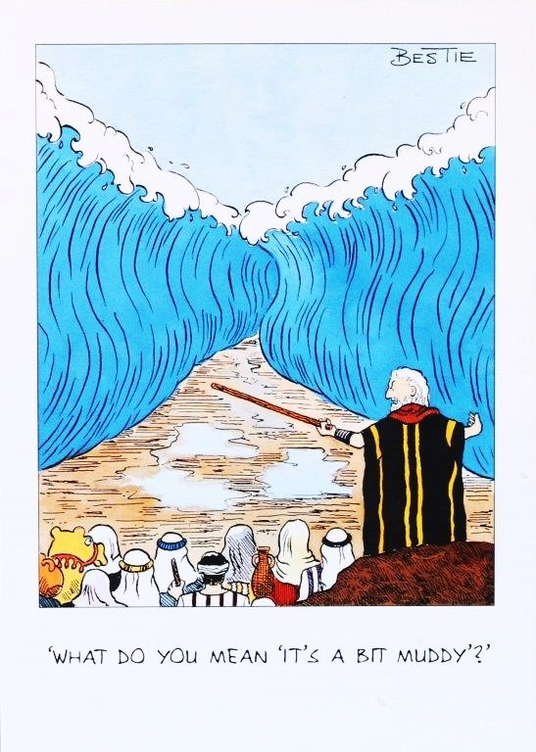
Leadership

Slide 2
Manager vs Leader
Manager
Leader
Implements
Does things right
Rational
Transactional
Concerned with means
Maintaining agreements
Static Orientation
Achieves desired outcomes by means of influence as feature of contractual exchange – extrinsic motivation
Shapes
Does the right thing
Emotional commitment
Transformational
Concerned with ends
Future aspiration
Dynamic orientation
Management of meaning by means of vision, inspiration, symbols, empowerment, trust – extrinsic motivation

Slide 3

Activity 1
Think about leaders and managers from private and public life.
  Whilst making a list of their names consider their characteristics
  Which of these characteristics do you admire and…
  Which of these characteristics do you dislike

Slide 4
Definition of Management
‘To manage is to forecast and plan, to organise, to command, to coordinate and to control’ (Fayol, 1916 cited in Cole,1996)
‘as a process of planning, organising and staffing, leading, and controlling actions to achieve goals.’(Dubrin, 2000 cited in kelly-heidenthal, 2004)
Notes:
Henri Fayol (1841-1925) French industrialist & theorist. Young mining engineer, worked for the same company all his life. Managing director at 47 and retiring on 77th birthday.
14 principles of management e.g division of work, authority, discipline, unity of command, unity of direction, remuneration, order, stability of tenure of personel, esprit de corps- harmony
kelly-heidenthall, american nurse for the last 40 years has been working in universities and parttime practitoner in A&E

Slide 5
A manager
The main aim of a manager is to maximise the output of the organisation through administrative implementation. To achieve this, managers must undertake the following functions:
organisation
planning
staffing
Directing/leading
controlling

Slide 6
Management
  Leading
    Influencing others to achieve the organisational goals, and involves energising, directing, persuading others to achieve those goals
  Controlling
    Comparing actual performance to a standard and revising the original plan as needed to achieve the goals
As professionals we need management skills whether we work alone or are team leaders

Slide 7
The difference?
"Managers do things right, while leaders do the right thing." [Pascale, 1990].
This means that managers do things by the book and follow company policy, while leaders follow their own intuition, which may in turn be of more benefit to the company. A leader is generally more emotional than a manager .
Notes:
"Leaders stand out by being different. They question assumption and are suspicious of tradition. They seek out the truth and make decisions based on fact, not prejudice. They have a preference for innovation." [4]

Slide 8

Think!
Equally a leader doesn’t have to be a manager.
Consider the team where you work…do you have both a leader and a manager or just the one. Is there conflict? Or compromise?

Slide 9
Overview of Orthodox Approaches
‘Great Men’ : possession of special traits
Style/Behaviour: concern for task/person
Contingency: choice of styles dependent on contingent factors
Transformational: inspire by managing meaning

Slide 10
Leaders for Change
Research shows that leaders need to both model and communicate their support for change. They must actively listen to the workforce and 'facilitate', and not necessarily 'direct' change (Fauth and Mahdon 2007).
Factors crucial for managers to implement change include:
  clarifying the reallocation of tasks
  allowing sufficient time for individuals to work out ‘who does what’
  ensuring that new tasks motivate staff
  keeping watch over the interpersonal ramifications of task reallocation
  working with the team to develop performance goals (Reay et al. 2003)
(SCIE)

Slide 11
Definition of Leadership
‘Leadership defines what the future should look like, aligns people with that vision, and inspires them to make it happen.’ (Kotter,1990)

Slide 12
Manager or Leader?
Zalesnik (Havard Business School)
  Manager motivates other people and administers resources to ensure company objectives are achieved
  Leader is involved in conceptual aspects, active rather than reactive, shaping ideas rather than responding to them
Notes:
Subordinate As A Leader
Often with small groups, it is not the manager who emerges as the leader. In many cases it is a subordinate member with specific talents who leads the group in a certain direction. "Leaders must let vision, strategies, goals, and values be the guide-post for action and behaviour rather than attempting to control others." [5]
When a natural leader emerges in a group containing a manager, conflict may arise if they have different views. When a manager sees the group looking towards someone else for leadership he may feel his authority is being questioned.
Loyalty
Groups are often more loyal to a leader than a manager. This loyalty is created by the leader taking responsibility in areas such as:
Taking the blame when things go wrong.
Celebrating group achievements, even minor ones.
Giving credit where it is due.
"The leader must take a point of highlighting the successes within a team, using charts or graphs, with little presentations and fun ideas" [6]
"Leaders are observant and sensitive people. They know their team and develop mutual confidence within it." [7]

Slide 13
The Leader Is Followed.
The Manager Rules
A leader is someone who people naturally follow through their own choice, whereas a manager must be obeyed.
A manager may only have obtained his position of authority through time and loyalty given to the company, not as a result of his leadership qualities.
A leader may have no organisational skills, but his vision unites people behind him.
A manager knows how each layer of the system works and may have good technical/practical knowledge

Slide 14
Team leaders and managers are responsible for bridging the gap between the vision at the top and the work at the front line (Tenkasi and Chesmore 2003), and therefore have a key role to play in making sense of the change and communicating plans to the workforce. Discuss.

Slide 15
Burns (1978)
Two types of leaders:
  transactional leader
    traditional manager concerned with day to day activities
  transformational leader
    leader who is committed to a vision that empowers others
    transformational leader is an extension of the transactional and charismatic leader (Bass, 1992)

Slide 16
Transformational leader
Motivates others by behaving in accordance with values, providing vision that reflects mutual values and empowering others to contribute
Identify themselves as agents of change; believe in people;are courageous; are lifelong learners;have the ability to deal with complexity;ambiguity and uncertainty; are visionaries (Tichy & Devanna, 1986)
Notes:
It can happen at any level of the organisation
is about innovation and change

Slide 17
Transactional
‘ The relations of most leaders and followers are transactional – leaders approach followers with an eye to exchange one thing for another: jobs for votes, or subsidies for campaign contributions. Such transactions comprise the bulk of the relationships among leaders and followers.

Slide 18
Transforming
‘Transforming leadership, while more complex than transactional, is more potent. The transforming leader recognises an existing need or demand of a potential follower. But, beyond that, the transforming leader looks for potential motives in followers, seeks to satisfy hunger, needs and engages the full person of the follower…’
Burns (1978)

Slide 19
Transforming
‘Moreover, these simple truths are expressed with conviction. The goal – or better still the vision – is rendered clear and it is made to seem both desirable and achievable. Organisational members are asked to forsake mediocrity and routine and aspire instead to reach a future state of such high achievement that it deserves the willing expenditure of extra discretionary effort and commitment.’
Storey (2004)

Slide 20
Transforming
‘…ordinary people achieving extraordinary things through the influence of the leader. This kind of leader reduces complexity, doubt, cynicism and ambiguity by cutting through to the essential elements, and these are expressed in simple, readily understandable language.’

Slide 21
Transforming
Individualised Consideration: Coaching, mentoring etc
Intellectual Stimulation: question the status quo, encourage imagination, creativity, logical thinking and intuition.
Inspirational Motivation: Clear vision, problems as opportunities, language and symbols…I have a dream…Ask not what your country can do for you etc. Go the extra mile.
Idealised influence (charisma): Confident in communicating a virtuous vision.
(Bass and Avolio, 1985)

Slide 22
Bennis (1985)
Management of Attention: ‘…they all had a strong, plausible and compelling vision of where they wanted their companies to go’ ‘the leader provides the important bridge from the present to the future of the organisation’
Management of Meaning: the ability to constantly communicate through the use of analogy, metaphor, vivid illustration

Slide 23
Management of Trust: ‘the emotional glue that binds the followers and leaders together’
Management of Self: ‘the learning leader looks forward to failure and mistakes…the worst problem in leadership is basically early success.’

Slide 24

Critique
Excessive, evangelical tone (leader single handedly steers the organisation through turbulent change and crisis)
Emotionally manipulate followers
Vision – blinkered attachment/surrounded by yes men who can’t challenge the vision
Elitist view that leadership and management are separate activities (indirectly reaffirms the trait theory of leadership and autocratic management styles)

Slide 25
Critique
Risky: putting power in the hands of one person – succession?
Not dependant on the organisation for their sense of who they are – they work in, but do not belong to the organisation
‘When times are particularly difficult or uncertain or changing rapidly the clamour for heroic leadership seems to rise, and the behavioural scientists seem to respond by dusting off the Leader as Monster theories yet again.’ (Statt 1994 p340)

Slide 26
References
Cole GA (1996) 5th Edition. Management Theory and Practice. Continuum.
Currie,G. and Lockett, A. (2007) ‘ A critique of Transformational Leadership: Moral, Professional and Contingent dimensions of Leadership within public service organisations,’ Human Relations 60 (2): 341-370
Handy C (1999) 4th Edition Understanding Organizations. Penguin
Institute of leadership and Management
Luthans F et al (1988) Teal Managers. Cambridge MA. Ballinger publishing
Mintzberg H (1979) The Nature of a Manager’s Work. Englewood Cliffs. NJ Prentice Hall
Pascale, R (1990) ‘ Managing on the Edge’, Penguin Book, pp 65,
Predpall, D (1994) ‘Developing Quality Improvement Processes In Consulting Engineering Firms’, Journal of Management in Engineering, pp 30-31, May-June
Van Wart, M. (2003) ‘Public-sector Leadership Theory: An Assessment,’ Public Administration Review, 63 (2): 214-226

