Slide 1
DSAW7043: Work-Based Project Management:Process
Anthony Gwyther
Work-based Learning Fellow – Anthony.Gwyther@tsd.ac.uk

Slide 2

Introduction to Workplace Project Management
Day 2

Slide 3
Recap of Last time
We covered:-
Project Manager role.
Team make up
Planning, task, schedule, budget.
Stakeholders.
Change management.
Risk Management

Slide 4
What is a project?
‘A unique set of co-ordinated activities, with definite starting and finishing points, undertaken by an individual or team to meet specific objectives within defined time, cost and performance parameters’
(Office of Government Commerce).

Slide 5
SCOPE
Project Deliverables
Quality
Time
Cost
RISK!!

Slide 6
What you Know
What you don’t know, but others might

Slide 7
Take home exercise:-
Pick a project, real or imaginary.
Conduct a stakeholder analysis.
Consider and list the change issues.
What will your acceptance strategy look like.
What is Mendolow’s matrix and why is it relevant?
15 minute feedback in class next time.

Slide 8
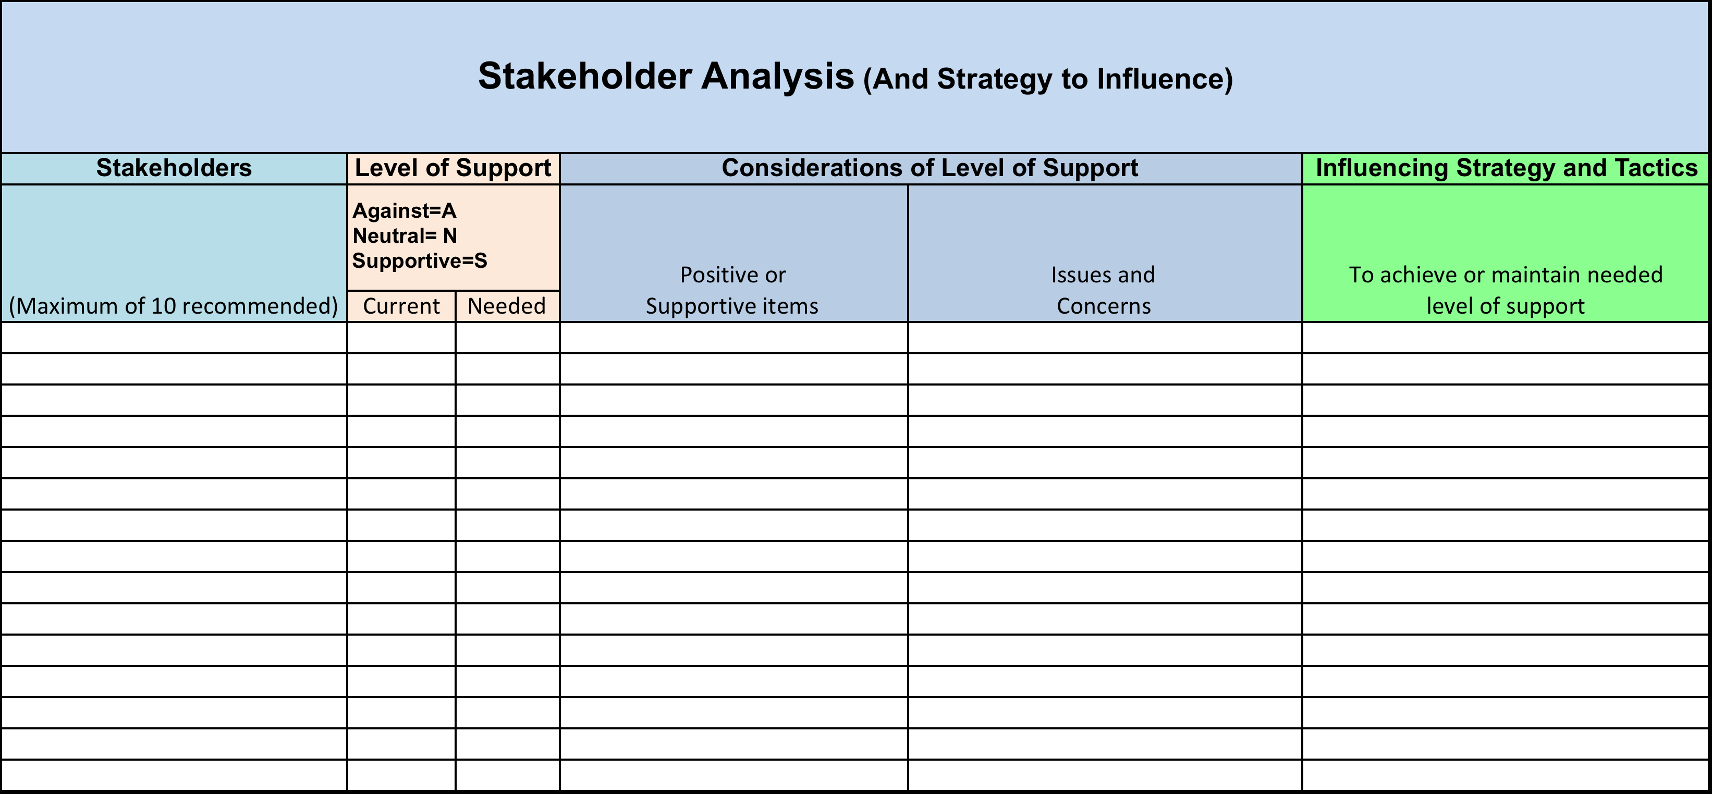

Slide 9
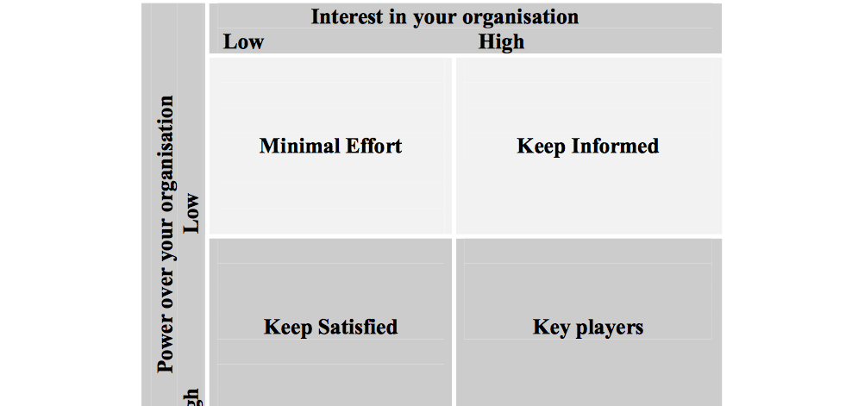
Mendelow’s Matrix

Slide 10
Aim of the day
Reinforce learning from previous day and to move into Project Execution, Monitoring and Controlling.
Objectives
Define the needs and outcomes of Execution phase
Introduce tools relevant for this phase of project management.
Additional Topic
Project Management Methodologies.

Slide 11
Some Reminders from Last Session

Slide 12
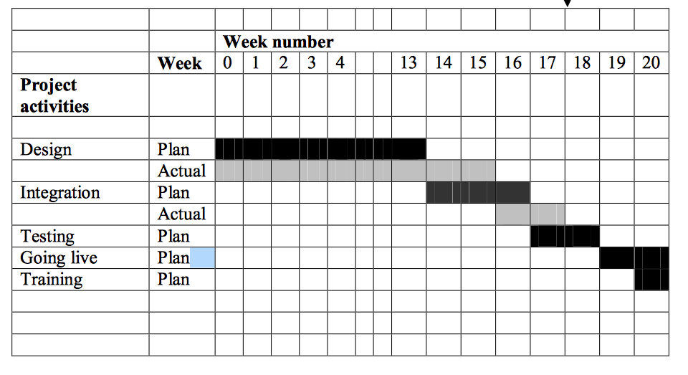
Example simple Gantt chart.

Slide 13
From Last time
Structural Tension Chart.
Ref:- Robert Fritz The Path of Least Resistance for Managers 1999

Slide 14
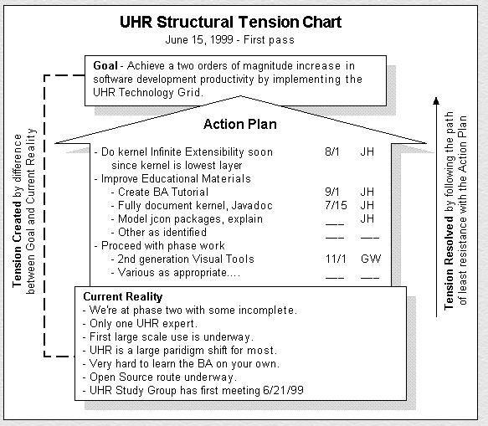

Slide 15
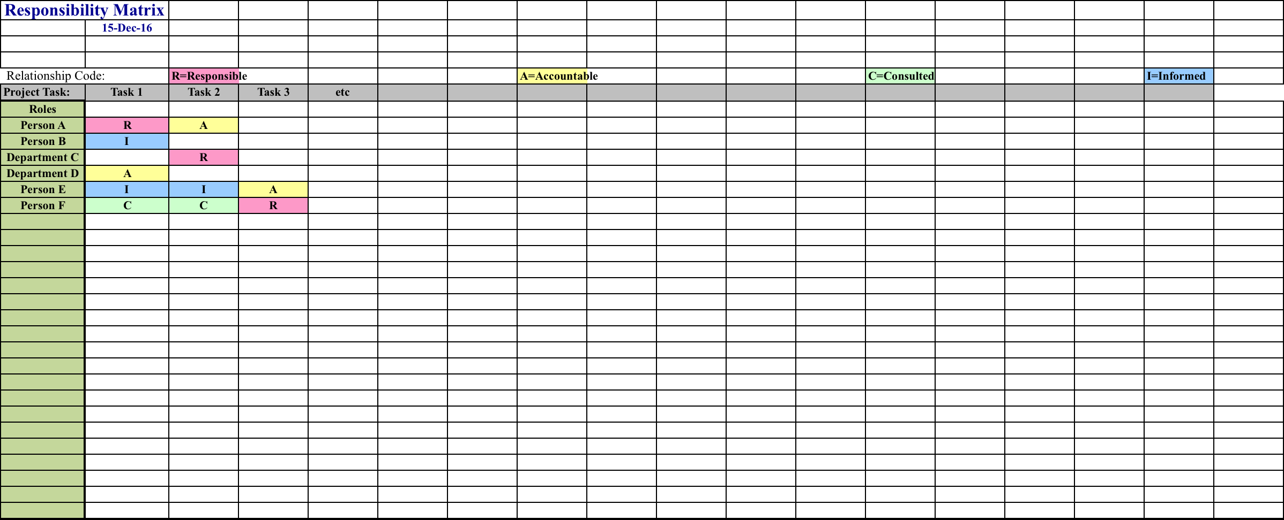
Responsibility Matrix
Great tool to pin down who does what
Can be used for today ‘ as is’ situation and ‘future state’ situation after project completion.

Slide 16
Risk
Before we go to Execution, Monitoring and Control.

Slide 17
Break.

Slide 18
Risk Management

Slide 19
Project Risk; an Opportunity or a Threat?

Slide 20
"Thinking is the hardest work there is............... which is probably the reason so few engage in it.”
Henry Ford

Slide 21
Project Risk Management
An important factor to consider.
Many people do not do it, or do it poorly
The big risks pertaining to a project can only be handled by the Project Manager/Stakeholders.
It Is Difficult!
It is ignored at your peril!
Structured or unstructured brainstorming is required.
Plan for the worst, hope for the best.

Slide 22
Considerations around Risk
An organization will not be able to fully eliminate or eradicate every risk.
There is certain degree of risk with every project
Each project will have its own set of risks to be dealt with.
The risk management process should not be compromised. If ignored it can lead to serious detrimental effects.
The entire project team and Stakeholders should be aware of the project risk and risk management methodology.
Enhanced education and frequent risk assessments are the best way to minimize the damage from risks.

Slide 23
Project Risk Management
Key Steps in Risk Management Process:-
Risk Identification.
Risk Quantification.
Risk Response.
Risk Monitoring and Control.

Slide 24
Risk Management Process
Considerations when it comes to risk management process:-
Each team member involved in the planning process needs to identify and understand the risks they see pertaining to the project.
Once the team members have given their list of risks, consolidate to a single list and remove the duplications.
Assess the probability and impact of the risks involved with the help of a matrix.
Split the team into subgroups where each group will identify the triggers that lead to project risks.
Devise contingency plans to eliminate the risks identified.
Plan the risk management process. Ideally Each person involved in the project is assigned a risk in which he/she identifies the triggers and then finds a suitable solution.

Slide 25
Risk Quantification
Risks can be evaluated based on quantity. At the simplest level Project Managers can analyse the likely effect of a risk with the help of a matrix.
Using the matrix, the project manager can categorize the risk into four categories as Low, Medium, High and Critical.
The probability of occurrence and the impact on the project are the two parameters used for placing the risk in the matrix categories.
As an example, if a risk occurrence is low (probability = 2) and it has the highest impact (impact = 4), the risk can be categorized as 'High'.

Slide 26
Risk Assessment Matrix
4
3
2
1
Medium | Critical
Low | High
Probability
1 2 3 4
Impact

Slide 27
Risk Categories
Scope Risk
Schedule Risk
Resource Risk
Financial Risk
Political and Environmental Risk
Supplier Risk
Customer Risk

Slide 28
1. Scope Risk
Scope risk would refer to risks associated with the scope being wrong or limited.
Scope creep
Scope being too constrained, so that it is impossible to achieve ‘only’ the objective stated.

Slide 29
2. Schedule Risk
Keeping to timelines and agreed critical paths is one of the most difficult situations.
Many Factors
Reliance on external parties whose input is not within the project manager’s scope of control.
Estimation errors, which most often are too optimistic
Hardware delays.
Putting off decision making. etc.
To minimize schedule risks:-
Break down tasks into small, clearly defined components (WBA) where the allocated time for each process is relatively short. (this makes it easy to identify things when tasks veer off schedule, at its earliest).
Be wary of team members or external parties, who hesitate to give estimates or whose estimates seem unrealistic. Use historical data and previous experience.
When formulating the critical path, ensure that holidays are in-built, create realistic expectations, right from inception.
Defining re-work loops too is also recommended, wherever possible.
Contingency time...rare but valuable if you can get it.

Slide 30
3. Resource Risk
The Risk associated primarily with the human resources used in the project
Availability in terms of numbers
Skill profile
Holidays or other dead periods
Absence and Sickness.
One or more critical people....... the only ones that can do certain tasks!

Slide 31
Resource Risk contd.
People and funds are any project's main resource base.
If the people are unskilled or incompetent to perform the task at hand
If the project is under-staffed from the beginning, or
if key project members come on aboard far after the inception of the project, this is a risk to the project.
placing undue expectations on the capacity of the staff in question and avoiding burn-out
Similarly, from a financial perspective, if insufficient funds are provided to carry out the necessary tasks,
Relevant training programs for the people
Appropriate investments in technology or required machinery
Estimating project costs accurately, allocating a suitable budget to meet these costs up front.
Outsourced functions merit even more attention to detail, as it is for the most part, it is away from the direct view of the project manager.
Conflict management, which too generally arises with the progression of a project, needs to be handled in a skilful manner, so that the project has a smooth run throughout its entire duration.

Slide 32
4. Financial or Budget Risk
The risks that can occur if the costs are more than the approved budget.
Suppliers increasing their prices.
Global Materials changes e.g. Oil price.
Exchange rate changes
Tasks taking longer than expected time=money.
External factors causing delays or other effects.

Slide 33
5. Environmental or Political Risk
Risks associated with the outside world changing.
Changes to Laws or Regulatory Aspects.
Technology changes.
Ethical issues.
Pressure groups or protestors!
Trade Unions

Slide 34
6. Supplier Risk
Contingent on how critical 3rd party suppliers are to the project.
Supplier risk would refer to risks that can occur in case the supplier is not meeting the timeline or cost to supply the resources required.
Multiple Factors
  How reliable the supplier is.
  Quality of goods or services supplied.
  Financial stability
What happens if the supplier goes out of business?
Suppliers can be assessed and ranked, for selection purposes and risk. i.e. avoid the risk by picking the best supplier in the first place.
Clearly defined contracts and regular monitoring help mitigate.

Slide 35
Risk Response
The project manager can choose strategies that will minimise or remove the risks.
There are four risk response strategies:-
Risks that can be avoided.
Pass on the risk to another party.
Take corrective measures to reduce the impact of risks.
Acknowledge the risk but do nothing.

Slide 36
Risk Monitoring and Control
Risk Analysis is not a once off “do and forget” activity.
Risks can and should be monitored on a continuous basis to check if any changes are needed.
New risks should be identified through the constant monitoring and assessing mechanisms.

Slide 37
Risk Register
Good Practice is that project managers compile a document, which outlines the risks involved and the strategies in place. This document is vital as it provides a great deal of information.
Risk register will often consists of visual aids for the reader as to the types of risks that are envisaged and the course of action to be taken.
The risk register should be accessible for the project team.

Slide 38
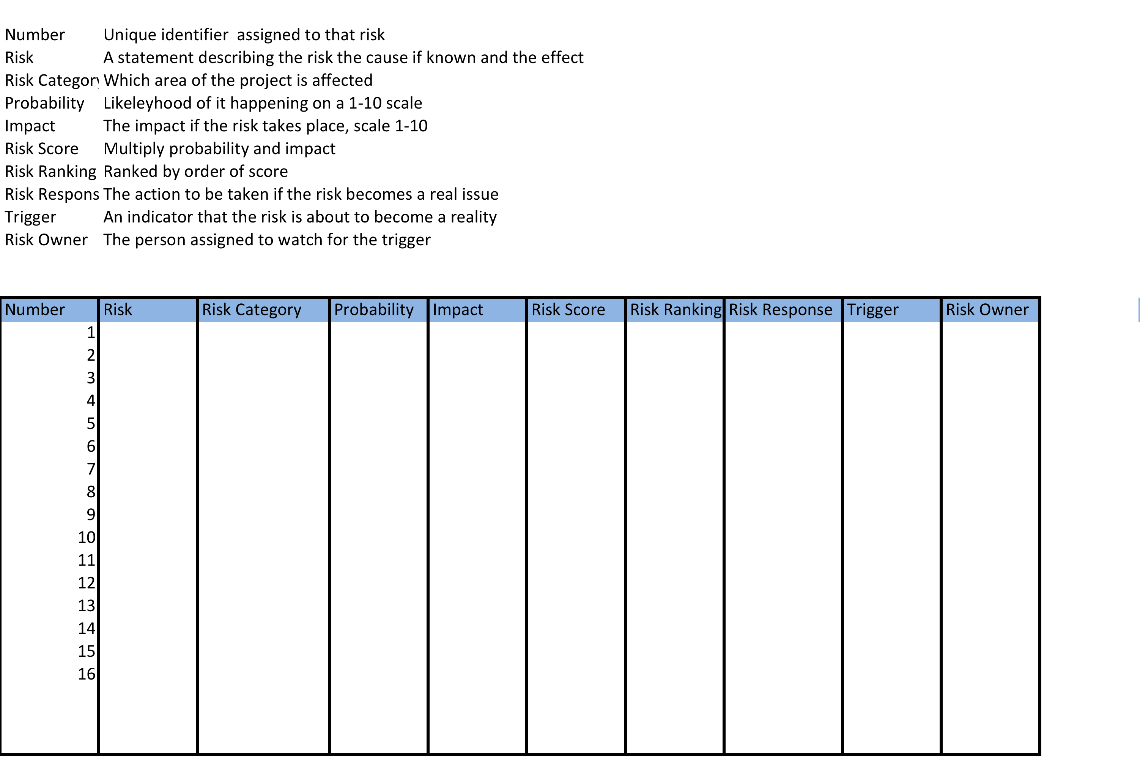
Risk Register Template

Slide 39
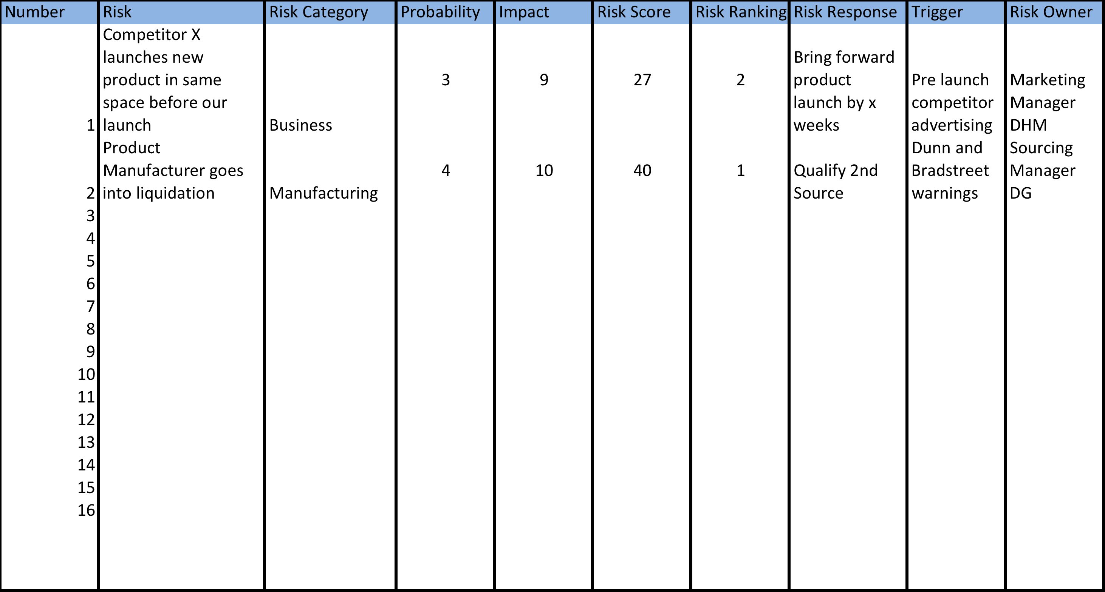
Example Risk Register

Slide 40
Exercise
Create a risk register for the process of getting up and getting to work on time!

Slide 41
Getting to Work – Process Map

Slide 42
Getting to Work – Process Map, cont.
fuel
fuel

Slide 43
Definition - FMEA
Failure Mode Effect Analysis
Primary objective:
  Identify ways a product or process can fail and the ways to eliminate or reduce the risk of failure
A structured approach:
  Estimating the risk associated with specific causes
  Prioritizing the actions that should be taken to reduce the risk
  Evaluating the design validation plan (Product) or the current control plan (Process)

Slide 44
FMEA History
First used in the 1960s in the U.S. Aerospace industry during the Apollo missions
In 1974 the Navy developed MIL-STD-1629 regarding the use of FMEA
In the late 1970s, automotive applications driven by liability costs

Slide 45
Where Do Risks Come From?
Potential Safety Hazards
Poor control plans & SOP’s
Unclear Customer Expectations
Poor Process Capability
Cumulative Risk
Raw Material Variation
Vague Workmanship Standards
Poorly developed Specification Limits
Machine Reliability
Measurement Variation (Online and QC)
D. H. Stamatis, FMEA:FMEA from Theory to Practice, Quality Press, 1995

Slide 46
Definition of Terms
Failure Mode
  What went wrong in the process?
Effects of Failure
  What are the impacts of the failure occurring?
Cause of Failure
  What are the potential causes of this failure?
Current Controls
  What controls or procedures exist to prevent the cause or failure mode?
Severity, Occurrence, Detection
  Risk Priority Number (RPN)

Slide 48

Project Management
The stages typically seen in a project:-
  Initiation
  Planning and Design
  Execution
  Monitoring and Controlling
  Delivery, Closing and Control system
Notes:
Project management in the modern sense began in the early 1950s, driven by businesses that realised the benefits of organising work around projects, and the critical need to communicate and co-ordinate work across departments and professions.
As mentioned a Project has a definite beginning and end, and is not a continuous process.
Project management uses various tools to measure progress and track project tasks.
Projects need ad-hoc resources, as opposed to businesses that have dedicated full-time positions.
Project management methodologies consist of four to five process groups, and a control system. Regardless of the methodology or terminology used, project management uses the same basic processes.
The next couple of slides will provide us with some more detail around what each of these stages contain.

Slide 49
Break

Slide 50
Project management methodologies
Martin Locock

Slide 51
Session outline
Common methodologies and terminology
PRINCE2
Agile
Lean
Six Sigma
MSP
Exercise: scenarios
Questions

Slide 52
Project management methodologies
Different flavours/ emphasis
Amount of pre-planning
Amount of control/freedom
Defined/undefined outcomes
Formal/informal
Overhead: specialist knowledge, documentation
Institutional decision

Slide 53

Office of Government Commerce
PRojects IN Controlled Environments (2nd ed)
Product-based planning
Continuing Business Justification
Project governance
Lessons learned
Management by stages
Management by exception
Tailoring/ PINO

Slide 54
Work Package
Highlight Report
Checkpoint Report
Project Board
Senior User/Supplier

Slide 55

Agile
Origins in software development
Family of approaches
Iterative development process (scrums/sprints)
Focus on scope (MoSCoW)
Fixed inputs
Visionary
Product Owner

Slide 56
Agile terminology
User stories
Prioritised Requirements List
Product backlog
Timebox
Scrum
Sprint
Scrum Master
Done

Slide 57

Lean management
Toyota from Total Quality Management
Re-engineering production line
Value stream
Reduce waste and delay
Continuous improvement

Slide 58

Six Sigma
Motorola
Focus on improved consistency/reliability
Black Belt
Problem Statement
Define Measure Analyse Improve Control

Slide 59

Managing Successful Programmes
Office of Government Commerce
Programme Management
Alignment on strategic goals
Vision statement
Focus on legacy - blueprint
Project portfolio
Tranche

Slide 60
Exercise- scenarios
Read the scenario
Discuss: Which project management methodology would you recommend for this work, and why?

Slide 61
Conclusions
Few companies adopt a standard method
Mixture of approaches fitting with business
Advantages/disadvantages to all
Shared best practice- planning, risk, reporting, product/customer value

Slide 62
Break

Slide 63
3. Project Execution
Assigning correct resources.
Communicating expectations.
Adjusting in light of actual progress.
Dealing with the unknowns.
Change Management.

Slide 64
3 - Project Execution
After planning is complete, the project management executes the project in order to achieve objectives.
Each member or department carries out their own assignments within the given deadline for each activity. The detailed project schedule is used for tracking the project progress.
Reporting activities need to be done. The senior management of the company may require daily or weekly status updates on the project progress.
In addition to that, the client/stakeholders may also want to track the progress of the project.
Effort and cost need to be tracked in order to determine whether the project is progressing in the right direction or not.
Project may contain milestones that are significant event that mark progress. E.g. completion of sub projects within the main.

Slide 65
Assigning Resources
Depends on the activity analysis (WBS) having been done correctly.
Initial schedule and resource plan is developed and analysed based on the resource type required, without considering resource availability.
Assignments are made as a second step.
Most individuals prefer to have a clear understanding of the work that needs to be performed.
Research shows that if more than three tasks simultaneously, the efficiency of a person is significantly hampered.
Without clear prioritization of tasks, it is human nature for people to work on tasks that they feel most comfortable with and not necessarily the ones that are most important to complete for the project!
As the project manager, it is critical to ensure people work on the tasks ‘per plan’ not ‘personal choice’.
It is inevitable that schedule changes will occur and the assignment of work will be modified.
Therefore, smaller, and regular assignments to individuals will minimize confusion and produce better results.

Slide 66
Communication
Don’t forget what you put in the comms plan!
Are regular meetings covering all parties that need to know.
Stakeholders kept in the loop.
Changes communicated.
Minimise uncertainty.
Avoid being too busy ‘doing’ to not have time for ‘telling’

Slide 67
4. Monitoring and Controlling
Monitor Key Indicators (KPIs)
Review Processes with team and Stakeholders.
Change Control.

Slide 68
4 –Monitoring and Control
Some may refer to this as Validation.
May be subject to Industry Regulatory standards.
The controlling is done by adhering to the initial protocols such as project plan, quality assurance test plan and communication plan for the project.
Project manager may have to develop new measurements as the project progresses, due to unforeseen changes.
Some projects may include a separate team called 'quality assurance team' who will assist the project team for validation and verification functions.

Slide 69
Control Tools
Gantt Chart or similar.
Project Scorecard.(KPIs)
Milestone Checklist.
Project Reviews.
Delivery Reviews.
Budget Variation Charts.
Change Request Forms.

Slide 70
Project Meetings
Weekly status meeting.
Project plan updates.
Task and activity planning sessions.
Management updates.
Change Control Boards.

Slide 71
Budget Monitoring
 | Year: |  | 0 | 0 | 1 | 1 | 2 | 2 | 3 | 3
 |  | Rate £ per | Quantity |  | Quantity |  | Quantity |  | Quantity
 |  | Unit/Day | Units/Days |  | Units/Days |  | Units/Days |  | Units/Days |  | Total
Ref | Project Expenditures |  |  | £ |  | £ |  | £ |  | £ | £
1 | Selection process
1.1 | Internal resources / staff costs:
1.1.1 | - Information Systems (IS) department | 300 | 10 | 3000 |  |  |  |  |  |  | 3000
1.1.2 | - user departments | 300 | 20 | 6000 |  |  |  |  |  |  | 6000
1.1.3 | - procurement department | 300 | 2 | 600 |  |  |  |  |  |  | 600
1.2 | Travel and expenses | 200 | 12 | 2400 |  |  |  |  |  |  | 2400
1.3 | Specification / RFP tools and programs | 500 | 2 | 1000 |  |  |  |  |  |  | 1000
1.4 | Consultancy assistance | 0 | 0 | 0 |  |  |  |  |  |  | 0
1.5 | Legal assistance | 0 | 0 | 0 |  |  |  |  |  |  | 0
 | Total selection costs |  |  | 13000 |  | 0 |  | 0 |  | 0 | 13000
 | Implementation process
2 | Software costs
2.1 | Application software user licences | 1000 | 0 | 0 | 55 | 55000 | 35 | 35000 | 0 | 0 | 90000
2.2 | Software modifications | 0 | 0 | 0 | 0 | 0 | 0 | 0 | 0 | 0 | 0
2.3 | Additional licences eg Citrix, EDI software | 1000 | 0 | 0 | 5 | 5000 | 0 | 0 | 0 | 0 | 5000
2.4 | Database user licences | 5000 | 0 | 0 | 1 | 5000 | 0 | 0 | 0 | 0 | 5000
2.5 | Operating system | 0 | 0 | 0 | 0 | 0 | 0 | 0 | 0 | 0 | 0
2.6 | Additional security applications | 0 | 0 | 0 | 0 | 0 | 0 | 0 | 0 | 0 | 0
 | Sub total |  |  | 0 |  | 65000 |  | 35000 |  | 0 | 100000
3 | Hardware costs
3.1 | Servers (new or upgraded, dedicated or shared) | 20000 | 0 | 0 | 2 | 40000 | 0 | 0 | 0 | 0 | 40000
3.2 | PC's (new or upgrades) | 1000 | 0 | 0 | 25 | 25000 | 0 | 0 | 0 | 0 | 25000
3.3 | Additional memory | 0 | 0 | 0 | 0 | 0 | 0 | 0 | 0 | 0 | 0
3.4 | Additional cpu | 0 | 0 | 0 | 0 | 0 | 0 | 0 | 0 | 0 | 0
3.5 | Additional processing services (temporary or permanent) eg via cloud services or other internal resource | 0 | 0 | 0 | 0 | 0 | 0 | 0 | 0 | 0 | 0

Slide 72
Managing Project Changes
Change requests are inevitable in most projects.
Changes can be positive, i.e. giving less work or cost.
Successful project management requires changes to be controlled.
Changes (sometimes called Variations) can be formalised by Change Control Boards (CCBs) or similar mechanisms.
Documentation of change is vital (see Project Record Control).
Stakeholder buy-in is again critical if changes materially affect the project.(possible change of Scope).

Slide 73
Managing Project Changes
There are three categories of changes that can occur:-
Changes that are necessary in order to meet the objectives of the project.
  Changes that were not part of the original scope.
Changes that were not part of the original scope but clearly must be done, Typically, these changes are in response to:-
  A change in the market.
  Additional knowledge forcing a modification in scope.
  A new technology or product that may not have been available earlier in the project
How to prioritize them?
The selection and prioritization of changes should be done by a CCB or other mechanism put in place.
Changes should be quantified, and prioritized using some form of a ranking system.
Having a pre-defined ranking system will facilitate decisions.

Slide 74
Project Record Management
Essential for Technical/ Construction type projects where version control is crucial, e.g. Drawings, technical specifications.
Vital to record changes in Scope, and approvals given.
General change management issues, (Variation instructions) and approvals.

Slide 75
Project Record Management
A record system is a systematic process in which an organization determines the following considerations, activities and characteristics:-
  The type of information that should be recorded.
  A process for recording data, handling and collecting of records.
  The time period for retention and storage.
  Disposal or protecting records, which relate to external events.
Elements in a record management system:-
  Content analysis, which states or describes the record system.
  A file plan, which indicates the kind of record that is required for each project.
  An IT policy document, which will outline the IT procedures that everyone needs to follow. Ensure compliance.
An Archive method to collects out dated documents. These should be done across all record sources such as e-mails, file servers, etc.
A method for auditing.

Slide 76
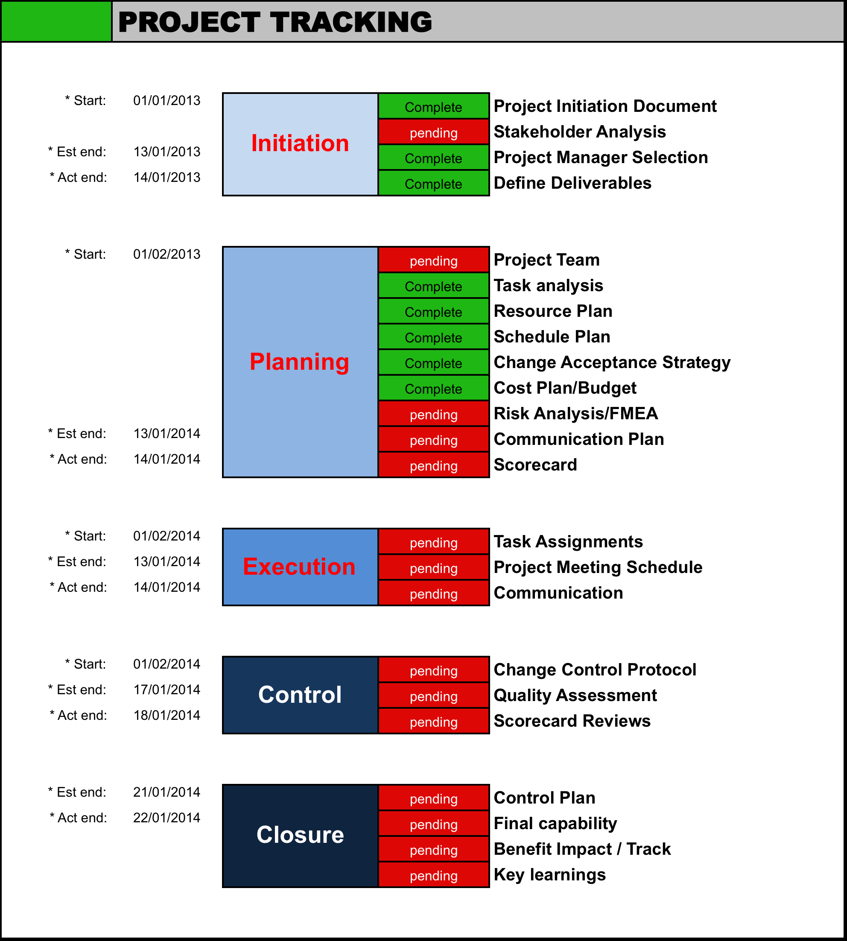

Slide 77
Success factors High level
The project manager - Needs to be the right person for the job in hand with appropriate skills to use during the project.
Project team - The team should consist of variety of skills and experience.
Project - The scope and timeline of the project is crucial.
Organization - The organization needs to provide support to both the project manager and the project team.
External environment - External constraints should not affect the project however back-up plans need to be in place in case tasks cannot be carried by the team as envisaged.

Slide 78
Success factors contd
Negotiations conducted when needed, flexible but accountable.
Good project plan.
Risk analysis done, risk register. Mitigation/contingency plans.
Delegation and responsibility to the team members.
Managing project risks effectively.
Reviewing, adjusting and doing a rework when needed.
Allocating time for process improvement if appropriate.
Proper estimation of the project not only quantitatively but also qualitatively.

Slide 79
Conclusion
All projects do run the risk of failure due to unplanned contingencies and inaccurate estimates.
Careful planning, constraint management, successful recovery from mistakes if and when they do arise will minimize most risks.
Luck too, does play a part in the success of a project, but hard work and correct management practices should override most such difficulties.

Slide 80
Conclusion
For a project to be a success it requires proper planning and the help from the management.
Exceeding customer requirements may bring about success to the project.
Understanding the business drivers and ensuring that the project meets the objectives of the business is critical.
Ensuring key performance indicators are aligned to the business objective will not only help project managers to keep track but also measure and improve performance.

Slide 81
Day 2 Summary
We have covered:-
Execution, Control and Monitoring.
Risk Evaluation.
Record Management.
Change Management.
Project Management Methodologies

Slide 82
End of Day 2
Any Questions?

