Slide 1
ECIE5010
E-Safety Keeping our children safe
Leah Jones, Gemma Thomas, Lucy Storton,
Ellie Kelman, Laura Glover.

Slide 2
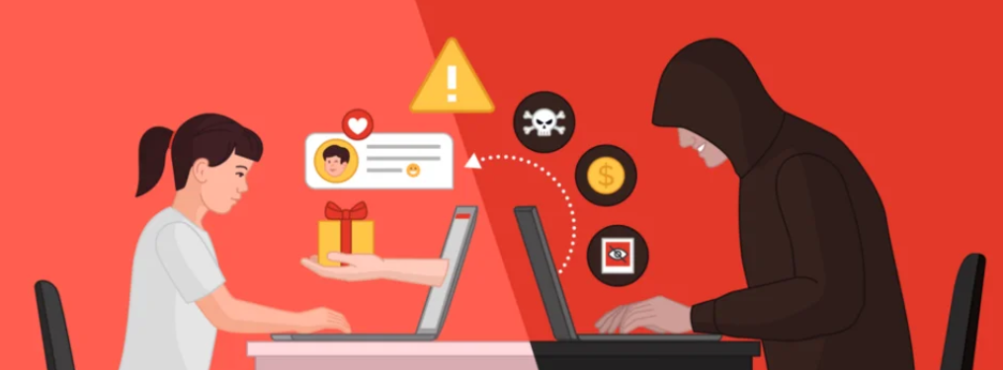

(Adobe stock, 2026)
What is E-Safety?
Protecting children from potential risks, dangers and maltreatment they may encounter whilst online such as:
  sexting
  sending and receiving nude pictures
  inappropriate and explicit content
  online grooming
  cyber bullying
  radicalisation
  extremism
Facilitating digital resilience in children
(Government, 2026) (Welsh Government, 2026) (Welsh Government, 2024)

Slide 3
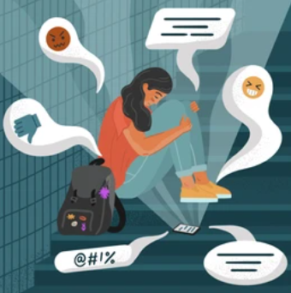

(Shutterstock, 2026)
What can we do in our school setting to help our children?
  Whole school approach
  Safeguarding children
  Protecting children
  E-safety Policies and procedures
  Reviewed annually
  Risk assessments
  The security act 2015
(School A, 2026) (Government, 2024) (Government, 2026b)
(Canva stock images, 2026)

Slide 4
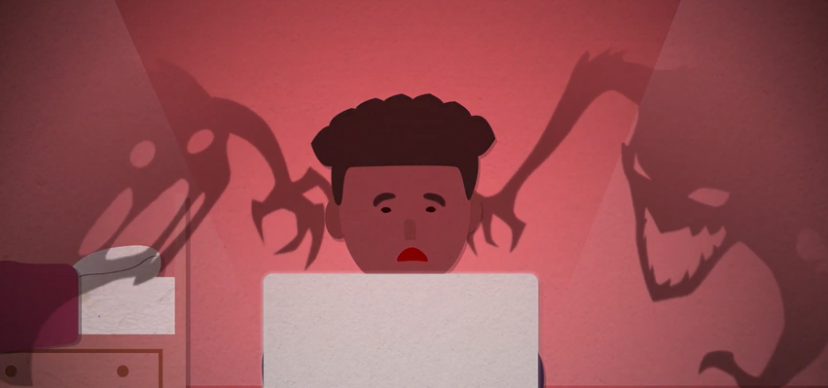
Other ways of promoting online safety
  IT safety - firewalls, anti virus software and password protected wifi
  Data protection - Manage data in accordance to the data protection act 2018
  Filtering systems - blocks children from accessing inappropriate content
  Monotoring strategies - manual monitoring by teachers and technical monitoring by software.
(Canva stock images, 2026)
(NSPCC, 2024) (Legislation Goverment, 2018) (Welsh Government, 2021) (Government, 2022)
(Hwb, 2026).

Slide 5
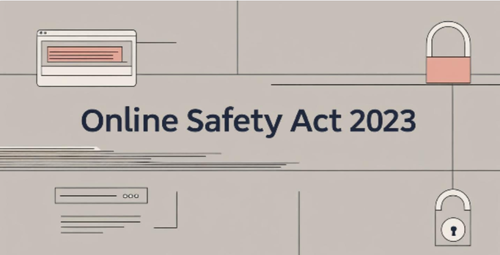

Further information on E-safety
(The BluePrint Brief, 2023)
  Online Safety Act 2023 - enforces social media companies and search engines to take responsibilities for their users
  UNESCO introduced the AI competency frameworks for students and teachers - aims to help students and teachers assess potential risks and informs them of how to be safe and ethical whilst engaging with AI
(UNESCO, 2021)
(Government, 2025) (Government, 2025b) (UNESCO, 2024) (UNICEF, 2026)

Slide 6
Leah’s references
Adobe Stock. (2026). Stock photos, royalty-free images, graphics, vectors & videos. [Online]. Available at: Online Safety Images – Browse 1,067,360 Stock Photos, Vectors, and Video | Adobe Stock. (Accessed: 13 April 2026).
Government. (2022). Meeting digital and technology standards in schools and colleges - Filtering and monitoring - core standard - Guidance - GOV.UK. [Online]. Available at: https://www.gov.uk/guidance/meeting-digital-and-technology-standards-in-schools-and-colleges/filtering-and-monitoring-core-standard. (Accessed: 19 April 2026).
Government. (2024). Prevent duty guidance: for England and Wales (accessible). [Online]. Available at: https://www.gov.uk/government/publications/prevent-duty-guidance/prevent-duty-guidance-for-england-and-wales-accessible#Education. (Accessed: 19 April 2026).
Government. (2025). Online Safety Act: explainer. [Online]. Available at: https://www.gov.uk/government/publications/online-safety-act-explainer/online-safety-act-explainer#age-appropriate-experiences-for-children-online. (Accessed: 18 April 2026).
Government. (2025b). Online Safety Act. [Online]. Available at: https://www.gov.uk/government/collections/online-safety-act. (Accessed: 19 April 2026).
Government. (2026). Working Together to Safeguard Children 2026. [Online] Available at:https://assets.publishing.service.gov.uk/media/69c2c4ce380a2a73a7cf9df4/Working_together_to_safeguard_children_2026.pdf. (Accessed: 18 April 2026).
Hwb. (2026). Enhancing digital resilience in education: An action plan to protect children and young people online. [Online]. Available at: Enhancing digital resilience in education: An action plan to protect children and young people online - Hwb. (Accessed: 21 April 2026).
Legislation Government. (2018). Data Protection Act 2018. [Online] Legislation.gov.uk. Available at: https://www.legislation.gov.uk/ukpga/2018/12/section/2/enacted. (Accessed: 19 April 2026).
NSPCC. (2024). Online Safety (e-safety) and Schools. [Online]. NSPCC Learning. Available at: https://learning.nspcc.org.uk/online-safety/online-safety-for-schools. (Accessed: 19 April 2026).
School A. (2026). Pwll Primary School E-Safety Policy. [Online] Available at: https://primarysite-prod-sorted.s3.amazonaws.com/pwll-cp-school/UploadedDocument/8d11d320-402f-495e-9b53-6f0e62baf663/e-safety-v1-jun24.pdf. (Accessed: 19 April 2026).
Shutterstock. (2026). Stock photos, royalty-free images, graphics, vectors & videos. [Online]. Available at: Teenage Girl Depression Crying After Reading Stock Vector (Royalty Free) 2234229085 | Shutterstock. (Accessed: 13 April 2026).
The BluePrint Brief. (2023). The Online Safety Act 2023 and The Future of Platform Liability. [Online] Theblueprintbrief.com. Available at: https://theblueprintbrief.com/articles/the-online-safety-act-2023-and-the-future-of-platf/. (Accessed: 21 Apr. 2026).
UNESCO. (2021). UNESCO Iogo. [Online] www.unesco.org. Available at: https://www.unesco.org/en. (Accessed: 21 April 2026).
UNESCO. (2024). Digital competence frameworks for teachers, learners and citizens. [Online]. Available at: https://unevoc.unesco.org/home/Digital+Competence+Frameworks/lang=en/id=1#tbar. (Accessed: 19 April 2026).
UNICEF. (2026). UN convention on the rights of the child (UNCRC). [Online] unicef. Available at: https://www.unicef.org.uk/what-we-do/un-convention-child-rights/. (Accessed: 19 April 2026).
Welsh Government. (2021). Web filtering and online safeguarding - Hwb. [Online]. Available at: https://hwb.gov.wales/school-improvement-and-leadership/education-digital-standards/web-filtering-and-online-safeguarding. (Accessed: 19 April 2026).
Welsh Government. (2024). Enhancing digital resilience in education: An action plan to protect children and young people online. [Online]. Available at: https://hwb.gov.wales/keeping-safe-online/enhancing-digital-resilience-in-education-an-action-plan-to-protect-children-and-young-people-online/. (Accessed: 18 April 2026).
Welsh Government. (2026). Rights, respect, equality: statutory guidance for schools and settings Guidance. [Online] Available at: https://www.gov.wales/sites/default/files/publications/2026-04/rights-respect-equality-guidance2.pdf. (Accessed: 19 April 2026).
Welsh Government. (2026b). Safeguarding Wales. [Online] safeguarding.wales. Available at: https://safeguarding.wales/en/chi-i/chi-i-c6/c6-p6/. (Accessed: 19 April 2026).

