Slide 1
HPAR4011
doing archaeology
Introduction: the ARCHAEOLOGICAL RECORD
from materialities to narratives
archaeological traditions and methodologies
the authority and hierarchy of the archaeological record
invested interests in the archaeological record

Slide 2
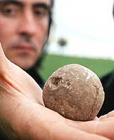

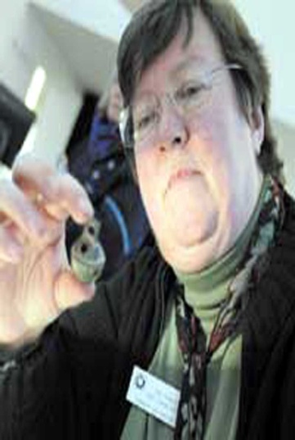
artifacts
THE
ARCHAEOLOGICAL
RECORD
ARTIFACTS
WOOD
STONE
GLASS
SHELL
BONE
METAL
PLASTIC
CERAMIC

Slide 3

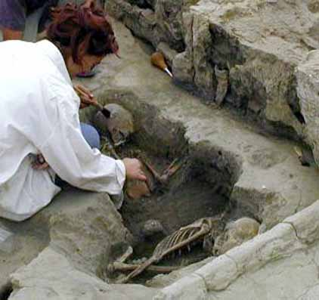
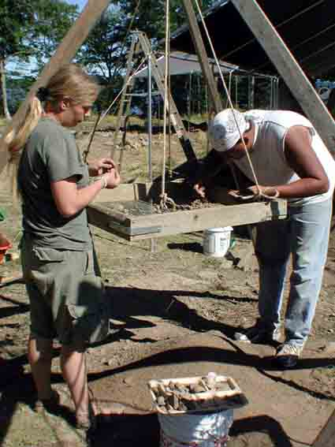
samples
THE
ARCHAEOLOGICAL
RECORD
SAMPLES
SOIL
WOOD
STONE
GLASS
BONE
METAL
PLASTIC
SHELL

Slide 4
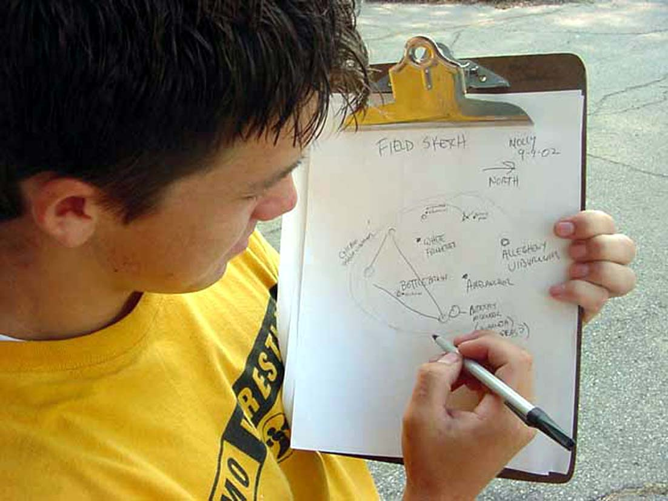
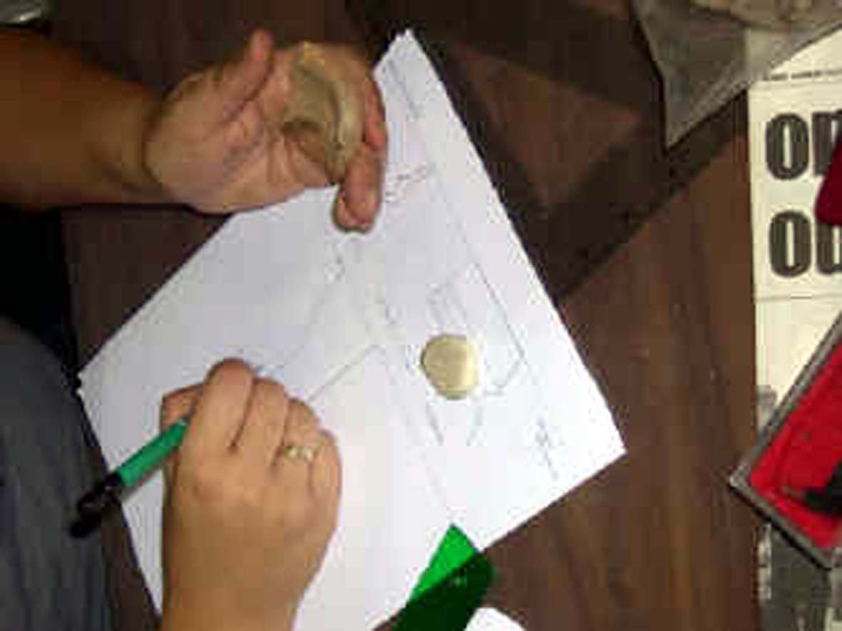
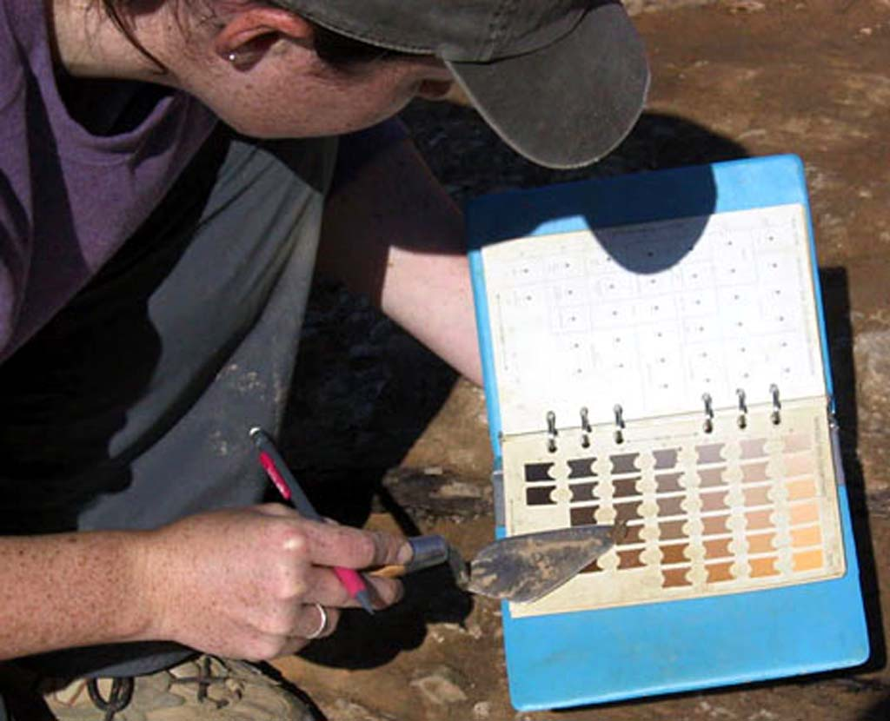
SAMPLE
FORMS
DIARIES
NOTES
SURVEY
PLOT
MATRIX
CONTEXT
SHEETS
PAPER
MEDIA
ELEVATIONS
SECTIONS
PLANS
SKETCHES
THE
ARCHAEOLOGICAL
RECORD
LOGISTICS
PERSONNEL
RECORDS
paper media

Slide 5
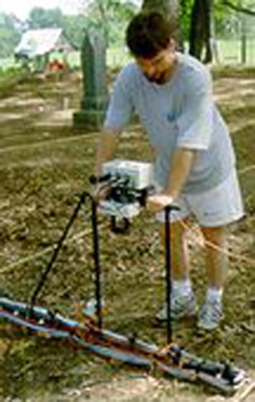
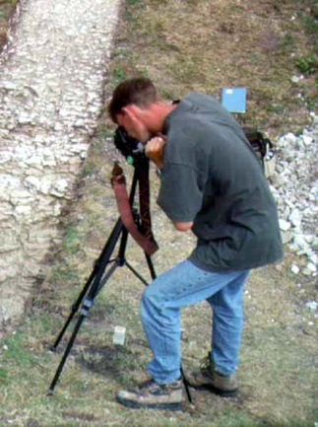
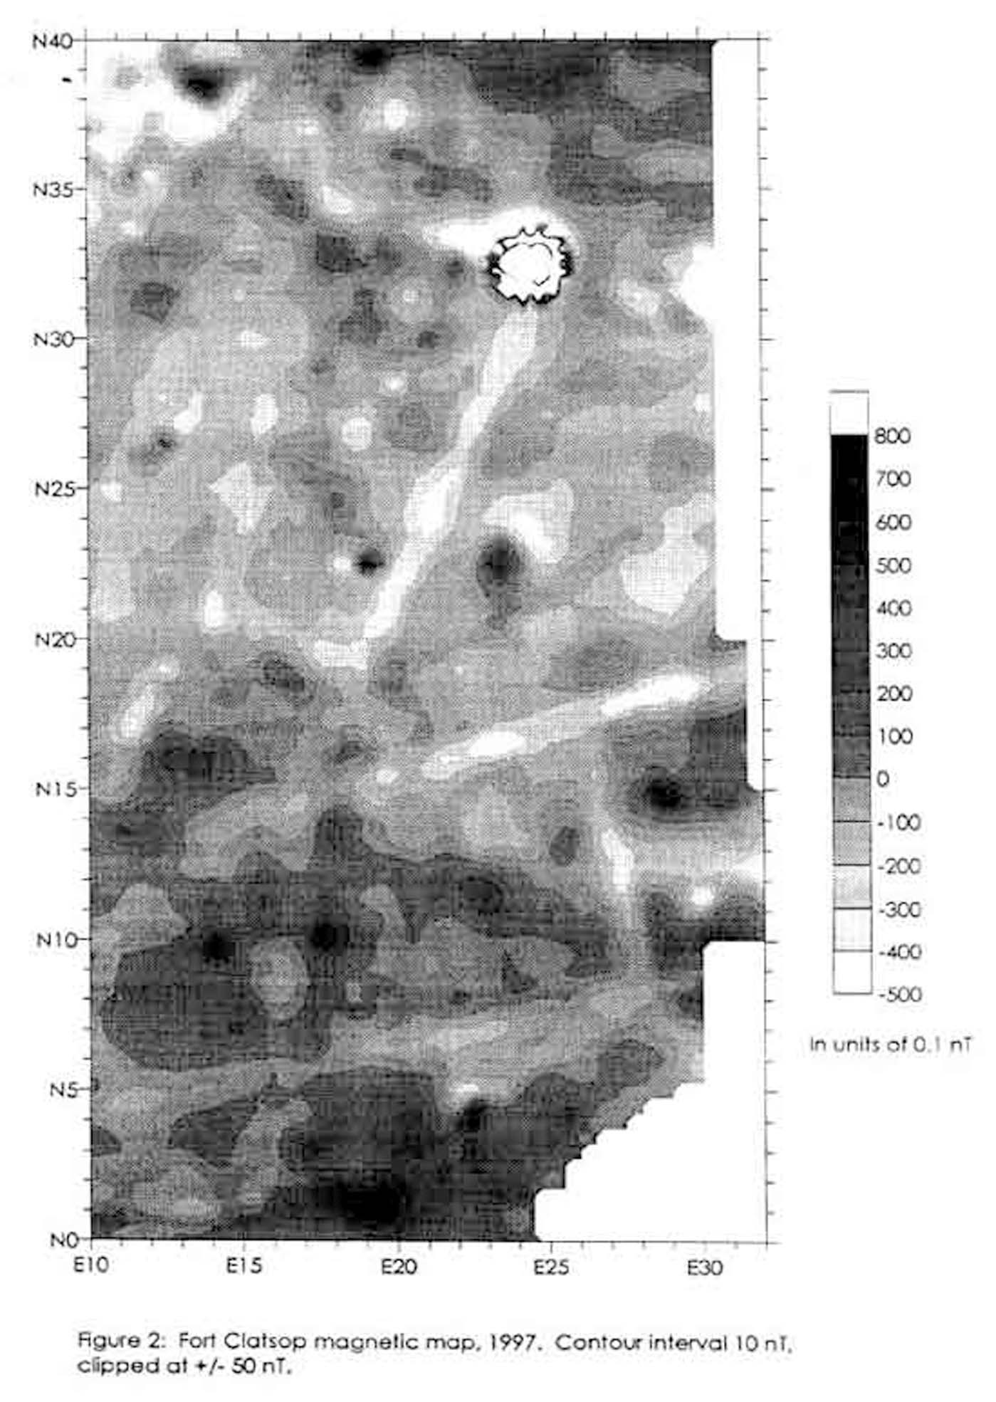
VIDEO
AUDIO
PHOTO
DATABASES
DIGITAL
MEDIA
CAD
GEOPHYSICS
EDM
DATA
THE
ARCHAEOLOGICAL
RECORD
digital media

Slide 6
SAMPLE
FORMS
SAMPLE
FORMS
DIARIES
DIARIES
NOTES
NOTES
SURVEY
PLOT
SURVEY
PLOT
MATRIX
VIDEO
AUDIO
PHOTO
DATABASES
CONTEXT
SHEETS
CONTEXT
SHEETS
CAD
DIGITAL
MEDIA
PAPER
MEDIA
PAPER
MEDIA
ELEVATIONS
ELEVATIONS
GEOPHYSICS
SECTIONS
SECTIONS
EDM
DATA
PLANS
PLANS
SKETCHES
SKETCHES
THE
ARCHAEOLOGICAL
RECORD
THE
ARCHAEOLOGICAL
RECORD
LOGISTICS
LOGISTICS
PERSONNEL
PERSONNEL
RECORDS
RECORDS
SAMPLES
SOIL
ARTIFACTS
WOOD
WOOD
STONE
STONE
GLASS
GLASS
SHELL
BONE
METAL
PLASTIC
CERAMIC
BONE
METAL
PLASTIC
SHELL

Slide 7
DIGITAL
MEDIA
PAPER
MEDIA
THE
ARCHAEOLOGICAL
RECORD
ARTIFACTS
SAMPLES

Slide 8
DIGITAL
MEDIA
PAPER
MEDIA
THE
ARCHAEOLOGICAL
RECORD
ARTIFACTS
SAMPLES
CONSERVATION

Slide 9
STABILITY
DIGITAL
MEDIA
PAPER
MEDIA
THE
ARCHAEOLOGICAL
RECORD
ARTIFACTS
SAMPLES
CONSERVATION

Slide 10
STABILITY
DIGITAL
MEDIA
PAPER
MEDIA
THE
ARCHAEOLOGICAL
RECORD
STORAGE
ARTIFACTS
SAMPLES
CONSERVATION

Slide 11
STABILITY
DIGITAL
MEDIA
PAPER
MEDIA
THE
ARCHAEOLOGICAL
RECORD
ACCESS
STORAGE
ARTIFACTS
SAMPLES
CONSERVATION

Slide 12
WEBSITE
INTRIM
REPORT
JOURNAL
ARTICLE
MONOGRAPH
ARTIFACT
DISPLAY
EXCAVATION PROJECT
PUBLICITY
ACADEMIC
BOOK
THE
ARCHAEOLOGICAL
RECORD

Slide 13
MONOGRAPH
ARTIFACT
DISPLAY
PUBLICITY
ACADEMIC
BOOK
MUSEUM
DISPLAY
POPULAR
BOOK
ARCH
COMMUNITY
THE
ARCHAEOLOGICAL
RECORD
SITES &
MONUMENTS
RECORD
NATIONAL
MONUMENTS
RECORD
EXTENDED
NATIONAL
DATABASE
NEWSPAPER
MAGAZINE
ARTICLE

Slide 14
THE
ARCHAEOLOGICAL
RECORD
TV / RADIO
PROGRAM
NEWSPAPER
MAGAZINE
ARTICLE
LIMITED REVIEW

Slide 15
WEBSITE
NEWSPAPER
/ MAGAZINE
PUBLIC
THE
ARCHAEOLOGICAL
RECORD
ART
INDIVIDUAL
EXPERIENCE
FACEBOOK
etc
TV / RADIO
PROGRAM

Slide 16
WEBSITE
INTRIM
REPORT
JOURNAL
ARTICLE
MONOGRAPH
ARTIFACT
DISPLAY
EXCAVATION PROJECT
PUBLICITY
ACADEMIC
BOOK
MUSEUM
DISPLAY
POPULAR
BOOK
NEWSPAPER
/ MAGAZINE
ARCH
COMMUNITY
PUBLIC
THE
ARCHAEOLOGICAL
RECORD
SITES &
MONUMENTS
RECORD
ART
NATIONAL
MONUMENTS
RECORD
INDIVIDUAL
EXPERIENCE
FACEBOOK
etc
EXTENDED
NATIONAL
DATABASE
TV / RADIO
PROGRAM
NEWSPAPER
MAGAZINE
ARTICLE
LIMITED REVIEW

Slide 17
EXCAVATION PROJECT
ARCH
COMMUNITY
PUBLIC
THE
ARCHAEOLOGICAL
RECORD
LIMITED REVIEW

Slide 18
COMPLETE CONTROL / RESTRICTED ACCESS
EXCAVATION PROJECT
ARCH
COMMUNITY
PUBLIC
THE
ARCHAEOLOGICAL
RECORD
LIMITED REVIEW

Slide 19
COMPLETE CONTROL / RESTRICTED ACCESS
EXCAVATION PROJECT
ARCH
COMMUNITY
PUBLIC
THE
ARCHAEOLOGICAL
RECORD
DIRECT
CONTROL /
LIMITED
ACCESS
LIMITED REVIEW

Slide 20
COMPLETE CONTROL / RESTRICTED ACCESS
EXCAVATION PROJECT
ARCH
COMMUNITY
PUBLIC
THE
ARCHAEOLOGICAL
RECORD
DIRECT
CONTROL /
LIMITED
ACCESS
LIMITED REVIEW
LIMITED CONTROL / LIMITED ACCESS

Slide 21
COMPLETE CONTROL / RESTRICTED ACCESS
EXCAVATION PROJECT
ARCH
COMMUNITY
PUBLIC
THE
ARCHAEOLOGICAL
RECORD
NO
CONTROL /
OPEN
ACCESS
DIRECT
CONTROL /
LIMITED
ACCESS
LIMITED REVIEW
LIMITED CONTROL / LIMITED ACCESS

Slide 22
DRAMATIC
CLINICAL
THE
ARCHAEOLOGICAL
RECORD
EMOTIVE
STERILE

Slide 23
THE
ARCHAEOLOGICAL
RECORD

Slide 24
NON – STATIC
& REFOCUSING
MEDIA
SOCIALLY
EMBEDDED
THE
ARCHAEOLOGICAL
RECORD
POLITICALLY
VARIABLE
CULTURALLY
CONSTRUCTED

Slide 25
VARIED
LEVELS OF
INVOLVEMENT
NON – STATIC
& REFOCUSING
CHANGING
FINANCIAL
IMPLICATIONS
MEDIA
SOCIALLY
EMBEDDED
THE
ARCHAEOLOGICAL
RECORD
POLITICALLY
VARIABLE
VARIED
RANGES OF
AVAILIBILITY
VARIED
PLATFORMS OF
ENGAGEMENT
CULTURALLY
CONSTRUCTED

Slide 26
Author
(ACADEMIC)
…..so where does that leave you (the archaeologist) ?
PUBLISHED
WORK

Slide 27
Author
(ACADEMIC)
RESEARCH
EXCELLENCE
FRAMEWORK
ACADEMIC
PROFILE
PUBLISHED
WORK

Slide 28
Author
(ACADEMIC)
RESEARCH
EXCELLENCE
FRAMEWORK
COMPARED
TO PREVIOUS
AND CURRENT
PUBLISHED
SOURCES
ACADEMIC
PROFILE
BASED ON
LOCATION
OF PUBLISHED
WORK
PUBLISHED
WORK

Slide 29
PUBLISHER
HOUSE
STYLE
PUBLISHED
WORK

Slide 30
PUBLISHER
MARKET
PLACE
IDENTITY
STABLE
&
PREDICTABLE
COSTINGS
HOUSE
STYLE
VIABILITY
VIABILITY
PUBLISHED
WORK

Slide 31
PUBLISHER
Author
RESEARCH
EXCELLNCE
FRAMEWOK
RAE TARGETED
BY PUBLISHER
HOUSE
STYLE
PUBLISHED
WORK
PUBLISHER
TARGETED BY RAE
ACADEMIC
PROFILE
PUBLISHED
WORK

Slide 32
PUBLISHER
Author
RESEARCH
EXCELLNCE
FRAMEWOK
REF TARGETED
BY PUBLISHER
HOUSE
STYLE
PUBLISHED
WORK
PUBLISHER
TARGETED BY RAE
ACADEMIC
PROFILE
PUBLISHED
WORK

Slide 33
PUBLISHER
Author
RESEARCH
EXCELLNCE
FRAMEWOK
REF TARGETED
BY PUBLISHER
HOUSE
STYLE
PUBLISHED
WORK
PUBLISHER
TARGETED BY REF
ACADEMIC
PROFILE
PUBLISHED
WORK

Slide 34
PUBLISHER
Author
RESEARCH
EXCELLNCE
FRAMEWOK
REF TARGETED
BY PUBLISHER
HOUSE
STYLE
PUBLISHED
WORK
PUBLISHER
TARGETED BY REF
IMPACT ON RESEARCH DIRECTION AND FOCUS?
IMPACT ON THE ARCHAEOLOGICAL RECORD?
ACADEMIC
PROFILE
PUBLISHED
WORK

