Slide 1
Global Business Environment

Slide 2
Table of Content
Introduction
Challenges for Wesfarmers Group in the Philippines
Barriers for Wesfarmers Group in the Philippines
Opportunities for Wesfarmers Group in the Philippines
Conclusion
Reference List

Slide 3
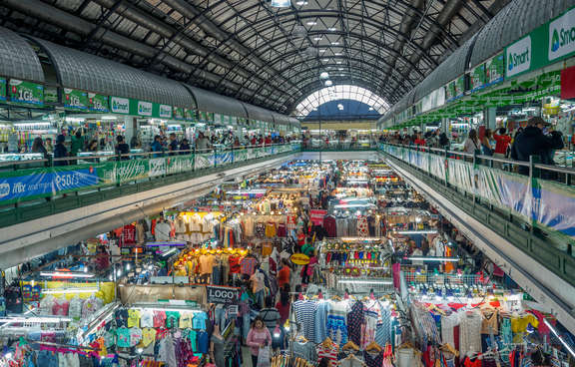
Introduction
The purpose of the study: The study aims to understand the business environment of the Philippines
About Wesfarmers Group: It is an Australian company which operates in conglomerate industry
Notes:
The study aims at the challenges as well as opportunities for a foreign business organisation like Wesfarmers Group which wants to expand its business in the Philippines. Wesfarmers Group is an Australian company that wants to spread in a developing country. The Philippines is a great place for them to expand their business because of its stable political and economic environment. There are some challenges for the company that they may face while establishing their business in the country and also may have some opportunities that they will look to grab for the better of the company.

Slide 4
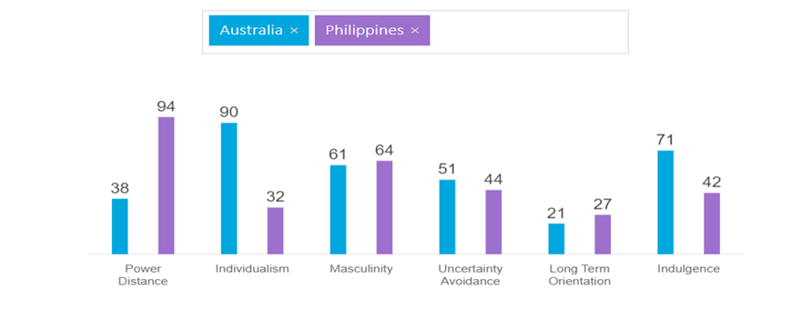
Challenges for Wesfarmers Group in the Philippines
Wesfarmers have to adapt its employees to a hierarchy system from a democratic system
The managers and the employees have to shift from the system of individualism to a cooperative system (Hofstede Insights, 2022).
Notes:
After conducting analysis using the Hofstede method, it is found that the power distance score of Australia is 36. It means that Australian business organisations follow a democratic model where the information is shared between the employees and the higher authorities. They talk in a very informal way and the work culture allows them to have discussions over any matter and take various opinions from various individuals before finalising any decision. It is all different in the Philippines as the country scores 94 in the same model. The organisations in the country follow a hierarchy system. The information is conveyed through a chain to reach the lower-level employees from the leadership group of the companies. This is going to be a challenge for Wesfarmers group to conduct and run the business successfully in the Philippines as the management and the employees have to adapt to a formal way of behaviour to maintain the culture of the country.
Australia scores 90 in individualism in the model and that indicates the individualistic culture of the Australian society and organisations. The employees are self-dependent while taking care of themselves and their families. The evidence of the skills, merit, and experience is given priority when hiring employees. On the other hand, the Philippines' score is 32 in this model. The employees are responsible and helpful to each other at the workplace and share a strong bond among them. This is going to be another challenge for Wesfarmers Group to train the management and the workers to adapt to this behaviour at the workplace.

Slide 5

Challenges for Wesfarmers Group in the Philippines
The company and its people have to restrain their desires to go with the system of the Philippines (Hofstede Insights, 2022).
Notes:
While analysing indulgence, Australia scores 71 in this model. This high score describes that the people of Australia live in an indulgent society. The employees carry a positive attitude and are very optimistic. They believe in spending money and enjoying leisure time. Whereas The Philippines scored 42 in the model and which shows the restrained lifestyle of the people and the employees of the country. They are least interested in emphasising leisure time as they prefer to control their desires for gratification. This can also bring Wesfarmers into a challenging situation as the employees of the company have to restrain their desire to go with the system of the country (Hofstede Insights, 2022).

Slide 6

Barriers for Wesfarmers Group in the Philippines
Political barrier: The act of terrorism is continuously increasing in the Philippines despite various steps by the government (Doj, 2022)
Economic barrier: The increasing inflation rate and the currency exchange rate of the country is a big area of concern
Notes:
Political barrier: The President of the Philippines has drawn global attention to his leadership skills. The government has introduced an anti-terrorism act in 2020 to protect the rights of citizens of the country (Doj, 2022). But the act of terrorism is increasing continuously across the country. This has increased the chance of kidnapping and it is a barrier for a foreign country like Wesfarmers Group.
Economic barrier: The recent coronavirus pandemic has shaken the economy of the Philippines which used to be very stable. The inflation rate and the currency exchange rate has been increasing every year since the pandemic and that is a big barrier for foreign investors like Wesfarmers Group.

Slide 7

Barriers for Wesfarmers Group in the Philippines
Bribery and Corruption: The corruption rate has been increasing across the Philippines from a long time which has created a barrier to Wesfarmers Group
Organised crime: Crimes are reported at a big numbers against businesses in the Philippines (GOV UK, 2022).
Notes:
Bribery and Corruption: Although the government of the Philippines has started a hotline service for the citizens of the country to register complaints against any government officials if they are involved in any form of corruption. But the cases of corruption are increasing in the country which is also a barrier for Wesfarmers to conduct business here.
Organised crime: Crimes like human trafficking, weapon trafficking, kidnapping, and murder are highly reported against businesses in the Philippines. It is also a barrier for Wesfarmers Group to invest in the country (GOV UK, 2022).

Slide 8

Opportunities for Wesfarmers Group in the Philippines
Similarity in masculinity between Australia and the Philippines will save the company’s resources as they will get an opportunity to use the resources in other areas
The company will get a chance to improve the work culture
Wesfarmers Group will be able to understand the market and the customer in a better way (Hofstede Insights, 2022).
Notes:
The Hofstede score of 61 for Australia and 64 for the Philippines in masculinity indicate the similarities between the culture of both these countries. Employees of both these countries drive themselves to put in the best effort and they are also good at resolving conflicts in the workplace. The employees are educated and highly skilled. At the same time, the managers and the employees do not waste much time in making decisions and carry a positive attitude while doing work at the workplace. Wesfarmers Group has not to waste time and resources training the workers to work hard and make decisions and this will create an opportunity for the company to grow faster in the Philippines.
Australia scores 51 in uncertainty avoidance. Whereas the score for the Philippines is 44. Philippian employees are more relaxed than Australians when it comes to following the principles of the organisations. They operate on flexible schedules and punctuality is something that is not natural to them and needs to be enforced. The Australian company, Wesfarmers can use this situation as an opportunity to improve the work culture in the country and run their business successfully in the Philippines.
Both Australia and the Philippines have a normative culture as they score 21 and 27 respectively in long-term orientation in the Hofstede model. The employees of both countries like to live in the present rather than thinking and saving too much for the future. Their efforts are dedicated to establishing the truth. This makes an opportunity for Wesfarmers to invest in the Philippines as they can understand the workforce of this country and the market in a better way that will help them in operating a successful business (Hofstede Insights, 2022).

Slide 9

Conclusion
The Philippines is an ideal place for Wesfarmers Group as they want to expand their business in a developing country. They have to find way to face some challenges to run their business successfully in the country
Notes:
Wesfarmers can invest in the Philippines for the expansion of their business as it is one of the best choices for doing so among developing countries around the globe. The political and economic stability of the country will encourage their decision while the highly competitive conglomerate industry in the country will drive them to make the best effort at all times. Although the cultural differences between Australia and the Philippines will produce some challenges, the company can train their workforce to deal with the challenges in a better manner.

Slide 10
Reference List
Doj.gov.ph. 2022. Anti-Terrorism Council Approves the Implementing Rules and Regulations of the Anti-Terrorism Act of 2020 :: Department of Justice - Republic of the Philippines :: Tel: (+632) 523 8482, (+632) 523 6826. [online] Available at: <https://www.doj.gov.ph/news_article.html?newsid=671> [Accessed 20 August 2022].
GOV.UK. 2022. Overseas Business Risk: Philippines. [online] Available at: <https://www.gov.uk/government/publications/overseas-business-risk-philippines/overseas-business-risk-philippines> [Accessed 19 August 2022].
Hofstede Insights. 2022. Country Comparison - Hofstede Insights. [online] Available at: <https://www.hofstede-insights.com/country-comparison/australia,the-philippines/> [Accessed 19 August 2022].

