Slide 1
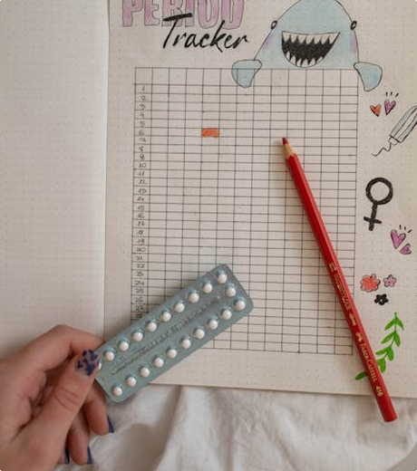

CycleConnect: A Digital Menstrual & Fertility Health Promotion Intervention for Women Aged 18–35
Addresses low menstrual health literacy, fertility misconceptions, and reproductive health stigma among diverse young women. Provides personalized digital support for timely diagnosis of Polycystic Ovary Syndrome (PCOS) and endometriosis.
Name: Vishal Hirani Student ID: 2431583 Lecturer: Dr. Ping Wu
Notes:
Welcome to CycleConnect, a digital intervention promoting menstrual and fertility health. Our platform targets women aged 18-35 from diverse backgrounds including students, professionals, and new mothers. We address critical public health challenges: low health literacy, fertility misconceptions, stigma, and delayed diagnosis of reproductive conditions. Through personalized digital support, we empower women with cycle awareness and promote proactive reproductive health management.

Slide 2




Aim & Activity Content
Primary Goal : To enhance menstrual health literacy and fertility awareness for women aged 18–35 through a customized digital health promotion strategy.
Cycle Tracking
Fertility Window
Symptom Logging
Educational Resources
Menstrual cycle monitoring provides personalized health insights and helps predict patterns for better awareness (Symul et al., 2019).
Accurate fertility window predictions support informed family planning decisions (Symul et al., 2019).
Recording symptoms aids in early detection of abnormalities like PCOS or endometriosis through warning indicators (Munro et al., 2021).
Evidence-based modules provide information on menstrual and fertility health, stress management, and self-care (Sanchez et al., 2020).
Notes:
Our primary aim is to improve menstrual health and fertility literacy for women aged 18-35 using digital tools. key features include cycle tracking for insights, fertility predictions for planning, symptom logging for early health issue detection, and educational modules covering essential topics and stigma reduction through accessible information.

Slide 3
Digital Technology Used: CycleConnect App
A cross-platform digital tool developed with Flutter for seamless performance, offering offline functionality and a user-friendly interface for women aged 18–35, ensuring privacy through local data storage.
Cross-Platform Development
Privacy & Accessibility
Cycle Prediction
Health Insights
Built with Flutter for seamless performance on both Android and Windows.
Features offline functionality and local data storage to ensure user confidentiality and access anytime, anywhere (Flores et al., 2021)
Enables accurate cycle tracking and prediction, empowering users to monitor their reproductive health effectively (Symul et al., 2019).
Allows for comprehensive symptom logging, trend analysis, and provides personalized health insights.
Notes:
This slide introduces the CycleConnect app, a Flutter-based cross-platform tool for women's health. It's designed to be secure and offline-focused. Key features include cycle prediction and symptom logging, offering personalized insights to the user.

Slide 4



Addressing the Public Health Problem
Exploring the critical challenges in women's reproductive health and how CycleConnect provides innovative solutions to address these issues effectively.
Prevalence of Disorders
Health Literacy Gap
Cultural Barriers
1 in 10 women experience endometriosis (Chapman et al., 2022). PCOS affects 8-13% of women of reproductive age globally (Bozdag et al., 2016).
Low menstrual health literacy leads to misconceptions about fertility and reproductive health management (Sanchez et al., 2020).
Stigma and cultural taboos prevent open discussions and delay necessary medical care for women (Kirk & Toner, 2023).
Notes:
This slide addresses the significant public health challenges facing women aged 18-35, including prevalent conditions like endometriosis and PCOS, low health literacy, and cultural barriers. We then present CycleConnect's comprehensive response through evidence-based information, early detection tools, and stigma reduction to empower women with informed health decisions. Each point represents a critical aspect of both the problem and our solution framework.

Slide 5

Personalization & User Engagement
Personalization Strategies
Adaptive educational modules are customized based on user profiles and learning progress. Customised reminders and notifications are tailored to individual cycles. Behavioural nudges encourage healthy lifestyle choices aligned with personal health goals.
This section explores tailored strategies and interactive features designed to enhance user engagement and improve reproductive health outcomes through personalized experiences (Munro et al., 2021).
User Engagement Features
Features include interactive symptom and mood logging for detailed health tracking. Progress tracking with visual feedback provides clear insights into patterns. Community support features are planned for future enhancements to foster peer connections.
Expected Outcomes
The approach aims to increase menstrual and fertility health literacy among users. It focuses on improving self-efficacy in managing reproductive health. The system enables early identification of potential health issues through consistent monitoring.
Notes:
Today's discussion focuses on how personalization drives user engagement. We'll explore three key areas: adaptive strategies that tailor content to individual needs, engaging features that make health tracking interactive, and the expected outcomes of improved health literacy and self-efficacy. These elements work together to create a supportive environment for reproductive health management.

Slide 6

Summary & Next Steps
Summary: CycleConnect targets women aged 18–35 to address menstrual and fertility health challenges. Combines digital technology with evidence-based education and behavioural support. Prioritises privacy, accessibility, and user engagement (Munro et al., 2021; Sanchez et al., 2020).
Notes:
In summary, CycleConnect is designed for women aged 18-35, combining digital tools with evidence-based education while prioritizing privacy. Our immediate next steps include pilot testing with our target demographic, using that feedback for iterative improvements, and then expanding both our educational content and community features to enhance user engagement and support.

Slide 7

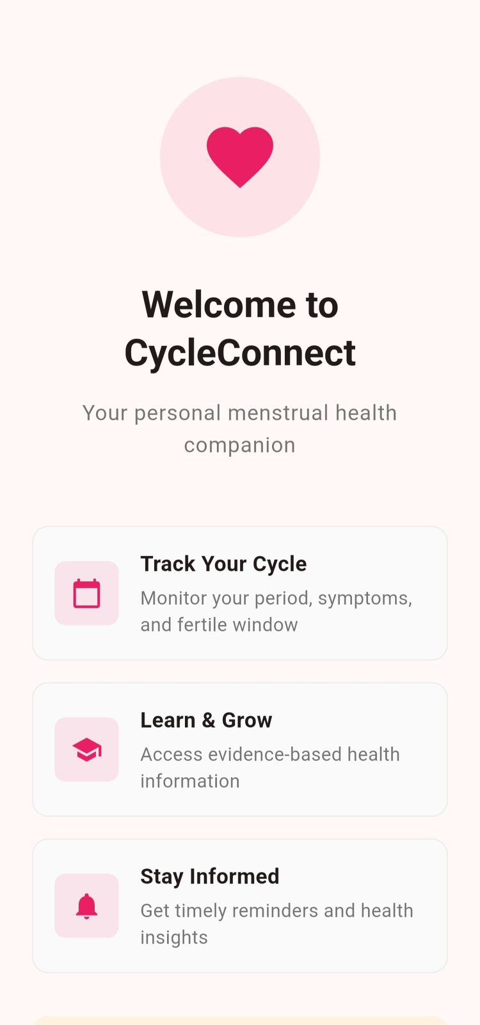


CycleConnect
QR Code to download application for Android
QR Code to download application for Windows
Notes:
In summary, CycleConnect is designed for women aged 18-35, combining digital tools with evidence-based education while prioritizing privacy. Our immediate next steps include pilot testing with our target demographic, using that feedback for iterative improvements, and then expanding both our educational content and community features to enhance user engagement and support.

Slide 8
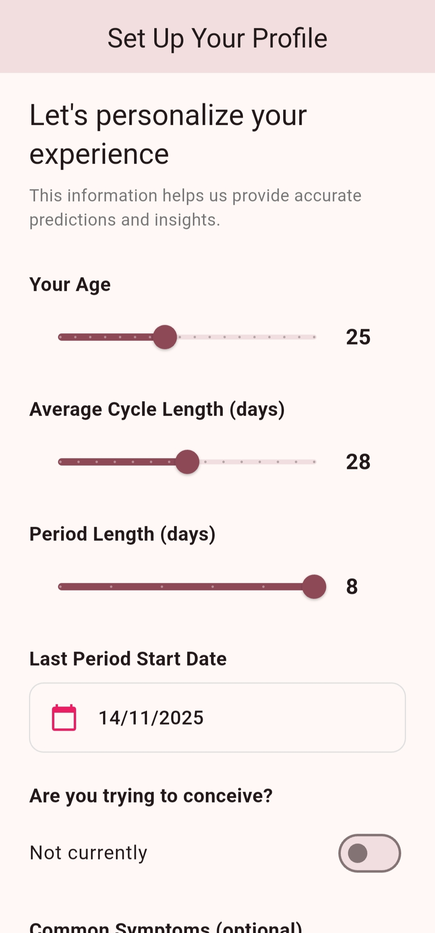
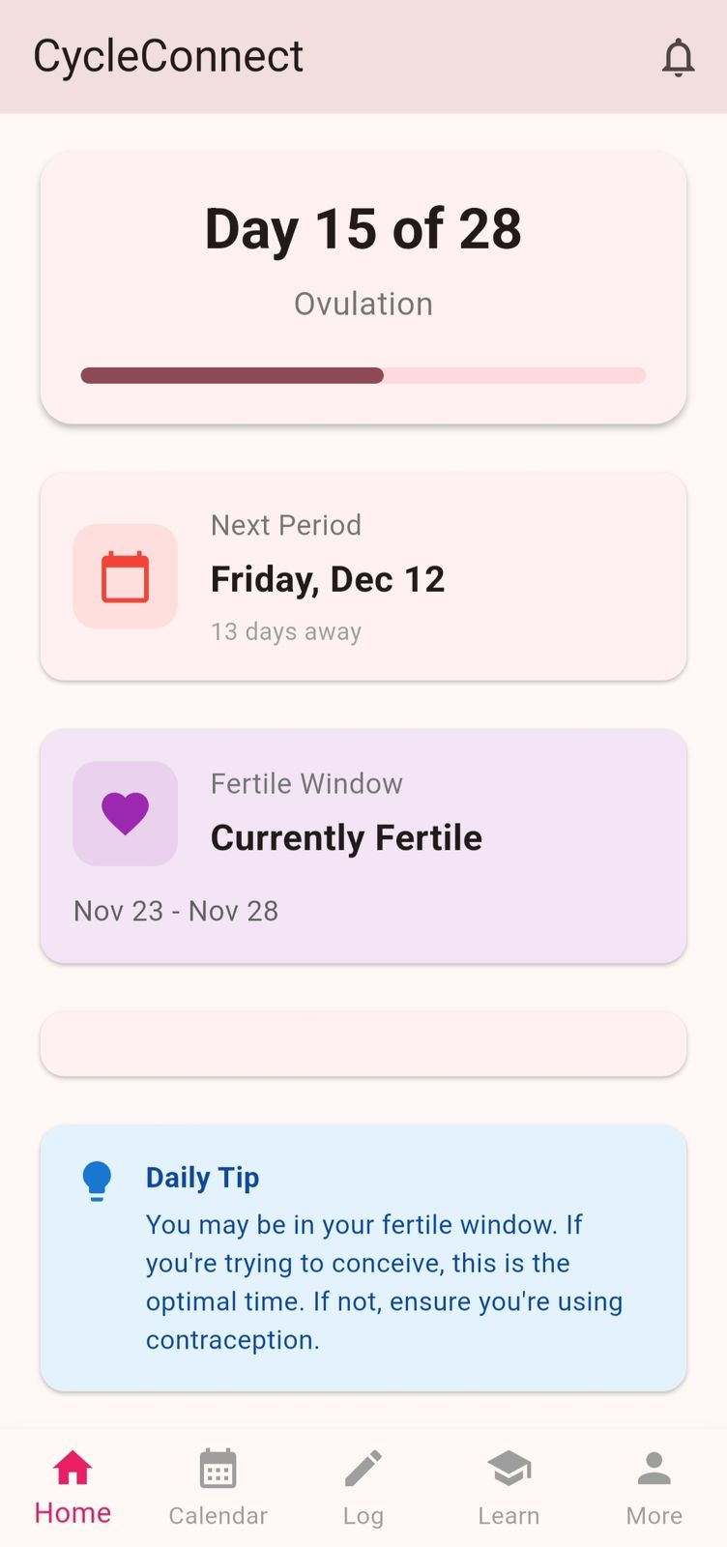
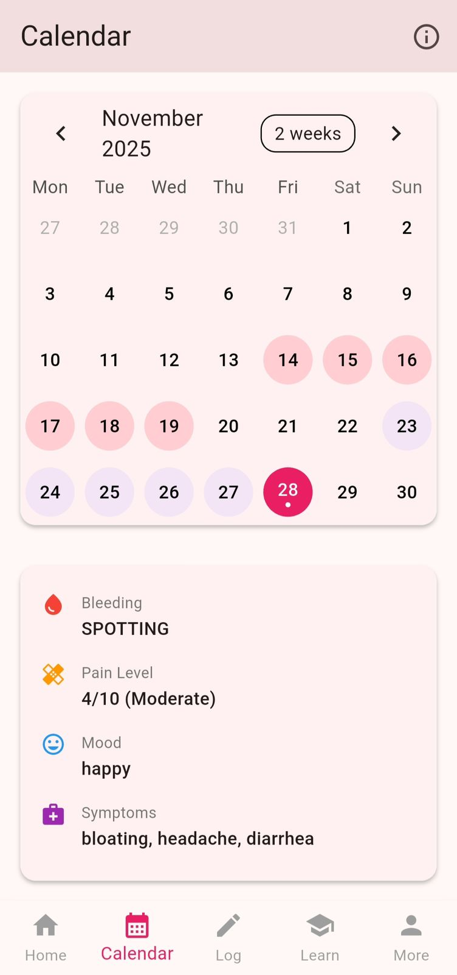
Interface of our Application
1
2
3
Notes:
In summary, CycleConnect is designed for women aged 18-35, combining digital tools with evidence-based education while prioritizing privacy. Our immediate next steps include pilot testing with our target demographic, using that feedback for iterative improvements, and then expanding both our educational content and community features to enhance user engagement and support.

Slide 9
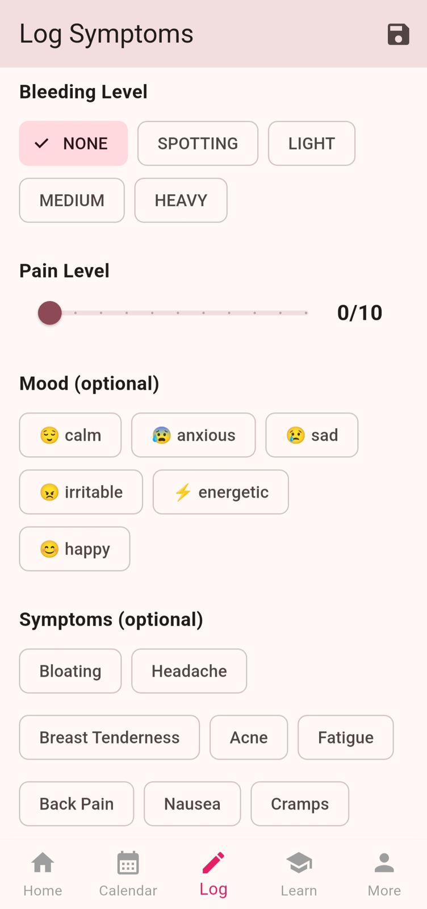
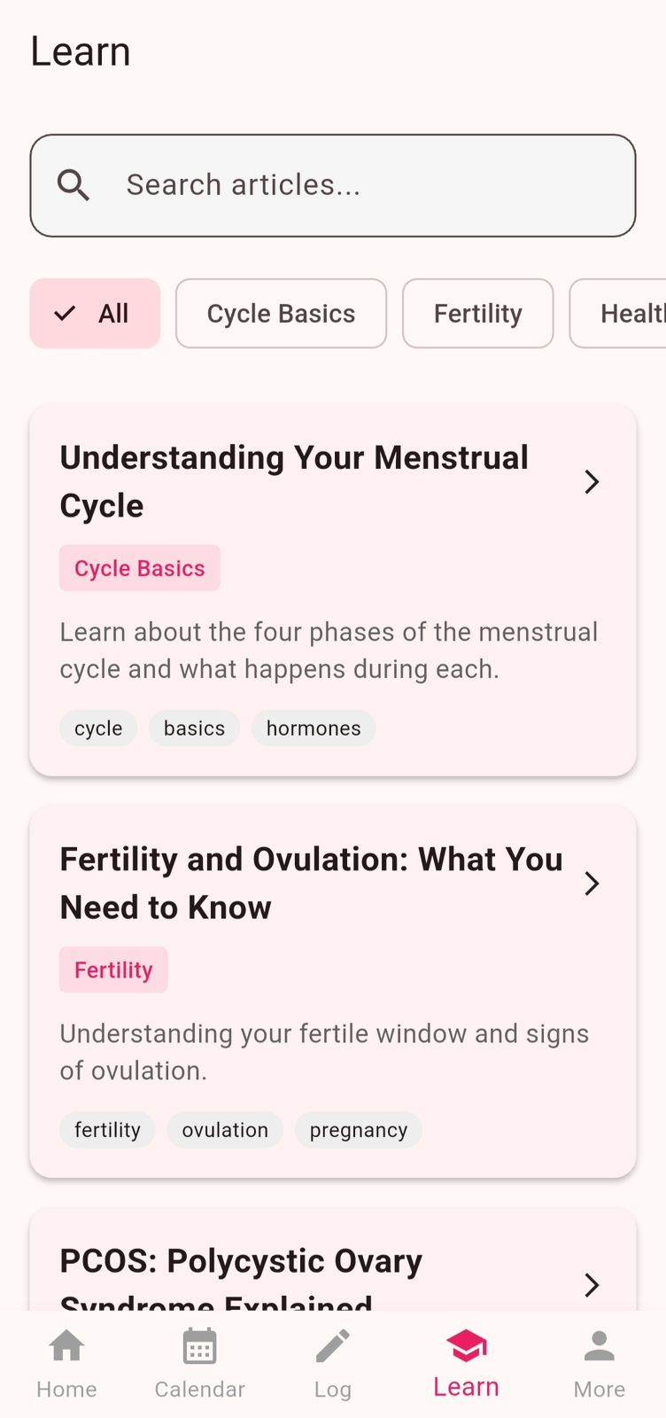
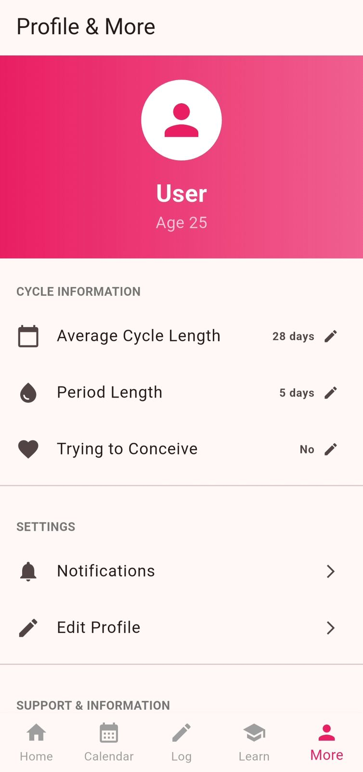
Interface of our Application
4
5
6
Notes:
In summary, CycleConnect is designed for women aged 18-35, combining digital tools with evidence-based education while prioritizing privacy. Our immediate next steps include pilot testing with our target demographic, using that feedback for iterative improvements, and then expanding both our educational content and community features to enhance user engagement and support.

Slide 10
References
Bozdag, G., Mumusoglu, S., Zengin, D., Karabulut, E. and Yildiz, B. (2016). The prevalence and phenotypic features of polycystic ovary syndrome: a cross-sectional study. Human Reproduction, 31(12), pp.2841–2848.
Chapman, H., Beaumont, A. and Rush, G. (2022). Global burden of endometriosis: diagnostic timelines and challenges. Lancet Women’s Health, 4(5), pp.320–329.
Flores, M., Benitez, C. and Roy, S. (2021). Determinants of user trust in reproductive health mobile applications: a qualitative review. Digital Health, 7(1), pp.1–14.
Kirk, M. and Toner, H. (2023). Menstrual stigma and its effect on reproductive health decision-making among young women. Journal of Reproductive Health, 30(2), pp.85–98.
Munro, K., Ellis, D. & Fry, H. (2021) Behaviour-based digital health strategies for reproductive self-care’, BMC Women’s Health, 21(1), pp. 1–10.
Sanchez, A., Thomas, R. and Koenig, L. (2020). Menstrual knowledge disparities among young adults: a global assessment. Reproductive Health, 17(4), pp.1–12.
Symul, L., Wac, K. and Hillard, P. (2019). Understanding menstrual cycle variability using mobile tracking data. npj Digital Medicine, 2(1), pp.1–10.

