Slide 1

04/11/2024
ACNA4004:
Lectures 5
Environmental Governance
Dr Alisdair Cunningham
Senior Lecturer
2024 / 2025
04/11/2024
Slide 1 / 23

Slide 2

Module ACNA4004: 2024 / 2025 Lecture Contents
04/11/2024
This lecture will contain the following:
Slide(s) | Topic
3 | Recap
4 | Level of response
5 | Definitions
6 | What is Environmental Governance?
7 | What is good governance?
8 | Who should govern?
9 | Ostrom: Self-Governing principles
10 | Scale of governance: Commons vs Global Public Goods
11 – 12 | Ozone Depletion: Example of international success
13 – 14 | Ozone Depletion vs Climate Change
15 | Role of Economy in Sustainability
16 – 17 | Three pillars: Environment, Society, Economy
18 | Ozone: Environment, Society, Economy
19 | Environment, Society, Economy: Examples
20 | Summary
21 | Next Session
A. Cunningham Lecture 5: Environmental Governance
Slide 2 / 23

Slide 3
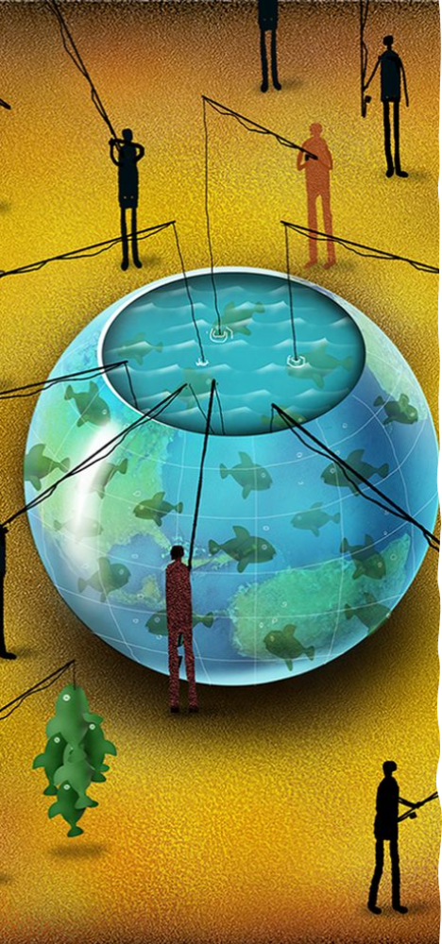
Module ACNA4004: 2024 / 2025 Recap
04/11/2024
Tragedy of the Commons – hypothetical model used to discuss today’s sustainability issues
Perhaps individual ‘selfishness’ is not the only culprit, instead the system by which resources are governed.
The scale of certain resources (air and global forests for example) is difficult to govern – other factors are also at play
A variety of solutions have been demonstrated historically, from bottom-up, to top-down – with varied outcomes
The challenges are still relevant today, with lessons from history to be used as examples of worst and best practice
A. Cunningham Lecture 5: Environmental Governance
Slide 3 / 23

Slide 4
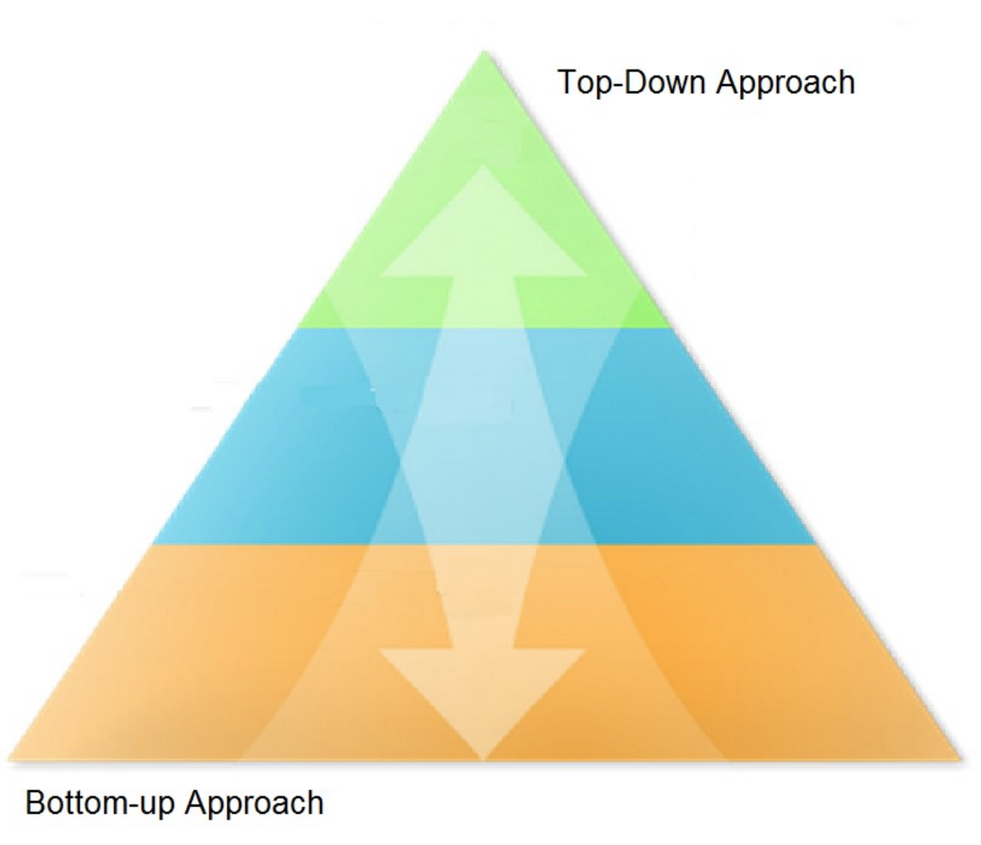
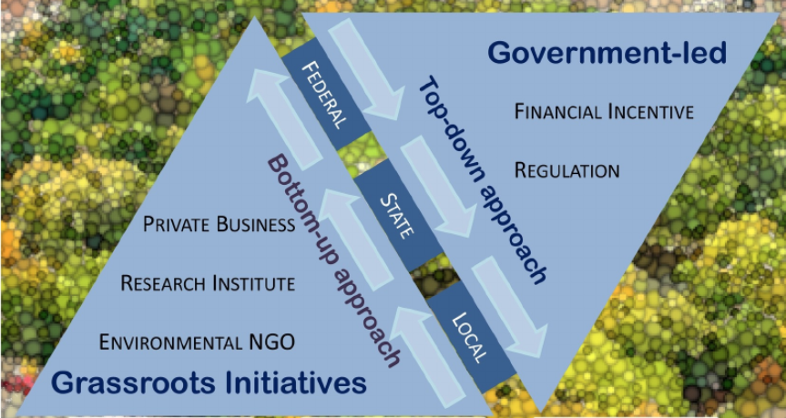
Module ACNA4004: 2024 / 2025 Levels of response
04/11/2024
Historic examples revealed responses at differing levels:
International Organisations
  Organisation for Economic Cooperation and Development (OECD)
  UN Food and Agriculture Organization (FAO)
Agreements
Treaties
Conventions e.g. UNECE Convention on Long-range Transboundary Air Pollution
Protocols
Government jurisdiction
  Dept. Fisheries and Oceans (DFO)
Parliamentary Acts
  Leeds Improvement Act (1842)
  Clean Air Act (1956)
  Fishery Zones Act (1976)
Self-governance (Ostrom’s observations)
Associations e.g. Manchester Association for the Prevention of Smoke - campaigns
Societies e.g. Coal Smoke Abatement Society
“Monocentric approach”
A top-down approach by a single authority, such as governments or private entities, in which a single authority decides and imposes the solution on everyone in the community
INTERNATIONAL / GLOBAL
NATIONAL
Source: Kumar, Prashant, et al. 2019
“Polycentric approach”
Implies a collaborative governance approach inclined to conceive solutions driven by community interests
LOCAL / REGIONAL
A. Cunningham Lecture 5: Environmental Governance
Slide 4 / 23
Notes:
Kumar, Prashant, et al. "The nexus between air pollution, green infrastructure and human health." Environment international 133 (2019): 105181.
Monocentric and Polycentric definitions from: Gazi, Sangita, et al. "Blockchain as Commons: Applying Ostrom’s Polycentric Approach to Blockchain Governance." Available at SSRN (2022).

Slide 5
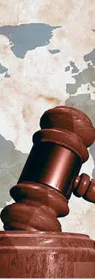
Module ACNA4004: 2024 / 2025 Definitions
04/11/2024
Grassroots – “Grassroots movements and organizations use collective action from the local level to implement change at the local, regional, national, or international levels” ¹
Acts - “An Act of Parliament creates a new law or changes an existing law. An Act is a Bill that has been approved by both the House of Commons and the House of Lords and been given Royal Assent by the Monarch” ²
Agreements – “Usually less formal and deal with a narrower range of subject-matter than ‘treaties’. There is a general tendency to apply the term ‘agreement’ to bilateral or restricted multilateral treaties.”³
Treaties – “an international agreement concluded between States in written form and governed by international law”³
Protocols – “The term ‘protocol’ is used for agreements less formal than those entitled ‘treaty’ or ‘convention’.” e.g.: “1987 Montreal Protocol on Substances that Deplete the Ozone Layer adopted on the basis of Arts.2 and 8 of the 1985 Vienna Convention for the Protection of the Ozone Layer.” ³
Conventions – “The generic term ‘convention’ is synonymous with the generic term ‘treaty’.” ³
A. Cunningham Lecture 5: Environmental Governance
Slide 5 / 23
Notes:
Wikipedia
UK Parliament: (source: https://www.parliament.uk/about/how/laws/acts/)
United Nations Treaty Collection (source: https://treaties.un.org/Pages/overview.aspx?path=overview/definition/page1_en.xml#agreements)

Slide 6
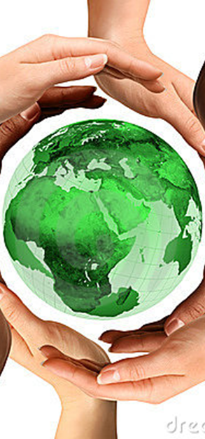
Module ACNA4004: 2024 / 2025 What is Environmental Governance?
04/11/2024
Environmental governance is the “set of regulatory processes, mechanisms and organizations through which political actors influence environmental actions and outcomes” (Lemos and Agrawal, 2006).
“Global Environmental Governance (GEG) is the sum of organizations, policy instruments, financing mechanisms, rules, procedures and norms that regulate the processes of global environmental protection.” (Najam et al., 2006)
UNEP definition: “Environmental governance includes policy, rules and norms that govern human behaviour and it also addresses who makes decisions, how decisions are made and carried out, the scientific information needed for decision-making and how the public and major stakeholders can participate in the decision-making.” Environmental Governance | | UNEP - UN Environment Programme
A. Cunningham Lecture 5: Environmental Governance
Slide 6 / 23
Notes:
Lemos, Maria C. and Agrawal, Arun, Environmental Governance. Annual Review of Environment and Resources, Vol. 31, November 2006, Available at SSRN: https://ssrn.com/abstract=1081963
Najam, A., Papa, M. & Taiyab, N., 2006. Global Environmental Governance: A Reform Agenda, IISD. Canada. Retrieved from https://policycommons.net/artifacts/615751/global-environmental-governance/1596339/

Slide 7
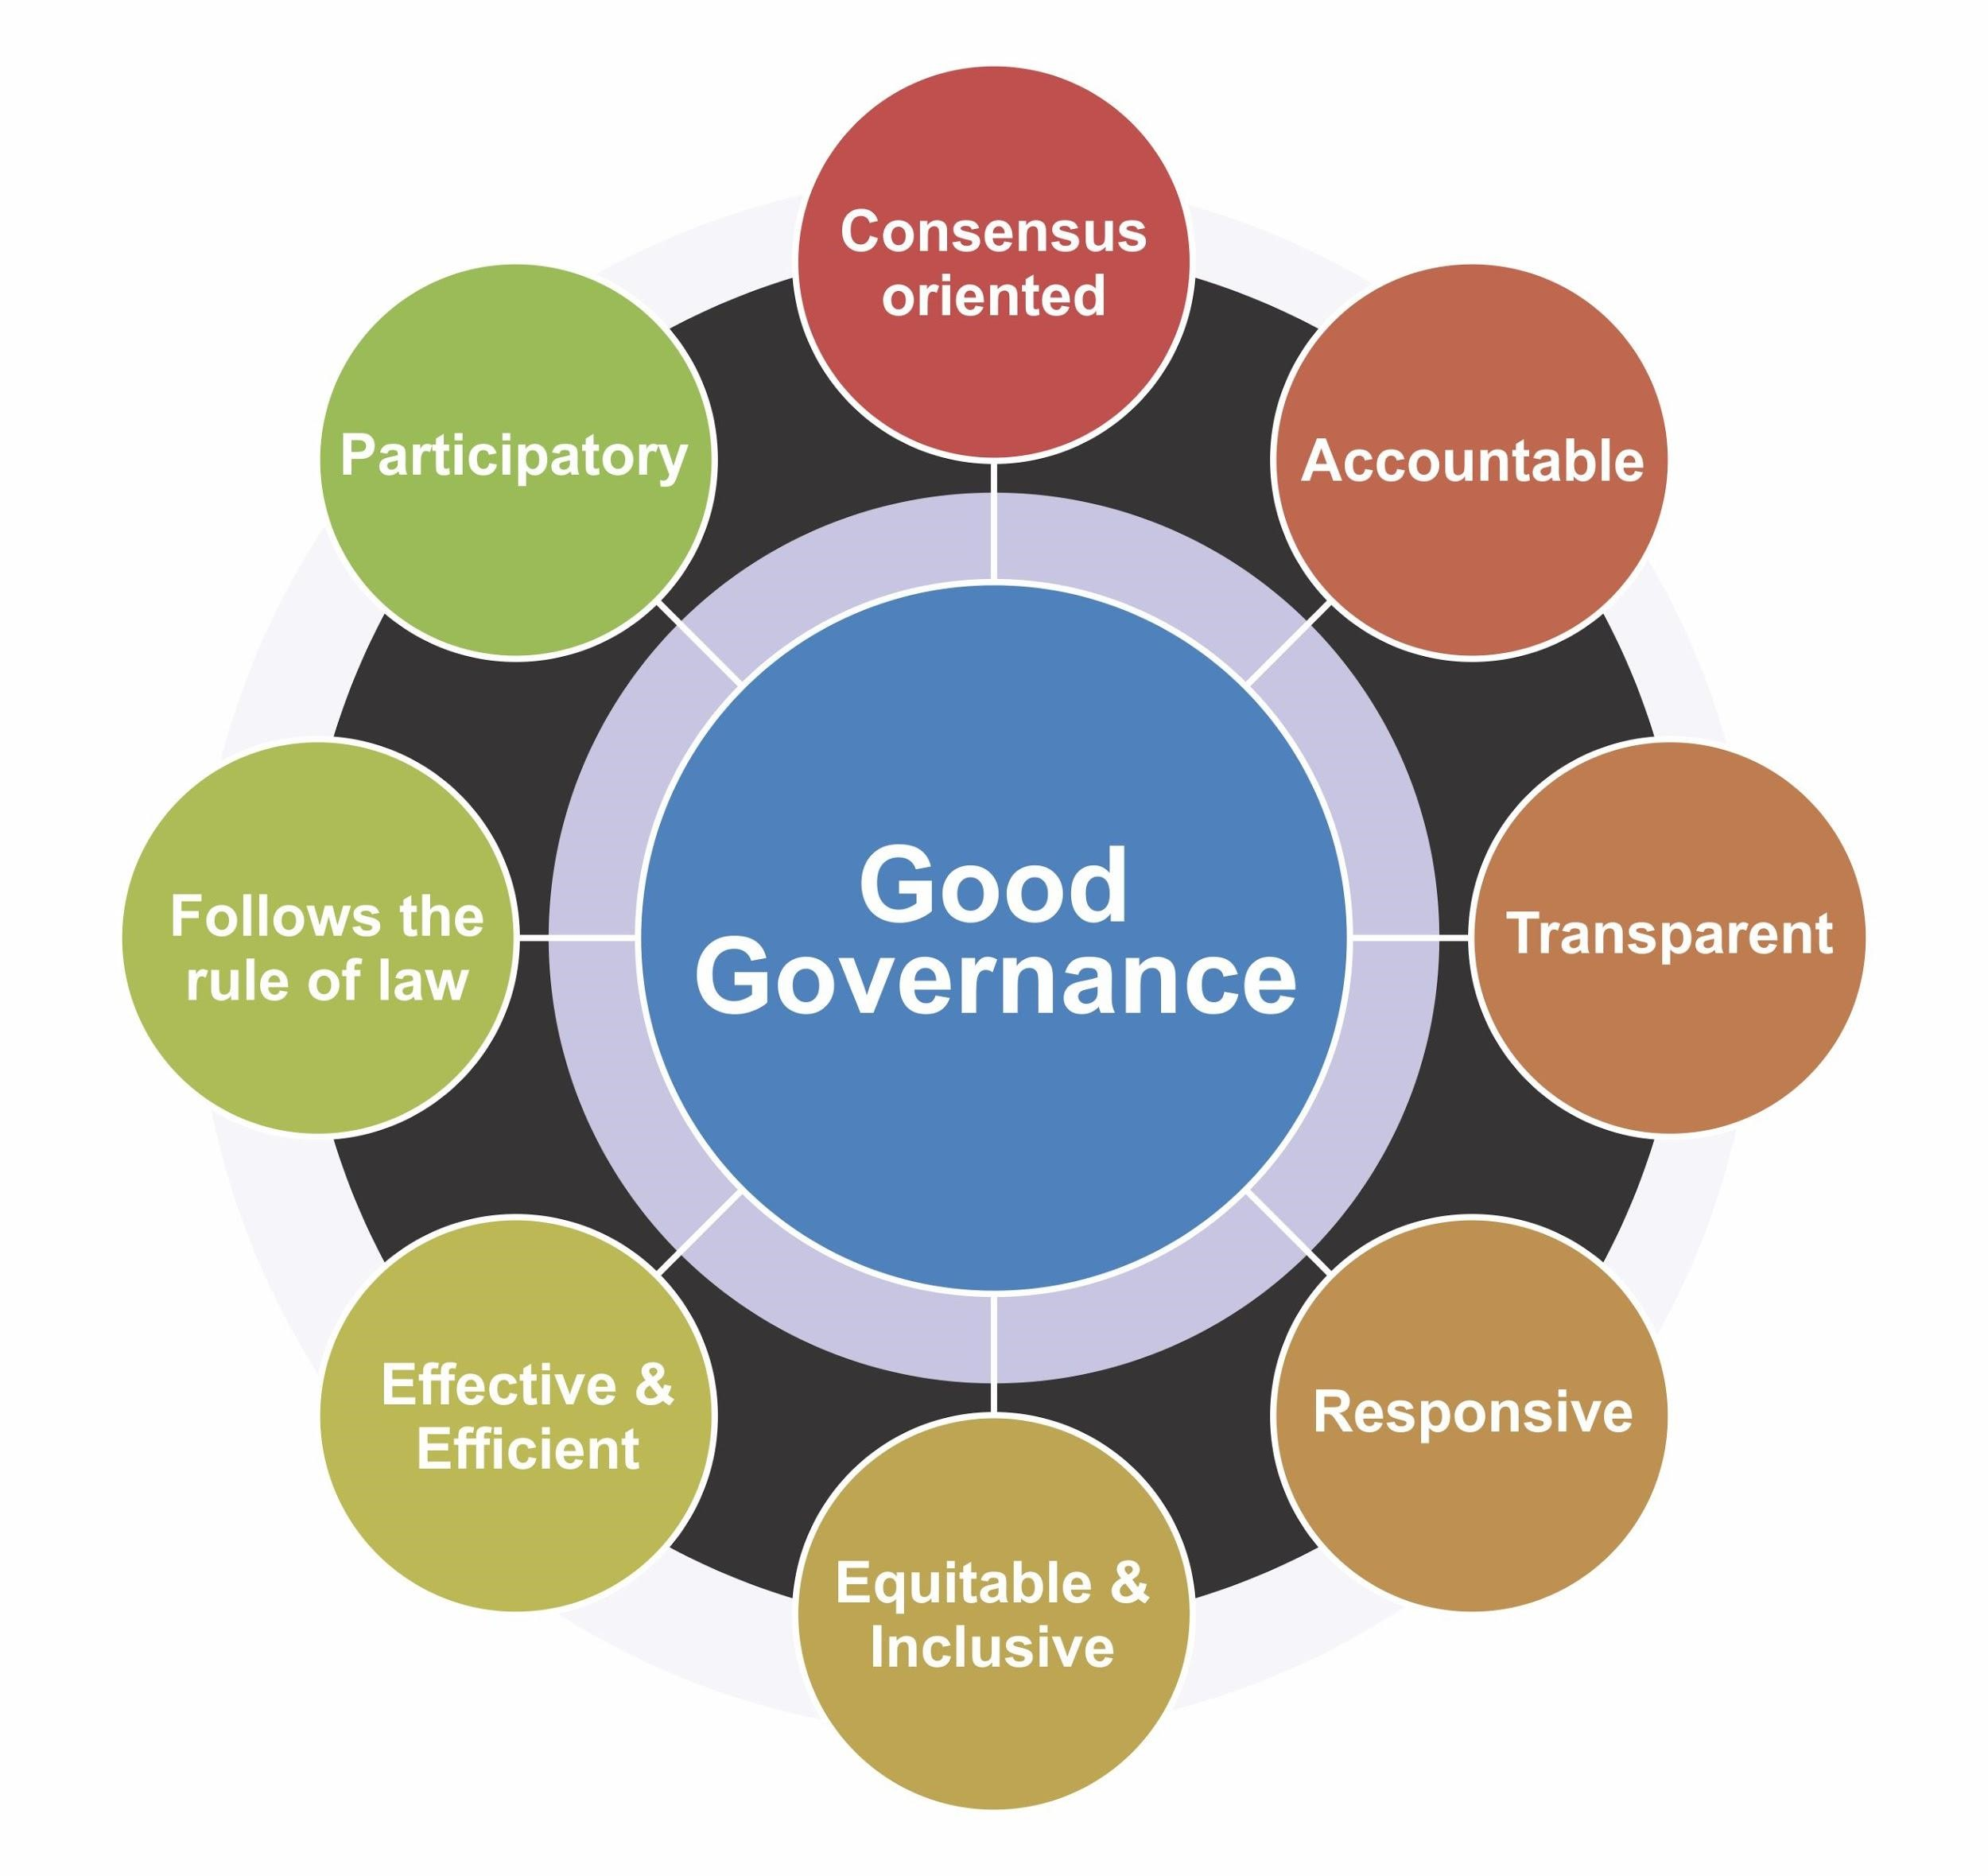
Module ACNA4004: 2024 / 2025 What makes for good governance?
04/11/2024
The United Nations Economic and Social Commissions for Asia and the Pacific stated there are 8 principles of good governance:
Activity:
Take a single a principle, research its meaning, and articulate it to the group.
(UNESCAP, 2009)
A. Cunningham Lecture 5: Environmental Governance
Slide 7 / 23
Notes:
Escap, U. "What is Good Governance? United Nations Economic and Social Commissions for Asia and the Pacific." (2009).

Slide 8

Module ACNA4004: 2024 / 2025 Who should Govern?
04/11/2024
A. Cunningham Lecture 5: Environmental Governance
Slide 8 / 23

Slide 9
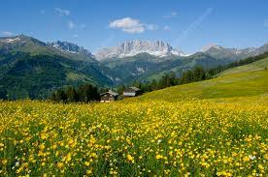
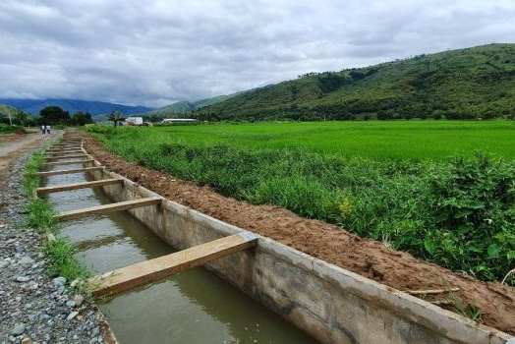
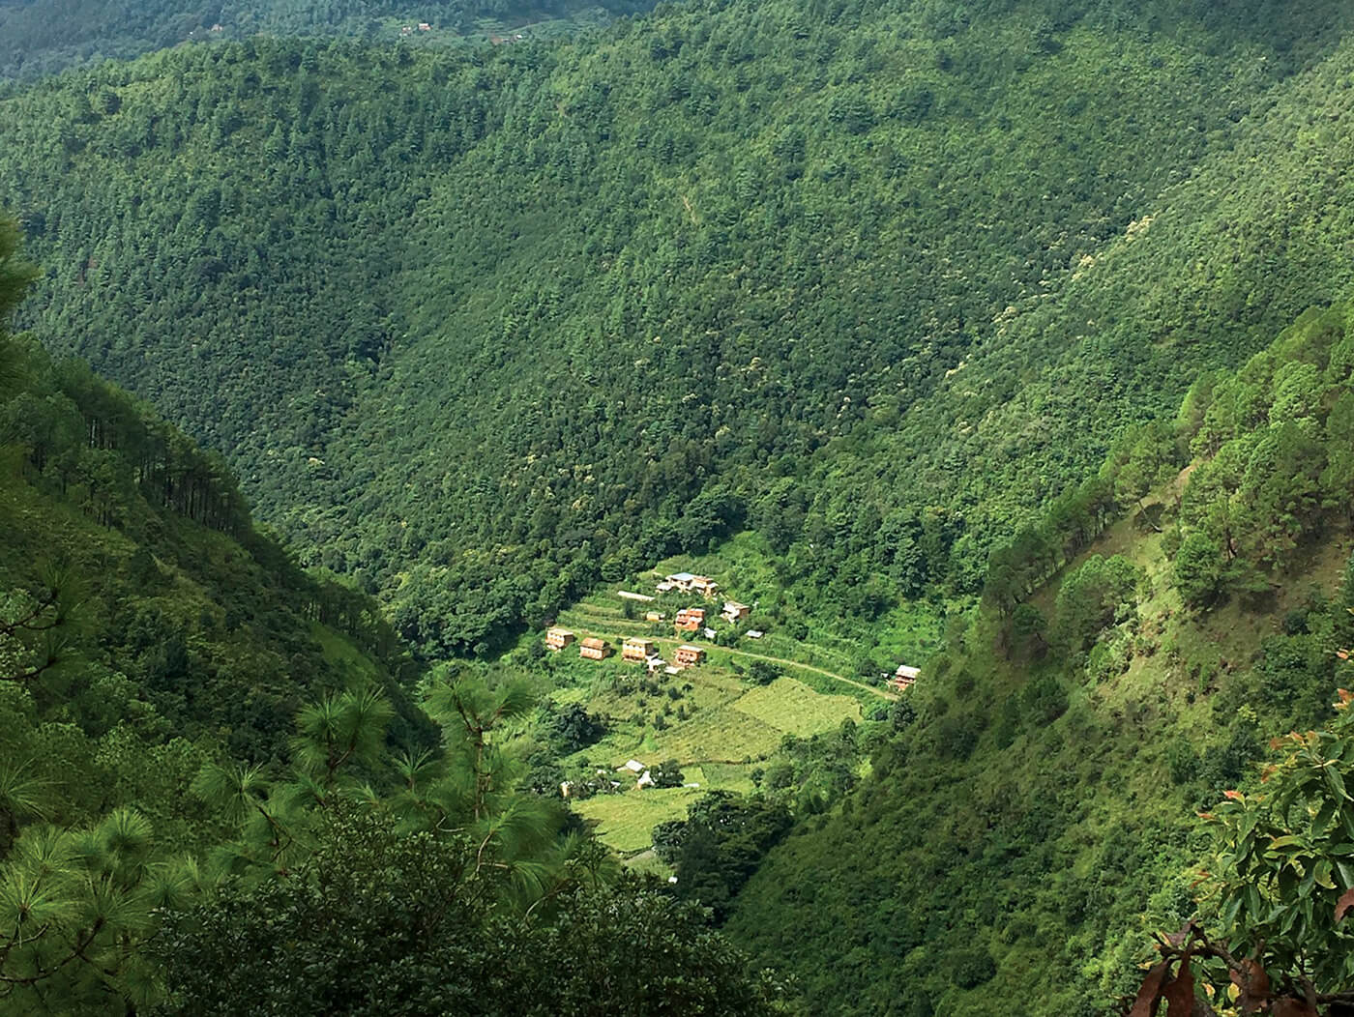
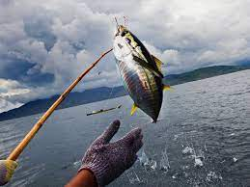
Module ACNA4004: 2024 / 2025 Ostrom: Self-Governing principles
04/11/2024
Mountain Meadows
Switzerland and Japan
Ostrom demonstrated that “grass-roots” self-governance could be successful in preserving resources, and that state action was not always required.
She devised eight Design Principles when devising self-regulatory systems:
1. Commons need to have clearly defined boundaries.
In particular, who is entitled to access to what? Unless there’s a specified community of benefit, it becomes a free for all, and that’s not how commons work.
2. Rules should fit local circumstances.
There is no one-size-fits-all approach to common resource management. Rules should be dictated by local people and local ecological needs.
3. Participatory decision-making is vital.
There are all kinds of ways to make it happen, but people will be more likely to follow the rules if they had a hand in writing them. Involve as many people as possible in decision-making.
4. Commons must be monitored.
Once rules have been set, communities need a way of checking that people are keeping them. Commons don’t run on good will, but on accountability.
5. Sanctions for those who abuse the commons should be graduated.
Ostrom observed that the commons that worked best didn’t just ban people who broke the rules. That tended to create resentment. Instead, they had systems of warnings and fines, as well as informal reputational consequences in the community.
6. Conflict resolution should be easily accessible.
When issues come up, resolving them should be informal, cheap and straightforward. That means that anyone can take their problems for mediation, and nobody is shut out. Problems are solved rather than ignoring them because nobody wants to pay legal fees.
7. Commons need the right to organise.
Your commons rules won’t count for anything if a higher local authority doesn’t recognise them as legitimate.
8. Commons work best when nested within larger networks.
Some things can be managed locally, but some might need wider regional cooperation – for example an irrigation network might depend on a river that others also draw on upstream.
Irrigation Systems Spain and Philippines
Forests
Nepal
Fisheries
Indonesia
A. Cunningham Lecture 5: Environmental Governance
Slide 9 / 23

Slide 10
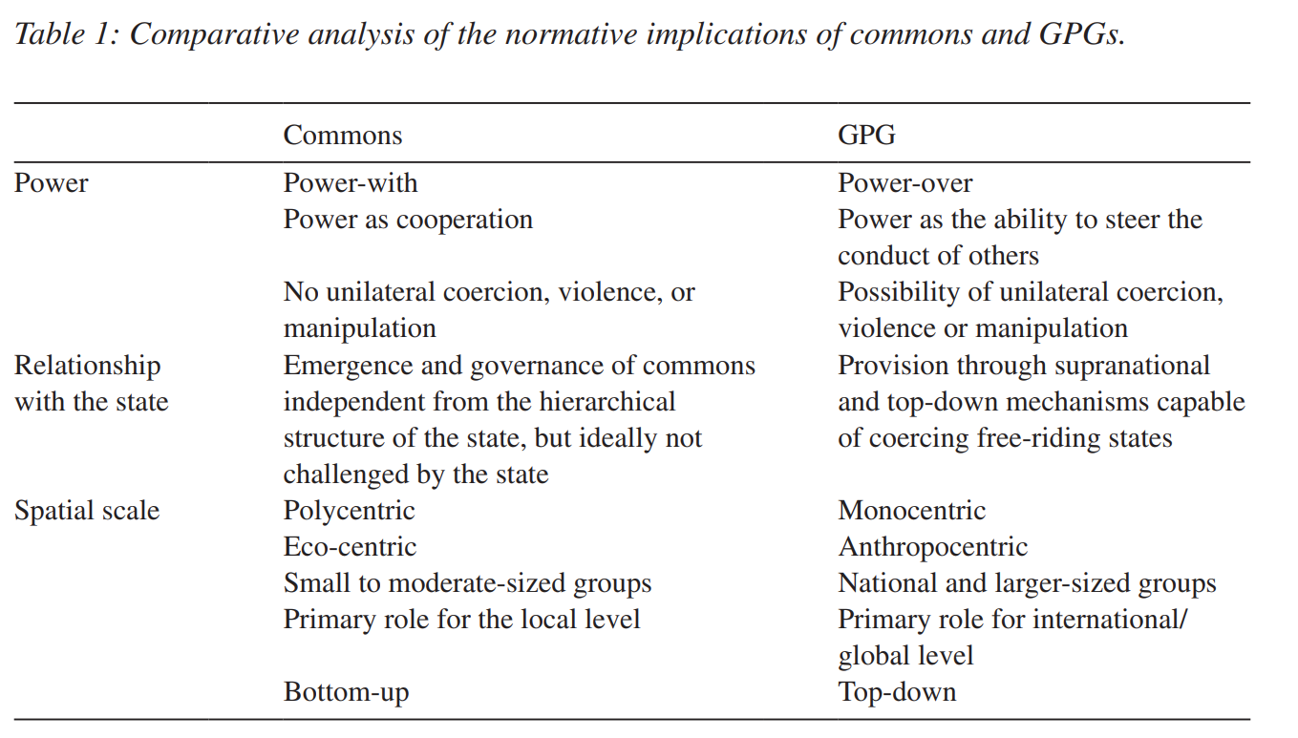
Module ACNA4004: 2024 / 2025 Scale of governance: Commons vs Global Public Goods
04/11/2024
Can the self-governing ‘commons’ approach be applied globally, adapting for the scale of the problem?
Despite Ostom’s belief for grassroots, localised, systems, she recognised that they may not always be applicable.
The growing scale of global issues supports this, climate change being a good contemporary example.
Boonen (2019) argues that the ‘commons’ model (Ostrom), and the ‘Global Public Goods’ (GPG’s) model (Kaul et al., 1999) reveal the implications of differences in scale, both of the resource and the governance.
Source: Boonen, Christiaan, et al. "Governing as commons or as global public goods." International Journal of the Commons 13.1 (2019): 553-577.
“If the problem is international in scope, decision making to address it will have to be done at that level” (Kaul et al. 1999, 466).
A. Cunningham Lecture 5: Environmental Governance
Slide 10 / 23
Notes:
Boonen, Christiaan, et al. "Governing as commons or as global public goods." International Journal of the Commons 13.1 (2019): 553-577.
Grunberg, Isabelle, Inge Kaul, and Marc A. Stern, eds. Global public goods: international cooperation in the 21st century. Oxford University Press, 1999.
“Global public goods are public goods whose benefits reach across borders, generations and population groups. They form part of the broader group of international public goods, which include as another sub-group, regional public goods.”
2000. Kaul, Inge – from Global Public Goods, transnational public goods: some definitions (keionline.org)

Slide 11
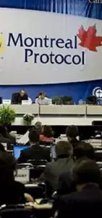

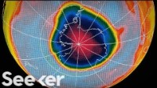
Module ACNA4004: 2024 / 2025 Ozone Depletion: Example of international success
04/11/2024
Despite criticism of ‘top-down’ mono-centric approaches, and examples of historic failures (Nepalese forests and New Brunswick fisheries), some historic examples have been successful.
The resolution of the ‘Ozone hole’ is believed to be a role model for how contemporary and future problems could be governed.
As of 2009, it is the only global agreement to be ratified by all 193 UN nations.
A. Cunningham Lecture 5: Environmental Governance
Slide 11 / 23

Slide 12
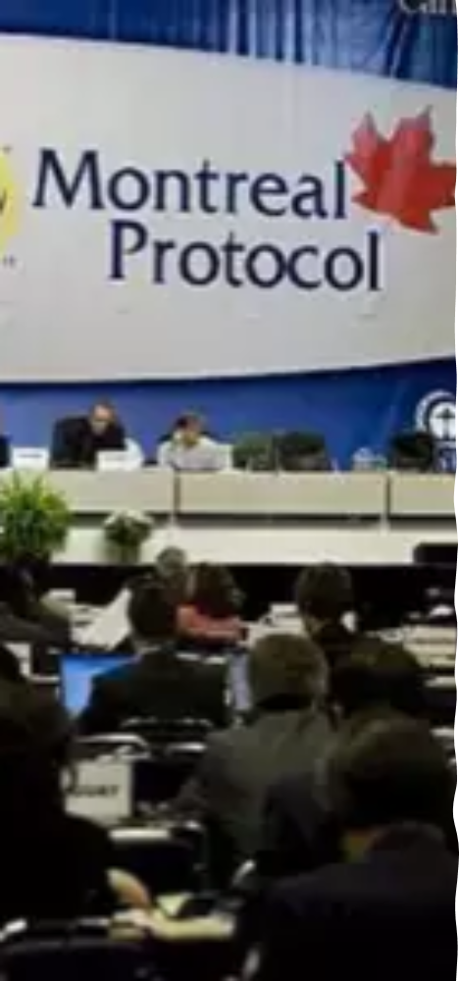
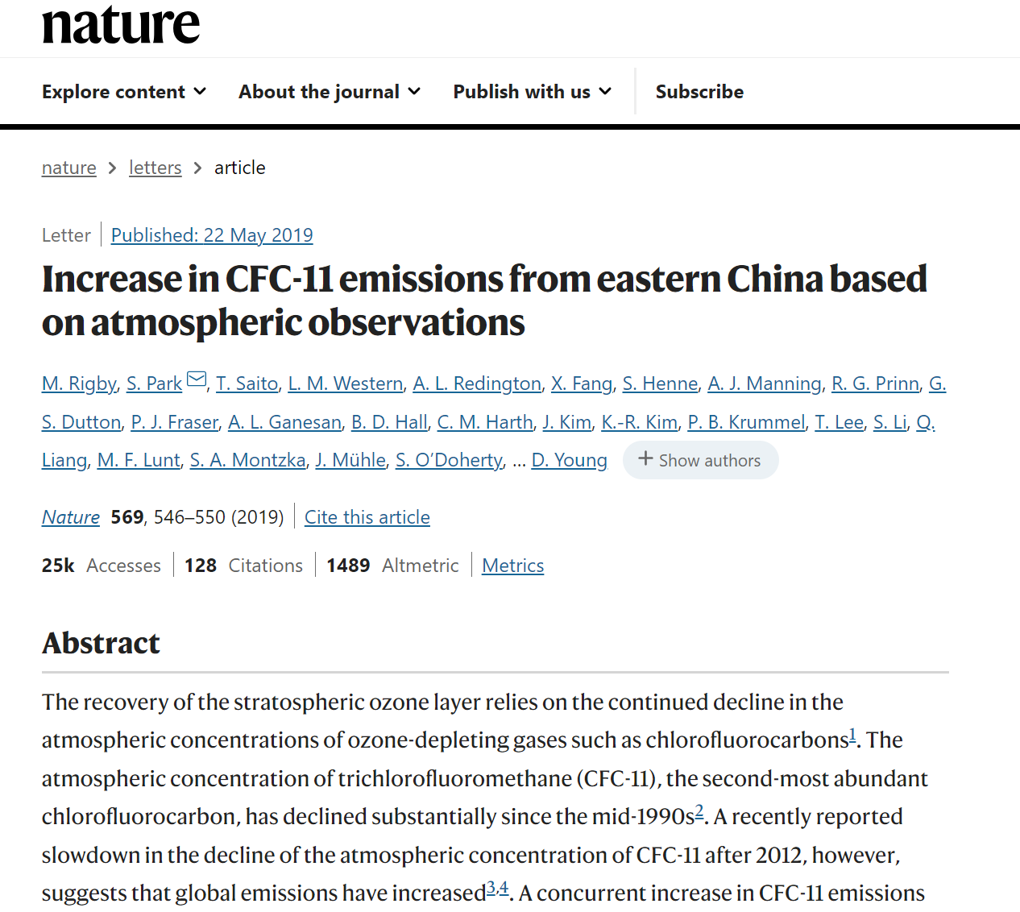
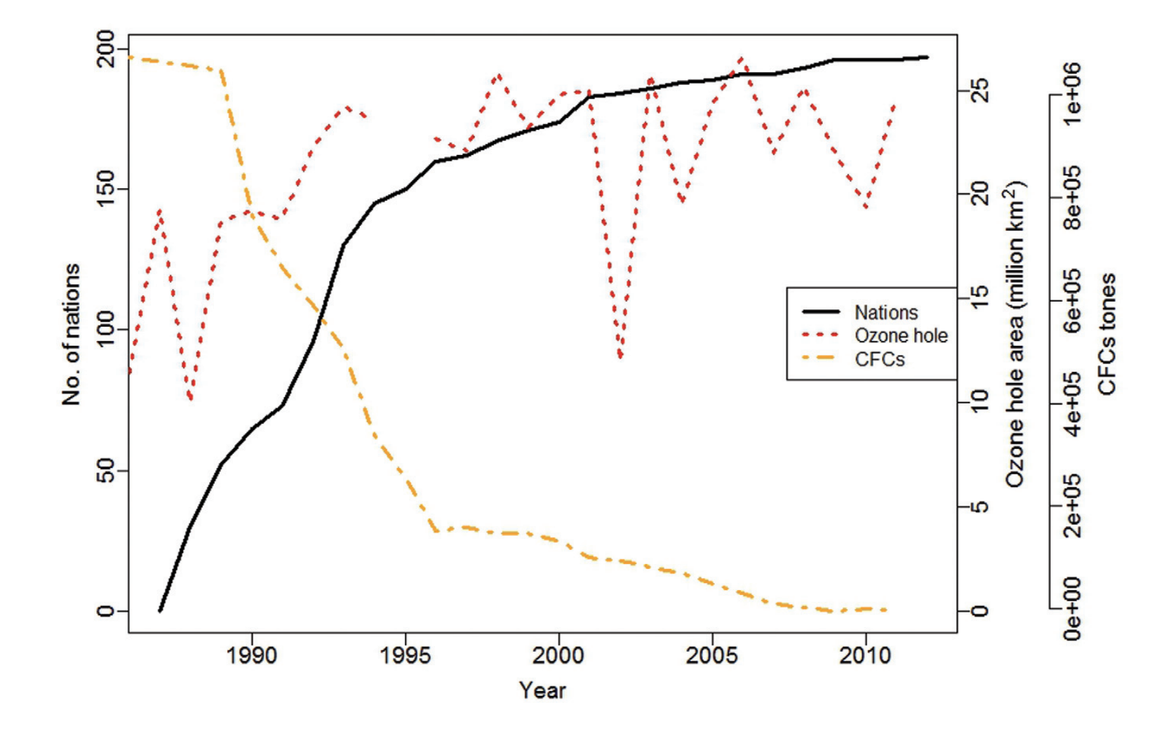
Module ACNA4004: 2024 / 2025 Ozone Depletion: Example of international success
04/11/2024
Why was the Montreal Protocol such a success?
Literature suggests:
  A single measurable source of pollution (CFC’s)
  a limited number of major industrial producers,
  advances in scientific knowledge,
  the availability of technological substitutes (and the consideration of substitutes built into the engagement process)
Also, the concept of skin cancer and loss of vegetation (crops) was a tangible threat to the public.
Epstein et al. (2014), explored whether the Montreal Protocol was successful due to governance using Ostrom’s small-scale ‘CRP’ principles.
There was opposition from ‘privileged actors’ – those who had had the most to gain from the production of CFC’s, and would face the greatest cost from ablation.
A. Cunningham Lecture 5: Environmental Governance
Slide 12 / 23
Notes:
Epstein, Graham, et al. “Governing the Invisible Commons: Ozone Regulation and the Montreal Protocol.” International Journal of the Commons, vol. 8, no. 2, 2014, pp. 337–60. JSTOR, https://www.jstor.org/stable/26523167. Accessed 11 Aug. 2023.

Slide 13
Module ACNA4004: 2024 / 2025 Ozone Depletion vs Climate Change
04/11/2024
Both Ozone Depleting Substances (ODS), and Greenhouse Gases (GHG), are similar in that they adversely affect the atmosphere, and have significant environmental consequences globally – so why is it seemingly more difficult to govern the latter?
It is important to consider the contributing factors that influence the potential governance:
ACTIVITY:
In groups, using the table (on the next slide), try to fill in the missing boxes in the comparison table of factors that influence the governance of both ODS and GHG.
A. Cunningham Lecture 5: Environmental Governance
Slide 13 / 23

Slide 14
Module ACNA4004: 2024 / 2025 Ozone Depletion vs Climate Change
04/11/2024
Comparison of factors that influence the governance of ODS vs GHG
Factor | Ozone Depleting Substances (ODS) | Greenhouse Gases (GHG)
Scale: Pollution sources | Industry (CFC’s) | Industry, transport, deforestation, domestic practices (e.g. heating), agriculture etc.
Availability of alternatives | HFC’s | Renewable energy sources (solar / wind / hydro / nuclear)
Access to alternatives | Transition funded by Montreal Protocol | Adaptation fund by Kyoto Protocol
Number of ‘actors’ (nation states / key stakeholders responsible) | 18 companies (4 major countries, 1 dominant producer) | Global: All fossil-fuel burning industries, owners of combustion engine vehicles etc..
Public perception | Initially sceptical, followed by global ‘panic’ | Initially sceptical, growing global consensus and concern
Duration of emissions | Since 1930’s | Since the industrial revolution (and before!)
?
?
?
?
?
?
A. Cunningham Lecture 5: Environmental Governance
Slide 14 / 23

Slide 15

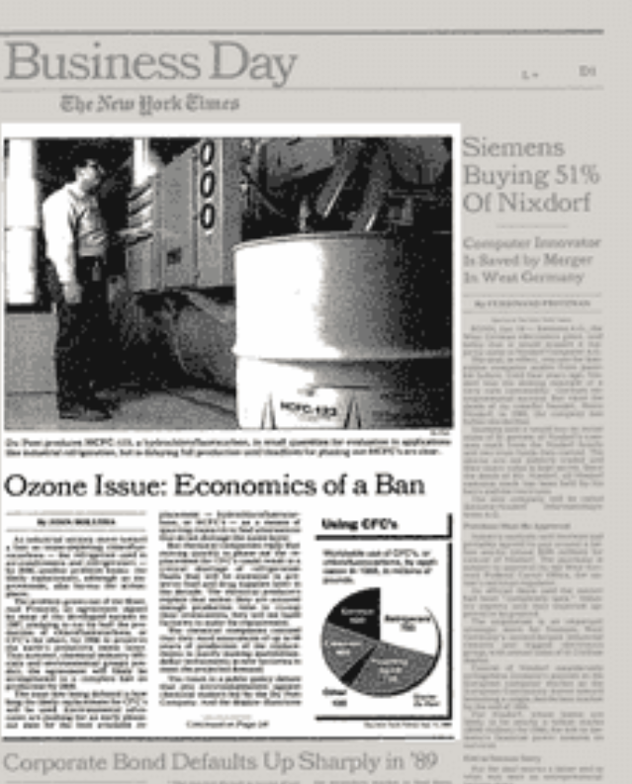
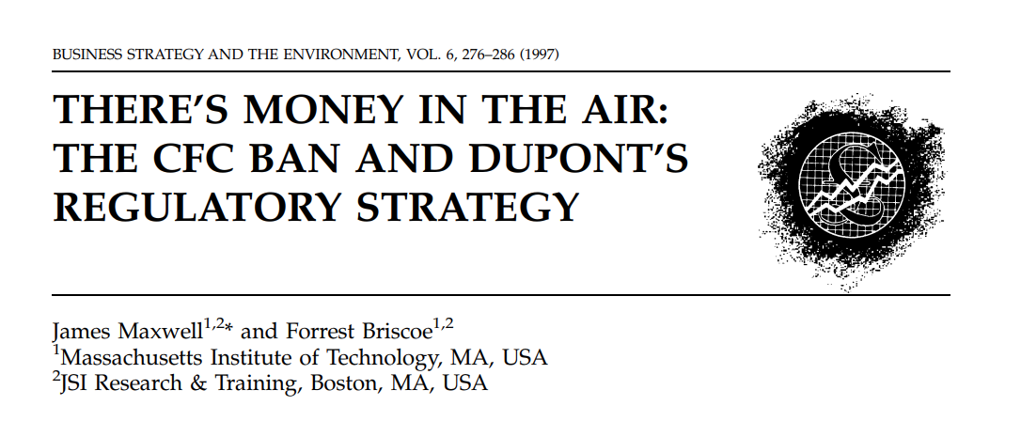
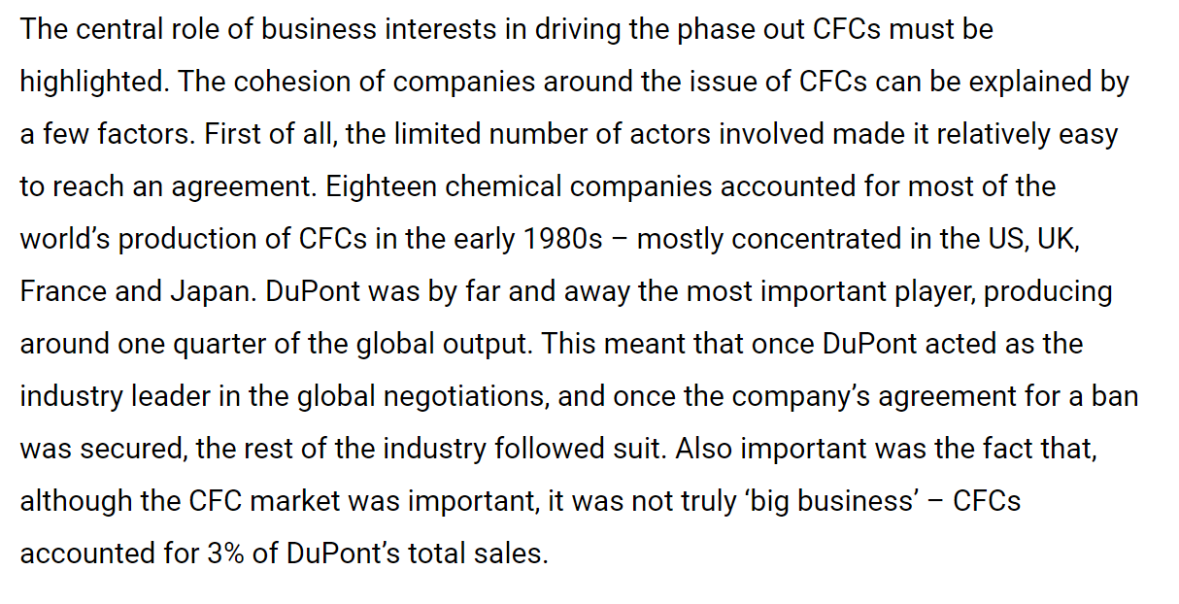
Module ACNA4004: 2024 / 2025 Role of Economy in Sustainability
04/11/2024
Role of economy in a sustainability issue cannot be underestimated.
It is a critical component when considering sustainable development.
Source: https://rapidtransition.org/stories/back-from-the-brink-how-the-world-rapidly-sealed-a-deal-to-save-the-ozone-layer/
A. Cunningham Lecture 5: Environmental Governance
Slide 15 / 23

Slide 16
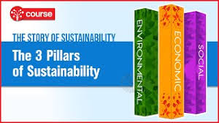
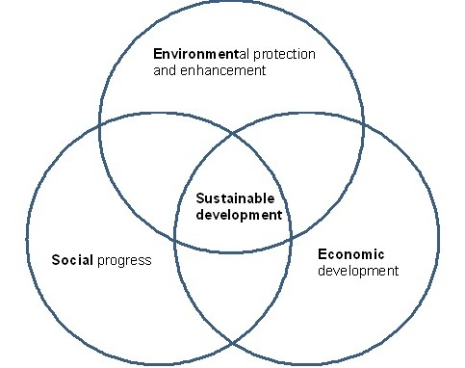

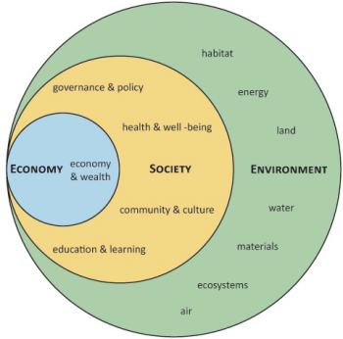
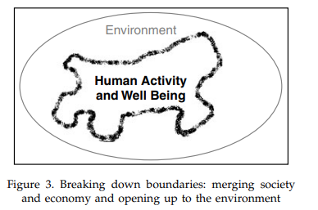
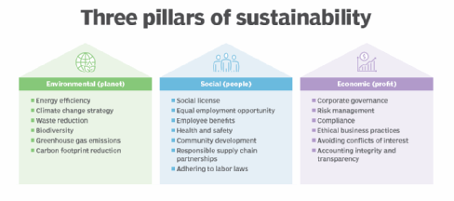
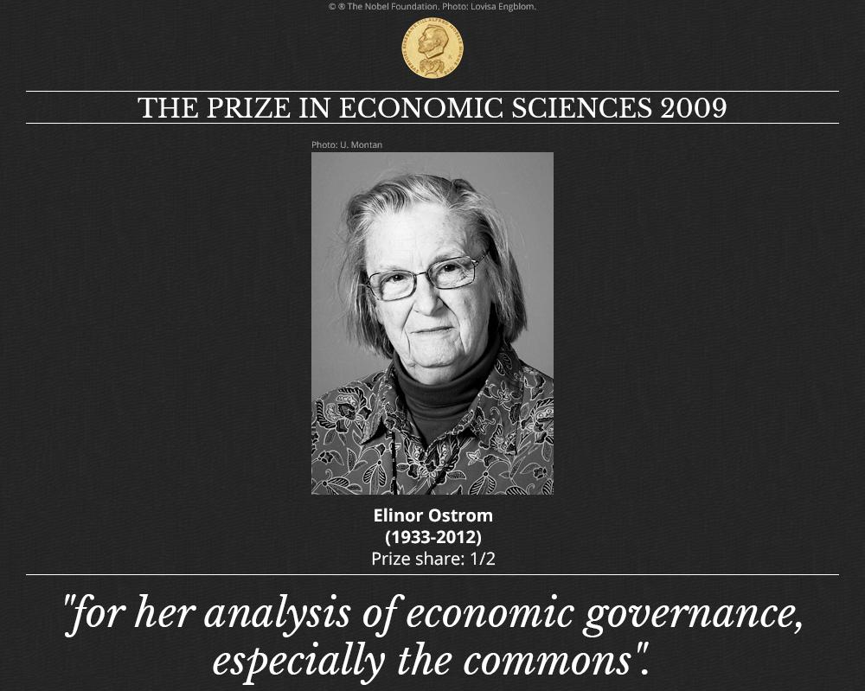
Module ACNA4004: 2024 / 2025 Three pillars: Environment, Society, Economy
04/11/2024
The threat to the ozone layer, and the various aspects of its international response (specifically from the industry responsible, and the public perception), reveal key aspects about the inter-related aspects of sustainability.
A. Cunningham Lecture 5: Environmental Governance
Slide 16 / 23
Notes:
Image: Giddings, Bob, et al. “Environment, Economy and Society: Fitting Them Together into Sustainable Development.” Sustainable Development, vol. 10, no. 4, 2002, pp. 187–96. Crossref, https://doi.org/10.1002/sd.199.

Slide 17

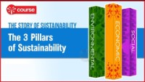
Module ACNA4004: 2024 / 2025 Three pillars: Environment, Society, Economy
04/11/2024
A. Cunningham Lecture 5: Environmental Governance
Slide 17 / 23

Slide 18
Module ACNA4004: 2024 / 2025 Ozone: Environment, Society, Economy
04/11/2024
DISCUSS: How do the following events / aspects of the ozone depletion timeline link to the three pillars of sustainability?:
1928: CFC invented: Safer alternative to public health
1951: CFC mass production begins
1973-4: Atmospheric scientists Mario Molina and F. Sherry Rowland research impact of CFCs on ozone molecules, and publish theory in ‘Nature’; the story is picked up by a science writer at The New York Times and published on the front page.
1974: DuPont responds with their own study claiming that CFCs are safe in the troposphere; calls for more research.
1975: 200% increase in CFC use from 1968- 1975, annual growth in consumption of 10- 20%/year.
1982: British scientific team in Antarctica using ground-based instruments announce 20% decline in ozone levels in the stratosphere
1985: British team reports a 50% decline in ozone levels. At first, U.S. team contradicts, re-check their instruments and then confirm the British findings.
1985: Acknowledgement of “ozone hole” in the media creates public and political alarm. Risk to health and natural environment. Risk to agriculture.
1986: Australian government announces doubling of skin cancer cases in previous 10 years.
1987: Preliminary research indicates that loss of ozone over Antarctica due primarily to human emissions of ozone-depleting chemicals.
1987: UN holds meetings in Montreal, and 45 nations sign the Montreal Protocol to reduce CFC use by 50% by the year 2000. Protocol is ratified in 1989.
1988: DuPont continues to argue that CFCs are safe to use, and initially oppose the Montreal Protocol.
1989: DuPont announce an impending phase-out of CFC production.
A. Cunningham Lecture 5: Environmental Governance
Slide 18 / 23

Slide 19
Module ACNA4004: 2024 / 2025 Environment, Society, Economy: Examples
04/11/2024
If we look at the previous case studies (shown in the previous lecture), these can be framed within the three pillars model also:
 | Over-fishing of cod |  | Burning of coal (and other fossil fuels) |  | Deforestation
 | Continue | Cease | Continue | Cease | Continue | Cease
Economy | Short-term: gains, returns on investments Long-term: losses | Loss of jobs, livelihoods, and failed investments | Driver for many forms of business internationally. Dependency. Continued industrial growth. Long-term: Increased demand and reduced supply. | Damaging to businesses and industry. Collapse of energy companies, and any associated businesses. Global economic collapse without appropriate alternative to match demand. | Short-term: Many industries dependent on timber (e.g. construction) Long-term: decreased supply and increased demand | Loss of jobs, livelihoods, and failed investments. Lack of investment in alternatives could result in issues for certain trades.
Society | Short-term: Continuation of key part of core industry. Long-term: Huge impacts to communities. If the fish decline, society is harmed through guilt / shame. | Dependent on fishing - part of historic culture and way of life. Loss of local heritage. | Industry progression, allowing for advancements in technology and benefits to daily life and healthcare. Long-term: Detrimental to human health through impacts of climatic change. | Dependent on energy supply. Essential for warmth, cooking etc. Impacts to health would be severe. Loss of business would harm livelihoods. | Short-term: Benefits of housing, construction, commodities etc. Long-term: Society is influenced by guilt from destruction of ecosystems. | Short-term: Issues associated with industrial changes, loss of timber communities and business. Long-term: Benefits from ecosystem services from forested landscapes.
Environment | Removal of a species or significant impact to species development Impacts on food chain. | Recovery of a species and retaining balance in a food chain. | Increased atmospheric emissions exacerbate greenhouse gas effect and subsequent global warming. Change in earth systems and indirect impact on all ecosystems globally. | Reduction of atmospheric pollution and impacts of climate change. Long-term: Recovery of species currently unable to adapt. Rebalancing of natural systems. | Forest fragmentation, loss, and destruction. Loss of forest species. Indirect consequences, including desertification, and lack of carbon sink for global warming. | Recovery of ecosystems and associated species. Increased absorption of atmospheric CO2, reducing future impacts of climate change.
A. Cunningham Lecture 5: Environmental Governance
Slide 19 / 23

Slide 20
Module ACNA4004: 2024 / 2025 Summary
04/11/2024
In this lecture, we covered:
What Environmental Governance is, how it is defined, and what makes good governance
Levels of governance, and implications of scale on relevance of monocentric or polycentric approaches
Example of the Montreal Protocol as an example of top-down international governance, and comparability with contemporary climate change governance
The role of economy as one of the three pillars of sustainability
A. Cunningham Lecture 5: Environmental Governance
Slide 20 / 23

Slide 21
Module ACNA4004: 2024 / 2025 Next Session
04/11/2024
The next lecture will cover:
Environmental Governance Cont.
Suggested activities:
  Read up on origins of the AONB designation
    Why was it created, and by whom?
Suggested reading:
  Escap, U. "What is Good Governance? United Nations Economic and Social Commissions for Asia and the Pacific." (2009).
  Boonen, Christiaan, et al. "Governing as commons or as global public goods." International Journal of the Commons 13.1 (2019): 553-577.
  Giddings, Bob, et al., “Environment, Economy and Society: Fitting Them Together into Sustainable Development.” Sustainable Development, vol. 10, no. 4, 2002.
A. Cunningham Lecture 5: Environmental Governance
Slide 21 / 23

Slide 22

Module ACNA4004: 2024 / 2025 References
04/11/2024
  Gazi, S., Treccani, M., Morini, M. and Sahdev, N.K., 2022. Blockchain as Commons: Applying Ostrom’s Polycentric Approach to Blockchain Governance. Available at SSRN 4250547.
  Kumar, P., Druckman, A., Gallagher, J., Gatersleben, B., Allison, S., Eisenman, T.S., Hoang, U., Hama, S., Tiwari, A., Sharma, A. and Abhijith, K.V., 2019. The nexus between air pollution, green infrastructure and human health. Environment international, 133, p.105181.
  Lemos, M.C. and Agrawal, A., 2006. Environmental governance. Annu. Rev. Environ. Resour., 31(1), pp.297-325.
  Najam, A., Papa, M. & Taiyab, N., 2006. Global Environmental Governance: A Reform Agenda, IISD. Canada
  Escap, U., 2006. What is Good Governance? United Nations Economic and Social Commissions for Asia and the Pacific.
  Boonen, C., Brando, N., Cogolati, S., Hagen, R., Vanstappen, N. and Wouters, J., 2019. Governing as commons or as global public goods. International Journal of the Commons, 13(1), pp.553-577.
  Grunberg, Isabelle, Inge Kaul, and Marc A. Stern, eds. 1999. Global public goods: international cooperation in the 21st century. Oxford University Press.
  Epstein, G., Pérez, I., Schoon, M. and Meek, C.L., 2014. Governing the invisible commons: Ozone regulation and the Montreal Protocol. International Journal of the Commons, 8(2), pp.337-360.
  Giddings, B., Hopwood, B. and O'brien, G., 2002. Environment, economy and society: fitting them together into sustainable development. Sustainable development, 10(4), pp.187-196.
A. Cunningham Lecture 5: Environmental Governance
Slide 22 / 23

Slide 23
Module ACNA4004: 2024 / 2025 Questions
04/11/2024
Any questions?
Please contact via:
Email: a.cunningham@uwtsd.ac.uk
Teams: “ACNA4004 Contemporary Challenges 2024/35_GRP”
ACNA4004 Contemporary Challenges 2024/35_GRP | General | Microsoft Teams
A. Cunningham Lecture 5: Environmental Governance
Slide 23 / 23

