Slide 1

Plan of Action
Employability Skills
By Jo Fender

Slide 2
Aim
Ensure all students are clear of assessment criteria.

Slide 3
Objectives
Discuss VIVA breakdown and assessment criteria.
Highlight assessment dates.
Evidence workplace practice placement hours.
Student Integration within university life
Revisit Johns reflective practice.
Practice interviews
Reflect on workplace learning.

Slide 4
VIVA - Breakdown
The assessment will take place during the week commencing 16th and 23rd March.
You will be assessed by having a development appraisal.
In this process you will sit down with a team of four UWTSD staff and answer questions regarding your placement and your professional development.
Whilst the appraisal will be delivered in an informal and supportive environment you will need to prepare well for it in order to pass, remember the key to this process is honesty, don’t be afraid to talk about where you feel you didn’t do well or need to improve, that’s the only way you will develop and will be scored higher if we can sense you are able to critique yourself!
The questions will be grouped into 4 sections so read the information below and prepare accordingly for each section:

Slide 5
Assessment Criteria
The PANEL will interview the student in relation to the following four themes:
1. Clinical and Practical Skills
This is a chance for you to consider the tangible skills you have developed. Come with examples of these skills you have learned and when you have put them into practice.
2. Personal Growth
In this section reflect on the wider skills and traits you have developed, these will be softer skills such as communication, confidence, professional conduct etc. Again, make sure you can give examples to illustrate these points.
3. Case Study using a Reflective Model
There are a wide range of reflective models that can be used in Health and Social Care. Using one of these models give a case study example of how you have effectively reflected on your practice and developed as a result.
4. Moving Forward
This is an important section and gives you the chance to think about the areas you need to develop moving forwards and how you can make this happen. Your planning for this section will be shaped by the three above so using a model of reflection consider what, where and how you can develop your clinical and practical skills and personal growth.
A WORKPLACE PRACTICE Handbook accompanies this assignment.

Slide 6
Assessment Dates
All modules listed will be assessed by way of PANEL INTERVIEW in the week commencing 16th and 23rd March 2020. The PANEL shall be made up of no less than;
Two Placement Officers
The Module Coordinator (or representative)
At least one health management student
At least one workplace practice student from each other level of study

Slide 7
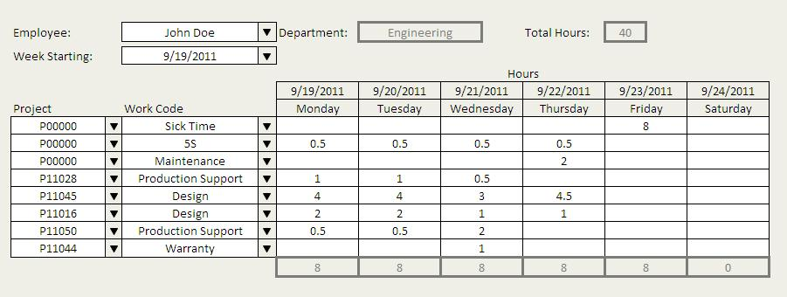
Evidence workplace placement hours.
All students will need to show evidence of their workplace practice hours.

Slide 8

Student Integration within university life.
Students will need to think about how they have integrated into university life in readiness for their VIVA.

Slide 9
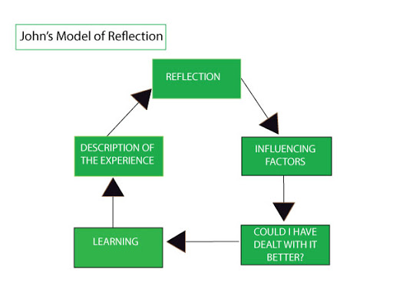
Revisit Johns reflective model.
We will revisit Johns reflective model to familiarise everyone in readiness for the VIVA.
You can find this on your Moodle page.

Slide 10

Practice interviews
We will practice interviews during every session, leading up to the VIVA assessment.

Slide 11

Reflect on workplace learning.
All students will need to reflect and identify the learning skills they have acquired, during their workplace practice placements.
This will provide good practice in readiness for your VIVA assessment.

Slide 12

Remember to breathe ………

