Slide 1
PLANNING PERFECTION, DIY CULTURE AND THE JOYS OF ESMP AND H&S
By Natalie Smith

Slide 2
TODAYS SUMMARY
01
02
03
04
05
Guest Michael Jobson discussing international touring, artist management and setting up a production company
DIY Industry with James Collins
Licensing and legislation with Justin Argent
An introduction to ESMP
Fun Friday finish with Health and Safety!

Slide 3
MICHAEL JOBSON
INTERNATIONAL TOURING

Slide 4
DIY METHODS
with
James Collins

Slide 5
MUDBATHS AND MOSHPITS: How safety makes the right kind of memories
with Guest Justin Argent

Slide 6

SUMMARY
Network your ass off
Be super keen, make yourself known
Maintaining good relationships with colleagues, suppliers, artists
Be bold
Show no fear
Shop around
Use your network. I am now apart of that so contact me any time

Slide 7

7 KEY STEPS TO PLANNING THE PERFECT EVENT

Slide 8
1 – PURPOSE
PRE EEVENT RESEARCH
IDENTIFY A NEED/ MARKET
ON/OFF LINE RESEARCH

Slide 9
2 – PRESENTATION
1
2
3
PREPARING A PROPOSAL OR BRIEF USING WORDS, NUMBERS AND PICTURES
AUDIENCE AT HEART OF DESIGN
‘WHAT IF’ BRAINSTORMING

Slide 10
3 – PLANNING
PLAN WITH END OF EVENT IN MIND
ESTABLISH EVENT REQUIREMENTS
RECRUIT TEAM
CREATE A PROJECT PLAN
CREATING AN OPERATIONAL PLAN

Slide 11

TEAM AND ROLES

Slide 12
WHO ARE THESE PEOPLE AND WHAT DO THEY DO?
THE CREW
TEAM MANAGERS
CORE MANAGEMENT
THE
IDEA

Slide 13
EXAMPLES OF FESTIVAL
CORE MANAGEMENT TEAM
Mischief
Festival director
Production manager
Operations manager
+ 3 friends with no defined role
BoomTown Fair
Creative director
Operations director
License manager
Infrastructure manager
Creative assistant manager
Operations assistant manager
Press manager
Music office manager
Technical Production Manager
Finance manager
Performance manager

Slide 14
WHO ARE THESE PEOPLE AND WHAT DO THEY DO?
THE CREW
TEAM MANAGERS
CORE MANAGEMENT
THE
IDEA

Slide 15
TEAM MANAGERS
Head Security
Head Steward
Waste Manager
Stage Manager
Artists Liaison Manager
Costume Manager
Build Manager
Decor Manager
Lighting Manager
Transport Manager internal/ external
Programme Manager
Ticket manager
Zone Manager
Site Manager
Trader Manager
Production office manager
Site Office Manager
H&S Manager
Event Control Manager
Production Manager
Ped Gate Manager
Crew Gate Manager
Welfare Manager
Information Point Manager
Bar managers

Slide 16
WHO ARE THESE PEOPLE AND WHAT DO THEY DO?
THE CREW
TEAM MANAGERS
CORE MANAGEMENT
THE
IDEA

Slide 17
THE CREW
Stewards
Security
Carpenters
Welders
Painters
Set builders
Performers
Site crew
Artists Liaisons
Stage Manager
Lighting engineers
Stage hands
Litter pickers
Scaffolders
Box office staff
Sound engineers
H&S team
Programme sellers
Production office staff
Music Office Staff
Runners
Caterers
Site Artists
Bar staff

Slide 18

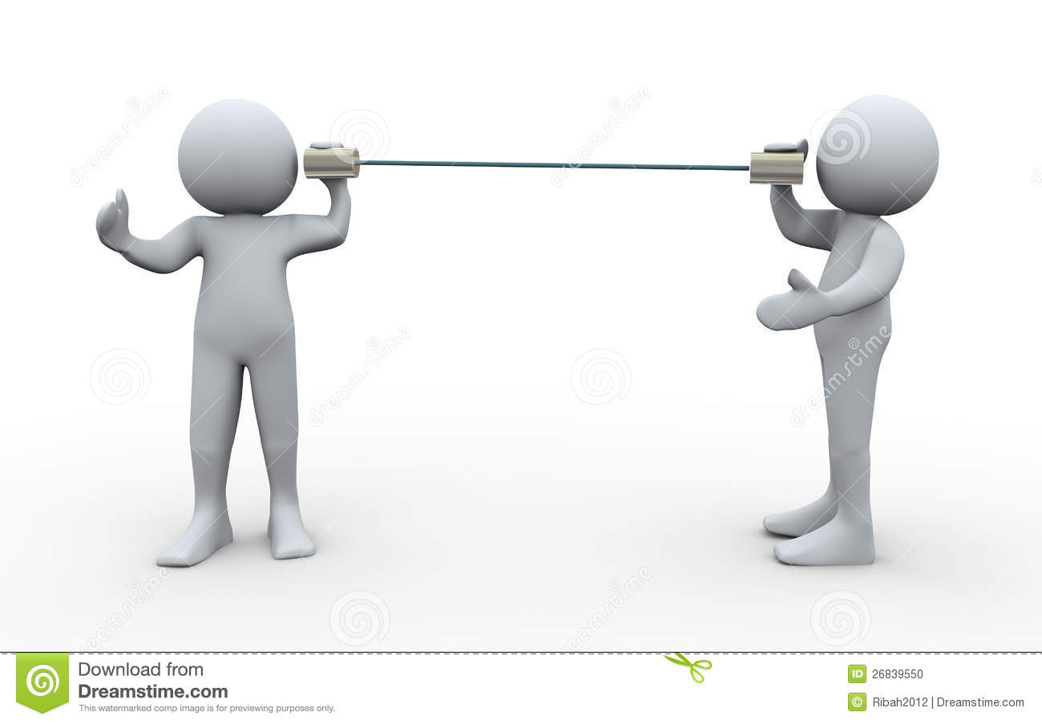

THE IMPORTANCE OF CLEAR LINES OF COMMUNICATION

Slide 19
USING THE 5WS HERE - LEVEL OF COMPLEXITY OF INFORMATION NEEDED: (DIRECTIONAL APPROACH)
Who needs to the information
When do they need it by
What do they actually need
How do they need it?

Slide 20
4 – PLACES AND SPACES
Agree venue criteria
Search, visit, evaluate
Contract and get to know

Slide 21
5 – PROGRAMME
1
2
3
Think audience value
Impact, relevance, time taken
Mix of activities

Slide 22
6 – PROMOTION
01
02
03
Be exciting
Being consistent
Make a marketing plan

Slide 23
7 – PRODUCTION
BUILD SCHEDULE
H&S SIGN OFF
DELIVERING THE EVENT

Slide 24
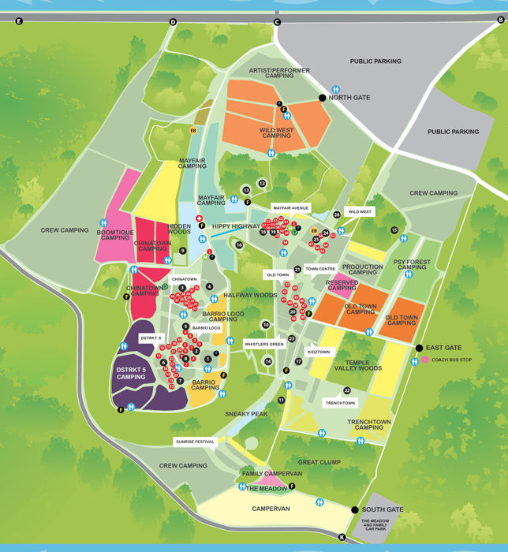
SITE LAYOUT
What will you need to think about?

Slide 25
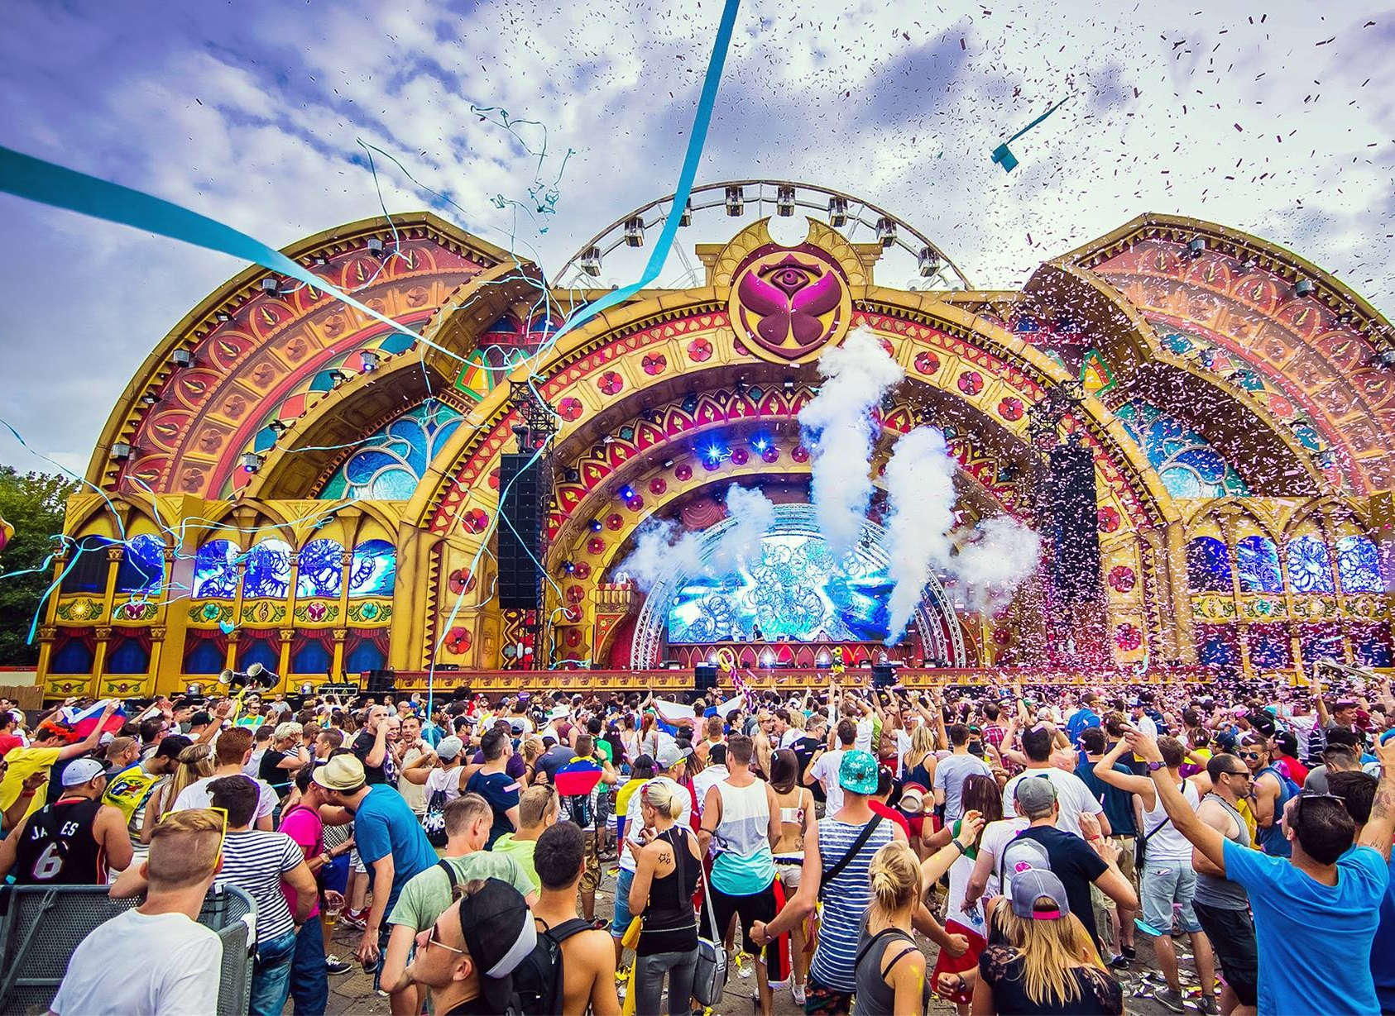
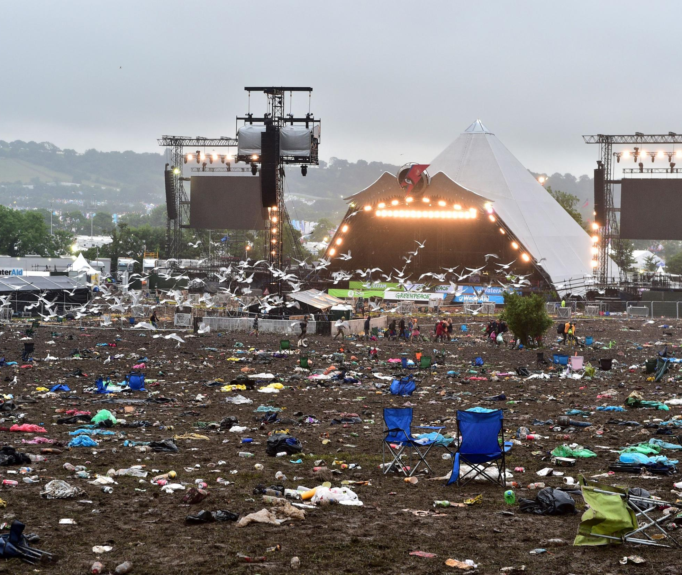
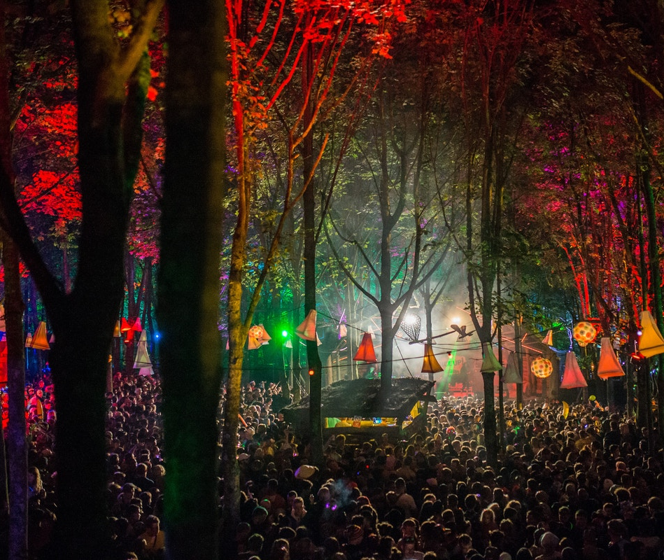
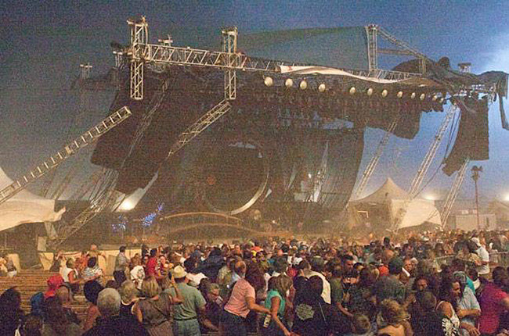
THE IMPORTANCE OF EVENT DESIGN

Slide 26
SUMMARY
Network your ass off
Be super keen, make yourself known
Maintaining good relationships with colleagues, suppliers, artists
Be bold
Show no fear
Shop around
Use your network. I am now apart of that so contact me any time

