Slide 1
INTRODUCTION TO PUBLIC HEALTH
Infectious disease
LCHS7000
Semester 1 2021/22
Dr Aishat Bakre

Slide 2
Learning outcomes
On successful completion of this module, you should be able to:
Demonstrate a thorough understanding and knowledge of the various approaches to social epidemiology interventions and ways for monitoring epidemiological information of a population during the life course.
Apply knowledge on the link between social environment and health for the development of needs assessments, considering the social determinants of health and impact of social factors on individual and public health.
Communicate analysis and evaluation of outcomes of epidemiological studies and how these outcomes relate to social and cultural contexts, public health interventions and policies.
Demonstrate knowledge and understanding of the various forms of health inequalities in the UK and globally, and critically compare and evaluate public health policies and interventions.

Slide 3
Module Summary
The module aims overall to introduce students to the various approaches to interventions and ways for monitoring public health information related to health inequalities, social determinants of health, socio-economic and demographic characteristics of a population.
To familiarise students with the core concepts of social epidemiology and public health development and to acquire the skills necessary to describe and interpret epidemiological information.

Slide 4
Lesson objectives
To understand
The term infectious disease
The infectious disease agents
Some examples of infectious diseases
How infection are transmitted/Mode of transmission of infectious diseases
How can infectious diseases be prevented?

Slide 5

What are infectious diseases?

Slide 6
Infectious Diseases
Infectious disease also called communicable diseases can be defined as “an illness due to a harmful organism (pathogens) or its toxic product, which arises through transmission from an infected person, an infected animal, or a contaminated inanimate object to a susceptible host”.
(van Seventer and Hochberg, 2017)

Slide 7
Infectious Diseases
Infectious diseases are “diseases caused by an agent, often a type of pathogenic microorganism, that impairs a person’s health”.
(Feigin et al., 2020; WHO, 2022)

Slide 8
Activity
Working in pairs research the term pathogen
Feedback your findings to the whole class
Notes:
Pathogens are micro-organism that cause infectious diseases
They are viruses, bacteria, fungi, parasites and, rarely, prions
Microorganisms that are capable of causing disease are called pathogens

Slide 9
Infectious Diseases
Infectious diseases are responsible for an immense global burden of disease that impacts public health systems and economies worldwide, disproportionately affecting the vulnerable populations.
In many cases, infectious disease can be spread from person to person, either
Directly (e.g., via skin contact) or
Indirectly (e.g., via contaminated food or water).
(van Seventer and Hochberg, 2017)

Slide 10
Activity
Working in groups research the term
Global burden of disease and
Vulnerable people
Feedback your findings to the whole class
Notes:
According to the US federal agency Centres for Medicare & Medicaid Services (CMS) (2022), vulnerable populations are populations that face health, financial, educational, and/or housing disparities, such as “facing barriers that make it difficult to get health coverage and basic health care services”
Vulnerable populations are defined as those at greater risk for poor health status and healthcare access, experience significant disparities in life expectancy, access to and use of healthcare services, morbidity, and mortality.
There are some groups who have been identified by the federal regulations as “vulnerable populations”: pregnant women and fetuses, minors, prisoners, persons with diminished mental capacity, and those who are educationally or economically disadvantaged.
Vulnerable populations include the economically disadvantaged, racial and ethnic minorities, the uninsured, low-income children, the elderly, the homeless, those with human immunodeficiency virus (HIV), and those with other chronic health conditions, including severe mental illness
Vulnerable Populations: Who Are They? (ajmc.com)
The Global Burden of Disease (GBD) provides a tool to quantify health loss from hundreds of diseases, injuries, and risk factors, so that health systems can be improved and disparities can be eliminated.
Global Burden of Disease (GBD) is an indicator used by experts to know the number of people dying prematurely due to a particular disease as well as the number of years spent by them in a state of 'disability' owing to the disease.

Slide 11
The Global Burden of Disease
GBD is a systematic, scientific effort to quantify the comparative magnitude of health loss due to diseases, injuries, and risk factors by age, sex, and geographies for specific points in time.

Slide 12
What are infectious diseases agents?

Slide 13
Infectious Disease Agents
The agents of infection can be divided into different groups on the basis of their size, biochemical characteristics, or manner in which they interact with the human host.
This infectious disease agent invade the body from the outside.
Infectious agents are present all around us, and they come in different shapes and sizes.
(van Seventer and Hochberg, 2017)

Slide 14
Infectious Disease Agents
Infectious diseases can be categorised based on some common characteristics.
Some are single-celled animals.
Others are multicellular organisms such as worms are known to cause diseases.
(van Seventer and Hochberg, 2017)

Slide 15
Activity
Working in independently research the term
Cell
Feedback your findings to the whole class
Notes:
A cell is the smallest unit that can live on its own and that makes up all living organisms and the tissues of the body.
A cell has three main parts: the cell membrane, the nucleus, and the cytoplasm
The cell membrane surrounds the cell and controls the substances that go into and out of the cell.
Definition of cell - NCI Dictionary of Cancer Terms - NCI

Slide 16
Infectious disease agents
The groups of organisms that cause infectious diseases called infectious disease agents are categorised as
Fungi,
Bacteria,
Viruses.
living parasites (helminths or protozoa),
Prion
(van Seventer and Hochberg, 2017)
Notes:
Understanding Emerging and Re-emerging Infectious Diseases - NIH Curriculum Supplement Series - NCBI Bookshelf

Slide 17
Infectious disease
Infected people develop symptoms when their cells are damaged or destroyed by the invading organism and as their immune system responds to the infection.
Under normal circumstances, when the immune system of the host is fully functional, disease symptoms may not develop.
If the host immune system is compromised, or the infectious agent overwhelms the immune system, it results into an infectious disease.
(Kotra, 2007)

Slide 18
Activity
Working in independently research the term immune system
Feedback your findings to the whole class
Notes:
The immune system is a complex network of organs, cells and proteins that defends the body against infection, whilst protecting the body's own cells. The immune system keeps a record of every germ (microbe) it has ever defeated so it can recognise and destroy the microbe quickly if it enters the body again.
A complex network of cells, tissues, organs, and the substances they make that helps the body fight infections and other diseases. The immune system includes white blood cells and organs and tissues of the lymph system,
Definition of immune system - NCI Dictionary of Cancer Terms - NCI

Slide 19
Activity
Working independently research the term microorganism
Feedback your findings to the whole class
Notes:
A Micro-organism or microbe, is an organism of microscopic size, which may exist in its single-celled form or as a colony of cells.
They are organism that cannot be seen with the naked eye except with the use of a microscope.
Microorganisms or microbes are microscopic organisms that exist as unicellular, multicellular, or cell clusters. Microorganism are widespread in nature and are beneficial to life, but some can cause serious harm. They can be divided into some major types: bacteria, fungi, protozoa, algae, and viruses.

Slide 20
Viral infections
Viruses are single-celled organism inside a protective shell (capsid).
Viruses are much smaller than human cells and have no way to reproduce on their own.
They get inside human cells and use the cells’ machinery to make copies of themselves.
There are millions of viruses existing in the world.
They are the main cause of viral infections such as common cold, and influenza.
(Cleveland, 2022)

Slide 21
Bacterial infections
Bacteria are single-celled organisms with their instructions written on a small piece of DNA.
Bacteria are all around us, including inside of our body and on our skin.
Many bacteria are harmless or even helpful, but certain bacteria release toxins that can make human sick.
(Cleveland, 2022)

Slide 22
Activity
Working independently research the term DNA
Feedback your findings to the whole class
Notes:
https://medlineplus.gov/genetics/understanding/basics
DNA, or deoxyribonucleic acid, is the hereditary material in humans and almost all other organisms. Nearly every cell in a person’s body has the same DNA. Most DNA is located in the cell nucleus (where it is called nuclear DNA), but a small amount of DNA can also be found in the mitochondria (where it is called mitochondrial DNA or mtDNA). Mitochondria are structures within cells that convert the energy from food into a form that cells can use.

Slide 23
Fungal infections
Like bacteria, there are many different fungi.
They live on and in our body.
When the fungi get overgrown or when harmful fungi get into our body through our mouth, our nose or a cut in your skin, one can get sick.
(Cleveland, 2022)

Slide 24
Parasitic infections
Parasites use the bodies of other organisms to live and reproduce.
Parasites include worms (helminths) and some single-celled organisms (protozoa).
(Cleveland, 2022)

Slide 25
Prion diseases
Prions are faulty proteins that cause other proteins in the body, usually in the brain, to become faulty as well.
Prion is a protein without a genetic material.
The body is unable to use these proteins or get rid of them, so they build up and make one sick.
Prions are an extremely rare cause of infectious diseases.
Prions are infectious proteins that are transmitted either by inheritance or by eating/receiving contaminated meat or other biological product.
Prions are responsible for slow-progressing neurological disorders such as Creutzfeldt-Jakob Disease and Transmissible spongiform encephalopathies (TSEs/prion diseases).
(Kotra, 2007)

Slide 26
What are the common examples of infectious diseases?

Slide 27
Infectious diseases
Diarrheal diseases,
HIV/AIDS,
Tuberculosis (TB)
Ebola virus
Hepatitis B
Coronavirus
(WHO, 2022)

Slide 28
Common Infectious diseases
Chickenpox.
Common cold.
Diphtheria.
E. coli.
HIV/AIDS.
Influenza (flu)
(WHO, 2022)

Slide 29
Common Viral Infectious Diseases
Common cold.
The flu (influenza).
COVID-19.
Stomach flu (gastroenteritis).
Hepatitis.
Respiratory syncytial virus (RSV).

Slide 30
Common Bacterial infectious diseases
Strep throat.
Salmonella.
Tuberculosis.
Whooping cough (pertussis).
Chlamydia, gonorrhea and other sexually transmitted diseases (STDs).
Urinary tract infections (UTIs).
E. coli.
Clostridioides difficile (C. diff).

Slide 31
Common Fungal infectious diseases
Ringworm (like athlete’s foot).
Fungal nail infections.
Vaginal candidiasis (vaginal yeast infection).
Thrush.

Slide 32
Common infectious diseases caused by parasites
Giardiasis.
Toxoplasmosis.
Hookworms.
Pinworms.
Notes:
Infectious Diseases - A to Z List: Department of Health (ri.gov)

Slide 33
Activity
Working in groups, brainstorm on this question in relation to disease
What is the meaning of exogenous factors ?
What is the meaning of endogenous factors?
Feedback your findings to the whole class
Notes:
Disease can be due to exogenous factors meaning outside the body e.g viral infection.
Disease can be due to endogenous factors meaning inside the body e.g, inadequate thyroid function

Slide 34
How are infectious diseases transmitted?

Slide 35
Infectious Diseases Transmission
A classic model of infectious disease causation, the epidemiological triad (triangle) (Snieszko, 1974), predicts that an infectious disease results from a combination of
agent (pathogen),
host, and
environmental factors
(van Seventer and Hochberg, 2017)
Notes:
Agent originally referred to an infectious microorganism or pathogen: a virus, bacterium, parasite, or other microbe. Generally, the agent must be present for disease to occur; however, presence of that agent alone is not always sufficient to cause disease. A variety of factors influence whether exposure to an organism will result in disease, including the organism’s pathogenicity (ability to cause disease) and dose.
Host refers to the human who can get the disease. A variety of factors intrinsic to the host, sometimes called risk factors, can influence an individual’s exposure, susceptibility, or response to a causative agent.
Environment refers to extrinsic factors that affect the agent and the opportunity for exposure. Environmental factors include physical factors such as geology and climate, biologic factors such as insects that transmit the agent, and socioeconomic factors such as crowding, sanitation, and the availability of health services.

Slide 36
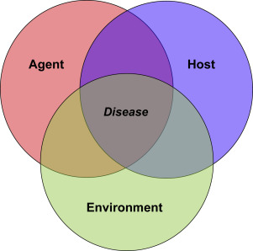
Infectious Diseases Transmission
The epidemiological triad model of infectious disease causation
(Snieszko, 1974)

Slide 37
Epidemiological triad model of infectious disease causation
“The triad consists of an agent (pathogen), a susceptible host, and an environment (physical, social, behavioural, cultural, political, and economic factors) that brings the agent and host together, causing infection and disease to occur in the host”
(van Seventer and Hochberg, 2017).

Slide 38
Transmission of infectious diseases
Environmental factors determine if a host will become exposed to one of these agents, and subsequent interactions between the agent and host will determine the exposure outcome.
Agent and host interactions occur in a cascade of stages that include infection, disease, and recovery or death.
In this model, disease results from the interaction between the agent and the susceptible host in an environment that supports transmission of the agent from a source to that host.
(van Seventer and Hochberg, 2017)

Slide 39
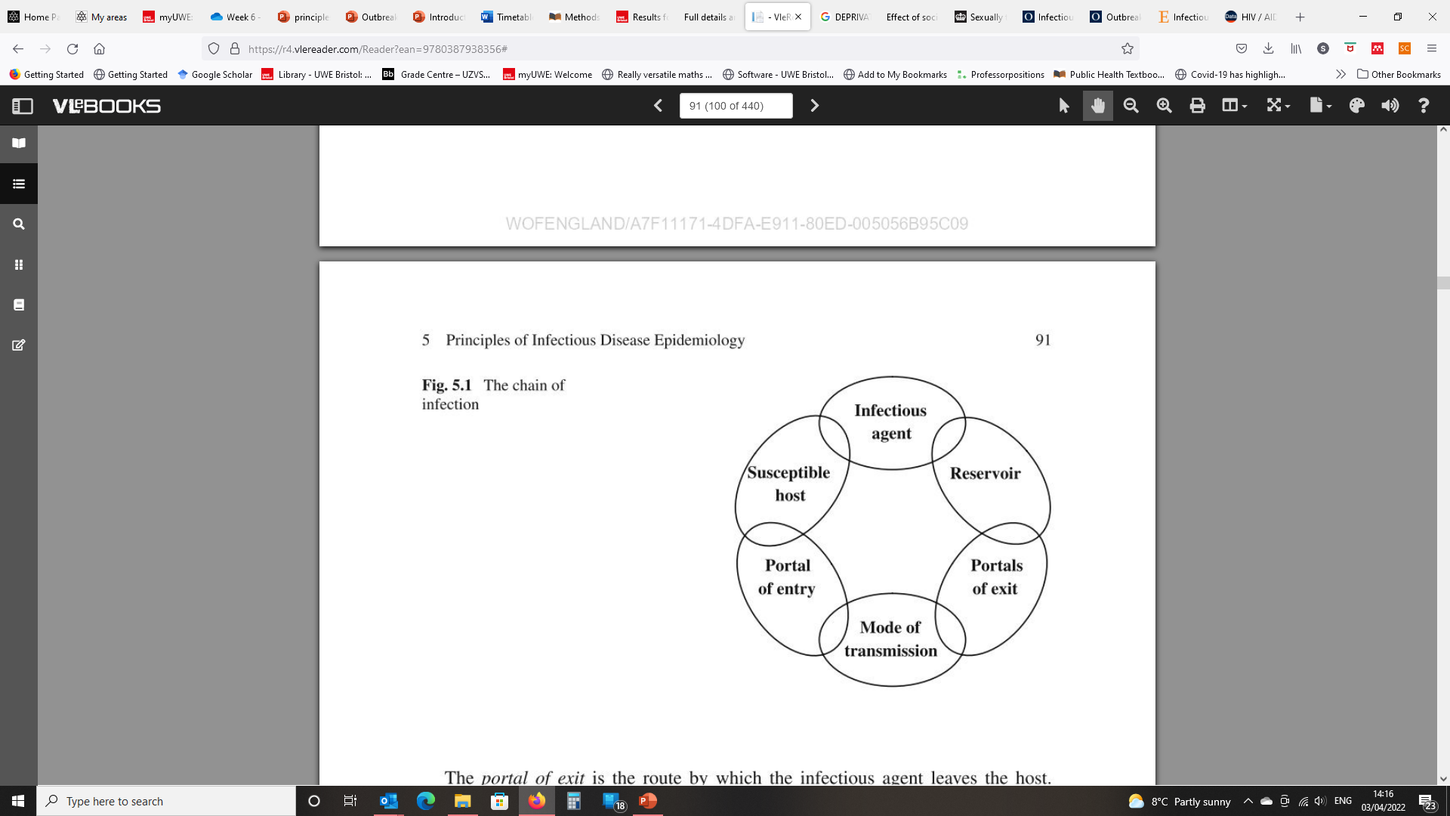
The chain of infection
Page RM, Cole GE, and Timmreck TC (1995) Basic Epidemiological Methods and Biostatistics. A Practical Guidebook. Boston London Singapore: Jones and Bartlett Publishers

Slide 40
Reservoir of infection
Reservoir of infection: Any person, animal, plant, soil or substance in which an infectious agent normally lives and multiplies.
The reservoir typically harbours the infectious agent without injury to itself and serves as a source from which other individuals can be infected.

Slide 41
Portal of entry
A portal of entry is the site through which micro-organisms enter the susceptible host and cause disease/infection. Infectious agents enter the body through various portals, including the mucous membranes, the skin, the respiratory and the gastrointestinal tracts.

Slide 42
Portal of exit
Portal of exit is the way the infectious agent leaves the reservoir (through open wounds, aerosols, and splatter of body fluids including coughing, sneezing, and saliva)
Mode of transmission is the way the infectious agent can be passed on (through direct or indirect contact, ingestion, or inhalation)

Slide 43
Susceptible host
This is the organism (e.g., You or your resident) that will feel the effects of the infectious disease that has travelled through the chain of infection.

Slide 44
How do infectious diseases spread?
Notes:
Infectious Diseases: Types, Causes, Symptoms And Preventions (byjus.com)

Slide 45
Spread of infectious diseases
Infectious diseases can spread through so many ways depending on the type.
Pathogens can enter the body through the common places like the mouth, nose and cuts on the skin.

Slide 46
Spread of infectious diseases
Diseases can spread through several means which include
From person to person when you cough or sneeze. In some cases, droplets from coughing or sneezing can stay in the air.
From close contact with another person, like kissing or oral, anal or vaginal sex.
By sharing utensils or cups with other people.
On surfaces like doorknobs, phones and countertops.

Slide 47
Spread of infectious diseases
Through contact with feaces from a person or animal with an infectious disease.
Through bug (mosquito or tick) or animal bites.
From contaminated or improperly prepared food or water.
From working with contaminated soil or sand (like gardening).
From a pregnant person to their unborn baby.
From blood transfusions, organ/tissue transplants or other medical procedures.

Slide 48
Activity
Epidemiologists use a model for studying infectious disease and its spread that involves the microbe that causes the disease, the organism that harbors the disease, and the external factors that cause or allow disease transmission. This is also known as
host, vector, and transmission.
transmission, host, and environment.
host, agent, and environment.
organism, transmission, and environment.
Notes:
C

Slide 49
Activity
Working in groups research the ways by which infectious diseases can be prevented
Feedback your findings to the whole class

Slide 50
How can infectious diseases be prevented?

Slide 51
Prevention of infectious diseases
Vaccination
Use of antibiotics.
Maintaining proper hygiene.
Avoid travelling or going to work when you fall ill.
Avoid sharing used personal belongings such as a razor, glass, toothbrush, comb, etc.
Keeping your kitchen clean by washing all the used utensils, cooking area before and after preparing each food.
Extra care needs to be taken while going to hospitals such as wearing a mask, using sanitizer, etc.

Slide 52
Activity
Watch the video below then discuss and
https://www.youtube.com/watch?v=2JWku3Kjpq0
Feedback your findings to the whole class
Notes:
Infectious Diseases - How do we control them? – YouTube

Slide 53
Who is most at risk for getting infectious diseases?

Slide 54
People Most at Higher Risk of ID
Anybody can get an infectious disease,
But one may be at a higher risk if the immune system is weakened or
If the person travel to areas with certain highly transmissible diseases.

Slide 55
People Most at Higher Risk of ID
People at higher risk of getting infectious disease include:
Those with suppressed or compromised immune systems, such as those receiving cancer treatments, living with HIV or on certain medicines.
Young children, pregnant people and adults over 60.
Those who are unvaccinated against common infectious diseases.
Healthcare workers.
People traveling to areas where they may be exposed to mosquitoes that carry pathogens such as malaria, dengue virus and Zika viruses.

Slide 56
What are the symptoms of infectious diseases?

Slide 57
Symptoms of infectious diseases
Symptoms of infectious diseases depend on the type of illness.
Fungal infections usually cause localised symptoms, like rash and itching.
Viral and bacterial infections can have symptoms in many areas of the body.
This include

Slide 58
Symptoms of infectious diseases
Fever
Chills
Congestion
Cough
Fatigue
Muscle aches and headache
Gastrointestinal symptoms (diarrohea, nausea, vomiting)
Prion diseases damage the brain, memory loss, and cognitive difficulties.

Slide 59
Activity
Working in a groups, research the following terms associated with disease causation
Host
Agent
Environment
Vector
Carrier – active
Incubatory
Feedback your findings to the whole class
Notes:
Agent originally referred to an infectious microorganism or pathogen: a virus, bacterium, parasite, or other microbe. Generally, the agent must be present for disease to occur; however, presence of that agent alone is not always sufficient to cause disease. A variety of factors influence whether exposure to an organism will result in disease, including the organism’s pathogenicity (ability to cause disease) and dose.
Host refers to the human who can get the disease. A variety of factors intrinsic to the host, sometimes called risk factors, can influence an individual’s exposure, susceptibility, or response to a causative agent.
Environment refers to extrinsic factors that affect the agent and the opportunity for exposure. Environmental factors include physical factors such as geology and climate, biologic factors such as insects that transmit the agent, and socioeconomic factors such as crowding, sanitation, and the availability of health services.

Slide 60
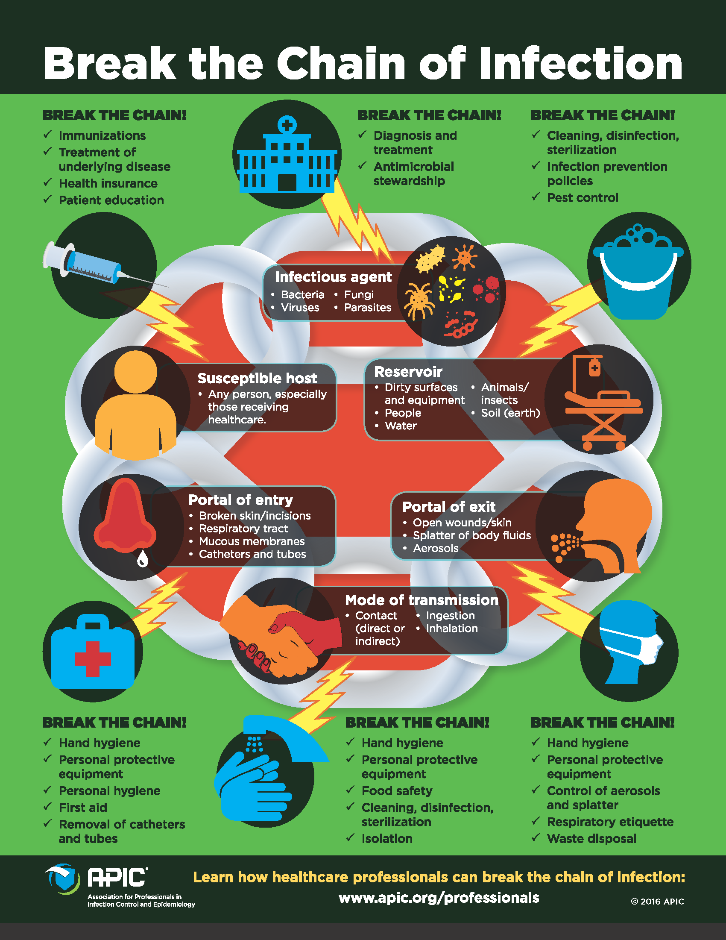

Slide 61
In summary: Activity
Watch the video below then discuss and
https://www.youtube.com/watch?v=9axOFtPqS0c
https://www.youtube.com/watch?v=Wmrlpa1XyMI
Feedback your findings to the whole class
Notes:
Infectious Diseases - An Introduction – YouTube
Infectious Diseases Overview, Animation - YouTube

Slide 62
Reference
Centre for Disease control (2012) Introduction to Epidemiology: Concepts of Disease Occurrence. Available at: https://www.cdc.gov/csels/dsepd/ss1978/Lesson1/Section1.html#_ref1. Accessed date 22nd August 2022
Cleveland clinic (2021) infectious disease. Available at https://my.clevelandclinic.org/health/diseases/17724-infectious-diseases Accessed date 22nd August 2022)
Feigin, R. D. , Garg, . Renu and Christie, Andrew Barnett (2020) Infectious disease. Encyclopedia Britannica. Available at https://www.britannica.com/science/infectious-disease (accessed date 10th August 2022).
Kotra L. P. (2007) Infectious Diseases University of Toronto, Toronto, Canada ã 2007 Elsevier Inc. All rights reserved
Louria, D. B. and Carbon, C.J., (1999) Section 1: Introduction to Infectious Diseases. In D. Armstrong and J. Cohen (Eds.), Infectious Diseases, Volume 1, 1st ed. Mosby Publishers, London, U.K., 1999.
Serving Vulnerable and Underserved Populations. (n.d.). https://marketplace.cms.gov/technical-assistance-resources/training-materials/vulnerable-and-underserved-populations.pdf
van Seventer J.M., Natasha S. Hochberg N.S., (2017) Principles of Infectious Diseases: Transmission, Diagnosis, Prevention, and Control, International Encyclopedia of Public Health (Second Edition), Academic Press, Pp. 22-39, Available at https://www.sciencedirect.com/science/article/pii/B9780128036785005166#cebib0010(accessed date 10th August 2022).
Understanding Emerging and Re-emerging Infectious Diseases - NIH Curriculum Supplement Series - NCBI Bookshelf Available at https://www.ncbi.nlm.nih.gov/books/NBK20370/ (Accessed at 22nd August 2022)
World Health Organisation (2022) Infectious Diseases Available at: https://www.who.int/ Accessed date 08 August 2022
Notes:
Principles of Infectious Diseases: Transmission, Diagnosis, Prevention, and Control - ScienceDirect

