Slide 1
Student Name: Agata Sekal
Student ID: 2511913
Lecturer’s Name: Deji Olaboye
Module Code: LCLM 4004
Module Name: Problem Solving and Decision-Making
Component 1: Basil’s Bakery

Slide 2

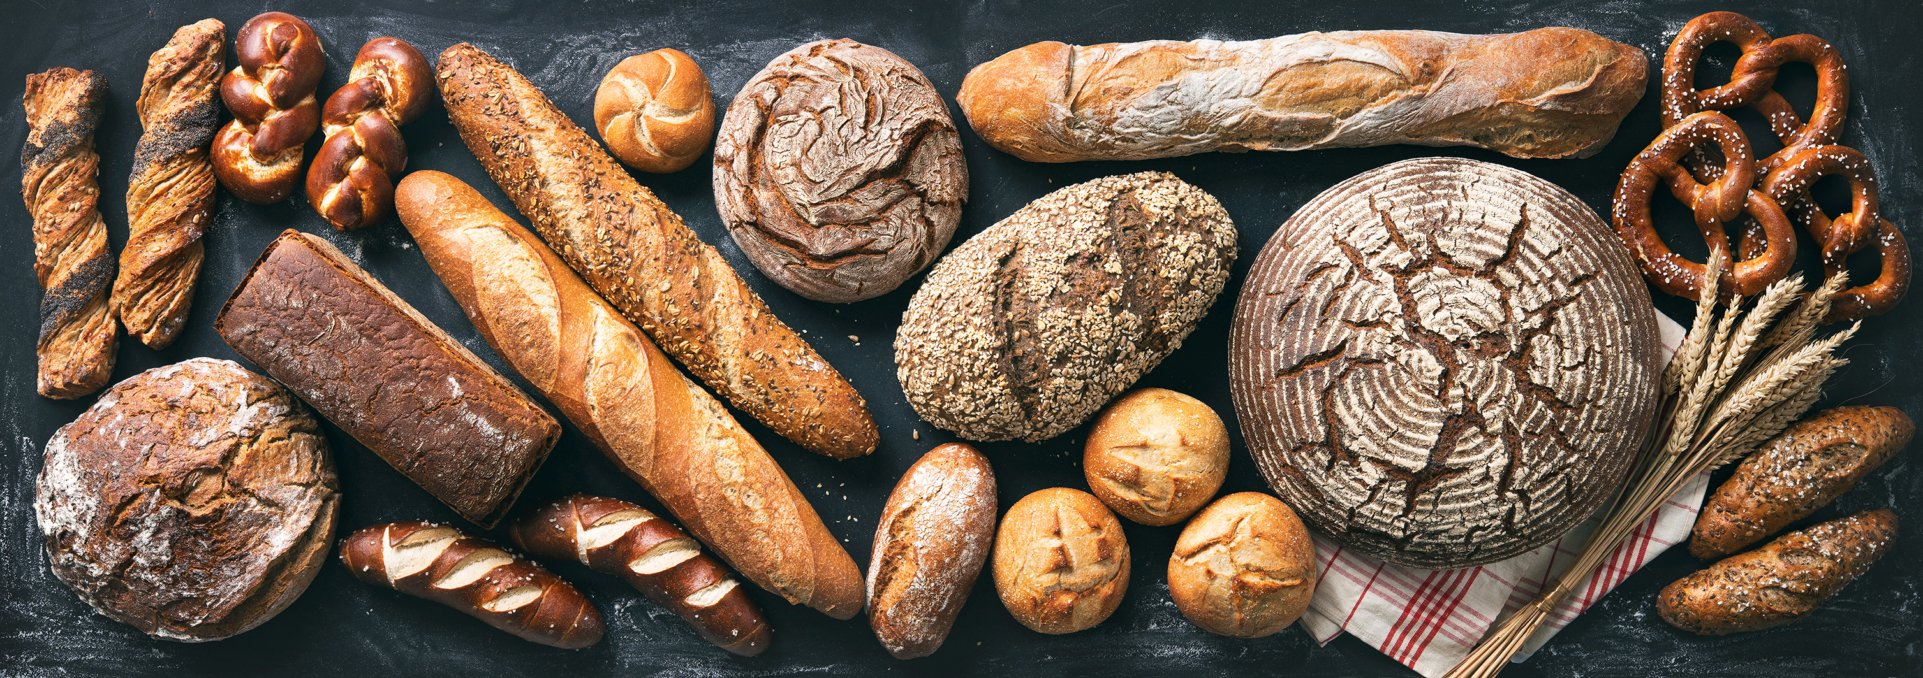
Presentation Overview
In my presentation I will:
  Apply the PESTEL framework to analyse the business environment.
  Apply a Fishbone (Cause-and-Effect). Diagram to identify the root causes of sales stagnation.
  Summarise the key findings and recommendation.
  Provide an overview of Basil’s Bakery and the issues affecting sales performance.

Slide 3
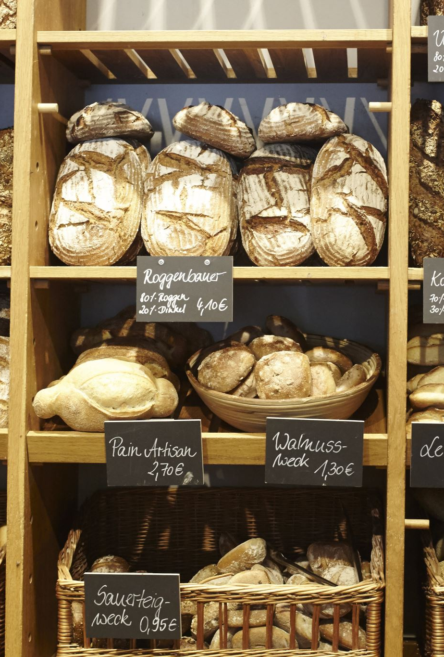
Overview of Basil’s Bakery.
Independent artisan bakery established in 2015.
Located in a retail park in Coventry, UK
Specialises in organic cakes, pastries and bread.
Serves shoppers, retail workers and office employees.
Sales have remained approximately 25% below 2019 levels since 2023.

Slide 4
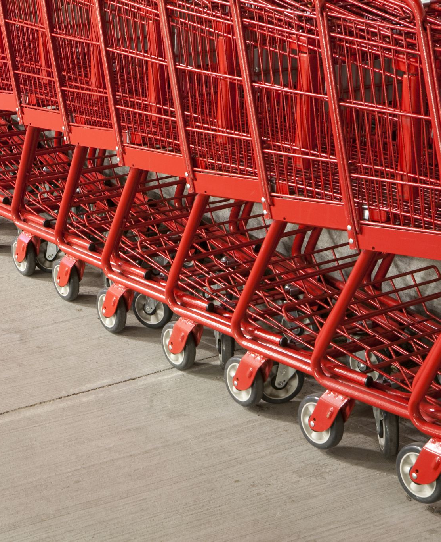
Issues Affecting Sales Stagnation
MAIN PROBLEM ;
Sales stagnation (25% below 2019 levels).
EXTERNAL ISSUES ;
Reduced footfall in the retail park.
More employees working from home.
Shop closures and customer redundancies.
INTERNAL ISSUES ;
No delivery service.
Difficulties managing pre-orders.
Long waiting times during busy periods.
FINANCIAL ISSUES ;
Rising rent and utility costs.
Increasing costs of organic ingredients.
Johnson, Whittington and Scholes (2017)

Slide 5
  PESTEL
  What is PESTEL?
  A framework used to analyse the external business environment.
  Benefits
  Identifies opportunities and threats.
  Supports strategic decision-making.
  Limitations
  Does not prioritise factors.
  External conditions can change quickly.
  Barney, J.B I Hesterly, W.S. (2015)
  Grant, R.M (2016)

Slide 6
PESTEL Analysis of Basil’s Bakery.
Political Factors | Economic Factors | Social Factors | Technological Factors | Legal Factors | Environmental Factors
Rising business rates Goverment regulations affecting small business Changes in taxation policies Economic policies affecting operating costs | Inflation increases costs Rising utility and rent costs Increasing costs of organic ingredients | More people working from home after COVID-19 Reduced customer footfall in the retail park Customer redundancies reducing spending | No online ordering system No delivery services available Difficulty managing pre-orders by phone | Food safety regulation Employment laws compliance costs Health and safety regulations | Crop failures affecting organic ingredients Supply chain disruptions increasing stock costs Dependence on organic produce availability
Lynch, R.(2015)

Slide 7
Critique of the Cause-and-Effect model
(FISHBONE)
  What is the Cause-and-Effect Model ?
  A tool used to identify the root causes.
  Benefits :
  Helps identify multiple causes.
  Supports problem solving and decision-making.
  Limitations :
  Depends on user judgment.
  Does not show which cause is most important
  Alrae (2024)

Slide 8
Provide an application and discuss the information provided in your Cause-and-Effect diagram (approx. 1 minute 30 seconds).
METHODS
MACHINES
PEOPLE
-No delivery service.
-Difficulty managing pre-orders.
-Long waiting times.
-No online ordering system.
-No delivery platform.
-More employees working from home.
-Customer job losses.
-Reduced customer demand.
ROOT PROBLEM
Sales Stagnation.
Root Problem
-Rising cost of organic ingredients.
-Unpredictable supply costs.
-Crop failures affecting ingredients.
-Sales remained 25% below 2019 levels since 2023.
-Reduced sales fgures.
-Reduced footfall in the retail park.
-Shop closured nearby.
-Fewer visitors to the area.
MATERIALS
MEASUREMENT
ENVIRONMENT
Kotler and Keller (2017)
McKinsey & Company (2025)

Slide 9

Key Findings
    Key Finding 1:
    Sales remain 25% below 2019 levels.
    Key Finding 2:
    Internal issues include no delivery service, re-order difficulties and long waiting times.
    Key Finding 3:
    Rising operating costs and organic ingredient prices are putting pressure on profitability.
    Key Finding 4:
    Reduced footfall and remote working have decreased customer numbers.

Slide 10
Reference List:
Johnson, G. Whittington, R. and Scholes, K.(2017) Exploring Strategy: Text and Cases. 11th ed. Harlow: Pearson.
Alrae, R.(2024) Quality Tolls, Technologies and Techniques: Enhancing Product and Service Excellence. In: Qamar, S.Z. and Al-Hinai, N. (eds.) Quality Control and Quality Assurance: Technques and Applications. IntechOpen.
Barney J.B. and Hesterly, W.S.(2015) Strategic Management and Competitive Advantage. 5th ed. Harlow: Pearson.
Grant, R.M. (2016) Contemporary Strategy Analysis. 9th ed. Chichester: Wiley.
McKinsey and Company (2025) Five COVID-19-era dynamist that are still shaping the consumer sector. Available at: State of the Consumer Trends Report 2025.(Accessed; 5 June 2026)
Kotler, P. and Keller, K.L (2017) Marketing Management.15th ed. Harlow: Pearson.
Lynch, R. (2015) Strategic Management. 7th ed.Harlow: Pearson.

Slide 11
Thank you for listening :)
Agata Sekal

Slide 12


