Slide 1
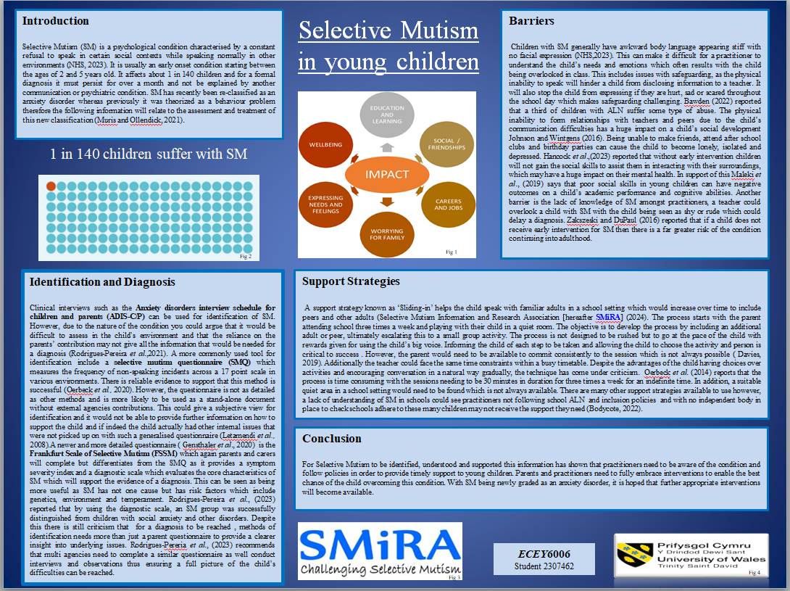

Slide 2
References
Baginsky,M. Driscoll, J. Purcell, C. Manthorpe, J. Hickman, B. (2022) Protecting and safeguarding children in schools: a multi-agency approach. Bristol. Policy Press.
Bawden, A.,(2022)’ Almost a third of disabled children and teenagers face abuse, global study finds, ’The Guardian,17 May. Available at: https://www.theguardian.com/society/2022/mar/17/almost-a-third-of-disabled-children-and-teenagers-face-abuse-global-study-finds (Accessed 25 April 2023).
Bodycote, B. (2022) Independent Complaints & Monitoring Body for Schools & Local Authorities. Available at: https://you.38degrees.org.uk/petitions/independent-complaints-monitoring-body-for-schools-local-authorities ( Accessed: 30 April 2024).
Cate, I.M.P.-T., Markova, M., Krischler, M. Krolak-Schwerdt, S. (2018) 'Promoting Inclusive Education: The Role of Teachers' Competence and Attitudes', Insights on Learning Disabilities: From Prevailing Theories to Validated Practices, 15(1), 49+. Available at: https://link.gale.com/apps/doc/A547630810/AONE?u=anon~39dda64c&sid=googleScholar&xid=d65860a6 (Accessed: 05 May 2024).
Cohan, S. L., Chavira, D. A., & Stein, M. B. (2006)’ Practitioner Review: Psychosocial interventions for children with selective mutism: a critical evaluation of the literature from 1990–2005’. Journal of Child Psychology and Psychiatry, 47(11),pp. 1085-1097. Available at: https://doi.org/10.1111/j.1469-7610.2006.01662.x
Davies,N. (2019) Children Speech and Language Therapy Initial Report. Cardiff Health Trust. Unpublished.
Driessen, J., Blom, J. D., Muris, P., Blashfield, R. K., & Molendijk, M. L. (2020). ‘Anxiety in children with selective mutism: A meta-analysis’. Child Psychiatry and Human Development, 51(2),pp. 330–341.Available at: https://doi.org/10.1007/s10578-019-00933-1
Gensthaler, A., Dieter, J., Raisig, S., Hartmann, B., Ligges, M., Kaess, M., Freitag, C. M., & Schwenck, C. (2020). ‘Frankfurt Scale of Selective Mutism (FSSM, FSSM 3-7, FSSM 6-11, FSSM 12-18)’ [Database record]. APA PsycTests. Available at: https://doi.org/10.1037/t79432-000

Slide 3
Hancock, A., Northcott, S., Hobson, H., & Clarke, M. (2023).’ Speech, language and communication needs and mental health: the experiences of speech and language therapists and mental health professionals’. International Journal of Language & Communication Disorders, 58(1), pp.52–66. Available at: https://doi.org/10.1111/1460-6984.12767
Johnson, M.,Wintgens, A.(2016) The Selective Mutism Resource Manual.2nd edn.Abingdon:Routledge.
Kovac, L.M. Furr, J.M. (2019) ‘What Teachers Should Know About Selective Mutism in Early Childhood’. Early Childhood Education Journal 47, pp.107–114. Available at: https://doi.org/10.1007/s10643-018-0905-y
Letamendi, A. M., Chavira, D. A., Hitchcock, C. A., Roesch, S. C., Shipon-Blum, E., & Stein, M. B. (2008)’ Selective Mutism Questionnaire: Measurement Structure and Validity.’ Journal of the American Academy of Child and Adolescent Psychiatry, 47(10),pp. 1197–1204. Available at: https://doi.org/10.1097/CHI.0b013e3181825a7b
Maleki, M., Mardani, A., Mitra Chehrzad, M., Dianatinasab, M., & Vaismoradi, M. (2019) ’Social Skills in Children at Home and in Preschool.’ Behavioural Sciences (Basel, Switzerland), 9(7), pp.74. Available at: https://doi.org/10.3390/bs9070074
Muris, P., & Ollendick, T.H. (2021) ‘Current Challenges in the Diagnosis and Management of Selective Mutism in Children.’ Psychology Research and Behaviour Management, 14, pp.159 - 167.Available at: DOI:10.2147/PRBM.S274538
National Health Service [NHS] (2023) Selective Mutism. Available at: https://www.nhs.uk/mental-health/conditions/selective-mutism/ (Accessed 30 April 2024).
Oerbeck, B., Overgaard, K. R., Bergman, R. L., Pripp, A. H., & Kristensen, H. (2020) ‘The Selective Mutism Questionnaire: Data from typically developing children and children with selective mutism’. Clinical child psychology and psychiatry, 25(4),pp. 754–765. Available at: https://doi.org/10.1177/1359104520914695
Oerbeck, B., Stein, M.B., Wentzel-Larsen, T., Langsrud, Ø. and Kristensen, H. (2014)’ A randomized controlled trial of a home and school-based intervention for selective mutism – defocused communication and behavioural techniques.’ Child Adolescent Mental Health, 19: pp.192-198.Available at: https://doi.org/10.1111/camh.12045
Rodrigues-Pereira, C., Ensink, J. B. M., Güldner, M. G., Lindauer, R. J. L., De Jonge, M. V., & Utens, E. M. W. J. (2021)’Diagnosing selective mutism: a critical review of measures for clinical practice and research.’ European Child & Adolescent Psychiatry, 32(10), pp.1821–1839.Available at: https://doi.org/10.1007/s00787-021-01907-2.

Slide 4
Selective Mutism Information and Research Association [SMiRA] (2024) Info-The Sliding-In Technique and progress charts .Available at: https://www.selectivemutism.org.uk/info-the-sliding-in-technique-and-progress-charts/ (Accessed: 26 April 2024).
Vogel, F., Gensthaler, A., Stahl, J. and Schwenck, C. (2019)’ Fears and fear-related cognitions in children with selective mutism’. European Child & Adolescent Psychiatry, 28(Sept). Available at: https://doi.org/10.1007/s00787-019-01281-0.
White, J., & Bond, C. (2022)’ The r444ole that schools hold in supporting young people with selective mutism: a systematic literature review.’ Journal of Research in Special Educational Needs. Available at: https://doi.org/10.1111/1471-3802.12561
Zakszeski, B., DuPaul, G., (2016) ‘Reinforce, shape, expose, and fade: a review of treatments for selective mutism (2005-2015)’.School Mental Health 9:pp.1-15.Available at: https://DOI 10.1007/s12310-0169198-8
Diagrams and Logos
Figure 1 Saunders, J (2016) The impact of SM on the life of a child. Available at: https://www.researchgate.net/publication/326560105_Parental_perspectives_of_provision_in_mainstream_primary_schools_for_children_with_Selective_Mutism. (Accessed 30 April,2024).
Figure 2 Welsh Government (2022) Talk with Me Selective Mutism Factsheet. Available at: https://www.gov.wales/sites/default/files/publications/2022-09/mutism-factsheet.pdf (Accessed: 30 April 2024).
Figure 3 Selective Mutism Information and Research Association [SMiRA] (no date) Logo. Available at: https://www.selectivemutism.org.uk/ (Accessed: 30 April 2024).
Figure 4 University Trinity St David’s Wales (2024) Logo. Available at: https://walesdtp.ac.uk/university-of-wales-trinity-saint-david-logo-vector (Accessed: 30 April 2024).

Slide 5
Presenter notes
While working in primary schools as a support assistant I came across young children with selective mutism so I have decided to research this quite unknown condition and how as a practitioner I can raise awareness and support the children. Selective mutism (SM) is a psychological condition characterised by a constant refusal to speak in certain social contexts while speaking normally in other environments (NHS 2023). For example, they will not reply and respond to a teachers question and more often will not communicate with their peers. However, they will speak in the home environment with familiar people and family.
It is typically an early onset condition starting between the ages of two and five years old it affects about 1 in 140 children and for a formal diagnosis it must persist for over a month and not be explained by other communication or psychiatric conditions.
Selective mutism has recently been reclassified as an anxiety disorder whereas previously it was theorised as behaviour problem therefore the following information will relate to the assessment and treatment of this new classification (Muris and Ollendick, 2021). In support of this recent studies have concluded that there is evidence of a link between social anxiety and SM. Driessen et al.(2020) analysed the findings of an investigation of 22 studies of which clinical interviews were undertaken with children with SM to establish if the children had other anxiety issues. Results showed that 90% of the children had at least one other anxiety disorder out of which 69% had social anxiety disorder (SAD). In support of this Vogel et al.,(2019) compared levels of social fear- related cognitions to typically developing children and discovered that children with SM were largely focused on the fear of being observed and being critically or negatively evaluated by their peers and unknown adults around them. However, this is not always the case; certain children who have suffered traumatic experiences in their childhood are more likely to develop SM. This can be traced back to Erikson's hypothesis, which claims that psychological problems can influence a significant component of personality (Erikson Institute, 2023)

Slide 6
There are a few ways to identify and diagnose SM. Clinical interviews such as the Anxiety Disorders Interview Schedule for Children and Parents (AD-IS/CP) can be used for identification however due to the nature of the condition you could argue that would be difficult to assess the child in their own environment and that the reliance on the parents contribution may not give all the information that would be needed for a diagnosis (Rodrigous- Pereira et al., 2021) A more commonly used tool for identification include is the Selective Mutism Questionnaire for parents otherwise known as an SMQ which measures the frequency of non- speaking incidents across a 17 point scale in various environments. There is reliable evidence to support that this method is successful (Oerbeck et al., 2020). However, the questionnaire is not as detailed as other methods and is more likely to be used as stand - alone document without external agencies contributions. This could give a subjective view for identification and will not be able to provide further information on how to support the child and if indeed the child actually had any other internal issues that were not picked up with such a generalised questionnaire (Letamendi et al.,2008). A newer and more detailed questionnaire (Gensthaler et al., 2020) is the Frankfurt scale of selective mutism otherwise known as (FSSM) which again parents and carers will complete but differentiates from the SMQ as it provides a severity index of symptoms and the diagnostic scale which evaluates the core characteristics of SM which will support the evidence of a diagnosis. This can be seen as being more useful to practitioners especially as SM has not one cause but has risk factors which include genetics, environment and temperament. Rodrigeous Pereira et al.,(2023) reported that by using the diagnostic scale a SM group was successfully distinguished from children with social anxiety and other disorders. Despite this, there is still criticism that for a diagnosis to be reached methods of identification need more than just a parent questionnaire to provide a clearer insight into underlying issues. Rodrigeous Pereria et al.,(2023) recommends that multi agencies need to complete a similar questionnaire as well as conduct interviews and observations thus ensuring a full picture of the child's difficulties could be reached.

Slide 7
Barriers for children with SM
Children with SM generally have awkward body language they can appear stiff with no facial expression NHS (2023) this can make it difficult for a practitioner to understand the child's needs and emotions which often results from the child being overlooked in class either academically or emotionally which will impact their education and learning. A major impact is safeguarding, as the physical inability to speak will hinder the child from disclosing information to a teacher. It will also stop the child from expressing if they're hurt sad or scared throughout the school day which makes safeguarding challenging. Bawden (2022) from The Guardian newspaper reported that 1/3 of children with a ALN suffer some type of abuse. Therefore early identification of SM is essential for keeping the child safe (Baginsky, 2022).
The physical inability to form relationships with teachers and peers due to the child's communication difficulties has a huge impact on the child's social development. Being unable to make friends attend after school clubs and birthday parties can cause the child to become lonely isolated and depressed (Johnson and Wintgens 2016). Additionally, Hancock et al.,( 2023) reported that without early intervention children will not gain the social skills to help them interact with the world around them which could have a significant impact on their mental health .In support of this Maleki et al., (2019) says that the poor social skills in young children can have negative outcomes on a child academic performance and cognitive abilities. Another barrier is a lack of knowledge of SM amongst practitioners, a teacher could overlook a child with SM with a child being seen as shy or rude and this could delay a diagnosis. Zakszeski and DuPaul (2016) reported that if a child does not receive early intervention for SM then there is far greater risk of the condition continuing into adulthood .Additionally, this lack of knowledge could see practitioners not highlighting the condition and therefore not following the school ALN and inclusion policies .With no independent body in place currently to check schools adhere to these policies many children may not receive the support they need (Bodycote, 2022).

Slide 8
Studies have been conducted in different countries on different continents of teacher’s competence and attitudes with regards to implementing inclusive practise. The results were consistent finding that teachers’ attitudes affect the extent to which teachers are willing to implement interventions that enables inclusive practise (Cate et al., 2018). With SM not being widely recognised by practitioners, young children are at risk of not receiving the support needed as early intervention has been shown to significantly improve outcomes (Kovac and Furr,2019).
Strategies
Once a child has been identified with SM schools are given advice from speech and language therapist and from The Selective Mutism Information and Research Association, 2024 otherwise known as SMiRA about which strategies to use in the school setting.
Now there are quite a few strategies available that you can use to support children with SM. Today I'm going to be focusing on the ‘sliding in’ technique. This strategy helps the child speak with familiar adults in a school setting which would increase overtime to include peers and other adults (SMIRA 2024). The process starts with a parent attending school three times a week and playing with a child in a quiet room. The objective is to develop the process by including an additional adult or peer into the room, ultimately escalating this to a small group activity. Now the process is not designed to be rushed but to go at the pace of the child with reward given for using the child’s big voice. Informing the child of each step to be taken and allowing the child to choose activity and person is critical to success. However the parent would need to be available to commit consistently to the session which is not always possible (Davies 2019). Additionally, the teacher could face the same time constraints within a busy timetable and a busy school it's difficult for the teacher to timetable in individual sessions with a child. Now despite the advantages of the child having choices over activities and the strategy which encourages conversation in a natural way gradually, the technique has come under criticism. Oerbeck et al.,(2014) reports that the process is time-consuming with the sessions needed to be 30 minutes in duration for three times a week for an indefinite time. In addition a suitable quiet area in a school setting would need to be found which is not always available.

Slide 9
This was the case with a child who I will call (child A) who I came across in school in 2018.The school was unable to deliver the sliding in technique due to various reasons such as school timetable, teachers availability and more interestingly child A did not wish her parent to enter what she considered her ‘special place’ (Kelly, 2024). Instead, weekly Facetime sessions were set up with the child at home where the teacher would chat or play a game with the child who would be in their environment with their parent. The child was diagnosed aged 3 while attending the same school, currently she is 8 and has been having weekly chats online over the years with different teachers. Her situation today is that in school she talks quietly to just 2 friends, she still doesn’t talk to teachers or answer questions. You could argue that a small group sliding in sessions could have been delivered to encourage communication between peers and therefore may have seen increased progress in the setting. However, a recent communication with the parent (Kelly 2024) reveals that child A loves school, she is academically above her peers in reading, spelling and writing and that she is going to join a football club outside school with her friends.
So for my conclusion
For selective mutism to be recognised understood and supported this information is showing that it is crucial that practitioners need to be aware of the condition and follow policies in order to provide timely support to young children .Parents and carers need to fully embrace interventions to enable the best chance of the child overcoming this condition. While at the same time, adapting the interventions to suit the individual child. With SM being newly graded as an anxiety disorder and therefore a growing awareness of the condition it is hoped that further appropriate support strategies will become available.

