Slide 1
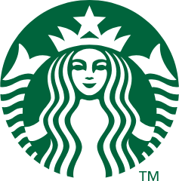
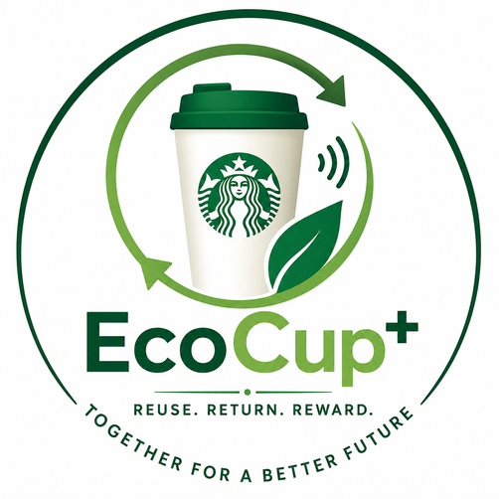
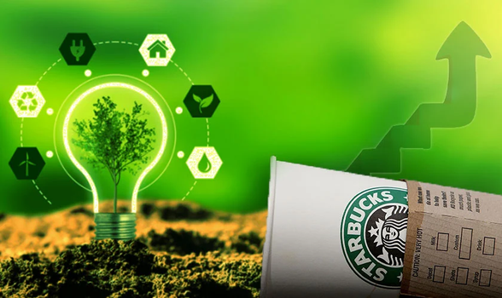
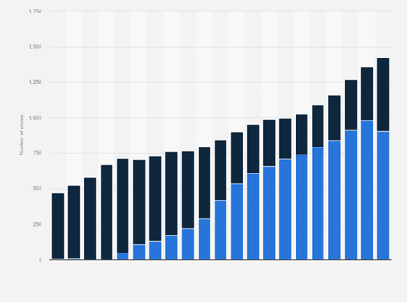
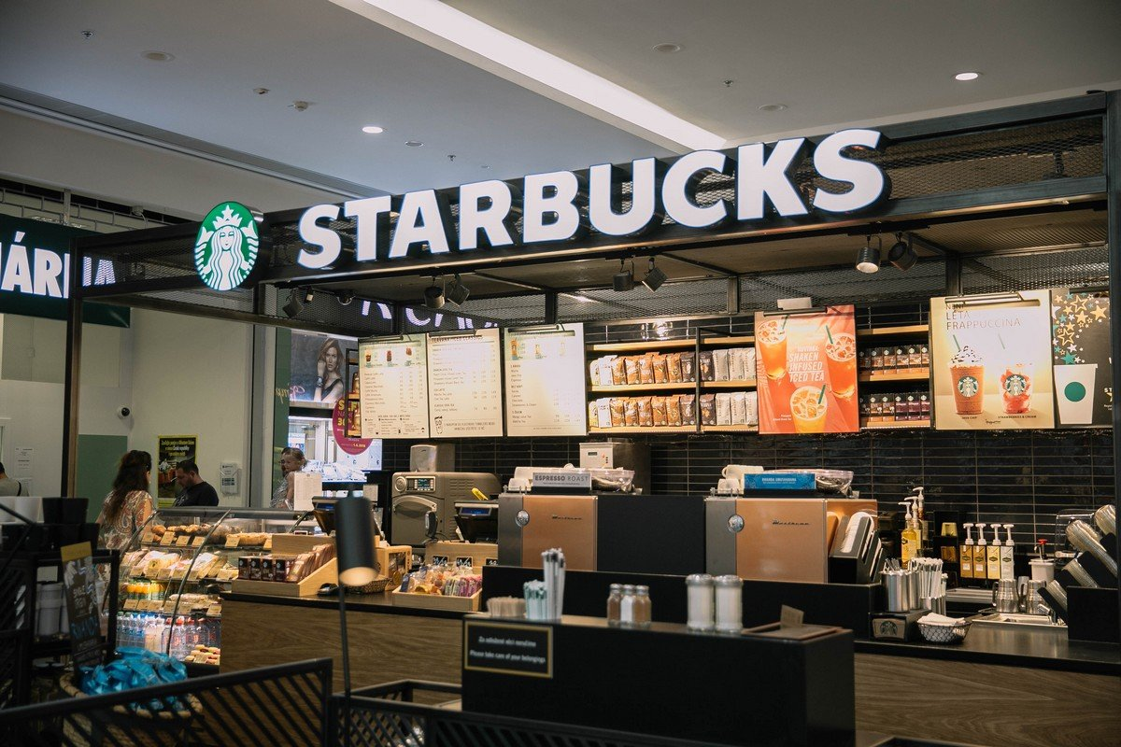
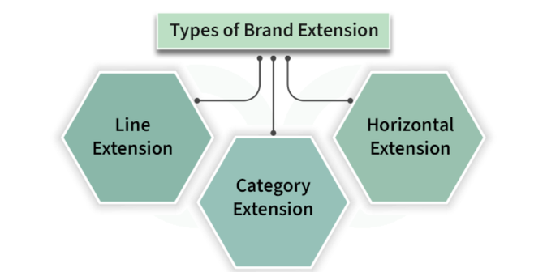
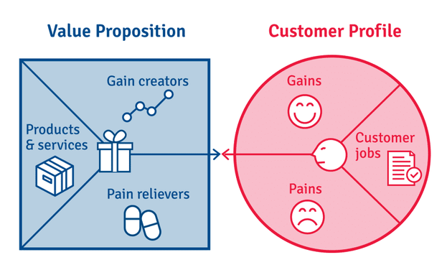
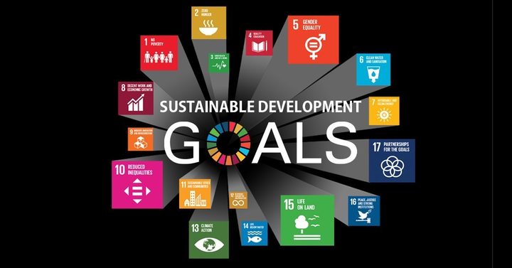
Sustainable Brand Extension Poster
Brand Extension through Starbucks EcoCup+; A Smart Reusable Cup Ecosystem
COMPANY OVERVIEW
SUSTAINABILITY CHALLENGE
Starbucks UK has more than an employee base of 16000 (Kollewe, 2025). It has many outlets in excess of 1304 making it one of the most prominent coffeehouse chains in the UK (Starbucks, 2026). Its brand is built on high quality coffee and customer experience, innovation, and ethical sourcing. The company enhances sustainability by C.A.F.E. Practices, reusable cup programs and waste reduction programs.
Nevertheless, millions of single-use takeaway cups keep accumulating in the trash despite the efforts, and consumers demand their brands implement circular consumption principles that would promote reuse and reduce negative effects on the environment (Shams et al., 2025).
PROPOSED BRAND EXTENSION
VALUE PROPOSITION
Starbucks EcoCup+ is an intelligent ecosystem of reusable cups with QR or NFC-based loyalty and a refundable deposit-return program, incorporating professional-level sanitisation points to allow guests to easily reuse the cup in any UK Starbucks store.
EcoCup+ customer rewards on sustainable behaviour, enhances Starbucks customer loyalty and differentiation strategy, and vastly minimizes the amount of waste due to disposable cups.
ALIGNMENT TO SUSTAINABILITY GOALS
REFERENCES
The extension helps in the principles of the circular economy, and waste and carbon minimization, and promote more sustainable coffee consumption.
  Kollewe, J. (2025). Starbucks tells corporate staff in US and Canada to work in office at least four days a week. [online] the Guardian. The Guardian. Available at: https://www.theguardian.com/business/2025/jul/15/starbucks-corporate-staff-us-canada-work-in-office-four-days-a-week [Accessed 27 July 2026].
  Shams, H., Ab Rahman, M.N., Hishamuddin, H. and Rafique, M.Z. (2025). A circular consumption behavior model for addressing and reducing product demand and disposal. Resources, 14(9), p.148. doi:10.3390/resources14090148.
  Starbucks (2026). Starbucks files UK and EMEA accounts for the fiscal year ended September 2025 - starbucks stories EMEA. [online] Starbucks Stories EMEA. Available at: https://stories.starbucks.com/emea/stories/2026/starbucks-uk-and-emea-accounts-fiscal-year-ended-september-2025/ [Accessed 27 July 2026].

