Slide 1
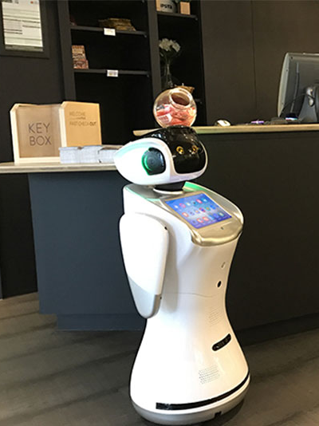
Week 5
Changing Guest Services

Slide 2
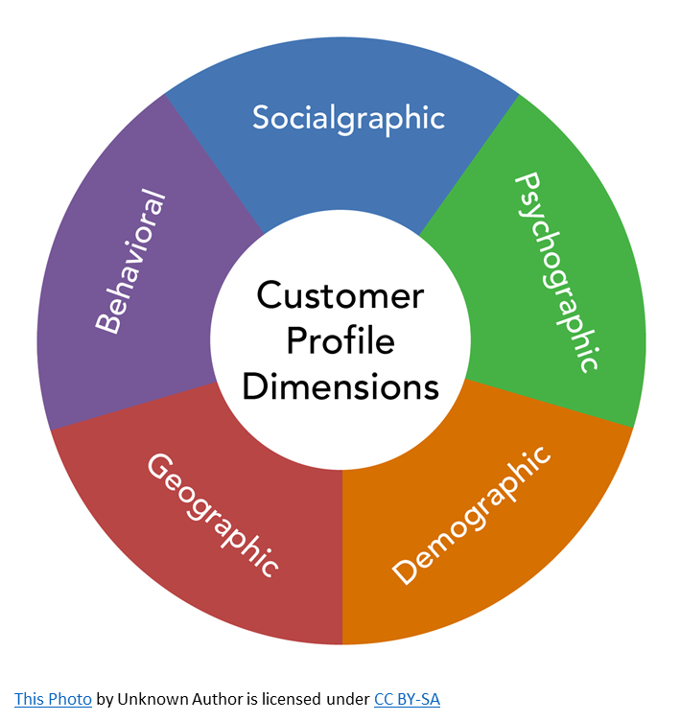
Who are our Consumers?
People travel for many different reasons:
Business, vacation, leisure, other purposes
Market Segmentation: We must target and market to a variety of consumer groups with different behaviour with an offer that matches their needs and budget

Slide 3

Meeting and Exceeding Guest Expectations
Appealing to all 5 senses to enhance the customer experience
Build relationships and connect emotionally (Emotional Intelligence)
Go the extra mile (WOW Factor)
Research the purpose of a guest’s stay and prepare their room accordingly
Q: Can you think of anything else?

Slide 4
Last Week…
…We learned about:
The difference between needs and wants
The importance of understanding and appreciating guest needs
Emotional intelligence/hospitality
How hotels use our five senses to WOW guests

Slide 5
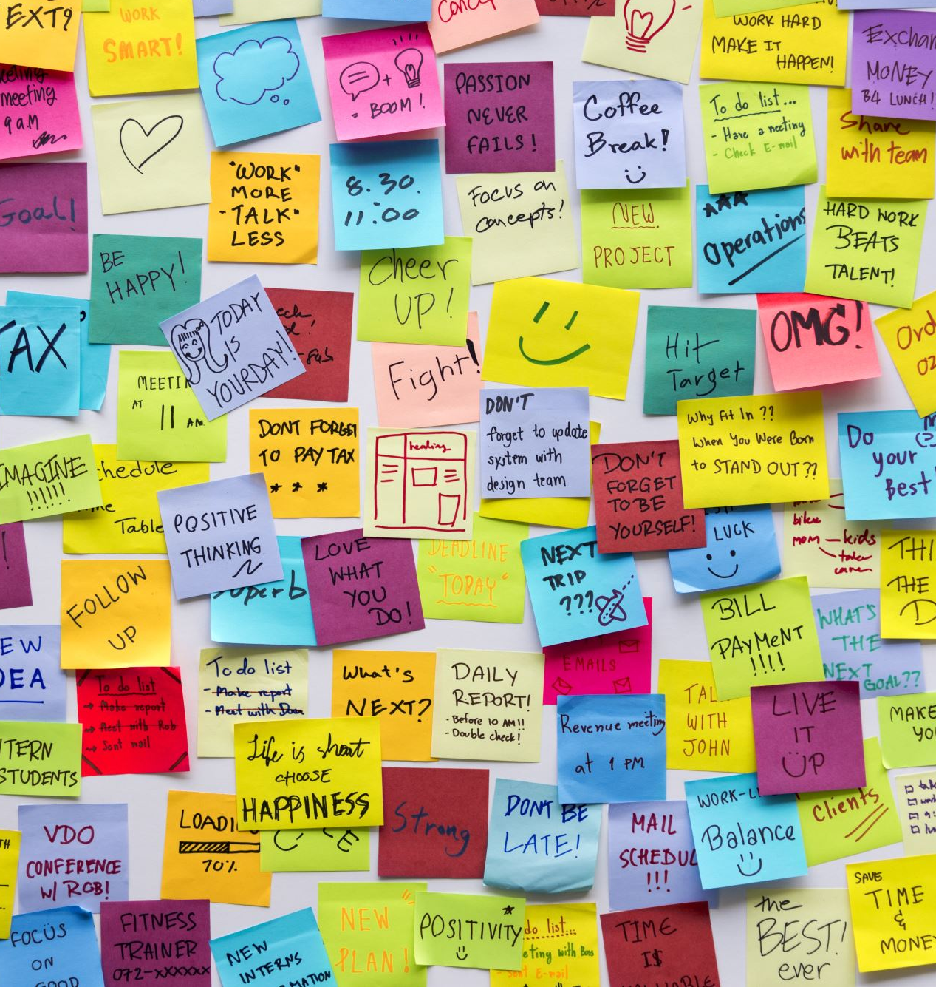
Today’s Content
Changing Guest Services
Market trends
Personalisation, Authenticity, One-of-a-Kind Experience
Emerging consumer and experience trends
Service expectations

Slide 6
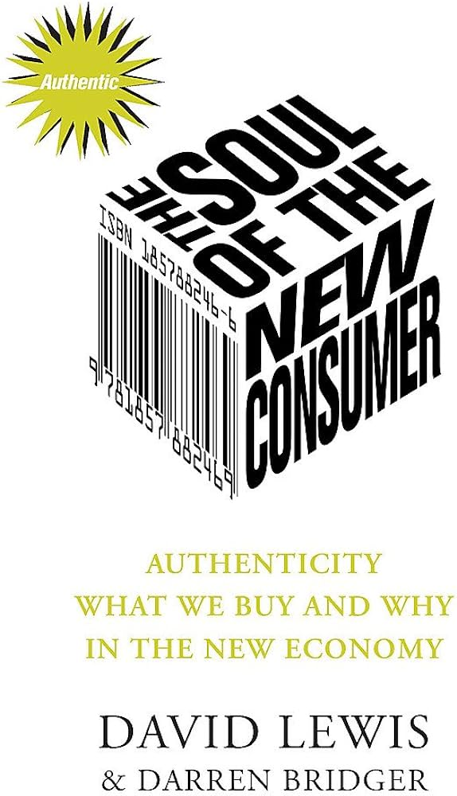
The new consumer
Consumers trends changing the industry
Health & wellbeing – renewed focus on hygiene - Hyatt have partnered with Headspace App to offer sleep meditation
Connection – people / human connection
Convenience – local delivery suppliers – culture – FAST DELIVERY
Peace of mind – worries / stress free
entertainment – gaming / innovation /VR & AI / TIKTOK - TikTok commands Gen. Z’s attention (and drives brand discovery),
Trust – brands information / rise in influencers
Fairness – concern about employment and laws
Sustainability – concern for environment, social impacts
Notes:
Health & well being – mental, physical and spiritual health – much more awareness on health – pandemic has increased this drastically so how do the hotels respond – Hyatt have partnered with Headspace App to offer sleep meditation and other meditate exercises for emotional 83% are having form of stress according to research
Connection – deeper connection to people – relying on digital connection – pandemic caused this for the industry -
Convenience – customers expect fast delivery – they like the idea of local cultural offering
Peace of mind – economic worries and staff shortages
Entertainment – more on line gaming and of course the use of technology for virtual reality etc and the social media platforms like TIKTOK that rose rapidly in the pademic

Slide 7

Consumer trends
But there are 3 prominent and important consumer trends in the hospitality industry today :
authenticity,
unique, one-of-a-kind experiences
a desire for more personalization
Hotel brands are responding to these demands……..
Notes:
Consumer trends are changing these are sometimes driven by industry trends too. We can also consider how the pandemic has changed the industry .
lets have a look at some examples of this…

Slide 8
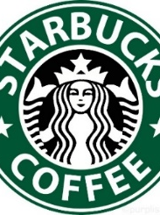
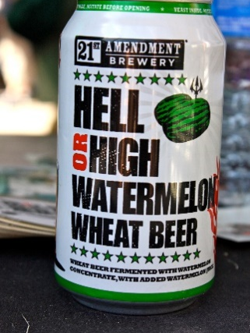
Authenticity
Appreciation for authenticity is significant—and also the most challenging
Growing appreciation for independent products and distinctive F&B concepts - high proportion of locally sourced and/or organic ingredients.
brands and F&B offerings connect with consumers in a way that feels authentic and impactful.
Authenticity creates memories by delivering brands, environments and experiences that are memorably distinctive.
Culture offering is a trend that is embraced today.
Taljinder Singh, GM of the Mumbai Taj Mahal Palace Hotel puts it, “authenticity will fail if it is just a brand strategy. It needs to become a way of life.”
Notes:
Ask the students to think of products that they themselves use because of the authenticity.

Slide 9

Local authenticity ( culture) – Taj Hotels
A powerful way to create emotional engagement is local authenticity
Taj Hotels a luxury hospitality brand -The Pierre in New York, St. James Hotel in London, and nearly a hundred other properties in Asia, Europe, and North America are committed to a model called “a continuum of sensation”
Similar employee uniforms, the Taj signature scent–which is a specific strain of jasmine–and the Taj-curated music that is played in their hotels as a soundtrack.
details of authentic furnishings to texture to layout are worked out with the intention of fitting into and paying tribute to local areas.
‘Tajness’ is expressed through timely events called “rituals,” which are customized for each locale, e.g the greeting ritual, when guests first arrive.
Taj Mahal Palace Hotel Mumbai - traditional “aarti” interaction, where the welcoming employee places a red dot on the guest’s head and presents the guest with a beaded garland intended to convey good fortune.
Sunset ritual in Mumbai consists of a wooden flute player playing a particular raga (musical modal scale) appropriate to the early evening, along with candle lighting and dancers in the twilight & musicians playing locally authentic music. (Solomon, 2016)

Slide 10

Tajness – You can feel it with your eyes closed
Notes:
Make sure the students pay attention to the wording that is used in the video and ask them how they feel watching it – remind them that we use our senses to make emotional connections and buying decisions.

Slide 11

EDITION Hotels - Authentic
‘you’re not going to come to an Edition Hotel and get a knockoff of anything. It’s going to be the real deal’ says Jay Coldren ,Vice President Edition Hotels.
EDITION combines the personal, intimate, individualized and unique lodging experience and locations around the world.
What signals authenticity is something intrinsic in the brand: the origins, location and unique features.
Hotels with historical features and original architecture benefit. Can be consciously crated as part of the overall guest experience delivered through service design and programming.
‘Our desire is to infuse emotion into a check-in/check-out world by bringing each location to life in an intimate, seductive environment’.
With a perfect mix of authentic design and gracious, sophisticated personalized service.
Created to give the guests a feeling of being somewhere so special, it may only be known to them.
‘THE NEW GENERATION OF LUXURY - A place to lay your head and get everything you need (and want). At EDITION, we believe true luxury is being heard before you even speak’.
Notes:
Under the Marriott umbrella

Slide 12

Discover How EDITION Hotels Combine Lifestyle with Luxury
Notes:
14 minutes https://www.youtube.com/watch?v=SRWwCv96pZk&t=41s
This is an interesting video about how this brand managed with the pandemic. Encourage the students to make notes on important points. Try to connect things like the emotional connections, needs and wants the idea of wow moments etc. DAN FLANERY – SNR VP

Slide 13


Mark Harmon talks Auberge Resorts Collection
‘Resorts should look like they belong there and have a strong sense of real’ according to Mark Harmon from Auberge Resorts. Mark Harmon is the founder of
Auberge Resorts Collection, a small, family company known in the hospitality industry for developing and operating ultra-luxury inns and resorts across the Americas. (SOLOMON, 2019)
Notes:
Encourage the students to pick out important points.

Slide 14
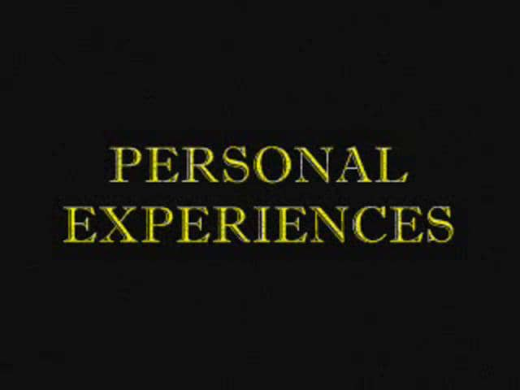
Treating guests as unique individuals they are is a way of personalising their experience in the hotel
Very important to differentiate from competitors by providing a unique experience to guests and engaging them with a personalized touch
Guests love personal attention – and attention from managers is especially welcomed.
The hotel technology has improved so much that now there are applications that can help collect important data about your existing and new customers. know who the top 100 - get to know their personal favourites in food, facilities, activity preferences, etc.
From menus to experiences, to décor and aesthetics, personalization has shifted into being a key consumer priority.
Personalization, and an interactive and engaging environment / experience leave guests and diners with a feeling that they are being cared for on a deeper level.
Adding small experiences and customization elements to restaurants, menus and services is creating an environment conducive to social engagement.

Slide 15
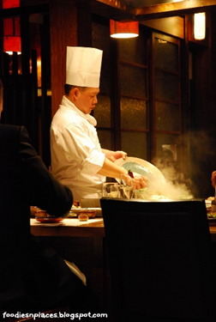
Other strategies : flexible menus, tableside cocktail mixing or food preparation, and create-it-yourself opportunities such as mobile stations or dessert buffets engages guests.
Increased chef engagement with guests make diners feel appreciated and connected to the food and the establishment.
Reinforcing that sense of personalization and customized engagement both inside and outside the hotel, bar or restaurant is one of the surest ways to keep guests connected—and coming back.
Notes:
Make mention of the chef engagement post pandemic situations – would it be the same?

Slide 16

TOURISM CHANGES :
The UK start-up creating ‘perfect’ personalised holidays
Personalised holiday offering is becoming much more popular and not just with people that have big budgets.
The traditional practice of sitting in front of the holiday agent in store was personalised as you could discuss your likes and dislikes with technology and booking on line this disappears so going to a company that will tailor your holiday wishes to the perfect holiday is becoming very popular.
Notes:
Personalised holiday offering is becoming much more popular and not just with people that have big budgets. The traditional practice of sitting in front of the holiday agent in store was personalised as you could discuss your likes and dislikes with technology and booking on line this disappears so going to a company that will taylor your holiday wishes to the perfect holiday is becoming very popular.

Slide 17

“Hotel 2020: The Personalization Paradox” is a report published by IBM Global Business Services. The report says that with the increasing competition among the hospitality industry players, personalization of a hotel’s guest experience will be the one and only feature which will help the industry survive.
Uniqueness and customization should be the norm, not the exception. Hospitality managers are in the business of making guests' dreams and wishes tangible.
Four Seasons made news, for example, when it spent $18 million to personalize the web experience for its guests.

Slide 18
Consumer Preferences
Consumer preferences are shifting towards authentic, localized, unique engagements in their travels.
hype on lifestyle hotels has started, driven by millennial needs, with even the big chains getting involved.
59% of millennials stayed at independent hotels in 2018, which is 20% more than baby boomers according to travel & hospitality marketing firm, MMGY.
As Jim Merkel the CEO of Rockbridge, a private investment company focused on hospitality rightly pointed out in predictions for 2018:
“The millennial traveller will continue to send shockwaves across the industry, and the hotels of five years from now will all feel like independents, even if they’re branded.”
Notes:
Make reference to the millennials being the largest group of customers that are making changes to the industry

Slide 19

Tribute Portfolio: a Family of Hotels
“Consumer preferences change. We create value by buying properties and making the investment that aligns it with customer wants, which in turn brings back cash flow and performance.”
Investing in the TRIBUTE portfolio of independent boutique hotels under the Marriott umbrella ,“More customers want an authentic experience. The market has reacted to that desire,” Merkel said.
“ Independents are more viable now, more institutional, than a decade ago. (Rockbridge’s Jim Merkel succeeds in hotel investment and goodwill, 2018)

Slide 20
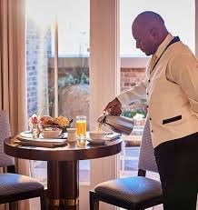
Differing service levels in the provision of hospitality and guest services in different accommodation.
The level of hospitality and guest services can vary significantly across different types of accommodation.
In Hotels service is linked to grading often or brand type?
Luxury Hotels & Resorts (5-Star & Boutique)
Personalized Service: Dedicated concierge, butler service, and tailored experiences.
High-End Amenities: Spa, fine dining, chauffeur service, and exclusive lounges.
Attention to Detail: Turn-down service, high staff-to-guest ratio, and premium room features.
Technology & Convenience: Smart rooms, 24/7 room service, and on-demand assistance

Slide 21
Hotel accommodation
Mid-Range Hotels (3-4 Star)
Standardized Services: Reception, housekeeping, and on-site dining options.
Comfortable Amenities: Gym, pool, and business center access.
Moderate Personalization: Some concierge services, but more self-service elements.
Budget Hotels & Motels (1-2 Star)
Basic Service: Limited front desk hours, minimal housekeeping.
No-Frills Approach: Simple rooms, basic furnishings, and fewer amenities.
Cost-Effective & Functional: Ideal for short stays or travelers on a budget.

Slide 22
Bed & Breakfasts (B&Bs) & Guesthouses
Personal Touch: Often owner-operated with homely service.
Limited Services: Breakfast included, but fewer facilities compared to hotels.
Cultural & Local Experience: Hosts may offer local insights and personalized recommendations.
Hostels & Backpacker Lodging
Self-Service Model: Guests manage their own needs, with shared facilities.
Social Atmosphere: Community-based experiences with group activities.
Minimalist Approach: Basic beds, shared bathrooms, and common areas.

Slide 23
Serviced Apartments & Extended-Stay Hotels
Home-Like Convenience: Fully furnished apartments with kitchenettes.
Flexible Services: Weekly housekeeping, laundry facilities, and sometimes concierge.
Ideal for Long-Term Stays: Targeted at business travelers and families.
Resorts & All-Inclusive Accommodations
Comprehensive Service: Everything included (meals, activities, entertainment).
High-End or Mid-Range Options: Varies from budget-friendly to ultra-luxury.
Guest-Centric Experience: Focus on relaxation, recreation, and hospitality.

Slide 24
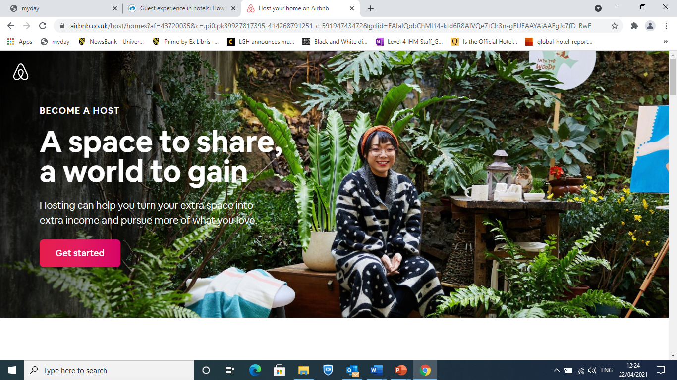

Differing service levels-
Hotels, B&Bs, Air BnB Hosting
New offers for millennials concentrate on other services, let’s take a look -
https://mamashelter.com/
https://www.joandjoe.com - It's not a hostel or a hotel but an “open house,” a NEW concept that “blends the best of private rental, hostel and hotel formats”
ACTIVITY:
Consider your website and discuss:
The graphics – what are the pictures saying?
Descriptions/ words used – what emotions are being connected to?
Services on offer?
Destinations? – places of interests etc
Notes:
Go through the two websites and ask the students to note down what they think about these brands.
Put the students on break out rooms for 10 minutes and let them discuss together if you want to.

Slide 25
B&B / Small independent hotels
B & B one off kind of offer, small, unique hotels which is changing – OYO.
B&B is a regulated small property subject to laws.
Always offered unique, personalised experiences.
A real B&B is usually operated by someone with formal training in the hospitality business. And that person has insurance – lots of insurance
B & B’s have to keep up with change.
Why is this needed?
Air BNB Hosting
Can easily book online, may carry some insurance but hosts may not have any formal hospitality training.
Each Airbnb has a unique personality of each house, apartment and location.
Spare income for owners.
Being a host – new to AirBNB more owners are interacting with guests.
Additional benefit of meeting new people for the owners
share your culture and connect with people
Notes:
Ask the students if they know about the OYO brand?
Air BNB came about in 2009 just as an idea of swopping accommodation between travellers then it developed into people letting out spaces in their homes more regauarly for extra income. Today it’s a big business and many people around the world are investing in properties specifically for renting out on a regularly basis. Many people are also involving themselves more and more in the hospitality side of the rental by being available to offer a more personalised experience.

Slide 26

UK hotel partners share their experiences with OYO

Slide 27

Why Host on Airbnb?

Slide 28
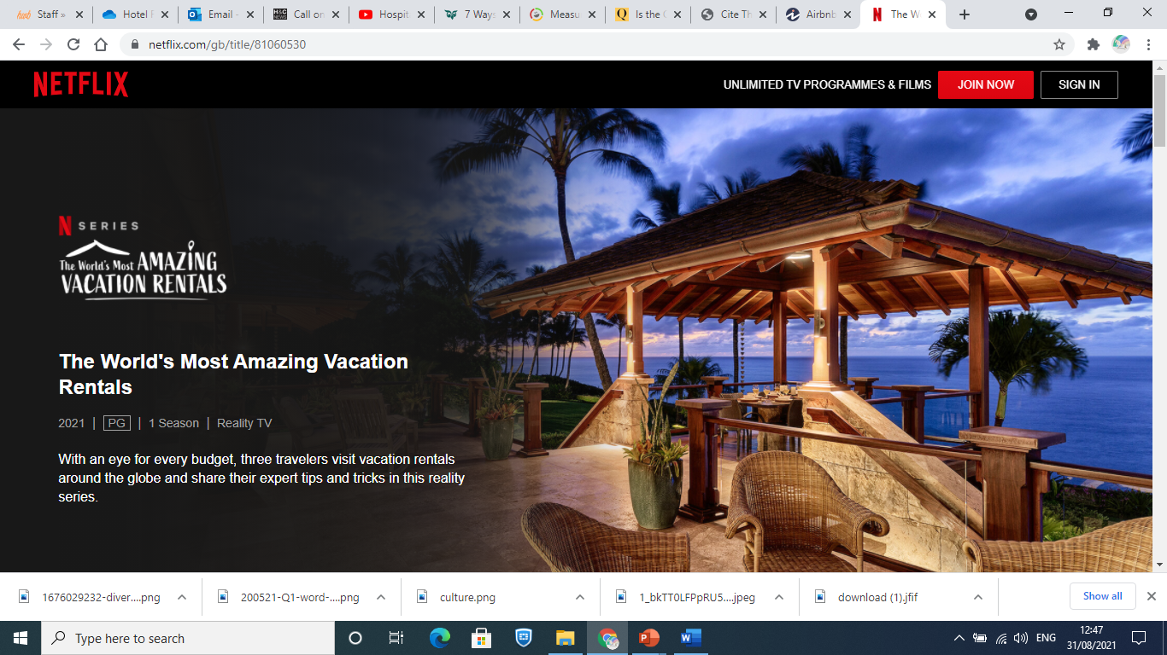

Notes:
This is a great example of millennials travelling around the globe and looking at the rental vacation market whether you are on a budget, midscale or luxury. Encourage the students to watch some of these episodes on Netflix
https://www.youtube.com/watch?v=EB_4iY91Ydw

Slide 29

Emerging Trends
Group Discussion:
Can you think of any emerging trends, lifestyle changes or fashion fads affecting the hospitality industry?
Type your answers in the chat box or raise your yellow hand.

Slide 30

Understanding the Factors Driving Hotel Trends
Emerging technology:
e.g. Artificial Intelligence (AI), robotics and virtual reality
Lifestyle changes:
e.g. Increased interest in sustainable business practices
Covid-19 Pandemic:
e.g. Increased emphasis on safety and hygiene
Notes:
-Technology is a key driver of trends in most industries

Slide 31

Artificial Intelligence (AI)
Group Discussion:
What is Artificial Intelligence (AI) and where can it be found in hotels?
Type your answers in the chat box or raise your yellow hand.

Slide 32

Artificial Intelligence (AI)
“AI is a type of computer technology which is concerned with making machines work in an intelligent way, similar to the way that the human mind works”
(Collins Dictionary)
AI can help improving personalisation and the quality of customer support
Concerns about risks and other ethical considerations remain
Notes:
-The term “artificial intelligence” was first formally introduced by John McCarthy at a conference at Dartmouth University in 1956, which he referred to as “the science and engineering of making intelligent machines”

Slide 33
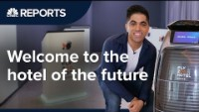
Case Study: Alibaba’s Keyless & Cashless Hotel
Notes:
Watch the video
Q: Which technologies are being used in this hotel? Discuss them with students

Slide 34
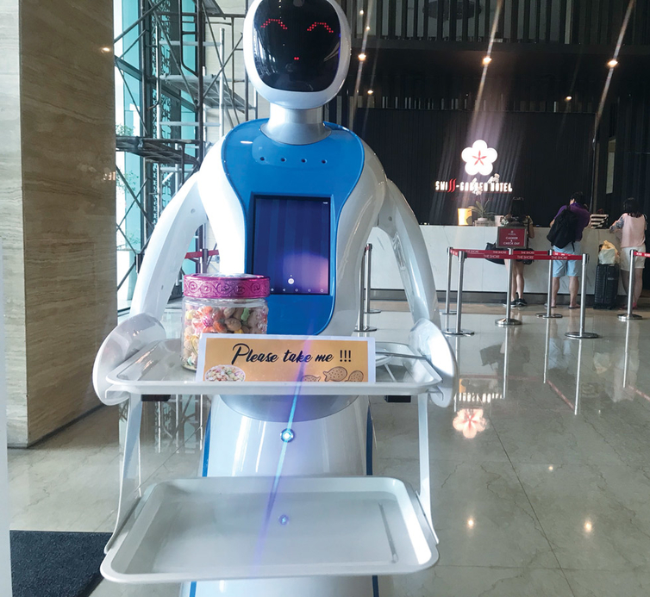
AI in Hotels
Group Discussion:
What are the benefits of increasingly using in AI and robotics from a hotel’s point of view?

Slide 35
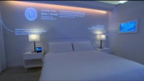
Smart Hotels
Notes:
-Smart hotels are AI-powered hotels that were built from the ground up
-Ask the students: Is your chosen hotel a “smart hotel”? If yes, make sure they mention this and its influence on the guest experience in their presentations

Slide 36
Hotels of the Future
Group Discussion:
How do you feel about the increasing use of technology?
Do you think hotel guests will miss interacting with human staff?
How will this affect the customer experience?
Notes:
-Remind students to check if AI technology is being used in their chosen hotels (for Assignment 1) and to make sure they mention it in their presentations if they do

Slide 37
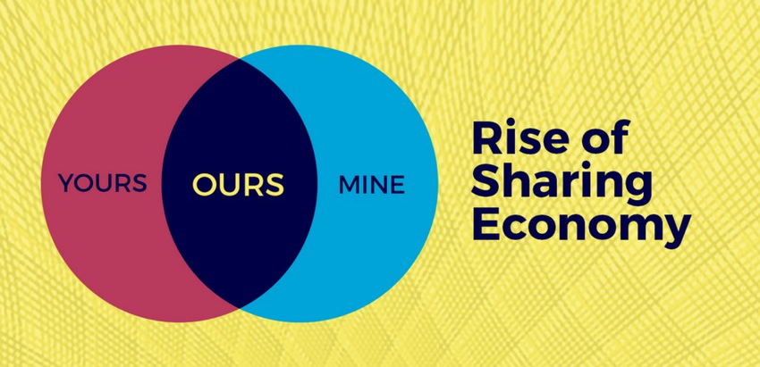
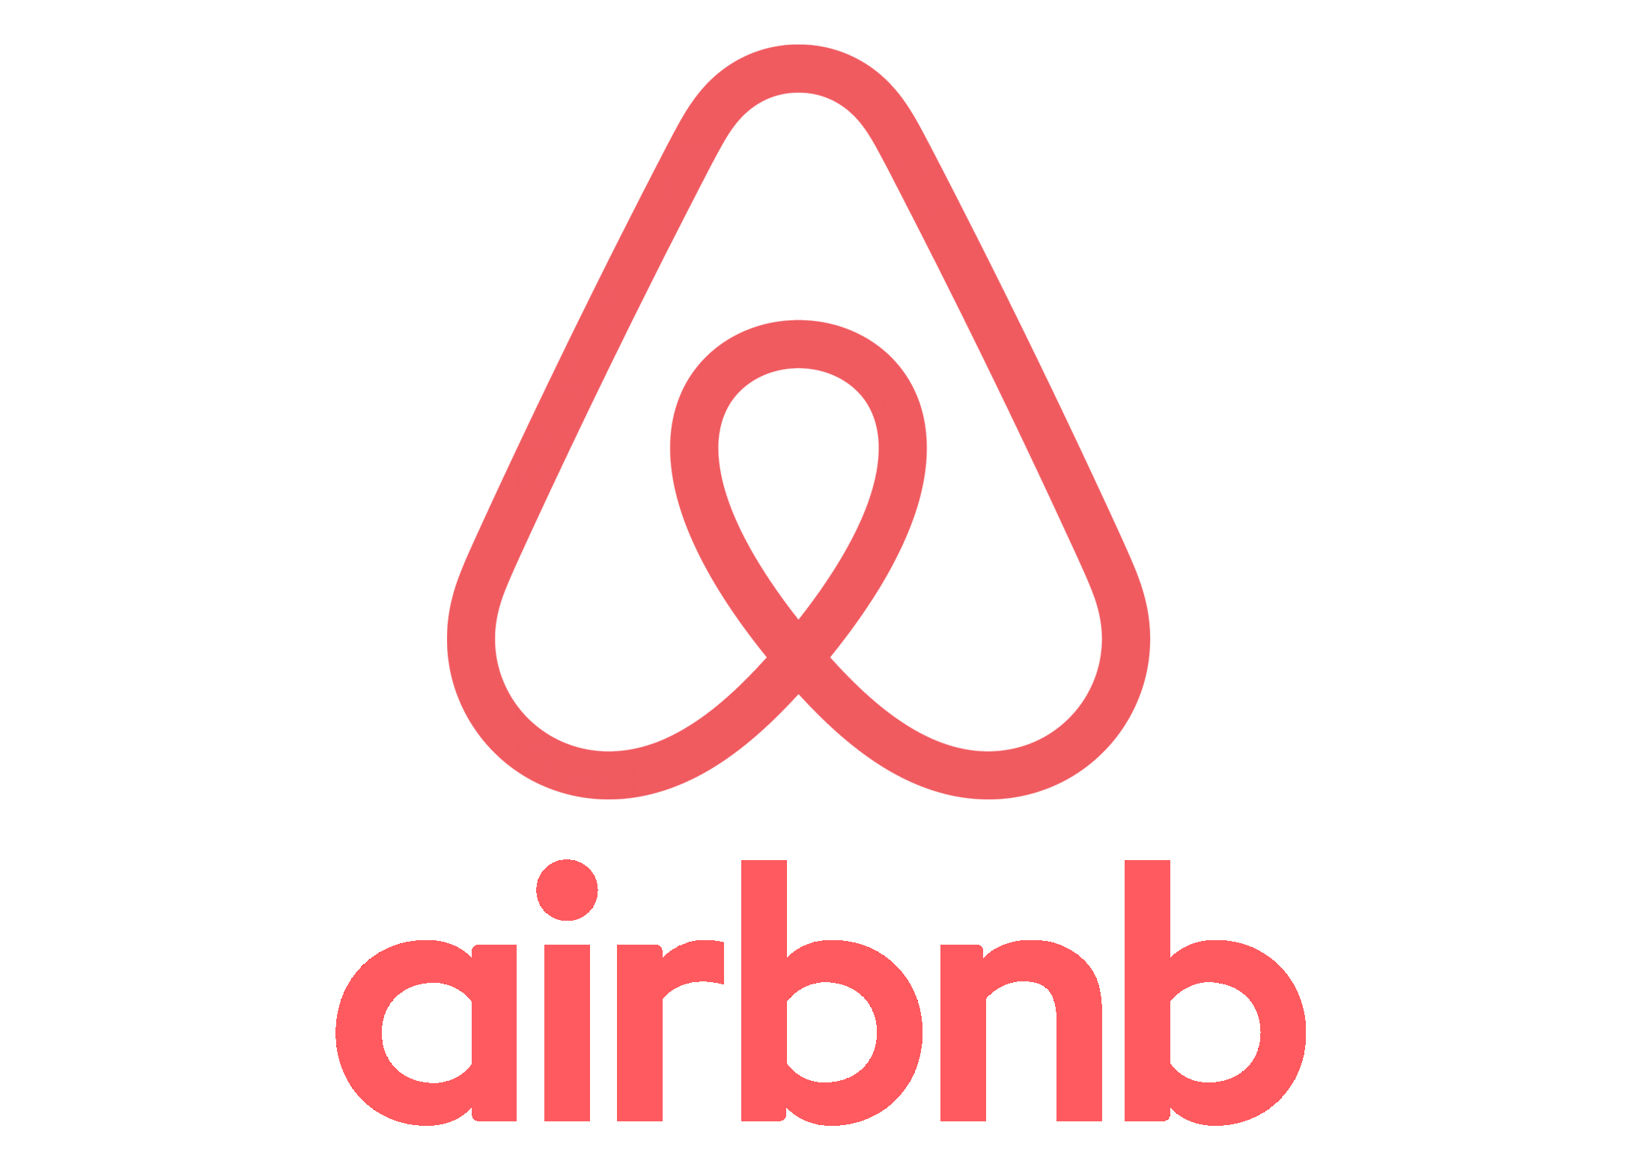
Case Study: Airbnb
Today, homes are designed around the idea of privacy and separation. What if homes were designed to be shared from the ground up?
~Joe Gebbia, Airbnb Co-Founder
https://youtu.be/4ensV8QkFKk?si=xZRRChHCphC1-9w1

Slide 38

Case Study: Airbnb
Notes:
Facts and figures:
81,000 cities
191 countries
5+ million listings
IPO in late 2020

Slide 39
Why Airbnb is so successful
‘Live like a local’
Flexibility
More space for less money
Amenities
Interaction with hosts
Notes:
-3 buzzwords

Slide 40
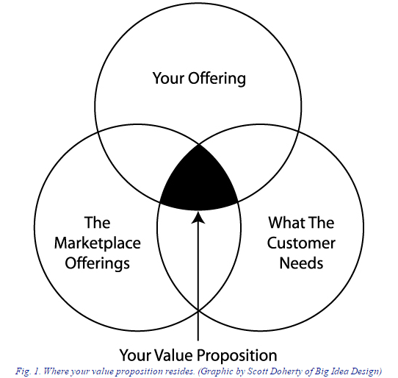
Hotels must promote their Unique Value Proposition
Notes:
-BUT:
Scams
Illegal rentals
Increased local housing prices
Legislation and taxation issues

Slide 41

Emphasis on Sustainable Practices

Slide 42
Group Discussion
Despite all these new trends, changes and technological developments…
Can we continue to provide customer service excellence like we used to? How?
How can we measure our success?

Slide 43
References
CBS Mornings (2018) “Smart” hotels come with privacy concerns for travelers [video]. Available at: https://www.youtube.com/watch?v=o5UxXN08Kfo (Accessed: 12th October 2022).
CNBC International (2019) Alibaba’s keyless and cashless hotel is straight out of the future | CNBC Reports [video]. Available at: https://www.youtube.com/watch?v=rnGpSZmj-cA (Accessed: 12th October 2022).
Collins Dictionary (2022) Artificial Intelligence. Available at: https://www.collinsdictionary.com/dictionary/english/artificial-intelligence (Accessed: 12th October 2022).
Hayes, D. K., Ninemeier, J. D. and Miller, A. A. (2020) Hotel Operations Management, 3rd Ed. Uttar Pradesh: Pearson India Education Services.
Revfine (2022) Hotel Trends: Discover the latest trends in the hospitality industry. Available at: https://www.revfine.com/hotel-trends/ (Accessed: 12th October 2022).
Slayed Magazine (2018) 10 Eco Friendly Hotels – Sustainability and Green Travel [video]. Available at: https://www.youtube.com/watch?v=-DSNyOW0L5Q (Accessed: 14th October 2022).

