Slide 1


Engineering Management Leadership
ACEA 7006
Business Analysis And Planning

Slide 2

Business Context & Key Challenges
Operating in a highly competitive logistics sector, the company is under constant pressure to improve profitability while maintaining exceptional customer service. With a fleet of 3 to 5-year-old MAN trucks, recent initiatives such as speed governors and advanced routing software aim to boost efficiency and reduce emissions.
Key Challenges:
Ongoing staff shortages and difficulty recruiting skilled workers.
Resistance to change from the workforce, such as agency hiring backlash.
Need to decarbonise fleet without major cost or service impact.
Balancing operational change with service quality and improved working conditions.

Slide 3
Root Cause Analysis of Employee Retention Using Herzberg’s Two-Factor Theory
Herzberg’s Two-Factor Theory distinguishes motivators like intrinsic factors from hygiene factors such as extrinsic conditions (Ybañez, 2024). Applying this in our logistics context reveals specific root causes:
Motivators
· Lack of Recognition and Career Development leads to demotivation among skilled workers (Chang et al., 2024).
· Poor Communication Channels weaken feedback and reduce engagement with operational changes (Lim, 2024).
Hygiene Factors
Use of Recruitment Agencies creates low job security and weak organisational belonging, worsening turnover (Chang et al., 2024).
Vehicle Restrictions & Route Scheduling perceived as limiting autonomy rather than supportive, causing disengagement (Lim, 2024).

Slide 4
Addressing Staff Shortages & Resistance through Leadership
Transformational Approach
Inspire a shared vision for sustainability and improved workflows through open communication and recognition. This cultivates engagement, reduces turnover, and strengthens retention by fostering a supportive, purpose-driven culture (Sinha & Mukherjee, 2024).
Situational Leadership
Adapt leadership styles to staff readiness – direct new recruits with clear guidance, while empowering skilled teams managing complex tasks like decarbonization. Flexibility in approach enhances job satisfaction and retention (Xuecheng et al., 2022).

Slide 5
Succession Planning Framework for Logistics
A targeted framework should be grounded in talent management theory and integrate structured internal development, talent identification, and leadership continuity. Using Keller’s (2018) strategic model, succession planning aligns with lean operations and agile workforce development, upskilling frontline talent at all levels.
Key Components
Career Progression: Implement internal pathways, mentorship schemes, and rotational assignments to retain employees and boost satisfaction (Tetteh & Asumeng, 2022).
Leadership Continuity: Identify high-potential staff and embed job security, supervisor support, and tailored non-monetary rewards to mitigate attrition risks (Hassan & Siddiqui, 2020).
This framework develops a dedicated, adaptable talent pipeline that maintains operational excellence amidst sectoral disruption.

Slide 6
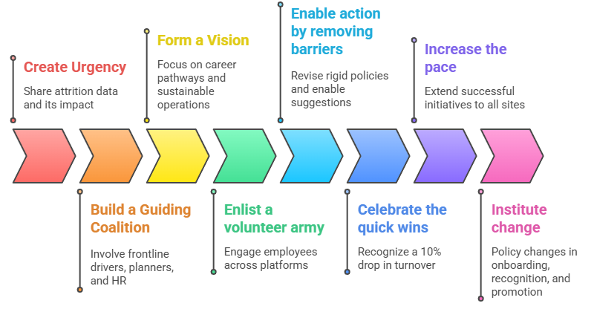
Applying Kotters Change Model for Retention

Slide 7
Measuring Retention Success
To evaluate the effectiveness of retention efforts in a logistics context, four specific KPIs are proposed:
Annual Turnover Rate (ATR): This quantifies total voluntary exits over total employees annually. A decrease post-intervention signals improved retention (Sishuwa & Phiri, 2020).
Employee Stability Index (ESI): Measures long-term retention by tracking employees with over one year of service. This metric reveals if core staff are being retained and aligns with operational stability goals.
Engagement-to-Retention Conversion (ERC): This method links engagement survey data with actual retention, revealing how sentiment predicts loyalty.
Critical Role Retention Rate (CRRR): Tracks retention of roles like fleet coordinators and planners, where loss impacts operations most. Targeted improvements here show real-time impact (Chang et al., 2024).

Slide 8
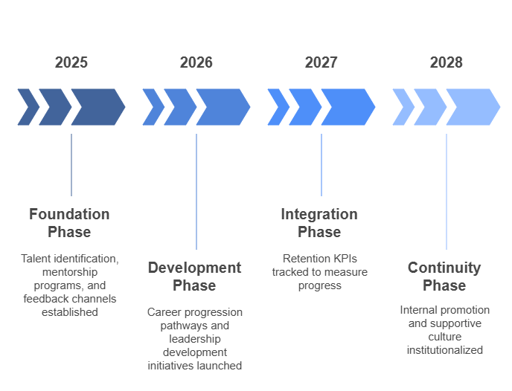
Succession Planning and Employee Retention Roadmap

Slide 9
Evaluating Current Fleet Decarbonisation & Labour Strategy
Decarbonisation Measures
Route optimisation software: Implementing route planning tools has delivered environmental and cost benefits. By allocating efficient paths and minimizing idle time, fuel consumption and CO₂ emissions can decrease by up to 15%. (Xue et al., 2022).
Speed governors: Installing 56 mph limiters improves fuel economy. Nonetheless, practical benefits decrease as payload, terrain, and delivery urgency change (Toktaş et al., 2024).
Recruitment Agency Reliance
Agencies help address labour shortages but often fail to secure long‑term engagement. Culture mismatches and missing retention plans lower motivation and stability (Kumar et al., 2024).

Slide 10
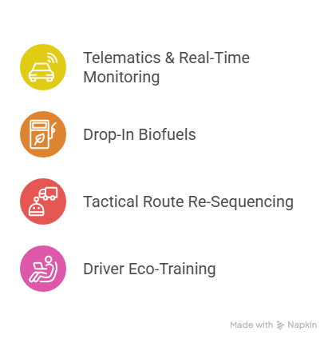
Short Term Decarbonisation Strategies
Telematics & Real‑Time Monitoring
Implement telematics with driver behaviour analytics and predictive maintenance to reduce fuel consumption, supporting lean objectives through waste identification (Xue et al., 2022).
Drop‑In Biofuels
Adopt hydrotreated vegetable oil (HVO) in existing vehicles to achieve immediate CO₂ reductions without infrastructure overhaul (Tomos et al., 2024).
Tactical Route Re‑Sequencing
Re-sequence deliveries based on density and time‑window constraints to lower mileage and emissions while preserving operational agility (Toktaş et al., 2024).
Driver Eco‑Training
Introduce eco‑training programs that improve fuel efficiency and enhance job satisfaction and retention (Guo et al., 2024).

Slide 11
Life Cycle Assessment (LCA) for Sustainable Fleet Transition
LCA offers a structured method to assess environmental impacts across a truck’s life cycle—from manufacturing to disposal. Findings indicate that the majority of emissions stem from the use phase, underscoring the importance of addressing fuel type and driving behaviour (Xue et al., 2022).
Strategic Decarbonisation Measures
Biofuel Integration: Using biofuel (HVO) reduces life cycle emissions where electrification is limited (Tomos et al., 2024).
Operational Optimisation: Retrofitting trucks and enhancing logistics planning cut emissions without fleet replacement.
Phased Electrification: LCA supports a gradual EV rollout, maximising benefits as grid decarbonisation advances.

Slide 12
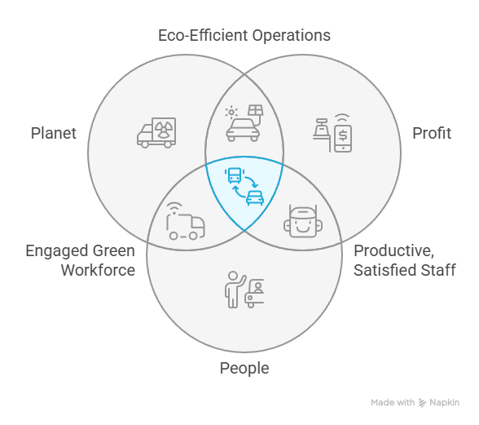
Long Term Decarbonisation Strategies
To achieve long term sustainable fleet decarbonisation, the company should adopt an integrated approach aligned with the Triple Bottom Line: People, Planet, and Profit.
Planet – Environmental Impact
Electrifying the fleet with battery electric and hydrogen fuel cell trucks significantly lowers lifecycle emissions (Xue et al., 2022).
Profit – Economic Viability
A phased fleet renewal, paired with investments in depot-based charging infrastructure, ensures cost-effective operations and maintenance savings (Eikenberry, 2020).
People – Workforce Readiness
Reskilling programs and enhanced driver ergonomics improve job satisfaction and retention (Breckon et al., 2019). Additionally, digital route optimisation boosts reliability and balances workloads (Sultan et al., 2023).

Slide 13
Adopting New Technology
To support the adoption of low-emission technologies, the company can apply the Technology Acceptance Model (TAM), focusing on two key factors: perceived usefulness (PU) and perceived ease of use (PEOU).
Enhancing Perceived Usefulness: Demonstrate how hybrid and electric trucks improve fuel efficiency and compliance. When staff recognize operational value, acceptance increases (Marisda et al., 2020).
Improving Ease of Use: Introduce user-friendly digital platforms and provide tailored training for smart scheduling, emissions tracking, and vehicle systems (Breckon et al., 2019).
Encouraging Participation: Engage staff in pilot projects and promote early adopters as internal champions to strengthen behavioural intention and actual usage (Marisda et al., 2020).

Slide 14
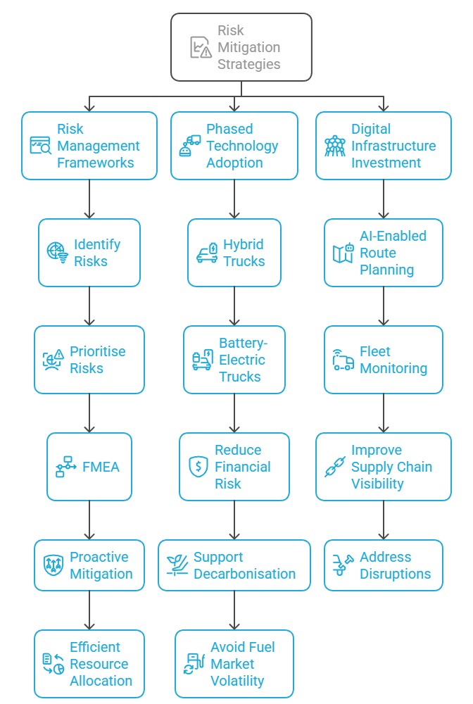
Risk Mitigation Strategies for Decarbonising Logistics Operations
To manage operational and decarbonisation risks effectively, the company should adopt an integrated, research-driven approach.
Risk Management Frameworks: Implement ISO 31000 to systematically identify and prioritise risks such as fleet failures and delays (Rahmah et al., 2025). Use FMEA to enable proactive mitigation and efficient resource allocation.
Phased Technology Adoption: Gradually transition to hybrid and battery-electric trucks to reduce financial risk, support decarbonisation, and avoid fuel market volatility (Xue et al., 2022).
Digital Infrastructure Investment: Deploy AI-enabled route planning and fleet monitoring to improve supply chain visibility and address disruptions from staff shortages and inefficiencies (Kim & Kim, 2024).

Slide 15
Key Performance Indicators for Measuring Fleet Decarbonisation
To assess decarbonisation progress, the company should monitor KPIs aligned with environmental, operational, and financial goals.
CO₂ Emissions per Kilometre (gCO₂/km): A core environmental metric used in transport audits, it directly measures carbon performance (Xue et al., 2022).
Fuel Consumption per Route (L/km): Indicates energy efficiency and route optimisation effectiveness, reflecting improvements from eco-driving tools and fleet upgrades (Miklautsch & Woschank, 2022).
Renewable Energy Usage (%): Tracks adoption of electric or hydrogen-powered vehicles in fleet operations (Eikenberry, 2020).
Carbon Cost Savings (£/tonne CO₂): Links emissions reduction to financial performance, supporting Lean principles.

Slide 16
Conclusion
A structured lean-agile succession framework that integrates mentorship cohorts, cross-functional rotations, and open performance feedback boosts employee engagement and retention while facilitating knowledge transfer. At the same time, utilizing advanced telematics and route optimization software, along with the gradual integration of hydrotreated vegetable oil and electric trucks, reduces fleet emissions and improves fuel efficiency. Collectively, these interconnected strategies ensure that operational excellence and decarbonization objectives progress together, maintaining service quality and long-term sustainability in a competitive logistics environment.

Slide 17
References
Chang, S., Saad, H. S., Aisya, N. Q., Yee, S. P., & Selvam, S. K. (2024). Why do People Stay? A Study on Factors Influencing Employees Retention in the Logistics Industry. International Journal of Academic Research in Business and Social Sciences, 14(10), 734–750. https://doi.org/10.6007/ijarbss/v14-i10/22931
Eikenberry, S. E. (2020). Hybrids are an effective transitional technology for limiting US passenger fleet carbon emissions. AIMS Environmental Science, 7(2), 117–139. https://doi.org/10.3934/environsci.2020007
Guo, S., Kutanoglu, E., Goodarzi, S., & Singh, M. (2024). Exploring the cost–carbon trade‐off in using a mixed fleet of hydrogen trucks and diesel trucks. Decision Sciences. https://doi.org/10.1111/deci.12659
Hassan, S. N. ul, & Siddiqui, D. A. (2020). Impact of effective succession planning practices on employee retention: Exploring the mediating roles. SSRN Electronic Journal, 10(2). https://doi.org/10.2139/ssrn.3556924
Keller, J. (2018). Succession planning management. Succession Planning, 41–48. https://doi.org/10.1007/978-3-319-72532-1_4
Kim, C.-Y., & Kim, S.-H. (2024). Efficiency analysis of shipping, aviation, land transport, and railway industries using dea-malmquist : Focusing on supply chain risks. Korean Logistics Research Association, 34(5), 77–87. https://doi.org/10.17825/klr.2024.34.5.77
Kumar, A., Singh, A., Kumar, A., Singh, A., & Garg, B. (2024). Modeling Framework for Sustained Supply Chain: A Triple Bottom Line Approach. 2024 ASU International Conference in Emerging Technologies for Sustainability and Intelligent Systems (ICETSIS). https://doi.org/10.1109/icetsis61505.2024.10459683
Lim, M. A. (2024). Herzberg’s Two-Factor Theory of Motivation and Employee Retention: Basis for Proposed Human Resource Management Guidelines. International Journal of Research Publication and Reviews, 5(12), 1125–1133. https://doi.org/10.55248/gengpi.5.1224.3433
Marisda, M., Keke, Y., Pratiwi, S., & Irenita, N. (2020). The application of the technology acceptance model (TAM) method for the acceptance of autonomous trucks as logistics delivery services. Advances in Transportation and Logistics Research, 3, 766–775. https://doi.org/10.25292/atlr.v3i0.347
Rahmah, T. L., Novianti, T., & Mulyati, H. (2025). Analysis of operational risk management in logistic companies: A case study of PT sugiarto jaya mandiri transport bogor. International Journal of Research and Review, 12(1), 140–147. https://doi.org/10.52403/ijrr.20250117
Sinha, M. K., & Mukherjee, K. (2024). The role of transformational leadership for talent retention and engagement. ShodhKosh Journal of Visual and Performing Arts, 5(5). https://doi.org/10.29121/shodhkosh.v5.i5.2024.3915
Sishuwa, Y., & Phiri, J. (2020). Factors influencing employee retention in the transport and logistics industry. Open Journal of Social Sciences, 08(06), 145–160. https://doi.org/10.4236/jss.2020.86013
Sultan, M. A., Kramberger, T., Barakat, M., & Ali, A. H. (2023). Barriers to applying last-mile logistics in the egyptian market: An extension of the technology acceptance model. Sustainability, 15(17), 12748. https://doi.org/10.3390/su151712748
Tetteh, J., & Asumeng, M. A. (2022). Succession planning, employee retention and career development programmes in selected organisations in Ghana. African Journal of Management Research, 27(1), 151–169. https://doi.org/10.4314/ajmr.v27i1.9
Toktaş, D., Ülkü, M. A., & Habib, M. A. (2024). Toward Greener Supply Chains by Decarbonizing City Logistics: A Systematic Literature Review and Research Pathways. Sustainability, 16(17), 7516–7516. https://doi.org/10.3390/su16177516
Tomos, B. A. D., Stamford, L., Welfle, A., & Larkin, A. (2024). Decarbonising international shipping – A life cycle perspective on alternative fuel options. Energy Conversion and Management, 299, 117848. https://doi.org/10.1016/j.enconman.2023.117848
Tomos, B., Stamford, L., Welfle, A., & Larkin, A. (2024). Decarbonising international shipping – A life cycle perspective on alternative fuel options. Energy Conversion and Management. https://doi.org/10.1016/j.enconman.2023.117848.
Xue, X., Li, J., Sun, X., Abdul-Manan, A. F. N., Du, S., Liu, H., Xu, S., & Zhao, M. (2022). Assessing decarbonization pathways of China’s heavy-duty trucks in a well-to-wheels perspective. The International Journal of Life Cycle Assessment. https://doi.org/10.1007/s11367-022-02124-y
Xuecheng, W., Iqbal, Q., & Saina, B. (2022). Factors affecting employee’s retention: Integration of situational leadership with social exchange theory. Frontiers in Psychology, 13(872105), 1–13. NCBI. https://doi.org/10.3389/fpsyg.2022.872105
Ybañez, R. (2024) ‘Application of Herzberg’s Two-Factor Theory: Motivational Factors and Hygiene Factors in the Financial Industry’, Journal of Interdisciplinary Perspectives., 2(4). doi: https://doi.org/10.69569/jip.2024.0055.

Slide 18

THANK YOU
Q..?

