Slide 1

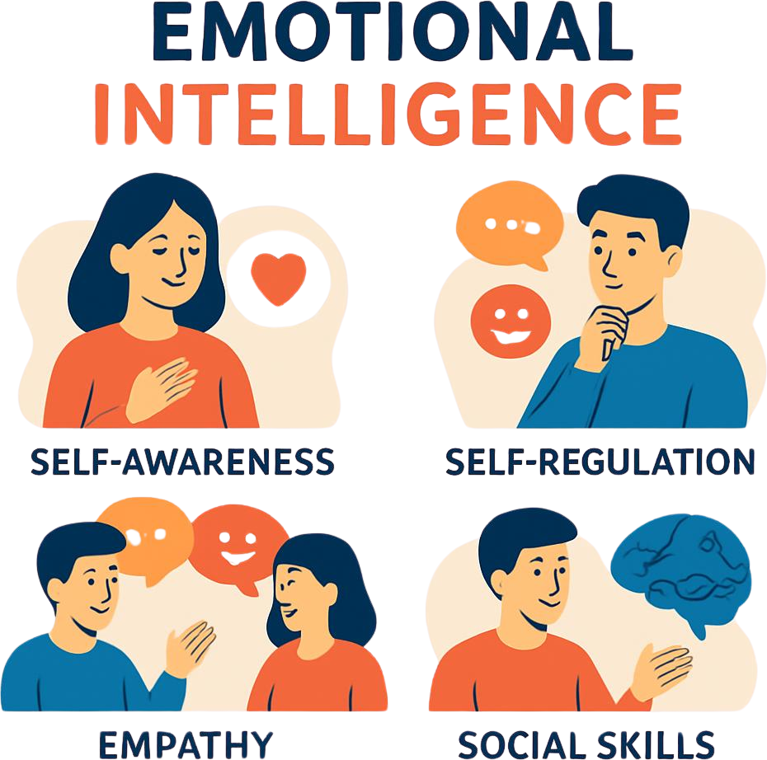

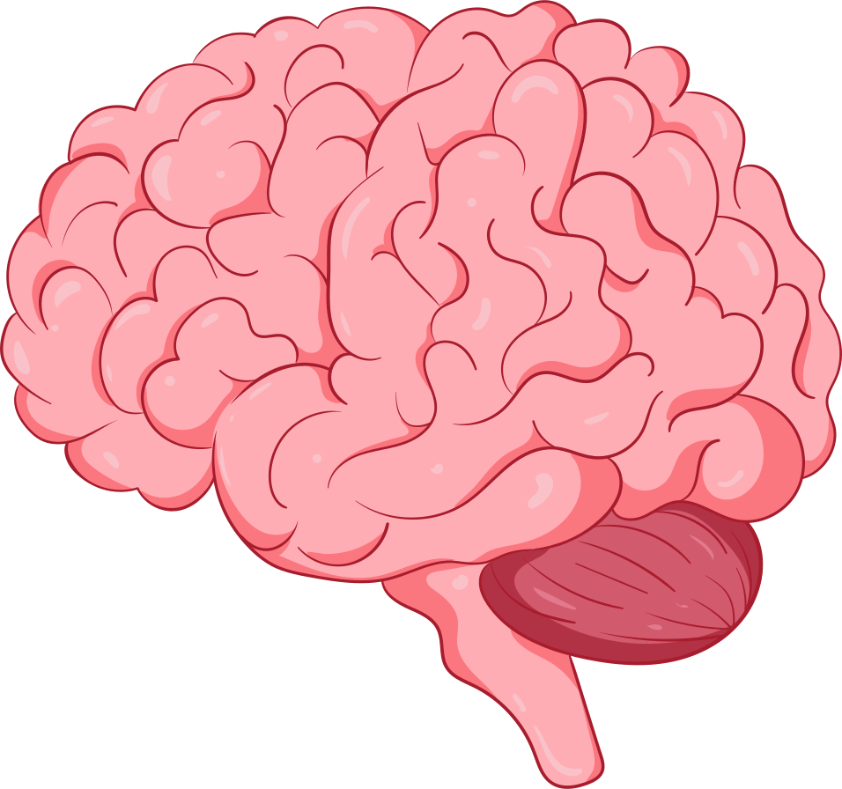
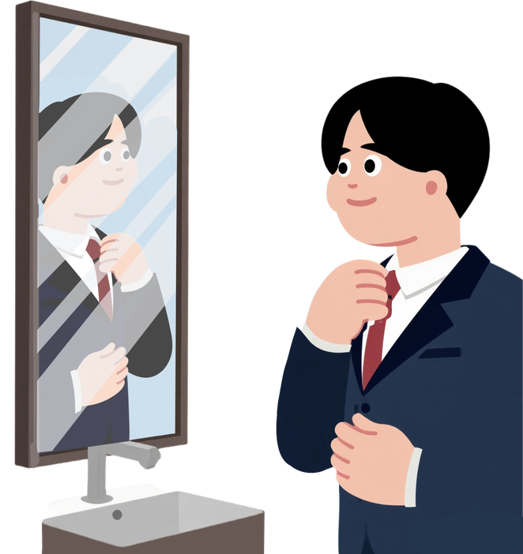
Student’s Name: Erasmus Onyeukwu
Module: Developing Emotional Intelligence ( LCLM5006_Lon)
Lecturer: Prof. Nishi Ramsurrun
It’s important to strike a balance between being emotionally aware and not overthinking.
practice mindfulness and self-reflection, allowing yourself to process emotions naturally without dwelling excessively
Understanding your emotions and the people around you is crucial for maintaining healthy relationships and emotional well-being
Building a strong and healthy relationships with others
Self Motivation
driving your self to achieve goals without external factors
“In a very real Sense, we have two minds, one that thinks and one that feels.”
(Goleman, 1995)

