Slide 1
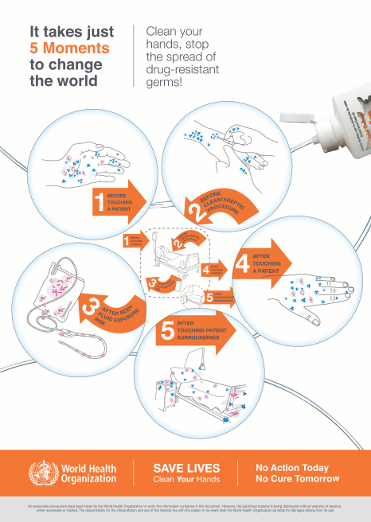
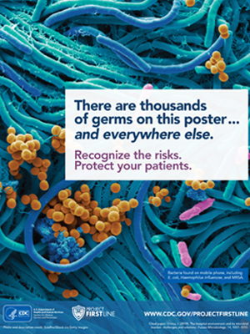
INFECTION PREVENTION AND CONTROL ( IPC )
By Mirela Ilie
INTRODUCTION
OBJECTIVES
KEY COMPONENT OF IPC
KEY COMPONENTOF IPC
CONCLUSION
Infection prevention and control (IPC) is a crucial framework designed to minimize the risk of acquiring and spreading infections in various settings, including healthcare facilities, community environments, and even within households.
In conclusion, infection prevention and control is an interdisciplinary field that combines medical knowledge, public health principles, and practical measures to mitigate the risk of infectious diseases. It is essential for maintaining the health and safety of individuals.
The primary objectives of infection prevention and control are to:
Protect patients and healthcare workers:
IPC measures are designed to reduce the risk of healthcare-associated infections (HAIs) and occupational exposure to infectious agents, ensuring the safety of both patients and healthcare providers.
2. Limit the spread of infections:
  By implementing effective IPC measures, the transmission of infectious diseases is minimized.
4.Isolation precautions:
Patients with contagious diseases are placed in isolation to prevent the spread of infections to others.
1 / 2
5.Vaccination:
Immunization is a crucial aspect of IPC, as it can prevent various infectious diseases.
1 / 2
Reference List
2.Personal protective equipment (PPE):
Healthcare workers and individuals in close contact with infected individuals often use PPE such as gloves, masks, gowns, and face shields to protect themselves and others.
6.Education and training:
Healthcare workers and the public need to be educated about infection prevention and control measures to ensure compliance with best practices.
Centers for Disease Control and Prevention (2023) Print Materials and Job Aids. Available at: Print Materials and Job Aids from Project Firstline | Infection Control | CDC (Accessed 02 November 2023).
Department of Health & Social Care (2022) Infection prevention and control: resource for adult social care. Available at: Infection prevention and control: resource for adult social care - GOV.UK (www.gov.uk) (Accessed 29 October 2023).
KEY COMPONENT OF IPC
3.Sterilization and disinfection:
Cleaning and sanitizing surfaces, medical equipment, and instruments help eliminate or reduce the presence of pathogens.
7.Surveillance and monitoring:
Regular monitoring and reporting of infectious disease patterns and outbreaks are vital for timely intervention and control.
Public Health Wales (2023 ) National Infection Prevention and Control Manual: Chapter 1- Standard Infection Control Precautions(SICPs). Available at:
https://phw.nhs.wales/services-and-teams/harp/infection-prevention-and-control/nipcm/chapter-1-standard-infection-control-precautions-sicps/ (Accessed 23 October 2023).
1.Hand hygiene: Proper handwashing and the use of hand sanitizers are essential to prevent the spread of germs from person to person.
World Health Organization (2021). Available at :Five moments for hand hygiene (who.int) (Accessed 24 October 2023).

