Slide 1
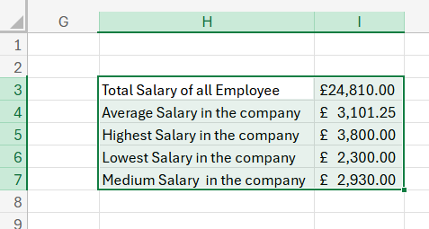
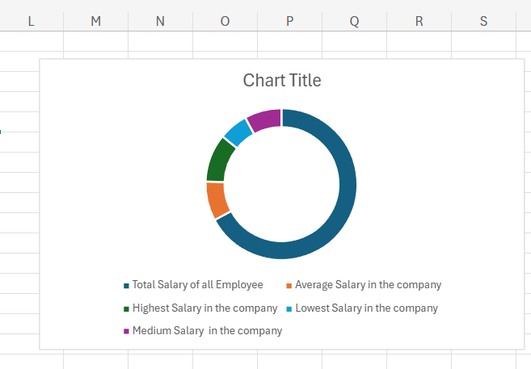
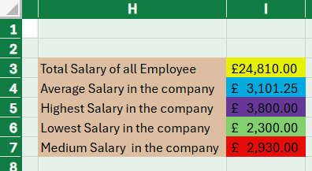
How to creat a Chart in Excel
Presented by:
Mihaela Sipetan(2521601)
Step 1 : Select Your Data by highlight the cells,rows,and columns as is ilustrated below.
Step 2 : Insert Chart by selecting Recommended Charts or choose specific type directly from the charts group as is shown in picture.
Step 3 :You can customize with the chart selected,using Chart Design and Format tabs to change colors,layout and styles.

