Slide 1

Student name: Delia Munteanu
Student number: 2314055
BMHP6029
Psychopathological Classifications and Provisions Component
Acknowledgement of the use of AI tools
I confirm that I have not used any AI tools in the research and creation of this assignment. I confirm that I have not presented any AI-generated materials as my own work. I confirm I have copies of my drafts, notes, and other resources I used, which I may be asked to provide in evidence.

Slide 2
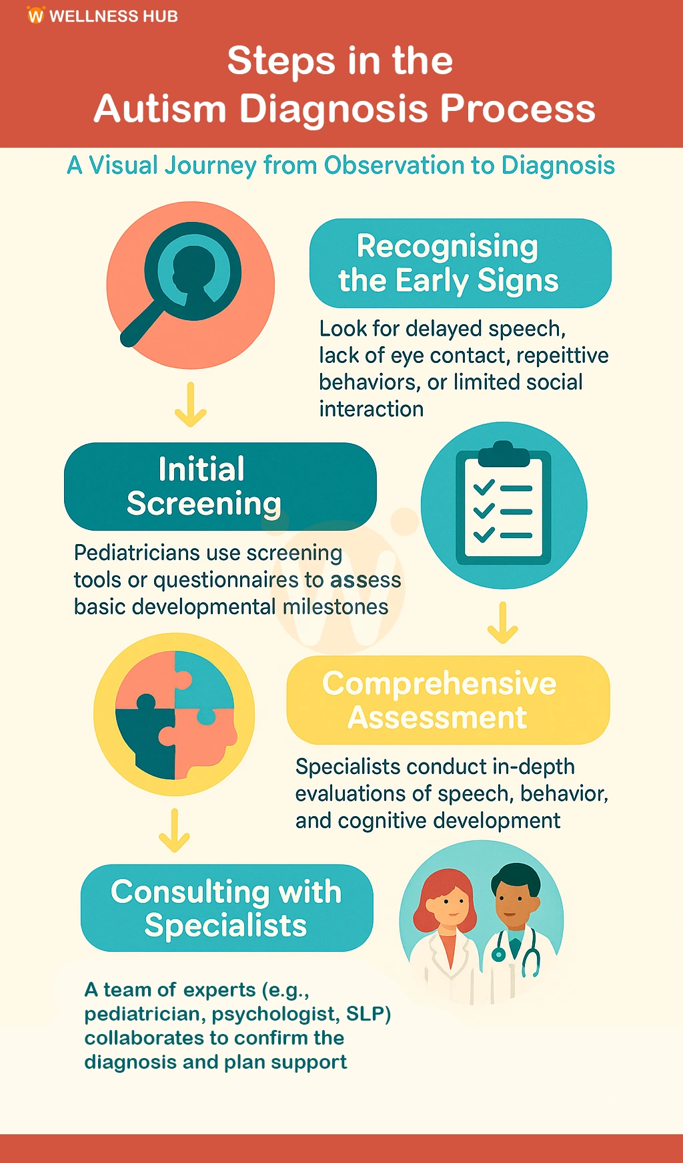
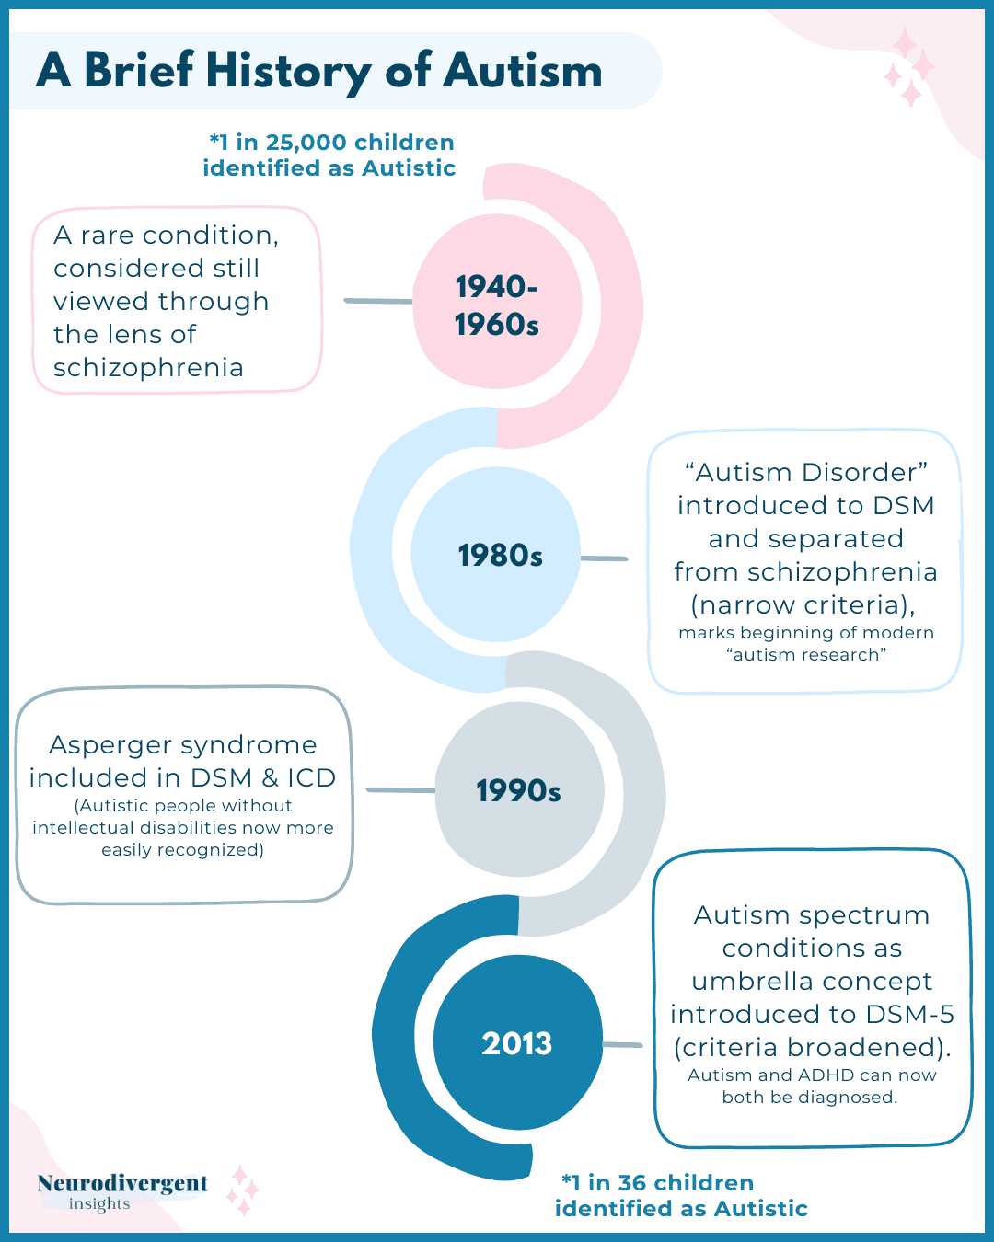
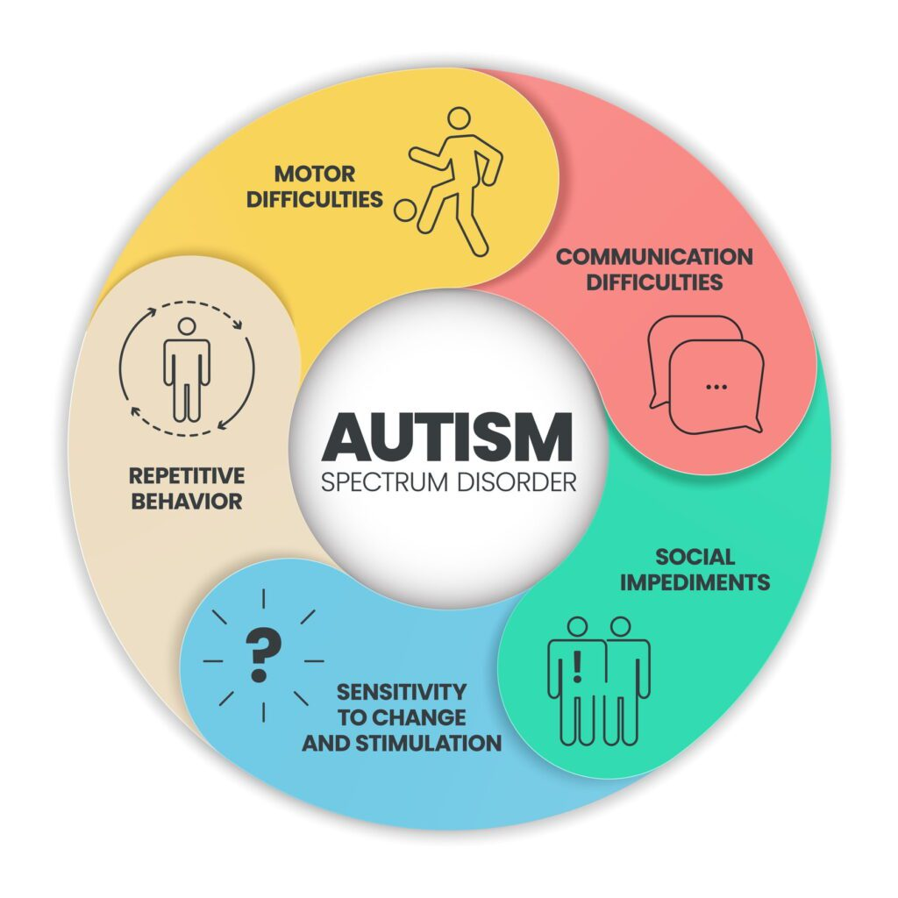
NEURODEVELOPMENTAL DISORDER
AUTISM SPECTRUM DISORDER
INTRODUCTION Autism Spectrum Disorder (ASD) is a neurodevelopmental condition that influences how individuals communicate and interact socially, often accompanied by repetitive behaviours or highly focused interests (Hodges et al., 2020). Current estimates indicate that around 1% of the population is autistic, which equates to approximately 700,000 people in the UK—covering both children and adults—who are identified as being on the autism spectrum (NAS, 2025).
Diagnosis
Diagnosis is based on behavioural and developmental evaluation.
Developmental Screening: Done during routine well-child visits.
Comprehensive Diagnostic Evaluation: Parent/caregiver interviews about development, direct observation of social interaction and behaviour,
Use of standardised tools: Autism Diagnostic Interview-Revised(ADI-R), Autism Diagnostic Observation Schedule (ADOS)(Duval et al,2025).
DSM-5 Criteria: Challenges in social communication and reciprocal interaction, restricted or repetitive behavioural patterns and focused interests
Additional Assessments: Hearing and speech tests, Genetic testing, Cognitive and language evaluation
Early Detection: Signs are often visible by. 18–24 months.
RECOMMENDATIONS
Strengthen early screening and diagnosis.
Use personalised, multidisciplinary approaches,
Prioritise evidence-based interventions,
Adapt environments and communication methods
Support families through parent-mediated programmes
Improve autism-inclusive educational practices.
Reduce stigma and promote neurodiversity,
addressing historical misconceptions about autism.
Expand lifespan services to support the autistic
adolescents and adults in employment, independence, and mental health.
CAUSES, SYMPTOMS, DIAGNOSIS Causes: Genetic Factors Around 25–35% of cases have an identifiable genetic origin (Wiśniowiecka-Kowalnik et. all, 2019). Brain development and neural function. Environmental Factors Environmental influences interact with genetic susceptibility, contributing to ASD risk. Prenatal factors and perinatal conditions, parental age, and exposure to certain environmental agents (Kuodza et. al, 2024). Symptoms: Social communication and interaction challenges, difficulties in understanding, expressing, or responding to social interactions and relationships. Sensitivity to change and stimulation Repetitive or restricted behaviours and interests, such as engaging in repeated actions, adhering to routines, or showing focused interests in specific topics or activities (Bal et al. 2019).
(Wellness Hub, 2025)
HISTORICAL PERSPECTIVE AND TREATMENTS
Autism was historically misunderstood and often seen as childhood schizophrenia or psychosis.
Early theories wrongly blamed parent–child relationships (Lang, 2025).
These misconceptions caused stigma and led to harmful practices like institutionalisation and the “refrigerator mother” theory.
Today, ASD is recognised as an early neurodevelopmental condition which affects social interaction, communication, behavioural patterns, and sensory processing (Silverman, 2015).
CONCLUSION
Autism Spectrum Disorder is now understood as a neurodevelopmental condition arising from complex genetic and environmental influences, replacing earlier misconceptions about its origins. Effective outcomes rely on early detection, thorough assessment, and the application of evidence-based, individualised interventions. Multidisciplinary collaboration, family engagement, and inclusive educational approaches remain central to supporting communication, learning, and daily functioning. Continued advancement in services, reductions in stigma, and sustained research are essential for improving long-term quality of life and promoting an inclusive, neurodiverse society.
(Neurodivergent Insight, 2025)
CURRENT SERVICES AND TREATMENTS Behavioural and developmental approaches Clinical support aimed at improving verbal expression and comprehension Occupational therapy supports the development of daily living skills. Psychological interventions, including adaptations of cognitive behavioural therapy. Pharmaceutical treatments are used to manage related conditions like hyperactivity disorder, aggression, and anxiety. Educational services (Politte, 2015). Family and community supports (Ono et al., 2013).
(Phoenix Autism Center 2025)

Slide 3
Reference
Bal, V.H. et al. (2019) ‘Autism spectrum disorder symptoms from ages 2 to 19 years: Implications for diagnosing adolescents and young adults’, Autism Research, 12(1), pp. 89–99. Available at: https://doi.org/10.1002/aur.2004.
Hodges, H., Fealko, C. and Soares, N. (2020) ‘Autism Spectrum Disorder: definition, epidemiology, causes, and clinical evaluation’, Translational Paediatrics, 9(S1), pp. S55–S65. Available at: https://doi.org/10.21037/tp.2019.09.09.
Kuodza, G.E., Kawai, R. and LaSalle, J.M. (2024) ‘Intercontinental insights into autism spectrum disorder: a synthesis of environmental influences and DNA methylation’, Current Zoology, 10(1), p. dvae023. Available at: https://doi.org/10.1093/eep/dvae023/
National Autistic Society (2025) What is autism?. Available at: https://www.autism.org.uk/advice-and-guidance/what-is-autism#:~:text=autism%20a%20disability?-,How%20many%20autistic%20people%20are%20there?,skills%2C%20abilities%20or%20support%20needs// (Accessed: 10 November 2025).
Wiśniowiecka-Kowalnik, B. and Nowakowska, B.A. (2019) ‘Genetics and epigenetics of autism spectrum disorder—current evidence in the field’, Journal of Applied Genetics, 60(1), pp. 37–47. Available at: https://doi.org/10.1007/s13353-018-00480-w.
Grodberg, D. et al. (2014) ‘The Autism Mental Status Exam: sensitivity and specificity using DSM-5 criteria for autism spectrum disorder in verbally fluent adults’, Journal of Autism and Developmental Disorders, 44(3), pp. 609–614. Available at: https://doi.org/10.1007/s10803-013-1917-5.
Duvall, S.W. et al. (2025) ‘Factors associated with confirmed and unconfirmed autism spectrum disorder diagnosis in children volunteering for research’, Journal of Autism and Developmental Disorders, 55(5), pp. 1660–1672. Available at: https://doi.org/10.1007/s10803-024-06329-y.
Lang, H.M. (2025) ‘History of the autism diagnosis– how perspectives have changed’, Healthcare Analysis [Preprint]. Available at: https://doi.org/10.1007/s10728-025-00527-0.
Silverman, C. (2015) ‘NeuroTribes: The legacy of autism and the future of neurodiversity’, Anthropological Quarterly. Washington: Institute for Ethnographic Research, p. 1111. Available at: https://doi.org/10.1353/anq.2015.0057.
Politte, L.C. et al. (2015) ‘Evidence-based treatments for autism spectrum disorder’, Current Treatment Options in Psychiatry, 2(1), pp. 38–56. Available at: https://doi.org/10.1007/s40501-015-0031-z.
Oono, I.P., Honey, E.J. and McConachie, H. (2013) ‘Parent‐mediated early intervention for young children with autism spectrum disorders (ASD)’, Cochrane Database of Systematic Reviews, 2013(10), p. CD009774. Available at: https://doi.org/10.1002/14651858.CD009774.pub2.

