Slide 1
Some approaches
Strategies and methods

Slide 2
Strategy
‘A strategy is a plan of action designed to achieve a specific goal.’
(Denscombe, 2010, pp3)
Broken down into parts, we can use the following pattern:
Overview
Plan of action
Goal

Slide 3
But first…E-mail through SCUDD
When we write about performance, what happens to that performance? How does our writing about performance re-perform, redefine, and recreate the work? In this process, what does the source material now become? In what ways can the language we use to document or describe what happens in a specific space and temporality radically open up the work and its associative discourse/s, rather than act as a restraining force through analysis?
There are many languages to explore and utilize in this investigation. We invite experiments in writing about/for/in performance. We invite the act of writing as research in itself, as a way to infiltrate, aerate, and celebrate the discoveries embedded in the process of making—and presenting—artistic work.

Slide 4
What next?
Can you answer the questions:
What is my practice?
What is Practice as Research?
What is Critical Reflection?
Do I understand how to document effectively?
Do I understand the importance of referencing?

Slide 5
What next?
New questions to underpin all previous questions:
What are the implications of research in the performing arts?
What is the broader meaning of research in the performing arts?

Slide 6
Strategy
‘A strategy is a plan of action designed to achieve a specific goal.’
(Denscombe, 2010, pp3)
Broken down into parts, we can use the following pattern to describe our next steps:
Create an Overview
Design a Plan of action
Set a specific Goal

Slide 7
Methods
Research methods are the tools for data collection.
We have considered qualitative and quantitative collection methods.
We must maintain a practical focus in Practice as Research to answer our questions.
How will you combine these elements?

Slide 8
Choices… Choices… Choices
Choose your strategies and methods wisely, always ask yourselves:
Is it suitable?
Is it feasible?
Is it ethical?

Slide 9
Grounded Theory
A qualitative research methodology.
The study of concepts or patterns often used in social science research.
The construction of a theory through analysis of data gathered in your study i.e. you look at results and construct a question which stands as your theory.
Could be described as research in reverse.
Has several key steps which are vital to the process.

Slide 10
Ethnographic Study
A qualitative research method.
Studying a distinct community or culture in a broader society.
Considers cultural phenomena based upon culture, language, behavior: needs fieldwork.
You must carefully consider the culture of the group you are studying and gain trust through key members of the community.
You must not influence the group.

Slide 11
Auto-Ethnographic Study
Qualitative self-reflection and writing is used to explore personal experience of a broader society.
A study of ‘you’ in relation to a wider community – but how will this be ‘practice’? Stand up comedy maybe?
Not for all as it is exposing and personal.
Auto-ethnography ‘Uses a researcher's personal experience to describe and critique cultural beliefs, practices, and experiences.’
(Adams 2015)

Slide 12
Action Research
A qualitative research strategy.
Links practice and research (an early version of P&R)
‘Driven by the need to solve practical real world problems’ (Denscombe, 2016 pp123)
Seeks to affect change.
Reflective and critical to support developmental change.
Requires group work.

Slide 13
Case Study
A qualitative research strategy with the aim ‘to illuminate the general by looking at the particular’ (Denscombe, 2016 pp55).
A self contained and distinct study of indentified factors in a specific setting.
Lets the researcher study deeply for good quality description of situations.
Can describe, explore, compare and explain situations for further practice as experiment.

Slide 14
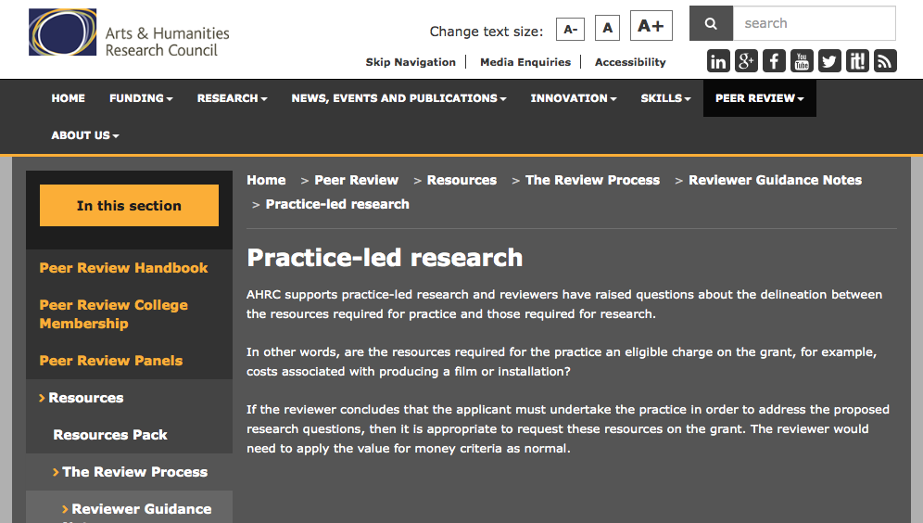
Arts & Humanities Research Council

Slide 15
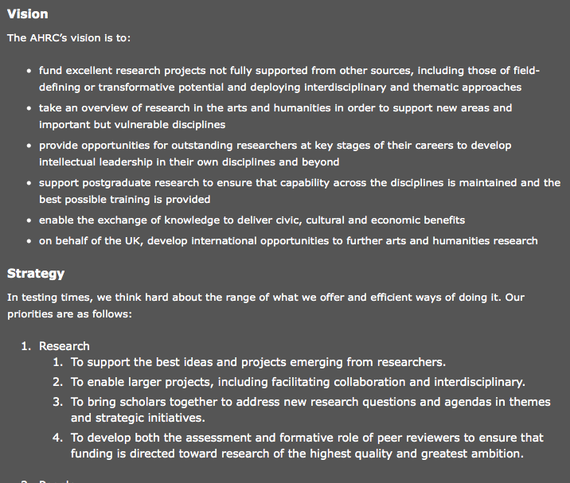
Arts & Humanities Research Council

Slide 16
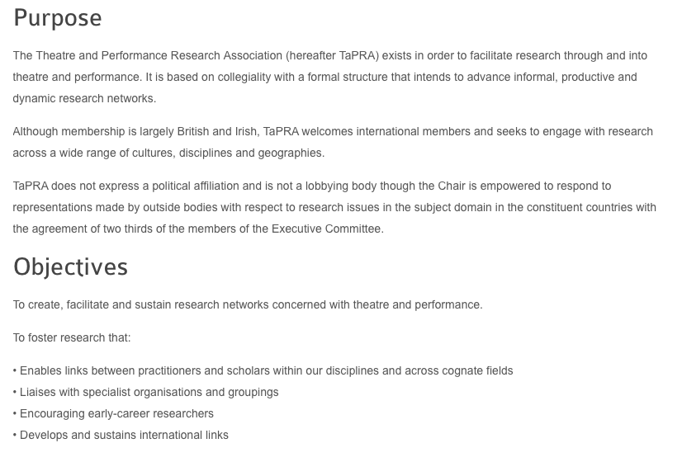
The Theatre and Performance Research Association

Slide 17


Slide 18
Methods II
To gain facts and evidence – and a better impression of your area of study you may use 1 or more of these methods:
Questionnaires
Interviews
Observation
Documents
But P&R requires innovative practice and documentation to underpin and inform these more traditional data collection methods.

Slide 19
Limitations
Time: If a data collection method relies on long term data collection then it may not be effective for us in this module – but evaluate how it could or would work for you.
Money: If your project needs supplies or incurs travel costs you can apply for bursaries.
Participants and contributors: who are these people? Are your sample groups going to be big enough?
Permission: Do you have permission from your participants and the institution to collect data?

Slide 20
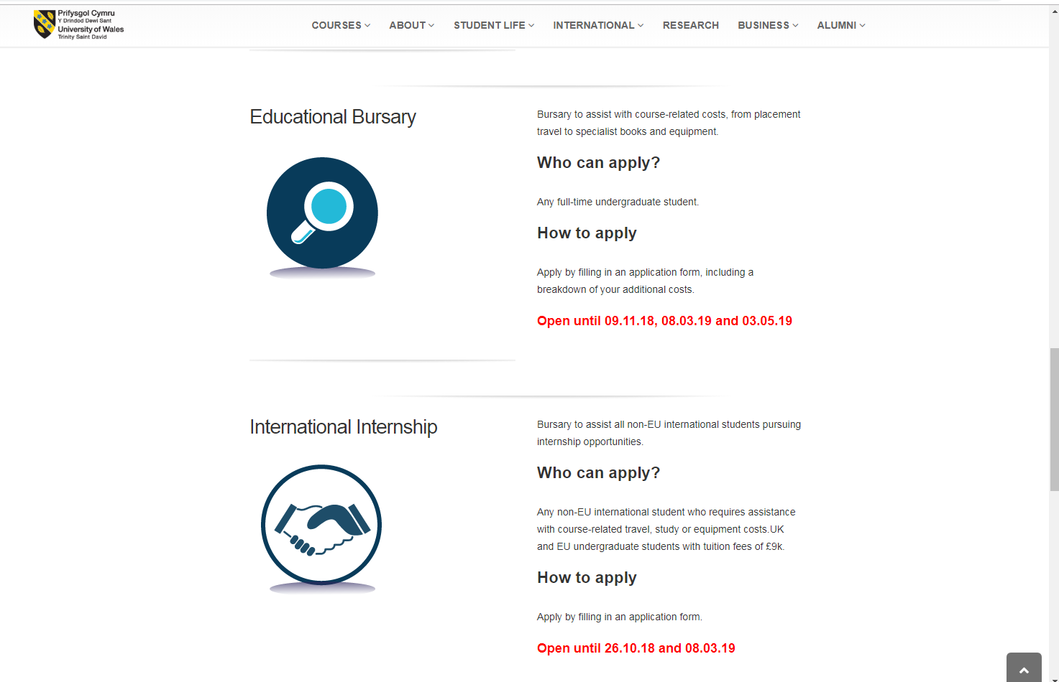
UWTSD financial support
https://www.uwtsd.ac.uk/bursaries/

Slide 21
Bibliography
http://www.ahrc.ac.uk/about/visionstrategygovernance/
http://www.ahrc.ac.uk/peerreview/resources/reviewprocess/reviewerguidance/practiceledresearch/
http://tapra.org/about-tapra/tapra-constitution/
http://tapra.org
http://www.uwtsd.ac.uk/bursaries/
Websites accessed 25/10/18
Adams, T.E. Autoethnography Understanding Qualitative Research. Oxford: Oxford University press, 2015.
Denscombe, M. The Good research guide: For Small-Scale Research Projects. Maidenhead. Oxford University press, 2014.
Reed-Danahay, D. E. Auto/Ethnography: Rewriting the Self and the Social. Oxford: Berg. 1997

