Slide 1
Quality Management in Healthcare
Case Study: The Bristol Royal Infirmary Inquiry (UK)
Student Name:- Darshankumar Patel
Student ID:- 2515501
Module Name:- Quality Assurance and Service Improvements
Module Code:- LCHS70019
Lecturer Name:- Dr Christopher Mafuva

Slide 2

The Bristol Royal Infirmary Inquiry (UK) Issue: Failures in pediatric cardiac surgery (1984–1995), high mortality rates due to poor QA, lack of audit, and systemic problems. QA relevance: Importance of clinical governance, audit, and learning systems in QA.

Slide 3

Introduction
The Bristol Royal Infirmary Inquiry investigated failures in paediatric cardiac surgery between 1984 and 1995 after unusually high mortality rates among children raised serious concerns about patient safety and healthcare quality (Powell, 2019).
Rather than identifying individual negligence alone, the inquiry concluded that widespread organisational, managerial, and governance failures contributed significantly to poor clinical outcomes (Irvine, 2024).
The findings highlighted the importance of quality assurance, clinical governance, effective leadership, and continuous learning within the National Health Service (NHS) (Irvine, 2024).
This case remains one of the most influential examples of healthcare quality improvement and patient safety reform in the United Kingdom.
(NHS England, 2014)

Slide 4
Overview of the Case
Bristol Royal Infirmary Inquiry
Between 1984 and 1995, paediatric cardiac surgery at Bristol Royal Infirmary experienced mortality rates that were substantially higher than those reported by comparable specialist centres across the United Kingdom (Drury et al, 2018).
The public inquiry, chaired by Professor Sir Ian Kennedy, examined organisational failures, clinical decision-making, leadership practices, and quality assurance systems that contributed to avoidable patient harm (Irvine, 2024).
The final report, published in 2001, presented more than 190 recommendations aimed at improving clinical governance, transparency, accountability, and patient safety throughout the NHS (Drury et al, 2018).

Slide 5

Quality Management in Healthcare
Quality management is a continuous organisational approach that ensures healthcare services are safe, effective, patient-centred, timely, efficient, and equitable through systematic monitoring and continuous improvement (Enahoro et al, 2024).
Clinical governance provides a structured framework that promotes accountability, evidence-based practice, clinical audit, risk management, and professional development to improve healthcare quality (Jabeen et al, 2024).
Effective quality assurance systems help healthcare organisations identify performance gaps, minimise preventable harm, and maintain consistently high standards of patient care (Jabeen et al, 2024).

Slide 6
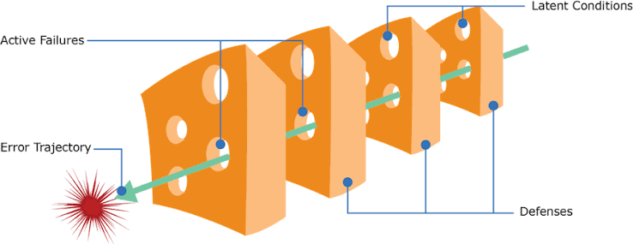
Swiss Cheese Model
James Reason's Swiss Cheese Model explains that patient harm usually results from multiple weaknesses within organisational systems rather than from a single individual's mistake (Lazányi, 2025).
At Bristol Royal Infirmary, failures in leadership, governance, communication, clinical audit, and external regulation aligned simultaneously, allowing serious patient safety incidents to occur (Lazányi, 2025).
The model demonstrates that strengthening each layer of organisational defence can significantly reduce the likelihood of preventable adverse events (Lazányi, 2025).
(Alan Higgins, 2023)

Slide 7
Application of the Swiss Cheese Model
Weak organisational leadership failed to recognise deteriorating surgical performance despite repeated evidence of poor patient outcomes (Hignett et al, 2018).
Ineffective clinical governance and the absence of routine performance monitoring prevented early identification of unacceptable mortality rates (Lazányi, 2025).
Poor communication between healthcare professionals, managers, and external regulators delayed corrective action and prolonged unsafe clinical practice (Hignett et al, 2018).
The alignment of these multiple system failures ultimately resulted in avoidable patient deaths and reduced public confidence in healthcare services (Hignett et al, 2018).

Slide 8
Root Cause Analysis
Root Cause Analysis identified inadequate quality assurance systems as one of the primary organisational failures contributing to poor surgical outcomes (Huang et al, 2025).
Limited clinical audit and benchmarking prevented healthcare professionals from recognising that mortality rates were significantly higher than national standards (Huang et al, 2025).
Weak leadership, ineffective communication, insufficient accountability, and a culture resistant to collective concern-raising allowed unsafe practices to continue for many years (Kellogg et al, 2017).
Addressing these underlying organisational issues would have been more effective than focusing solely on individual clinical errors (Kellogg et al, 2017).

Slide 9
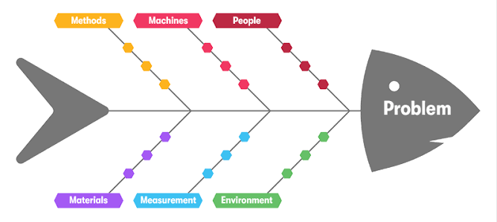
(HKMLC, 2026)

Slide 10
Fishbone Diagram
People: Limited specialist expertise, inadequate teamwork, and ineffective communication reduced the overall quality and safety of paediatric cardiac care (Loredana, 2017).
Leadership: Weak organisational leadership failed to monitor clinical performance or respond appropriately to concerns raised by healthcare professionals (Tagaram and Chen, 2024).
Process: The absence of structured clinical audits and standardised quality-assurance processes delayed the identification of poor surgical outcomes (Loredana, 2017).
Policy: National regulatory systems lacked effective performance monitoring and accountability mechanisms during the period of investigation (Tagaram and Chen, 2024).
Equipment: Resource limitations and insufficient specialist support reduced the effectiveness of complex paediatric cardiac services (Loredana, 2017).
Environment: A hierarchical organisational culture discouraged staff from openly reporting safety concerns or challenging poor clinical practice (Tagaram and Chen, 2024).

Slide 11
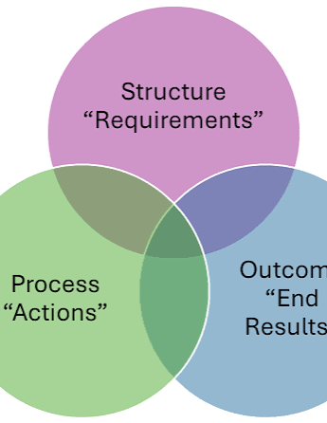
Donabedian Model
The structure component revealed weaknesses in staffing, governance arrangements, organisational leadership, and resource allocation that negatively influenced healthcare quality (Sharew et al, 2020).
The process component identified deficiencies in communication, clinical decision-making, multidisciplinary collaboration, and routine quality monitoring throughout patient care (Sharew et al, 2020).
The outcome component demonstrated increased mortality rates, avoidable patient harm, reduced public confidence, and significant national healthcare reforms following the inquiry (Sharew et al, 2020).
(Sitaji Gurung, 2026)

Slide 12
Policy Issues
The absence of mandatory national reporting systems prevented healthcare organisations from identifying poor clinical outcomes at an early stage (McDonald, 2016).
Clinical governance policies were underdeveloped, resulting in weak accountability and limited organisational responsibility for maintaining healthcare quality (McDonald, 2016).
External regulatory oversight lacked effective mechanisms for monitoring hospital performance and enforcing quality improvement measures (McDonald, 2016).
These policy weaknesses contributed directly to delayed intervention and prolonged unsafe clinical practices.

Slide 13
Impact on Quality
Poor governance and ineffective quality assurance systems significantly reduced the safety, effectiveness, and reliability of paediatric cardiac services (Gillam, 2022).
Delayed identification of poor clinical outcomes increased preventable mortality while undermining patient confidence in NHS healthcare services (Pande and Ghosh, 2023).
The inquiry demonstrated that sustainable improvements in healthcare quality require continuous monitoring, transparency, and organisational accountability (Gillam, 2022).

Slide 14
Impact on Efficiency
Ineffective quality management resulted in increased healthcare costs through prolonged hospital admissions, additional treatments, repeat surgical procedures, and legal compensation claims (Gillam, 2022).
Resources were used inefficiently because organisational failures prevented early corrective action that could have reduced avoidable patient harm (Pande and Ghosh, 2023).
Strengthening quality assurance systems improves efficiency by reducing clinical errors, unnecessary interventions, and financial waste (Pande and Ghosh, 2023).

Slide 15
Impact on Equity
Children receiving treatment at Bristol experienced poorer clinical outcomes than patients treated at comparable specialist centres, creating significant inequalities in healthcare delivery (Pande and Ghosh, 2023).
Limited transparency prevented families from making fully informed decisions regarding treatment options and provider performance (Gillam, 2022).
The inquiry reinforced the importance of ensuring consistent, high-quality healthcare regardless of geographical location or healthcare provider (Pande and Ghosh, 2023).

Slide 16
Conclusion
The Bristol Royal Infirmary Inquiry demonstrated how failures in governance, leadership, quality assurance, and organisational culture can combine to produce serious patient safety incidents.
Applying the Swiss Cheese Model, Root Cause Analysis, Fishbone Diagram, and Donabedian Model provides a comprehensive understanding of the systemic factors responsible for poor healthcare outcomes.
The inquiry continues to influence NHS policy by promoting clinical governance, transparency, continuous learning, and evidence-based quality improvement to deliver safer, more effective, and equitable healthcare services.

Slide 17
References
Drury, N.E., Patel, A.J., Oswald, N.K., Chong, C.R., Stickley, J., Barron, D.J. and Jones, T.J., 2018. Randomized controlled trials in children’s heart surgery in the 21st century: a systematic review. European Journal of Cardio-Thoracic Surgery, 53(4), pp.724-731. https://academic.oup.com/ejcts/article-abstract/53/4/724/4644816
Enahoro, A., Osunlaja, O., Maha, C.C., Kolawole, T.O. and Abdul, S., 2024. Reviewing healthcare quality improvement initiatives: Best practices in management and leadership. International Journal of Management & Entrepreneurship Research, 6(6), pp.1869-1884.
Gillam, S., 2022. Quality improvement in primary care: the essential guide. CRC Press. https://api.taylorfrancis.com/content/books/mono/download?identifierName=doi&identifierValue=10.1201/9780429084041&type=googlepdf
Hignett, S., Lang, A., Pickup, L., Ives, C., Fray, M., McKeown, C., Tapley, S., Woodward, M. and Bowie, P., 2018. More holes than cheese. What prevents the delivery of effective, high quality and safe health care in England?. Ergonomics, 61(1), pp.5-14. https://www.tandfonline.com/doi/abs/10.1080/00140139.2016.1245446
Huang, L.L., Yang, J.H., Hong, W.W., Wang, B.L. and Chen, H.F., 2025. Tracing Missing Surgical Specimens: A Quality Improvement Strategy for Adverse Events Based on Root Cause Analysis. Risk Management and Healthcare Policy, pp.2139-2150. https://www.tandfonline.com/doi/abs/10.2147/RMHP.S527015
Irvine, D., 2024. The Doctors' Tale-Professionalism and Public Trust. CRC Press. https://www.taylorfrancis.com/books/mono/10.1201/9781315375823/doctors-tale-professionalism-public-trust-donald-irvine
Jabeen, G., Goli, G. and Kafila, 2024. Building trust: The foundations of reliability in healthcare. In Healthcare Industry Assessment: analyzing risks, security, and reliability (pp. 43-65). Cham: Springer Nature Switzerland. https://link.springer.com/chapter/10.1007/978-3-031-65434-3_3
Kellogg, K.M., Hettinger, Z., Shah, M., Wears, R.L., Sellers, C.R., Squires, M. and Fairbanks, R.J., 2017. Our current approach to root cause analysis: is it contributing to our failure to improve patient safety?. BMJ quality & safety, 26(5), pp.381-387. https://qualitysafety.bmj.com/content/26/5/381.short
Lazányi, K., 2025, March. Cheese? Exploring the inherent limits of safety and the human factor. In The Impact of the Energy Dependency on Critical Infrastructure Protection. Proceedings of the 5th International Conference on Central European Critical Infrastructure Protection (ICCECIP 2023), Budapest, Hungary (p. 17).
Loredana, E.M., 2017. The analysis of causes and effects of a phenomenon by means of the “fishbone” diagram. Ann Econ Ser, 5, pp.97-103. https://www.utgjiu.ro/revista/ec/pdf/2017-05/11_Ecobici%20Loredana.pdf
McDonald, F., 2016. Scandals, public inquiries and health professional regulation. In Health Workforce Governance (pp. 223-248). Routledge. https://api.taylorfrancis.com/content/chapters/edit/download?identifierName=doi&identifierValue=10.4324/9781315586366-16&type=chapterpdf
Pande, A. and Ghosh, S., 2023. The Hawthorne effect: quality and outcomes in neurosurgery. In Complications in Neurosurgery (pp. 207-216). Cham: Springer International Publishing. https://link.springer.com/chapter/10.1007/978-3-030-12887-6_25
Powell, M., 2019. Inquiries in the British National Health Service. Political Quarterly, 90(2). https://search.ebscohost.com/login.aspx?direct=true&profile=ehost&scope=site&authtype=crawler&jrnl=00323179&asa=N&AN=137200792&h=v4FODa0zjd1MhSc4AWmVdiIZSOe4y52x%2BXtHufGKPvZ3ImWXinTRf1ms4H5DN9BhWsneBiv7MDz4JaCedqeYBg%3D%3D&crl=c
Sharew, Y., Mullu, G., Abebe, N. and Mehare, T., 2020. Quality of health care service assessment using Donabedian model in East Gojjam Zone, Northwest Ethiopia, 2018. African Journal of Medical and Health Sciences, 19(9), pp.157-165. https://academicjournals.org/journal/AJMHS/article-full-text/907FD8365504
Tagaram, S.D. and Chen, C., 2024. Quality tools and techniques (Fishbone diagram, Pareto chart, process map). In StatPearls [Internet]. StatPearls Publishing. https://www.ncbi.nlm.nih.gov/books/NBK607994/

