Slide 1
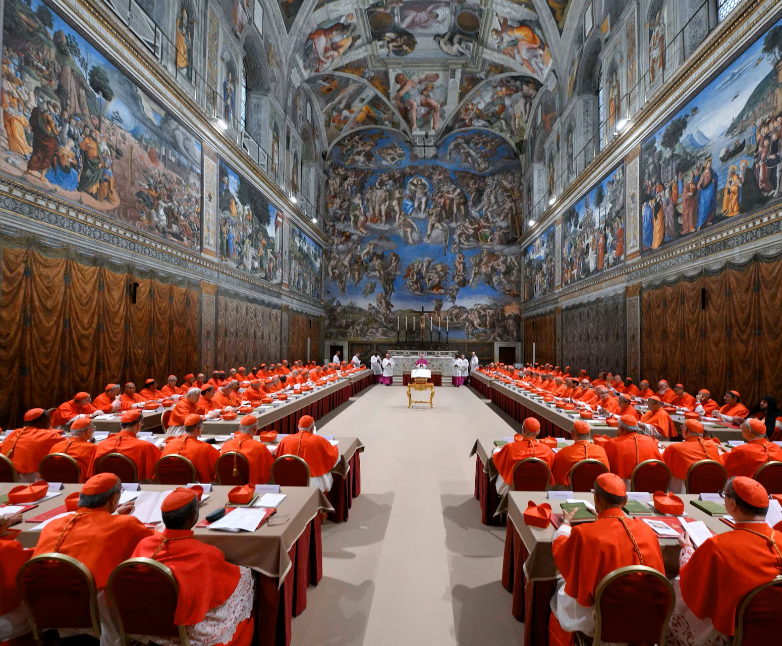
The Conclave: what is it?
7
Emily Calvert

Slide 2
What is a conclave?
A secret vote for the next pope
Conclave = “with key” (Latin)
1274 by Pope Gregory X ¹

Slide 3
When and where does it happen?
20 days after the death of the Pope
E.g. - Pope Francis
The Sistine Chapel – 1878 ²
Has been held elsewhere – e.g. France and Germany ¹

Slide 4
Who takes part?
The College of Cardinals
Maximum age limit
Normally capped at 120 participants

Slide 5
What is the process?
Cardinals locked in
Prayer and meditation ³
Take an oath of secrecy ⁴

Slide 6
How does the voting work?
Secret ballots ⁵
2/3 majority needed
Ballots deposited into a chalice
Ballots counted
Burnt for secrecy

Slide 7
What does the smoke mean?
White smoke – Pope chosen ⁶
Black smoke – no Pope chosen
Cut off but needed to communicate with the public
Pope appears on a balcony

Slide 8
Conclusion
Old tradition ⁵
affects millions
Brings people together

Slide 9
BIBLIOGRAPHY
¹ Zengarini, Lisa, 'The Conclave from the Middle Ages to the Present Day', (05 May 2025) https://www.vaticannews.va/en/pope/news/2025-05/the-conclave-from-the-middle-ages-to-our-days.html
² Burack, Emily, 'Why does the Conclave Take Place in the Sistine Chapel? Conclave Location, Explained.', (May 7 2025) https://www.townandcountrymag.com/society/money-and-power/a64690460/conclave-location-sistine-chapel-explained/
³ Wooden, Cindy, 'How the Conclave Works: It's Guided by a Rule Book and a Prayer Book', (April 30 2025) https://www.usccb.org/news/2025/how-conclave-works-its-guided-rule-book-and-prayer-book
⁴ Catholic Church England and Wales, 'Conclave Observance of Secrecy', (July 31 2020) https://www.cbcew.org.uk/observance-of-secrecy/
⁵ Chacko, Thomas, 'Explained: What is the Conclave and how does it Work?', (2 May 2025) https://www.premierchristianity.com/news-analysis/explained-what-is-the-conclave-and-how-does-it-work/19372.article
⁶ Pitt, David A., 'What is the Origin of the Papal Smoke?', (April 29 2025) https://uscatholic.org/articles/202504/what-is-the-origin-of-the-papal-smoke/
⁷ Reuters, Cardinals Pray in the Sistine Chapel, Ahead of the Conclave to Elect the Next Pope at the Vatican, (Reuters, 2025) https://www.reuters.com/pictures/scenes-vatican-conclave-begins-2025-05-07/IZSJ6CGMWBKLHPWEMYNPSD3YJM

