Slide 1

“A child’s experience between the ages of 0 – 5 years can affect the rest of their lives”
Experiences that can affect adulthood

Slide 2
Adverse/ traumatic experiences
Some of the stressful experiences of children involve sexual abuse, emotional neglect and physical abuse (Sevilla et al., 2020)
This can also affect their ability to show their emotions which can create difficulties in sleeping, lower the functioning of the immune system, and increase the numbers of risks (World Health Organization, 2020).
These experiences vary from different situations and different conditions.
Individuals who experience negative outcomes in childhood would lack many soft skills and the desire to have closeness in practical life
Notes:
There have been ten years of research on the topic of childhood experiences, precisely things experienced by children between the ages of 0 to 5. However, these bad experiences impact their adulthood by affecting their health and well-being. A child could face many types of experiences at the age of 0 to 5 (World Health Organization, 2020). These experiences vary from different situations and different conditions. Some of the stressful experiences involve sexual abuse, emotional neglect and physical abuse. There have been cases of domestic violence experienced by children (Sevilla et al., 2020). As a result, children get exposed to abuse and trauma that may assist them in developing a high-level response to stress. This can also affect their ability to show their emotions which can create difficulties in sleeping, lower the functioning of the immune system, and increase the numbers of risks.
Similarly, affecting adulthood from childhood is clear, but the experience of childhood can also positively impact individual lives (Sameroff, A.J. and Seifer, R., 2021. Thus, adults who have reported to be at high levels of stress tend to have depressed childhood due to which their hormones pattern is associated with negative outcomes (Fairchild et al.2019). At the age of 0 to 5 child can experience cognitive mental health problems that can affect their brain development. Individuals who experience negative outcomes in childhood would lack many soft skills and the desire to have closeness in practical life (Orgilés et al., 2020). Children who had experienced bad trauma and had it unresolved with repressed trauma at the age between o to 5 could be unable to cope them with daily events. However, stress usually weaken the architectural development of the brain what can lead to lifelong hardships such as learning, mental and physical and health. The most common hardship experience that children face at very early ages is economic hardship.

Slide 3


Slide 4
Psychological Theories
Erikson psychological theory
The critical factor of this theory is to encourage children and adolcents to face disputes in each stage.
Psychological theory was developed by Erikson’s in his book (childhood and society) that was published in 1950
The first stage of Erikson is titled as “trust vs mistrust. In which 0 to 3 year old children have to go through this stage.
The second stage of that cover 3 to 5 year of age group autonomy vs shame and doubt
Notes:
Psychological theory was developed by Erikson’s in his book (childhood and society) that was published in 1950. Erikson determines that personalities that are developed in pre-arranged order due to the eight stages of psychosocial development (Li, et al.2021). Furthermore, the critical factor of this theory is to encourage individuals to face disputes in each stage. However, it may not be resolved within that stage. The first stage of Erikson is titled as “trust vs mistrust”. In order to emphasize the theory, Erikson state that the environment had played a major role in creating self-adjustments development of humans and each stage of Erikson (Li, et al. 2021). Every stage of his theory revolves around central conflict for psychosocial development. Similarly, he further believed that behaviour and actions are driven mainly by a sense of competence. In order to focus on developing competence in certain areas of life that can also be 0 to 5 years, each phase of Erikson theory is handled well, and the individual has developed a sense of mastery that has reflected ego strength in the end.
Moreover, between the age of 3 to 5, many young children tend to have the ability to predict and explain the behaviour and their feelings of others (Tully et al. 2019). In stage 1 of Erikson theory, psychosocial development starts developing at the age of birth and 1 year of age. In order to develop a sense of trust, it is commonly based on the dependability and the quality of children caregivers. Furthermore, children are mostly dependent on adult caregivers at the point of development (Sevilla, A., 2020). If a caretaker fails to provide sufficient love and care, the child will feel that they can’t trust anyone or can’t be dependent on the adult in their life. However, at the age of 0 to 5 child who successfully manages to develop the trust will mostly feel secure and safe in the world.

Slide 5
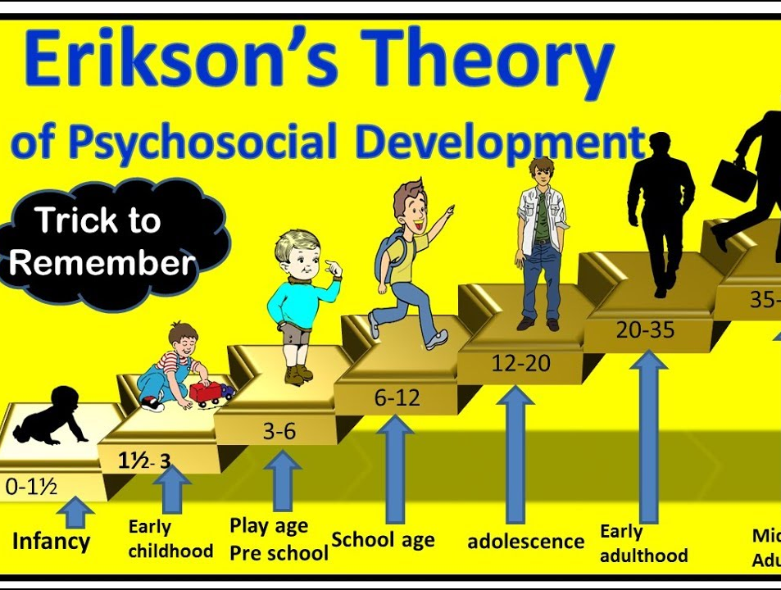

Slide 6
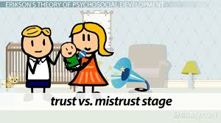
Attachment theory
Attachment theory was developed by John Bowlby in the year of 1958
John Bowlby worked as a psychiatrist at the child guidance clinic of London (1930) where he used to treat many emotionally disturbed children.
Children who are emotionally attached tend to be better in managing their feelings and adjustment of behaviour during traumas. (Sevilla, A., 2020)
Notes:
Attachment was developed by John Bowlby in the year of 1958. During his early years, John Bowlby worked as a psychiatrist in the child guidance clinic of London (1930) where he used to treat many emotionally disturbed children. He has drawn the concepts of ethology, development of psychology and psychiatrist (Orgilés et al. 2020). However, John Bowlby has formulated the general tenets of the theory. Many children and babies between 0 to 5 tend to develop attachment issues that later lead them to create behavioural problems. Children who have forming healthy relationships can lead toward conduct disorder and hyperactivity disorder. Attachments can easily create positive or negative paths to grow for childhood development (Sevilla,2020). In order to learn the development of sense that will assist them in feeling consoled and loved, many children learn that their care of parents is helping them to feel loved and consoled (World Health Organization, 2020).
Attachment was developed by John Bowlby in the year of 1958. During his early years, John Bowlby worked as a psychiatrist in the child guidance clinic of London (1930) where he used to treat many emotionally disturbed children. He has drawn the concepts of ethology, development of psychology and psychiatrist (Orgilés et al. 2020). However, John Bowlby has formulated the general tenets of the theory. Many children and babies between 0 to 5 tend to develop attachment issues that later lead them to create behavioural problems. Children who have forming healthy relationships can lead toward conduct disorder and hyperactivity disorder. Attachments can easily create positive or negative paths to grow for childhood development (Sevilla,2020). In order to learn the development of sense that will assist them in feeling consoled and loved, many children learn that their care of parents is helping them to feel loved and consoled (World Health Organization, 2020).

Slide 7
Parents support in children development
Parent should determine those personalities that are developed in pre-arranged order for psychosocial development from early age according to the theory of Erikson.
As per Erikson theory Parents need to provide motivation to their children for helping them in facing different disputes in each stage of life
children who tend to suffer from mental health issues have an impact on their behaviour and emotional issues. As per attachment theory these problems can be solved by getting enough attention from parents and assistance of them in difficult times of life(Orgilés et al., 2020)
According to attachment theory parents can meet the need for attachment by fulfilliing their responsibilities as caregivers and parents. Providing children safe and secure environment can assist them in boosting their self-esteem
Notes:
Development of children for the cognitive and social skills required for success in adulthood can easily be supported by the parental style that is known as responsive parenting. The aspect of responsiveness is helpful in supporting parenting and different frameworks (attachment and sociocultural) as it is an essential role in the functioning developing of children optimally. Parenting that provides a high level of affection and warmth is responsive parenting. There is a responsive way to provide contingencies linked to the child in the age group of 0 to 5 are more effective in emotional aspects of a responsive style (Cleary et al.2020). However, the combination of responsive behaviour for the child need also include the maintenance and verbal input on the child's interest, including necessities for multiple aspects of child learning such as providing the range of support (Sevilla, A., 2020). Accepting the child's interest by facilitating the development of mechanism for fighting with stress and novelty is the major signal of supporting the child (Li, et al. 2021). Bond of trust develop in between of child and parent can allow the child to ultimately understand the basics of this trust and assist them in generalizing the learning to new experiences. In order to promote joint engagement and parent-child interaction, parents have to develop attentional and cognitive capacities.

Slide 8
References
Sevilla, A., 2020. Learning during the lockdown: real-time data on children’s experiences during home learning.
World Health Organization, 2020. ApartTogether survey: preliminary overview of refugees and migrants self-reported impact of Covid-19.
Sameroff, A.J. and Seifer, R., 2021. Accumulation of environmental risk and child mental health. In Children of poverty (pp. 233-258). Routledge.
Orgilés, M., Morales, A., Delvecchio, E., Mazzeschi, C. and Espada, J.P., 2020. Immediate psychological effects of the COVID-19 quarantine in youth from Italy and Spain. Frontiers in psychology, 11, p.2986.

