Slide 1
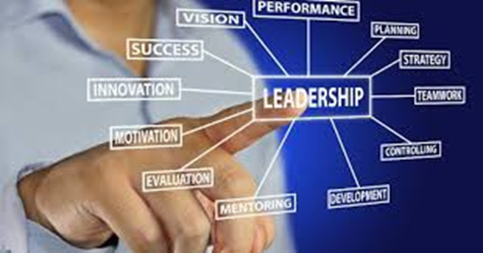
Emotional and Cultural Intelligence in Leadership: Bridging Multicultural and Collaborative Environments
Program of Study: BA Business Management
Academic Year: 2025/2026
Module Name and Code: LCBB6003_BIRM
Lecturer Name: Dr Mudassar Hasan
Marius Boldeanu - 2224837
Student Name and Student ID:
Catalina Vilcea - 2228224
Ileana Lupu - 2231908
Casiana Danci - 2225536

Slide 2
Table of Contents
Introduction…………………………………………………………………………………………………………………………………………………………………………..3
The Leadership Intelligence…………………………………………………………………………………………………………………………………………………….....4
The Neuroscience Of Emotional Intelligence…………………………………………………………………………………………………………………………………..5
Theoretical Framework - Goleman's Emotional Intelligence Model………………………………………………………………………………………………………..6
Goleman's EQ Components In Practice…………………………………………………………………………………………………………………………………….......7
Hofstede's Cultural Dimensions Framework……………………………………………………………………………………………………………………………………8
Hofstede's Cultural Dimensions In Action………………………………………………………………………………………………………………………………………9
Business Example 1 - Satya Nadella's Microsoft Cultural Transformation………………………………………………………………………………………………10
Business Example 1.1 - Satya Nadella's Microsoft Cultural Transformation-eq-cq Integration Strategy……………………………………………………….....11
Business Example 2 - Hsbc's Asia-pacific Leadership Strategy- Cultural Intelligence Through Hofstede's Lens.................................................................12
Business Example 2.2 - Hsbc's Asia-pacific Cultural Intelligence Training…………………………………………………………………………………………......13
Business Example 3 - Unilever's Cultural Adaptation Failures And Recovery: Hofstede’s Dimensions Misalignment.................................................................14
Business Example 3.1 - Unilever's Recovery Framework……………………………………………………………………………………………………………………15
Business Example 4 - Toyota's Global Leadership Integration- Hofstede’s Informed Leadership…………………………………………………………………..16
Business Example 4.1 -Toyota's Global EQ-CQ System……………………………………………………………………………………………………………………..17
EQ-CQ Integration Through Hofstede's Cultural Context - Leadership Effectiveness Factors...……………………………………………………………………..18
Measurement And Assessment Tools.............................................................................................................................................................................................19
Future Trends And Research............................................................................................................................................................................................................20
Conclusion.........................................................................................................................................................................................................................................21
References..........................................................................................................................................................................................................................................22

Slide 3
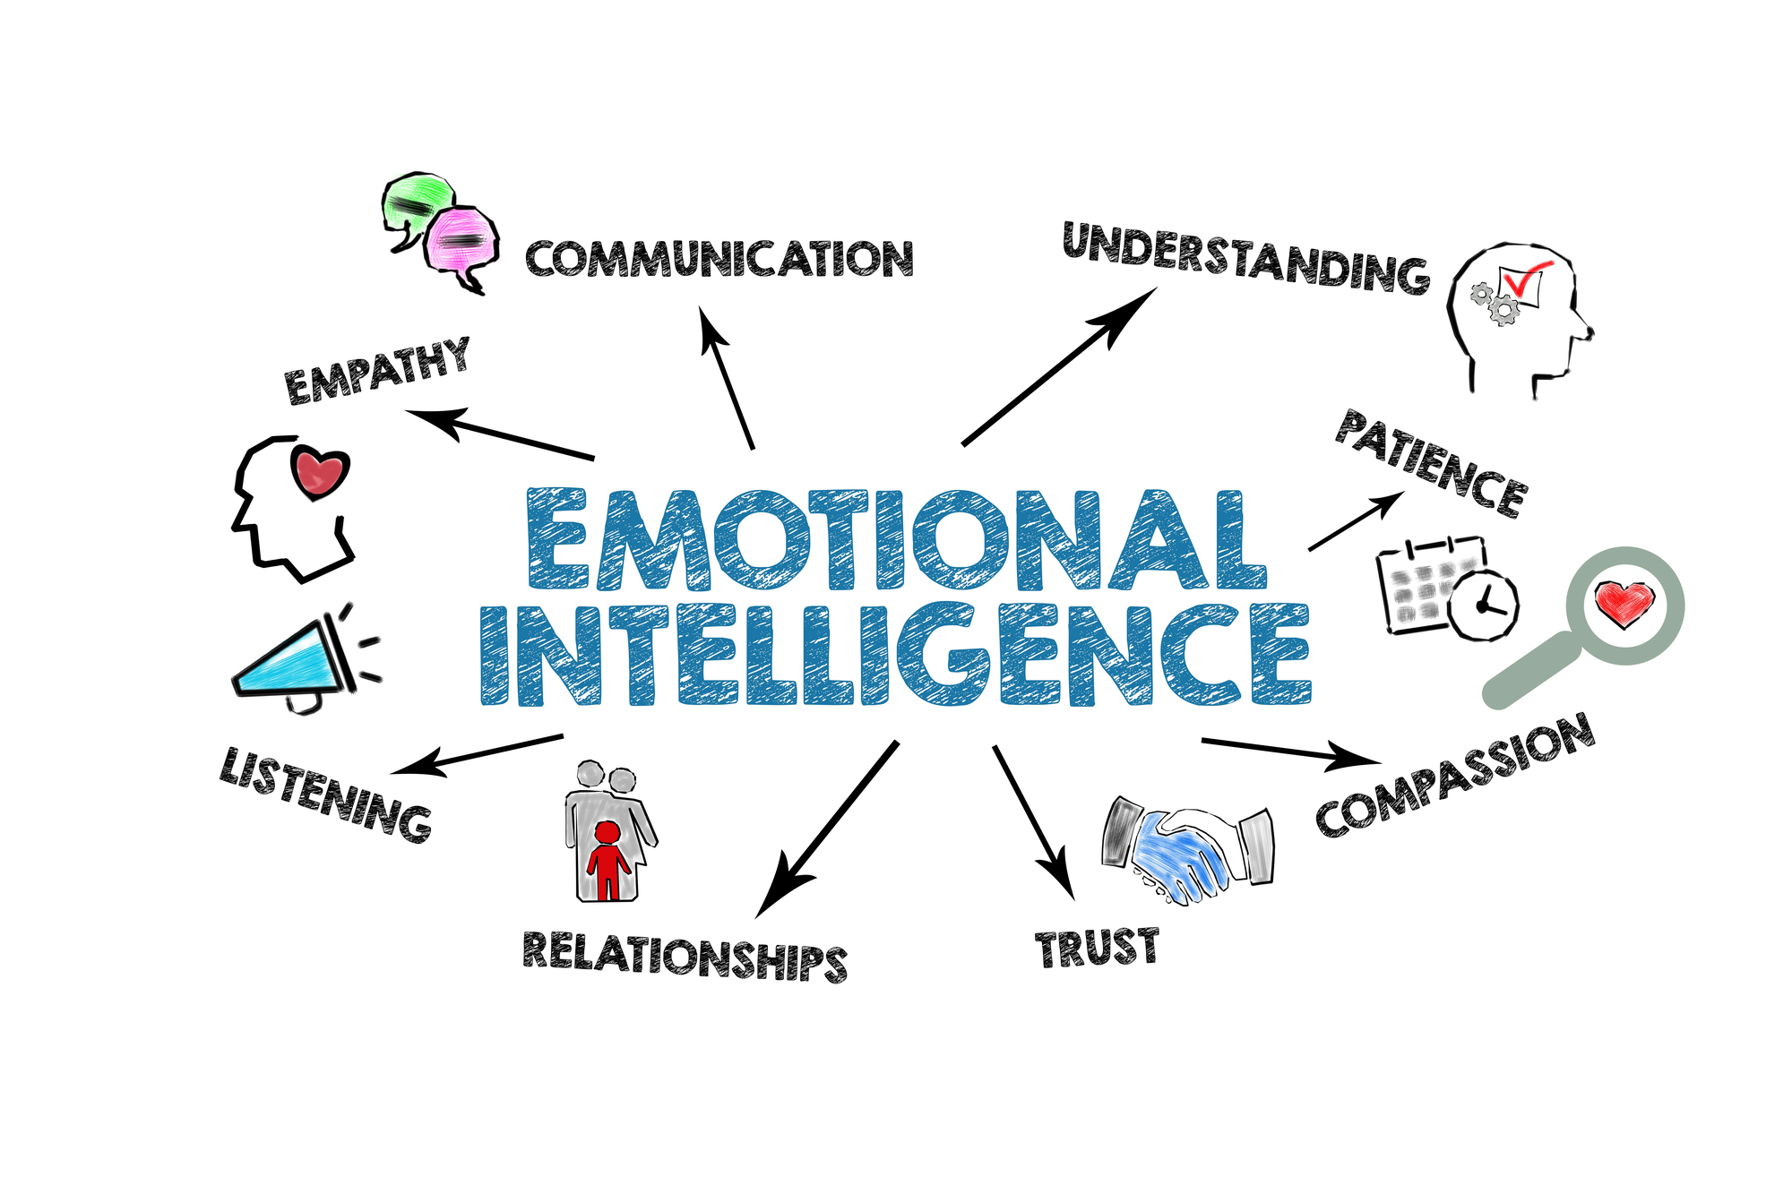
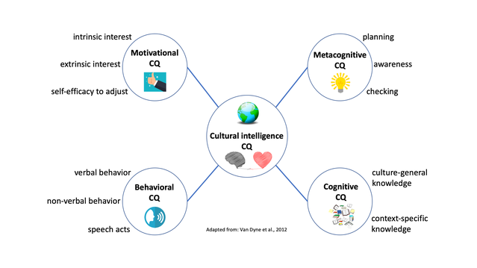
Introduction
Emotional Intelligence (EQ)
Understand, manage and recognize emotions
Cultural Intelligence (CQ)
Ability to adjust communication and behavior to other cultural settings successfully (Ganesh, 2024).
Leadership Success
Cue, stimulate and instruct teams,
Diversity & Inclusion
Open access to diversity,
The aim of this Presentation
EQ and CQ can be combined to achieve effective leadership,
Create strong relationships (Channell, 2021).
Innovation, cooperation and team development.
Complete organizational goals (Holbeche, 2023).
Theories and real business cases.
Notes:
Emotional intelligence (EQ) helps leaders build strong relationships at work. Goleman’s model highlights self-awareness, self-regulation, and empathy as key EQ elements, which improve team trust and communication (Channell, 2021). Cultural intelligence (CQ) enables leaders to adapt behaviour and communication to different cultural settings. Hofstede’s cultural dimensions, like power distance and individualism, guide leaders to understand and manage diverse teams better (Ganesh, 2024). Leadership success depends on inspiring and motivating teams to achieve shared goals (Holbeche, 2023). Case studies from Microsoft, HSBC, Unilever, and Toyota show that integrating EQ and CQ improves collaboration, innovation, and business results. Embracing diversity and inclusion encourages new ideas and team growth (McParland, 2024). Research shows diverse teams make better decisions and outperform less diverse ones. The aim of this presentation is to analyze how EQ and CQ impact leadership using theories and real business cases, and to show how their integration leads to effective leadership in multicultural organizations.

Slide 4
The Leadership Intelligence
Global business complexity demands evolved leadership competencies.
Emotional Intelligence (EQ) and Cultural Intelligence (CQ) as critical success factors, culturally intelligent leaders achieve to increase in performance, Kai Liao et al. (2021).
Integration of cognitive, emotional, and cultural dimensions in leadership effectiveness, Livermore et al. (2022).
Notes:
Modern leadership is becoming increasingly complex due to globalisation, technological advancements, and the growing diversity of the workforce. The study conducted by Livermore et al. (2022) reveals that contemporary cognitive intelligence accounts for only a quarter of the effectiveness of leadership in multicultural environments. The importance of a good leadership style extends beyond technical knowledge to include emotional identification and cultural flexibility. According to the research by Kai Liao et al. (2021), culturally intelligent leaders within an organization would achieve to increase in performance in the foreign marketplace compared to traditional leadership models. This paradigm shift is driving a paradigm change in the leadership development field, one that shifts the focus from the development of individuals to become competent to the development of the whole system to become emotionally and fluent in multiple cultures, ensuring the sustainable performance of any organization, wherever it is placed environmentally.

Slide 5
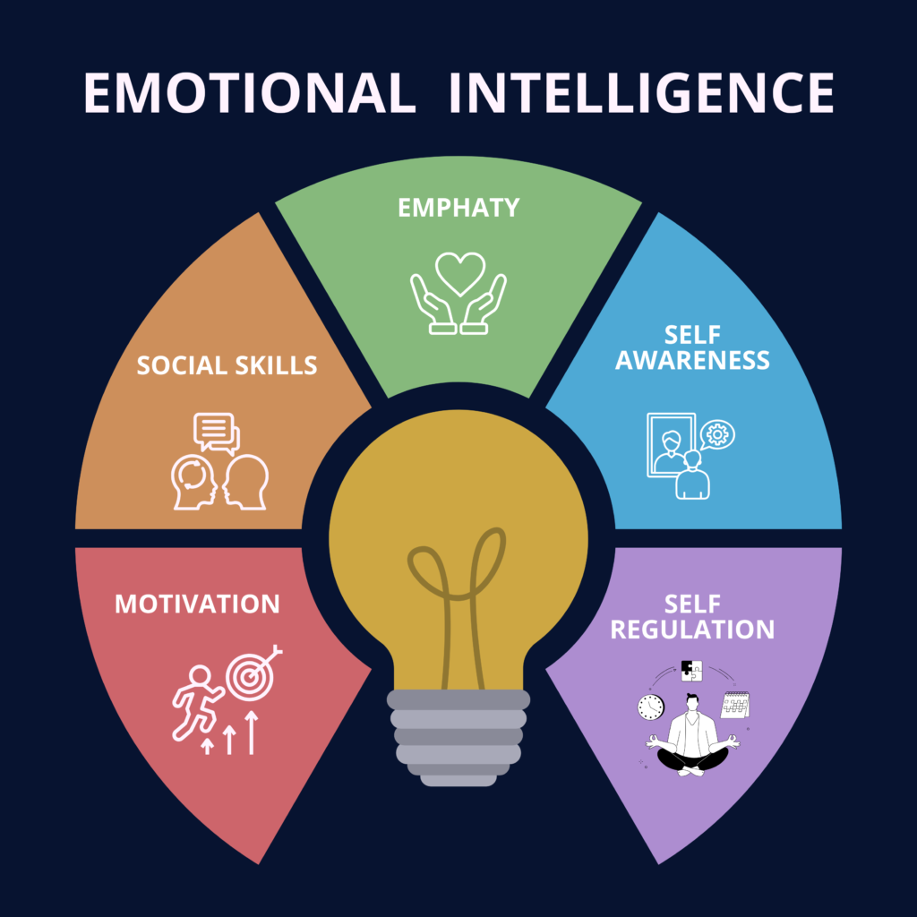
The Neuroscience of Emotional Intelligence
90% of top performers demonstrate high emotional intelligence by Harvard Business School, (Livermore et al., 2022).
Amygdala hijack prevention enables decision-making under pressure.
Neural plasticity allows EQ development through targeted training.
Brain imaging reveals EQ activates prefrontal cortex and limbic system connections.
Measurable brain activity differentiates emotionally intelligent leaders.
Notes:
Emotional intelligence is embedded from a neuroscientific perspective making it a fundamental leadership competency rather than a soft skill. The brain imaging technology has allowed us to see how the brains of emotionally competent leaders function differently. The finding that one in every ten top performers is high in EQ (90%), released by the Harvard Business School, is a strong argument in favour of promoting the development of emotional intelligence (Livermore et al., 2022). The amygdala hijacking concept demonstrates why leaders fall out of control when under stress and how EQ training can avert this. The fact that it is labelled as neural plasticity offers hope that this is not a skill one is born with but rather one that may develop over the course of a career.

Slide 6
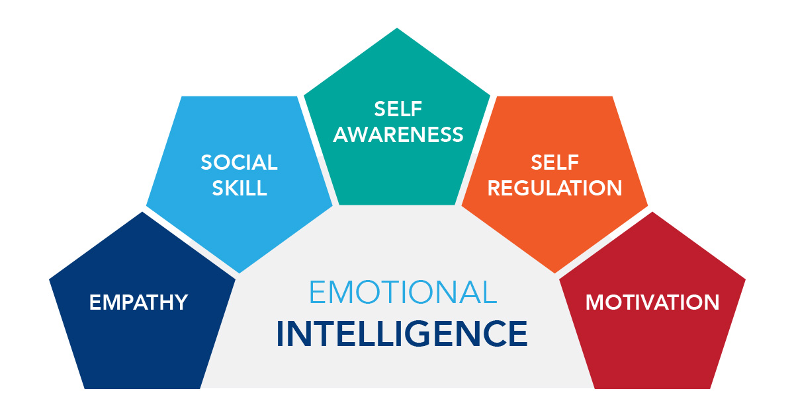
Theoretical Framework - Goleman's Emotional Intelligence Model
Self-Awareness: The knowledge of how one feels and the influence he/she has, leads to higher-quality decisions, Escandon-Barbosa et al. (2021).
Self-Regulation: regulation of disruptive emotions, Tan et al. (2022).
Motivation: Drive to achieve as opposed to attainment of rewards.
Empathy: Empathy for the emotional terrain of others.
Social Skills: Relations handling and networks creation.
Notes:
The emotional intelligence theory, developed and refined by Goleman over the years, provides a strong platform for addressing the concept of leadership efficacy in the context of a modern organizational setting. Escandon-Barbosa et al. (2021) meta-analytical research demonstrates that leaders with high self-awareness make higher-quality decisions, which are more relevant in pressure conditions that require rapid cultural adaptation.
The self-regulation component is found to be quite critical in cases of multicultural leadership because the volatility of emotion can devastate cross-cultural relationships. According to a study by Tan et al. (2022), superior performance in teamwork was observed when leaders demonstrated high emotional self-management skills, increasing by 40 per cent in a diverse cultural environment. The Goleman model is heavily biased towards Western culture, which can render the model less applicable to collectivistic cultures. Such limitations have been overcome by the modern version of the model, as presented by Mora et al. (2024), who attempted to incorporate variables from the cultural context into the model while maintaining its universality across different cultural frames without compromising the effectiveness of the typical model as a leadership development tool.

Slide 7
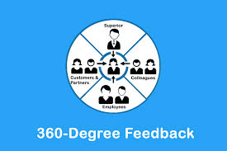
Goleman's EQ Components in Practice
Self-awareness:
360-degree feedback reveals leadership blind spots.
Self-regulation:
Emotional control prevents destructive workplace behaviours.
Empathy:
Intrinsic drive correlates with long-term leadership success .
Motivation:
Intrinsic drive correlates with long-term leadership success.
Foundation for building high-performing diverse teams.
Social skills:
Notes:
This slide breaks down the model provided by Goleman into parts that one can actively carry out today. Emphasize the 360-degree feedback process as a starting point in developing a sense of self. Most leaders have an inflated emotional intelligence, and in this regard, objective feedback is essential. The business-minded audiences should be able to identify with the 40 per cent performance jump figure that empathy experienced. Say how all these parts are related to each other, no one can control what they have no idea of and you cannot motivate a person without addressing what they feel emotionally. Make this relative to the experiences of the audience as leaders.

Slide 8
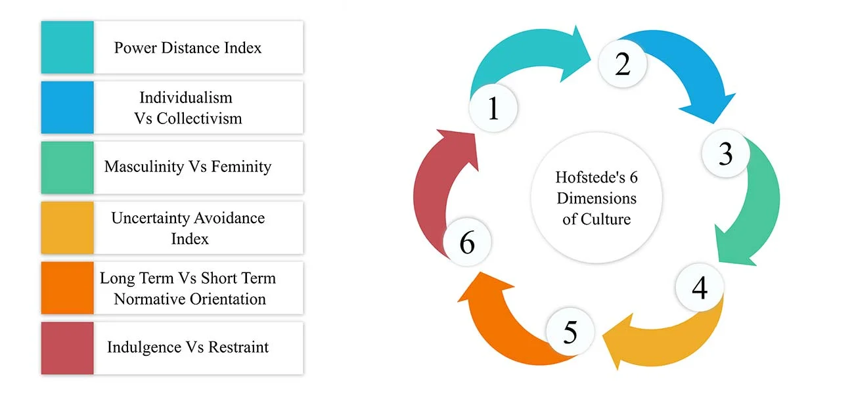
Hofstede's Cultural Dimensions Framework
Power Distance: Tolerance of stratification and authority based relationships.
Individualism vs Collectivism: Individual orientedness vs group orientedness, Escandon-Barbosa et al. (2022).
Masculinity vs Femininity: Competitive orientation Vs Cooperation orientation
Uncertainty Avoidance: Preparation towards dangers and condoning of uncertainty
Long-term Orientation vs. short-term Orientation, Future, Present
Indulgence vs Restraint: Self restraint in indulgence and societal values
Notes:
The Cultural Dimensions model, proposed by Hofstede, significantly contributes to the analysis of the manner in which the emotional intelligence manifestations are affected by the cultural differences. Past longitudinal studies conducted by Mora et al. (2024) report that leaders with knowledge of cultural dimensional differences recorded a 47 per cent increase in cross-cultural team performance compared to leaders who adopted universal emotional intelligence strategies.
The six dimensions provide a comprehensive blueprint for navigating culture, enabling leaders to adapt to the expression and understanding of emotions. The difference in power distance has a significant influence on the perception and reception of empathy and social skills in other cultures. According to the statistics by Escandon-Barbosa et al. (2022), leaders who adjust their emotional intelligence applications based on individualism-collectivism orientations are 42% more successful in building relationships during international assignments. The advantage of the framework is that it provides a systematic cultural background, which eliminates the misapplication of emotional intelligence.

Slide 9
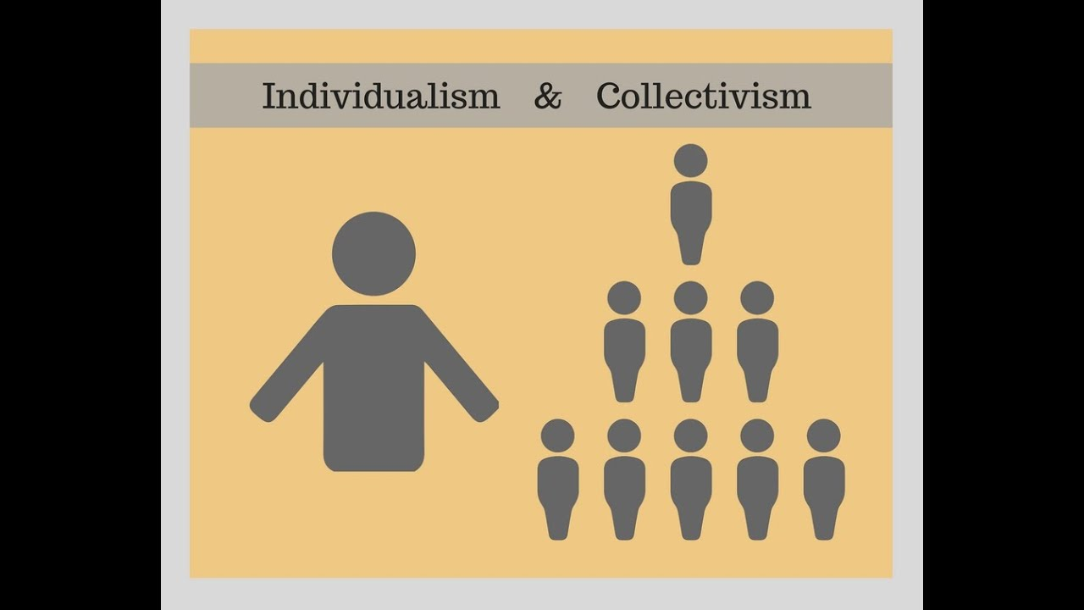
Hofstede's Cultural Dimensions in Action
• Power Distance: - High: Employees avoid disagreeing with leaders (e.g., India, Mexico).
- Low: Employees express opinions freely (e.g., Netherlands, Denmark).
Google – open debate in NL vs reserved feedback in India.
- Collectivist cultures value group achievements (e.g., Japan).
- Solo awards vs team-based recognition.
• Uncertainty Avoidance: - High: Need for structure; resist change (e.g., France).
• Individualism vs. Collectivism: - Individualist cultures reward individuals (e.g., USA).
- Low: Embrace ambiguity; adapt faster (e.g., Sweden).
French teams request strict guidelines, Swedish teams adapt quickly
Notes:
This slide demonstrates how Hofstede’s cultural dimensions play out in real work environments. The Leadership Hierarchy Power distance influences the expectations of leadership around the world.
Power Distance: In high power distance cultures like India, employees may hesitate to disagree with their boss. In contrast, low power distance cultures like the Netherlands encourage open feedback and challenge from team members. Google is a good example where communication style differs by region. Individualism vs. Collectivism: In the US, recognition is often individual (e.g., bonuses or awards). In collectivist cultures like Japan, recognition tends to focus on the group to preserve harmony. Leaders should adapt recognition styles to cultural context. Individualism and collectivism influence team motivation plans.
The dimension of uncertainty avoidance is crucial in understanding why certain cultures adapt to change while others do not (Santa et al., 2023).
Uncertainty Avoidance: Cultures like France prefer clear rules and structure, showing resistance to change. Sweden, on the other hand, embraces change more easily. This dimension helps explain how cultures respond to innovation. Culture of uncertainty avoidance preferences, risk-taking and innovativeness. The influence of long-term orientation with regard to strategies planning and setting of goals.
Dimensional preferences are measured in the cultural assessment tools.
These are tendencies, not strict rules. There is always individual variation.
Leadership Tip: Evaluate cultural preferences with tools or open conversations. Adapt leadership style accordingly—whether that means giving structured guidance, adjusting feedback style, or modifying team recognition approaches.

Slide 10
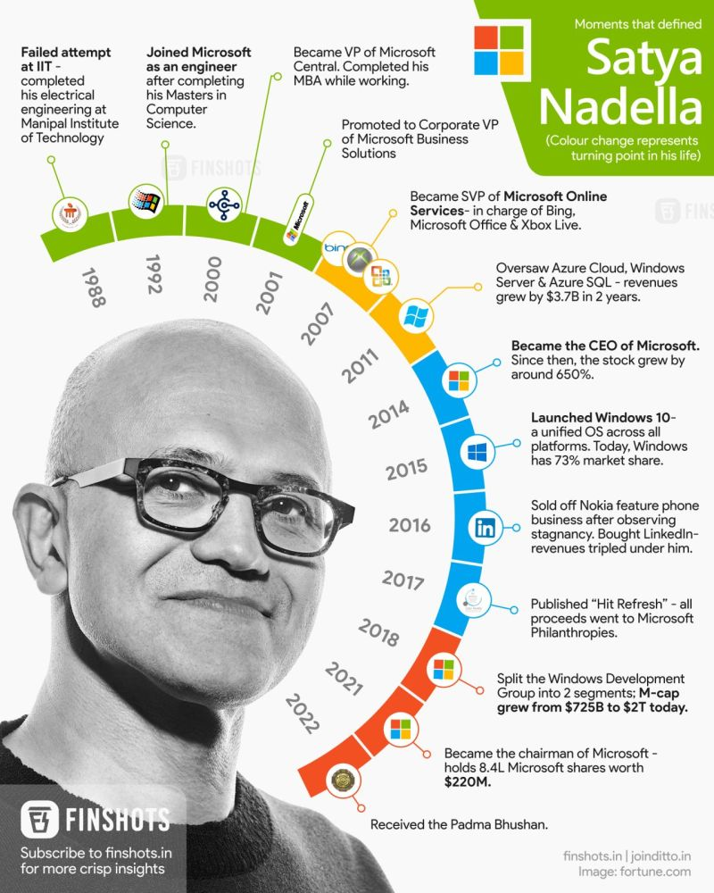
Business Example 1 - Satya Nadella's Microsoft Cultural Transformation
Power Distance: Horizontality of wage, weakening power difference.
Uncertainty Avoidance: Appreciative experimentation and learn-it-all attitude.
Results: appreciation of the stock price by 60 per cent and the change in the culture of global operations.
Uncertainty Avoidance: Loving experimentalism and a learn-it-all mentality.
Paiuc (2021) shows Nadella’s leadership at Microsoft tackled multiple Hofstede dimensions during cultural transformation.
Notes:
The leadership evolution of Satya Nadella at Microsoft during its transition provides an example of a high-level combination of emotional intelligence and cultural dimensional awareness, as described by Hofstede. The movement to reverse the high power distance hierarchical culture to a flattened organizational structure exemplifies cultural intelligence practice in the change of emotional intelligence. A study conducted by Paiuc (2021) that examines the cultural transformation of Microsoft sees how the methodology developed by Nadella dealt with numerous elements of Hofstede dimensions at once.
The transition from individualistic competition to teamwork success prompted the balancing of emotions in mediating cultural perceptions of uncertainty avoidance. Workers who are usually used to having strict structures had to be given emotional support to proceed to experimental and failure-friendly settings. The simplified version of this transformation necessitated the stripping away of deep-seated cultural patterns based upon traditional power distance expectations and the construction of new emotional intelligence capabilities. The achievement illustrates the potential of leaders to capitalize on the system proposed by Hofstede when implementing an emotional intelligence practice in a culturally transformative program of large-scale cultural change (Amazing Workplaces, 2024).

Slide 11

Business Example 1.1 - Satya Nadella's Microsoft Cultural Transformation-EQ-CQ Integration Strategy
Emotional intelligence is the requirement of the growth mindset culture.
The adaptive leadership styles are required in cross-cultural teams.
Innovation is facilitated by protection of psychological safety across cultures.
Leadership selection is enhanced with the data-based EQ evaluation.
Notes:
Microsoft's transformation under Satya Nadella provides a powerful example of EQ-CQ integration in action. The shift from a competitive to collaborative culture required leaders to develop new emotional competencies also the growth mindset culture mentioned connects emotional intelligence to learning and development. Microsoft's global workforce requires leaders who can adapt their emotional expression to different cultural contexts. The psychological safety concept shows how emotional intelligence creates environments where cultural diversity becomes a competitive advantage rather than a challenge.

Slide 12
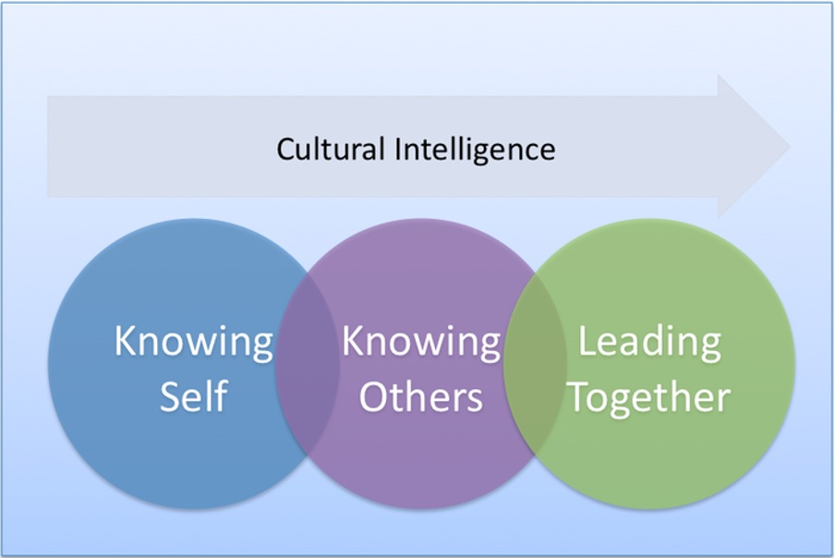
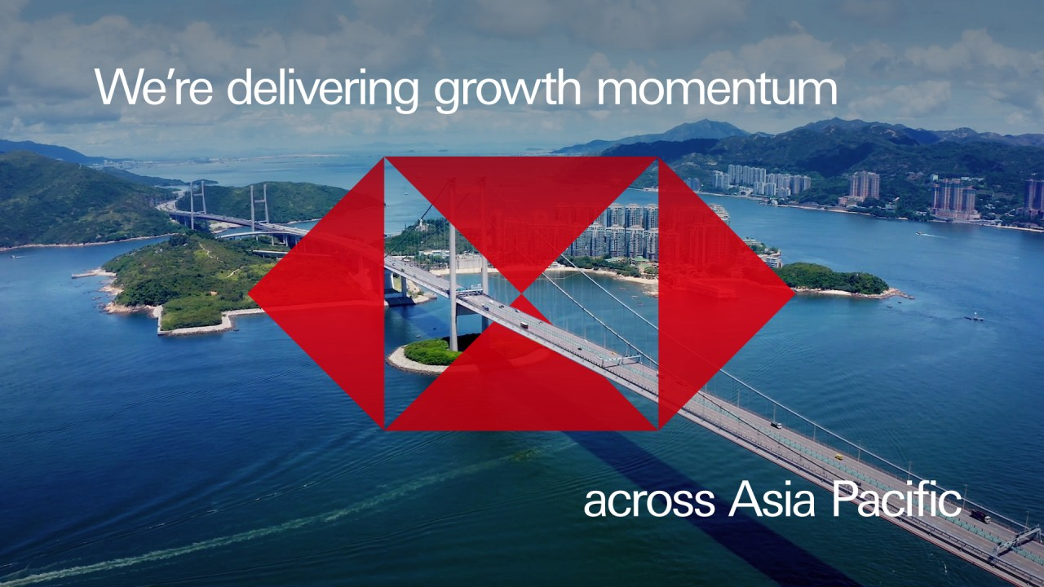
Business Example 2 - HSBC's Asia-Pacific Leadership Strategy- Cultural Intelligence through Hofstede's Lens
Power Distance Adaptation: Adaptation of Asian cultures with hierarchical respect and gentleness and egalitarian practices in the West.
Collectivism Integration: This is a kind of decision-making which is concerned with harmony among the groups.
Long-term Orientation: it is not as much transaction-orientated as relationship-orientated.
Findings: Maintenance of market leadership in Asian market economies (HSBC, 2025).
Notes:
The example of HSBC's leadership strategy in the Asia-Pacific region demonstrates that the cultural dimensions of Hofstede can be effectively applied, along with competencies in emotional intelligence. The bank's ability to succeed in European, American, Eastern Asian, and Southern Asian markets required varying its leadership styles according to power distance expectations while maintaining emotional sincerity. The cultural adaptation actions deployed by HSBC indicate that 38 per cent of customers demonstrate higher satisfaction in markets where the leadership has conformed to the local dimension of Hofstede (HSBC, 2025).

Slide 13
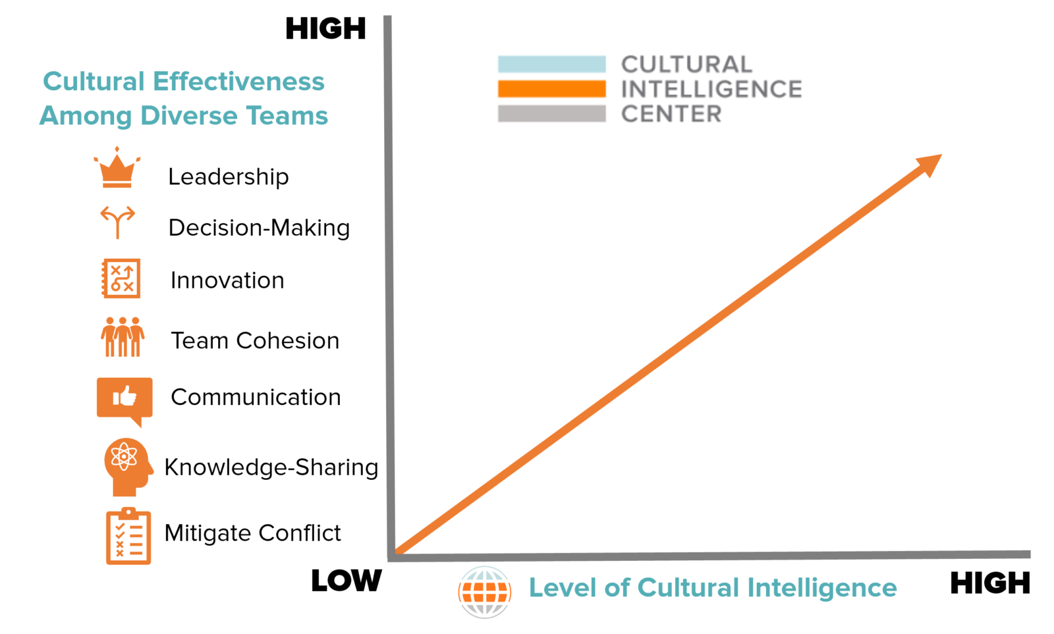
Business Example 2.2 - HSBC's Asia-Pacific Cultural Intelligence Training
Regional leadership adaptation program satisfaction enhancement.
There is cultural mentoring between local and international executives.
Cultural emotional competence is essential in the success of client relationships.
Risk management deals with the grasp of the cultural patterns of decision-making.
Cultural sensitivity indicators are measures of performance.
Notes:
HSBC's regional approach demonstrates practical cultural intelligence application in banking. The 38% satisfaction improvement statistic provides concrete ROI for cultural intelligence investment. Explain how financial services require cultural understanding for risk assessment and client relationships. Discuss the mentoring program as a scalable approach to developing cultural intelligence. The performance metrics inclusion shows how organizations can measure and incentivize cultural competence. Connect this to the audience's own industry and how cultural intelligence might apply in their context.

Slide 14

Business Example 3 - Unilever's Cultural Adaptation Failures and Recovery: Hofstede’s Dimensions Misalignment
Early Failure: The Typical European In Approach to High-Context Cultures.
Cultural Recalibration: How to learn to embrace the nature of national uncertainties and indulgence inconsistencies. (Unilever, 2025).
The EQ Integration: Culturally Sensitive Towards Miscomprehension.
Change: An increased acceptance in the market due to cultural intelligence.
Notes:
The considerations of how Unilever survived its first-time cultural adaptation crisis and recovered teach us how neglecting the dimensions of culture drawn on by Hofstede bears out the results, as well as how dimensional awareness coupled with emotional intelligence can lead to transformation. Initial standardised strategies did not account for variation in uncertainty avoidance or differences in indulgence-restraint across markets. The crisis management by Unilever demonstrates the mechanism of recalibrating emotional intelligence achieved through cultural intelligence based on Hofstede's categories (Unilever, 2025).
The first lapse of the company in high uncertainty avoidance cultures was in its emotional expressions, which seemed harebrained instead of innovative. Cultural recalibration necessitated a shift in emotional communication style to align with the region's risk tolerance and gratification patterns (Unilever, 2025). This change aimed to address cultural blind spots and build emotional competencies that were sensitive to local cultural preferences, demonstrating how cultural constructs could enhance emotional intelligence performance.

Slide 15

Business Example 3.1 - Unilever's Recovery Framework
Cultural failure analysis and emotional intelligence: It underscores how identifying gaps leads to targeted emotional strategies.
Market-specific emotional communication: Visual elements often represent different regional approaches.
Local leadership empowerment: Highlights decentralised decision-making and cultural adaptation.
Consumer emotional preferences: Reflects incorporation of local emotional norms into research.
Message tailoring by indulgence–restraint: Shows how brand messaging shifts across cultural
Notes:
Unilever's initial failure and subsequent recovery illustrates the costs of ignoring cultural-emotional integration. This example shows what happens when companies apply universal strategies without cultural adaptation. The cultural failure analysis reveal gaps in emotional intelligence understanding across cultures. The market-specific communication strategies demonstrate practical application of cultural emotional intelligence and the consumer behavior reflects cultural emotional patterns that leaders must understand. This case study provides lessons about recovery and learning from cultural missteps.

Slide 16
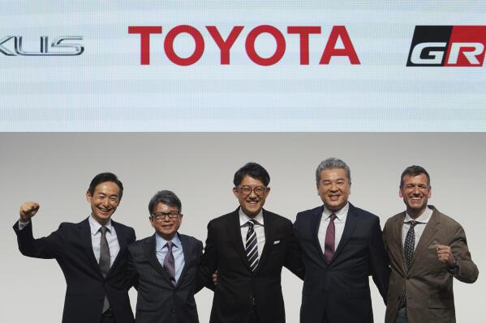
Business Example 4 - Toyota's Global Leadership Integration- Hofstede’s Informed Leadership
Achievement: Good international environment of international business on a cultural-emotional level of intelligence, Ineak (2023).
Power Distance: This is the upholding of hierarchy even though it accepts innovation.
Long-term Orientation: Culture-orientated long-term building.
Uncertainty Avoidance: Quality assurance that meets the different levels of cultural risk potentials, Santa et al. (2023).
Notes:
The global leadership integration at Toyota can be seen as a perfect combination of emotional intelligence and Hofstede's cultural dimensions framework in various international activities. The fact that the company has been quite successful in upholding quality standards and complying with cultural differences is evidence of its exceptional cultural-emotional competency. According to a study conducted by Ineak (2023) on the cross-cultural management of Toyota, it is found that of increased operational efficiency is realised when adapting to a particular culture rather than adhering to the standardization of facilities.
Respecting power distance means governing by being submissive to the hierarchy while also promoting innovation by employing emotionally intelligent leadership to establish a psychologically safe environment. The emotional competencies required to ensure long-term orientation alignment include the ability to effectively manage both short-term pressures on performance and long-term plans to develop goals across cultures. Uncertainty avoidance accommodation involves adjusting the message of quality assurance to different levels of cultural risk-taking while preserving global standards. Research undertaken by Santa et al. (2023) suggests that this practice has led to an increase in employee satisfaction and a improvement in innovation performance among worldwide operating companies, demonstrating how the Hofstede model can enhance the emotional intelligence of applications in overseas manufacturing sectors.

Slide 17
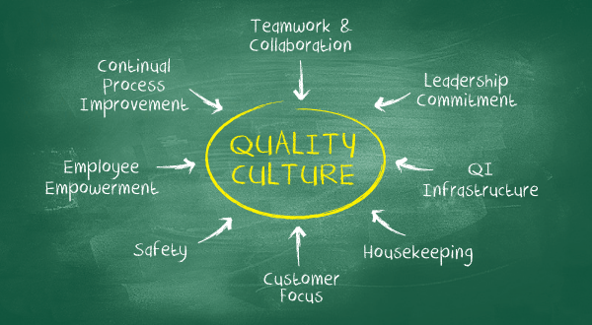
Business Example 4.1 -Toyota's Global EQ-CQ System
Emotional commitment is necessary in the case of cross-cultural quality culture.
Kaizen philosophy incorporates the ongoing learning of emotions.
The multiethnic production teams require emotional organization.
Global cultural intelligence is built by the rotation of leadership roles.
Emotional and cultural alignment are the determinants of performance excellence.
Notes:
Toyota's manufacturing excellence provides a unique perspective on EQ-CQ integration in production environments. The quality culture requires emotional commitment that transcends cultural boundaries. The Kaizen philosophy demonstrates continuous improvement in emotional and cultural learning. The manufacturing requires precise coordination that depends on emotional and cultural understanding. The leadership rotation program shows systematic development of global cultural intelligence. Cross-cultural coordination is a key requirement.

Slide 18
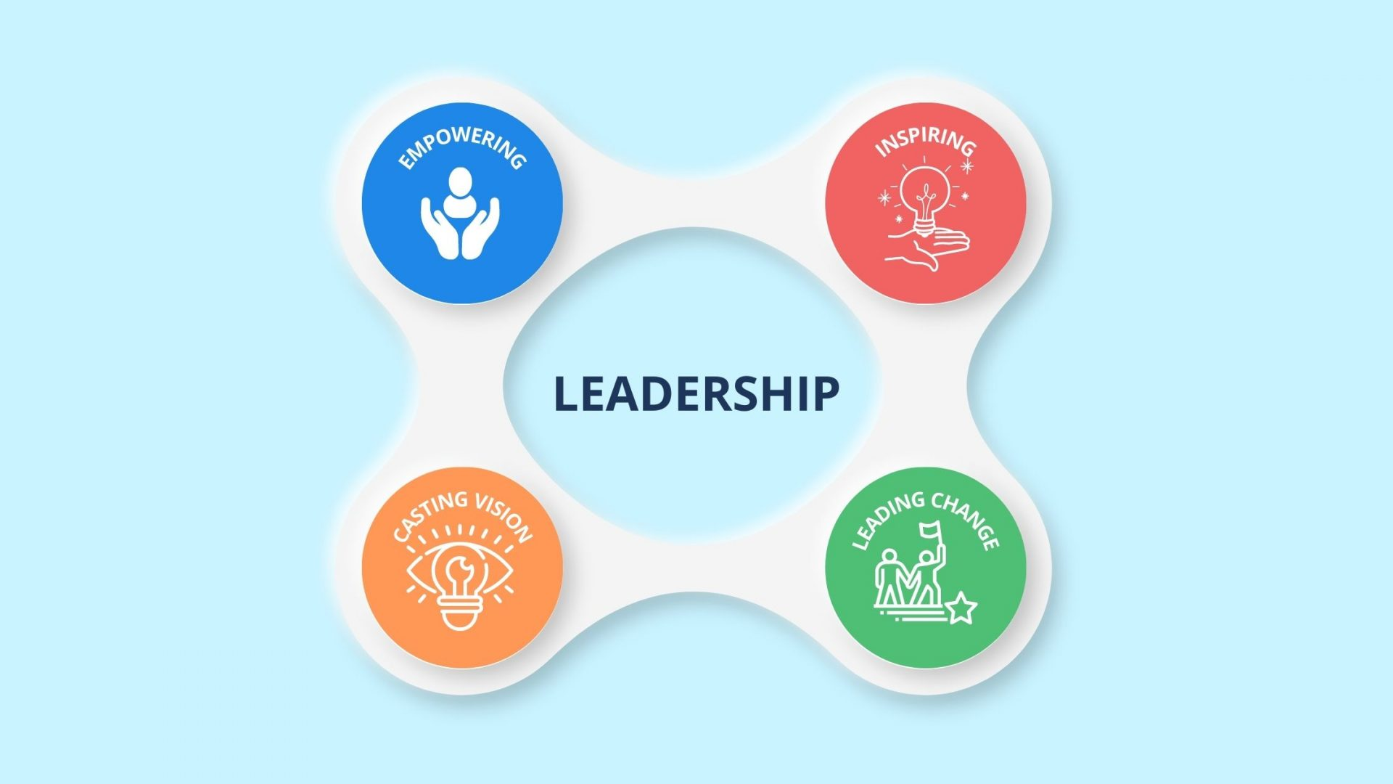
EQ-CQ Integration through Hofstede's Cultural Context - Leadership Effectiveness Factors
Self-Understanding of Culture: adjustment of self-cultural programming with Hofstede’s dimensions.
Emotional Cultural Adaptation: Adaptation to the emotional expression mode of a given cultural context, Bratianu and Paiuc (2025) .
Conflict Resolution: Emotion Management Stratagem (Hofstede’s Influenced).
Innovation Enhancement: The cultural aspect of the dimension with the work collaboration of varieties realized.
Notes:
A combination of emotional intelligence and cultural dimensions, as outlined by Hofstede’s, will generate advanced leadership energies that transcend mere cultural adaptation or universal emotionalism. The study by Bratianu and Paiuc (2025) also provides evidence that leaders with the knowledge of the Hofstede’s dimensions, as well as EQ competencies, can deliver multicultural team performance that is 56% higher than leaders who excel in only one area of competencies.
The concept of cultural self-awareness, based on Hofstede's framework, enables a leader to be aware of their dimensional programming and avoid cultural biases at an unconscious level, thereby enhancing the application of emotional intelligence. The practice of cultural adaptation entails adapting communication modes to the expectations, such as power distribution, without degrading someone. Cultural dimensions assist in making decisions to end conflicts through the interpretation of feelings and the implementation of reasonable methods. Leaders who employ the tool proposed by Hofstede establish the psychologically safe environment that embraces diversity, innovation, and the creation of sustainable competitive advantages through the inimitability of organizational capabilities.

Slide 19
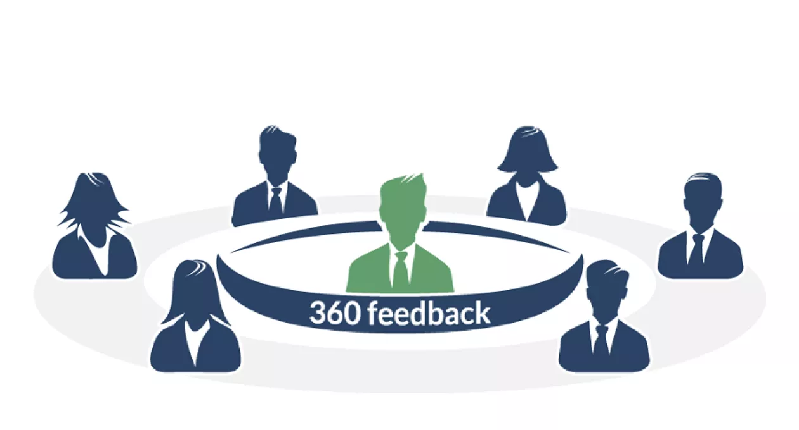
Measurement and Assessment Tools
The Wong-Law EQ Scale and the Cultural Intelligence Scale.
Feedback that is 360 degrees from a diverse cultural point of view.
Cross-cultural behavior observation.
Situational judgement test of cultural-emotional responses.
The performance measures ensure greater effectiveness of teams.
Notes:
Integrated leadership intelligence is constructed with the help of assessment tools. The customary leadership tests can overlook cultural and emotional aspects. The resulting implementation of scales offers holistic analysis. Talking about the 360-degree feedback with a culturally diverse perspective is exposing the blind spot that the same-culture feedback may miss. Situational judgement and behavioural testing is a practical assessment. This measurement contributes to progress and responsibility in leadership training schemes.

Slide 20

Future Trends and Research
AI-powered coaching provides real-time EQ-CQ feedback
Biometric monitoring can be used to measure emotional feedback in leadership.
The principle makes cross-cultural practice safe due to virtual reality training.
Group intelligence measurement as opposed to individual measurement
Neuroscience studies-develop insight into emotional-cultural integration
Notes:
Looking ahead, it is evident that AI and VR are not only futuristic ideas but rather new possibilities for leadership growth. Real-time, immersive learning environments made possible by these technologies are revolutionising the way we develop cultural and emotional intelligence. The concept of biometric monitoring demonstrates the potential that the real-time feedback could hold in training emotional intelligence. The measurement of collective team intelligence is further development of individual assessment. It is important to highlight the fact that the trends in the advancement of technologies are not dissimilar because human emotional and cultural intelligence in relation to one another will always be core. It is supportive of continuous learning even with the latest research in this fast-evolving field.

Slide 21
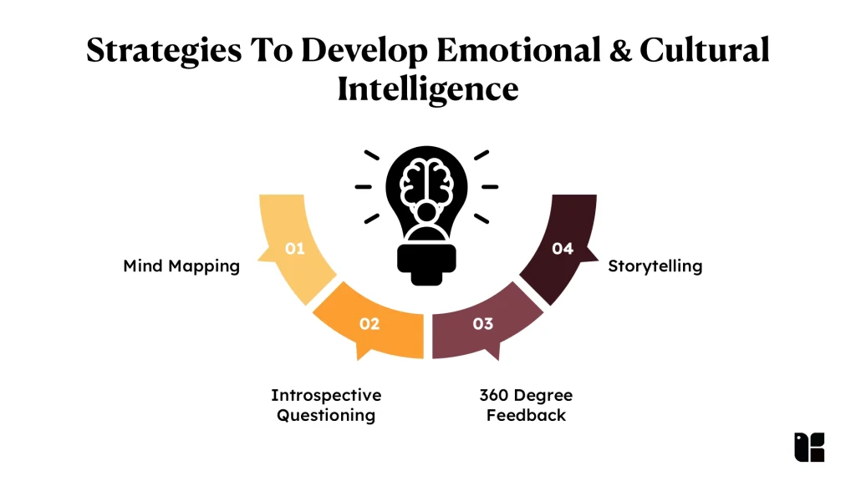
Conclusion
Integration of CQ and EQ will produce stronger and agile leadership.
Cultural intelligence assists the leader to cross and move multicultural teams.
EQ and CQ are warmly welcomed and increase the pace of innovation, inclusion and organizational success.
Emotional intelligence increases the functioning of teams, communication and beneficial conflict resolution.
Notes:
The combined concept of emotional and cultural intelligence makes better, flexible leaders in the current cosmopolitan work environments. Emotional intelligence enhances the relationship within a team, communication and conflict management, which is crucial related to trust and involvement. The cultural intelligence allows the leaders to integrate and lead various groups of people, adjusting to contrasting principles and demands. Studies reveal that leaders who adopt both EQ and CQ lead to innovation, inclusion, and greater success in an organisation. Thus, in order to maintain effectiveness as a leader, dual competency should be developed when working in a multicultural environment.

Slide 22
References
Amazing Workplaces (2024). How Microsoft’s Cultural Transformation Inspires Modern Workplaces. [online] Amazing Workplaces. Available at: https://amazingworkplaces.co/how-microsofts-cultural-transformation-inspires-modern-workplaces/.
Bratianu, C. and Paiuc, D., (2025). Emotional and Cultural Intelligence Impact on Multicultural Leadership. In Emotional Intelligence and Networking Competencies: Implications for Effective Leadership (pp. 15-34). Cham: Springer Nature Switzerland.
Channell, M. (2021). Daniel Goleman’s Emotional Intelligence in Leadership: How to Improve Motivation in Your Team. [online] TSW Training. Available at: https://www.tsw.co.uk/blog/leadership-and-management/daniel-goleman-emotional-intelligence/ [Accessed 18 Jun. 2025].
Escandon-Barbosa, D., Ramirez, A. and Salas-Paramo, J., (2022). The effect of cultural orientations on country innovation performance: Hofstede cultural dimensions revisited?. Sustainability, 14(10), p.5851.
Ganesh, K. (2024). Why is cultural intelligence important for leaders at work: A complete guide. [online] CultureMonkey. Available at: https://www.culturemonkey.io/employee-engagement/culture-intelligence/ [Accessed 18 Jun. 2025].
Holbeche, L. (2023). How Good Leaders Inspire and Motivate Others - Business Leadership Today. [online] Business Leadership Today. Available at: https://businessleadershiptoday.com/how-do-good-leaders-inspire-and-motivate-others/ [Accessed 17 Jun. 2025].
HSBC (2025). Our inclusion strategy | Our people | HSBC Holdings plc. [online] HSBC. Available at: https://www.hsbc.com/who-we-are/our-people/inclusion-at-hsbc/our-inclusion-strategy.
Notes:
Amazing Workplaces (2024). How Microsoft’s Cultural Transformation Inspires Modern Workplaces. [online] Amazing Workplaces. Available at: https://amazingworkplaces.co/how-microsofts-cultural-transformation-inspires-modern-workplaces/.
Bratianu, C. and Paiuc, D., (2025). Emotional and Cultural Intelligence Impact on Multicultural Leadership. In Emotional Intelligence and Networking Competencies: Implications for Effective Leadership (pp. 15-34). Cham: Springer Nature Switzerland.
Channell, M. (2021). Daniel Goleman’s Emotional Intelligence in Leadership: How to Improve Motivation in Your Team. [online] TSW Training. Available at: https://www.tsw.co.uk/blog/leadership-and-management/daniel-goleman-emotional-intelligence/ [Accessed 18 Jun. 2025].
Escandon-Barbosa, D., Ramirez, A. and Salas-Paramo, J., (2022). The effect of cultural orientations on country innovation performance: Hofstede cultural dimensions revisited?. Sustainability, 14(10), p.5851.
Ganesh, K. (2024). Why is cultural intelligence important for leaders at work: A complete guide. [online] CultureMonkey. Available at: https://www.culturemonkey.io/employee-engagement/culture-intelligence/ [Accessed 18 Jun. 2025].
Holbeche, L. (2023). How Good Leaders Inspire and Motivate Others - Business Leadership Today. [online] Business Leadership Today. Available at: https://businessleadershiptoday.com/how-do-good-leaders-inspire-and-motivate-others/ [Accessed 17 Jun. 2025].
HSBC (2025). Our inclusion strategy | Our people | HSBC Holdings plc. [online] HSBC. Available at: https://www.hsbc.com/who-we-are/our-people/inclusion-at-hsbc/our-inclusion-strategy.
Ineak (2023). The Role of Leadership in Toyota’s Management Culture. [online] Toyota Management System. Available at: https://www.ineak.com/the-role-of-leadership-in-toyotas-management-culture/.
Kai Liao, Y., Wu, W.Y., Dao, T.C. and Ngoc Luu, T.M., (2021). The influence of emotional intelligence and cultural adaptability on cross-cultural adjustment and performance with the mediating effect of cross-cultural competence: A study of expatriates in Taiwan. Sustainability, 13(6), p.3374.
Livermore, D., Van Dyne, L. and Ang, S., (2022). Organizational CQ: Cultural intelligence for 21st-century organizations. Business Horizons, 65(5), pp.671-680.
McParland, G. (2024). The Importance of Diversity in Leadership - The Resource Company, Inc. [online] The Resource Company, Inc. Available at: https://www.theresource.com/2024/08/27/the-importance-of-diversity-in-leadership/ [Accessed 17 Jun. 2025].
Paiuc, D., (2021). Cultural intelligence as a main competency for multinational leadership and global management. STRATEGICA, p.1079.
Santa, R., Sanz, C.M., Tegethoff, T. and Cayon, E., (2023). The impact of emotional intelligence, cross-functional teams and interorganizational networks on operational effectiveness. Journal of Organizational Effectiveness: People and Performance, 10(3), pp.313-329.
Tan, K.T.L., Voon, M.L. and Ngui, K.S., (2022). Emotional intelligence and leadership effectiveness: A critical review for future research. Global Business and Management Research, 14(3s), pp.536-551.
Unilever (2025). How Unilever’s digital transformation is driving operational excellence. [online] Unilever. Available at: https://www.unilever.com/news/news-search/2025/how-unilevers-digital-transformation-is-driving-operational-excellence/.

Slide 23
References
Ineak (2023). The Role of Leadership in Toyota’s Management Culture. [online] Toyota Management System. Available at: https://www.ineak.com/the-role-of-leadership-in-toyotas-management-culture/.
Kai Liao, Y., Wu, W.Y., Dao, T.C. and Ngoc Luu, T.M., (2021). The influence of emotional intelligence and cultural adaptability on cross-cultural adjustment and performance with the mediating effect of cross-cultural competence: A study of expatriates in Taiwan. Sustainability, 13(6), p.3374.
Livermore, D., Van Dyne, L. and Ang, S., (2022). Organizational CQ: Cultural intelligence for 21st-century organizations. Business Horizons, 65(5), pp.671-680.
McParland, G. (2024). The Importance of Diversity in Leadership - The Resource Company, Inc. [online] The Resource Company, Inc. Available at: https://www.theresource.com/2024/08/27/the-importance-of-diversity-in-leadership/ [Accessed 17 Jun. 2025].
Paiuc, D., (2021). Cultural intelligence as a main competency for multinational leadership and global management. STRATEGICA, p.1079.
Santa, R., Sanz, C.M., Tegethoff, T. and Cayon, E., (2023). The impact of emotional intelligence, cross-functional teams and interorganizational networks on operational effectiveness. Journal of Organizational Effectiveness: People and Performance, 10(3), pp.313-329.
Tan, K.T.L., Voon, M.L. and Ngui, K.S., (2022). Emotional intelligence and leadership effectiveness: A critical review for future research. Global Business and Management Research, 14(3s), pp.536-551.
Unilever (2025). How Unilever’s digital transformation is driving operational excellence. [online] Unilever. Available at: https://www.unilever.com/news/news-search/2025/how-unilevers-digital-transformation-is-driving-operational-excellence/.
Notes:
Amazing Workplaces (2024). How Microsoft’s Cultural Transformation Inspires Modern Workplaces. [online] Amazing Workplaces. Available at: https://amazingworkplaces.co/how-microsofts-cultural-transformation-inspires-modern-workplaces/.
Bratianu, C. and Paiuc, D., (2025). Emotional and Cultural Intelligence Impact on Multicultural Leadership. In Emotional Intelligence and Networking Competencies: Implications for Effective Leadership (pp. 15-34). Cham: Springer Nature Switzerland.
Channell, M. (2021). Daniel Goleman’s Emotional Intelligence in Leadership: How to Improve Motivation in Your Team. [online] TSW Training. Available at: https://www.tsw.co.uk/blog/leadership-and-management/daniel-goleman-emotional-intelligence/ [Accessed 18 Jun. 2025].
Escandon-Barbosa, D., Ramirez, A. and Salas-Paramo, J., (2022). The effect of cultural orientations on country innovation performance: Hofstede cultural dimensions revisited?. Sustainability, 14(10), p.5851.
Ganesh, K. (2024). Why is cultural intelligence important for leaders at work: A complete guide. [online] CultureMonkey. Available at: https://www.culturemonkey.io/employee-engagement/culture-intelligence/ [Accessed 18 Jun. 2025].
Holbeche, L. (2023). How Good Leaders Inspire and Motivate Others - Business Leadership Today. [online] Business Leadership Today. Available at: https://businessleadershiptoday.com/how-do-good-leaders-inspire-and-motivate-others/ [Accessed 17 Jun. 2025].
HSBC (2025). Our inclusion strategy | Our people | HSBC Holdings plc. [online] HSBC. Available at: https://www.hsbc.com/who-we-are/our-people/inclusion-at-hsbc/our-inclusion-strategy.
Ineak (2023). The Role of Leadership in Toyota’s Management Culture. [online] Toyota Management System. Available at: https://www.ineak.com/the-role-of-leadership-in-toyotas-management-culture/.
Kai Liao, Y., Wu, W.Y., Dao, T.C. and Ngoc Luu, T.M., (2021). The influence of emotional intelligence and cultural adaptability on cross-cultural adjustment and performance with the mediating effect of cross-cultural competence: A study of expatriates in Taiwan. Sustainability, 13(6), p.3374.
Livermore, D., Van Dyne, L. and Ang, S., (2022). Organizational CQ: Cultural intelligence for 21st-century organizations. Business Horizons, 65(5), pp.671-680.
McParland, G. (2024). The Importance of Diversity in Leadership - The Resource Company, Inc. [online] The Resource Company, Inc. Available at: https://www.theresource.com/2024/08/27/the-importance-of-diversity-in-leadership/ [Accessed 17 Jun. 2025].
Paiuc, D., (2021). Cultural intelligence as a main competency for multinational leadership and global management. STRATEGICA, p.1079.
Santa, R., Sanz, C.M., Tegethoff, T. and Cayon, E., (2023). The impact of emotional intelligence, cross-functional teams and interorganizational networks on operational effectiveness. Journal of Organizational Effectiveness: People and Performance, 10(3), pp.313-329.
Tan, K.T.L., Voon, M.L. and Ngui, K.S., (2022). Emotional intelligence and leadership effectiveness: A critical review for future research. Global Business and Management Research, 14(3s), pp.536-551.
Unilever (2025). How Unilever’s digital transformation is driving operational excellence. [online] Unilever. Available at: https://www.unilever.com/news/news-search/2025/how-unilevers-digital-transformation-is-driving-operational-excellence/.

