Slide 1
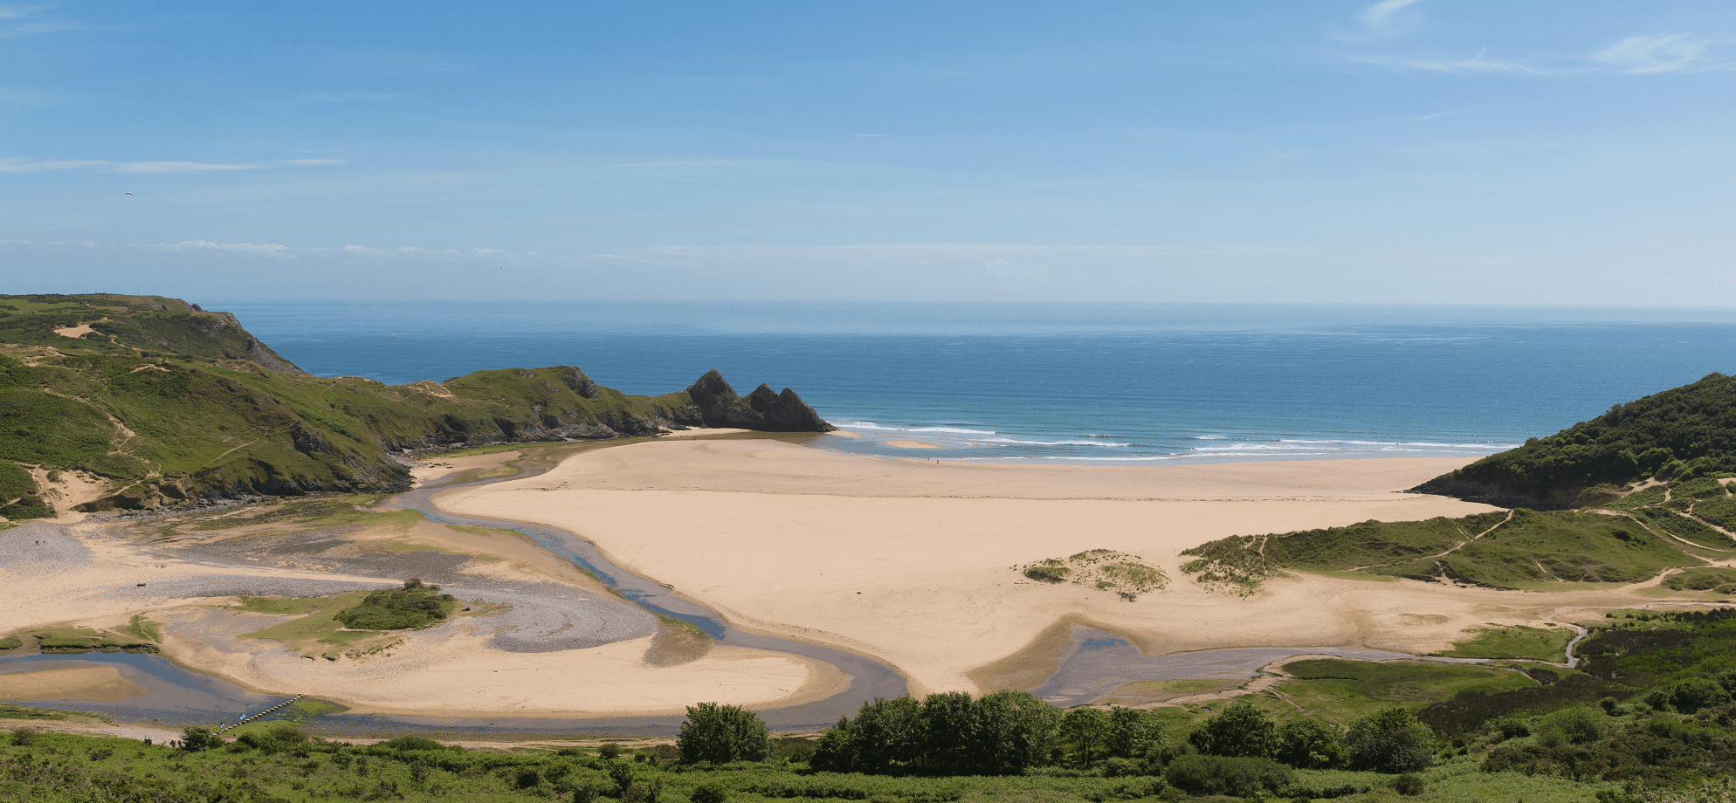
Landscape & Geology
The Gower Peninsula

Slide 2
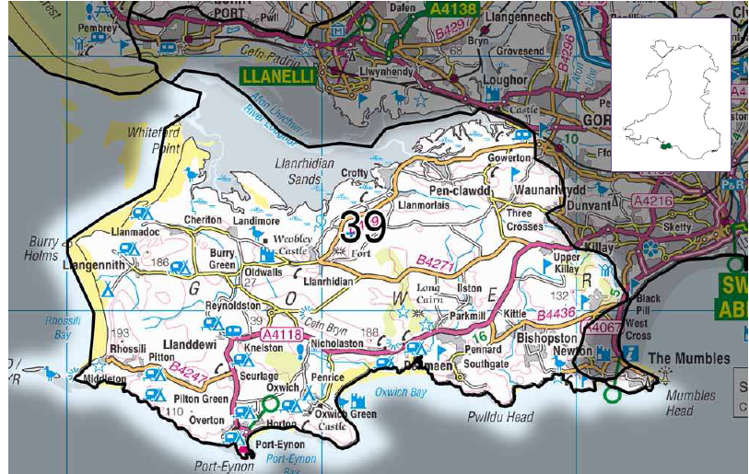
Notes:
Summary description
Gower is a coastal peninsula starting at the western edge of greater urban Swansea. Its
geology gives rise to a wide variety of scenery in a relatively small area - from the south
coast's superb limestone scenery at Worm’s Head, Three Cliff Bay and Oxwich Bay to the
salt marshes and dune systems in the north. The most prominent inland features are the
large areas of common, dominated by sandstone ridges including the high ground of Cefn
Bryn. The outstanding scenery and golden sandy beaches backed by cliffs led to the area
becoming an extremely popular tourist destination. Key roads can become busy and the
most scenic beaches can become honey pots. Tourism pressures have changed the
cultural character. It was the first AONB to be designated in the UK in 1956, while the
coastline is also designated as Heritage Coast.
The area remains very rural. The ridges form a series of gentle, open, heath-covered
‘downs’. Between the hills there is a mixed agricultural landscape varying from small
pastures enclosed with high hedges to larger open fields. In some areas, old strip field
patterns remain, with the ‘Vile’ landscape at Rhossili being exceptional in it’s survival. In
the more exposed western coastal and higher ground, the tradition of stone-faced earth
hedge banks remains. This is typical in areas where there are few trees. A notable
feature is the series of small but steep-sided and often wooded valleys, whose streams
issue along the south coast.
The long spine ridge of Cefn Bryn separates north and south areas. The northern coast
from Gowerton to Crofty had a small-scale industrial past, reflected in the character of their
settlements, for example Gowerton, Penclawdd and Crofty. There the coast is open salt
marsh, with muddy channels running out into the Burry inlet. This is the extensive and
ecologically important estuary of the River Loughor. The larger southern and western
areas are distinctly agricultural with farmsteads, manor estates and a number of small
villages. There are still peaceful corners in this rural landscape, with historic settlements of
whitewashed buildings reinforcing a traditional sense of place. The area is exceptionally
rich in archaeology with remarkable evidence of human occupation over millennia
surviving in coastal caves.

Slide 3
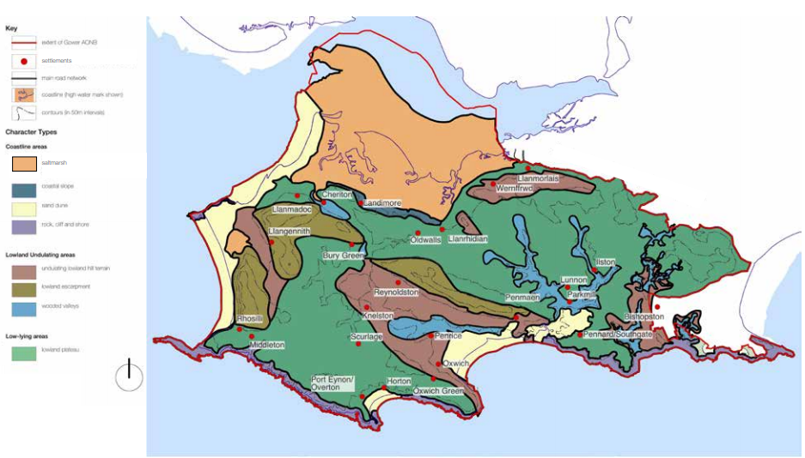
Notes:
Key Characteristics
Coastal peninsula - with exposed cliffs and sandy bays to the south and west and
sheltered estuary with saltmarsh to the north. The neck of the peninsula is defined by the
edge of the built up area of greater Swansea.
Carboniferous Limestone plateau – but intersected by the prominent Cefn Bryn ridge of
old red sandstone. Millstone Grit separates coal measures to the NE.
Limestone cliffs and raised beaches – to the south on an exposed coast, with ESEtrending
rocky headlands.
Sandy bays – on the south coast, popular for recreation and very scenic, e.g. Three Cliffs
Bay – with a stream issuing across the sand and a natural arch on the cliff.
Mud flats and salt marsh – extensive areas in the Burry (Lougher) estuary to the north
Sand dunes – to the west, and long, open undeveloped beaches
Open heath and common especially on long, low hills across the spine of the area.
Narrow, twisting, small limestone valleys - often wooded, and emerging on the south
coast. Some sections are dry (see geological influences), others have streams.
‘Vile’ Field system – medieval / post-medieval relict open strip field system and
traditional boundaries, tracks and paths, Rhossili. Many long, thin or irregular shaped
fields elsewhere, clusters of small fields, some larger improved ones.
Hedgebanks – stone-faced earth field enclosures in windswept areas and thicker
hedgerows in sheltered valleys and further east.
Archaeology - with features dating from most phases of prehistory and history, from the
Upper Palaeolithic period to the recent past. Notably at Paviland Cave, one of the most
significant sites in Britain, radiocarbon dated remains 28,000BP.
Woodlands – a focus of sheltered valleys as well as plantations on Parc-le-Breos and
areas closer to Swansea. Some mixed and coniferous plantations occur on the Millstone
Grit areas. Broadleaved and mixed woodlands fringe streams and occupy some slopes in
the east.
Commons – extensive and important for their dry and wet lowland heath habitats and as
strongholds for populations of the southern damselfly and marsh fritillary.
Scattered settlements –clustered around Medieval churches or castles, linked by a
network of often rural roads. Settlements abutting open commons. Retains rural,
traditional character – in contrast to the immediately adjacent greater Swansea.
Very scenic - the area became Britain’s first AONB in 1956. A number of iconic, ‘voted
best’ views, including Rhossili Bay, Three Cliffs Bay and Worms Head.
Tourism and recreation - traffic and the close proximity of Swansea bring large number
of visitors. Honey pots result by popular beaches.
Swansea Airport - lies amidst flat heath land to the east, however in recent years use
has just been for light aircraft.

Slide 4
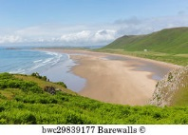
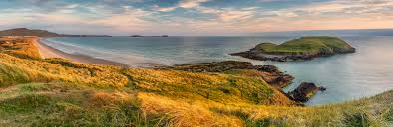
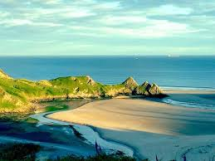
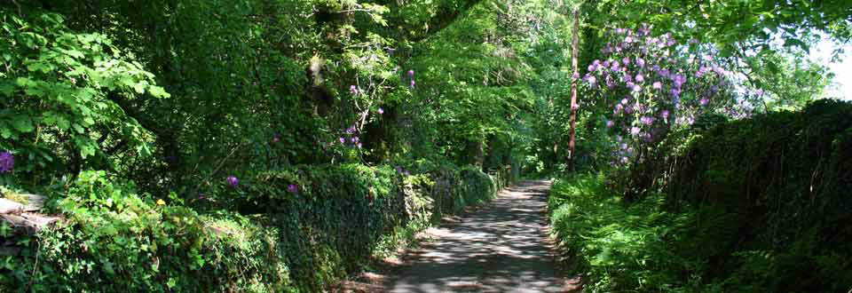
Gower Peninsula
Beaches
Gower marks transition from industrial Wales to Urban Wales
First ANOB in UK 1956
Country lanes to busy tourist areas:
  Campsites numerous in places
  Golf course
  Swansea Airport
Notes:
Visual and Sensory profile
The overriding visual image is that of an area of outstanding natural beauty. It’s varied
coastline is a principle defining feature and gives rise to a number of iconic ‘voted best’
views. The change in character between the adjacent developed, urban edge of greater
Swansea to the east, and the tranquil, unspoilt, rural, remoter western end of Gower is
remarkable. In particular, Rhossili Down slopes smoothly down to the vast empty sandy
beach of Rhossili Bay. The beach is backed by dunes. To the north end of the bay the
headland of Burry Holme is a visual feature. To the south end of the bay Worms Head
forms a thin, strangely profiled peninsula at low tide, becoming an island at high tide. At
Three Cliffs Bay the semi-enclosed sandy beach is framed by rocky headlands and a
stream issues across the sand and past a natural rock arch on the cliff. There are many
other examples of outstanding scenic coastal places too. The close proximity of Swansea
and the numbers of tourists lead to busy honey pots forming in popular places, with many
people enjoying beach recreation, walking and surfing.
Inland the countryside is gentle compared to the drama of the main upland areas of Wales.
However there is a very appealing, intimate relationship of patterns field boundaries, land
use and settlements, to topography. The heaths emphasise the hills (or ‘downs’), which
are important features of the peninsula. These hills offer wide views from the South Wales
valleys to the Exmoor hills. As with the Gwendraeth Vales to the north, the Gower marks
the transition from industrial and urban Wales to the east and an open, rural Wales to the
west. Gower provides a compact taste of the west without a long drive from Swansea.
Settlements of whitewashed buildings are linked by a network of minor roads, fringed by
high, flower rich verges. Woodland areas to the east and the high road verges create a
sense of enclosure.
This combination of exceptional scenic qualities led to the Gower becoming Britain’s first
AONB in 1956. In addition, its coastline is designated as a Heritage Coast. The sense of
place is one of a relaxed society in an unspoilt and well-protected landscape. However its
popularity with visitors can result in congestion along the roads and narrow lanes during
peak season. On occasions this erodes the peaceful and remote qualities of the area,
while the extensive static caravan and chalet parks at Llangennith, Wern-halog,
Kennexstone, Llanddewi, Horton and Port Eynon and Caswell Bay, and the numerous
summer camping sites, add visible distractions that increase awareness of busyness.
Swansea Airport, the main A 4118, Sketty to Port Eynon road and golf courses at
Fairwoood, Langland, Clyne and Pennard, are further modern features impinging on the
area's otherwise historic ambience, while night-time light

Slide 5
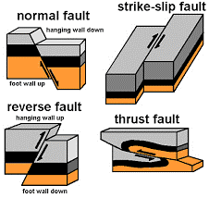
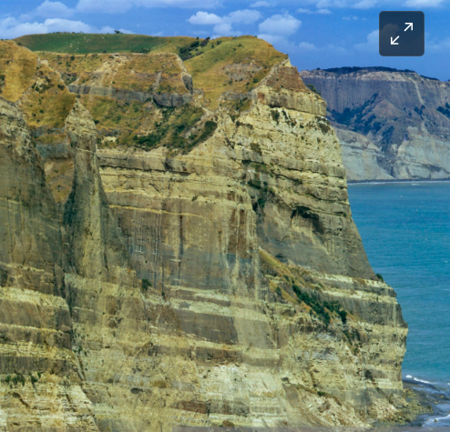
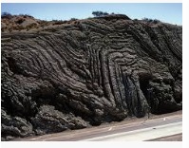
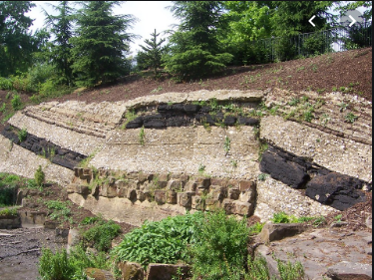
Crash course in Sedimentary rock formation (The rocks of Gower)
https://www.youtube.com/watch?v=uozyWZ6XQzM
Notes:
How does a geologist look at rocks? To understand what a cliff-face is trying to tell you, you must first identify two things about the rocks which compose it - the succession, and the structure.
As time goes on, sediments build up in the sea or on land, and form a sedimentary pile. Obviously, the youngest sediments will be those on the top of the pile, and the pile will remain as it is unless Earth movements - such as those involved in the creation of mountains deform it. Now since mountain-building is something that happens when the drifting continents collide, the forces are compressional, and the rocks in the sedimentary pile are folded up. An example of this is provided by the Himalayas, formed when India crashed into Asia (right).
When rocks are deposited in the sedimentary pile, they are formed in horizontal layers, called beds or strata (s. stratum). These may be of various thicknesses, and may change in thickness from place to place, depending upon how much sediment was accumulating in each locality. Minor breaks in deposition, or changes in the type of sediment (mud to sand, sand to gravel, etc.) can cause the beds to become visibly separated from one another. The interface between one bed and another is called the bedding plane, and it represents an ancient depositional surface, such as the seabed.
Img0058_thumbnail.jpgIt is the bedding which enables us to see when rocks have been folded. Folds where the beds have been bent up into an arch are called anticlines. Downward-facing U-shaped folds are called synclines. When the mountains are uplifted and erosion planes off the tops of these folds (as in the picture, right), anticlines will have the oldest rocks at the centre, while synclines will have the youngest rocks at their cores.
The line that marks the core of the fold (as it is exposed in section along the ground) we shall call the hinge. The picture to the left shows an eroded anticline, whose hinge runs roughly in the direction of sight, through the highest point.
The rocks of Gower were affected by mountain building about 280 million years ago, and were strongly folded. This is why the bedding is no longer horizontal. But sometimes, the forces of deformation can be too great to be accommodated by this kind of plastic response, and the rocks break. Such breaks are called faults, and they take the form of deep fracture-planes, rather like a knife-cut through a cake.
Along these fractures, neighbouring rock-masses have moved against each other, and the type of relative motion that occurred is used to classify the various kinds of fault. The rocks may, for example, have slid past each other. Alternatively, one block may have ridden up over its neighbour. In cases where the rocks have been stretched rather than compressed, one block may slip down and away from its adjacent mass. All these kinds are to be seen in Gower and they frequently occur in bays. This is because faults are lines of weakness that the sea will always pick out. This is fortunate, because it means that rocks tend to be well exposed where it really matters!

Slide 6
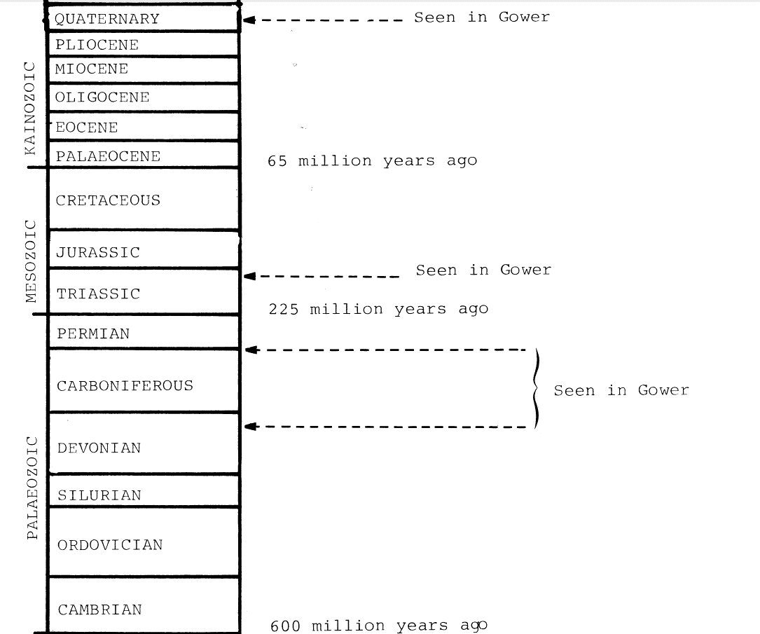
Stratigraphic table showing all the main periods of Earth history, and their ages in years

Slide 7
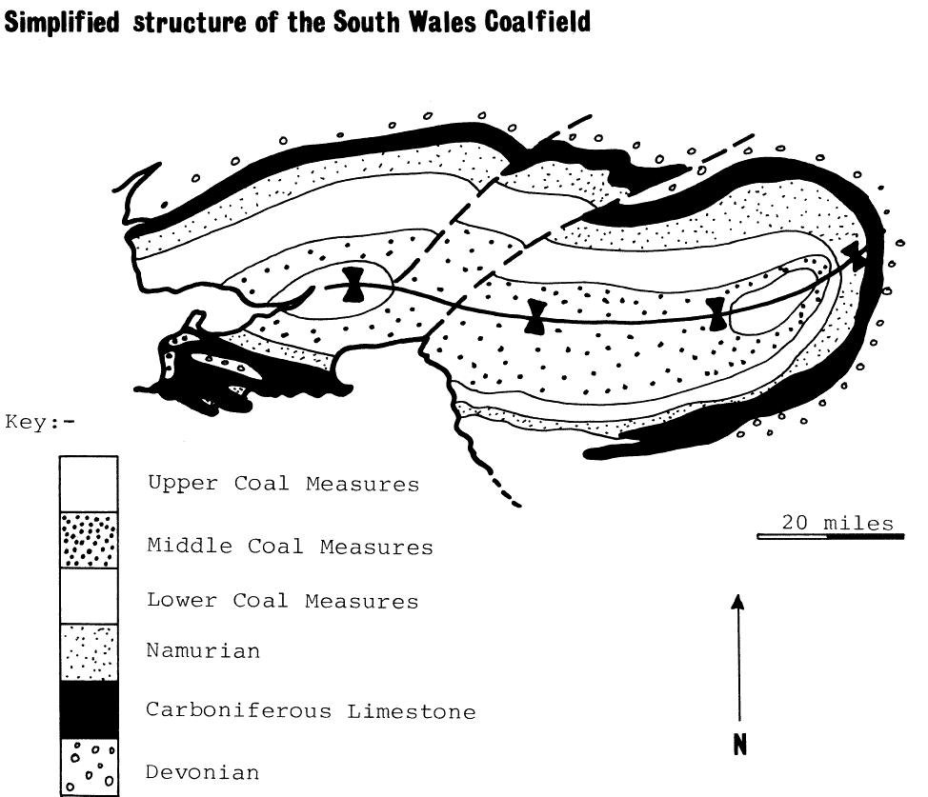
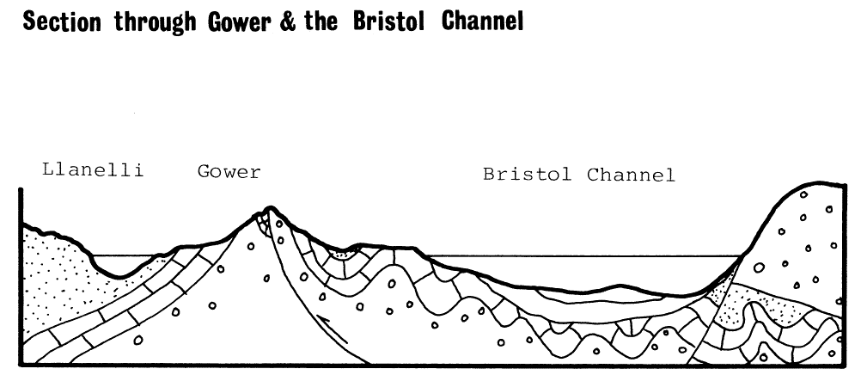
South Wales & Gower Geology structure
Notes:
Everyone associates South Wales with coal, and it is mined here because of a massive syncline which dominates the geology north of Swansea. This trough of downwarped rocks preserves in its core rocks of the Upper Carboniferous; these are rich in beds of coal, and they have given the name to the period in which they were deposited.
Swansea sits on the southern limb of this syncline, so the rocks, therefore, dip to the north. As is the case with synclines, the older rocks crop out around the edges, and thus Gower rocks are those which are emerging from beneath the Coal Measures on this southerly limb.
But if this were the whole story, Gower would consist of northerly dipping strata becoming progressively older southwards. This is not so, because of a series of tight folds which begins on the peninsula and continues right under the Bristol Channel, as far as Devon (see North South section through Loughor Estuary, Gower, Bristol Channel and North Devon, below left).
The hinges of these folds lie roughly east-west, just like the hinge of the coalfield itself, and this shows that the pressure during the mountain-building phase was coming from the south.
So Gower displays a transition-zone between the broad and open style of folding in the coalfield and the tight, narrow folds of the Bristol Channel. The section in Figure demonstrates this in simplified form. You will notice in this diagram that some of the shortening of the rocks has taken place along a fault-line, where one mass of rock has ridden up over another. This is a reverse fault, and there are many examples to be seen. They tend to run parallel with the hinges of the folds, as you might expect. They are called 'thrusts' in Gower, though this is not strictly correct usage of this term.
The hinges of these folds lie roughly east-west, just like the hinge of the coalfield itself, and this shows that the pressure during the mountain-building phase was coming from the south.
So Gower displays a transition-zone between the broad and open style of folding in the coalfield and the tight, narrow folds of the Bristol Channel. The section in Figure demonstrates this in simplified form. You will notice in this diagram that some of the shortening of the rocks has taken place along a fault-line, where one mass of rock has ridden up over another. This is a reverse fault, and there are many examples to be seen. They tend to run parallel with the hinges of the folds, as you might expect. They are called 'thrusts' in Gower, though this is not strictly correct usage of this term.

Slide 8
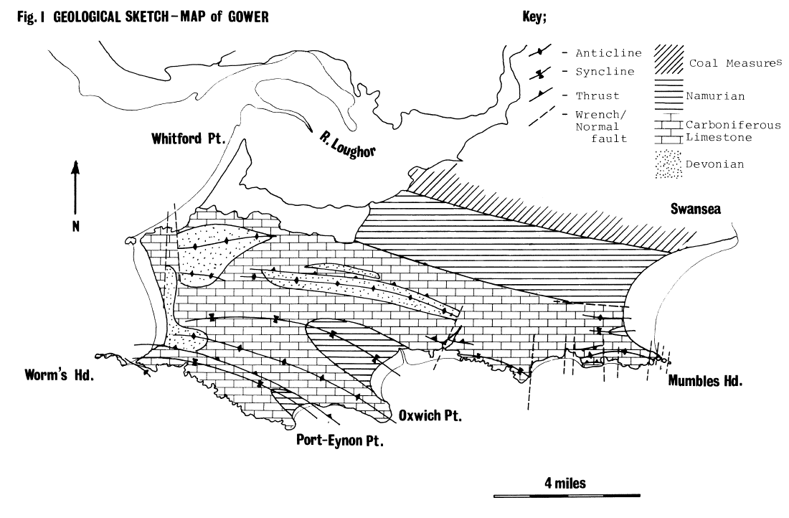
Structure of Gower Rocks Anticline and Synclines
Notes:
Talk about the anticline and hence the uplift of Devonian rocks to form Rhossili downs and Cefn Bryn.

Slide 9
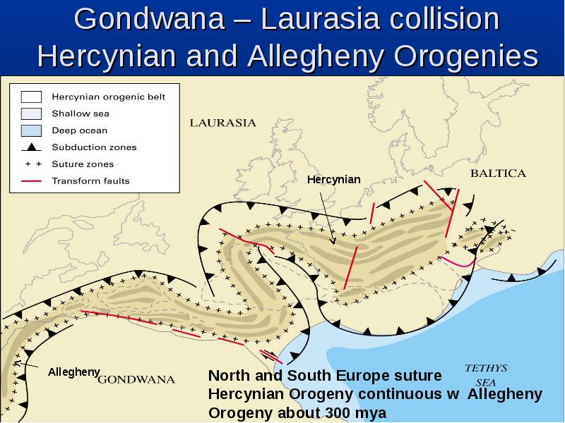
Hercynian Orogeny
Notes:
The Laurasia continental plate was collided into by the Gondwana plate, which was subducted under the Laurasia plate and formed mountains to the North of it. Causing all the folding and faulting of the rocks to the north of the subduction zone and uplifting the land.

Slide 10
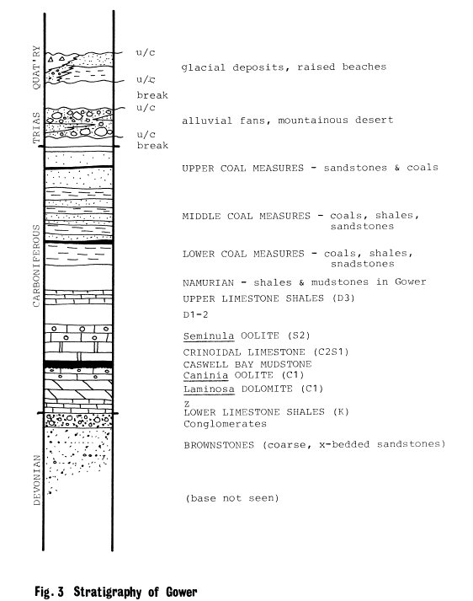
Gower Geology of the Actual Rocks
Stratigraphy
Notes:
So far, we have been concerned with the structures that have been imposed upon the originally flat-lying rock-layers. Now we come to the interpretation of the sedimentary pile itself, which means deciding what sort of sediment each rock-type one was, and deducing from this the nature of the environment in which they were deposited. Conditions of deposition change through time, and this is what produces the characteristic sequence of rock types that we see in the peninsula
The oldest rocks cropping out on Gower represent the latter part of the Devonian period. They only occur in the cores of major anticlines. At this time, Gower lay in a region of sediment-laden rivers crossing a wide plain between mountains to the north and the sea, which at that time lay over Devon. These mountains were made of still older rocks, and their roots now form much of central and north Wales. The climate at this time was tropical, possibly monsoonal, and the choked streams carried sediment from the intense erosion taking place in the hills. Much coarse material was dropped en route, on the riverbanks and in the islands that split the streams into many minor channels. In Gower, we see pebbly rocks (conglomerates) at the top of the sequence overlying coarse sandstones.

Slide 11
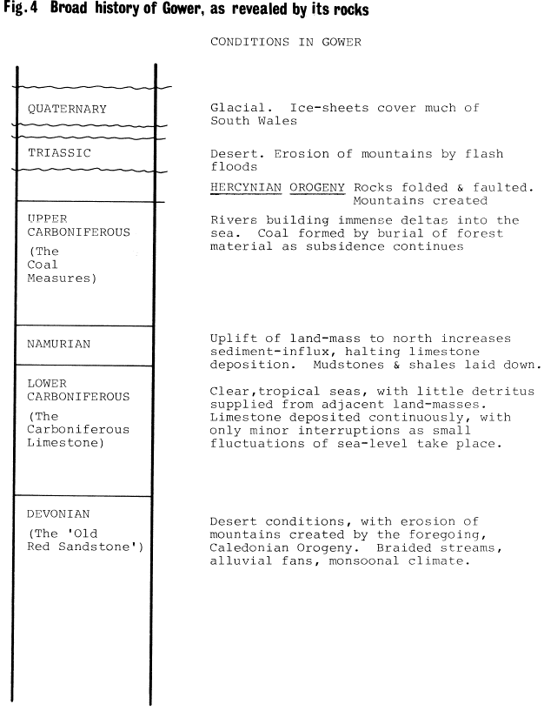
Gower Geology
of the Actual Rocks
Stratigraphy and formation history
Sea level transgression (rise) at the end of Devonian
Period creating shallow seas in which Carboniferous
limestone put down
Carboniferious limestone formation video
Notes:
The sea at this time began to rise relative to the land, and, as the Carboniferous Period began, the wide coastal plains of the Devonian were drowned. This was an example of a marine transgression, and on top of the continental conglomerates, marine shales (dark, fine-grained friable rocks) were laid down. Then, gradually, the water became clear; the amount of detritus reaching the area from the land was drastically reduced, and limestones began to form.
Britain was passing the equator now from south to north, and in the present-day ocean it is principally in such equatorial latitudes, in areas where sediment-supply is low, that limestones are being made. In the clear water calcium carbonate (lime) can precipitate, aided by the abundant life forms that secrete shells and skeletons. Without land-derived sediment to dilute them, these shells can form rocks in their own right, although many limestones are composed of microscopic particles of lime, called lime-mud.
The Carboniferous Limestone in Gower is about 800 metres thick, but traced northward, it can be seen to grow progressively thinner. Each individual unit becomes narrower, and there may also be some units missing. This suggests that the sea further north, being nearer to the land, was shallower and subsiding less quickly. Also, minor fluctuations of sea level could mean that in these shoreward areas, sedimentation could be interrupted more frequently, so resulting in omitted units.
There are many different units making up the Carboniferous Limestone, each with differing texture, thickness, fossil-assemblage, and so on. These differences were the result of subtle environmental changes, which we will touch on when we visit the localities. Not one of these little changes, however, was as severe as that which marked the complete end of limestone deposition in this part of the world.
During the Lower Carboniferous the forces which were eventually to fold and fault the rocks of Gower were beginning to flex the crust of the Earth upwards. This gave added impetus to erosion on the landmasses, which resulted in turn in river deltas swamping the limestone sea with detrital sediment. The water over Gower at this time was relatively deep, and fine shales with marine animals preserved in them were deposited. This time-period is called the Namurian.
The stage was now set for the deposition of the Coal Measures, which are the sediments of a widespread system of river-deltas close to sea level, upon which grew the lush forests of giant mosses, horsetails and ferns which eventually became coal. The Coal Measures therefore consist of sandstones, shales and coals arranged in repeated sequence, which tells of how forests grew, were buried by shales as the land subsided and then by sands as the rivers built out. On top of the river-sand, soil developed and eventually the forest became established all over again. So the cycle went on, bestowing upon Wales the mineral wealth which made it the birthplace of British industry.
This is the broad history of the rocks that make up Gower. After the Coal Measures were deposited, the period of mountain building folded and faulted them into their present arrangement. There are many names for this episode of deformation, but we shall call it the Hercynian. You may also see it called 'Armorican' or 'Variscan’ in other books.
After this orogeny, which took place about 280 million years ago. The rocks were eroded away as the great cycle of geological history repeated itself. More seas entered the area, more sediments were laid down over the eroded remnants of the Devonian and Carboniferous, and yet another orogeny (not so severe in Britain) folded the rocks. But no trace of these later rocks can be seen in Gower, except for one small patch of Triassic sediment in Port Eynon.
The last major episode to affect Gower was the Great Ice Age, which occupied the last 2 million years of Earth history. The climatic changes of this period put the finishing touches to the topography of the peninsula, at a time when man was first making an appearance upon it.

Slide 12
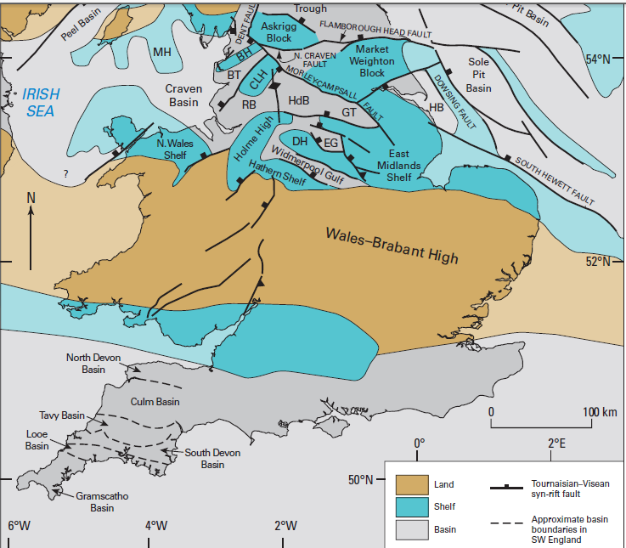
The UK in Carboniferious times
Notes:
DEVONIAN RIVERS AND CARBONIFEROUS SWAMPS
390-290 million years ago
By the middle of the Devonian period, the former Welsh Basin had therefore become part of a range of mountains. The climate was arid, with occasional rainfall eroding the mountains away and generating new sediments in the process. Rivers carried debris away towards the Midlands and South Wales, depositing sands over the plains. The sands eventually consolidated, to form what is today called the Old Red Sandstone. These strata give the characteristic red colour to the soils of parts of South and East Wales.
The Devonian period has been called the "age of fishes". It marked the major evolutionary burst that established these creatures in their full diversity - bony fish, sharks, lungfish - in seas, lakes and rivers worldwide. And from the lungfish there evolved the first amphibians to crawl onto the land, where the colonisation by plants was already well underway.
With the onset of the Carboniferous period, shallow warm seas invaded areas of NE and South Wales, once again allowing coral reefs to flourish and lay down the limestones in which Wale's caves were later formed.
But by the Upper Carboniferous, and particularly in South Wales, extensive coastal deltas and swamps dominated the landscape. These were dense with tree-sized club mosses while ferns, seed-ferns, and other plant life lived on the raised river levees. Great thicknesses of peaty matter accumulated in these swamps, which, under the higher pressures and temperatures of deeper and deeper burial, were slowly converted into coal seams. In South Wales, Rhondda Heritage Centre and Big Pit are places to find out everything you need to know about coal and coal mining. Some impressive mineral specimens are also known from cavities in coalfield ironstones.
Later Carboniferous rocks in South Wales include river-deposited sandstones containing pellets of coal. These show that, by that time, the strata deposited in the coal-swamps had been uplifted and was already being eroded. This is evidence for the early phases of the next mountain-building episode - the Variscan orogeny.
Brief Geological History of the UK
Cambrian
During this period the area that is now occupied by Britain was flooded by lapetus. This ocean, similar to the modern Atlantic, contained hard-shelled animals and so, for the first time the marine sediments contained fossils. Initially beach and shallow marine sediments were deposited on both sides of the ocean and these can mainly be found in Scotland and North Wales, but as the sea deepened these sediments were replaced by muds and calcareous ooze and can only be found in NW Scotland. The rest of the Lower Palaeozoic tended to be dominated by these muddy sediments. During this period, Northern Ireland and Scotland were on the opposite side of lapetus to Wales and Southern Ireland and hence were separated by a vast expanse of deep water. Therefore the faunas of the shallow seas on the margins of lapetus evolved separately because they could not mingle and hence they are completely different to each other. These shallow shelf seas represent the flooding of the continental margins possibly caused by the eustatic rise in sea-level due to the development of an oceanic ridge.
To return to the start, click here:
Ordovician
Lapetus was now beginning to shut as subduction became faster than the spreading rate. In Scotland and Northern Ireland, sedimentation ceased and the compression accompanying the closure led to the first phase of the Caledonian Orogeney known as the Grampian Orogeney. This orogenic phase occurred in the Lower Ordovician (535Ma - 465Ma) and it affected the rocks on the NW margin of lapetus. In early Ordovician times, NW Britain was a shallow shelf sea in which carbonates were slowly accumulating while to the SE the sea was deepened into a turbidite filled basin. The Grampian Orogoney uplifted this basin and shelf sea into a series of mountain chains, evidence of which can still be seen today. Lower Ordovician rocks are the youngest to be affected by deformation and metamorphism whilst it is late Silurian rocks which are the oldest above the associated unconformity in Ireland and Devonian in Scotland. In the SE side of lapetus the sediments continued to be deposited and were interspersed with volcanic rocks ranging in composition from andesites to rhylites. This can be seen in Snowdonia and the Lake District. Towards the end of the Ordovician, lapetus had closed sufficiently for the shelf faunas to mingle, resulting in a more unified fauna.
To return to the start, click here:
Silurian
The final closure of lapetus not only occurred during this period but also not before the vast thicknesses of muddy sediments were deposited across Wales, N England and Scotland where sands probably derived from Cockburnland replaced the more typical L Palaeozoic muds around the middle of the period. The later phases of the Caledonian orogeney uplifted, folded and faulted these rocks.
To return to the start, click here:
Devonian
Thick marine sediments were deposited in a shallow shelf sea in what is now SW England while further north lay a newly created continent formed from the closure of lapetus during the Caledonian orogeney. A collective name for the sediments deposited in subsiding basins on this new continental surface is the Old Red Sandstone. It was probably deposited by streams and rivers flowing off the newly formed mountains and the large outcrops of it in S Wales and the Welsh Borderlands is thought to represent a large delta of one of the larger rivers.
The Old Red Sandstone facies can be seen in a transitional stage in the Welsh Boarderlans and Ireland. In the Orcadian Basin a classic Old Red Sanstone facies can be seen and it contains some fossils of fish. Here the facies is up to 10km. thick and is belived to have been deposited ina great lake that covered the NE of Scotland and was linked to the Baltic. The conglomerates found at it's base are derived from the surrounding uplands.
The Old Red Sanstone was deposited over most of the British Isles with the exception of the marine sediments of SW England which were formed in a marine basin. These sediments are a classitype with limestones and corals, turbidites with fluvial and deltaic sediments also present. There is an almost comlete sequence of strata covering almost 50 million years which is dateable by goniatite fossils and somne radiometric dating of volcanics
Some late Caledonian volcanaicity occurred more notably in Scotland.
During this period there was a move of the plants and animals from a marine environment to a terrstrial one. Globally, there was a eustatic sealevel high but this had dropped since the end of the Silurian. The climates were warm and semi-tropical over most of the Earth.
Carboniferous
The Old Red Sandstone continent had begun to subside at the beginning of this period to a sufficient level where it became flooded by a shallow shelf sea in which muddy goniatitic sediments were deposited. The rate of subsidence varied and areas such as the Pennine Block subsided more slowly and were eventually subsided by the Dinantian. Deposits contain corals and brachiopods in large numbers, which were teeming in the clear tropical water.
As the period progressed, river deltas bounding the continent to the north spread over large areas of Britain from the Midland Valley Southwards giving rise to the Millstone Grit sequence.
There were periodic marine transgressions over a predominantly peneplain landsurface but they receded later in the period and the deltas became forested. The remnants of which can be found in the coal seams most of which have been worked in recent times. The cyclicity of the Upper Carboniferous gave rise to the repetition of the coal seems at different depths. This is generally caused by repeated advance and retreat of the sea and this could possibly be associated with a variation in the spreading rate of a distant palaeo-ocean.
Globally, the early Carboniferous was in equitorial zones, alloiwing for vast thicknesses of limestones to accumulate in North America and Europe and the humid forests with gave rise to the coal deposits. It was also the begining of a period of glaciation in the south.
Towards the end of the Carboniferous a continental collision occurred known as Hercynian Orogeney, to the South of Britain. South Wales and Southern Ireland were the areas most intensely affected by this collision and intense deformation occurred with the same low grade metamorphism and thrusting occurring. It was during this time that SW England botholith was implaced. Northwards, much more gentle faulting and folding occurred resulting in the preservation of the coal seams in the down faulted/folded regions.During the Dinantian Britain was divided into three parts; a SW province, a central province and a Northern province. The SW province was called St. George's Land and it extended over much of Wales, E Ireland and the Midlands and there are marine sediments from Bristol to W Ireland recording the marine transgression that occured during this time. The central province covers huges parts of Ireland and the English Midlands. It has more mudstone sediments but there is good evidence of cyclicity and there are six recognisable cycles. There are major developments of lime mudbanks and these can be seen in Ireland and Yorkshire. The Northern province contains thinner limestone and sandstone sequences showing a similar cyclicity as those in the central province. In the Northumberland basin, rivers flowed from the north and east, eroding debris from the Southern Uplands block. There is also evidence of active faulting and vulcanism along the margins of the province.
Permian and Triassic
Britain essentially became a land area on the northern fringe of a new continent after the Hercynian Orogeney. The climate was arid and so a characteristic new deposit was laid down in desert environment. This was called the New Red Sandstone. This was produced by rapid erosion from the uplands producing this coarse sandstone. There is also evidence of some fluvial sediment which would have transported this coarse sandsone.
During the Permian, a crustal warping of part of NE England caused the land surface to be invaded by the Zechstein Sea. This invasion is possible due to the deglaciation which then caused a eustatic rise in sea level. It is possible to recognise up to five major cycles of transgression by studing the salt deposits whichnare precipitated out in a set sequence. the base of the transgressionis a Marl Slate which is abundant in fish and plant fossils and this is then followed by the Magnesian Limestone which is then overlain by typical evaporite deposits.This occured as the coninents continued to fuse together after the Hercynian Orogeny. There was also some continued vulcanism in SW England, the Midland Valley and the North Sea. In general there was an increase in land area as many areas were fused together.
Most Triassic deposits are typically terrestrial. In the Lower-Mid Triassic there are three types of sandstone facies; coarse grained breccias,conglomerates and sandstones; red sandstones and siltsones; and evaporites.Triassic salt deposits can also be found, especially in Cheshire and they were believed to have been formed in a smaller sea or large lake on the opposite side of the Pennine Ridge. In the Mid-Upper Triassic there are again another three types of facies; the Mudstone group ( reprenseting great lakes or inland seas); the Penarth group (representing a transition from shalow to deep marine sediments) contain the classic Rhaetic bonebeds; and a set of arid deposits towards the end of the Triassic.
One of the most famous episodes in the Permo-Triassic is the mass extinction that occured. It involved the extinction of most of the major groups of organisms that had dominated the Palaeozoic seas in a time of less than 15 million years. Many of the organisms that wre not made extinct were rapidly reduced in numbers. Despite these extictions there were also some organisms that were unaffected and this causes some curiosity as some were morphologically similar to some of those that had died out, E.g. ammonoids died out where as nautiloids survived. As a result of all these changes, the early Triassic seas conained an unusually narrow range of organisms.
Towards the end of the Triassic the super continent of Pangea began to break up, rifting between N Africa, Europe amd N America.
Really good more on Devonian and Carboniferous
The Devonian, 385 – 359 million years ago
The Mendip region formed part of a broad coastal plain in the Devonian. Meandering rivers crossing this plain deposited sands, pebble beds and muds.
Earth movements at the end of the Silurian saw the final closure of the Iapetus Ocean that had separated northern and southern Britain. With the final elimination of the sea from most of the UK, and the creation of mountain chains across Scotland, Wales and Northern England, Britain was now part of a semi-arid continental landmass.
In the Mendips, only the youngest part of the Devonian is represented in the rock succession. The thick sandstones, pebbly sandstones and mudstones of the Portishead Formation were laid down by meandering river systems at the southern margin of a large landmass. The sea covered southern England south of the Mendips.
During the Devonian land plants evolved, and the microscopic spores they produced are sometimes found as fossils. Towards the top of the largely unfossiliferous Devonian succession in the Mendips, there are the remains of plants and fish, heralding the dramatic change in environment that occurred across the region at the beginning of the Carboniferous.
The Carboniferous, 359 – 299 million years ago
Tropical reefs
A reconstruction of the paleogeography in the early Carboniferous.
At the end of the Devonian the sea spread across the Mendip area, marking the beginning of a long phase of limestone deposition. Initially, muddy sediments accumulated (Avon Group) in shallow, turbid waters, but gradually the reef limestones that are characteristic of the Carboniferous Limestone (Pembroke Limestone Group) became predominant. The environment in which these rocks formed was analogous to the Bahamas today, with tropical, warm, clear shallow water conditions covering the Mendip region in the early Carboniferous.
Sandstone deltas
Deposition of the Carboniferous Limestone was abruptly terminated by the southward spread of sandy sediment that today forms the Quartzitic Sandstone Formation. This sandstone formed part of a delta complex, built out by rivers that drained a landmass (St George's Land) to the north of the Mendip region.
Coal swamps
Throughout the Upper Carboniferous the river deltas that now covered the Mendip region were densely colonised by lush forests of giant tree ferns, horsetails and club mosses. River channels meandered through the forest and periodically the delta was flooded by the sea. Thick peat deposits formed in this tropical swamp, eventually becoming buried and transformed into coal.

Slide 13
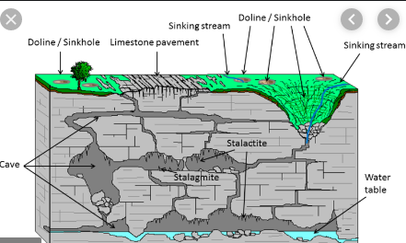
Geological landscape influences
The high points of Gower – Cefn Bryn and Rhossili Downs
Mewslade line of weakness
Karst sceneray (sinkholes and cave systems)
Glacial Valleys and boulder clay
Notes:
Geological Landscape influences
This coastal peninsula shows a close relationship between topography, the shape of the
coastline and geology. It reflects rock type and structure including folds and faults. The
exception is along the northern coast where depositional landforms of sand spits, sand
dunes and saltmarsh partly obscure the underlying geology.
The highest ground is formed by Rhossili Down and Llanmadoc Hill in the west, and the
prominent ridge of Cefn Bryn, trending WNW-ESE through the central area of the
peninsula. The summits of these hills are at c.180m. There are possible remnants of other
plateau surfaces at lower levels, but most of the landscape has been very heavily modified
and dissected by glacial and periglacial processes and rivers, and the whole area has also
been bevelled by the passage of ice. Along the south coast of the peninsula, the former
existence of a plateau surface at 60m can be easily discerned from numerous viewpoints.
These plateau surfaces are thought to represent marine erosion surfaces similar to, but
much more extensive than, the modern wave-cut platforms, that resulted from relatively
long periods of constant sea level, interspersed with periodic uplift. The marine planation
occurred towards the end of the Cretaceous Period (c.70 million years ago) when sea level
was globally high, and was followed by sea level fall and tectonic uplift of the land during
the Tertiary Period.
In order of decreasing age, the bedrock geology of Gower Peninsula comprises
conglomerates of the Old Red Sandstone (which form the highest ground) and typical
sequences of the Carboniferous Limestone, Millstone Grit and Coal Measures. The latter
two sequences are dominated by shales, but also include some resistant sandstones. In
the southern part of the peninsula these sequences are folded and subsequent erosion
has not only cut across the folds but also exploited the softer shales to form valleys and embayments. To the north of Cefn Bryn the rocks dip northwards and in the north-eastern part of the peninsula they can be followed in sequence, with resistant sandstone units standing out as south-facing escarpments with intervening boggy ground (e.g. Barland Common) developed on the shales.
In many places, particularly along the coast, lines of weakness have been exploited and
accentuated by marine erosion and now frequently form gullies in the foreshore and cliffs,
extending towards valleys in the coastal slope referred to locally as ‘slades’ (e.g.
Mewslade).
Another distinctive feature of the Gower topography is the karst scenery (sinkholes and
cave systems) developed on and in the limestone.
Karst is a topography formed from the dissolution of soluble rocks such as limestone, dolomite, and gypsum. It is characterized by underground drainage systems with sinkholes and caves.[1] It has also been documented for more weathering-resistant rocks, such as quartzite, given the right conditions.[2] Subterranean drainage may limit surface water, with few to no rivers or lakes. However, in regions where the dissolved bedrock is covered (perhaps by debris) or confined by one or more superimposed non-soluble rock strata, distinctive karst features may occur only at subsurface levels and can be totally missing above ground. Weathered limestone-surfaces are called karsts, and the hummocks and hollows which characterize them vary in size from a few inches to thousands of feet. Limestone platforms at Caswell created by sea weathering and limestone pavements in other places cut by glaciers mainly north east gower or bottom of Swansea valley.
In places (e.g. Llethrid and Bishopston
valleys) the collapse and subsequent erosion of cave passages have led to the
development of limestone gorges with some higher-level caves having been truncated
(e.g. at Cat Hole in the Llethrid Valley). These caves were once used as shelter by animals
including cave lion and bear. Bones of many different creatures and their prey are
preserved within the cave sediments and provide a good indication of climatic changes
during the ‘Ice Age’. The caves also show evidence of temporary human habitation.
Although climate during the Ice Age (c. 2.6 million to 11,500 years ago) was generally
colder than today, it was warmer for relatively short periods, causing higher sea level,
fragmentary evidence of which remains around much of the southern coastline in the form
of raised beach deposits.
During colder climatic conditions glaciers moved out of the higher ground to the north-east
of Gower along what are now the main river valleys. Ice from the Irish Sea area also
advanced over Pembrokeshire towards Gower and at times either butted up against the
western hills or even passed over the whole peninsula. This caused significant erosion and
modification of the topography, and as the ice melted torrents of water deepened the
valleys. The ice also deposited ‘boulder clay’ in many areas and locally there are sands
and gravels deposited by meltwaters. Arthur’s Stone on Cefn Bryn is an example of a
glacially transported rock. Although the ice sheets did not reach the southern part of the
peninsula during the most recent glaciation of south-west Wales, the intense cold created
frost-shattered scree under cliffs and crags. Solifluction, a process which occurs when soil
saturated with water from melting snow and subsurface ice flows downhill over frozen
ground, created the distinctive terraces of the southern and south-western coast (e.g.
between Port Eynon and Oxwich Head and perhaps most notably along the seaward
margins of Rhosili Down).

Slide 14
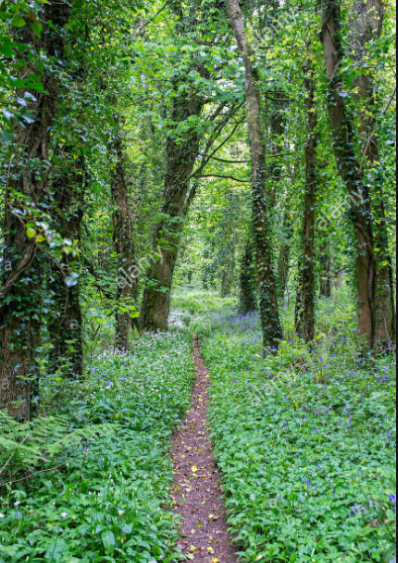
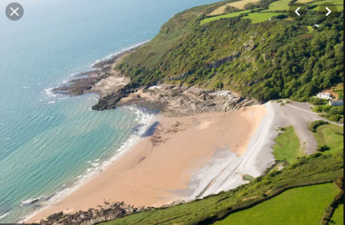
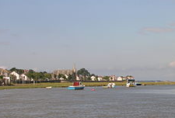
Landscape Habitats of Gower
Agriculture
SSSIs and common land
Deciduous woodland areas
Coastline
North Gower Mud flats & Marshes
Notes:
Landscape Habitats influences
Bullet one - Inland, soils broadly follow the underlying geology with generally fine and well drained
loamy soils with some seasonal waterlogging where they lie above shaley limestones, and
acidic soils over the bands of Millstone Grit. The peninsula supports a mixed agricultural
landscape, but with grazing concentrated in the less productive areas. The saltmarshes
and dune grasslands along the north coast are grazed by a variety of free-roaming
livestock, whereas inland the higher ridges and hills are of a heathy character and
common grazed by sheep, ponies and cattle. Elsewhere, the chequerboard pattern of
regular, medium to large-scale fields is used for cereal cropping, horticulture, dairying and
sheep rearing. The fields are mainly bounded by hawthorn hedgerows or hedgebanks,
fringed by often wildflower-rich grass verges along roads, which are of considerable
ecological value. The undulating land to the east of the Cefn Bryn ridge is characterised byswathes of mixed and broadleaved woodlands fringing streams and clothing gentle slopes.
Bullet two - Where Millstone Grit is present, there are blocks of mixed and coniferous plantations.
The areas of common land found across the southern half of the landscape include a
complex of SSSIs, falling within the Gower Commons SAC. Formed on the underlying,
poorly draining surface-water gley soils, they include Fairwood, Pengwern, Welshmoor and
Cefn Bryn Commons, which are important for a variety of habitats and species, including
wet and dry heath and molinia meadows, the latter habitat supporting the nationally
scarce soft-leaved sedge. The only South Wales populations of the southern damselfly
and marsh fritillary are found within the commons, with the SAC supporting the second
most important area for the southern damselfly in Wales.
Another for bullet twoAnother distinct and ecologically valuable feature which is also part of Cefn Bryn Common
but is distinct from the other areas is the dry heath and bracken habitats along the Cefn
Bryn Ridge, the habitat differing here due to the much more freely draining podsolic soils.
There is a similar, significant area of habitat present further west at Rhosilli Down, which is
also part of the Gower Commons SAC.
Bullet three - Deciduous woodland areas are more prevalent within the eastern half of the area, where
many fringe streams. The most significant woods are those at Nicholaston and others
surrounding Oxwich Bay, Bishopston and Parkmill, which form the Gower Ash Woods
SAC.
Bullet four The southern coast is dominated by steep limestone cliffs interspersed with sandy bays,
the most significant being Oxwich, which also has associated sand dunes and an
extensive reed-bed area just inland. Much of the southern coastline is within the Limestone
Coast of South West Wales SAC, which includes much of the generally agriculturally
unimproved, calcareous/coastal grassland that fringes the cliff tops.
Bullet five - The north coast falls within the Burry Inlet SAC, SPA, Ramsar site and SSSI, which is
characterised by extensive areas of mud-flat, salt-marsh and coastal grazing marsh,
supporting a wide range of species, notably wading bird and wildfowl populations.

Slide 15
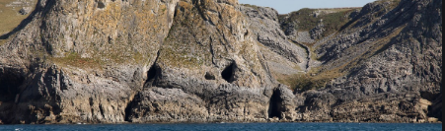
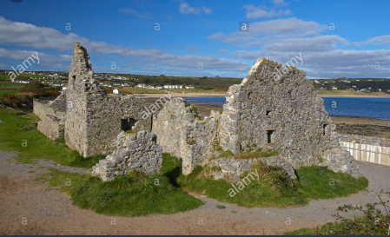
Historic Landscape influences
Palaeolithic caves
Port Eynon salt house
Iron age settlements at the Knave
Notes:
Archaeologically the Gower coast is particularly noted for its Upper Palaeolithic cave sites,
notably Longhole, Paviland and Deborah's Hole, which were occupied during warmer
intervals at the end of the last Ice Age (c. 38000 – 8000 years ago). Well-defined
remains of later, Iron Age settlements and forts occupy the headland at the Knave and
Thurba Head, where there are also good examples of recent limekilns. The recently
conserved salthouse at Port-Eynon, remains a unique example in Wales of a 16th century
coastal saltworks.

Slide 16
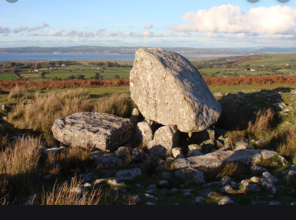
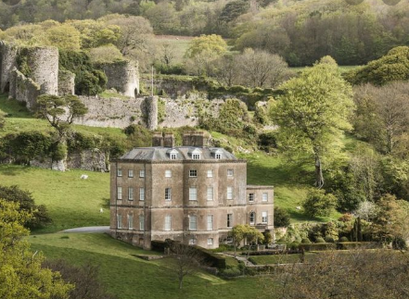
Historic Landscape influences
Cefn Bryn monuments of human activity
from 4th or 3rd millennium BC
Medieval period – Manorial system
Anglo-Norman influence
Industrialisation North Gower
Notes:
Bullet one and two Inland, the central ridge of Cefn Bryn is undoubtedly one of the richest archaeological
areas of South Wales, containing dense concentrations of monuments providing evidence
of human activity from at least the 4th or 3rd millennium BC, including a Neolithic tomb and
possible settlement and Bronze Age funerary and ritual monuments. In the Medieval
period, the imposition of the manorial system on Gower was an important influence on the
land use on the ridge, which fell within the ‘Welshry of the Lordship of Gower’. Generally,
that area had poorer soils and Cefn Bryn was manorial waste over which commoners
rights were established and exist to the present day.
Bullet three - Anglo-Norman influence is also apparent elsewhere in the landscape, with stone castles
such as Oystermouth, Penrice and Oxwich in the south and Bovehill and the fortified
manor of Weobley castle to the north, each occupying prominent locations with views
across Swansea Bay and the Burry estuary respectively. Settlements such as Llanmadoc
and Cheriton also reflect Anglo-Norman influences, while St Cadog Church at Cheriton is
acknowledged to be one of the most beautiful of the Gower churches. Of outstanding
importance from this period is the Penrice manorial estate, complete with ruined castle,
gentry house, home farm and historic park and garden, which have grown around Penrice
hamlet and survived without being broken up.
Bullet four - The C19th saw industrialisation of north Gower around Penclawdd and Crofty where coal
was extracted, and limestone quarrying from the cliffs stretching from Pwll Du to Rhossili
on the southern and eastern cliffs.

Slide 17
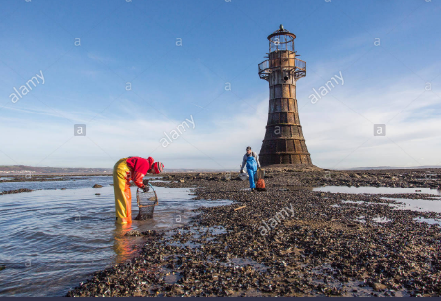
Cultural Landscape influences
Agriculture replaced by tourism over the last 50 years
Commuter settlements
Campsites
Surfing
Paragliding (Rhossili Downs)
Industry decline apart from Cockle
Gathering
Notes:
Bullets one and two - The cultural essence of Gower's landscape has changed radically over the past 50 years.
Agriculture, which has been the traditional mainstay, is gradually being replaced by tourism
and a residential population whose increasing presence is displacing long-held family
farms. Outside the boundary of, but close to the AONB area, many commuter housing
estates of undistinguished appearance have been permitted, their presence also shifting
the balance. However, today’s pattern of scattered nucleated settlements remains largely
True to their historic development, often centred on churches or castles in a compact form.
Bullets 3, 4 & 5 - The exceptionally picturesque beaches have attracted several very large static caravan
parks associated, particularly, with Horton and Port Eynon on the southern coast, and
Broughton Burrows in the north west. Seasonally, many farmers open their fields as camp
grounds. Two of those beaches – Three Cliff Bay and Rhossili Bay, coupled with the
intriguing topography of Worm’s Head, have become iconic images of the glories of
Gower. The southern and western coasts are a mecca for surfers, and Rhossili Down is
popular with hang-glider enthusiasts.
Bullet six - Industry, apart from agriculture, has also declined. Limestone quarrying ceased in the
C19th, while coal mining lingered on into the early part of the 20th century. However, the
abiding traditional cultural image associated with north Gower is the still-active cockle
gathering off Penclawdd in the Burry (Loughor) estuary.

Slide 18
Further reading
Brief Guide to Geological Britain - http://www.chm.bris.ac.uk/webprojects1997/SimonH/welcome.htm
Geological Guide to ages of UK - https://www.bgs.ac.uk/mendips/AncientEnv/Devonian.html

