Slide 1
Student name: Mary O Leigh
Student ID: 2327314
Module Name: Digital Transformation in the Health and Care Professions
Module Code: (BMHP6026)
Lecture Name: Muhammed Khan
Component 2 Assessment

Slide 2
Table of Contents
Use of AI Acknowledgement ……………………………………………….. 2
Table of Contents …………………………………………………………….. 3
Introduction …………………………………………………………………… 4
Impact on Workforce ………………………………………………………… 5
Impact on Service Delivery ………………………………………………… 6
Impact on Patients …………………………………………………………… 7
Impact on Community ………………………………………………………. 8
Challenges of the Innovation ………………………………………………. 9
Recommendations ……………………………………………………………10
Conclusion ……………………………………………………………………..11
References ……………………………………………………………………..12

Slide 3
Use of AI Acknowledgement
I hereby declare that no part of this assignment was generated, written, or assisted by any artificial intelligence tools, and that all work presented is entirely my own.

Slide 4
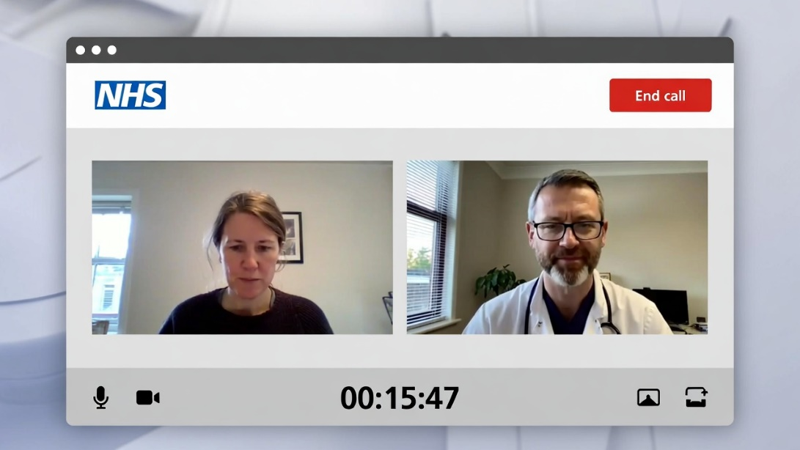
Introduction
Telemedicine refers to the use of digital platforms (video/phone) for providing healthcare remotely in the UK health/social care.
It was a major driver at COVID, 19 (2020 onward); now, it is an essential part of NHS hybrid models for routine, chronic, and mental health care (Jerjes et al., 2025).
Telemedicine has been a part of the UK/England healthcare system very well since the 2020 acceleration; only pre, pandemic trials were limited (Nuffield Trust, 2022).
Remote consultations are still significantly higher than before the pandemic (e.g., ~2734% of GP appointments after 2020); the telemedicine market is experiencing fast growth with the NHS digital push (Jerjes et al., 2025).

Slide 5

Impact on Workforce
Positive:
Flexible work hours, handling a higher number of cases, less time spent traveling contributed to better work, life balance and productivity even in the situation of staff shortages (Green et al., 2026; NHS England, 2023).
Negative:
It is necessary to acquire new digital skills (e.g. remote assessment, tech troubleshooting); and because of an informal way of learning, staff felt stressed and burned out (Chaloner et al., 2025; Jerjes et al., 2025).Role blurring:
Role Blurring:
Nurses and allied staff doing more diagnostics gaining more control/freedom but also increased exposure to liabilities (Gobburi, 2025).
Critique:
The difference in training quality; the divide between rural and urban areas keeps existing (Alashek et al., 2024).

Slide 6
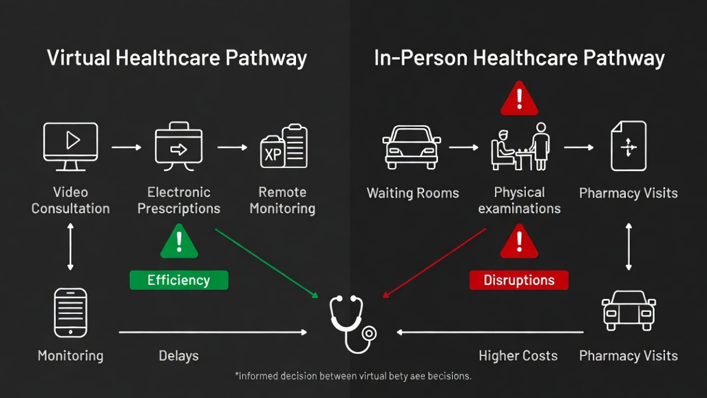
Impact on service delivery
Positive:
Increased speed of triage, higher capacity (consultations increased up to 30%) and clearing of backlog (Allcock et al., 2024; Shah et al., 2025). Working perfectly for chronic condition monitoring (Nuffield Trust, 2022).
Negative:
Risk of diagnostics due to the absence of the physical exams (e.g., conditions which are not spotted) (Jerjes et al., 2024).
Technology barriers:
Connectivity issues in rural areas disrupt the workflow (Gobburi, 2025).
Critique:
Predispositions towards tech users; the long, term expenses negate the savings (Campbell et al., 2023).

Slide 7

Impact on patients
Positive:
Convenience, autonomy in chronic/mental health; enhanced self, management and privacy (Campbell et al., 2023; Alashek et al., 2024).
Negative:
Lack of personalization, missing cues lead to less trust/rapport (Chaloner et al., 2025).
Disparities:
Younger/urban gain; elderly/low, literacy are left out; lower satisfaction in heavy, use situations (Jerjes et al., 2025; Ge et al., 2024).
Critique:
Increased anxiety (e.g., fear of misdiagnosis) (Hewitt et al., 2023).

Slide 8
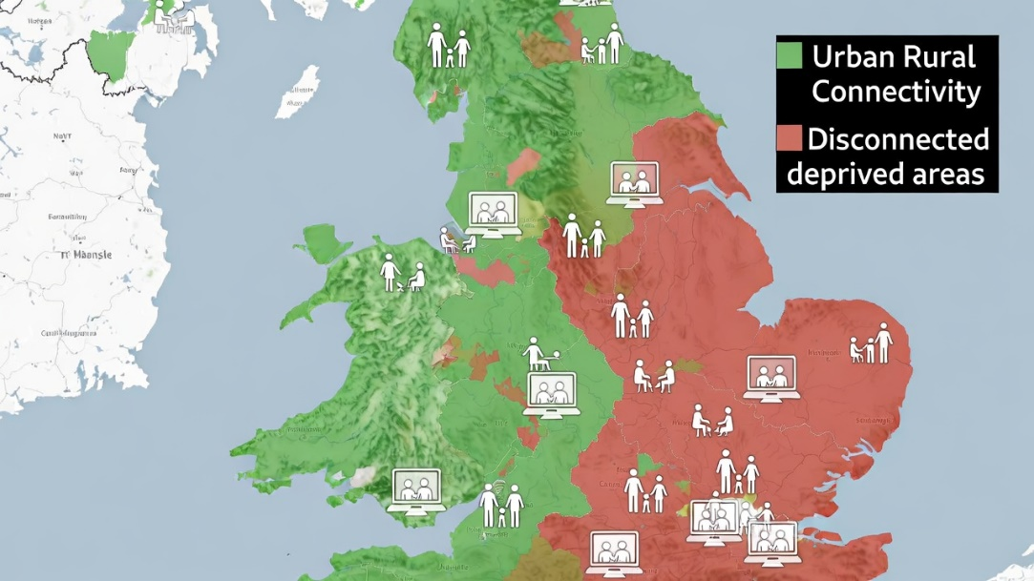
Impact on community
Positive:
Significantly decreases the need for travel of rural patients; makes it possible for family co, production; helps public health monitoring (Gobburi, 2025; Maita et al., 2024).
Negative:
Digital exclusion in deprived/ethnic/rural areas intensifies inequalities (Eddison et al., 2022). Family burden shift to potential isolation (Warmoth et al., 2023).
Critique:
social factors;~15% of rural are still left out (Shah et al., 2025; Allcock et al., 2024).

Slide 9

Challenges of the innovation
Diagnostic limitations without physical exams → higher misdiagnosis risk (Jerjes et al., 2024; DP Medical Law, 2025).
Digital exclusion/inequities: Poor connectivity, low literacy, device access barriers (Gobburi, 2025; Ko et al., 2025).
Privacy/security concerns; trust issues; technical glitches (Haleem et al., 2021 updated context; Painter et al., 2023).
Workforce strain and infrastructure costs; not fully cost-effective long-term (Campbell et al., 2023).
Critique:
Amplifies health inequalities if not addressed (Campbell et al., 2023).

Slide 10
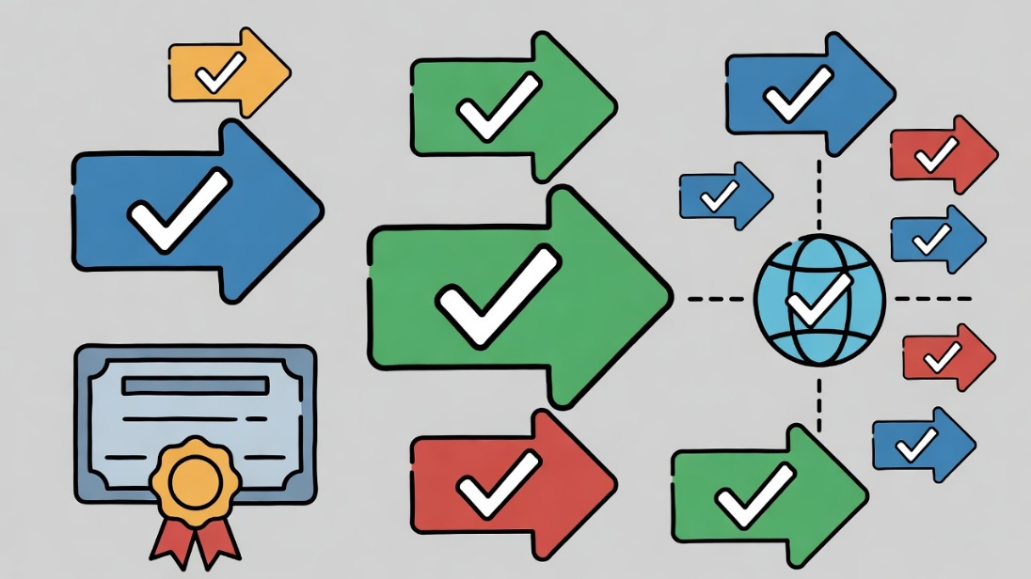
Recommendations
Equal access could be achieved through enlarging digital infrastructure (broadband subsidies) and providing literacy training for all (Gobburi, 2025).
It should be compulsory to have clinician upskilling and patient, centered virtual training (Jerjes et al., 2025).
Hybrid treatment models (virtual + face, to, face) should be encouraged especially for complicated cases (Campbell et al., 2023).
Disparities can be further reduced through monitoring and evaluation by data (NHS England, 2023)
Along with upholding the law, ensuring privacy and security of data for strengthening the trust of the public, the NHS must be financially supported to carry out the integration in a sustainable way (NHS England, 2023).

Slide 11

Conclusion
Telemedicine is growing fast in the UK NHS. It lets patients see doctors without traveling, great for remote areas. Care gets faster, backlogs shrink, and staff work smarter. Doctors manage more cases in less time, efficiency climbs. Patients feel more in control. They can check symptoms at their own pace.
But not every condition shows up clearly online. Physical exams matter, and they're missing now. Some clinicians struggle to keep roles clear. Stress builds when tasks blur into tech duties. Digital divides hurt older people, those with low education levels, poor income, or living far from cities. Privacy risks remain sharp too. Who really owns patient data? Long-term costs aren't proven yet; only short-term wins appear solid.
Fixing this means better training for both doctors and users. We need wider internet access and real support programs. Hybrid visits make sense for serious illnesses. Track outcomes carefully using data tools. Invest consistently and watch how things shift over years. This review ties tightly to what we learned about digital changes in health care..
.

Slide 12
References
Alashek, W.A. et al., 2024. Satisfaction with telemedicine use during COVID-19 pandemic in the UK: a systematic review. Libyan Journal of Medicine, 19(1), p.2301829. https://doi.org/10.1080/19932820.2024.2301829.
Allcock, J.A. et al., 2024. Landscape of digital technologies used in the National Health Service in England: content analysis. JMIR Formative Research, 8, e51859. https://doi.org/10.2196/51859.
Campbell, K. et al., 2023. The impact of virtual consultations on the quality of primary care: systematic review. Journal of Medical Internet Research, 25, e42091. https://doi.org/10.2196/42091.
Chaloner, C. et al., 2025. What is the impact of a shift to remote consultations? A qualitative interview study in primary and secondary healthcare. BMJ Open, 15(6), e097633. https://doi.org/10.1136/bmjopen-2024-097633.
Eddison, N. et al., 2022. The potential impact of allied health professional telehealth consultations on health inequities and the burden of treatment. International Journal for Equity in Health, 21(1), 91. https://doi.org/10.1186/s12939-022-01689-2.
Ge, X. et al., 2024. The use of online consultation systems and patient experience of primary care: cross-sectional analysis using the General Practice Patient Survey. Journal of Medical Internet Research, 26, e51272. https://doi.org/10.2196/51272.
Gobburi, R.K., 2025. Telemedicine use in rural areas of the United Kingdom to improve access to healthcare facilities: a review of current evidence. Telemedicine Reports, 6(1), pp.1-12. https://doi.org/10.1089/tmr.2025.0005.
Green, N. et al., 2026. The impact of telehealth videoconferencing on the healthcare work system: designing for sustained practice. Applied Ergonomics, 120, 104367. https://doi.org/10.1016/j.apergo.2025.104367.
Hewitt, R.M. et al., 2023. A UK online survey exploring patient perspectives of remote consultations for managing psoriasis and psoriatic arthritis during the SARS-CoV-2 pandemic. Psychology, Health & Medicine, 28(5), pp.1285-1294. https://doi.org/10.1080/13548506.2022.2104883.
Jerjes, W. et al., 2024. Telemedicine in the post-COVID era: balancing accessibility, equity, and sustainability in primary healthcare. Frontiers in Digital Health, 6, 1432871. https://doi.org/10.3389/fdgth.2024.1432871.
Jerjes, W. et al., 2025. Transforming GP training in the UK: the lasting impact of COVID-19 on telehealth and hybrid care models. Frontiers in Medicine, 12, 1595937. https://doi.org/10.3389/fmed.2025.1595937.
Ko, M. et al., 2025. Telehealth and people with disabilities in the United Kingdom: a scoping review. Disability and Health Journal. https://doi.org/10.1016/j.dhjo.2025.101XXX (updated scoping review on barriers; PMC11860869).
Maita, K.C. et al., 2024. The impact of digital health solutions on bridging the health care gap in rural areas: a scoping review. Journal of Medical Internet Research, 26, e50662. https://doi.org/10.2196/50662.
NHS England, 2023. NHS Long Term Workforce Plan. Available at: https://www.england.nhs.uk/publication/nhs-long-term-workforce-plan/ (Accessed: 22 February 2026).
Nuffield Trust, 2022. Digital health care across the UK: where are we now? Available at: https://www.nuffieldtrust.org.uk/resource/digital-health-care-across-the-uk-where-are-we-now (Accessed: 22 February 2026).
Shah, S.A. et al., 2025. Impact of COVID-19 pandemic on elective care backlog trends, recovery efforts, and capacity needs to address backlogs in Scotland (2013–2023). The Lancet Regional Health - Europe, 40, 100895. https://doi.org/10.1016/j.lanepe.2024.100895.
Warmoth, K. et al., 2023. Using online consultations to facilitate health and social care delivery during COVID-19: an interview study of care home staff. Journal of Long-Term Care, pp.102-111. https://doi.org/10.31389/jltc.184.

