Slide 1
Student Name: Roshane Gordon
Student ID: 2505631
Lecturer’s Name: XXXX
Module Code: LCLM 4004
Module Name: Problem Solving and Decision-Making
Component 1: Basil’s Bakery

Slide 2
Introduction
Good morning, everyone my name is Roshane Gordon and today I will be presenting to you an overview of Basil’s Bakery and the types of issues they face, a critique and application of the PESTEL framework (providing you with good information). I will also present a critique and application of the Cause-And-Effect model. Lastly will be providing a summary of the key findings of Basil’s Bakery.

Slide 3

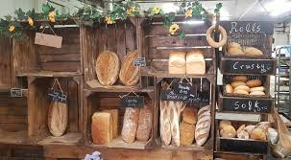
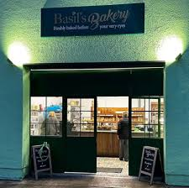
Basil’s Bakery is a small bakery owned by Basil and is located, in a shopping retail park. The bakery was established in 2015 and is well known for selling pastries, cakes and bread made from high-quality organic ingredients.
Problems.
Unfortunately, there are some problems at Basil’s Bakery which caused the bakery to have a footfall and a significant decrease towards sale.
These are:
Organic resources
No delivery sources
Some loyal customers lost their jobs
Fewer people visit the retail the retail park

Slide 4


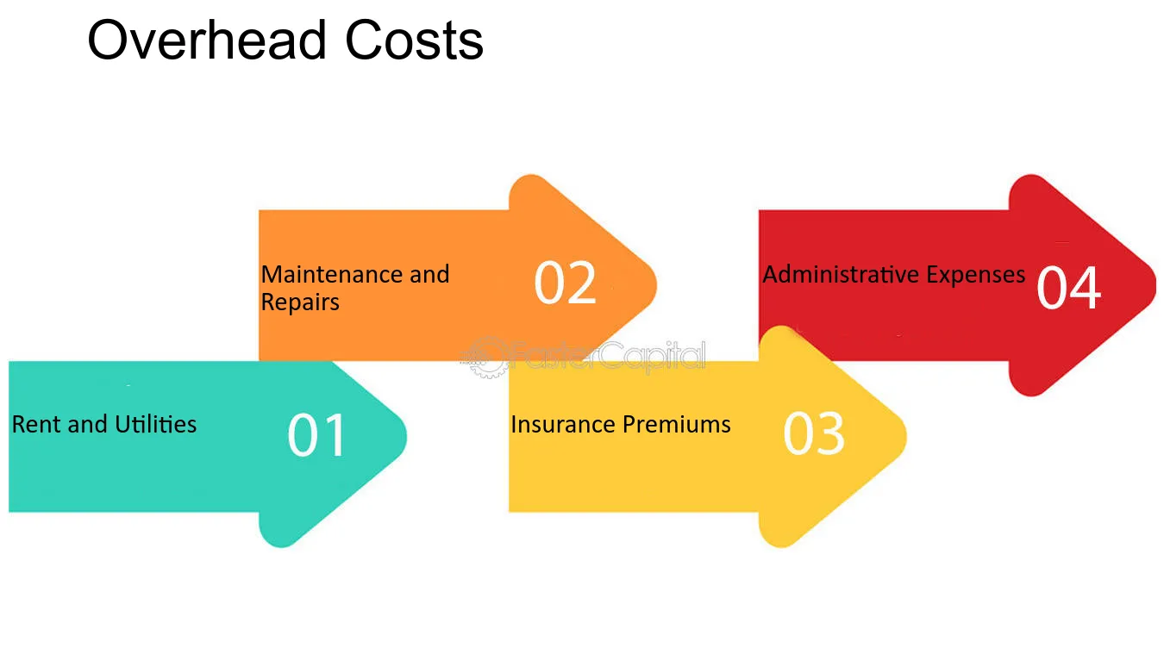



Problems Basil’s Bakery are facing
No online ordering or delivery systems in place.
Customers want greater convenience, such as delivery and pre-order services.
Organic ingredient prices are unpredictable due to crop failure.
Rising utility bills, rent, insurances, and overhead cost.
Limited technology for handling pre-orders efficiently.
More office workers now work from home.

Slide 5
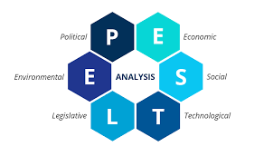
PESTEL Analysis
The benefits of the PESTEL Analysis is that it creates an opportunity for businesses to catch mistakes early allowing them to improve or fix it before it proceeds to get worse. (oxford college of Marketing, 2024)
PESTEL stands for:
Political
Economical
Social
Technological
Environmental
Legal
The criticism of the PESTEL framework is that it only focuses on the the broad problems of a business instead of the internal operations (referring to the small things that happen behind the scenes. (CIPD 2024)
The PESTEL Analysis is a strategic tool used in businesses to evaluate or find out the different factors that could impact an organization. (Johnson, Scholes and Wittington, 2017)

Slide 6
PESTEL Framework of Basil’s Bakery
Here is the tabular PESTLE analysis of Olive Tree Bistro.
Political Factors | Economic Factors | Social Factors | Technological Factors | Legal Factors | Environmental Factors
Increased business rates affecting operating cost Government COVID-19 restrictions previously reduced footfall and sales | Rising utility bills, rent, insurances, and overhead cost Organic ingredient prices are unpredictable due to crop failure | Customers want greater convenience, such as delivery and pre-order services More office workers now work from home | Limited technology for handling pre-orders efficiently No online ordering or delivery systems in place | Compliance with food hygiene and health & safety relegation Employment law affecting staffing and work-places | consumers increasingly prefer environmentally sustainable products Dependence on organically grown produce vulnerable to crop failure

Slide 7
Critique of the Cause-and-Effect model
The Fishbone Diagram is applied in such areas as quality management, manufacturing, medicine, and business for solving problems, wherein all the factors that cause the problem are grouped into categories such as methods, machines, people, materials, measurements, and environment (6Ms). At Basil’s Bakery, the Fishbone Diagram was applied to study the problem of stagnant sales.
Its main function is the determination of the underlying reasons behind the occurrence of a problem without simply treating the symptoms but also by promoting systematic thinking and a careful examination of the problem.
Strengths associated with this framework include visualization of the problem at hand, cooperation and group discussions, recognizing several causes, and root cause analysis.
However, there are some limitations as well. Some of them are as follows: it cannot differentiate between different causes in order of importance; it is influenced by the ideas and perceptions of the individuals involved; no solutions are provided; and the diagram may become too crowded.
The cause-and-effect model also known as the fishbone model, is one that was invented by Kaoru Ishikawa in 1968. This diagram serves the purpose of identifying the causes or factors related to the issue in question.

Slide 8
The Fishbone Method
Methods
Machines
People
Despite customer demand, there are no delivery service offered.
Lack of equipment/technology to support online ordering and delivering.
Fewer shoppers visiting the retail park.
Pre-ordering system are not reliable as the shop cannot always answer the phone.
Redundancies among local retail workers (loss of loyal customers).
Limited systems to deal with customer orders efficiently.
The viability of Basil’s Bakery due to the sales remaining 25% below 2019 levels
Organic ingredients are more expensive
Sales have stopped at around 25% below 2019 levels since 2023
The retail park is quieter than before.
Crop failure makes prices unpredictable
Reduced footfall compared with pandemic levels.
Shops are closing and remaining units are vacant.
Materials
Measurement
Environment

Slide 9
MY Key Findings
Key Finding 1:
My first key finding was that Basil’s sales figures, have consistently been about 25% lower than in 2019 since there have been fewer visitors to the retail park. This Is because of the closure of shops and more staff working from home.
Key Finding 3:
My third key finding was that many problems faced by Basil are beyond his control. Some of them include increased electricity charges, business rate charges, increased insurance premiums, and altered consumer behaviour due to the coronavirus pandemic.
Key Finding 2:
My second key finding was that no delivery services are provided by the bakery, and the ordering process is inefficient since Basil does not always have time to answer the calls. It becomes more difficult to satisfy customers' demands, which leads to sales losses.
Key Finding 4:
My last key finding was that considering the reduction in sales and escalating costs, Basil fears that it will not make financial sense for him to continue operating in the same manner. Meaning if he does not change his operations, his bakery’s survival in the long term is not looking good.

Slide 10
Reference List:
Slide 5:
American Society for Quality (ASQ) (2024) Fishbone Diagram (Cause-and-Effect Diagram). Available at: https://asq.org/quality-resources/fishbone (Accessed: 13 June 2025).
Mind Tools (2024) Cause and Effect Analysis: Identifying the Likely Causes of Problems. Available at: https://www.mindtools.com/a3mi00v/cause-and-effect-analysis (Accessed: 13 June 2025).
Slide 6:
Department for Environment, Food & Rural Affairs (DEFRA) (2024) UK Food Security Report 2024. London: DEFRA. Available at: https://www.gov.uk/government/publications/uk-food-security-report-2024
Office for National Statistics (ONS) (2024) Homeworking in the UK. Available at: https://www.ons.gov.uk/employmentandlabourmarket/peopleinwork/employmentandemployeetypes
Food Standards Agency (FSA) (2024) Food hygiene for businesses. Available at: https://www.food.gov.uk/business-guidance
GOV.UK (2024) Business rates guidance. Available at: https://www.gov.uk/introduction-to-business-rates
Chartered Institute of Personnel and Development (CIPD) (2024) Flexible and hybrid working practices. Available at: https://www.cipd.org/uk/knowledge/factsheets/flexible-working-factsheet/
Slide 7:
Johnson, G., Scholes, K. and Whittington, R. (2017) Exploring Strategy. 11th ed. Harlow: Pearson Education.
Oxford College of Marketing (2024) PESTEL Analysis Explained. Available at: https://blog.oxfordcollegeofmarketing.com/2016/06/30/pestel-analysis/ (Accessed: 13 June 2025).
CIPD (2024) External Factors Affecting Organisations. Available at: https://www.cipd.org/uk/knowledge/factsheets/business-environment-factsheet/ (Accessed: 13 June 2025).

Slide 11

Thank you for listening

Slide 12


