Slide 1
Strategic Models

Slide 2
THE USES AND
VALUE OF STRATEGY
RECAP
Assists in the formulation of goals & objectives
A form of management control- operations level (budgets and targets)
Assists in the process of allocating resources
Identification of key strategic issues in the future
Integrating power of strategy ‘corporate culture’

Slide 3
Strategy and success
Hofer and Schendel 1978 found that the introduction of strategic planning caused organisations to become more successful
Greenley 1990 found very few links between strategy and improved organisational performance
It is difficult to measure the overall success of the strategy to an organisation because of so many variables that the organisation cannot control
You can however, measure parts of the strategy more effectively (Strategic Business units, Staff Development etc)

Slide 4
Three Models of Strategy
Simple and Static
These types of organisations exits in environments that hardly change.
They base their strategies on historical information from sales/usage data.
Even in this environment however changes can take place e.g. a change in legislation, resources becoming scarce

Slide 5
Dynamic
This environment changes quickly and frequently
Managers need to be visionary and sense what is going to occur.
Failure of organisations in this type of environment come from management who do not read the signs
A weakness here however, is that some organisations are always looking for change in the environment and react when they need to stand still.

Slide 6
Complex
In this organisation different demands are placed on different aspects of the firm
A firm producing different products for different markets would experience a complex environment
Organisational structures would reflect this complexity
Dynamic and complex organisations face interconnected problems
Managers will try to reduce uncertainty within the firm by:
Collecting information and influencing and controlling the environment

Slide 7
Core Competences-Used to influence Strategy
Hamel and Prahalad(1990) and Kay(1993) are three recognised researchers in the area of core competences
Core competences are the activities that give the organisation a competitive edge
This could be good quality of a particular produce, excellent customer service, a specialist within a market
Core competence sees the organisation give added value to the customer in cost,differentiation,innovation.
This is achieved through knowledge,skills and technology integration

Slide 8
Kay (1993) identified three areas of core competence:
Architecture- built around relationships both internal and external e.g. customers. A key here is information exchange.
Reputation- quality goods and services, dependability/speed
Innovation- new products/processes to gain competitive advantage

Slide 9
Companies can focus around their core competences rather than the market and link their resource allocation to these
Core competences need to be different from your competitor and difficult to copy. (Remember Grant’s Resource Based View of the Firm from Knowledge Management.

Slide 10
PORTFOLIO ANALYSIS
This tends to be used by organisations operating in different businesses and markets or in the same market but with different products.
Enables managers to assess the attractiveness of particular products and help with investment decisions
Model BCG(Boston Group Matrix)
Stars/Dogs/Question Marks/Cash Cows

Slide 11
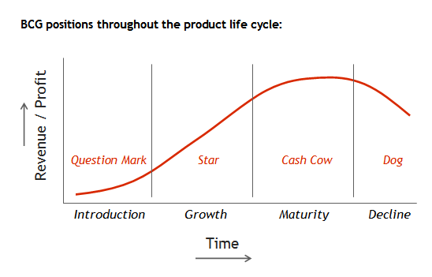
The BCG Matrix Method
(The Boston Consultantancy Group)

Slide 12
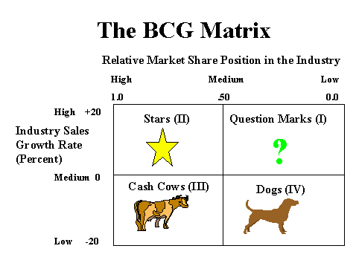
The BCG Matrix Method Stern & Stalk(1978)
Notes:
he Boston Consulting group's product portfolio matrix (BCG matrix) is designed to help with long-term strategic planning, to help a business consider growth opportunities by reviewing its portfolio of products to decide where to invest, to discontinue or develop products. It's also known as the Growth/Share Matrix.
It provides a high-level way to see the opportunities for each product in your portfolio. It enables you to think about how to allocate your limited resources to the portfolio so that profit is maximized over the long-term. It shows if your portfolio is balanced.

Slide 13
The BCG Matrix Method Stern & Stalk(1978)
Perspectives on Strategy
Stars (high growth, high market share)
    use large amounts of cash and are leaders in the business so they should also generate large amounts of cash
    frequently roughly in balance on net cash flow. However if needed any attempt should be made to hold share, because the rewards will be a cash cow if market share is kept
Cash Cows (low growth, high market share)
    profits and cash generation should be high , and because of the low growth, investments needed should be low. Keep profits high
    Foundation of a company
Notes:
Stars
High Growth, High Market Share
Star units are leaders in the category. Products located in this quadrant are attractive as they are located in a robust category and these products are highly competitive in the category
Question Marks
High Growth, Low Market Share
Like the name suggests, the future potential of these products is doubtful. Since the growth rate is high here, with the right strategies and investments, they can become Cash cows and ultimately Stars. But they have low market share so wrong investments can downgrade them to Dogs even after lots of investment.
Cash Cows
Low Growth, High Market Share
These products or services generate interesting profits and cash but need to be replaced because the future growth will be lower. If they are profitable, they can finance other activities in progress (including stars and question marks).
Dogs
Low Growth, Low Market Share
Dogs hold low market share compared to competitors. Neither do they generate cash nor do they require huge cash. In general, they are not worth investing in because they generate low or negative cash returns and may require large sums of money to support. Due to low market share, these products face cost disadvantages

Slide 14
Dogs (low growth, low market share)
    avoid and minimize the number of dogs in a company
    beware of expensive ‘turn around plans’
    deliver cash, otherwise liquidate
Question Marks (high growth, low market share) – Sometimes called ‘Problem Child’
    have the worst cash characteristics of all, because high demands and low returns due to low market share
    if nothing is done to change the market share, question marks will simply absorb great amounts of cash and later, as the growth stops, a dog.
    either invest heavily or sell off or invest nothing and generate whatever cash it can. Increase market share or deliver cash
    Will it be a Star or a Dog?

Slide 15
    If nothing is done to change the market share, question marks will simply absorb great amounts of cash and later, as the growth stops, a dog.
    Either invest heavily or sell off or invest nothing and generate whatever cash it can. Increase market share or deliver cash
    Will it be a Star or a Dog?

Slide 16
The BCG Matrix Example
The BCG Matrix method can help understand a frequently made strategy mistake: having a one-size-fits-all-approach to strategy, such as a generic growth target (9 percent per year) or a generic return on capital of say 9.5% for an entire corporation.
In such a scenario:
Cash Cows Business Units will beat their profit target easily; their management have an easy job and are often praised anyhow. Even worse, they are often allowed to reinvest substantial cash amounts in their businesses which are mature and not growing anymore.
Dogs Business Units fight an impossible battle and, even worse, investments are made now and then in hopeless attempts to 'turn the business around'.
As a result (all) Question Marks and Stars Business Units get mediocre size investment funds. In this way they are unable to ever become cash cows.

Slide 17
Activity
Using the BCG matrix identify products / service from an organisation you are familiar with - Place them in each area of the matrix and explain why they have been placed there.

Slide 18
A perfect example to demonstrate BCG matrix could be the BCG matrix of Pepsico. The company has perfected its product mix over the years according to what’s working and what’s not.
Here are the four quadrants of Pepsico’s growth-share matrix:
Cash Cows – With a market share of 58.8% in the US, Frito Lay is the biggest cash cow for Pepsico.
Stars – Even though Pepsi’s share in the market has been reduced to 8.4%, it’s still the star for Pepsico because of its brand equity. Other stars are Aquafina (biggest selling mineral water brand in the USA), Tropicana, Gatorade, and Mountain Dew.
Question Marks – Since it’s a mystery whether the diet food and soda industry will boom in the future and will Pepsico’s products will find their place or not, Diet Pepsi, Pepsi Max, Quaker, etc. fall in the question marks section of the Pepsico’s BCG matrix.
Dogs – As of now, there isn’t any product line that falls in the dogs section of the Pepsico’s BCG matrix. However, seasonal and experimental products like Pepsi Real Sugar, Mtn Merry Mash-up can be inserted in this section.

Slide 19
STAKEHOLDERS
“Individuals and/or groups who are affected by or affect the performance of the organisation in which they have an interest”
(Worthington & Britton 2003)

Slide 20
LEVEL OF INTEREST
POWER
Exhibit 5.5 Stakeholder mapping: the power/interest matrix
Source: Adapted from A. Mendelow, Proceedings of the Second International Conference on Information Systems, Cambridge, MA, 1991
Notes:
The power/interest grid is a matrix used for categorising stakeholders during a change project to allow them to be effectively managed. Stakeholders are plotted on the grid in relation to the power and interest they have in respect of the project. The grid categorises stakeholders into the following four groups:
High power/high interest
High power/low interest
Low power/high interest
Low power/low interest

Slide 21
Case Study Tasks
Who are the stakeholders of Primark and Amazon
Place each of your stakeholders in the appropriate cell in the power / interest matrix.
Explain why you have placed them in this section.

