Slide 1

Forensic Psychology and the Criminal Mind
What is Crime?

Slide 2

Aims of the Module:
To enable students to critically appraise the complex biological, environmental and psychological factors which impact upon criminality, judicial and rehabilitative processes, and the investigation of crime.

Slide 3
Learning outcomes:
Critically consider how psychological knowledge and research has informed our understanding of the causes and consequences of criminality;
Critically appraise the role of psychology in informing judicial processes;
Critically apply evidence- based practice in an attempt to identify and respond effectively to a range of criminal populations;
Take responsibility for their own learning and skill development; including effective personal planning, self-reflection and project management skills.

Slide 4
Things to consider:
What behaviours can be considered a crime?
Violence against a person /animal – ever justified?
Why are sports such as boxing not considered as criminal acts?
Sexual offences?
What do you think about capital punishment?
And the death penalty?

Slide 5
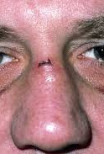
Are these behaviours ever appropriate?
Spraying C.S. Gas into someone's face
Setting fire to a drink or food substance
Breaking someone`s nose
Exceeding the speed limit
Carrying a gun
Cannibalism

Slide 6

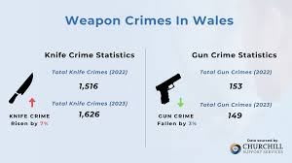
Today`s session:
The definition and measurement of crime
Official Crime Statistics
The Social Context of Crime
Victims of Crime
Modern Criminology

Slide 7
A definition:
“Crimes...are acts attracting legal punishment. [They] are offences against the community”
Blackburn (1993; p. 5)
Crimes have consequences that may range from trivial to highly injurious.
They also:
Are socially disapproved of,
Involve the violation of moral rules.
However, Blackburn notes exceptions to these conditions

Slide 8

What about?
What about...
Using work stationery for personal use?
Exceeding the speed limit?
Possessing marijuana?
Consensual sex between 15-year-olds?

Slide 9
Various Definitions – what do you think?
The Oxford English Dictionary defines crime simply as:
The Oxford Dictionary of Law defines crime as being:
The Oxford Dictionary of Sociology defines crime in a more complex way:
‘An action or omission which constitutes an offence and is punishable by law’.
“An act (or sometimes a failure to act) that is deemed by statute or by the common law to be a public wrong and is therefore punishable by the state in criminal proceedings.”
‘An offence which goes beyond the personal and into the public sphere, breaking prohibitory rules or laws, to which legitimate punishments or sanctions are attached, and which requires the intervention of a public authority.’

Slide 10
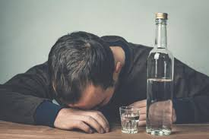
“The core of criminal law is the same, but the border moves” (Feldman, 1993; p4).
Sexual conduct
Drugs and alcohol
Religious conduct
Criminal law in these areas varies greatly over time and between different places.
Are there any acts that everyone can agree are deserving of legal punishment?

Slide 11
Moving borders:
Most societies condemn murder, rape and theft, however, whilst these are considered crimes pretty much everywhere, the definition of many acts as criminal depends on which societies you look at, and when.
Feldman’s ‘moving borders’ might include laws about sexual conduct, drug and alcohol use and religious conduct.
  E.g. UK laws have previously prohibited adultery and consensual sex between men, both of which are now legal (1967) in the UK but not necessarily elsewhere.
  In the US, prohibition banned alcohol between 1919 and 1933 but not before or after, just as in many countries' alcohol is still illegal.
  Now, in England, Scotland and Wales, same-sex marriages are permissible and legal.

Slide 12
Actus Reus and Mens Rea:
The prevailing Western legal view is that a crime involves:
Actus Reus – a voluntary act (the guilty action)
Mens Rea – an intention to commit the act (the state of mind)
  Does this distinguish between crimes and non-crimes?
  In this view, acts that are not chosen by the individual are not crimes.
  E.g. an injury caused by a person who was having an epileptic fit satisfies neither the mens rea nor the actus reus criterion.

Slide 13
Actus Reus and Mens Rea:
The prevailing Western legal view is that a crime involves:
Actus Reus – a voluntary act (the guilty action).
Mens Rea – an intention to commit the act (the state of mind).
  A person who acts under compulsion (e.g. a bank manager who opens the bank vault to a gang who are holding close relatives' hostage and threatening to kill them).
  Does this example satisfy the actus reus criterion?

Slide 14
British Law:
However, in reality, the legal picture is more complicated.
A general principle of British law is that ‘ignorance of the law is no excuse.`
Second, there are some ‘strict liability’ offences where a person’s intentions are considered irrelevant to their guilt (i.e. to have carried out the act is enough).
E.g. In UK law a man who has sexual intercourse with a girl under 13 years is guilty of rape regardless of what he believed her age to be.

Slide 15
One example:
Leslie Gadsby killed his father in February 2004, and his mother in March 2010. Following the death of his father he was held at medium-security unit.
He was conditionally discharged in 2006 following a Mental Health Review Tribunal and moved to supported housing.
Conditions of his release were that he must not go within 200 metres of his mother's house, though they regularly met for lunch with his key workers.
His mental health continued to deteriorate, and he finally killed his mother, stabbing her five times.
He was jailed in 2011 after admitting Mrs Gadsby's manslaughter with diminished responsibility and was detained for life at a high security Hospital.

Slide 16
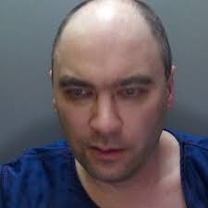
Legally relevant
Then, there is the issue of establishing mens rea where it is legally relevant.
This is difficult in cases where it is claimed that a person could not have prevented themselves from acting in violation the law (e.g. through mental illness).
E.g. Leslie Gadsby

Slide 17
Leslie Gadsby
Liverpool Coroner Andre Rebello recorded a verdict of unlawful killing on Edna Gadsby, 70, who was stabbed by her son Leslie, 39, in March 2010.
Gadsby, who had paranoid schizophrenia, spent more than two years in a secure unit after killing his father, Arthur, with a hammer in 2004.
On release, he had been ordered not to go within 200m of his mother's house.
At first Mrs Gadsby did not visit her son after he killed his father.
But, gradually that changed and she saw him regularly on his release from a secure hospital, in 2006.
Gadsby was conditionally discharged from the Scott Clinic secure hospital in 2006 because medication had stabilised his mental condition - a decision supported by his medical team.
The court heard the conditions of his release took into account the potential risk he posed to his mother, with the court orders preventing him from going near her home in Gateacre.
The inquest heard in the week before killing his mother, Gadbsy gave away money and possessions - a sign with hindsight he was nearing another psychotic episode.
Gadsby was sentenced to a life term in a secure psychiatric hospital in March 2011, after admitting his mother's manslaughter.

Slide 18
Leslie Gadsby
This example illustrates the problem of criminal responsibility, which is one of several areas where the fields of legal and psychological knowledge may come into conflict.
Usually, insanity claims fall under automatism or diminished responsibility.
Under British law, the McNaughten rule, which governs the use of a plea of insanity, a person may be found not guilty of a crime by reason of insanity, if at the time they suffered from a ‘disease of the mind’ such that they either did not know what they were doing, or did not know it was against the law.

Slide 19
More Recently:
The Lindsay Clancy Case:
Examining Postpartum Psychosis
In January of 2023, Lindsay Clancy, a wife, mother, and labour and delivery nurse, was accused of murdering her three children by strangulation and attempting to kill herself by jumping off her second-story balcony, leaving her paralysed from the waist down.
Her ex-husband Patrick, colleagues, friends, and family said that Lindsay was a dedicated mother who was extremely loving with her children.
Sometime in 2022, Lindsay began showing signs of mental deterioration in the months before the killings.
Patrick testified that his ex-wife was struggling and began telling him that she was experiencing symptoms of extreme anxiety and depression. Two months before the murders, Lindsay told him she was feeling suicidal and expressed thoughts of hurting the kids.
A chaplain who met her following the killings reported that Lindsey heard a male voice telling her that if she didn't act, neither she nor her children would be safe.
Her mother and sister testified that in the months leading up to the incident, she had become increasingly paranoid, with insomnia and suicidal thoughts.
They claimed that she became afraid to sleep alone and believed the numerous medications prescribed were worsening her mental health.
Lindsay checked herself into Women & Infants Hospital of Rhode Island for treatment in December 2022 due to suicidal ideation, but she was released the same day.
She also attempted admission at another hospital but was rejected again. In total 6 GP`s, 14 medications.

Slide 20
6-week Trial:
(2026)
Expert Evidence –
The defence called two experts:
Forensic psychologist Dr. Paul Zeizel interviewed her 45 times, from 11 days after the killings.
He diagnosed Ms. Clancy with postpartum psychosis and bipolar II disorder
Defence forensic psychiatrist Dr. Phillip Resnick, an expert on maternal filicide, examined Ms. Clancy four months after the killings for three hours.
He diagnosed severe depression, bipolar II disorder, suicidal intent, and postpartum psychosis
Expert Evidence –
The prosecution called three rebuttal experts:
Psychologist Dr. Kirk Heilbrun and psychiatrist Dr. Avram Mack, interviewed the defendant together and apart for about 13 hours over three days, three years after the killings.
Dr. Heilbrun concluded that Ms. Clancy was suicidal and did not want to leave her children behind. Dr. Avram Mack opined that Ms. Clancy suffered major depression, but not postpartum psychosis.
Psychiatrist Dr. Gregory Saathoff, opined that Ms. Clancy was purposeful in her suicide plan, evidenced by a normal conversation with her husband before the killings.

Slide 21
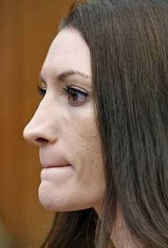
What do you think?
11 of 12 jurors found Ms. Clancy to be insane. The one holdout, expressed the belief that he had reasonable doubt about Ms. Clancy’s criminal responsibility, but refused to acquit.
In Massachusetts, the burden of proof is on the prosecution to prove beyond a reasonable doubt that the defendant was criminally responsible, i.e., sane, which is why the jury foreperson complained to the Judge that the juror was refusing to follow the law. The judge disagreed.

Slide 22
However:
For many Psychologists these criteria ‘set the bar too high’ and impute criminal responsibility to people who should not be held responsible.
In recognition of this, there is `diminished responsibility` which reduces the crime of murder to manslaughter if a defendant can show that their mental capacity was ‘substantially impaired’ when they carried out the crime.
(NB. they are still guilty, only to a lesser extent).
A fundamental area of conflict between legal and psychological understandings of crime arises from the fact that the legal view of human behaviour is predicated on the idea that people choose how they act and their choices are the causes of their actions.

Slide 23
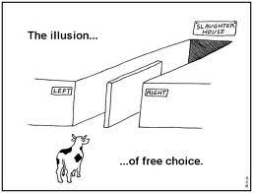
The issue:
There is, therefore, an explicit endorsement of the idea of free will in the legal view of crime.
However, most Psychologists take a deterministic view of behaviour where every action has a cause, and each cause has causes of its own.
Since the chains of causation that determine a person’s actions ultimately extend outside the person it could be argued that no-one actually chooses how they act, which undermines the legal conception of criminal responsibility.

Slide 24
What can we agree upon?
What we can agree upon, is that crime violates the law of a particular society at a particular time.
Beyond that, ‘crime’ is a social construction – it means different things to different people in different societies and at different times.
Crime is not a natural category of behaviour.
This leaves open the question of what it is that Forensic Psychologists should study.
There are two choices –
1. A legal definition
But, this is unsatisfactory because Psychology must study natural phenomena; the law, changing as it does, does not fit this criteria easily.

Slide 25

What can we agree upon?
Or 2. B. Adopt a broader definition of crime, to include harmful and antisocial behaviour which may fall outside the legal definition of crime.
Blackburn (1993) suggests the conscious breaking of rules. People who understand that an act they are contemplating is a crime, know that it attracts punishment, yet carry it out anyway.
Looked at this way, Forensic Psychology encompasses not only law-breaking but other types of rule breaking and acts, such as aggression in children.

Slide 26
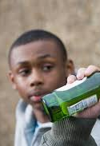
Conclusions:
Some basic conclusions:
A crime is an act that violates the criminal law of a particular society at a particular time.
‘Crime’ is not a natural or homogenous category of behaviour.
So Forensic Psychologists study-
Crime as legally defined, and
Harmful antisocial behaviour (‘criminal’ or not).
We will be considering the insanity defence in more detail later on…

Slide 27
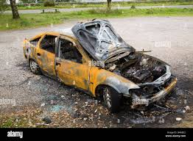
Knowledge and meaning:
“one common feature is the knowledge of the lawbreaker that it attracts legal punishment [...]
rule breaking is a meaningful [...] focus for criminological psychology.”
Blackburn (1993; p.17)

Slide 28
Moderating and mediating factors:
What issues arise in defining crime?
Moderating and mediating factors…
Age = moderator
SES = mediator.
A moderator is something that acts upon a variable and changes its direction or strength.
Age can moderate the likelihood of an individual committing a crime. As you get older your propensity to crime is reduced…
A mediator is a go-between for two variables. It explains the process through which two variables are related.
SES can affect the relationship between Employment and Criminality

Slide 29
Usually:
Age
Crime
SES
Unemployment
Crime

Slide 30

Where does Forensic Psychology originate from?
The term literally translates `Psychology in the context of Law`
Forensic Psychology took off in the 1980`s but its history goes back centuries to when `diminished responsibility` and fitness for trial were introduced into the legal system.
Diminished responsibility 16th century
Expert witness 17th century
Mental illness and crime 18th century
Criminology 18th century
First official crime statistics: France (1827)

Slide 31

Early concepts of criminality:
One of the earliest concepts in relation to Forensic Psychology was KLEPTOMANIA (1816) which refers to `stealing insanity`.
Characterised by impulses to steal negligible value goods, not out of economic necessity, accompanied by elation or a sense of relief – often affecting women.
Some argued it was a form of repressed sexual desire or a form of penis envy, stealing phallic symbols.
It still exists in DSM(5)TR

Slide 32
Early concepts of crime:
Crime is not seen in isolation.
It is affected by many factors. For example:
Media Representation.
The different interpretations of crime statistics.
Crime research suggests that nearly half of men admit to committing at least one offence, and a third of women.
International comparisons of crime demonstrate variations across the world.
The variety of criminal justice systems worldwide show how the principles of crime are not universally applicable.

Slide 33
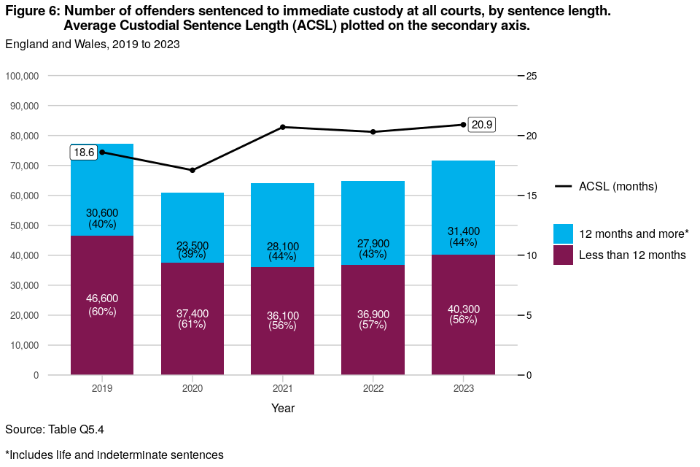
Question:
In which ways might the true extent of crime be distorted by looking at:
The numbers of people convicted of various types of offence?
The numbers of people imprisoned for various types of offence?

Slide 34
Crime Statistics:
Working out how much crime takes place is not easy.
Attempts to measure crime give a misleading picture of how much there is.
Different ways of measuring offending biases the measurement in various ways.
This does not mean that crime statistics are useless, but it does mean that no single measure can be relied upon to tell ‘the whole truth’ about the extent of crime.
Where does the information come from?
Official statistics
Crimes reported to the police
Court & prison statistics
General population surveys
Victimisation surveys
Offender surveys
  Problems?
  How and why?

Slide 35
Problems:
An obvious source of information on the extent of crime is the police.
The police compile records of the crimes that come to their attention, divided into types:
  Violence against the person,
  Sexual crimes,
  Burglary,
  Vehicle crimes etc.
These give an indication of whether crime is increasing or decreasing and allow geographical comparisons.
However, there are many sources of bias.
The courts record convictions, and the prison system records how many offenders are in prison and what for.

Slide 36
Why?
The Crown Prosecution Service (CPS) may decide that there is insufficient evidence to mount a prosecution.
The jury may not be convinced by the prosecution’s case.
It may also be that a prolific offender is tried and convicted of only one or a few of many offences they have actually committed.
Consequently, statistics on criminal convictions may also underestimate the true extent of crime.
Prison statistics suffer from the same problems with the additional issue that they also reflect sentencing policies that may be politically determined.
E.g. government ‘crackdown’ on drug offences or burglaries, translating into harsher sentencing policies, resulting in more imprisonments despite actual rates of offending remaining unchanged.

Slide 37
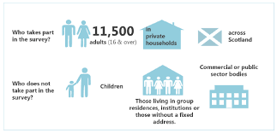
Surveys:
General population surveys:
Provided the sample is sufficiently large and representative, this approach may avoid some of the biasing factors that affect official crime statistics.
Offender surveys:
In a general population offender survey randomly selected members of the population are asked about the crimes they have committed recently.
Whilst this approach is likely to detect some crimes that have escaped police attention, they are likely to be biased by
1. a tendency to under-report and
2. the perpetrators of more serious offences are more likely to have been detected and convicted, removing them from the sampling frame.

Slide 38
The British crime Survey:
In the UK the BCS samples a large number of people about their experiences of crime and victimization in the previous year and their attitudes.
The BCS produces estimates of the crime rate that are substantially higher than official figures. Only about half of the crimes recorded by the BCS are reported to the police.
The BCS is considered the most accurate measure but is also affected by biasing factors.
It relies on respondents’ willingness to report victimisation, which they may not.
It also records incidents that the police might regard as ‘no crime’ so there could be a tendency for some types of offence to be over reported.
The BCS only samples individuals, so crimes against companies are not recorded and neither are crimes where the victim is not a person (e.g. vandalism of bus shelters).
Until 2010, the BCS was limited to adults. From 2010, however, children aged 10-15 have been included in the results.

Slide 39
But:
Each of these measures provide a different perspective on the extent of crime.
Different measures are useful for different purposes. E.g. even though police statistics tend to underestimate the crime rate, they may still provide useful information about offending trends.
This, however, assumes that biased reporting remains constant over time, but changing public attitudes may affect the rate of reporting. E.g. If the number of reported rapes increase, there is a question of whether more rapes were committed, or victims were more likely to report having been raped.
This raises a third issue. Definitions of crime change over time producing artefacts in measures of crime.
In the example of rape, until 2003 English law only allowed for women to be the victims of rape, making it difficult to compare statistics before and after this date.

Slide 40
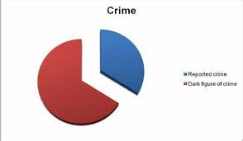
The `Dark Figure`:
There is a ‘dark figure’ of unreported and unrecorded crime
Generally, the more serious crimes are more likely to be noticed & reported, so much of the dark figure consists of less serious crime…
Or does it?

Slide 41
Biases or observations?
What about Fraud, embezzlement, tax evasion?
Biases in the criminal justice system?
15% of women are sent to prison for violent offences; in men’s prisons, almost half of the prisoners are sentenced for violent and sexual crimes.
By June 2026, the total prison population stood at around 86,000 and the sentenced population at around 70,000.
64% of persons jailed are of ethnic minority –true or false?
While White prisoners accounted for 73% of the sentenced population, they represented only 64% of the remand population. By contrast, all other reported ethnic groups had a higher proportional representation in the remand population than in the sentenced population.

Slide 42
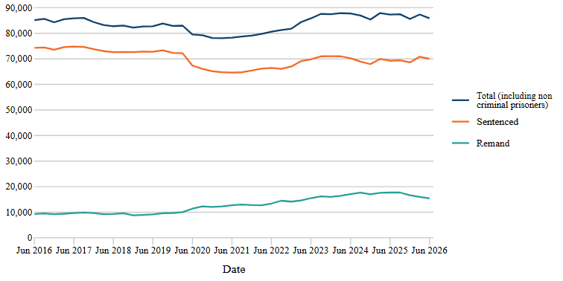
Extended Determinate Sentences
Sexual offences
Violence against the person
Public Order offences
Recalls – 32% above 2025
Reoffending 58% above 2025
Fraud/Cybercrime -highest
……………………………….
Short sentences
FNOs
Prison Statistics 2016-2026

Slide 43
What is happening at this current time?
UK prisons face an acute overcrowding crisis operating near 98% capacity, prompting the government to implement controversial early release schemes.
High Capacity: Prisons in England and Wales remain near total capacity, forcing staff to double up inmates in single-occupancy prefab cells.
Early Release Scheme: Around 700 prisoners are scheduled for release on October 1 under modified arrangements, allowing some to leave partway through their sentences.
Exclusions: Following intense public outcry and victim lobbying, the government excluded individuals convicted of unlawful killing, rape, serious child sex offences, and grooming from these early releases.
Vocational Courses Dropped: Watchdogs recently expressed alarm over deep cuts to prison education, noting a 25% national reduction in core education and the dropping of vocational programs that support rehabilitation.

Slide 44
Exclusions and Conditions
The government has updated the Sentencing Act 2026 early release provisions (often referred to as the earned progression model or SDS changes) to explicitly exclude several broad categories of serious offences.
1. Sexual Offences and Exploitation
2. Unlawful Killing and Fatal Incidents
3. General Sentence-Type Exclusions (EDS, Stalking, Terrorism)
Under the Sentencing Act 2026, prisoner early releases are staggered across 10 monthly tranches between October 2026 and June 2027 based on sentence length, to manage the flow safely.
Qualified individuals released early are subject to intensive community oversight, strict licence conditions, and an expanded system of mandatory electronic monitoring.

Slide 45
What is happening with female prisoners at this current time?
According to the latest HM Chief Inspector of Prisons Annual Report, self-harm in the female estate is roughly eight times higher than in the male estate.
Frequency of Incidents: Ministry of Justice data indicates that roughly one in three women in prison commit at least one act of self-harm per year, compared to just one in eight men. Furthermore, women who self-harm do so with a much higher frequency, averaging more than 12 to 17 separate incidents per year.
Young Women: Analyses reveal that young women aged 18–24 account for over 40% of all self-harm incidents. Girls in youth custody self-harm at ten times the rate of boys.
Women on Remand: Those held in prison while awaiting trial or sentencing display heavily elevated rates of distress and self-harm.

Slide 46
The wider picture for women:
Prior Abuse and Trauma: An overwhelming majority of women entering custody are victims themselves. Around 82% of female inmates report mental health issues, and over 60% have documented histories of severe trauma, including domestic violence and childhood abuse.
Inappropriate Sentencing: A charity report (Inquest) found that prisons have become holding centres for women experiencing acute psychiatric or addiction crises. The report criticised prisons for ignoring signs of distress, failing to respond to emergency cell bells, and leaving vulnerable women without adequate medical oversight.
Short-Term Destabilisation: The Prison Reform Trust notes that most women are jailed for short, non-violent offences (such as shoplifting). These brief sentences tear mothers away from an estimated 17,000 children annually, completely dismantling their housing and support systems, which dramatically worsens their mental health.

Slide 47
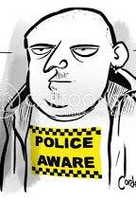
The extent of criminality?
`Once a criminal, always a criminal…`
The media promotes the publicity of serious crime.
Also, people's perceptions of crime and their vulnerability is varied.
How / Why?

Slide 48

Final conclusions:
Crime is not easy to measure.
Crime statistics are not necessarily accurate.
Criminal activity is diverse and subject to change across culture and time.
Public perceptions and beliefs about crime are influenced by many factors.
This poses a problem for psychologists, particularly when aiming to explain criminality and devise successful rehabilitation strategies.
More on that later…

