Slide 1

Training & Development needs for an HR Officer
Developing Relationships and Workplace Achievements
Lenia fuakatinna
2022292
BMSW 5102-A1

Slide 2
Off to work agency
UK and Ireland hospitality recruitment, staffing , raining and consulatancy agency company.
Aim- employees to expand in their experience through the company so that they can apply it in their dream career in the future
Organisation goal- to keep and continue seeing growth in their reputation in the hospitality industry worldwide.

Slide 3
Responsibility as a HR
Advice on pay
Conduct disciplinary action
Maintaining employee records
Maximise productivity of an organization

Slide 4
Diversity as part of the culture of the organisation
More and creative ideas
Everyone gets and feels treated equally
A good reputation to the company
Quick at decision making
Different perspectives
Appendix A

Slide 5
Administering payroll and maintaining employee records
Making sure that everyone gets paid on time and accurately
Make sure that there aware of their holiday
Just in case of emergency they will be able to contact your next of kin
Prevent the company from any future legal action
Also helps the company to pass on information
Appendix A​

Slide 6
Liaising with a range of people involved in policy areas such as staff performance and health and safety
Reduces absences and turnover
A company is legally required to make sure that every employee follow the health and safety procedure.
Staff performances help the company achieve its goal and see growth.
It helps the company to recruit the right people especially when see great performances that shows result to the company.
Appendix A​

Slide 7
SWOT Analysis
Appendix B
Strength Leadership Communication Committed | Weakness Time management Multi-tasking Information technology
Opportunities Learning new things | Threats No customer interaction Competitors with better service or pay Cancellations Recession
58% of recruitment professionals are nervous about the economy and future growth.

Slide 8
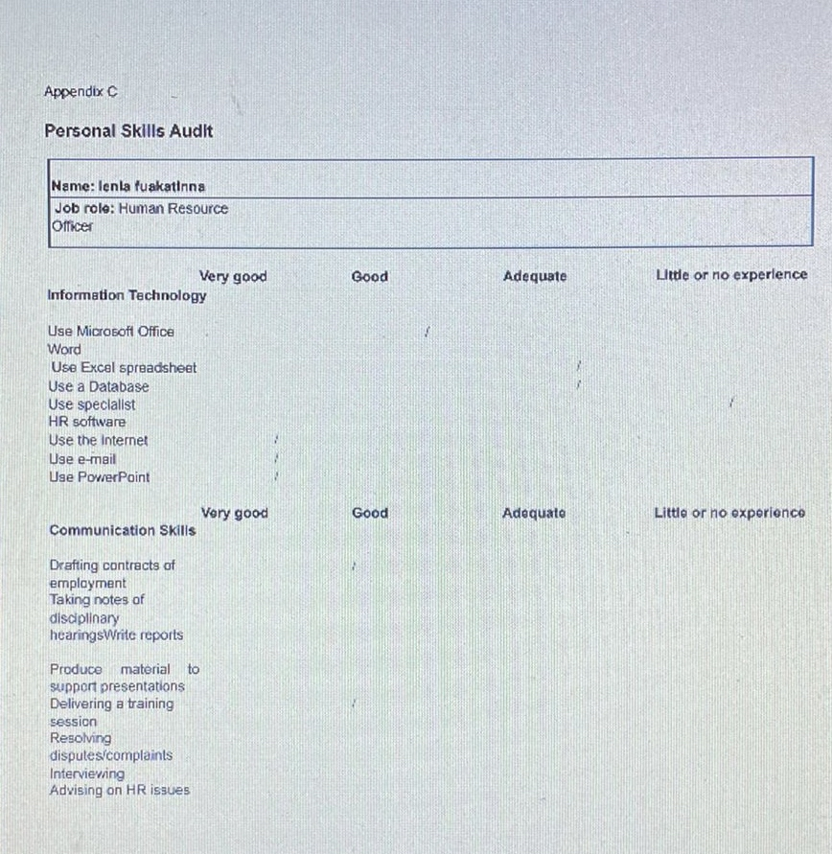

Slide 9
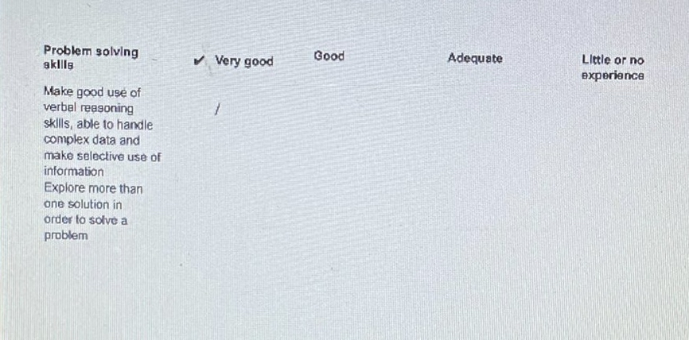

Slide 10
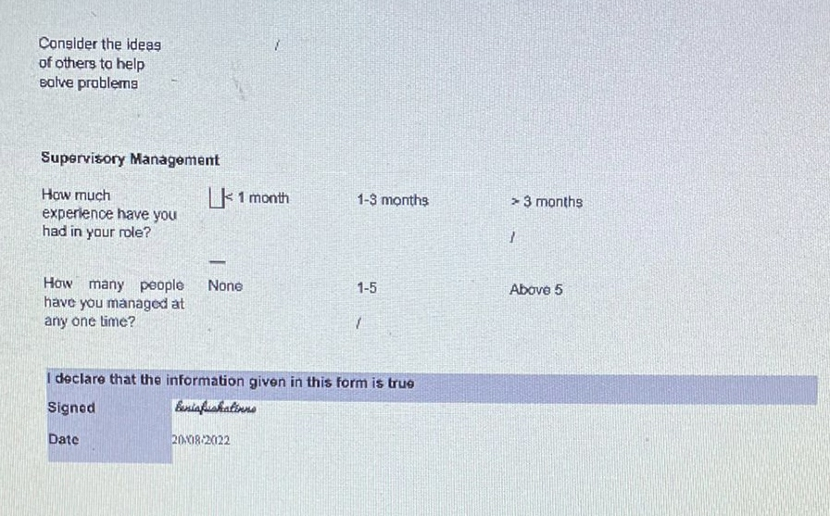

Slide 11
Benefits of training and development in my role
It helped me to improves my productivity
Bring quality in my performance which bought results into the company
Profit / growth was made
Employee engagement increased
Gained more knowledge in my role and what the company was missing and needing
I was able to develop skills and improve
Notes:
Developing on my skills has allow the training process to go smooth and it has definitely bought quality in the organization as there's been growth and profit between the staff and company.

Slide 12
Conclusion
After having learning and understanding about my HR role I was able to know the importance and significance my role has within the company and how it benefits everyone that works in it. After doing the SWOT analysis and the skills audit I was able to identify my strength and weakness which allowed me to know what to work on. I was able to develop many new skills or improve some skills that already have through the training.

Slide 13
Reference
Recruitment Industry (2020,15 May)
https://www.newmillennia.co.uk/blog/16-recruitment-agency-statistics-you-need-to-know/

